Slide 1



GitHub Pull Requests hands-on
Summary
PR - how do they work and why to use them
Branch and Fork – definition
PR - main topics
The real world, practical examples
Let's do a practical examples

Slide 2
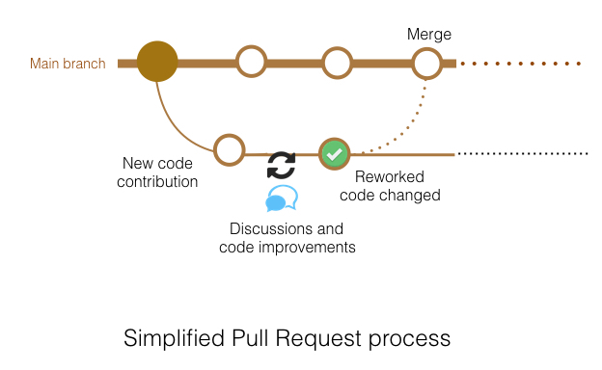
PR - how do they work and why to use them
Pull requests let you tell others about changes you've pushed to a branch in a repository on GitHub. Once a pull request is opened, you can discuss and review the potential changes with collaborators and add follow-up commits before your changes are merged into the base branch. Github Docs
The main principles of PRs
Propose and discuss a change -> a simple pushed commit may be not aware our peers about a change
Document the changes proposed -> take care to document as detailed as possible the changes introduced by the PR
PR can be DRAFT -> this kind of PR is not mergeable and is intended to discuss the proposed changes or added features

Slide 3
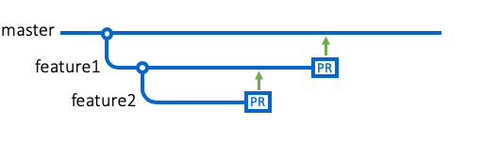

Branch and Fork - definition
BRANCH
Use a branch to isolate development work without affecting other branches in the repository. Each repository has one default branch, and can have multiple other branches. You can merge a branch into another branch using a pull request.
Github Docs
How PRs deal with them?
PR can be opened both from a branch in the original repo (usually to the default branch in our case called master ) or from a forked repo to the original repo
You can use a branch if you have write access to the target repo; anyway, for our policy, forking repo is preferred
Use a forked repo to open PR to the original repo where you have no write access
FORK
A fork is a copy of a repository. Forking a repository allows you to freely experiment with changes without affecting the original project.
Github Docs

Slide 4
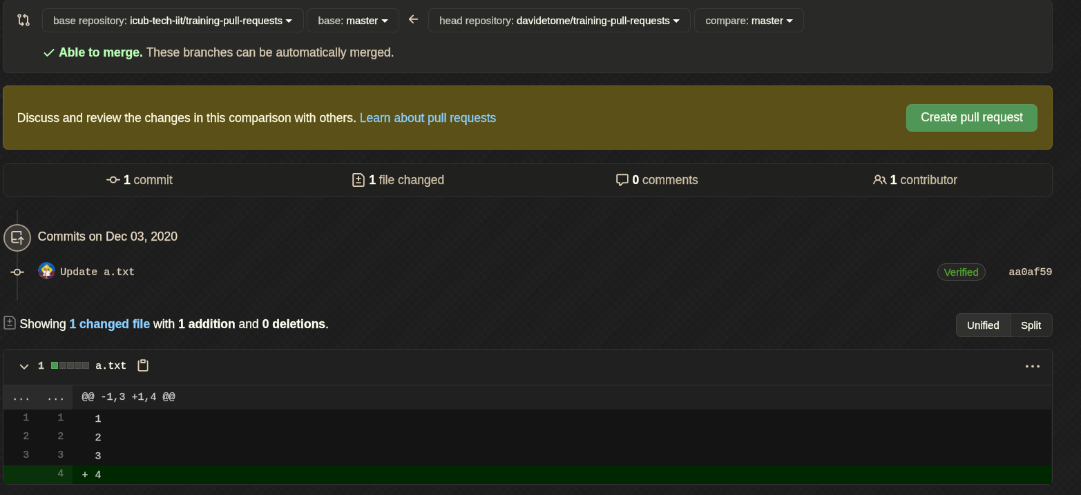
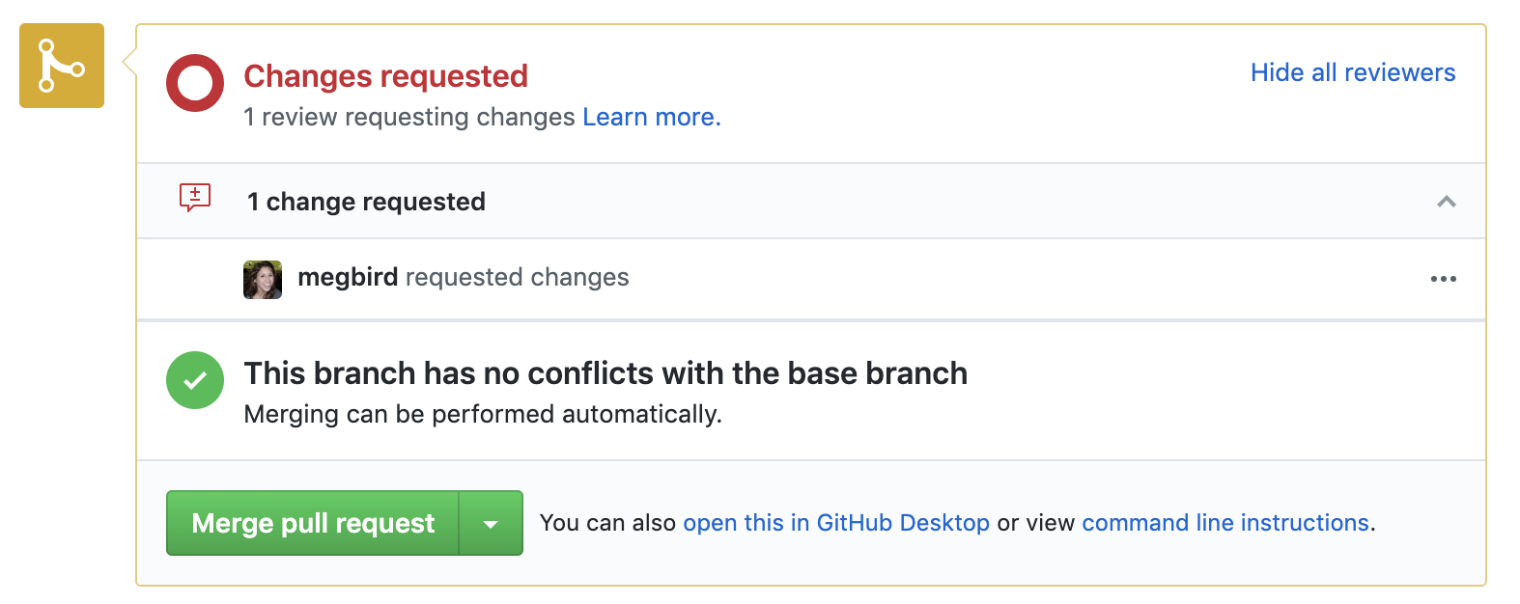
PR - main topics
Open a PR
Reviewers and codeowners
Assignees
Compare branch
Base branch
Review a PR
Ask for a change
General comment
Inline comment
Merge a PR : merge, rebase and merge, squash and rebase
Reject (kindly) a PR

Slide 5
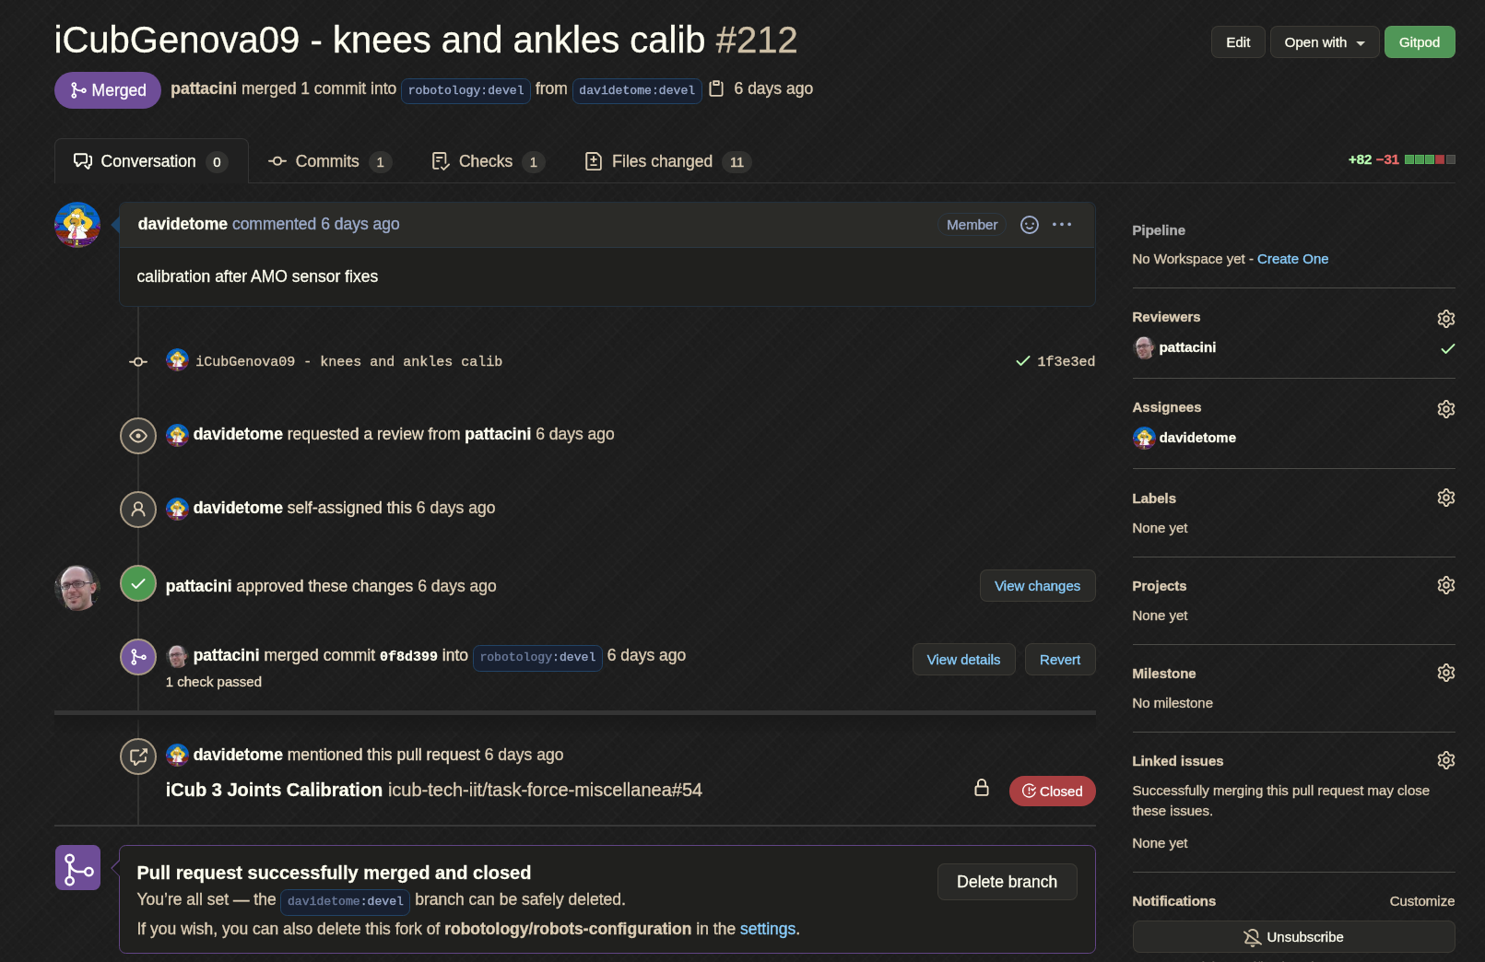
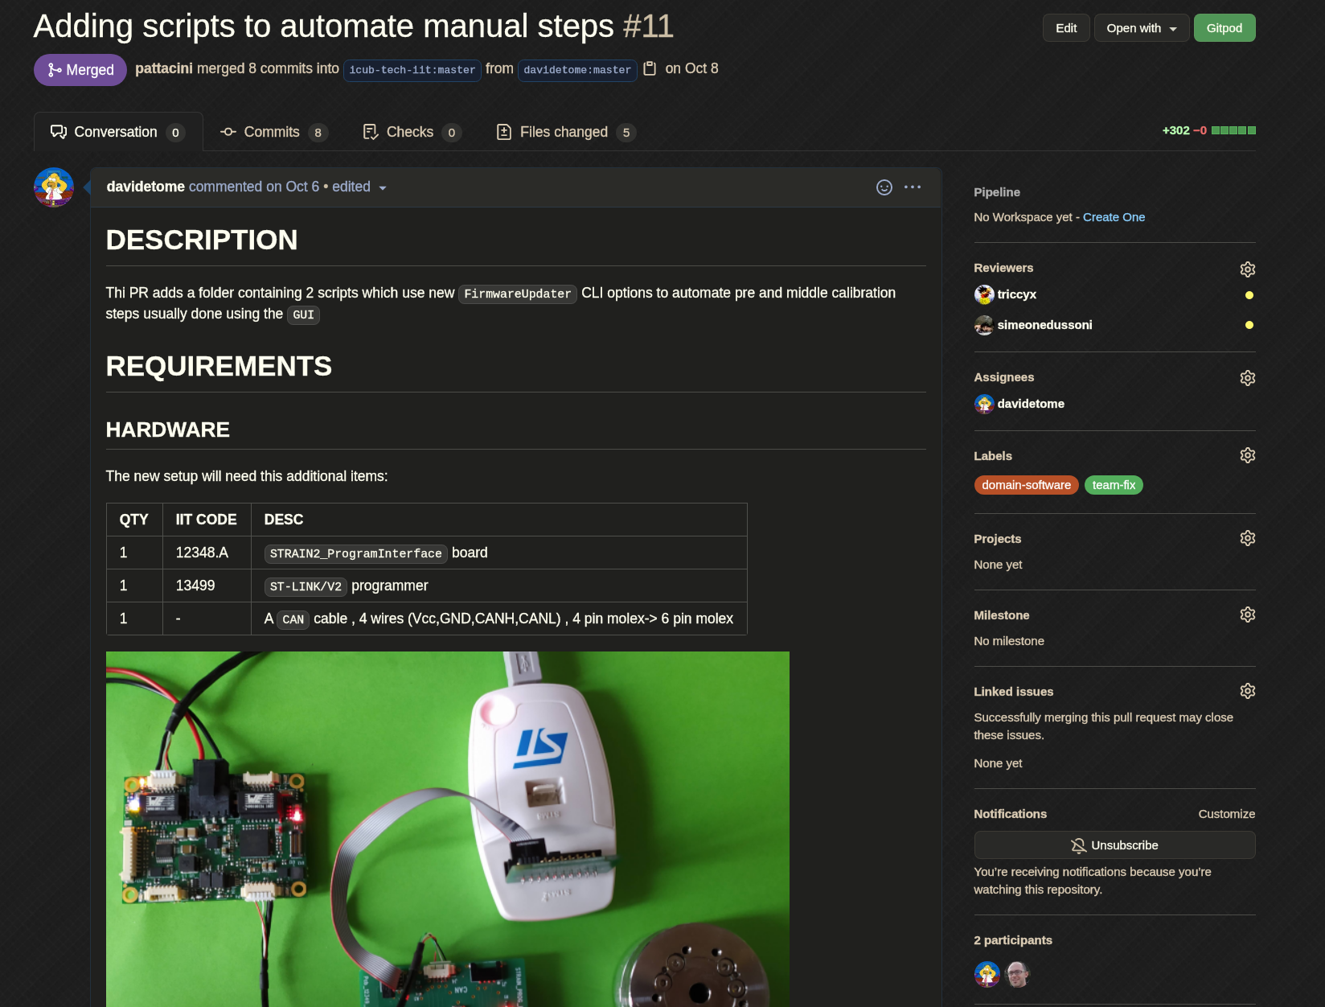
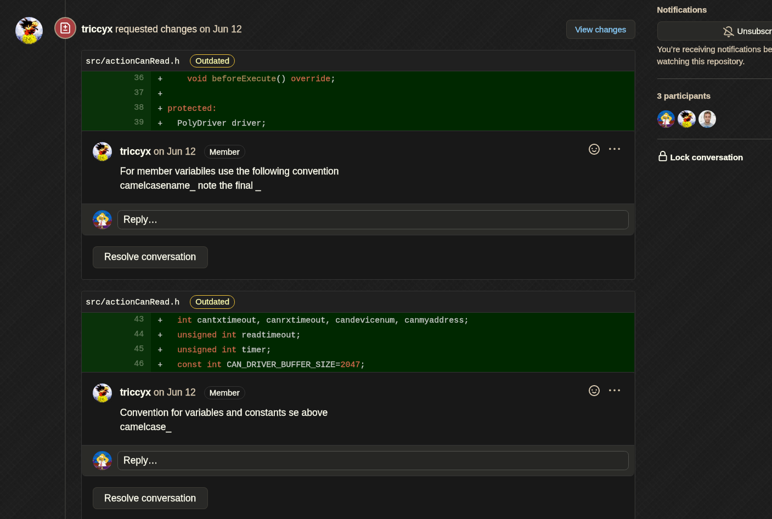
The real world, practical examples
Some practical examples
A simple PR (issue)
A documented PR (issue)
Reviewer change requested (issue)
Resolve comments to keep PR clean (comment)
Codeowners (repo)
Text vs Binary (issue)

Slide 6

Let's do a practical example 1 - text files
Fork and clone
Fork and clone the repo
Modify
Switch to the "hands-on-1" branch. Modify a.txt and/or b.txt files
Commit the change
Push
Push your commit
Open PR
Go to your forked repo and open a PR
Fill PR fields
Set Reviewers, Assignee, comment/document your PR
Commit
Open a PR
Review and Merge a PR
Read
Read the content of the PR and check the files changed
Change Request
If needed ask for a change
Approve
If change requested approve them
Merge the PR
Merge and squash
Rebase and Merge
Merge
github docs

Slide 7
Let's do a practical example 2 - binary files
Fork and clone
Fork and clone the repo
Modify
Switch to the "hands-on-2" branch. Modify a.tx and/or b.txt files and replace the c.pdf file with another pdf (maintaining the same name)
Commit
Commit the change
Push
Push your commit
Open PR
Go to your forked repo and open a PR
Fill PR fields
Set Reviewers, Assignee, comment/document your PR
Open a PR
Review and Merge a PR
Read
Read the content of the PR and check the files changed
Change Request
If needed ask for a change
Approve
If change requested approve them
Merge the PR
Merge and squash
Rebase and Merge
Merge
github docs

