Slide 1



GitHub Pull Requests hands-on
Summary
PR - how do they work and why to use them
Branch and Fork – definition
PR - main topics
The real world, practical examples
Let's do a practical example

Slide 2
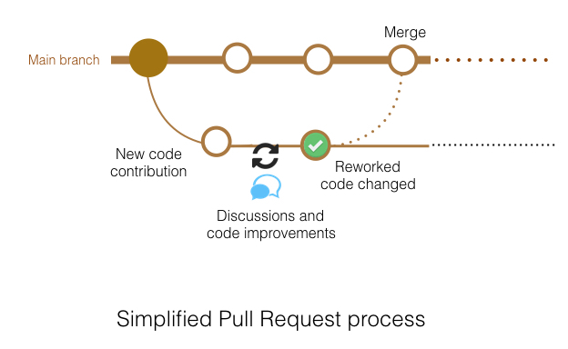
PR - how do they work and why to use them
Pull requests let you tell others about changes you've pushed to a branch in a repository on GitHub. Once a pull request is opened, you can discuss and review the potential changes with collaborators and add follow-up commits before your changes are merged into the base branch. Github Docs
The main principles of PRs
Propose and discuss a change -> a simple pushed commit may be not aware our peers about a change
Document the changes proposed -> take care to document as detailed as possible the changes introduced by the PR
PR can be DRAFT -> this kind of PR is not mergeable and is intended to discuss the proposed changes or added features

Slide 3
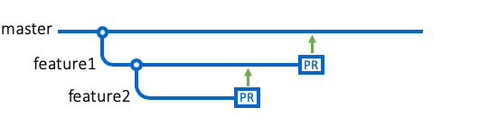

Branch and Fork - definition
BRANCH
Use a branch to isolate development work without affecting other branches in the repository. Each repository has one default branch, and can have multiple other branches. You can merge a branch into another branch using a pull request.
Github Docs
How PRs deal with them?
PR can be opened both from a branch in the original repo (usually to the default branch in our case called master ) or from a forked repo to the original repo
You can use a branch if you have write access to the target repo; anyway, for our policy, forking repo is preferred
Use a forked repo to open PR to the original repo where you have no write access
FORK
A fork is a copy of a repository. Forking a repository allows you to freely experiment with changes without affecting the original project.
Github Docs

Slide 4
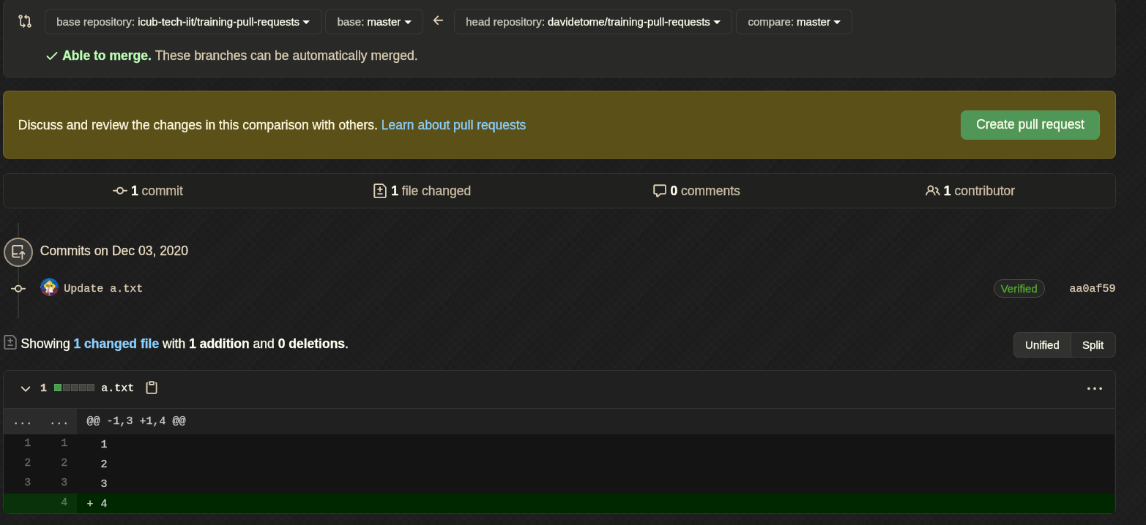
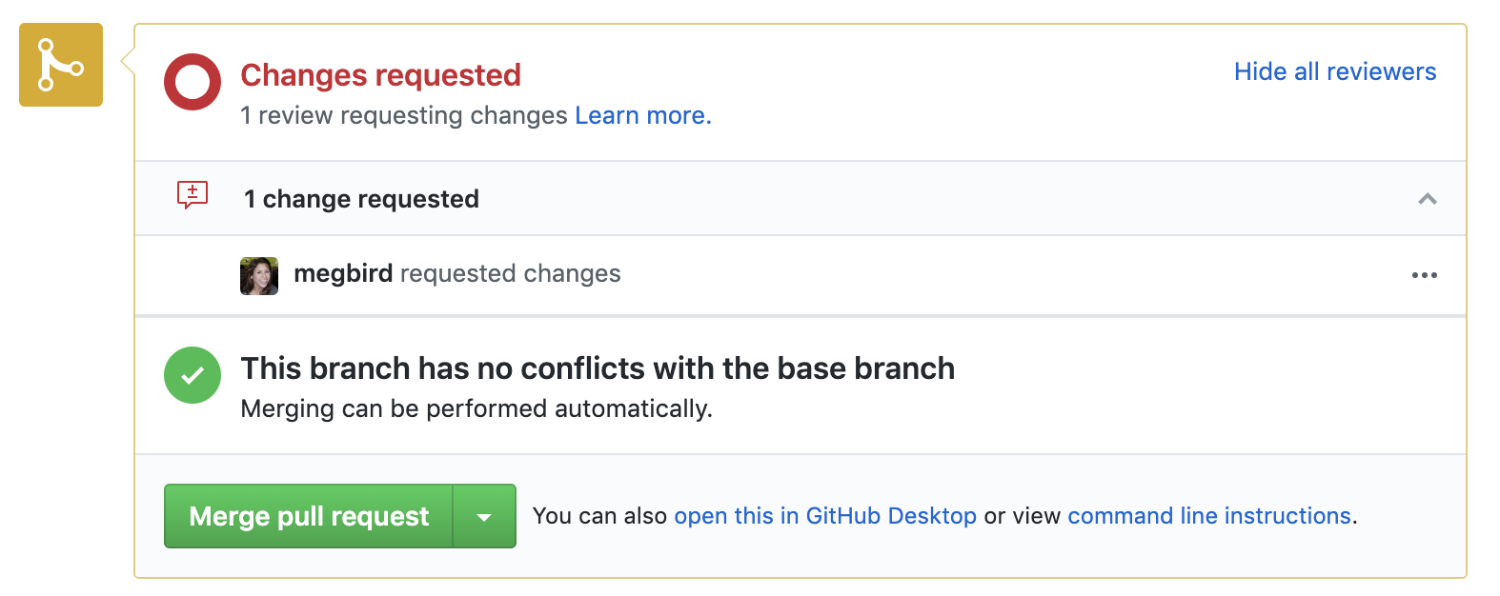
PR - main topics
Open a PR
Reviewers and codeowners
Assignees
Compare branch
Base branch
Review a PR
Ask for a change
General comment
Inline comment
Merge a PR : merge, rebase and merge, squash and rebase
Reject (kindly) a PR

Slide 5
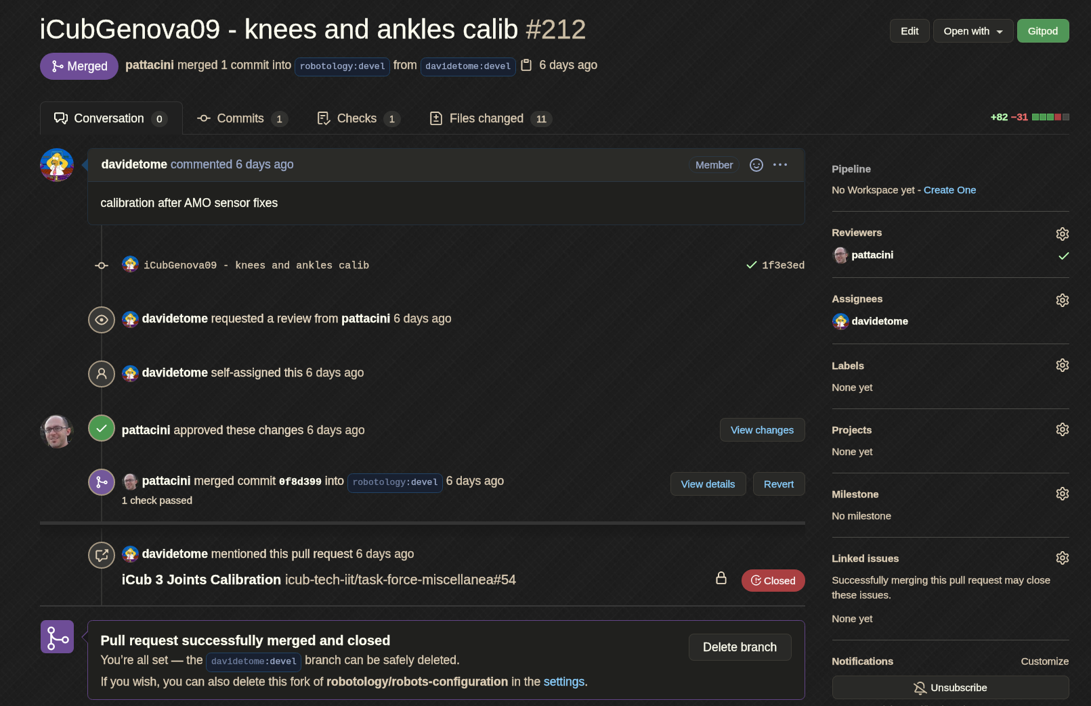
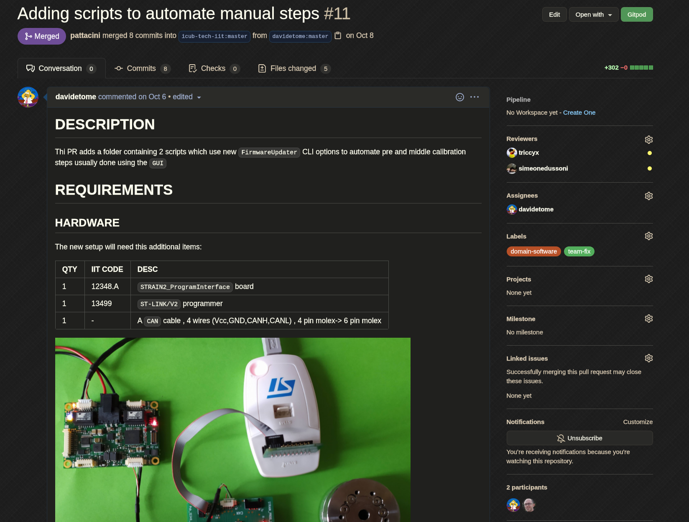
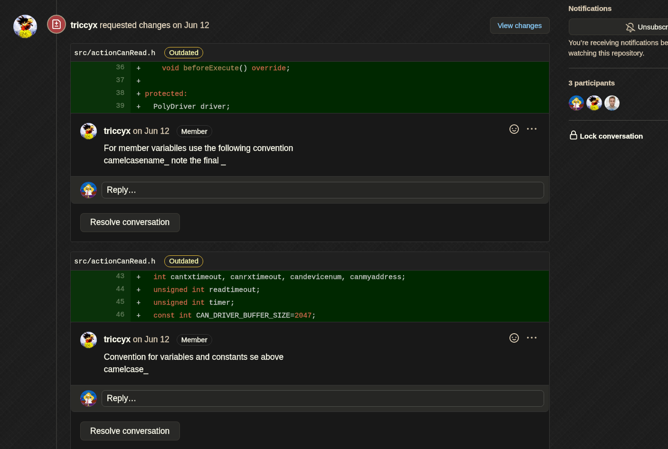
The real world, practical examples
Some practical examples
A simple PR (issue)
A documented PR (issue)
Reviewer change requested (issue)
Resolve comments to keep PR clean (comment)
Codeowners (repo)
Text vs Binary (issue)

Slide 6

Let's do a practical example 1 - text files
Fork and clone
Fork and clone the repo
Modify
Switch to the "hands-on-1" branch. In this branch a.txt and b.txt files have been modified
Commit
Commit the change
Push
Push your commit
Open PR
Go to your forked repo and open a PR
Fill PR fields
Set Reviewers, Assignee, comment/document your PR
Open a PR
Review and Merge a PR
Read
Read the content of the PR and check the files changed
Change Request
If needed ask for a change
Approve
If change requested approve them
Merge the PR
Merge and squash
Rebase and Merge
Merge
github docs

Slide 7
Let's do a practical example 2 - binary files
Fork and clone
Fork and clone the repo
Modify
Switch to the "hands-on-2" branch. In this branch c.pdf file have been modified
Commit
Commit the change
Push
Push your commit
Open PR
Go to your forked repo and open a PR
Fill PR fields
Set Reviewers, Assignee, comment/document your PR
Open a PR
Review and Merge a PR
Read
Read the content of the PR and check the files changed
Change Request
If needed ask for a change
Approve
If change requested approve them
Merge the PR
Merge and squash
Rebase and Merge
Merge
github docs

