Slide 1


DEMONSTRATION OF CANCER CELLS AND ITS CAUSES
MAHARAJA INSTITUTE OF TECHNOLOGY THANDAVAPURA
DEPARTMENT OF COMPUTER SCIENCE AND ENGINEERING
COMPUTER GRAPHICS LABORATORY MINI – PROJECT PRESENTATION
Presented by,
ARUN M [4MN17CS005]
MAMATHA H S [4MN17CS014]
Under the guidance of
Prof. Bharath Bharadwaj B S,
Assistant Professor,
Department of CSE,
MITT, Mysore

Slide 2
Contents
Abstract
Introduction
Overview
Flowchart
UI design and Interaction
Snapshots
Conclusion
Future Enhancement

Slide 3
Abstract
Cancer is a group of diseases involving abnormal cell growth with the potential to invade or spread to other parts of the body.
Not all tumors are cancerous
Benign tumors do not spread to other parts of the body Possible signs and symptoms include a lump, abnormal bleeding, prolonged cough, unexplained weight loss and a change in bowel movement.
While these symptoms may indicate cancer, they may have other causes. Over 100 cancers affect humans.

Slide 4
Introduction
Computer Graphics become a powerful tool for the rapid and economical production of pictures.
There is virtually no area in which Graphical displays cannot be used to some advantage so it is not surprising to find the use of CG so widespread.
Computer Graphics is used in a diverse area such as science, engineering, medicine, business, industry, government, art, entertainment, education and training.

Slide 5
Overview
In this project, we are demonstrating about cancer cells and its causes.
We have shown from basic illustration of cancer to how it spreads, different types of cancer to its causes.
It’s a 4 slide basic demonstration of cancer as a disease
In second frame we have shown two main classification of cancer.
      Malignant Tumor
      Benign Tumor
In third frame is the extension of the second
In last frame we have shown the causes of cancer

Slide 6
Flowchart
Start
Introduction frame
Uncontrolled cell division
Bening and malignant tumors
Spread of malignant tumor to other parts
Causes of cancer
Stop

Slide 7
Keyboard interaction
start
switch(key)
case 'c':
case 'q':
glutPostRedisplay()
exit(0)
return

Slide 8
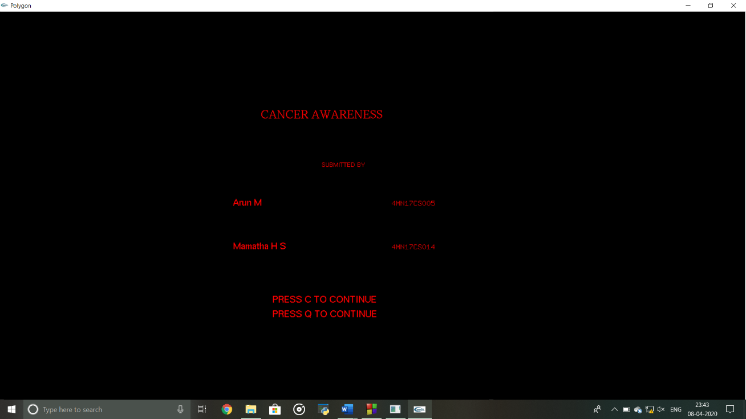
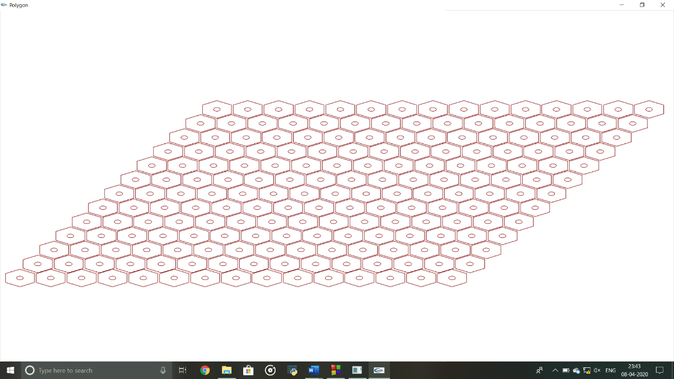
Snapshots
3.1 SNAPSHOTS:
Fig . introduction frame Fig . Abnormal Cells
fig3.2 Inside the multiplex theatre in day mode
fig3.3 user is in the Hindi movie
fig3.4 user is in the Kannada movie
fig3.5 user is in the English movie
fig3.6 user is in the Tamil movie
fig3.7 user is in the Popcorn Counter
fig3.8 Outside of the multiplex theatre in night mode
fig3.9 Inside the multiplex theatre in night mode

Slide 9
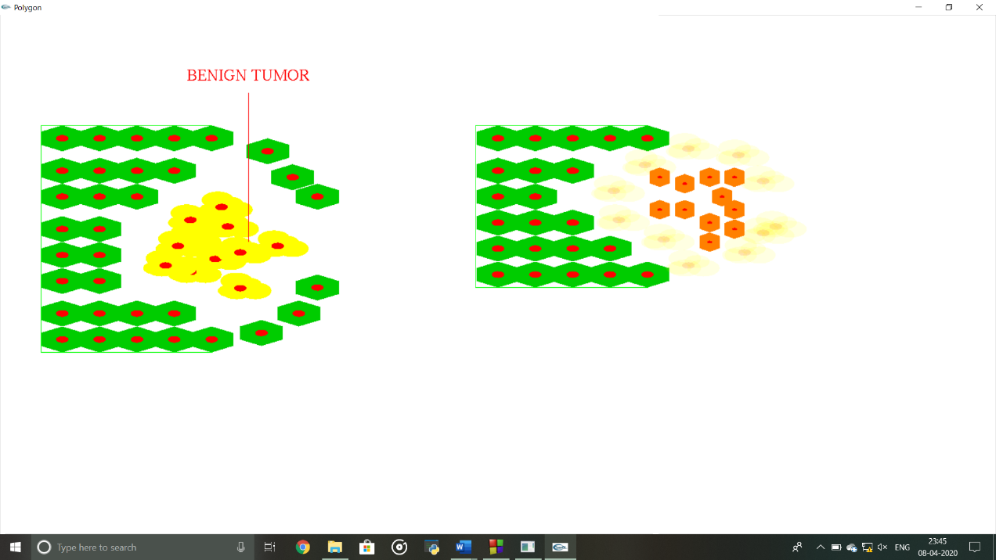
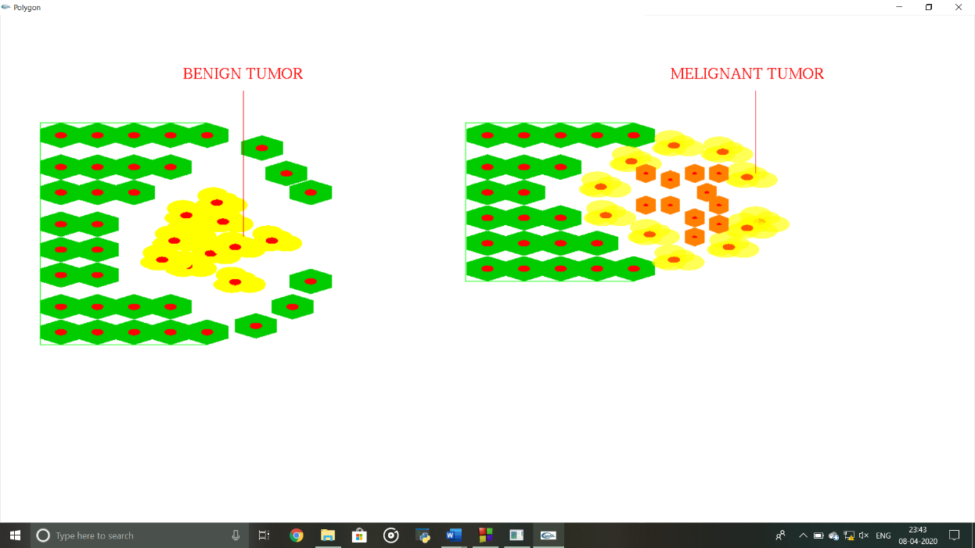
Fig . Initial malignant Tumor Fig .Bening and Melignant Tumor

Slide 10
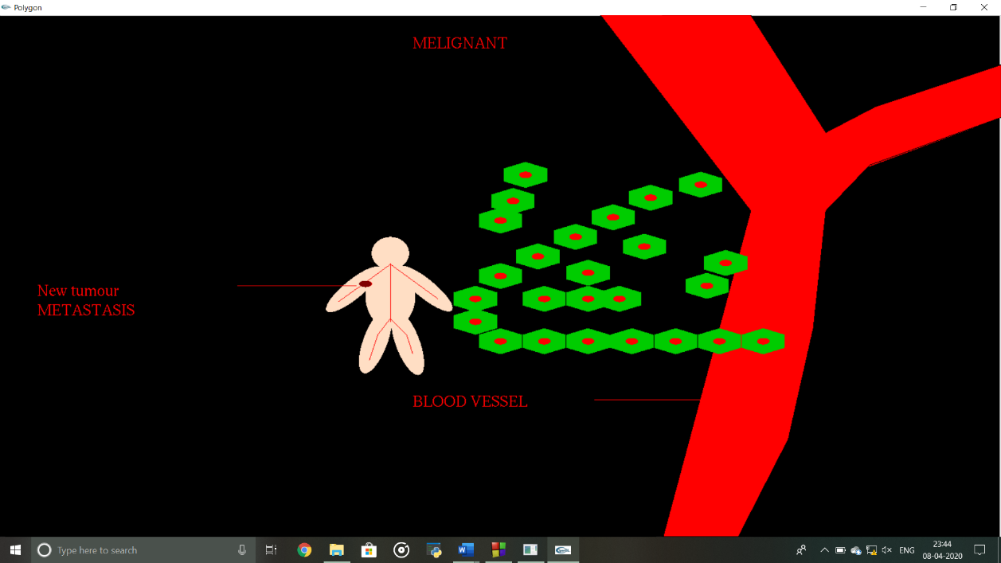
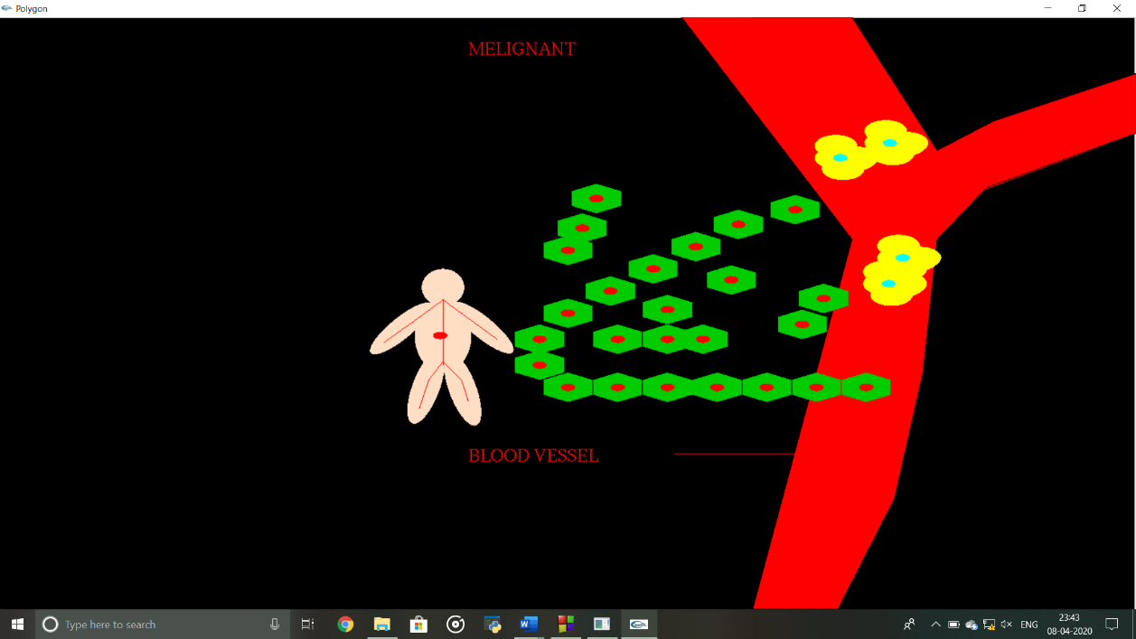
Fig . Human blood vein Fig .spreading cancer to other part

Slide 11
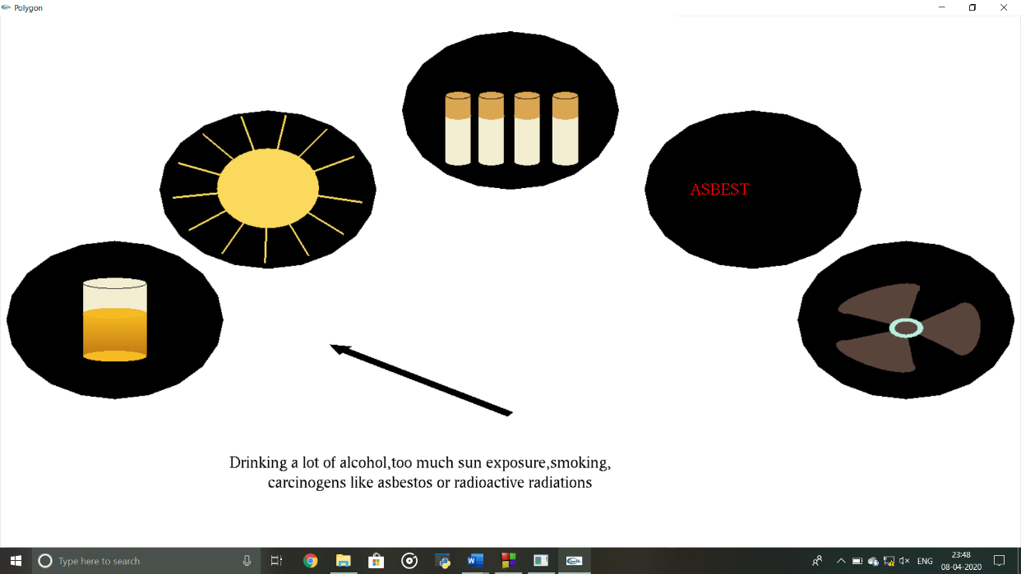

Fig . Causes of cancer Fig . Causes of cancer

Slide 12

Fig . Causes of cancer

Slide 13
Conclusion
The source code developed is relatively simple, easy to comprehend and works effectively.
A simple working model of the famous dining philosophers problem has been implemented.
Also the flooding algorithm used in computer networks has been developed to explain the concept with relative ease.
Development of this computer graphics project has given us a better understanding of the topics and concepts learnt in theory.
The project increased our knowledge in the field of computer graphics.

Slide 14
Future Enhancement
Even though demo designed is enriched with many options, it is a two dimensional demo, in future it can be redesigned with 3D animation.
In future we can make a movement of a 3d cells over blood veins.
Making the user interface of this program simpler and more user friendly.
In future we can add other types of cancers also

