Slide 1
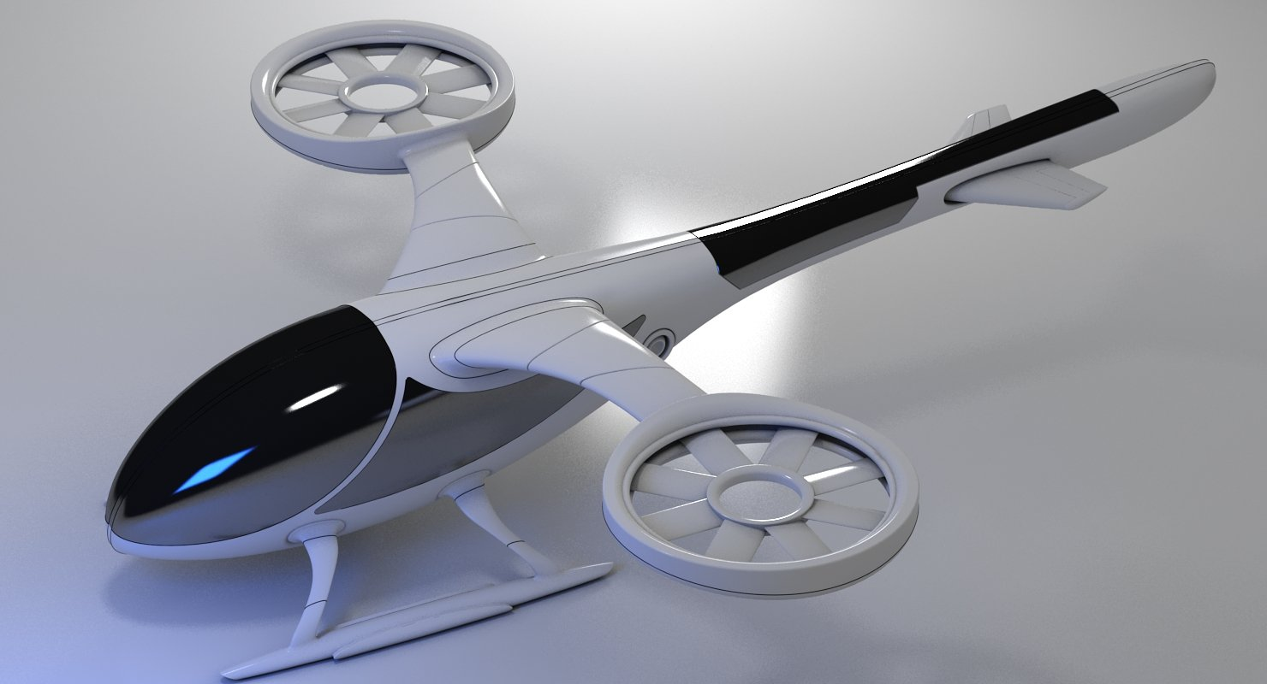
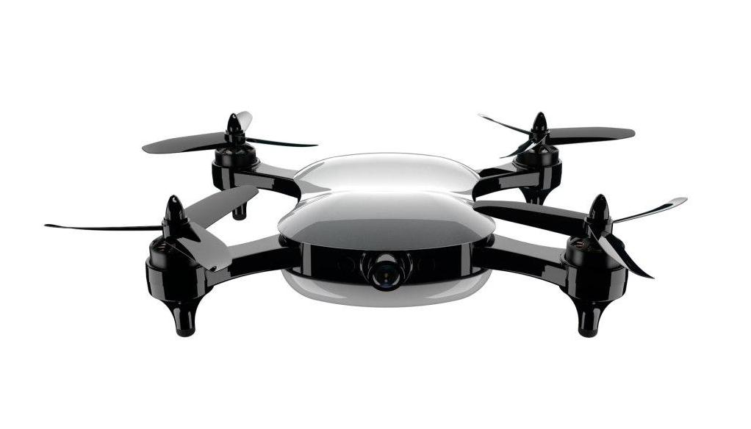
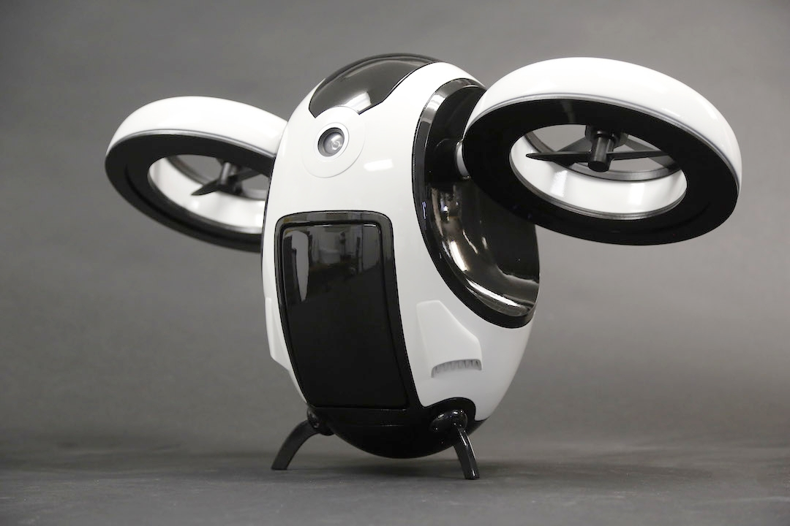
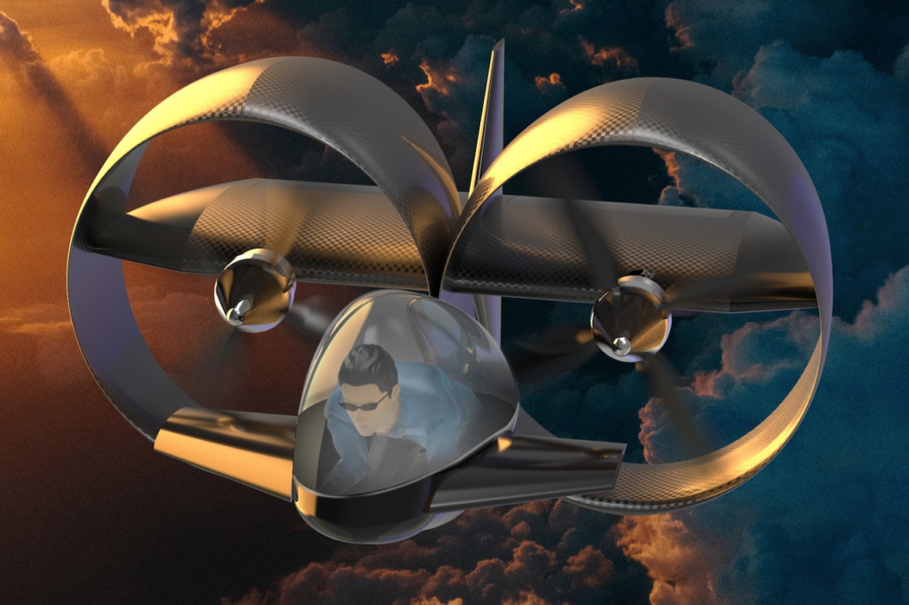
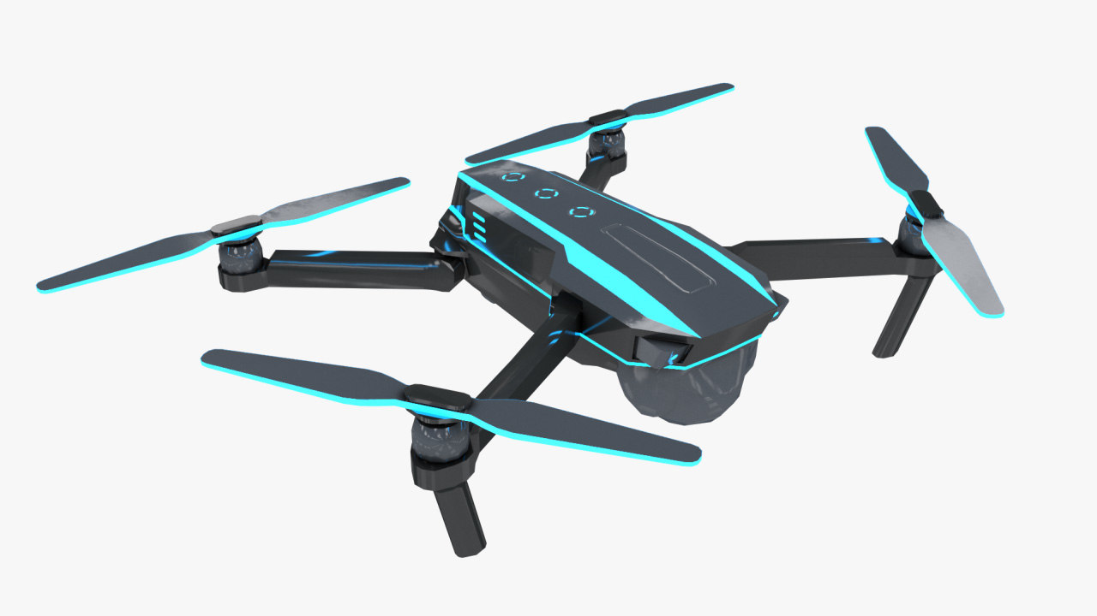
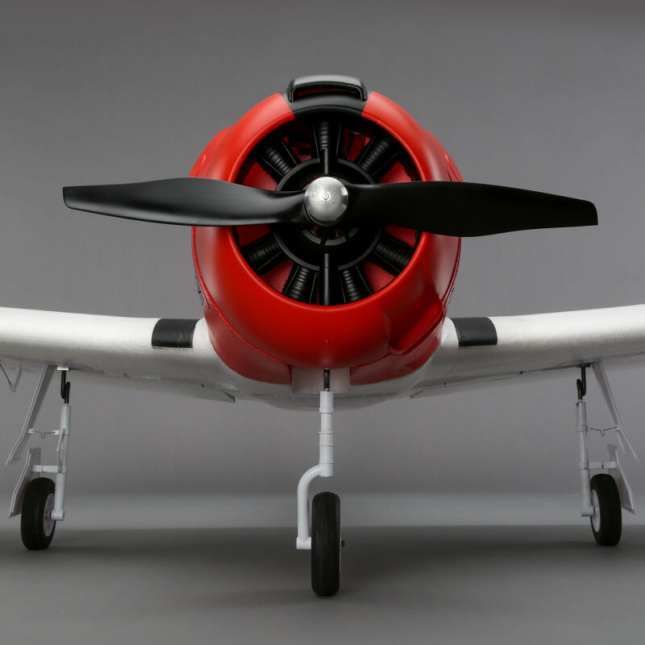
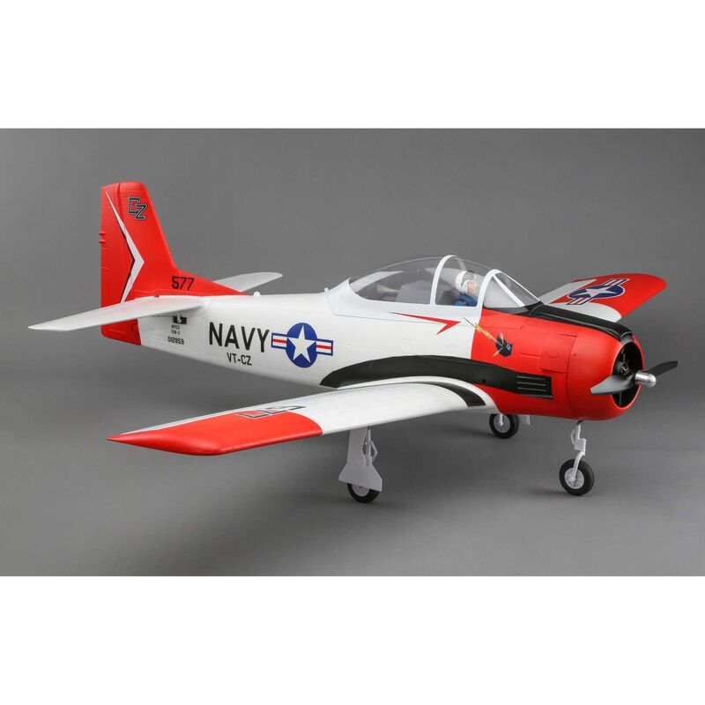
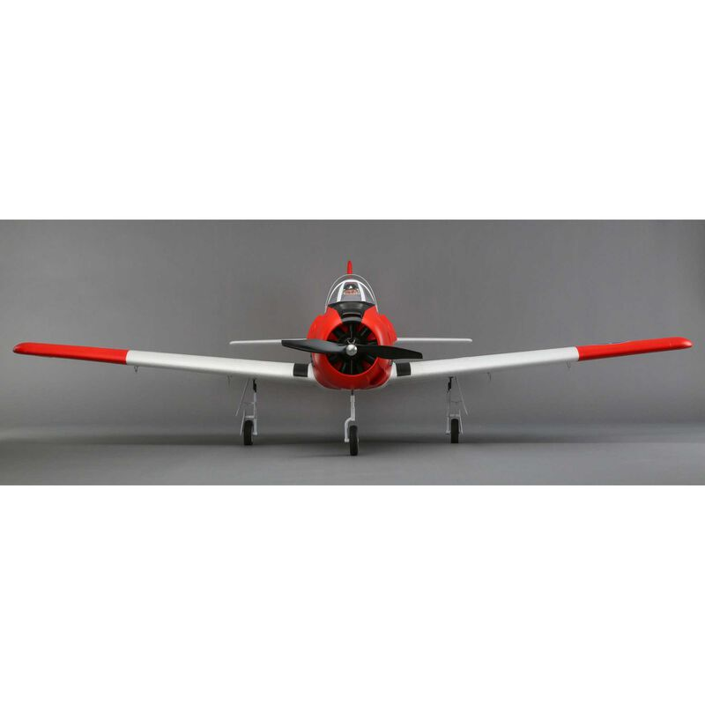
DRONE FAULT AND ANOMALY DETECTION
BY JEAN BAPTISTE MBAYA / Woz –U

Slide 2

Jean Baptiste Mbaya
Currently a Cloud Data Analyst & Power BI Dev at AT&T
Data Analyst at The Coca Cola Company &
Data Analyst - Data Engineer at Millennial R&D, LLC…
Total of 5 years experience in Data Analysis
Education:
Bachelor’s in MIS & IT Minor From Georgia Gwinnett College (GGC)
Expecting Master’s in Data Science from Illinois Institute of Tech (IIT)
Expecting Certification in Data Science from Woz –U …
Areas of focus: ML and AI

Slide 3
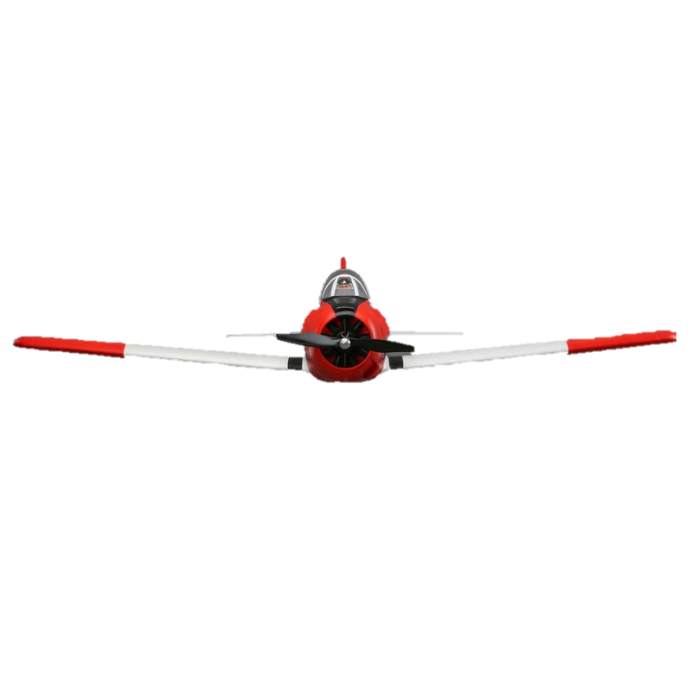
Overview
INTRODUCTION
SCOPE AND DEFINITION
PROCEDURE AND DEVELOPMENT
MACHINE LEARNING MODEL
SUMMARY
CONCLUSIONS

Slide 4
INTRODUCTION
Rising safety concerns due to increasing number of Autonomous drones.
The purpose for this project is to build a machine learning model that could predict faults and anomalies on drones.
Our research focused on the Carbon Z drone

Slide 5
SCOPE AND DEFINITION
There are two questions that are researched in this project:
Which attributes have the highest influence?
Is it possible to build a machine learning model predicting failure at least 80% accuracy?

Slide 6
PROCESS AND ANALYSIS
Data Collection & Wrangling
Process
Data Prep
Data Exp
Backward Elimination
Analysis
ML
Tools : Jupiter Notebook, GitHub, Python and Rstudio

Slide 7
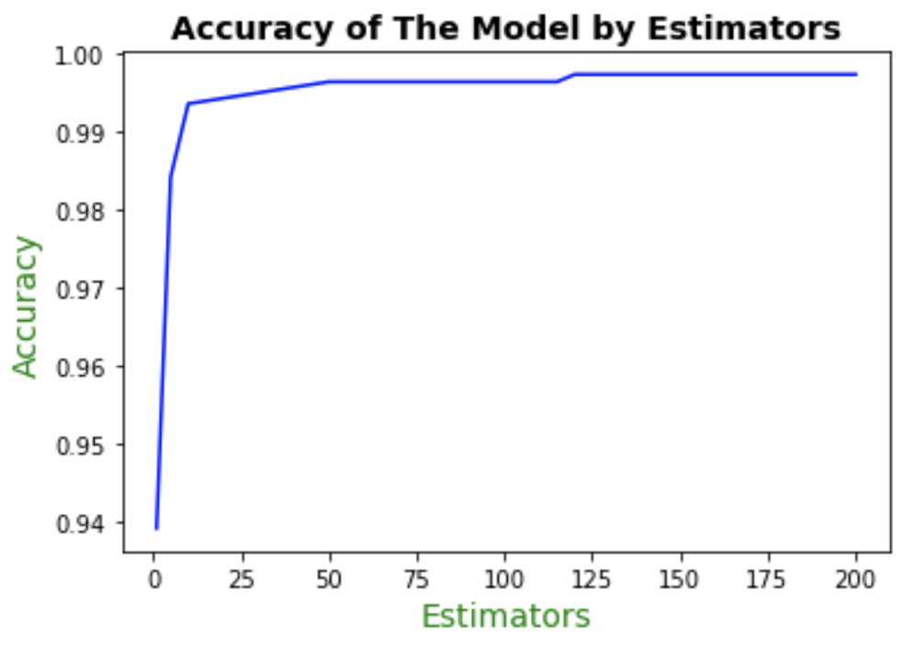
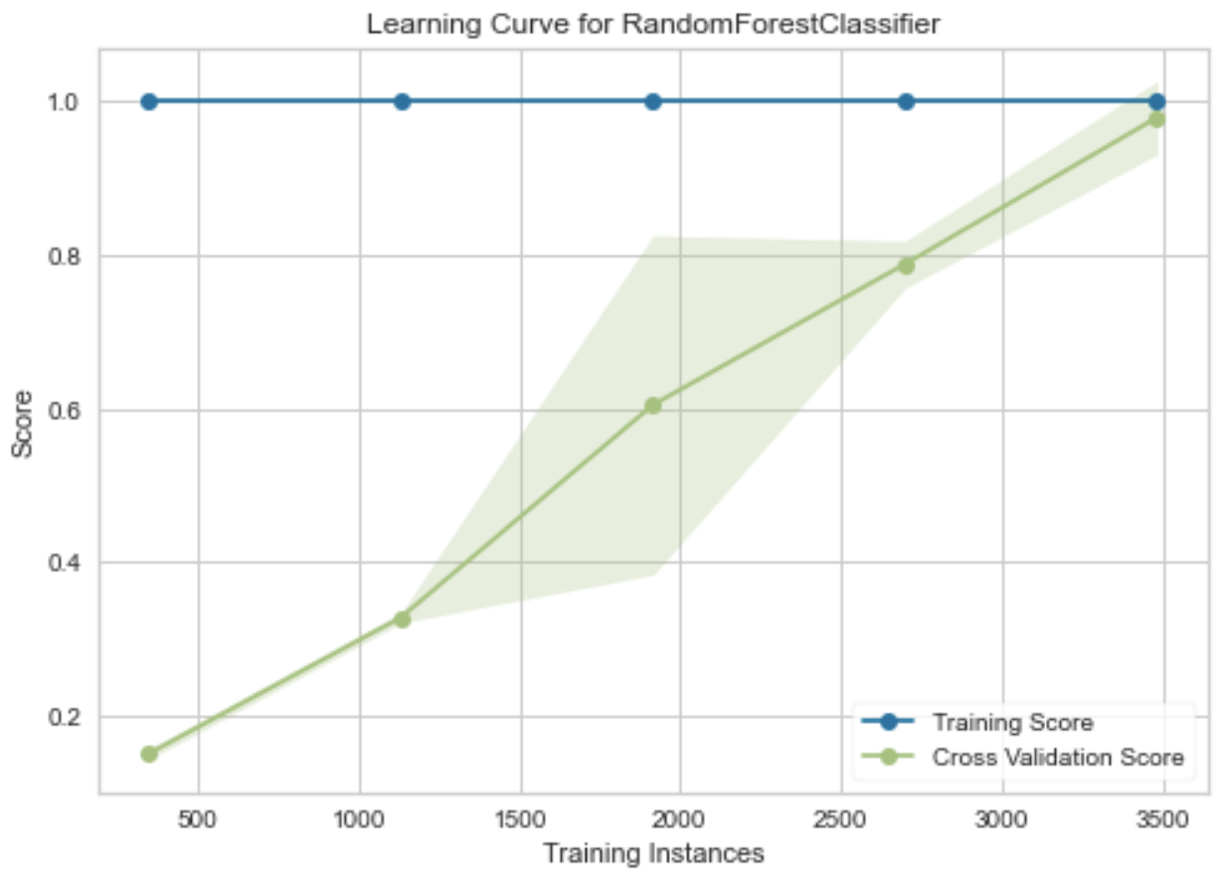
MACHINE LEARNING MODEL
Random Forest : 120 estimators | Learning Curve:
X

Slide 8
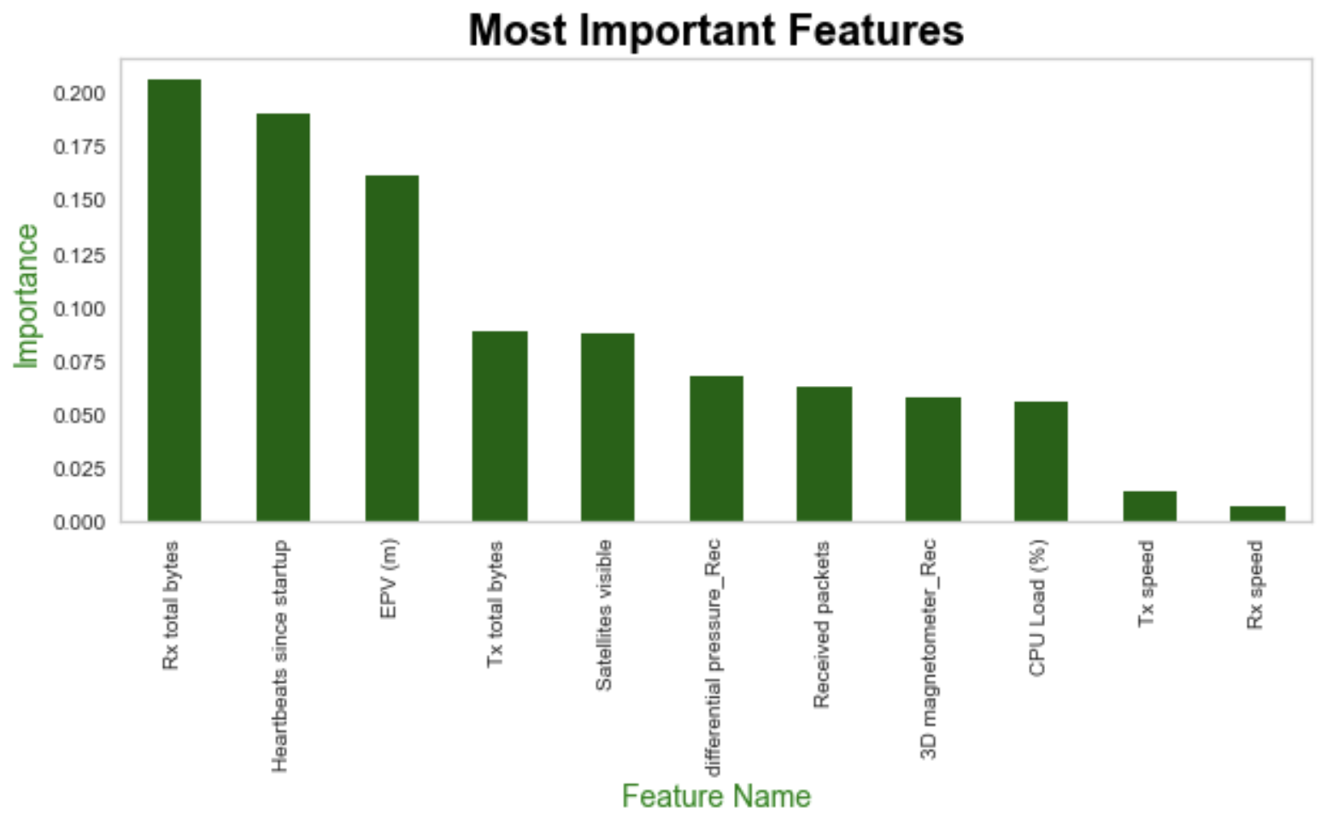
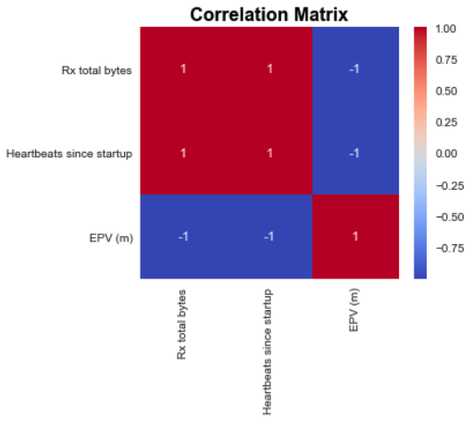
MACHINE LEARNING MODEL
Most Important features: | Rx total bytes Heartbeats since startup EPV (m)

Slide 9
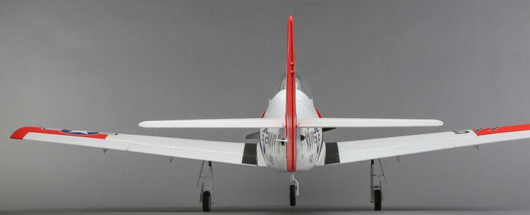
SUMMARY
6 variables that influence faults and anomalies.
Responsible for 29% of change in the outcome.
Our model predicts faults and anomalies at 100% accuracy overall
96% accuracy on right aileron failure predictions.
More data instances on right aileron failures to reach 100% accuracy

Slide 10
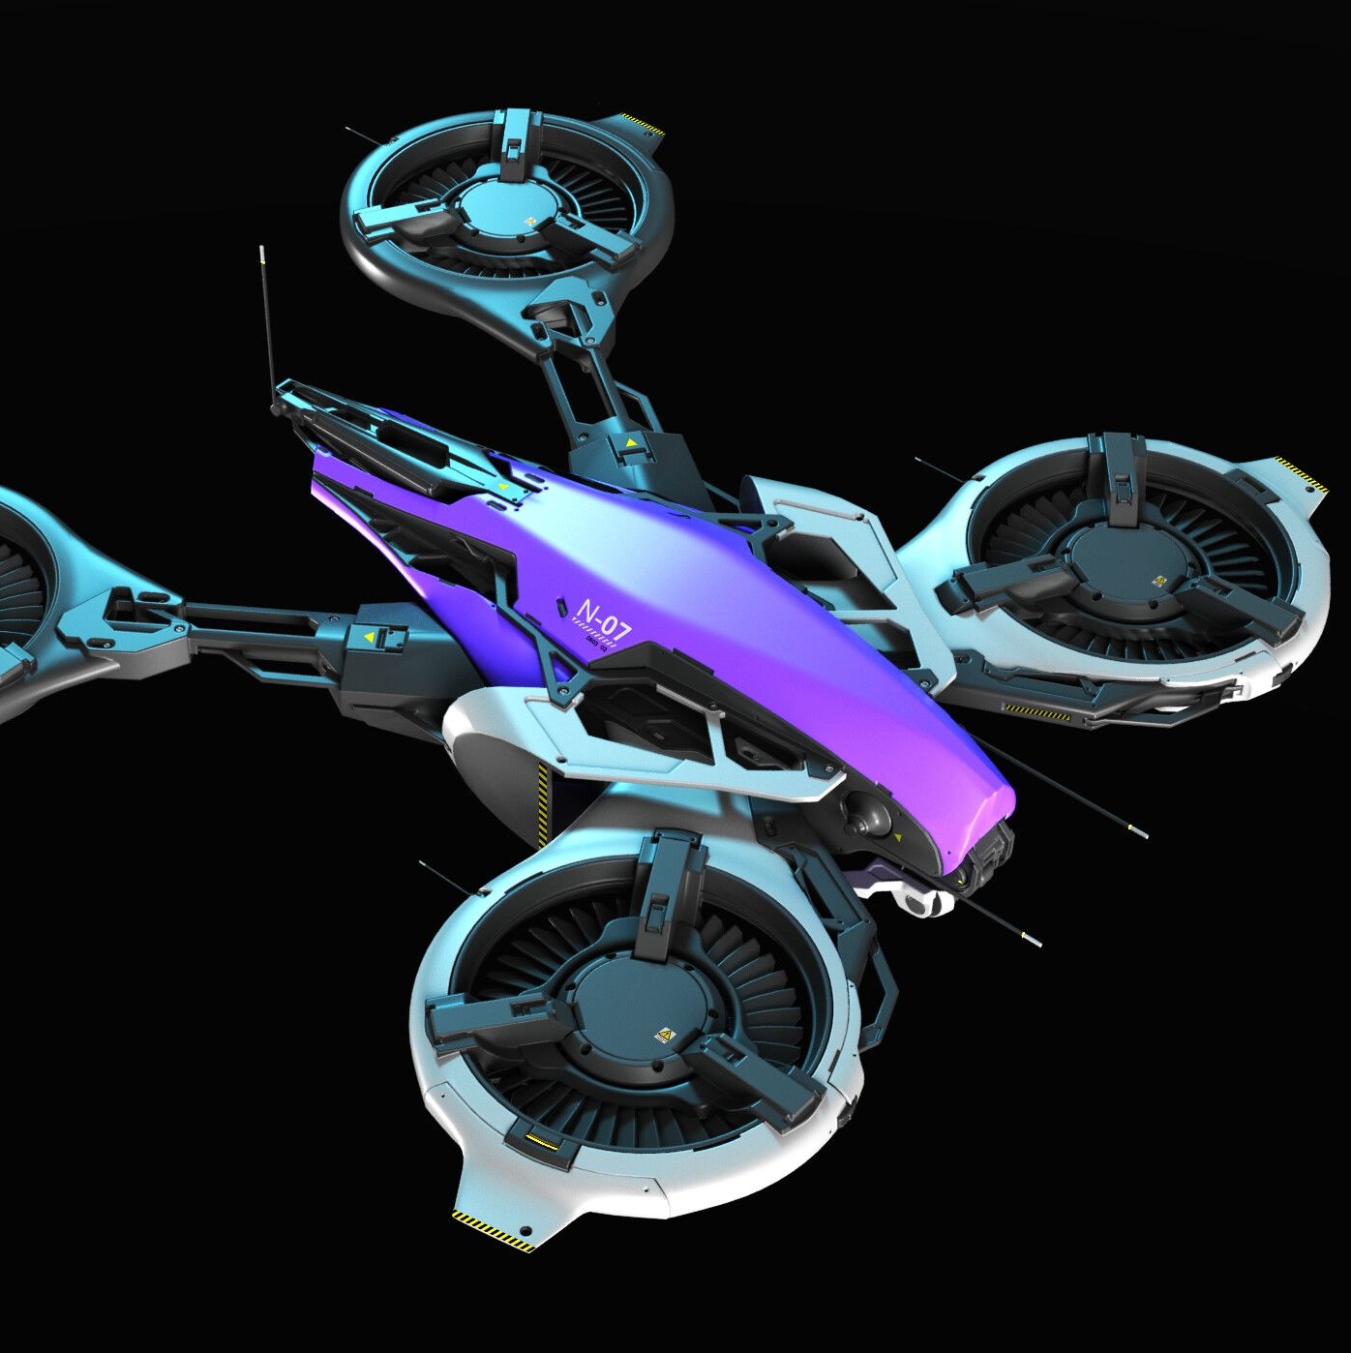
CONCLUSIONS
UAVs would be able to fly and land safely without causing injuries.
A fault and anomaly detection model can be applied to many fields, not limited to Banking, being detecting and preventing fraud, in Agriculture, to predict crop yielding; in health to predict and prevent sickness like cancer, and so on. This model can be applied in so many other fields.
There are about 21,000 unmanned areal vehicles (Business Insider, 2019) and counting. In a world full of drones, this model is another safety layer.

Slide 11
REFERENCES
Data Source:
Keipour, A., Mohammadreza Mousaei, & Scherer, S. (2020). ALFA: A Dataset for UAV Fault and Anomaly Detection [Data set]. Carnegie Mellon University. https://doi.org/10.1184/R1/12707963
Project Code:
Mbaya, J.(2021).GITHUB: https://github.com/MrAshTag/Drone_Faults_Anomaly_Dectection
Citations:
https://www.businessinsider.com/world-rethinks-war-as-nearly-100-countries-field-military-drones-2019-9

Slide 12
QUESTIONS?

