Slide 1
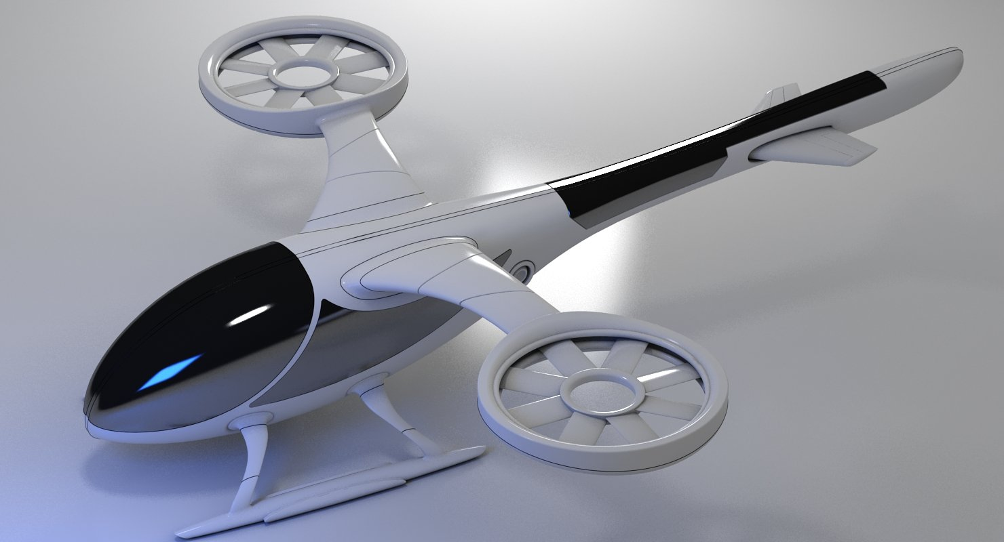
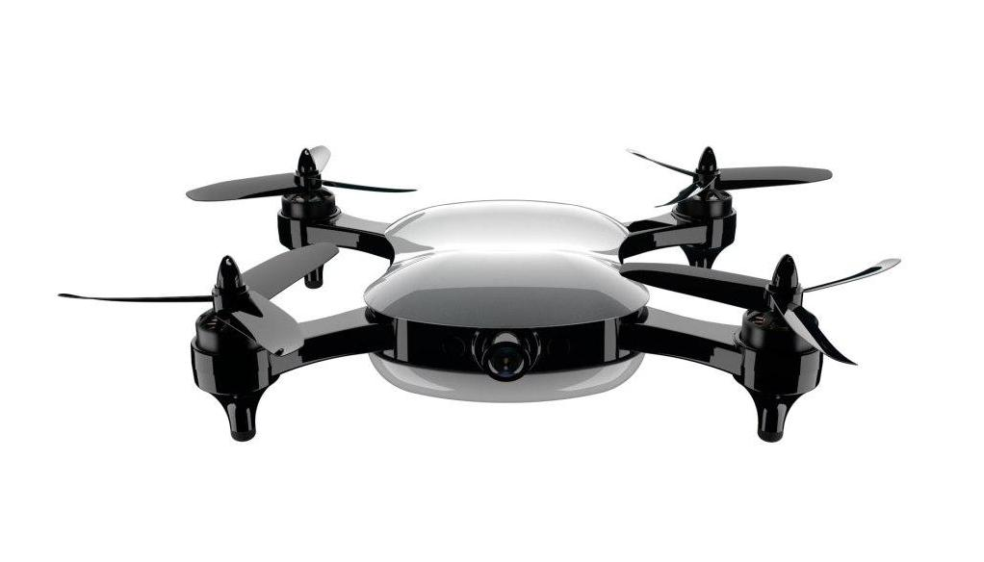
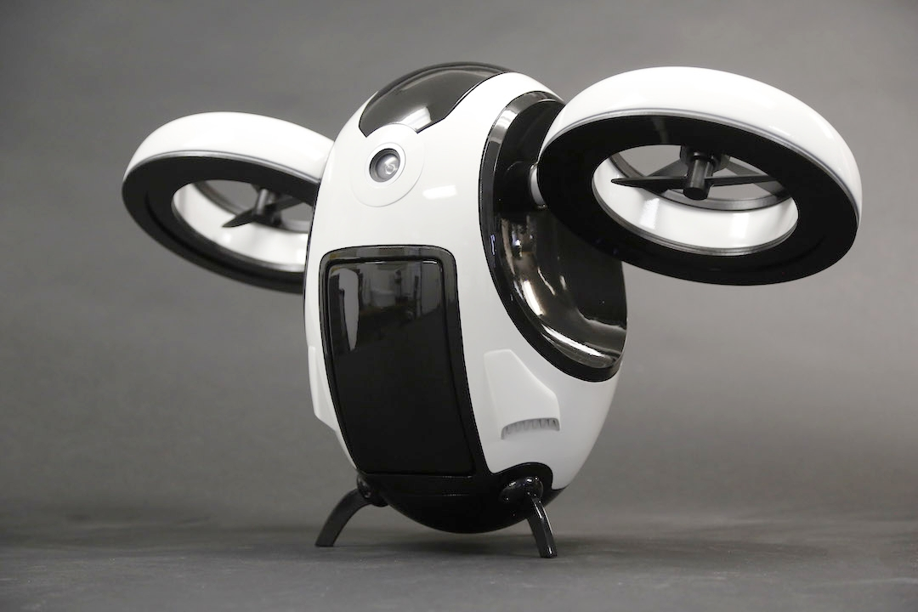
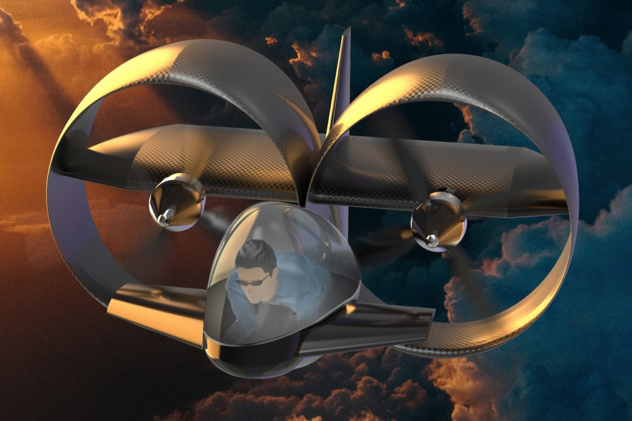
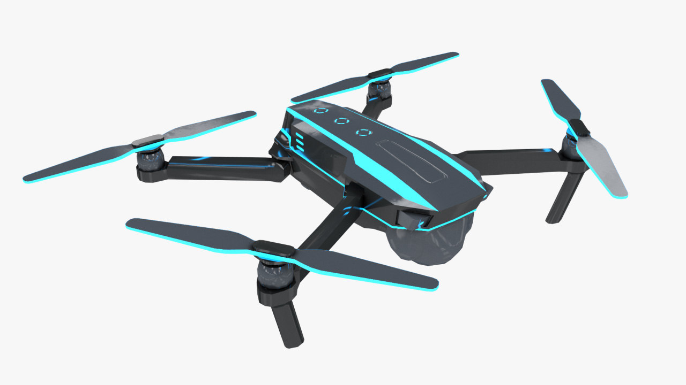
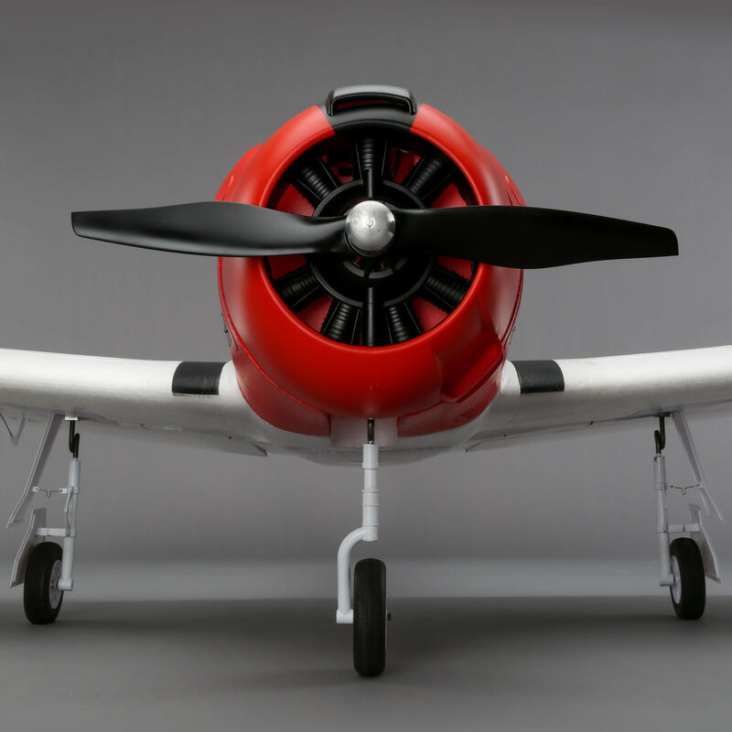
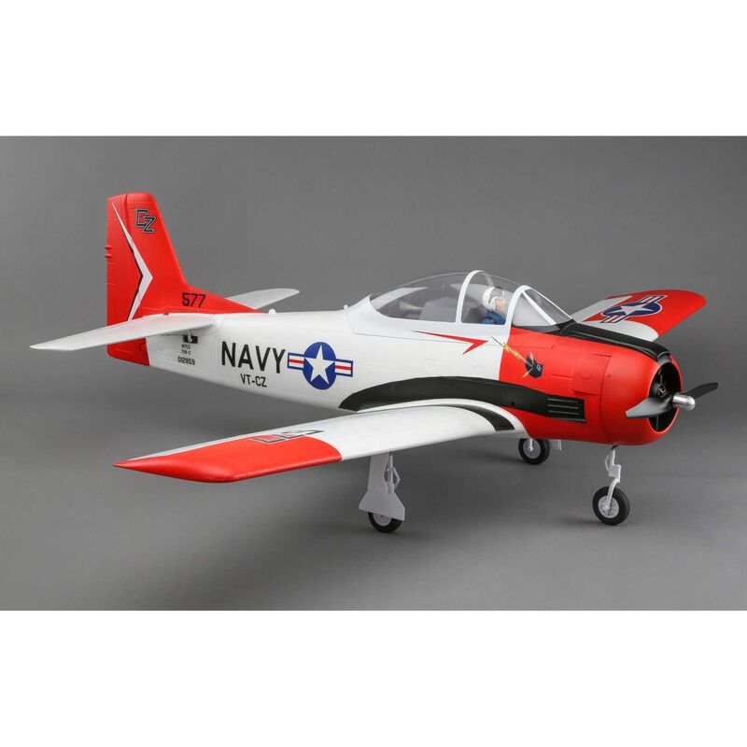
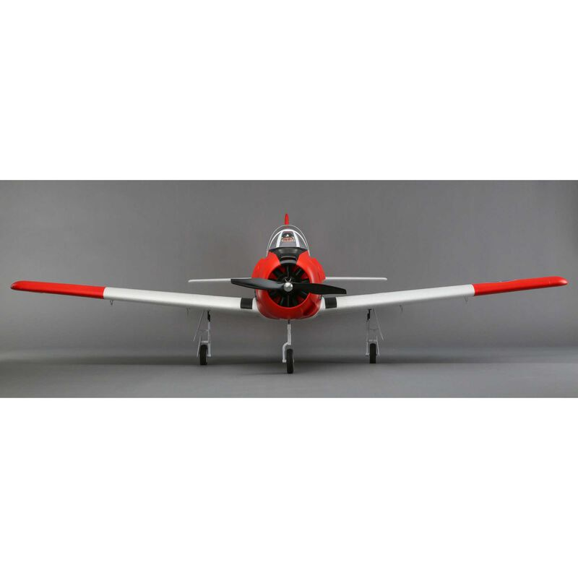
DRONE FAULT AND ANOMALY DETECTION
BY JEAN BAPTISTE MBAYA

Slide 2

Jean Baptiste Mbaya
Currently a Cloud Data Analyst & Power BI at AT&T
Was also a Data Analyst at The Coca Cola Company &
Data Analyst - Data Engineer at Millennial R&D, LLC
Total of 5 years experience in Data Analysis
Education:
Bachelor’s in MIS & IT Minor From Georgia Gwinnett College (GGC)
Expecting Master’s in Data Science from Illinois Institute of Tech (IIT)
Area of interest: ML and AI

Slide 3
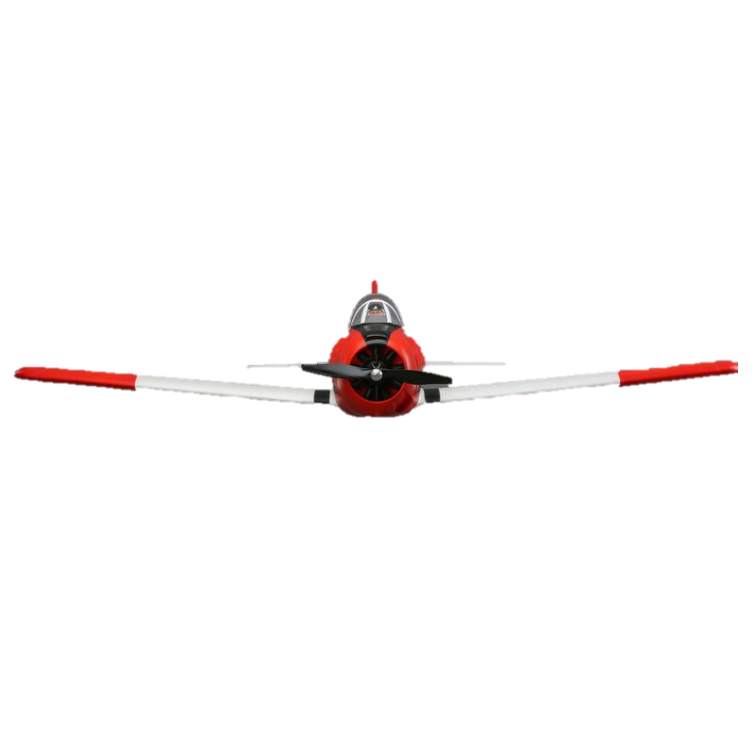
Overview
INTRODUCTION
SCOPE AND DEFINITION
PROCEDURE AND DEVELOPMENT
SUMMARY

Slide 4
INTRODUCTION
Rising safety concerns due to increasing number of Autonomous drones.
The purpose for this project is to build a machine learning model that could predict faults and anomalies on drones.
Preventing drones from randomly falling out of the sky.
Our research focused on the Carbon Z drone

Slide 5
SCOPE AND DEFINITION
There are two questions that we’re trying to answer in our project:
Which variables have the highest influence on whether the Carbon Z drone is has failures or not?
Could we build a machine learning model to predict faults and anomalies on Carbon Z drone at least 80% accuracy

Slide 6
PROCESS AND ANALYSIS
Data Collection & Wrangling
Process
Data Prep
Data Exp
Backward Elimination
Analysis
ML
Tools : Jupiter Notebook, GitHub, Python and R

Slide 7
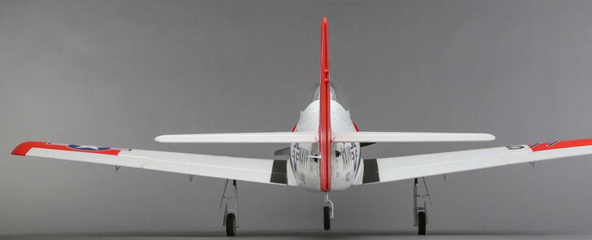
SUMMARY
Our best model has 6 variables that influence faults and anomalies on Carbon Z: Tx Speed, Rx Speed… that are responsible for 29% of outcome changes, the remaining 70% can be caused by noise and other uncaptured variables.
Our model can predict faults and anomalies on Carbon Z drones in flight, with a 100% accuracy overall and 96% accuracy on right aileron failure predictions.
We need more data on right aileron failures in order to make better predictions on this fault.

Slide 8
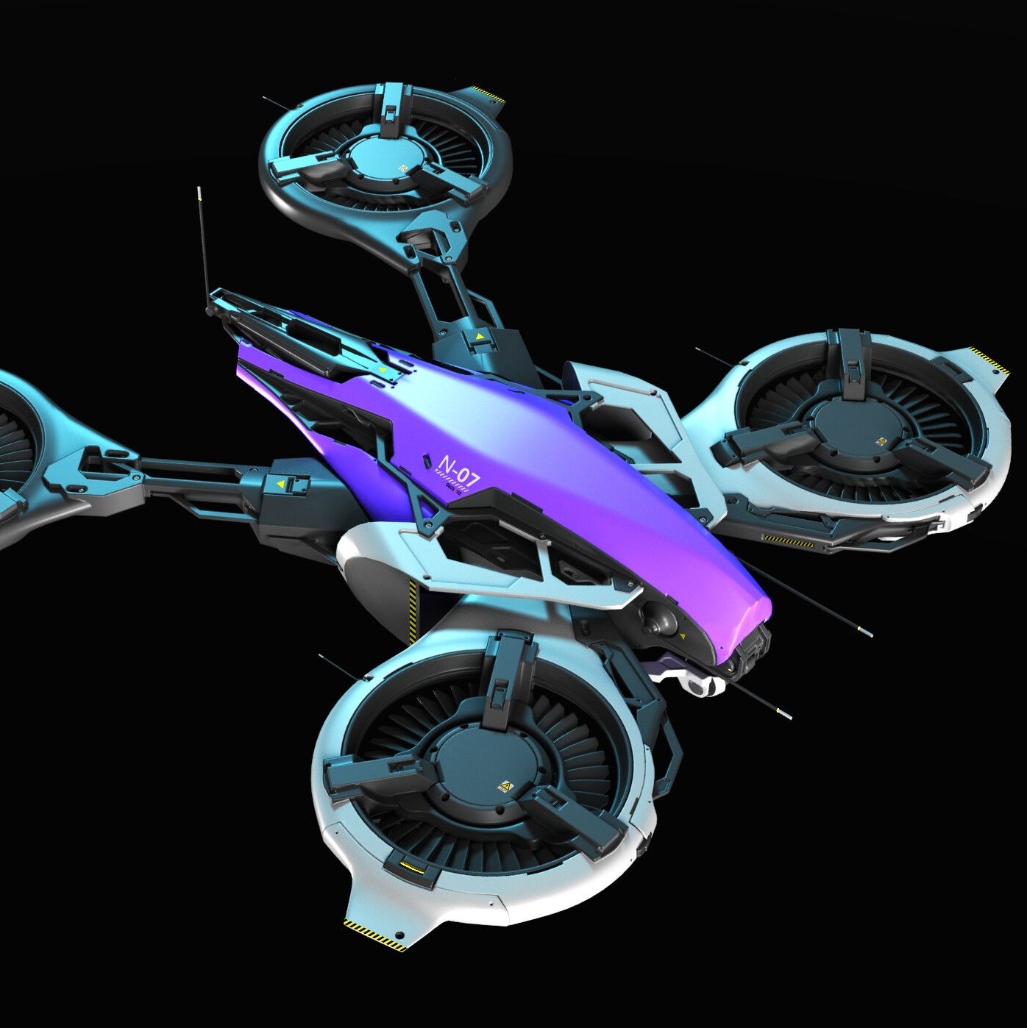
CONCLUSION
Autonomous drones would be able to fly and land safely without causing injuries.
A faults and anomaly detection model can be applied to some many fields, not limited to Banking, being detecting and preventing fraud, in Agriculture, to predict crop yielding; in health to predict and prevent sickness like cancer, and so on. This model can be applied in so many other fields.
There are about 100000 autonomous drones in the world( www.goofler.com) and 200000 drones. By 2030, we project there would be at least 30000 drones. In a world full of drones, this model would another safety layer.

Slide 9
REFERENCES
Data Source:
Keipour, A., Mohammadreza Mousaei, & Scherer, S. (2020). ALFA: A Dataset for UAV Fault and Anomaly Detection [Data set]. Carnegie Mellon University. https://doi.org/10.1184/R1/12707963
Project Code:
Mbaya, J.(2021).GITHUB: https://github.com/MrAshTag/Drone_Faults_Anomaly_Dectection

Slide 10
QUESTIONS?

