Slide 1
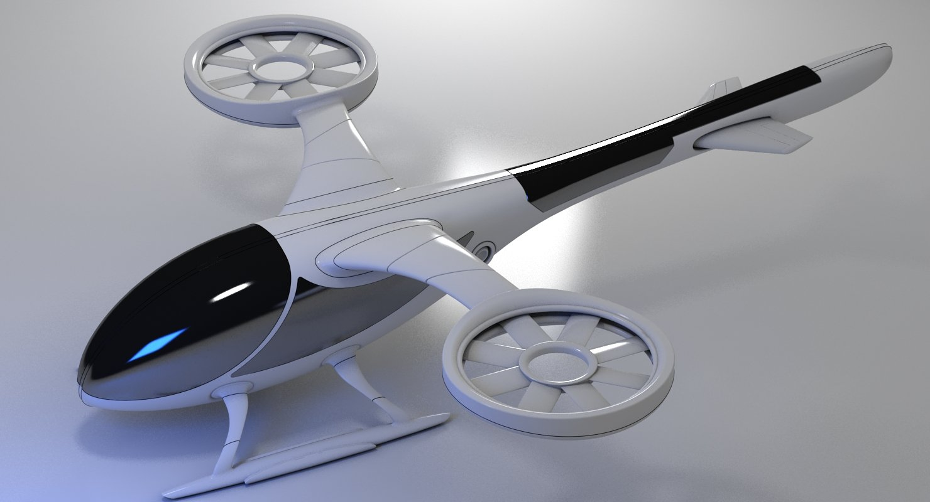
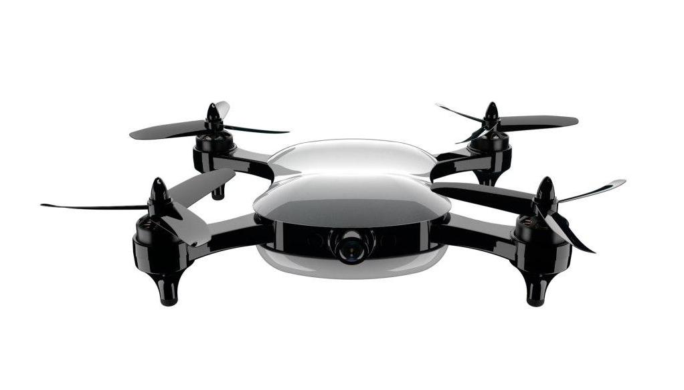
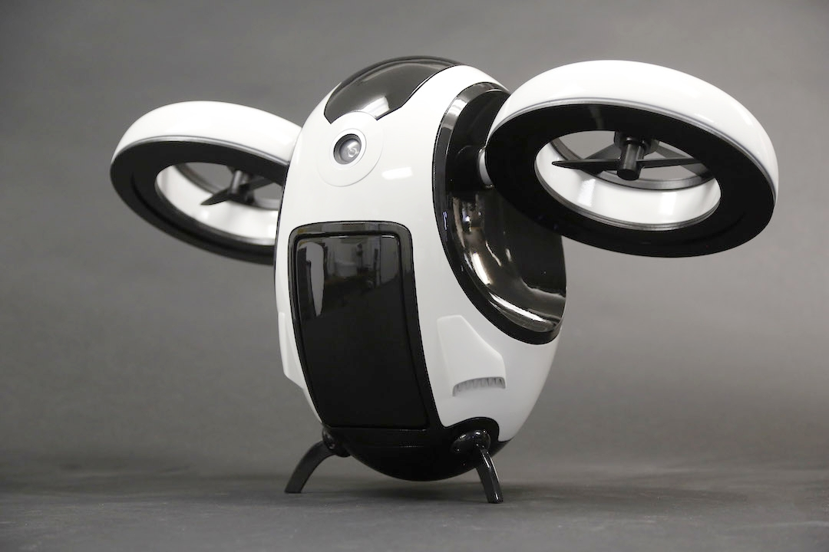
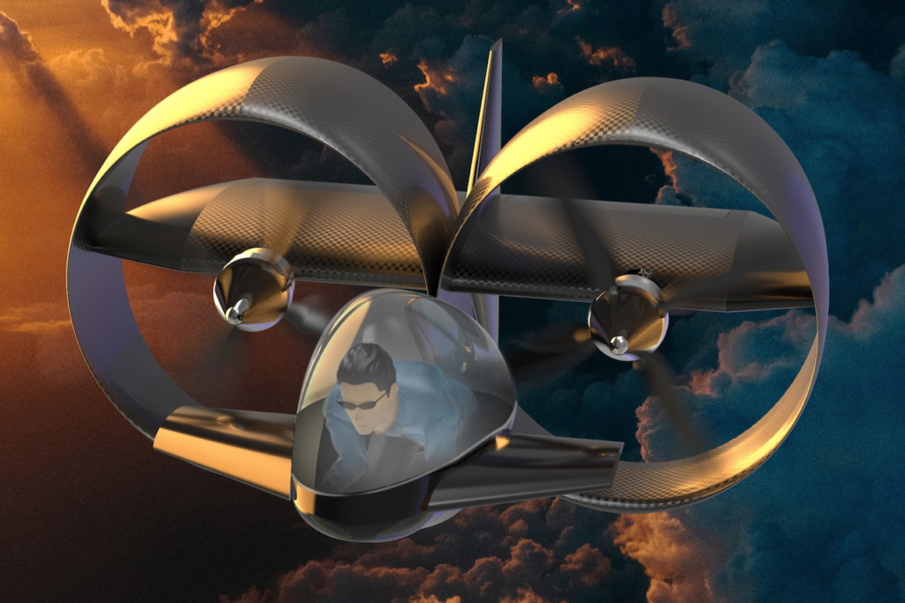
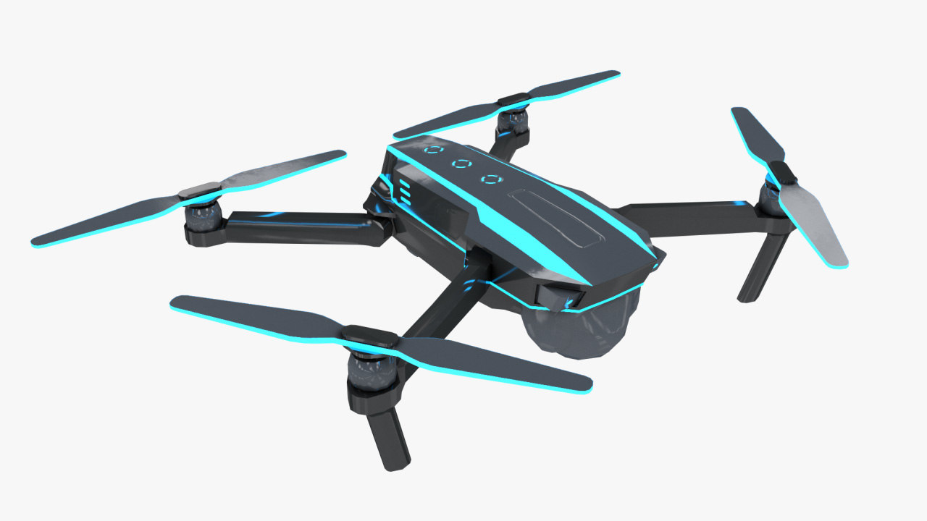
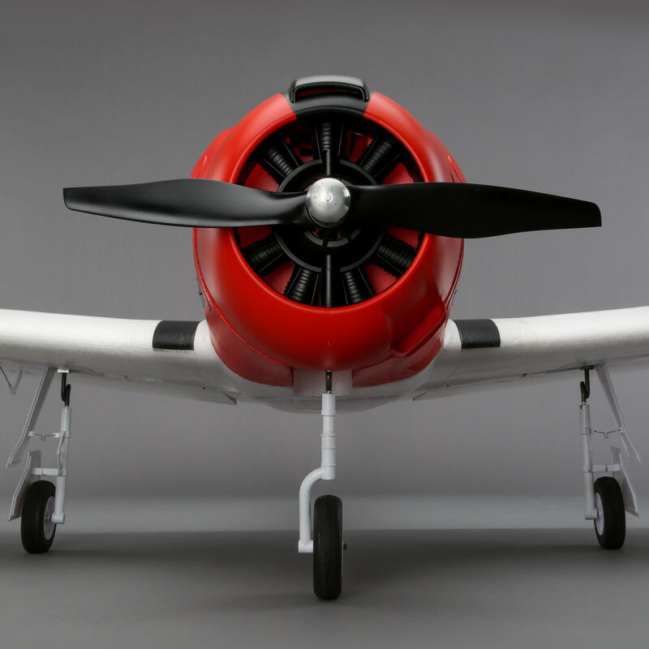
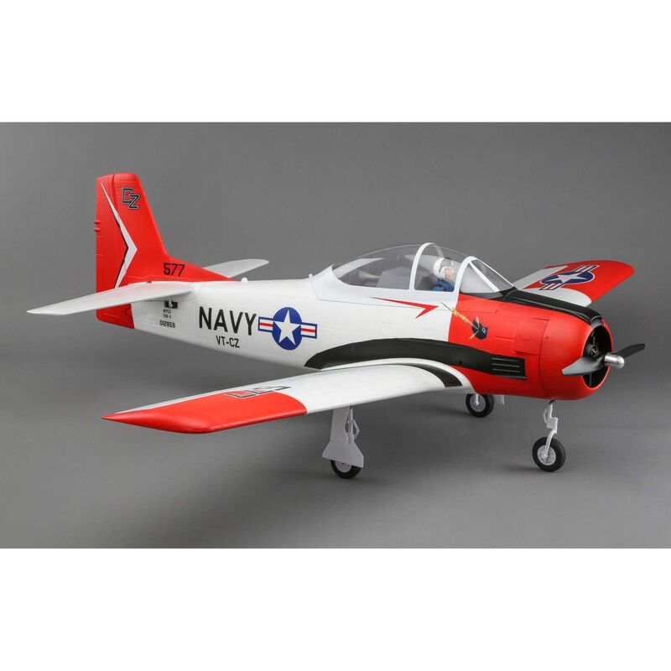
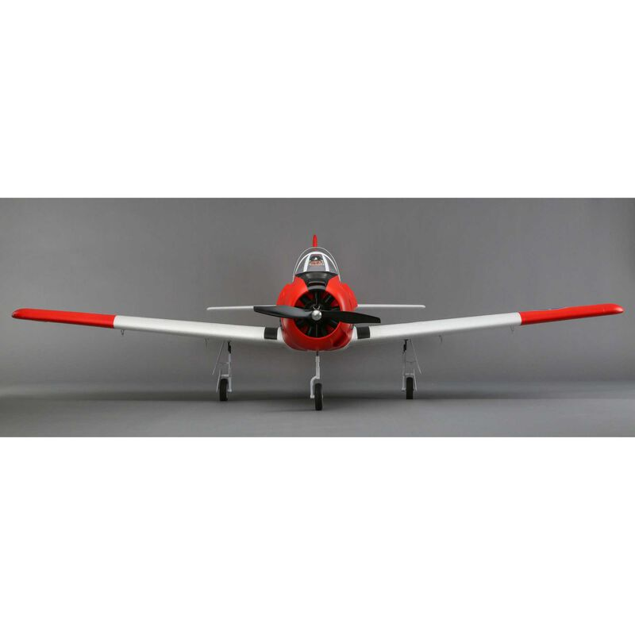
DRONE FAULT AND ANOMALY DETECTION
BY JEAN BAPTISTE MBAYA

Slide 2
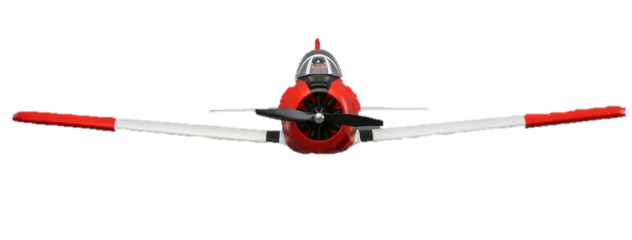
Overview
INTRODUCTION
SCOPE AND DEFINITION
PROCEDURE AND DEVELOPMENT
SUMMARY

Slide 3
INTRODUCTION
Rising safety concerns due to increasing number of Autonomous drones.
The purpose for this project is to build a machine learning model that could predict faults and anomalies on drones.
Preventing drones from randomly falling out of the sky.
Our research focused on the Carbon Z drone

Slide 4
SCOPE AND DEFINITION
There are two questions that we’re trying to answer in our project:
Which variables have the highest influence on whether the Carbon Z drone is has failures or not?
Could we build a machine learning model to predict faults and anomalies on Carbon Z drone at least 80% accuracy

Slide 5
PROCESS AND ANALYSIS
Data Collection & Wrangling
Process
Data Prep
Data Exp
Backward Elimination
Analysis
ML
Tools : Jupiter Notebook, GitHub, Python and R

Slide 6
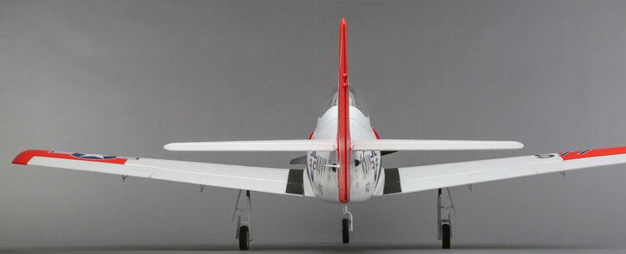
SUMMARY
Our best model has 6 variables that influence faults and anomalies on Carbon Z: Tx Speed, Rx Speed… that are responsible for 29% of outcome changes, the remaining 70% can be cause by noise and other uncaptured variables.
Our model can predict faults and anomalies on Carbon Z drones in flight, with a 100% accuracy overall and 96% accuracy on right aileron failure predictions.
We need more data on right aileron failures in order to make better predictions on this fault.

Slide 7
REFERENCES
Data Source:
Keipour, A., Mohammadreza Mousaei, & Scherer, S. (2020). ALFA: A Dataset for UAV Fault and Anomaly Detection [Data set]. Carnegie Mellon University. https://doi.org/10.1184/R1/12707963
Project Code:
Mbaya, J.(2021).GITHUB: https://github.com/MrAshTag/Drone_Faults_Anomaly_Dectection

