Slide 1

Random Forest
Yao-Yi Chiang
Computer Science and Engineering
University of Minnesota
yaoyi@umn.edu
CC-BY
Attribution
Slides adopted from Machine Learning 10601, Recitation 8, Oct 21, 2009 Oznur Tastan (http://people.sabanciuniv.edu/otastan/)

Slide 2
Outline
Tree representation
Brief information theory
Learning decision trees
Bagging
Random forests

Slide 3
Decision trees
Non-linear classifier & regressor
Easy to use
Can handle both numerical and categorial variables
Easy to interpret
Non-parametric method
Susceptible to overfitting but can be avoided

Slide 4
Anatomy of a decision tree
Each node is a test on
one attribute
Outlook
sunny
overcast
rain
Possible attribute values
of the node
Humidity
Yes
Windy
high
normal
true
false
Leafs are the decisions
No
Yes
No
Yes

Slide 5
Anatomy of a decision tree
Sample size
Each node is a test on
one attribute
Outlook
Your data
gets smaller
sunny
overcast
rain
Possible attribute values
of the node
Humidity
Yes
Windy
high
normal
true
false
Leafs are the decisions
No
Yes
No
Yes

Slide 6
To ‘play tennis’ or not
Outlook
A new test example:
(Outlook==rain) and (Windy==false)
Pass it on the tree
-> Decision is yes.
sunny
overcast
rain
Humidity
Yes
Windy
high
normal
true
false
No
Yes
No
Yes

Slide 7
To ‘play tennis’ or not
Outlook
(Outlook ==overcast) -> yes
(Outlook==rain) and (Windy==false) ->yes
(Outlook==sunny) and (Humidity=normal) ->yes
sunny
overcast
rain
Humidity
Yes
Windy
high
normal
true
false
No
Yes
No
Yes

Slide 8
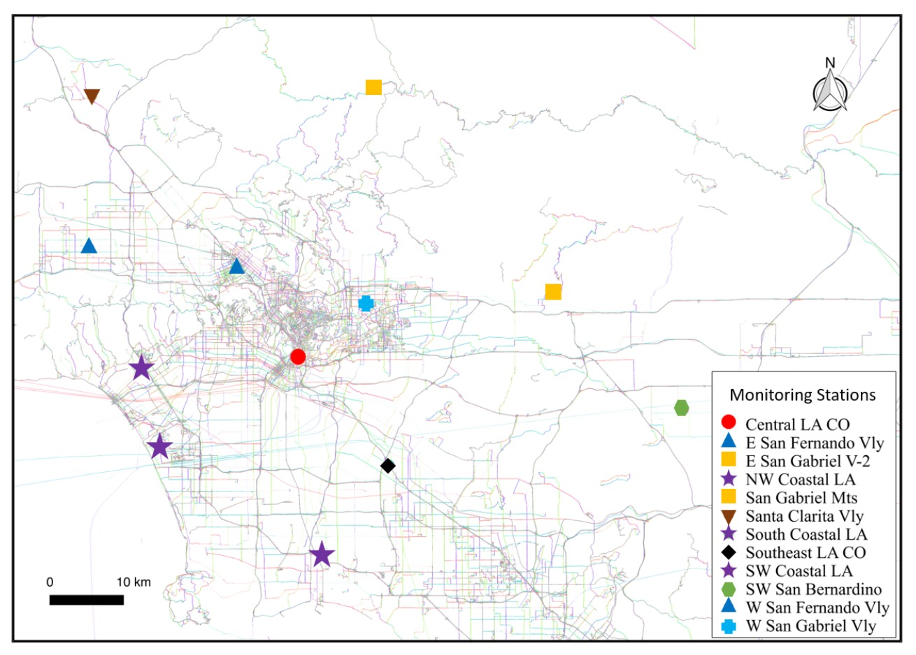
How environment affect air quality
Areas of Park within 500m
<300 sq. feet
> 300 sq. feet
= 300 sq. feet
Length of major roads within 100m
G1
# of apartment within 100m
>50m
<=50m
>-5
<5
G2
G1
G2
G1

Slide 9
Decision trees
Decision trees represent a disjunction of conjunctions of constraints on the attribute values of instances.
(Outlook ==overcast)
OR
((Outlook==rain) and (Windy==false))
OR
((Outlook==sunny) and (Humidity=normal))
=> yes play tennis

Slide 10
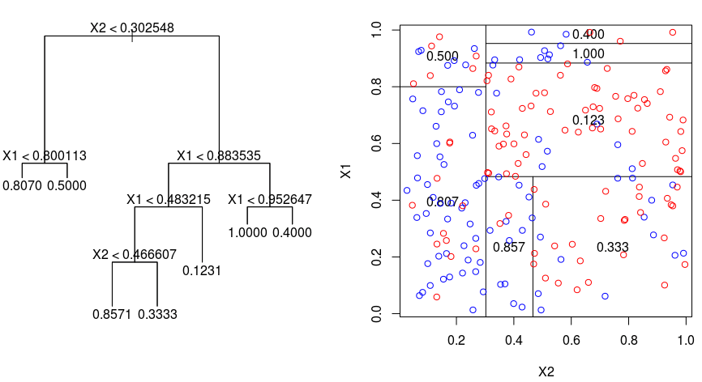
Decision trees as a regressor
Use mean response in the region as the result
https://gdcoder.com/decision-tree-regressor-explained-in-depth/

Slide 11
Tree Representation
Y=((A and B) or ((not A) and C))
0
A
1
C
B
0
1
0
1
false
true
false
true

Slide 12
Same concept different representation
Y=((A and B) or ((not A) and C))
0
A
1
C
B
0
1
0
1
false
true
false
true
0
C
1
B
A
0
1
1
0
false
A
false
true
1
0
true
false

Slide 13
Which attribute to select for splitting?
the distribution of
each class (not attribute)
16 +
16 -
8 +
8 -
8 +
8 -
4 +
4 -
4 +
4 -
4 +
4 -
4 +
4 -
2 +
2 -
2 +
2 -
This is bad splitting…

Slide 14
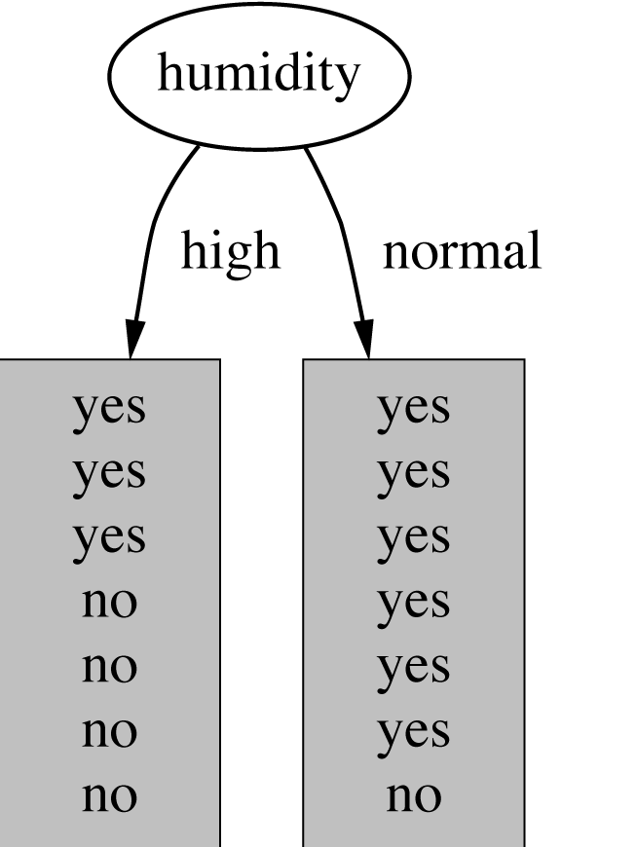
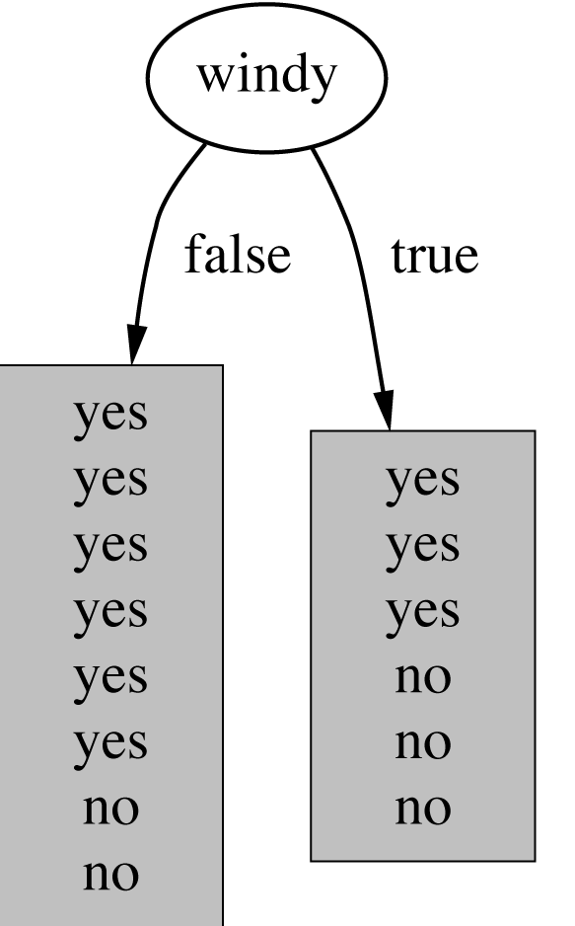
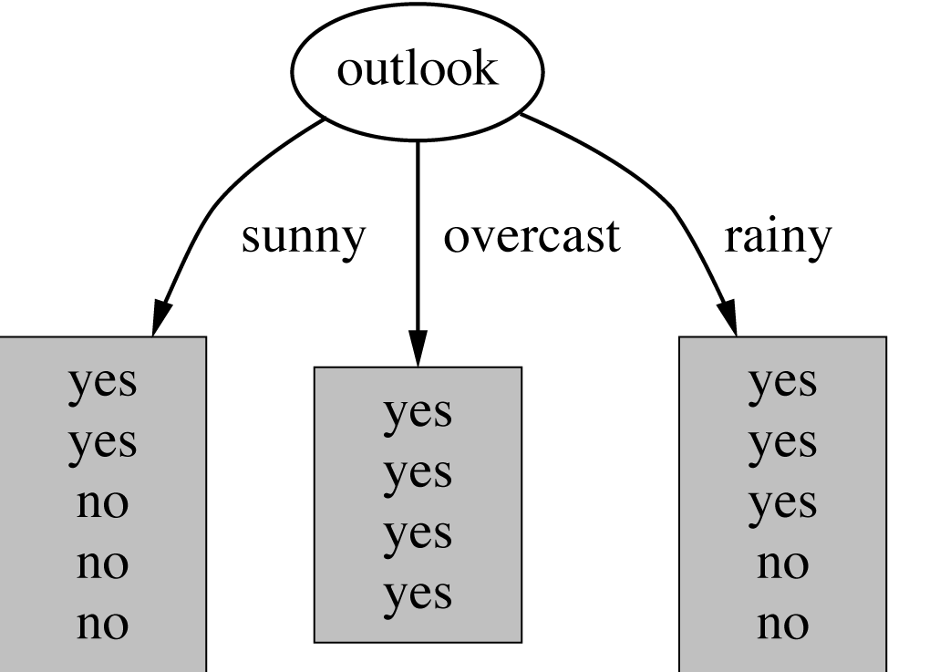
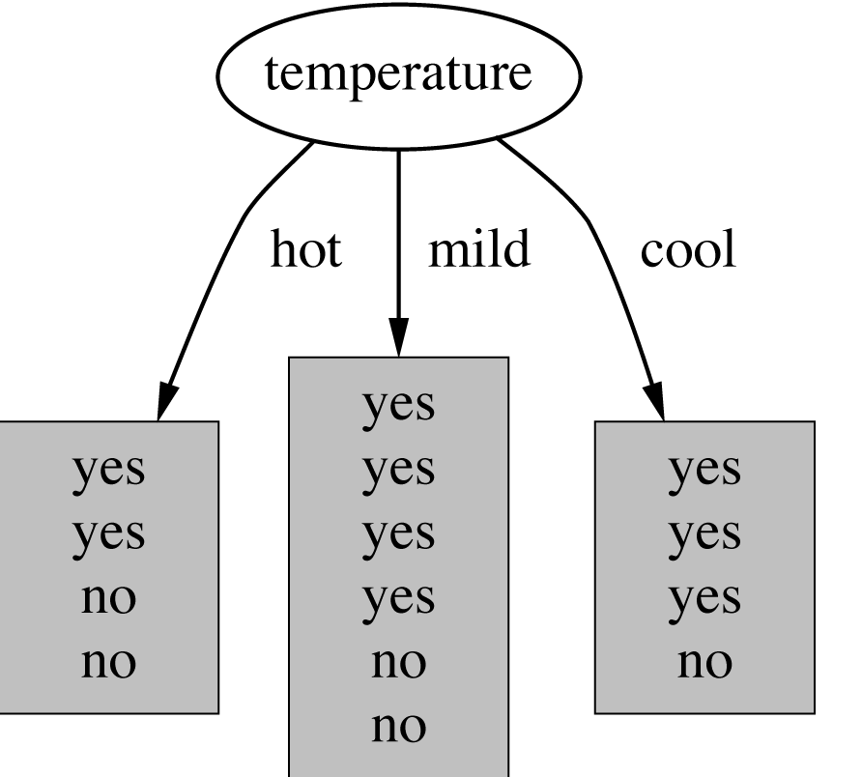
How do we choose the test ?
Which attribute should be used as the test?
Intuitively, you would prefer the
attribute that separates the training
examples as much as possible.

Slide 15
Information Gain
Information gain is one criteria to decide on the split attribute.

Slide 16
Information
Imagine:
1. Someone is about to tell you your own name
2. You are about to observe the outcome of a dice roll
2. You are about to observe the outcome of a coin flip
3. You are about to observe the outcome of a biased coin flip
Each situation have a different amount of uncertainty as to what outcome you will observe.

Slide 17
Information Theory
If the probability of this event happening is small and it happens
the information is large.
Observing the outcome of a coin flip is head
Observe the outcome of a dice is 6
Information:
reduction in uncertainty (amount of surprise in the outcome)
Notes:
A
C B
C
B A
A

Slide 18
Entropy of an information source
If X can have 8 outcomes and all are equally likely
bits
If X can have 6 outcomes and all are equally likely
6 x 1/6 x
Biased dice roll that shows only 1 or 2 50% of the chance
50% x 1 + 50% x1 + 4 x 0
The expected amount of information (in bits with log base 2) when observing the output of a random variable X

Slide 19
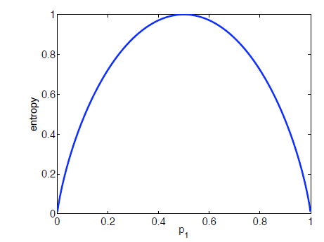
Entropy
Equality holds when all outcomes are equally likely
The more the probability distribution deviates from uniformity the lower the entropy
e.g., unbiased coin toss – p = 0.5 has the highest entropy 1
Fair dice roll:
6 x 1/6 x
Biased dice roll that shows only 1 or 2 50% of the chance:
50% x 1 + 50% x1 + 4 x 0

Slide 20
Entropy, purity
4 +
4 -
8 +
0 -
The distribution is less uniform
Entropy is lower
The node is purer
Entropy measures the purity

Slide 21
Information Gain
Reduction in uncertainty by knowing Y
Information gain:
(information before split) – (information after split)
IG(X,Y)=H(X)-H(X|Y)

Slide 22
Conditional entropy

Slide 23
Information Gain
Information gain:
(information before split) – (information after split)

Slide 24
Example
Attributes
Labels
Attributes
Labels
X1 | X2 | Y | Count
T | T | + | 2
T | F | + | 2
F | T | - | 5
F | F | + | 1
X1 | X2 | Y | Count
T | T | + | 2
T | F | + | 2
F | T | - | 5
F | F | + | 1
Which one do we choose X1 or X2?
Information gain: (information before split) – (information after split)
IG(X1,Y) = H(Y) – H(Y|X1)
H(Y) = - (5/10) log(5/10) -5/10log(5/10) = 1
H(Y|X1) = P(X1=T)H(Y|X1=T) + P(X1=F) H(Y|X1=F)
= 4/10 (1log 1 + 0 log 0) +6/10 (5/6log 5/6 +1/6log1/6)
= 0.39
+
-
Y: +, -
X1: T, F
X2: T, F
+
-
-
+
J: loop through T, F
I: loop through +, -
Information gain (X1,Y)= 1-0.39=0.61

Slide 25
Which one do we choose?
X1 | X2 | Y | Count
T | T | + | 2
T | F | + | 2
F | T | - | 5
F | F | + | 1
Information gain (X1,Y)= 0.61
Information gain (X2,Y)= 0.12
Pick the variable which provides
the most information gain about Y
Pick X1

Slide 26
Recurse on branches
X1 | X2 | Y | Count
T | T | + | 2
T | F | + | 2
F | T | - | 5
F | F | + | 1
One branch
The other branch

Slide 27
Purity (diversity) measures
Gini (population diversity)
Information Gain
Chi-square Test

Slide 28
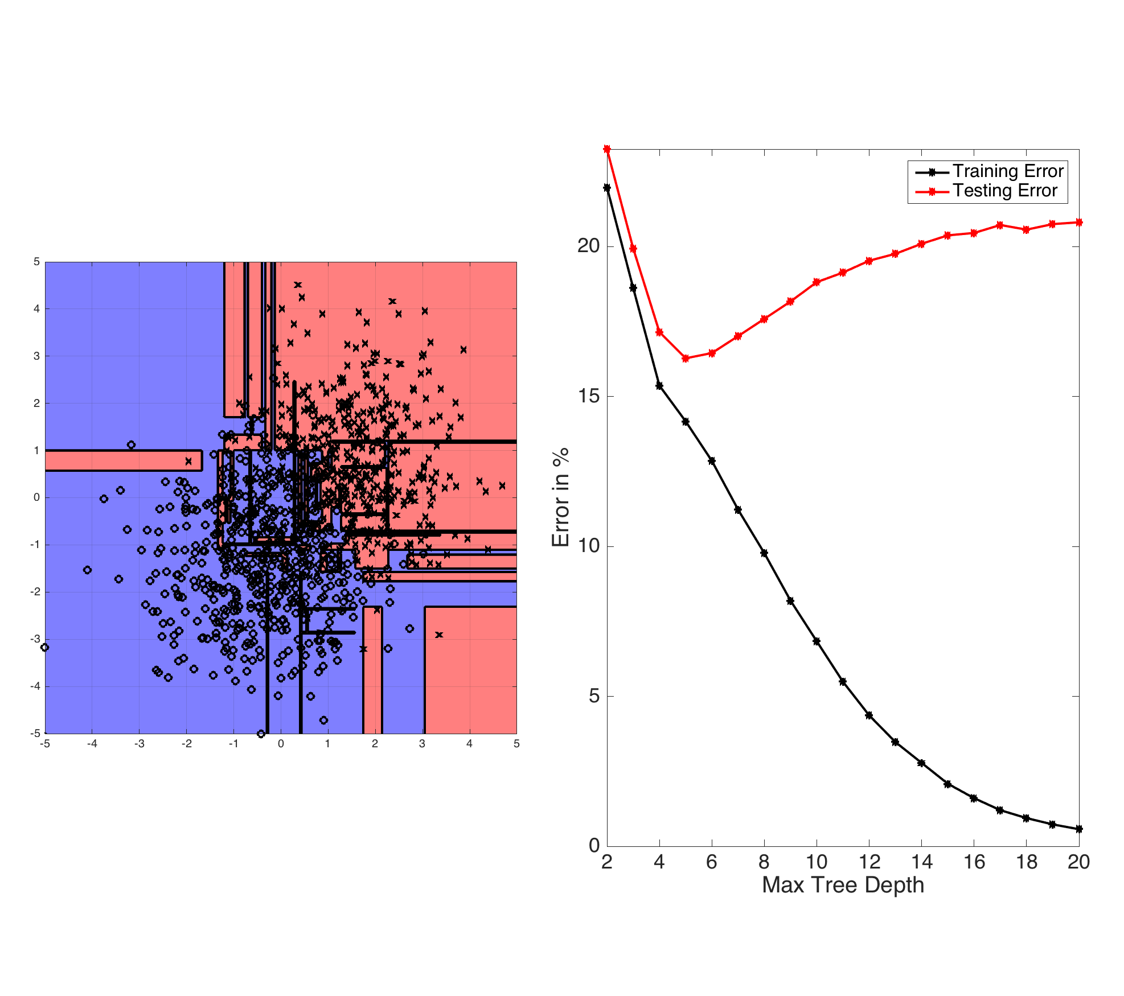
Overfitting
You can perfectly fit to any training data
Two approaches:
Stop growing the tree when further splitting the data does not yield an improvement
Grow a full tree, then prune the tree, by eliminating nodes.
https://www.cs.cornell.edu/courses/cs4780/2018fa/lectures/lecturenote17.html

Slide 29
Bagging
Bagging or bootstrap aggregation a technique for reducing the variance of an estimated prediction function.
For classification, a committee of trees each cast a vote for the predicted class.

Slide 30
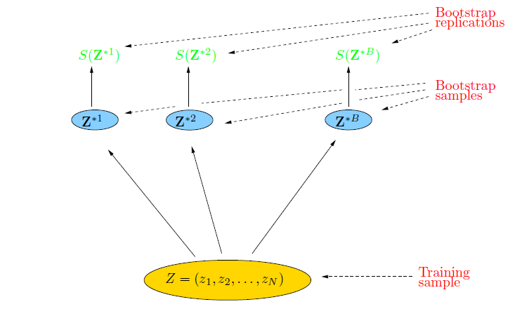
Bootstrap
The basic idea:
randomly draw datasets with replacement from the
training data, each sample the same size as the original training set

Slide 31
Bagging
Create bootstrap samples
from the training data
M features
N examples
....…

Slide 32
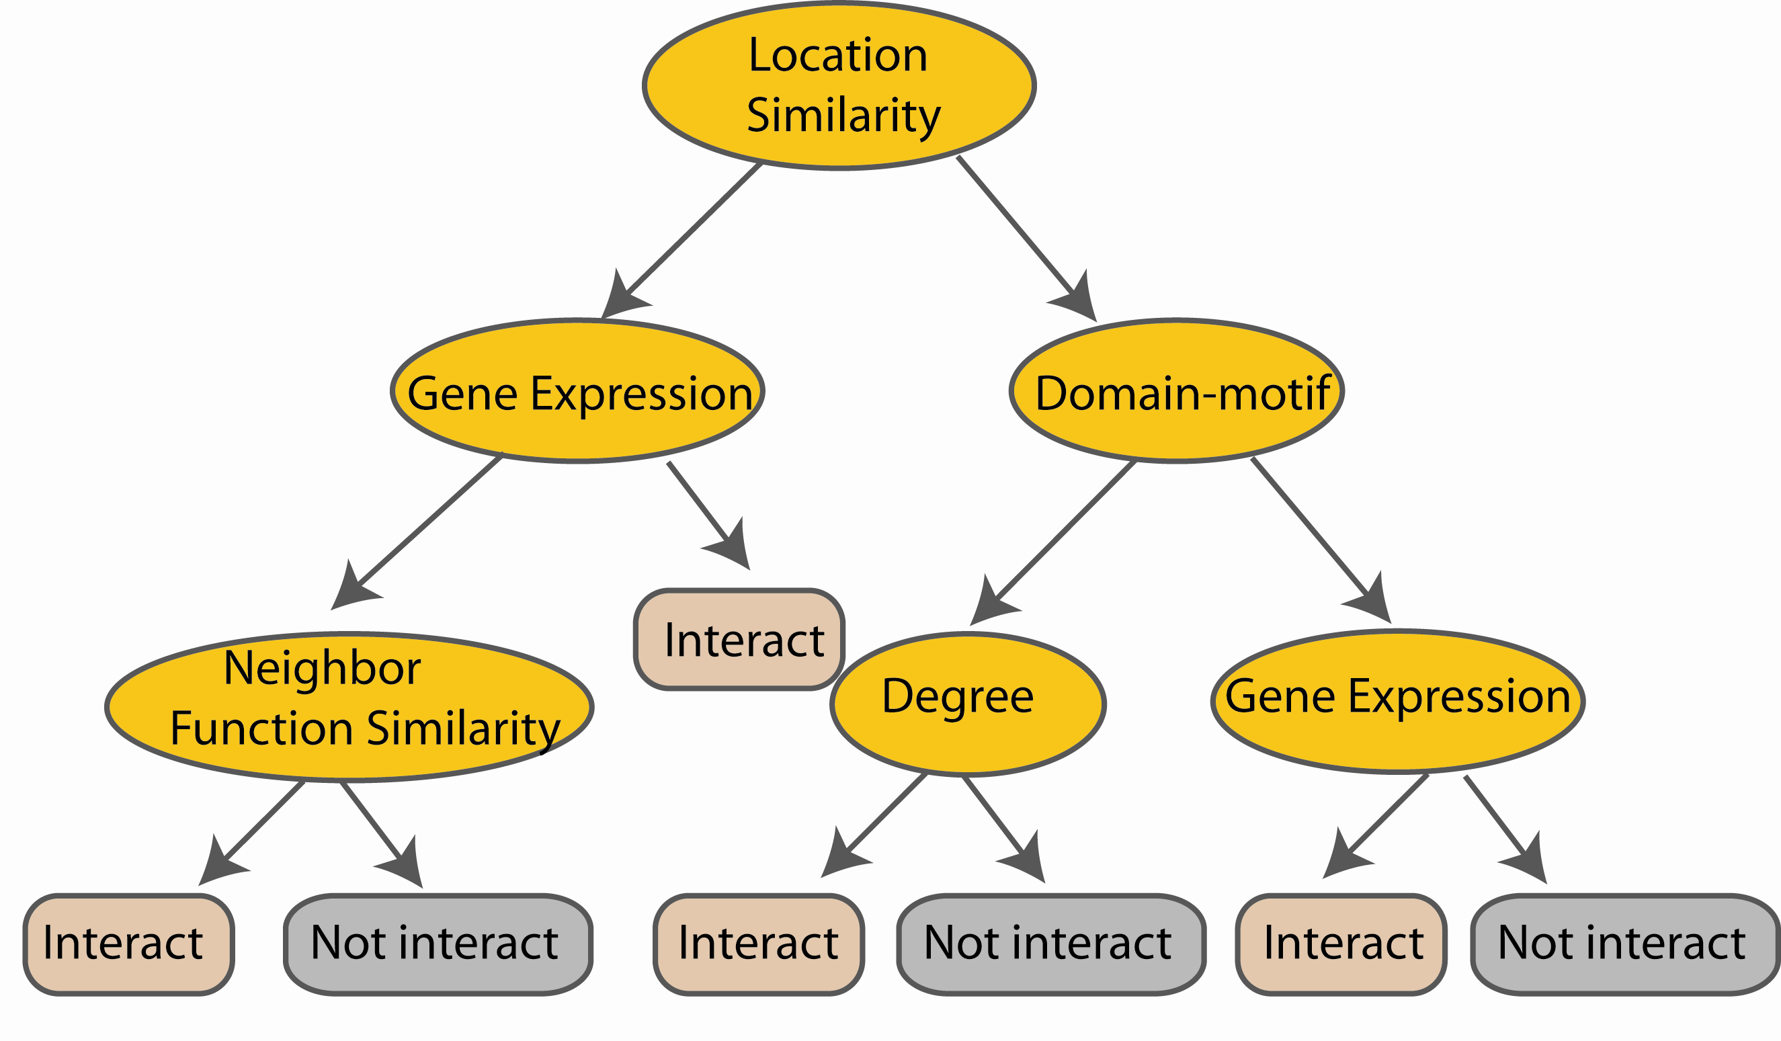
Random Forest Classifier
Construct a decision tree
M features
N examples
....…

Slide 33

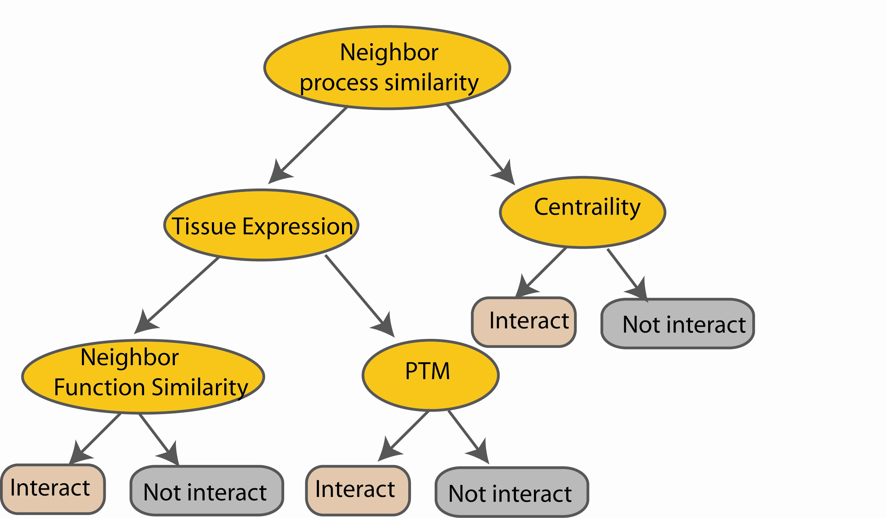
Random Forest Classifier
M features
N examples
Take the majority vote
....…
....…
Notes:
Finally the given an input data the decision is made as follows given an input data,

Slide 34
Bagging : a simulated example
Generated a sample of size N = 30,
two classes and p = 5 features, each having a standard Gaussian distribution with pairwise correlation 0.95.
The response Y was generated according to
Pr(Y = 1|x1 ≤ 0.5) = 0.2,
Pr(Y = 0|x1 > 0.5) = 0.8.

Slide 35
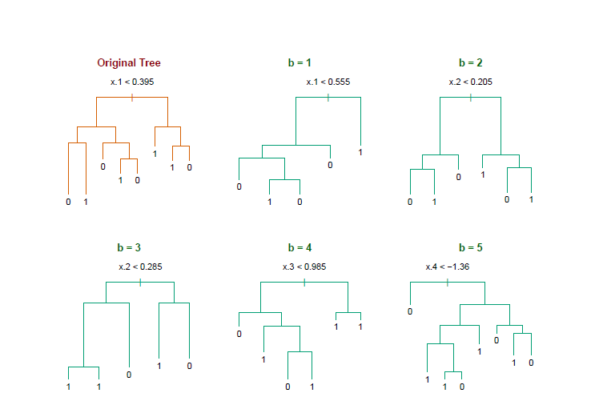
Bagging
Notice the bootstrap trees are different than the original tree

Slide 36
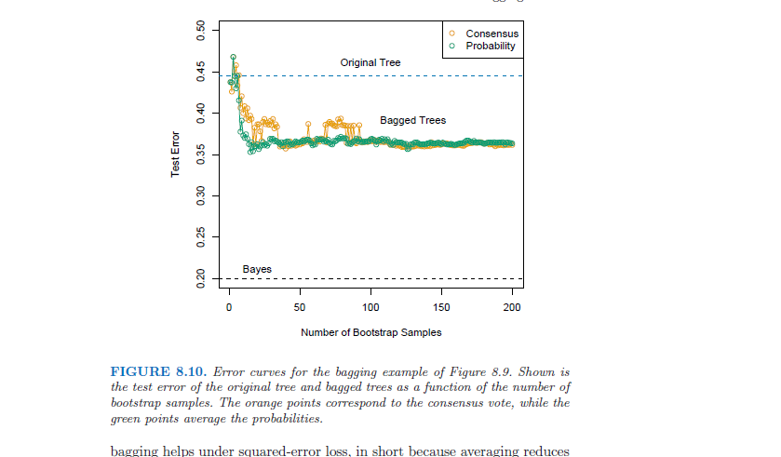
Bagging
Treat the voting
Proportions as
probabilities
http://www-stat.stanford.edu/~hastie/Papers/ESLII.pdf Example 8.7.1

Slide 37
Random forest classifier
Random forest classifier, an extension to bagging which uses de-correlated trees.

Slide 38
Random Forest Classifier
Training Data
M features
N examples
Notes:
As the classifier of choice we adopt Random Forest Classifier, due to its robustness to heterogenous and noisy feature.
Random Forest is an ensembe classifier. Briefly, given N data and M features, bootsrap samples are created from the traning data

Slide 39
Random Forest Classifier
Create bootstrap samples
from the training data
M features
N examples
....…

Slide 40
Random Forest Classifier
Construct a decision tree
M features
N examples
....…
Notes:
From eachd descision tree .. In spliting the nodes, the Gini Gain is employed

Slide 41
Random Forest Classifier
At each node in choosing the split feature
choose only among m<M features
M features
N examples
....…
Notes:
Different from the regular decision trees in random forest, when the splitting feature is chosen from only a subset of allf eatures.
The robostness of the classifier arises from
bootsraping of the training data and the random selection of features, the the random choose of features.

Slide 42
Random Forest Classifier
Create decision tree
from each bootstrap sample
M features
N examples
....…
....…

Slide 43
Random Forest Classifier
M features
N examples
Take he majority vote
....…
....…
Notes:
Finally the given an input data the decision is made as follows given an input data,

Slide 44
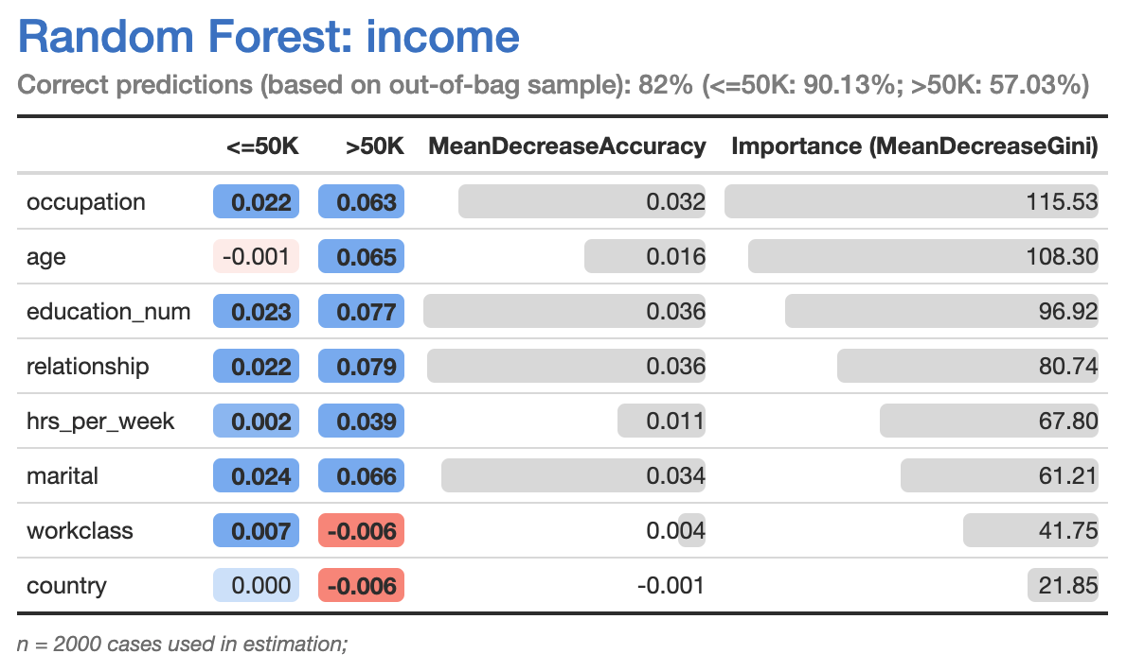
Importance Score (Categorical RF)
How much the accuracy decreases when the variable is excluded
The decrease of Gini impurity when a variable is chosen to split a node
https://www.displayr.com/how-is-variable-importance-calculated-for-a-random-forest/

Slide 45
Importance Scores (Categorical RF)
Gini Importance (mean decrease impurity)
On average, how the selected feature at a node decreases the impurity of the split
Measured for every three
Derived from the RF structure
Often prefer numerical features (or categorical features with high cardinality)
Ignore important but not the most important features at a node
Mean Decrease Accuracy
Set a feature with random values (so that it has no predictive power)
Calculate how the accuracy number decreases

Slide 46
Random forest Resouces
Available package:
https://scikit-learn.org/stable/modules/generated/sklearn.ensemble.RandomForestClassifier.html
https://spark.apache.org/docs/latest/api/python/reference/api/pyspark.mllib.tree.RandomForest.html
To read more:
http://www-stat.stanford.edu/~hastie/Papers/ESLII.pdf

Slide 47
Acknowledgements
Gil, Yolanda (Ed.) Introduction to Computational Thinking and Data Science. Available from http://www.datascience4all.org
Oznur Tastan, Geoffrey J. Gordon, Machine Learning 10601, Recitation 8, Oct 21, 2009 (http://people.sabanciuniv.edu/otastan/, https://www.cs.cmu.edu/~ggordon/10601/recitations/rec08/Rec08_Oct21.ppt)

Slide 48

These materials are released under a CC-BY License
https://creativecommons.org/licenses/by/2.0/
You are free to:
Share — copy and redistribute the material in any medium or format
Adapt — remix, transform, and build upon the material
for any purpose, even commercially.
The licensor cannot revoke these freedoms as long as you follow the license terms.
Under the following terms:
Attribution — You must give appropriate credit, provide a link to the license,
and indicate if changes were made. You may do so in any reasonable manner,
but not in any way that suggests the licensor endorses you or your use.
Artwork taken from other sources is acknowledged where it appears.
Artwork that is not acknowledged is by the author.
Please credit as: Chiang, Yao-Yi Introduction to Spatial Artificial Intelligence. Available from https://yaoyichi.github.io/spatial-ai.html
If you use an individual slide, please place the following at the bottom: “Credit: https://yaoyichi.github.io/spatial-ai.html
We welcome your feedback and contributions.
Credit: http://www.datascience4all.org/

