Slide 1
Map-Reduce (Part II)
Yao-Yi Chiang
Computer Science and Engineering
University of Minnesota
yaoyi@umn.edu
Thanks for source slides and material to: J. Leskovec, A. Rajaraman, J. Ullman: Mining of Massive Datasets (http://www.mmds.org)
Also slides from Yijun Lin, Ann Chervenak, and Wensheng Wu
Notes:
In last few years, map reduce has been widely used for mining really massive data sets.
Why we need Map reduce for processing the large data sets?
Start with basics

Slide 2
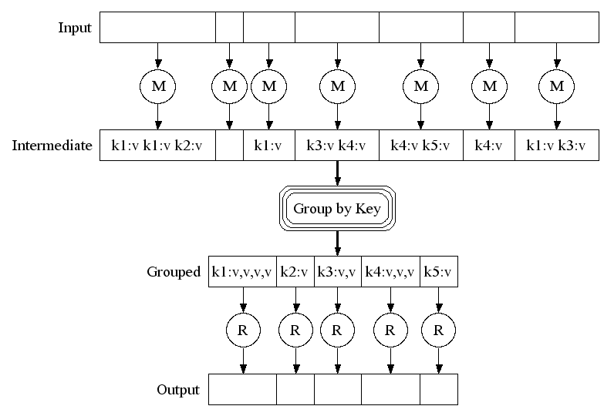
Map-Reduce: A diagram
Big document
MAP:
Read input and produces a set of key-value pairs
Group by key:
Collect all pairs with same key
(Hash merge, Shuffle, Sort, Partition)
Reduce:
Collect all values belonging to the key and output

Slide 3
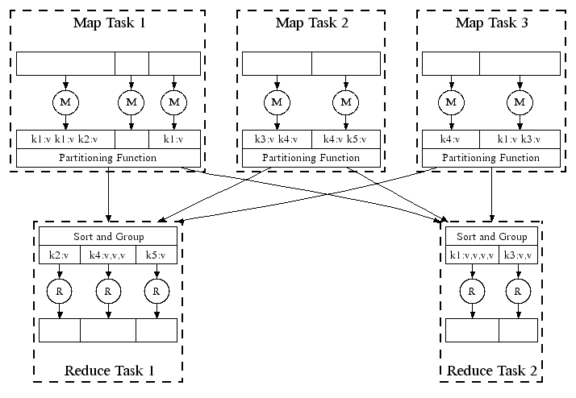
Map-Reduce: In Parallel
Hash function
All phases are distributed with many tasks doing the work
Notes:
Here is the architecture of how it actually works in a distributed file system.
And map and reduce tasks are running parallelly on different nodes.
Here are few chunks of file to be on node 1.
The hash function would tell the map reduce system which reduce node to send that key value pair to.
This ensures that all the pairs with the same key values. whether they are in map task 1, 2, 3. would end up being in the same reduce task.
Once the map tasks have completed, the reduce tasks first job is to sort its input and group it together by key.

Slide 4
Map-Reduce: Environment
MapReduce environment takes care of:
Partitioning the input data
Scheduling the program’s execution across a set of nodes
Performing the group by key step
Handling machine failures
Managing required inter-machine communication
Notes:
Remember that a programmer would need to write Map and Reduce program.
The Map-Reduce environment has to take care of a bunch of things. It takes care of partitioning the input data.
Scheduling the program’s execution across a set of nodes to figure out where the map tasks run where the reduce tasks run and so on.
The environment would make sure that the nodes are hidden from the program

Slide 5
Data Flow
Input and final output are stored on a distributed file system (DFS)
Scheduler tries to schedule map tasks “close” to physical storage location of input data
Intermediate results are stored on local file system of Map workers
e.g., output of the map step
Output is often input to another Map-Reduce task
Notes:
Let’s take a look at the data flow
It is reasonable to create one Map task for every chunk of the input file(s). Run on the same chunk server.
So there is actually no data copy or data moving associated with the map step.

Slide 6
Coordination: Primary
Primary node takes care of coordination:
Task status: idle, in-progress, completed
Idle tasks get scheduled as workers become available
When a map task completes, it sends the primary the location and sizes of its R intermediate files, one for each reducer (R = number of reducers)
Primary pushes this info to reducers
Primary pings workers periodically to detect failures
Notes:
Master node takes care of all the coordination of a Map-reduce job. The master node keeps a task status with each task.
And each task has a status flag, the status flag can either be idle, in-progress or completed.
if there is a free node. The master would go through its queue of idle tasks and schedules an idle task on that.
There would be one intermediate file created for each of the reducer. So when a map task completes, it stores R intermediate file on its local file system, and let the master know what are those file location and sizes
Once the reducers knows that all the mappers are completed, then they copy the intermediate file from each of the map tasks

Slide 7
Dealing with Failures
Map worker failure
Map tasks completed or in-process at worker are reset to idle
Idle tasks eventually rescheduled on other worker(s)
Notes:
If a map worker fails, then all the map tasks that scheduled on that map worker may have failed.
The tricky thing is that the output of a map task is written to the local file system of the map worker.
So if a map worker fails, then all the intermediate output created by all the map tasks are lost.
And what master does, is that it resets all the completed or in-process tasks to be idle and reschedule those tasks.
If a reduce

Slide 8
Dealing with Failures
Map worker failure
Map tasks completed or in-process at worker are reset to idle
Idle tasks eventually rescheduled on other worker(s)
Reduce worker failure
Only in-process tasks are reset to idle
Idle Reduce tasks restarted on other worker(s)
Notes:
If a reduce worker fails, only the in-process tasks are set to idle. the tasks that have already completed don’t need to set to idle. Because the output pf the reduce worker is a final output and it’s written to the distributed file system and not to the local file system of the reduce worker. Since the output is written to the distributed file system. even the reduce worker fails, the output is not lost.

Slide 9
Dealing with Failures
Map worker failure
Map tasks completed or in-process at worker are reset to idle
Idle tasks eventually rescheduled on other worker(s)
Reduce worker failure
Only in-process tasks are reset to idle
Idle Reduce tasks restarted on other worker(s)
Primary failure
Map-reduce task is aborted and client is notified
Notes:
And client can do something like restarting the mapreduce task.
The master is a single node, and therefore, the chance of the master can fail is actually quite uncommon
So the problem that you have with is if you have multiple workers running map and reduce tasks. It’s much more likely that one of many workers failed

Slide 10
How many map and reduce jobs?
M map tasks, R reduce tasks
Notes:
Suppose we have M map task and R reduce task, our goal is to determine what is the number for M and R
This is part of the input that given to the map reduce system to let it know how many tasks it needs to schedule.

Slide 11
How many map and reduce jobs?
M map tasks, R reduce tasks
Rule of a thumb:
Make M much larger than the number of nodes in the cluster
One DFS chunk per map task is common
Improves dynamic load balancing and speeds up recovery from worker failures
Notes:
That means on each node you will have many small map tasks on one node
and if that node fails, then those map tasks can then be spread across all the available nodes and so the entire tasks with complete much faster.

Slide 12
How many map and reduce jobs?
M map tasks, R reduce tasks
Rule of a thumb:
Make M much larger than the number of nodes in the cluster
One DFS chunk per map task is common
Improves dynamic load balancing and speeds up recovery from worker failures
Usually R is smaller than M
Output is spread across R files
Google example: Often use 200,000 map tasks, 5000 reduce tasks on 2000 machines
Notes:
It usually convenient to have the output spread across small number of nodes instead of large number of nodes

Slide 13
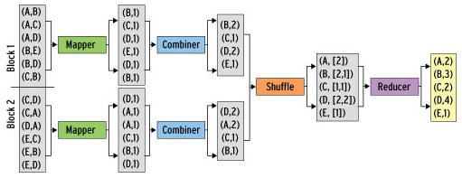
Refinement: Combiners
Combiner combines the values of all keys of a single mapper (single node)
Much less data needs to be copied and shuffled!
Works if reduce function is commutative and associative

Slide 14
Refinement: Partition Function
Control how keys get partitioned
Reduce needs to ensure that records with the same intermediate key end up at the same worker
System uses a default partition function:
hash(key) mod R
Sometimes useful to override the hash function:
E.g., hash(hostname(URL)) mod R ensures URLs from a host to end up in the same output file
Notes:
Remember that we use a hash function in the intermediate key value pairs to decide which node each key value pair should go
Sometimes you want to override this function with a customer function.

Slide 15
Implementations
Google’s MapReduce
Not available outside Google
Hadoop
Open-source implementation in Java
Uses HDFS for stable storage
Download: http://hadoop.apache.org/releases.html
Spark

Slide 16
Example: Relational Join
Employee
Assigned Departments
Name | SSN
Sue | 999999999
Tony | 777777777
EmpSSN | DepName
999999999 | Accounts
777777777 | Sales
777777777 | Marketing
Emplyee ⨝ Assigned Departments
Name | SSN | EmpSSN | DepName
Sue | 999999999 | 999999999 | Accounts
Tony | 777777777 | 777777777 | Sales
Tony | 777777777 | 777777777 | Marketing

Slide 17

Example: Relational Join
Map Task: Emit (key, value) pair
Key is key used for join
Value is a tuple with all fields from table (including the table name)
Employee
Name | SSN
Sue | 999999999
Tony | 777777777
Assigned Departments
EmpSSN | DepName
999999999 | Accounts
777777777 | Sales
777777777 | Marketing
key=999999999, value=(Employee, Sue, 999999999) key=777777777, value=(Employee, Tony, 777777777) key=999999999, value=(Department, 999999999, Accounts) key=777777777, value=(Department, 777777777, Sales) key=777777777, value=(Department, 777777777, Marketing)

Slide 18
Example: Relational Join
Group by Key: groups together all values (tuples) associated with each key
Reduce task: emit joined values (without table names)
key=999999999, values=[(Employee, Sue, 999999999),
(Department, 999999999, Accounts)]
Sue, 999999999, 999999999, Accounts
key=777777777, values=[(Employee, Tony, 777777777),
(Department, 777777777, Sales),
(Department, 777777777, Marketing)]
Tony, 777777777, 777777777, Sales
Tony, 777777777, 777777777, Marketing

Slide 19
Example: Distributed Sort
Goal: Sort a very large list of (firstName, lastName) pairs by lastName followed by firstName
Map task:
Reduce task:

Slide 20
Example: Distributed Sort
Map task
Emit (lastName, firstName)
Group by keys:
Group together entries with same last name
Divide into non-overlapping alphabetical ranges (sorting)
Keys are sorted in alphabetical order
Reduce task
Processes one key at a time
For each (lastName, list(firstName)), emit (lastName, firstName) in alphabetical order (sorting)
Merge output from all Reduce tasks (e.g., write)

Slide 21
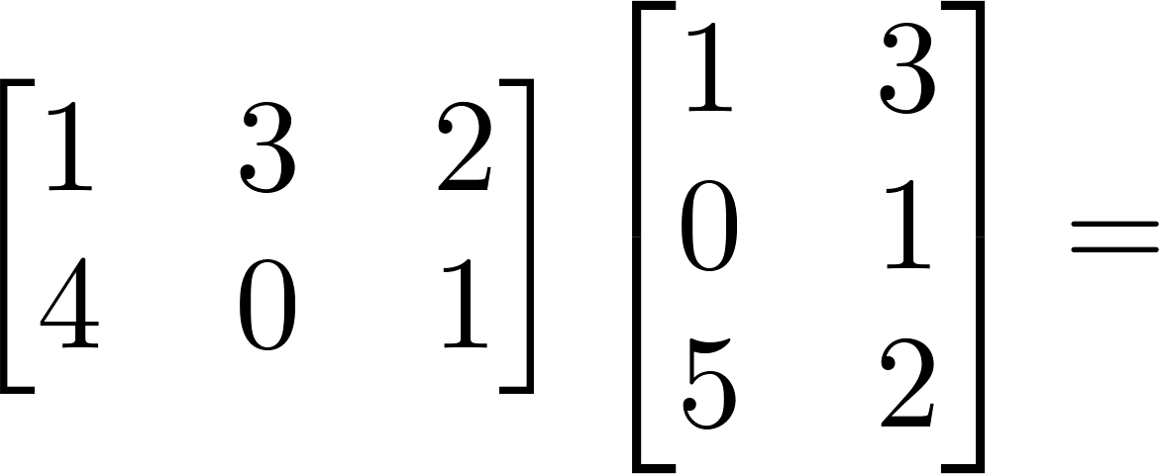

Example: Matrix Multiplication
Assume two matrices A and B, and AB = C
A_{ij} is the element in row i and column j of matrix A
Similarly for B and C
C_{ik} = ∑_{j} A_{ij} × B_{jk}
C_{ik} depends on the i^{th} row of A, that is A_{ij} for all j, and the k^{th} column of B, that is B_{jk} for all j
11
10
e.g., C₁₁ = 1×1 + 3×0
+ 2×5 = 11
9
14
A
B
C

Slide 22











Matrix Multiplication
Map-Reduce (One phase)
C = A X B
A has dimensions L x M
B has dimensions M x N
C has dimensions L x N
Matrix Multiplication: C[i, k] = SUM_{j} (A[i, j] x B[j, k])
Map task:
Reduce task:
X
=
A
B
C
Notes:
For each map, we might take a chunk of elements in the matrix
And our goal is to get the element in A and B that would contribute to a certain element in C, and then multiply each pair and then sum up value to get each element in result C

Slide 23
Matrix Multiplication
Map-Reduce (One phase)
C = A X B
A has dimensions L x M
B has dimensions M x N
C has dimensions L x N
Matrix Multiplication: C[i, k] = SUM_{j} (A[i, j] x B[j, k])
Map task:
for each element (i,j) of A, emit ((i,k), A[i,j]) for k in 1..N
e.g., For A[1, 1] emit ((1, 1), 1), ((1, 2), 1)
For A[1, 2] emit ((1, 1), 3), ((1, 2), 3)
For A[2, 1] emit ((2, 1), 4), ((2, 2), 4)
for each element (j,k) of B, emit ((i,k), B[j,k]) for i in 1..L
e.g., For B[1, 1] emit ((1, 1), 1), ((2, 1), 1)
For B[2, 1] emit ((1, 1), 0), ((2, 1), 0)
For B[1, 2] emit ((1, 2), 3), ((2, 2), 3)
11
10
9
14
A
B
C
Notes:
However, this kind of key value par
When we ship them to reduce node, you lose the information about which matrix it comes from, also what is the original column or row.
you won’t know which pair times which pair

Slide 24
Matrix Multiplication
Map-Reduce (One phase)
C = A X B
A has dimensions L x M
B has dimensions M x N
C has dimensions L x N
Matrix Multiplication: C[i, k] = SUM_{j} (A[i, j] x B[j, k])
Map task:
for each element (i,j) of A, emit ((i,k), A[i,j]) for k in 1..N
Better: emit ((i,k), (‘A’, i, j, A[i,j])) for k in 1..N
Or just emit ((i,k), (‘A’, j, A[i,j])) for k in 1..N
for each element (j,k) of B, emit ((i,k), B[j,k]) for i in 1..L
Better: emit ((i,k), (‘B’, j, k, B[j,k])) for i in 1..L
Or just emit ((i,k), (‘B’, j, B[j,k])) for i in 1..L
X
=
A
B
C
Notes:
So to improve it, in the value part, we not only have the element value, we also include the information about the matrix name and the original location of the element

Slide 25
Matrix Multiplication
Map-Reduce (One phase)
C = A X B
A has dimensions L x M
B has dimensions M x N
C has dimensions L x N
Matrix Multiplication: C[i, k] = SUM_{j} (A[i, j] x B[j, k])
Map task:
for each element (i,j) of A, emit ((i,k), (‘A’, i, j, A[i,j])) for k in 1..N
e.g., For A[1, 1] emit ((1, 1), (‘A’, 1, 1, 1)), ((1, 2), (‘A’, 1, 1, 1))
For A[1, 2] emit ((1, 1), (‘A’, 1, 2, 3)), ((1, 2), (‘A’, 1, 2, 3))
For A[2, 1] emit ((2, 1), (‘A’, 2, 1, 4)), ((2, 2), (‘A’, 2, 1, 4))
for each element (j,k) of B, emit ((i,k), (‘B’, j, k, B[j,k])) for i in 1..L
e.g., For B[1, 1] emit ((1, 1), (‘B’, 1, 1, 1)), ((2, 1), (‘B’, 1, 1, 1))
For B[2, 1] emit ((1, 1), (‘B’, 2, 1, 0)), ((2, 1), (‘B’, 2, 1, 0))
For B[1, 2] emit ((1, 2), (‘B’, 1, 2, 3)), ((2, 2), (‘B’, 1, 2, 3))
11
10
9
14
A
B
C

Slide 26
X
=
C[i,k] = Sum_{j} (A[i,j] x B[j,k]), C is L x N
In the map phase:
for each element (i,j) of A, emit ((i,k), (‘A’, i, j, A[i,j])) for k in 1..N
for each element (j,k) of B, emit ((i,k), (‘B’, j, k, B[j,k])) for i in 1..L
e.g.,
C[1,1] = A[1,1] * B[1,1] + A[1,2] * B[2,1] + A[1,3] * B[3,1] + A[1,4] * B[4,1] + A[1,5] * B[5,1]
C[1,2] = A[1,1] * B[1,2] + A[1,2] * B[2,2] + A[1,3] * B[3,2] + A[1,4] * B[4,2] + A[1,5] * B[5,2]
C[2,1] = A[2,1] * B[1,1] + A[2,2] * B[2,1] + A[2,3] * B[3,1] + A[2,4] * B[4,1] + A[2,5] * B[5,1]
C[3,1] = A[3,1] * B[1,1] + A[3,2] * B[2,1] + A[3,3] * B[3,1] + A[3,4] * B[4,1] + A[3,5] * B[5,1]
Map phase: For A[1,2], emit ((1, k), (‘A’, 1, 2, A[1,2])) for k in 1..2
emit ((1,1)(‘A’, 1, 2, A[1,2])) ((1,2)(‘A’, 1, 2, A[1,2]))
For B[3,1], emit ((i, 1), (‘B’, 3, 1, B[3,1])) for i in 1..3
emit ((1,1), (‘B’, 3, 1,B[3,1])), ((2,1)(‘B’, 3, 1,B[3,1])), ((3,1)(‘B’, 3, 1,B[3,1]))
A
B
C
Notes:
2.1 notice that if a reducer gets some of the elements in a row of A, but not all of them, then the elements of that row are useless;
the reducer cannot produce any output in that row. Similarly, if a reducer receives some but not all of a column of B, these inputs are also useless.
Thus, we may assume that the best mapping schema will send to each reducer some number of full rows of A and some number of full columns of B.
if and only if it has received the entire ith row of A and the entire kth column of B

Slide 27
Matrix Multiplication
Map-Reduce (Two phase)
Idea: 1, Multiply the appropriate values in 1st MapReduce phase
2, Add up in 2nd MapReduce phase
Try this tonight!

Slide 28
General Characteristic of Good Problem for Map-Reduce
Data set is truly “big”
Terabytes, not tens of gigabytes
Hadoop/MapReduce designed for terabyte/petabyte scale computation
Most real-world problems process less than 100 GB of input
Microsoft, Yahoo: median job under 14 GB
Facebook: 90% of jobs under 100 GB
Source: “To Hadoop or Not to Hadoop” by Anand Krishnaswamy 8/13/2013

Slide 29
General Characteristic of Good Problem for Map-Reduce
Don’t need fast response time
When submitting jobs, Hadoop latency can be 1 min
Not well-suited for problems that require faster response time
online purchases, transaction processing
A good pre-computation engine
E.g., pre-compute related items for every item in inventory
Source: “To Hadoop or Not to Hadoop” by Anand Krishnaswamy 8/13/2013

Slide 30
General Characteristic of Good Problem for Map-Reduce
Good for applications that work in batch mode
Runs over entire data set
Takes time to initiate, run;
Shuffle step can be time-consuming;
Does not provide good support for random access to datasets
Extensions: Hive, Dremel, Shark, Amplab
Source: “To Hadoop or Not to Hadoop” by Anand Krishnaswamy 8/13/2013

Slide 31
General Characteristic of Good Problem for Map-Reduce
Best suited for data that can be expressed as key-value pairs without losing context, dependencies
Graph data is hard to process using Map-Reduce
Implicit relationships: edges, sub-trees, child/parent relationships, weights, etc.
Graph algorithms need information about the entire graph for each iteration
Hard to break into independent chunks for Map tasks
Alternatives: Google’s Pregel, Apache Giraph
Source: “To Hadoop or Not to Hadoop” by Anand Krishnaswamy 8/13/2013

Slide 32
General Characteristic of Good Problem for Map-Reduce
Other problems/data NOT suited for MapReduce
Tasks that need results of intermediate steps to compute results of current step
Interdependencies among tasks
Map tasks must be independent
Some machine learning algorithms
Gradient-based learning
Source: “To Hadoop or Not to Hadoop” by Anand Krishnaswamy 8/13/2013

Slide 33
General Characteristic of Good Problem for Map-Reduce
Summary: Good candidates for Map-Reduce:
Jobs that process huge quantities of data and either summarize or transform the content
Collected data has elements that can easily be captured with an identifier (key) and corresponding value
Source: “To Hadoop or Not to Hadoop” by Anand Krishnaswamy 8/13/2013

