Slide 1
Final Project Proposal: Building Damage Assessment on Very High-Resolution Satellite Images.
Tanisha Shrotriya, shrot007@umn.edu, MS in CS

Slide 2
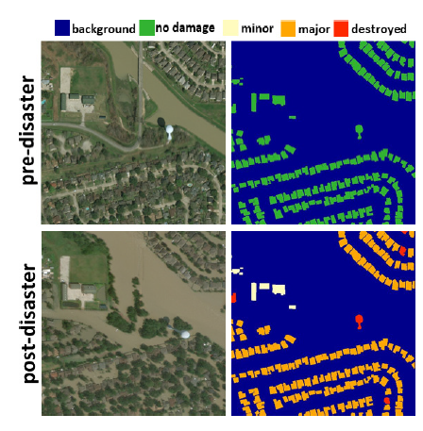
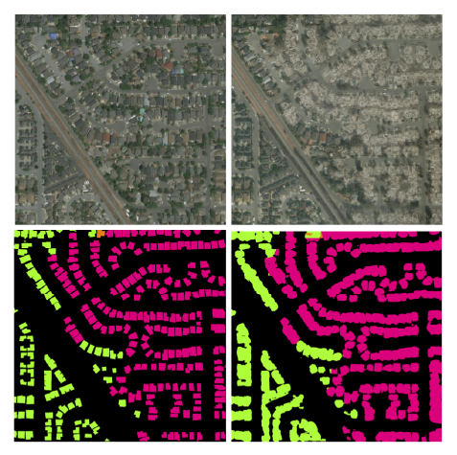
What is the project trying to do?
Tasks: Image Segmentation and CNN based Classification for different levels of damage with an Attention Module.

Slide 3
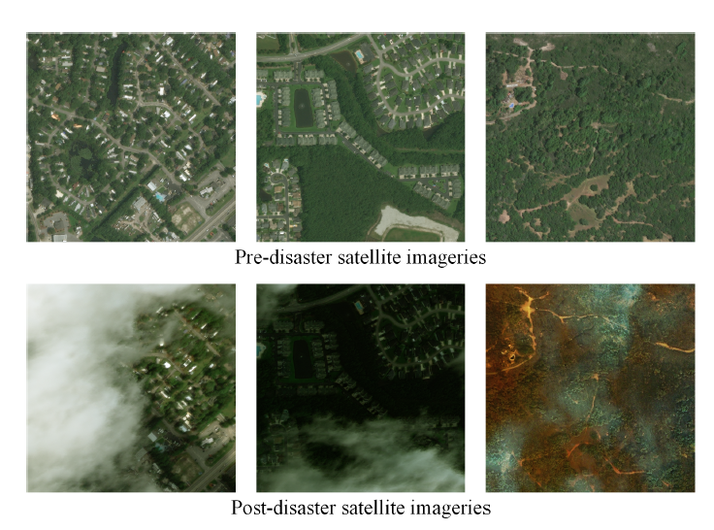
Dataset: xView2
Contains 2,799 pairs of pre-event/post event multi-band images with resolution 1024 X 1024 pixels.
And segmentation ground truth masks with building polygons and classification labels.
There are four damage levels:
No-damage
Minor-damage
Major-damage
Destroyed
Notes:
This dataset is designed for the task of building damage assessment and covers a wide variety of disaster events, such as tsunamis, earthquakes, and volcanic eruptions.

Slide 4
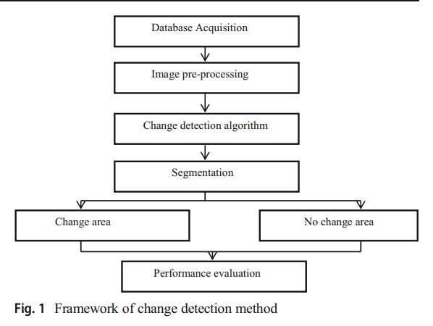
How is it done today, and what are the limits of current practice?
Broader idea: Change detection.
The process of identifying differences in the state of an object by observing it at different times.
There are a few primary categories in which change detection approaches fall:
Algebra-based
Transform-based
Classification-based
Notes:
Change detection a process of identifying differences in the state of an object or phenomenon by observing it at different times.
When presented with two preprocessed images, the goal is to identify the set of pixels that exhibit significant changes; these pixels comprise the change mask.

Slide 5
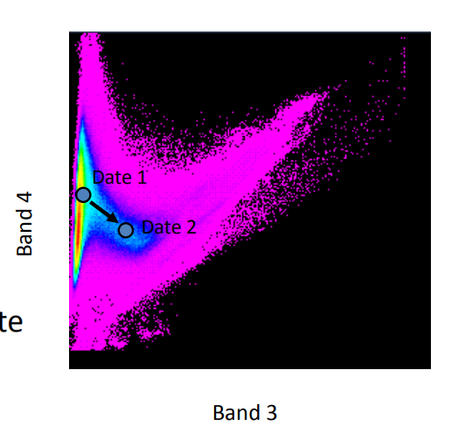
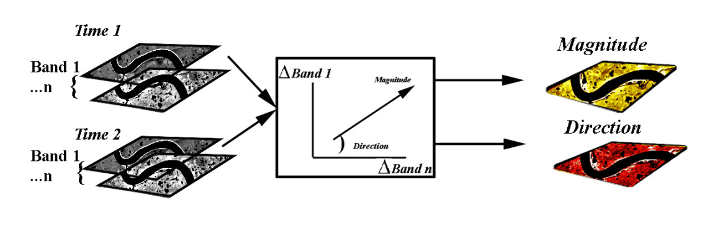
Algebra-Based Change Detection
Perform mathematical operations on image pixels to obtain a difference image.
Change vector analysis(2015) and Image differencing(2018) involve a threshold selection process to determine which components changed.
Cannot capture contextual information about
the detected changes.
Notes:
Significance Testing: This model is based on the Bayesian theory under the maximum a posteriori (MAP) estimate. It is a kind of threshold selection method that operates by discriminating between changed and unchanged pixels in terms of their contextual properties rather than the grey-level values of a single pixel. Considering neighborhood information in the block and giving added weight to every pixel can result in higher precision.

Slide 6
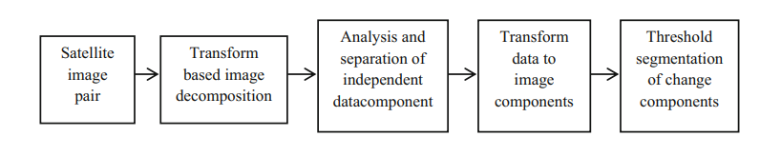
Transform-Based Change Detection
Advantage: It reduces the redundant information between the bands.
Drawback: It is difficult to label the information about the change area in the transformed image.

Slide 7
Classification-Based Change Detection
ML Algorithms, from Random forests to CNNs to CNN-LSTM networks.
Advantage: Provides accurate change information which is not much affected by external factors like atmospheric interferences.
Spatial Context allows multiclass labeling instead of binary no-damage, damage labels.

Slide 8
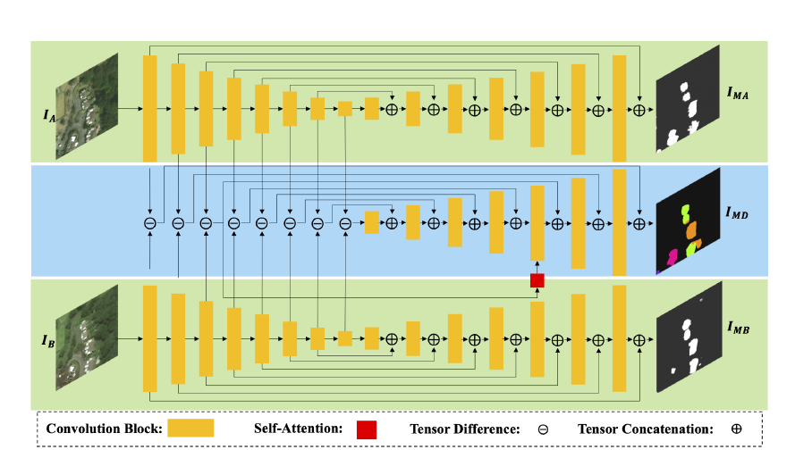
What is your approach, and what is new in your approach?
Development of a multi-class deep learning model with attention technique that accurately classifies damage levels of buildings in satellite imagery.
UNet: Semantic Segmentation
Siamese Model: Classification, reduces total dimensions.
Self-Attention Module: Incorporates long-range information from entire image.
Results: Produces pixel-wise classification masks with better accuracy.
Notes:
The use of the Siamese model allows us
to reduce the number of learned parameters and the size of
the model during both training and inferencing in comparison
to [8]. By combining these models, we achieve multitask
learning of both segmentation and classification. Additionally,
we introduce a self-attention module that improves
the performance by incorporating long-range information
from the entire image.

Slide 9
Who cares? If you succeed, what difference will it make?
Humanitarian purposes such as responding to natural disasters
High resolution satellite images enable emergency responders to estimate locations, causes, and severity of damage.
Broader applications of change detection include –
Landcover Transition Detection
Monitoring of Forest Defoliation
Damage Assessment, and so on

Slide 10
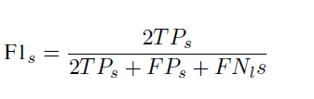


How do you know if your approach is successful?
The project will evaluate the proposed building damage detection algorithm using the xView2 dataset and F1 score as evaluation metrics.
Building semantic segmentation task F1 score:
Damage scale classification task F1 score:

Slide 11
References
Asokan & Jude. “Change detection techniques for remote sensing applications: a survey.” Springer 2018
Ling et al. “Adaptive Change Detection With Significance Test.” IEEE 2018
Hao et al. “An attention-based system for damage assessment using satellite imagery.” arXiv 2020.
Yu Shen et al. “BDANet: Multiscale Convolutional Neural Network With Cross-Directional Attention for Building Damage Assessment From Satellite Images.” IEEE Transactions on Geoscience and Remote Sensing 2021.
Change Vector Analysis

