Slide 1
A Survey on Graph Based Neural Networks models in Traffic Forecasting
Zishuo Li and Yilong Wang
li002273@umn.edu, wan00618@umn.edu

Slide 2
Background
Traditional approaches:
Knowledge driven:
differential equations and numerical methods to model traffic flows
Heavily relies on prior knowledge to produce accurate modeling results
Data-driven:
E,g., ARIMA
Machine learning models in learning traffic patterns
Can be further categorized into methods modeling spatial dependency and those not
Poor performance in dealing with large-scale and complicated data
Deep Learning approaches:
Standard feedforward network, RNN, CNN, etc.
Graph based neural networks

Slide 3
Goal
A general overview of state-of-the-art GNN models for traffic forecasting (probably forecasting on traffic speed).
Implementation of representative models such as DCRNN, ST-GCN, ST-UNet, Graph Wavenet.
Comparison of modeling performance.

Slide 4
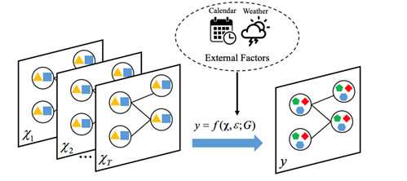
Problem Statement
Input:
Graph G(V, E, W)
Traffic states X1, X2, …, X_{T} based on G
Output:
Prediction function y
Constraints:
External factors not considered
Generally computationally inefficient
Jiang, W & Luo, J. Graph Neural Network for Traffic Forecasting: A Survey. arXiv preprint arXiv:2101.11174, 2021

Slide 5
Project Importance
Traffic congestion, urban planning
Eco-engineering on vehicles, road infractures
Forecasting methods

Slide 6
Evaluation methods
predicted values of speed, flow, volume…
Error Measures:
RMSE
MAE

Slide 7
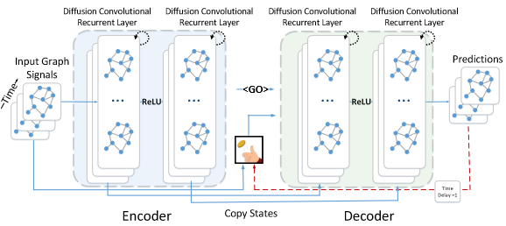
Models
Diffusion Convolutional Recurrent Neural Network (DCRNN)
Diffusion process: a random walk on the graph of many time steps to obtain a stationary distribution of possible states
Li, Y et al.. Diffusion Convolutional Recurrent Neural Network: Data-Driven Traffic Forecasting. arXiv preprint arXiv:1707.01926, 2017

Slide 8
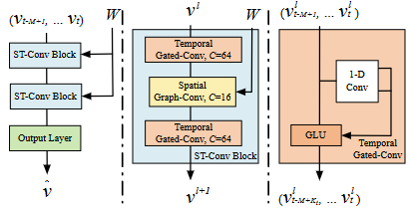
Models
Spatio-Temporal Graph Convolutional Networks (ST-GCN)
Chebyshev Polynomials Approximation: localize the filter and reduce the number of parameters by limiting the kernel size to a Chebyshev polynomial
1st order approximation: used with stacking multiple localized graph convolution layers to define a layer-wise linear formulation that can help construct a deeper architecture to recover spatial information
Bing Yu, Haoteng Yin, Zhanxing Zhu. Spatio-Temporal Graph Convolutional Networks: A Deep Learning Framework for Traffic Forecasting. arXiv preprint arXiv:1709.04875, 2017

Slide 9
Methodology
Implementation of models on toy datasets
Extend Python code of state-of-the-art models on datasets METR-LA, PeMS, TaxiNYC, etc.
Compare results for each method

Slide 10
Sources
[1] Jiang, W & Luo, J. Graph Neural Network for Traffic Forecasting: A Survey. arXiv preprint arXiv:2101.11174, 2021
[2] Rico, J, Barateiro, J & Oliveira, A. Graph Neural Networks for Traffic Forecasting. arXiv preprint arXiv:2104.13096. 2019.
[3] Li, Y et al.. Diffusion Convolutional Recurrent Neural Network: Data-Driven Traffic Forecasting. arXiv preprint arXiv:1707.01926, 2017
[4] Bing Yu, Haoteng Yin, Zhanxing Zhu. Spatio-Temporal Graph Convolutional Networks: A Deep Learning Framework for Traffic Forecasting. arXiv preprint arXiv:1709.04875, 2017

