Slide 1
Deep Learning for Crop Yield Prediction Using Remote Sensing Data
Shivam Bhandari, bhand092@umn.edu, 2nd Year MS in Computer Science

Slide 2
What is the project trying to do?
The aim of this project is to make a deep learning model for prediction of crop yield using remotely sensed data
Firstly, I will train a deep learning model with features from the MODIS satellite imagery paired with the ground truth for county level soyabean crop yield statistics from Argentina and Brazil
Later, I will use transfer learning to make yield predictions for regions in India, USA, and Ethiopia.
Notes:
which provide, respectively, eight-day compositesfor seven-band reflectance imagery, two-band daytime and nighttimetemperature imagery, and a land cover mask. Each reflectance bandrepresents a distinct range of wavelengths sensed by the MODISsatellite. The land cover mask is updated annually and was only usedto distinguish cropland from non-cropland.

Slide 3
How is it done today, and what are the limits of current practice?
Currently, leading crop yield prediction techniques mostly rely on locally sensed data, such as rainfall measurements and farmer surveys from field visits.
Locally sensed data provide detailed information but are expensive to collect, often noisy, and extremely difficult to scale.
Remote sensing data, a cheap and globally accessible resource, coupled with modern machine learning approaches offers a potential solution.
Prior models for predicting crop yields from remotely-sensed data utilize human-engineered features which represent specific combinations of measurements on one or two spectral bands, thus discarding a large amount of potentially useful data.
Notes:
Prior models for predicting crop yields from remotely-sensed datautilize human-engineered features, such as NDVI, EVI2 , andGCVI, which represent specific combinations of measurements on one or two spectral bands. While such features are useful for visualization and on-the-ground analysis, they discard large amounts of spectral information from particular images and may not representthe optimal feature combination for machine learning.

Slide 4
What is your approach, and what is new in your approach?
Dataset and Features
Models

Slide 5



Data Sources

Slide 6
Dataset and Features
I will use MOD09A1, MYD11A2, and MCD12Q1, which provide, respectively, eight-day composites for seven-band reflectance imagery, two-band daytime and nighttime temperature imagery, and a land cover mask.
As our ground truth for soybean crop yields, we used county-level and province-level yield statistics compiled by the Argentine Undersecretary of Agriculture and the Brazilian Institute of Geography and Statistics. All yields were reported in units of metric tones per cultivated hectare (t/Ha).
Each officially reported crop yield of a particular region for a particular harvest was paired with a sequence of MODIS reflectance and temperature images from the months preceding the harvest.

Slide 7
Approach
Preprocess to transform the satellite images from I ∈ R^{h×w×d} to H ∈ R^{b×d} using the methodology described in You et al [1]. This significantly reduces the dimensionality of data being used for training while retaining information from all bands.
Get a baseline estimate using a ridge regression model by further dimensionality reduction using feature extraction
Then use a deep learning model (LSTM) to train the model on the data from Argentina.
Use transfer learning to remove the last layer and apply the model for Brazilian training data to fine tune the model. [2]

Slide 8
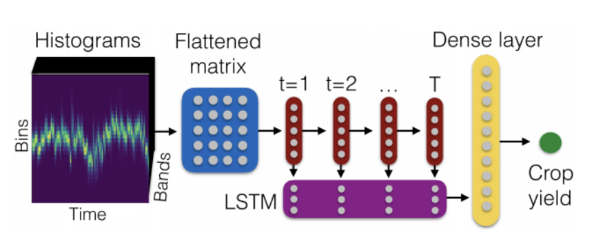
Model

Slide 9
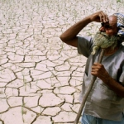
Impact
Farmer suicides in developing countries like India is reaching epidemic levels. [3]
With accurate forecasts we can predict crop efficacy and failure which will have a direct impact on the aid distribution to the farmers in need as well as ensuring food security for the region/country.
Having accurate forecasts also help with decision-making about imports and exports in more commercialized systems.

Slide 10
How do you know if your approach is successful?
To evaluate my results, I will use R² score and RMSE metrics against the ground truth.
I expect the LSTM model to perform much better than the ridge regression model.
RMSE will be measured in metric tonnes per hectacre.
R² of > 0 will indicate that my approach managed to learn something. A value of > 0.6 will indicate strong prediction capability.

Slide 11
References
[1] Jiaxuan You, Xiaocheng Li, Melvin Low, David Lobell, and Stefano Ermon. 2017. Deep Gaussian Process for Crop Yield Prediction Based on Remote Sensing Data. 2017 Association for the Advancement of Articial Intelligence (2017)
[2] Wang, Anna & Tran, Caelin & Desai, Nikhil & Lobell, David & Ermon, Stefano. (2018). Deep Transfer Learning for Crop Yield Prediction with Remote Sensing Data. 1-5. 10.1145/3209811.3212707.
[3] https://www.cnn.com/2022/03/17/opinions/india-farmer-suicide-agriculture-reform-kaur/index.html

