Slide 1
Weapon Detection using ML
Roby Thomas
thom5141@umn.edu
4th year Computer Science major

Slide 2
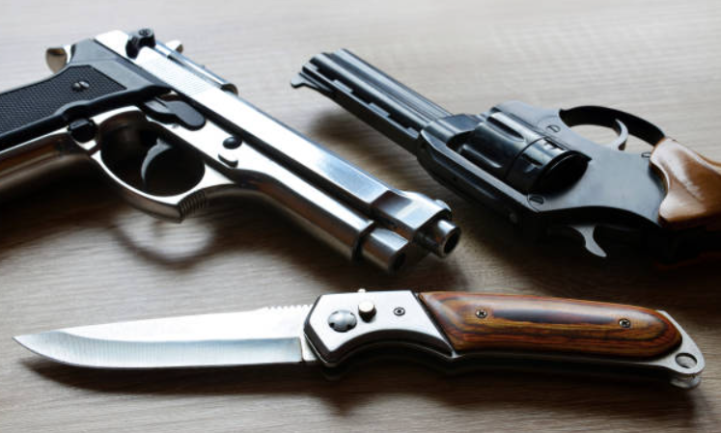
What is the project trying to do?
This project will use machine learning to build an object detection model for weapons, such as guns and knives.

Slide 3
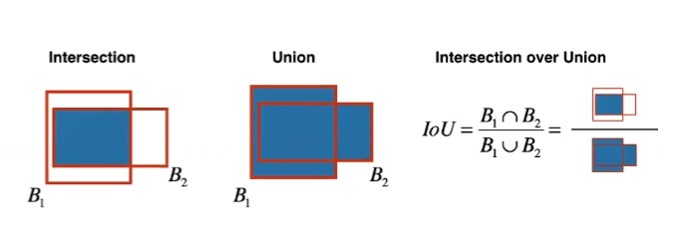
How is it done today, and what are the limits of current practice?
Object detection is mainly done by training a set of data with predefined bounding boxes, such that the CNN used can learn using the IOU (Intersection over Union).
Things like clutter, point of view, as well as lighting can cause issues with how object detection is currently done.

Slide 4
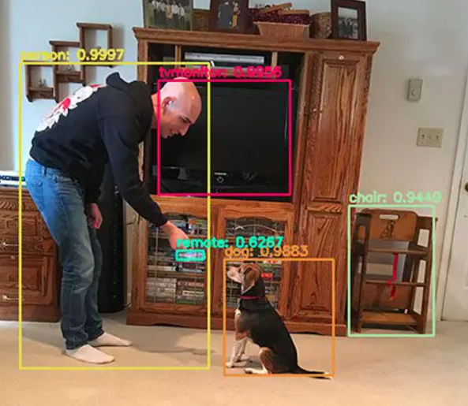
What is your approach, and what is new in your approach?
The project will use weapon images as well as other objects with predefined bounding boxes to train the data using YOLO and RetinaNet.

Slide 5
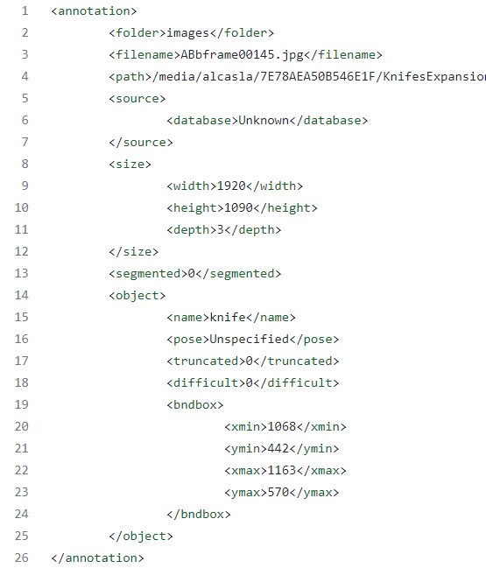
Weapon Detection Dataset
Contains 1000 images of varying weapons and objects.
Bounding boxes as well as object names are recorded in xml files paired with each image.
https://www.kaggle.com/datasets/ankan1998/weapon-detection-dataset

Slide 6
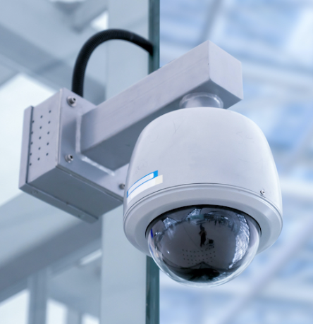
Who cares? If you succeed, what difference will it make?
Object detection is an large field of study that can contribute to society in many ways. I hope that continuous improvement to object detection normalizes it enough to the point where it is more affordable.

Slide 7
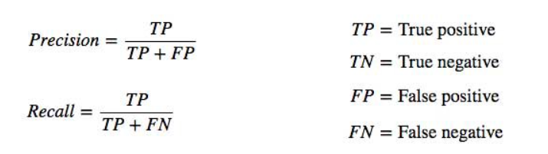

How do you know if your approach is successful?
The model created in this project will be tested using a partition of the data and utilize AP (average precision), and AP50 (AP with 50% threshold of IOU) to evaluate the results.

