Slide 1
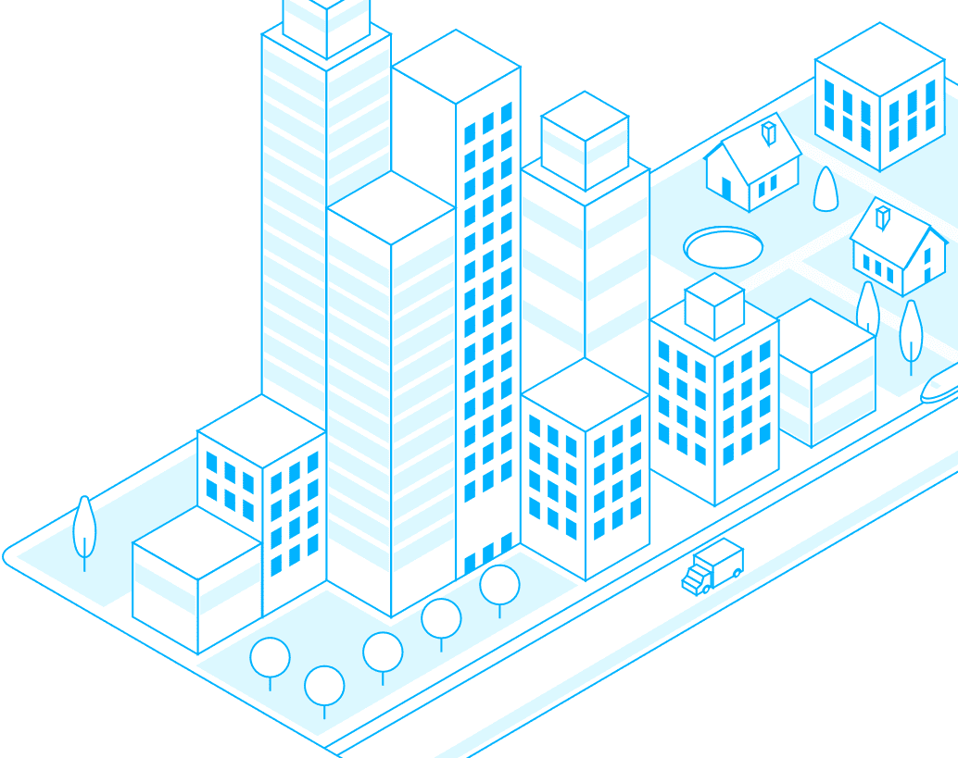
Collaborative Smart Buildings
FAULT DETECTION VIA MULTI-AGENT NETWORKS
Madhu Tennakoon
Computer Science MS | Class of 2022
tenna031@umn.edu

Slide 2
What is the project trying to do?
Time-series anomaly detection
Sensor error, equipment failure, user error
Implement a knowledge-sharing mechanism between similar buildings

Slide 3
Who cares? If you succeed, what difference will it make?
Buildings consume about 40% of the world’s energy and make up 30% of CO₂ emissions.
5–30% of building energy is wasted due to faulty equipment and operational errors in building control systems.
Sharing knowledge across buildings can make buildings more robust to faults (even when local fault data is sparse)
Notes:
:
Is cost-effective
Can eliminate breakdowns
Reduces equipment downtime
And leads to more energy-efficient buildings

Slide 4
How is it done today, and what are the limits of current practice?
RULE-BASED ALARMS
Inflexible
Too many false-positives
Requires manual fine-tuning
EXPERT SYSTEMS
Requires domain knowledge
Expensive to build & maintain
Non-adaptive
STATISTICAL/ML METHODS
Dynamic Time-Warping
Clustering, PCA
Bayesian Networks
One-class SVMs
Autoencoders

Slide 5

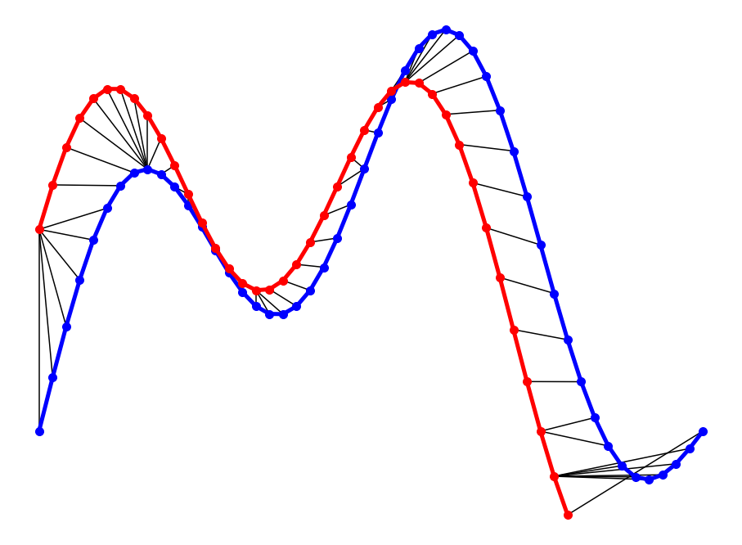
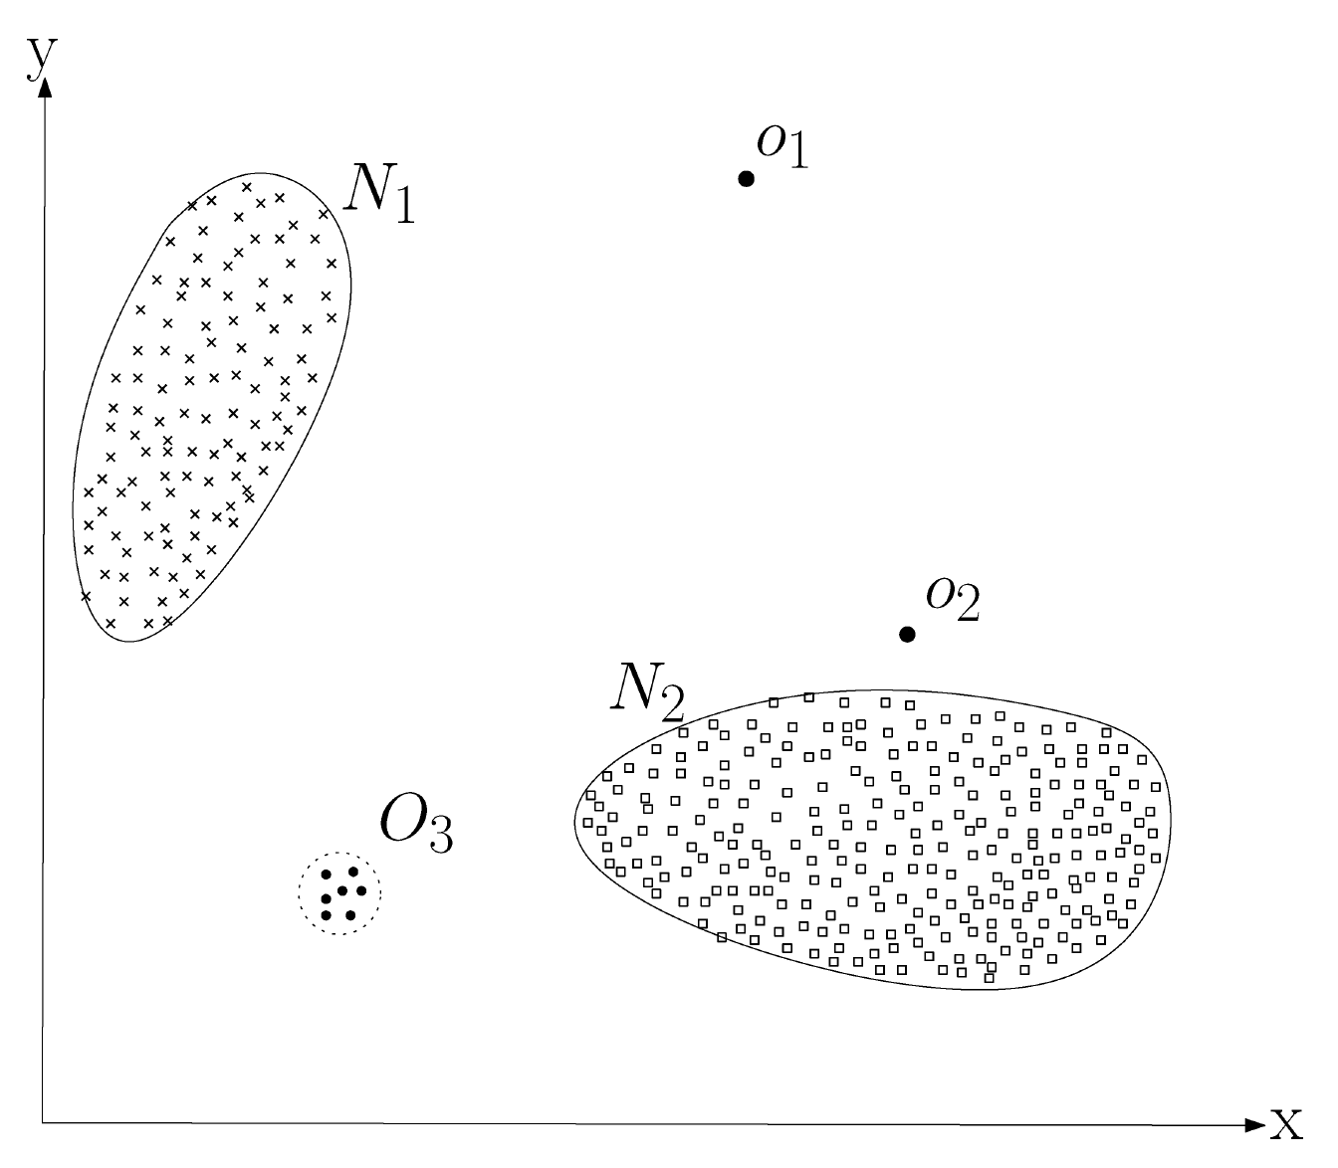
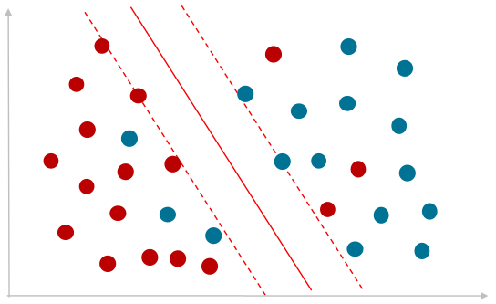
Statistical / ML methods & limitations
Dynamic Time-Warping (DTW)
Pattern matching of known anomalous trends with observed data
Computationally intensive at runtime
Clustering
Nearest-neighbor methods
Scalability & Complexity issues: distance computing
Classification
One-class SVMs, neural networks
Global models cannot represent all building anomalies
Local models depend on availability of anomalies at that location
Other methods:
Spectral decomposition, knowledge-graphs, deep autoencoders

Slide 6
What is your approach, and what is new in your approach?
Building clustering
- Discover buildings with similar thermal characteristics and operational trends
- Similar buildings share the same faults
Time-series anomaly detection
via shared learning
- Sharing combined experiences of buildings can improve performance
- Learning shared representations across buildings can lead to more robust detections

Slide 7
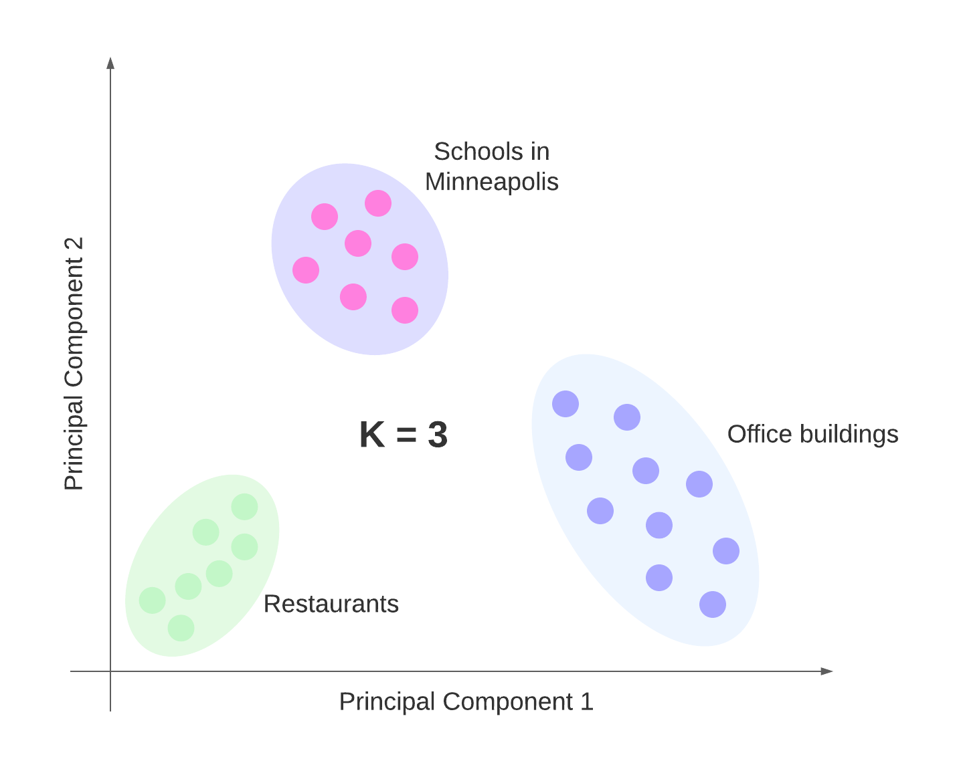
Building Clustering
Assumption: Buildings that behave similarly are more likely to have the same faults
Cluster buildings by:
Geographic location:
Buildings near the lake may need more heating
Properties:
Number of rooms, square-footage, volume
% brick, concrete, steel affects thermal insulation
Operational trends:
Office buildings have high usage during work-hours
Occupancy patterns:
Restaurants operate on weekends
Schools & offices are closed on weekends

Slide 8
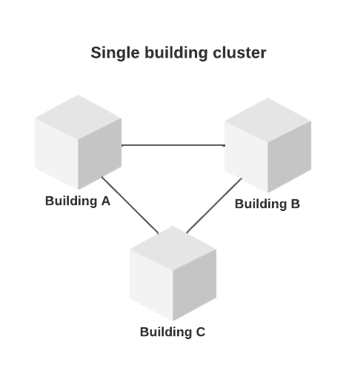
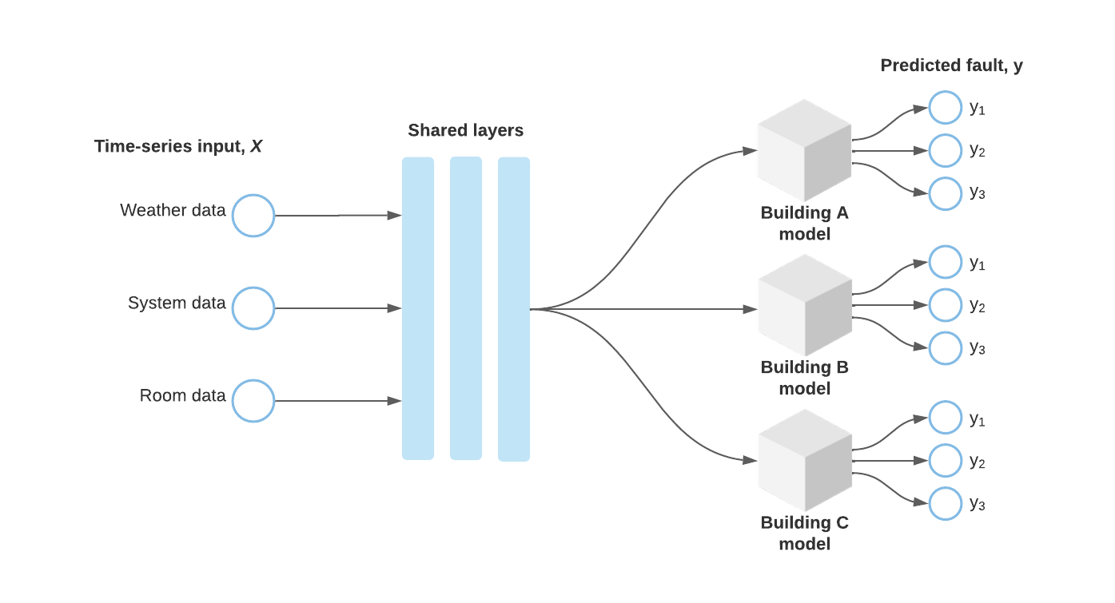
Shared Learning
Create collaborative networks within each cluster
Each building is assigned a neural network
All networks in a cluster learn simultaneously
Shared representations can enable better fault detection

Slide 9
How do you know if your approach is successful?
Labeled dataset from OpenEI Buildings for training & evaluation
Train a baseline model without knowledge-sharing
Benchmark performance
Baseline model
Contemporary methods: fbprophet
Evaluation metrics: average loss and accuracy, F1-score, potential energy savings

Slide 10
References
Chandola, V., Banerjee, A., & Kumar, V. (2009). Anomaly detection – A Survey. ACM Computing Surveys, 41(3), 1–58. https://doi.org/10.1145/1541880.1541882
Araya, D. B., Grolinger, K., ElYamany, H. F., Capretz, M. A., & Bitsuamlak, G. (2016). Collective Contextual Anomaly Detection Framework for smart buildings. 2016 International Joint Conference on Neural Networks (IJCNN). https://doi.org/10.1109/ijcnn.2016.7727242
Kim, J., Frank, S., Braun, J. E., & Goldwasser, D. (2019). Representing small commercial building faults in energyplus, part I: Model development. Buildings, 9(11), 233. https://doi.org/10.3390/buildings9110233
Chen, L.-J., Ho, Y.-H., Hsieh, H.-H., Huang, S.-T., Lee, H.-C., & Mahajan, S. (2018). ADF: An anomaly detection framework for large-scale PM2.5 Sensing Systems. IEEE Internet of Things Journal, 5(2), 559–570. https://doi.org/10.1109/jiot.2017.2766085
Dey, M., Rana, S. P., & Dudley, S. (2020). Smart building creation in large scale HVAC environments through Automated Fault Detection and diagnosis. Future Generation Computer Systems, 108, 950–966. https://doi.org/10.1016/j.future.2018.02.019

