Slide 1
Deep Learning with Differential Privacy
Minoh Jeong / ECE / 3rd year PhD student
University of Minnesota
Notes:
Hello everyone. My name is Minoh. I am a phd student at the University of Minnesota.
In this presentation, I am going to present an overview on permutation recovery problems, with focus on a related problem that we have recently investigated.
This is a joint work with professor Alex and professor Martina.

Slide 2
What is the project trying to do?
The project is going to survey the work on deep learning (DL) with focus on privacy and security.
The goal is to make contributions to the research of DL with privacy.
We will consider differential privacy for the privacy metric.
Notes:
Before delving into permutation recovery problems, let us consider a simple model which is referred to linear model Y = HX + N.
Here Y is the observation, H is the measurement matrix, X is the signal, and N is the noise.
In general, the goal of this problem is to estimate the signal X given the observation Y and the measurement matrix H.
This model has been extensively studied in the literature and finds applications in several fields, such as wireless communication and linear regression.
Now, let us consider a more challenging problem that is a variant of this linear model.

Slide 3
Motivation
Machine learning (ML) needs large amount of data.
Data may contain sensitive information: ex) medical images, street-view images, individuals’ portraits, moving trajectory, user preferences, video detection, location-based services.
Notes:
Here is a linear model with an unknown permutation matrix P.
This is a more general model and has been studied for many problems such as feature matching, point cloud registration, sensor network.
The general goal of this problem is to estimate the signal X given the observation Y and the measurement matrix H.
We note that the permutation matrix P breaks the correspondence, label, or order between the signal and the observation.

Slide 4
Interesting approaches
Deep learning with differential privacy [1]
Generative adversarial privacy [2]
[1] Abadi, Martin, Andy Chu, Ian Goodfellow, H. Brendan McMahan, Ilya Mironov, Kunal Talwar, and Li Zhang. "Deep learning with differential privacy." In Proceedings of the 2016 ACM SIGSAC conference on computer and communications security, pp. 308-318. 2016.
[2] Huang, Chong, Peter Kairouz, Xiao Chen, Lalitha Sankar, and Ram Rajagopal. "Generative adversarial privacy." arXiv preprint arXiv:1807.05306 (2018).
Notes:
Before delving into permutation recovery problems, let us consider a simple model which is referred to linear model Y = HX + N.
Here Y is the observation, H is the measurement matrix, X is the signal, and N is the noise.
In general, the goal of this problem is to estimate the signal X given the observation Y and the measurement matrix H.
This model has been extensively studied in the literature and finds applications in several fields, such as wireless communication and linear regression.
Now, let us consider a more challenging problem that is a variant of this linear model.

Slide 5
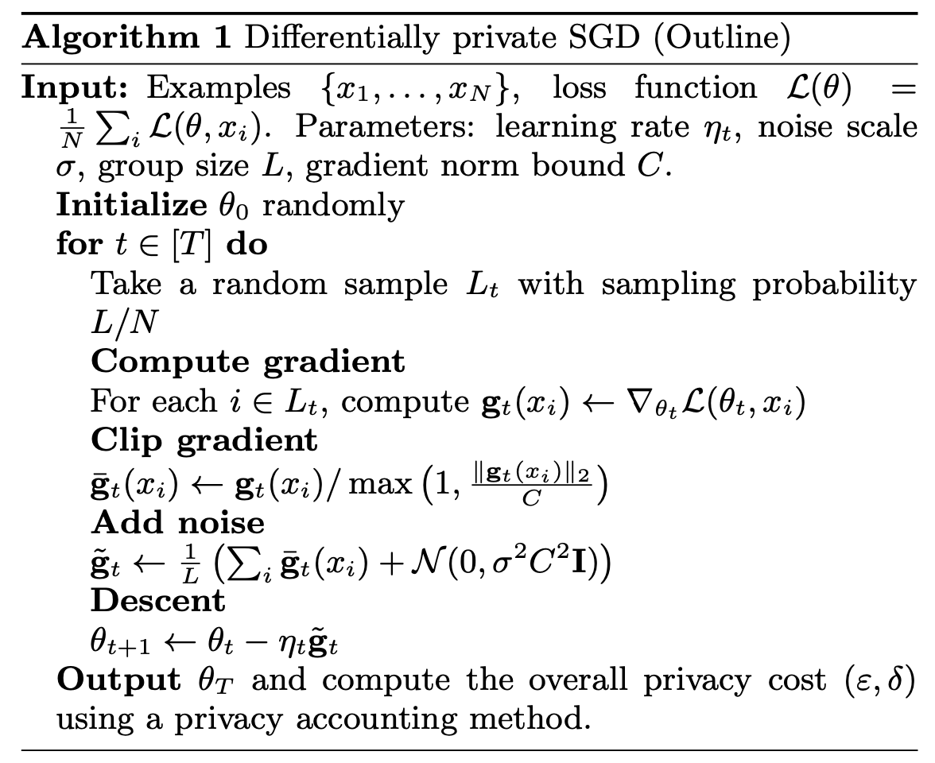
Interesting approaches
Deep learning with differential privacy [1]
Generative adversarial privacy [2]
Differentially private SGD
The moments accountant
[1] Abadi, Martin, Andy Chu, Ian Goodfellow, H. Brendan McMahan, Ilya Mironov, Kunal Talwar, and Li Zhang. "Deep learning with differential privacy." In Proceedings of the 2016 ACM SIGSAC conference on computer and communications security, pp. 308-318. 2016.
[2] Huang, Chong, Peter Kairouz, Xiao Chen, Lalitha Sankar, and Ram Rajagopal. "Generative adversarial privacy." arXiv preprint arXiv:1807.05306 (2018).
[3] Goodfellow, Ian, Jean Pouget-Abadie, Mehdi Mirza, Bing Xu, David Warde-Farley, Sherjil Ozair, Aaron Courville, and Yoshua Bengio. "Generative adversarial nets." Advances in neural information processing systems 27 (2014).
Notes:
Before delving into permutation recovery problems, let us consider a simple model which is referred to linear model Y = HX + N.
Here Y is the observation, H is the measurement matrix, X is the signal, and N is the noise.
In general, the goal of this problem is to estimate the signal X given the observation Y and the measurement matrix H.
This model has been extensively studied in the literature and finds applications in several fields, such as wireless communication and linear regression.
Now, let us consider a more challenging problem that is a variant of this linear model.

Slide 6
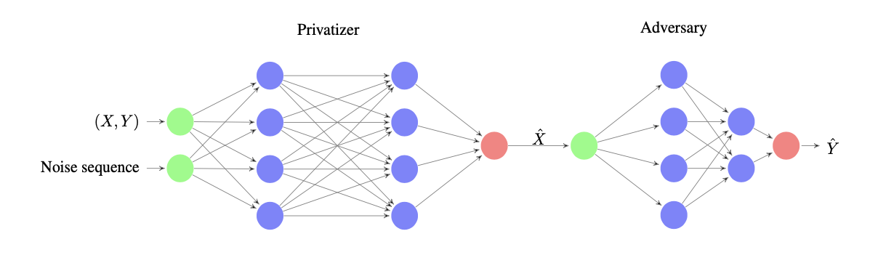
Interesting approaches
Deep learning with differential privacy [1]
Generative adversarial privacy [2]
Using data, finding optimal privatize mechanism by using GAN [3] based model.
[1] Abadi, Martin, Andy Chu, Ian Goodfellow, H. Brendan McMahan, Ilya Mironov, Kunal Talwar, and Li Zhang. "Deep learning with differential privacy." In Proceedings of the 2016 ACM SIGSAC conference on computer and communications security, pp. 308-318. 2016.
[2] Huang, Chong, Peter Kairouz, Xiao Chen, Lalitha Sankar, and Ram Rajagopal. "Generative adversarial privacy." arXiv preprint arXiv:1807.05306 (2018).
[3] Goodfellow, Ian, Jean Pouget-Abadie, Mehdi Mirza, Bing Xu, David Warde-Farley, Sherjil Ozair, Aaron Courville, and Yoshua Bengio. "Generative adversarial nets." Advances in neural information processing systems 27 (2014).
Notes:
Before delving into permutation recovery problems, let us consider a simple model which is referred to linear model Y = HX + N.
Here Y is the observation, H is the measurement matrix, X is the signal, and N is the noise.
In general, the goal of this problem is to estimate the signal X given the observation Y and the measurement matrix H.
This model has been extensively studied in the literature and finds applications in several fields, such as wireless communication and linear regression.
Now, let us consider a more challenging problem that is a variant of this linear model.

Slide 7
Metric / Evaluation
Comparing average loss between private and non-private ML models
The metric for privacy guarantee is differential privacy defined below
[4] Dwork, Cynthia, and Aaron Roth. "The algorithmic foundations of differential privacy." Found. Trends Theor. Comput. Sci. 9, no. 3-4 (2014): 211-407.
Notes:
Before delving into permutation recovery problems, let us consider a simple model which is referred to linear model Y = HX + N.
Here Y is the observation, H is the measurement matrix, X is the signal, and N is the noise.
In general, the goal of this problem is to estimate the signal X given the observation Y and the measurement matrix H.
This model has been extensively studied in the literature and finds applications in several fields, such as wireless communication and linear regression.
Now, let us consider a more challenging problem that is a variant of this linear model.

Slide 8
Thank you Email: jeong316@umn.edu
Notes:
So, this is my presentation for today, and I am happy to answer any questions. Thank you very much.

