Slide 1
Final Project Proposal: Model-Based Lake Assessment
Eric McCalla, mccal223@umn.edu, CS MS 2nd year
Suzie Hoops, shoops@umn.edu, CS PhD 2nd year
Group ID: 9
Notes:
Intro: Eric & Suzie

Slide 2
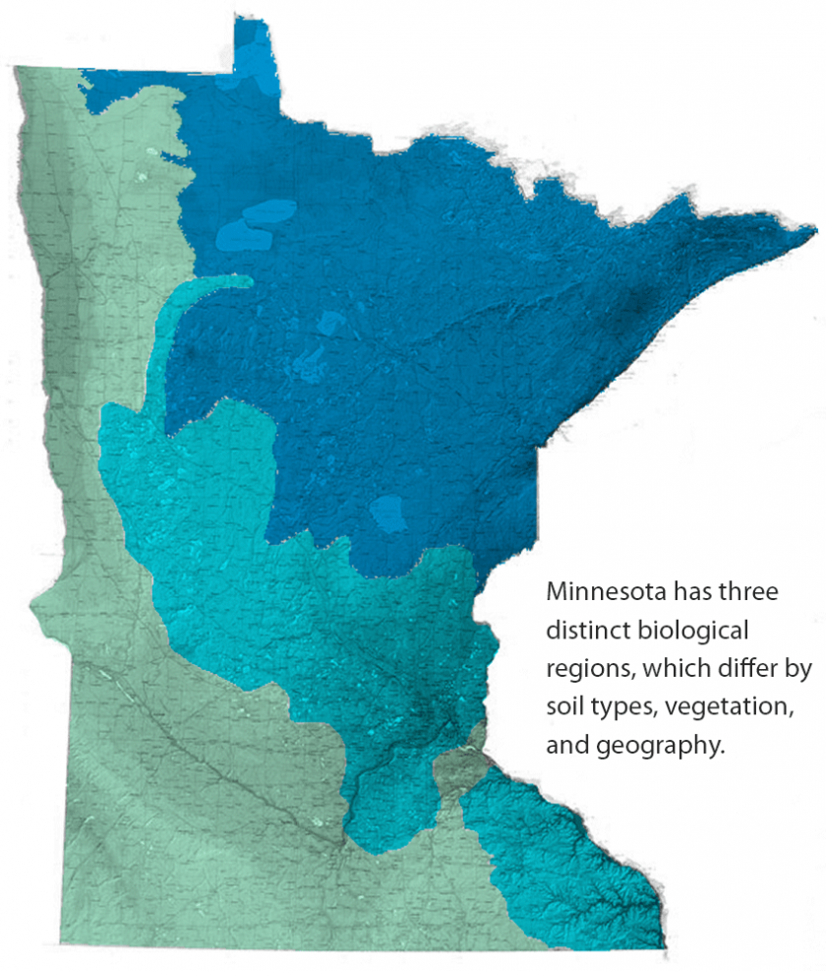
How can spatial AI improve lake surveying in MN?
Determine important geographic features indicating a lake will be flagged as “impaired”
Incorporate zoning data (residential, agricultural, business) into model predicting lake health
https://www.pca.state.mn.us/water/state-lakes
Notes:
Eric: What is the project trying to do?

Slide 3
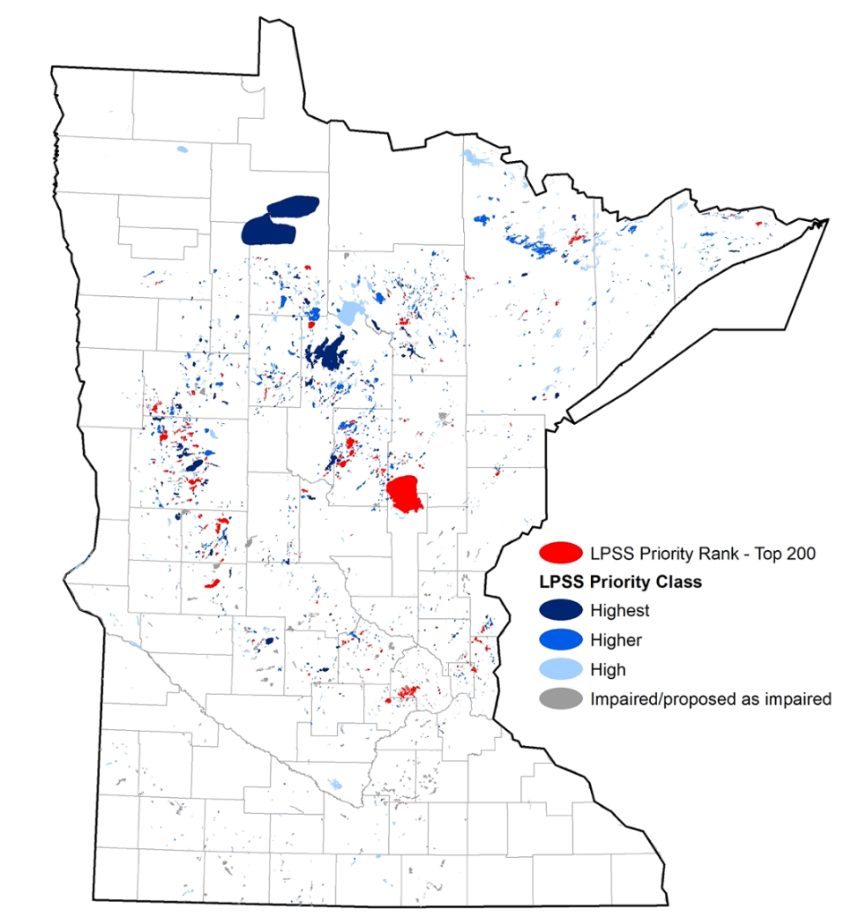
Lakes are surveyed sparingly
Primary concerns with MN lakes:
Phosphorus levels: feeds algae growth, often comes from agricultural fertilizers & erosion
Chloride levels: road salts remain in water indefinitely
E. coli contamination: many causes, but one possibility is outdated sewage infrastructure nearby
Current Practice in surveying lakes:
Only sampled every 10 years
Lakes added to “impaired list” if assessed as poor health
Linear log-log regression models for determining “phosphorus sensitivity”
Notes:
Eric: “What are current practices? What are their limitations?”
Another Current Practices bullet point if desired:
Mathematical models used in determining lake risk are often regression models (example: phosphorus sensitivity study from MN Pollution Control Agency and Department of Natural Resources)

Slide 4
Incorporating Geospatial Data to the 2020/2021 MN Lake Survey
Resources:
OpenStreetMap data for Minnesota (link)
Lake Classification (44 classes)
MN Assessed Waters in 2020 & MN impaired lakes report 2022
MN Residential data (lon/lat of properties w/ some metadata on properties)
Approach:
Merge data & determine buffers of geographic features (from diverse data sets: OSM & MN data).
Use lake classifications as cluster assignments.
Factors impacting similarity of lakes: Important features from RF Classifier in predicting lake class.
Training on Impairment(s): Train Random Forest classifiers for (1) “impaired” yes/no, (2) pollutants
Prediction of Impairment: Ground Truth (1): 2022 Impaired waters list, Ground Truth (2): primary pollutant (reason for joining impairment list)
Notes:
Eric/Suzie: ”What is your approach? How does it improve on current practices?”

Slide 5
Our model could inform lake survey schedules
Minnesota life revolves around lakes:
Recreation: Swimming, Fishing, Canoeing, and more.
Wildlife: Fish, plants, and land animals native to Minnesota depend on healthy water conditions to thrive.
Actionable findings to assist lake surveys:
Model-guided lake assessments: determine lake monitoring schedule based on our model predictions of impairment.
More broadly, potential policy changes to negate factors negatively impacting lake health.
Notes:
Suzie: “Who cares? If you succeed, what difference will it make?”

Slide 6
Measures of model success.
Evaluation data from assessment dataset:
Use a testing set of lakes
~4620 total matched b/w MN datasets: 80% training, 20% testing/validation
Evaluation metric:
Ground truth:
(1) Lakes flagged as “impaired” or not
(2) pollutants (examples: “E. coli”, “mercury in fish tissue”, “fecal coliform”, etc.)
Random Forest Classification metrics:
Accuracy score (% correct in test set).
Confusion matrix of true and predicted labels (false positives/negatives per category).
Notes:
Suzie: “How do you know if your approach will be successful?”

