Slide 1

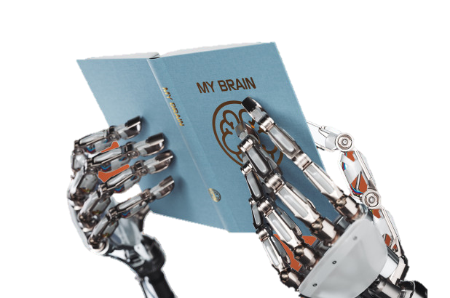
Korean-optimized Word Representations
for Out of Vocabulary Problems caused by Misspelling
using Sub-character Information
15th March 2019
AI Labs, Saltlux Inc.
Seonghyun Kim

Slide 2
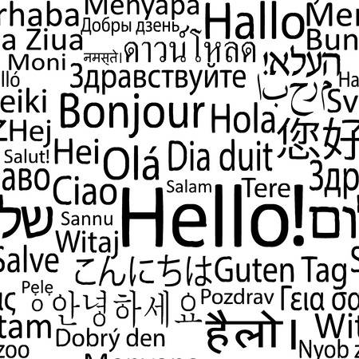
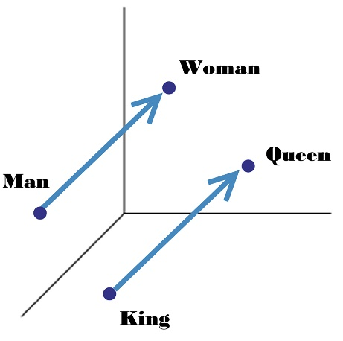


Natural Language Processing (NLP)
Introduction
1P
Natural language refers to a human language such as English, Russian, or Korean as distinct from the typically artificial command or programming language with which one usually talks to a computer
The term usually refers to a written language but might also apply to spoken language
ASCII encoded
natural language
Natural language
?
?
?
Woman
109 97 110 32 119 111 109 97 110 10 107 105 110 103 32 113 117 101 101 110
Queen
Man
King

Slide 3
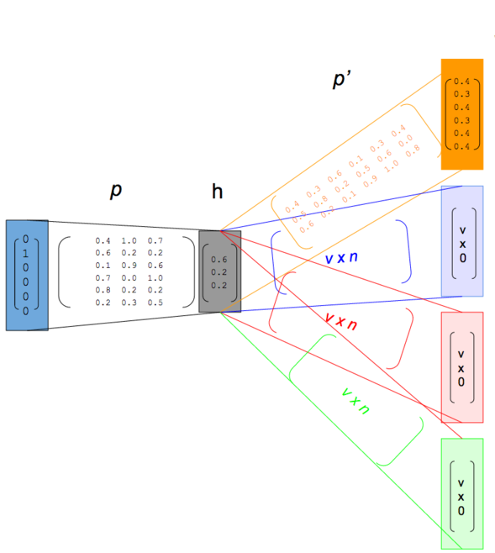
Word Representation
Introduction
2P
Word representation is a language modeling where words or phrases from the un-labeled large corpus are mapped to vectors of real numbers [1-2]
Skip-gram word embedding model vectorizing a target word to predict the surrounding words
An
“An orange is so delicious”
Word | One-hot-vector
An | [1, 0, 0, 0, 0]
Orange | [0, 1, 0, 0, 0]
is | [0, 0, 1, 0, 0]
so | [0, 0, 0, 1, 0]
delicious | [0, 0, 0, 0, 1]
orange
is
so
delicious
[1] Mikolov et al., arxiv, 2013 [2] Pennington et al., EMNLP, 2014

Slide 4
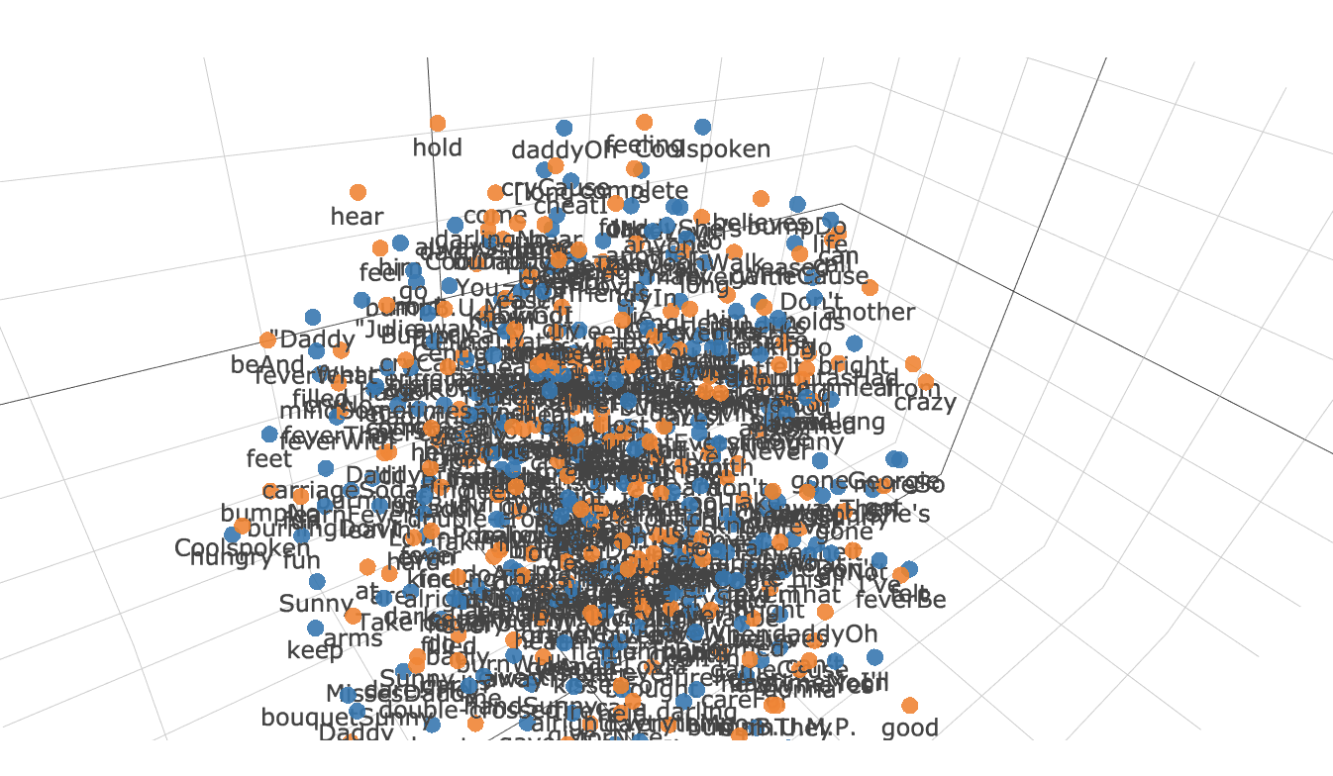
Word Representation
Introduction
3P
Word representation algorithm could represent the relationship between words by locate a word into vector space
A word vector is determined by weight between hidden layer and output word layer

Slide 5
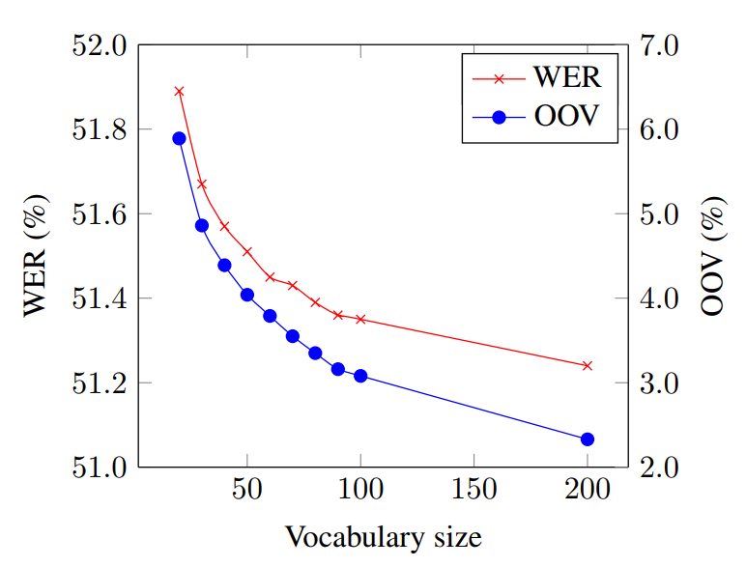
Out-of-vocabulary Problem
Introduction
4P
However, previous word embedding models could only represent words that were used in learning
Out-of-vocabulary (OOV) words are unknown words that appear in the training corpus
Morphologically rich languages, such as Korean contain many word forms that occur rarely (or not at all) in the training corpus, making it difficult to learn good word representations
Various conjugation of predicate
Word error rate (WER) and OOV range
Original form: 모르다 (Do not know)
모르네
모르데
모르지
모르더라
모르리라
모르는구나
모르잖아
모르려나
모르니
모르고
모르나
모르면
모르면서
모르거든
모르는데
모르지만
모르더라도
모르다가도
모르기조차
모르기까지
모르기를
모르기는
모르기도
모르기만
모르는
모르던
모른
모른다
모른다면
모른다만
모른답시고
모르겠다
모르겠네
모르겠지
모르겠더라
모르겠구나
모르겠니
모르겠고
모르겠으나
모르겠으면
모르겠으면서
모르겠거나
모르겠거든
모르겠는데
모르겠지만
모르겠더라도
모르겠다가도
모르겠던
모르겠다면
모르겠다만
모를까
모를지
모를지도
모를수록
몰라
몰라도
몰라서
몰라야
몰라요
몰라라
몰랐다
몰랐네
몰랐지
몰랐더라
몰랐으리라
몰랐구나
몰랐잖아
몰랐으려나
몰랐으니
몰랐거나
몰랐거든
몰랐는데
몰랐지만
몰랐더라도
몰랐다가도
몰랐던
몰랐다면
몰랐다만
몰랐을
몰랐을까
몰랐을지
몰랐을지도
몰랐어
몰랐어도
몰랐어야
몰랐어요
몰랐더라면
몰랐더라도
몰랐겠다
몰랐겠네
몰랐겠지
몰랐겠더라
몰랐겠구나
몰랐겠니
몰랐겠고
몰랐겠으나
몰랐겠으면
몰랐겠으면서
몰랐겠거나
몰랐겠거든
몰랐겠는데
몰랐겠지만
몰랐겠더라도
몰랐겠다가도
몰랐겠던
몰랐겠다면
몰랐겠다만
몰랐겠어
몰랐겠어도
몰랐겠어서
몰랐겠어야
몰랐겠어요
몰랐겠더라면
몰랐겠더라도
[1]
[1] Gorin et al., LTC, 2016

Slide 6
FastText Word Representation
Introduction
5P
FastText word representation algorithm proposes to representations for character n-grams, and to represent words as the sum of the n-gram vectors [1-2]
n-gram vocabs (n-gram: 2-5)
2-gram
3-gram
4-gram
5-gram
original
<O,
Or,
ra,
an,
ng,
ge,
e>
<Or,
Ora,
ran,
ang,
nge,
ge>
<Ora,
Oran,
rang,
ange,
nge>
<Oran,
Orang,
range,
ange>
Orange
<Orange>
Orange
Total n-gram vocab size: 22 n-grams
[1] Bojanowski et al., arXiv, 2016 [2] Joulin et al., arXiv, 2016

Slide 7
FastText Word Representation
Introduction
6P
FastText word representation algorithm proposes to representations for character n-grams, and to represent words as the sum of the n-gram vectors
n-gram vocabs (n-gram: 2-5)
2-gram
3-gram
4-gram
5-gram
original
<O,
Or,
ra,
an,
ng,
ge,
es,
s>
<Or,
Ora,
ran,
ang,
nge,
ges,
es>
<Ora,
Oran,
rang,
ange,
nges,
ges>
<Oran,
Orang,
range,
anges,
nges>
Oranges
<Oranges>
Oranges

Slide 8
FastText Word Representation
Introduction
6P
FastText word representation algorithm proposes to representations for character n-grams, and to represent words as the sum of the n-gram vectors
n-gram vocabs (n-gram: 2-5)
2-gram
3-gram
4-gram
5-gram
original
<O,
Or,
ra,
an,
nz,
ze,
e>
<Or,
Ora,
ran,
anz,
nze,
ze>
<Ora,
Oran,
ranz,
anze,
nze>
<Oran,
Oranz,
ranze,
anze>
Oranze
<Oranze>
Oranze

Slide 9
Decomposition of Korean
Introduction
7P
Korean can be further separated from a word
Sentence level
오렌지는 맛있다
(Orange is delicious)
Word level
오렌지는
맛있다
Morpheme
level
오렌지
는
맛있
다
(Noun)
(Subject case marker)
(Verb)
(for declarative form)
Character
level
오 [o]
렌 [ren]
지 [ʧi]
(Syllable)
Sub-character
level
ㅇ [ᴓ]
ㅗ [o]
ㄹ [r]
ㅔ [e]
ㄴ [n]
ㅈ [ʧ]
ㅣ [i]
(Jamo-letter)

Slide 10
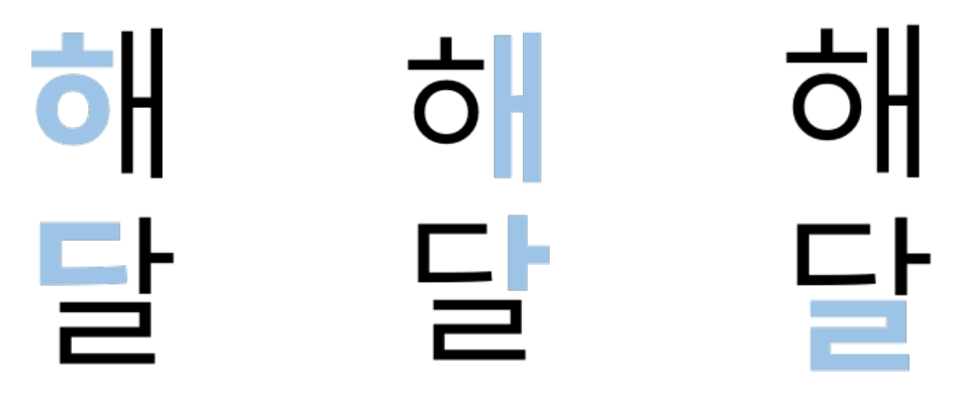
Decomposition of Korean
Introduction
8P
Korean characters can be decomposed into a sequence of three sub-characters, Jamo
Chosung and jongsung are consonants while joongsung are vowels
Chosung
(syllable onset)
Joongsung
(syllable nucleus)
Jonggsung
(syllable coda)
(Sun)
(Moon)
[1] Park et al., ACL, 2018

Slide 11
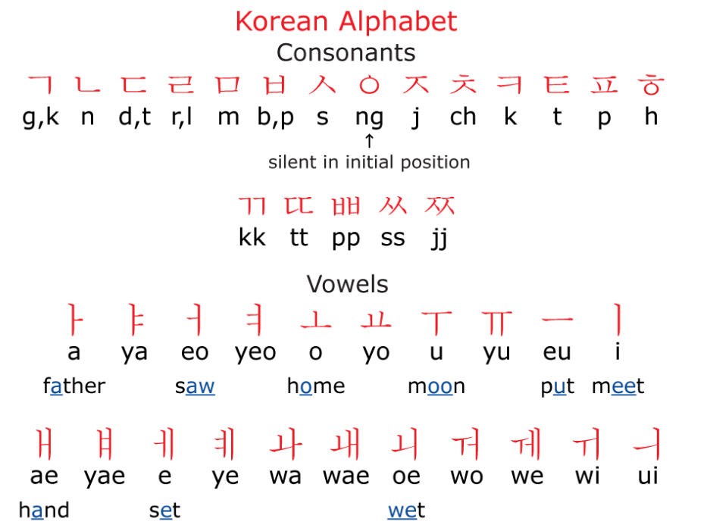
Decomposition of Korean
Introduction
9P
Jamo is consists of 19 consonants and 21 vowels

Slide 12
Research Aims
10P
To develop Korean-optimized word embedding model to solve OOV problem based on FastText model
Developing a model that can embed well in misspelling or foreign languages in Korean

Slide 13
Methods
11P
Model variations
<오,
오렌,
렌지,
지>
<오렌,
오렌지,
렌지>
Baseline model [1-2]
오렌지
(Orange)
<오렌지, 오렌지>
<오렌지>
오렌지
오렌지
(Orange)
오
렌
지
Jamo-static model
ㅇ
ㅗ
ᴥ
ㄹ
ㅔ
ㄴ
ᴥ
ㅈ
ㅣ
ᴥ
<ㅇㅗ ᴥㄹㅔ,
ㅇㅗ ᴥㄹㅔㄴ,
ㅇㅗ ᴥㄹㅔㄴ,ㅈㅣ ᴥ
오렌지
(Orange)
. . . 6-12 n-grams . . .
[1] Bojanowski et al., arXiv, 2016 [2] Joulin et al., arXiv, 2016

Slide 14
Methods
12P
Model variations
오렌지
(Orange)
ㅇㅗ ᴥ ㄹㅔㄴ ᴥ ㅈㅣ ᴥ
Without ㅗ: ㅇ ᴥ ㄹㅔㄴ ᴥ ㅈㅣ ᴥ
오
렌
지
Without ㅔ: ㅇㅗ ᴥ ㄹㄴ ᴥ ㅈㅣ ᴥ
ㅇ
ㅗ
ᴥ
ㄹ
ㅔ
ㄴ
ᴥ
ㅈ
Without ㅣ: ㅇㅗ ᴥ ㄹㅔㄴ ᴥ ㅈ ᴥ
ㅣ
ᴥ
<ㅇᴥㄹㅔㄴ,
ㅇ ᴥㄹㅔㄴ ᴥ,
ᴥㄹㅔㄴ ᴥㅈ,
ㄹㅔㄴᴥㅈㅣ
ㅇ ᴥ ㄹㅔㄴ ᴥ ㅈㅣ ᴥ
. . . 6-12 n-grams . . .
Jamo-advanced model
(w/ or w/o vowels)
오렌지
(Orange)
<ㅇㅗᴥㄹㄴ,
ㅇ ㅗᴥㄹㄴ ᴥ,
ㅗᴥㄹㄴ ᴥ,
ㄹㄴᴥㅈㅣ ᴥ
. . . 6-12 n-grams . . .
ㅇㅗ ᴥ ㄹㄴ ᴥ ㅈㅣ ᴥ
<ㅇㅗᴥㄹㅔ,
ㅇㅗᴥㄹㅔㄴ,
ㅗ ᴥㄹㅔㄴ ᴥ, ᴥㄹㅔㄴ ᴥㅈ,
ㄹㅔㄴ ᴥㅈ ᴥ
. . . 6-12 n-grams . . .
ㅇㅗ ᴥㄹㅔㄴ,ㅈㅣ ᴥ

Slide 15
Methods
13P
Data sets
Translated WordSim353 [1]
250 paired corrected word – misspelled OOV words in Korean
Word1 | Word2 | Translated Word1 | Translated Word2 | Relatedness
Tiger | Cat | 호랑이 | 고양이 | 7.35
Tiger | Tiger | 호랑이 | 호랑이 | 10
Book | Paper | 책 | 종이 | 7.46
Computer | Keyboard | 컴퓨터 | 키보드 | 7.62
Professor | Cucumber | 교수 | 오이 | 0.31
King | Cabbage | 왕 | 배추 | 0.23
Word | Corrected word | Misspelled OOV word
Gasoline | 가솔린 | 게솔린
Nazism | 나치즘 | 나찌즘
Design | 디자인 | 디쟈인
Banana | 바나나 | 빠나나
Item | 아이템 | 아이탬
Caffeine | 카페인 | 카패인
[1] Finkelestein et al., ACM, 2002

Slide 16
Methods
14P
Model parameters
300 dimensional vector space
1-5 context window size
6-12 n-gram range to include 2-3 syllables with special boundary symbols
10-4 rejection threshold
Training Corpus
Wikipedia dumps of September 2016 in Korean
1,762,935 lines
44,600,242 words
Corpus is tokenized by morpheme level
Data analysis
Pearson’s correlation coefficient between human judgement and the cosine similarity of the vector representations
Student’s t-test

Slide 17
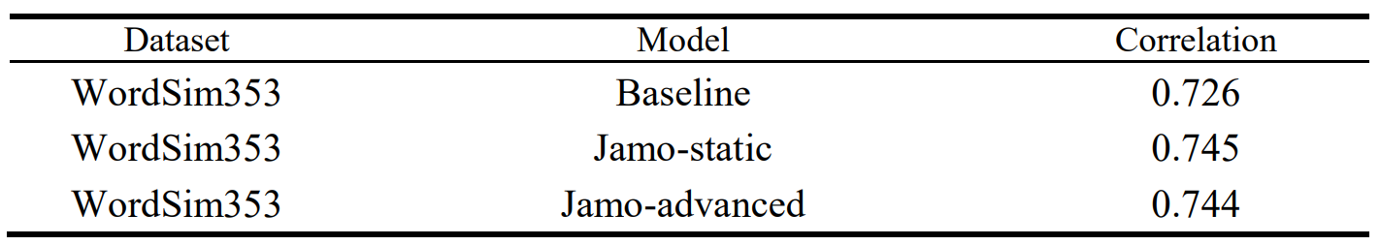
Results
15P
We first evaluated the semantic relationship between words by computing Pearson’s correlation coefficient between human judgement and the cosine similarity of the vector representations

Slide 18
Results
16P
we compared the cosine similarity between the misspelled OOV words and the corrected words
Sub-character information is better reflected in the word representation based on sub-character units than word units
1
***
***
0.8
0.6
Cosine similarity
0.4
0.2
0
Baseline
Jamo-static
Jamo-advanced

Slide 19
Results
17P
Top 3 neighboring words based on cosine similarity for some example misspelled OOV words in baseline model and Jamo-advanced model.
Out-of-vocabulary words
Input word | Model | Most similar words in range of top 3
페날티 (Penalty) OOV word | Baseline | 리날디 (Rinaldi) | 페레티 (Ferretti) | 마셰티 (Machete)
 | Jamo-advanced | 페널티골 (Penalty goal) | 페널티 (Penalty) | 드록바 (Drogba)
나푸탈렌 (Naphthalene) OOV word | Baseline | 야렌 (Yaren) | 콜루바라 (Kolubara) | 몽클로아아라바카 (Moncloa-Aravaca)
 | Jamo-advanced | 나프탈렌 (Naphthalene) | 테레프탈산 (Terephthalic acid) | 아디프산 (Adipic acid)
스태이크 (Steak) OOV word | Baseline | 스태너프 (Stanhope) | 스태너드 (Stannard) | 화이트스네이크 (White Snake)
 | Jamo-advanced | 롱테이크 (Long take) | 비프스테이크 (Beefsteak) | 스테이크 (Steak)

Slide 20
Results
18P
To evaluate how close the misspelled word is to the corrected word in the word vector space, we observed the 10 words that are most similar to the misspelled words
The accuracy of the proposed method was determined by checking whether the corrected word was included in the words that are most similar based on the range of words
100
Jamo-advanced
Jamo-static
80
Baseline
72
75
76
69
60
Accuracy (%)
44
46
48
50
40
41
27
31
32
33
25
20
17
0
1
2
3
4
5
6
7
8
9
10
The range of most similar words (n)

Slide 21
Conclusion & Discussion
19P
We introduce word representations specialized in Korean using morpheme analysis and extra sub-characters (Jamo)
The similarity test shows higher correlation than the baseline model; thus, our model is competitive for word representations with semantic relations.
For misspelled OOV words, our model shows a significantly increased cosine similarity between misspelled words and corrected words.
We will try to apply our model for spelling correction and utilize it as an input for NLP applications, such as named entity recognition (NER) or machine reading comprehension (MRC)
By applying our model, we expect that the performance of NLP applications will be increased

Slide 22
Thank You

Slide 23
Results
17P
Top 3 neighboring words based on cosine similarity for some example words that
contain misspelled OOV words (bold text) in baseline model and Jamo-advanced model.
In vocab words
Input word | Model | Most similar words in range of top 3
페이스북 (Facebook) | Baseline | 트위터 (Twitter) | 공식페이스북 (Official Facebook) | 인스타그램 (Instagram)
 | Jamo-advanced | 트위터 (Twitter) | SNS (Social Media) | 인스타그램 (Instagram)
월트디즈니 (Walt Disney) | Baseline | 디즈니 (Disney) | 디즈니툰 (DisneyToon) | 디즈니주니어 (Disney Junior)
 | Jamo-advanced | 디즈니툰 (DisneyToon) | 디즈니채널 (Disney Channel) | 디즈니사 (Walt Disney Company)
타자 (Hitter) | Baseline | 톱타자 (Lead-off man) | 좌타자 (Left-handed hitter) | 다음타자 (Next hitter)
 | Jamo-advanced | 우타자 (Right-handed hitter) | 좌타자 (Left-handed hitter) | 장타자 (Power hitter)

