Slide 1
COS 301 & DVT Kinder Finder
Uteshlen Nadesan 28163304 Team Leader
Michael Johnston 12053300 Lead Programmer
Po-Han Chiu (Arthur) 11063612 Psychological Counsellor

Slide 2
DVT
Software development company
Specialising in mobile application development for firms and companies
E.g.
Price Check app
Standard bank tablet app
Vodacom/MTN tracking app
Located in Hyde Park, JHB

Slide 3
Kinder Finder A Vision
Many restaurants aim to give parents a worry free dining experience
However, a parent still has the worry
They have a consistent need to ensure their children are still in the safe and designated areas
This solution will attempt to assist the parents in being able to make sure their children are still in these areas without the need to get up from their tables

Slide 4
What is Kinder Finder
Using RFID receivers and transmitters to track the whereabouts of children in an area
E.g. In a restaurant
Parents (of the children) are able to track their child’s location via
Smart phone
Table map (optional)

Slide 5
Kinder Finder
Web Administration
Mobile Application
Web API
Basic Reporting
Statistics
Zone use
Errors
Embedded Hardware and prototyping (POC).
Nice-to-have (unless we finish implementation early)

Slide 6
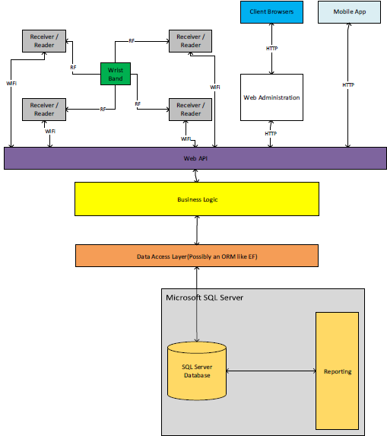

Slide 7
Implementation
For the report
Divide and conquer
First deliverable - Requested by DVT
A working database – SQL Server Express (Uteshlen)
First Deliverable – Team Goal
A Data Access Layer (Michael)
Business Logic Layer (Team Effort)

Slide 8
Technologies
Programming Language (Primary)
C# , .net
Database
SQL Server Express 2012
Data Access Layer
Entity Framework (ORM)

Slide 9
Technologies
Web Development
.net
ASP.Net MVC 5 (HTML 5, JavaScript, JQuery)
IDE (Provided by DVT)
Microsoft Visual Studio 2013
Xamarin – Mobile App Development

Slide 10
Version Control System
GitHub
Microsoft Visual Studio Online
Integrates with GitHub and Visual Studio
Requested to be used by client

Slide 11
The End
Questions?
Thank you for your time ☺

