Slide 1
ANALOG CLOCK READER
Obed Jamir (D23CSE004)
Anirban Maitra (M23CSA005)
Manaswi Vichare (M23CSA013)

Slide 2
PROBLEM STATEMENT
DETECTION
1
2
ROBUST
Detecting the time displayed on an analog clock, regardless of its orientation or angle
To handle variations in lighting conditions, clock design, and background clutter
IDENTIFY
TRANSLATE
Accurately identify the position of the clock hands
Translate their positions into a digital time format
3
4

Slide 3
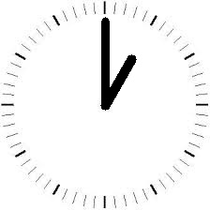
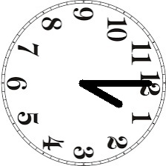
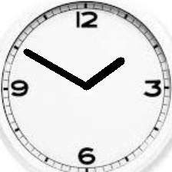
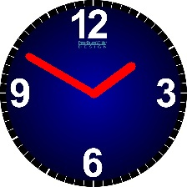
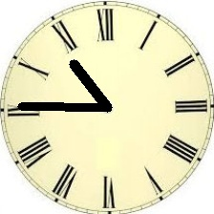
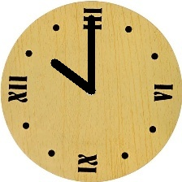
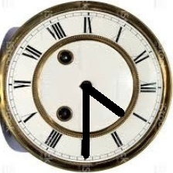
DATASET
Used the “Time - Image Dataset-Classification”
Contains Conical Clock Images

Slide 4
CLASSIC COMPUTER VISION APPROACHES
Contour Detection &
Sorting
Hough Transformation
Inverse Thresholding
Time Estimation
Face Estimation

Slide 5
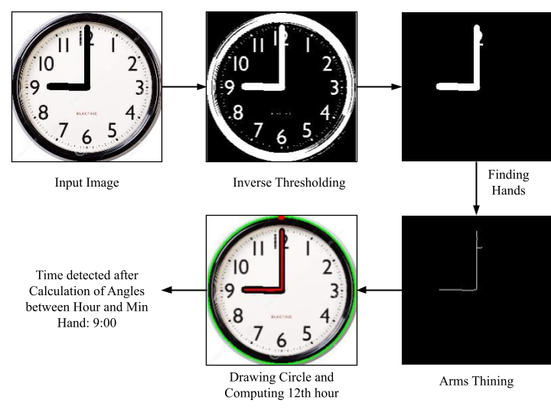
CLASSIC COMPUTER VISION APPROACHES

Slide 6
LIMITATIONS OF TRADITIONAL CV TECHNIQUES:
1
Ideal Conditions vs. Real-world Scenarios
Disrupted Spatial Relationships
4
2
Assumptions of Flat Clock Faces
Impact on Detection Accuracy
5
3
Challenges with Non-frontal Angles
Need for Robustness and Adaptability
6
Notes:
Ideal Conditions vs. Real-world Scenarios:
Traditional CV techniques excel under ideal conditions but struggle with real-world scenarios.
Clock images may be skewed, tilted, or viewed from varying perspectives, challenging the assumptions of traditional methods.
Assumptions of Flat Clock Faces:
Traditional techniques assume perfectly aligned and flat clock faces, which often do not hold true in real-world environments.
These assumptions compromise the accuracy of contour detection and other key steps in the process.
Challenges with Non-frontal Angles:
Clock images captured from non-frontal angles introduce distortions that disrupt spatial relationships between clock hands and faces.
This makes hand position determination challenging, especially when images are viewed from oblique perspectives.
Disrupted Spatial Relationships:
Perspective effects in non-frontal images can distort the spatial relationships between clock hands and faces.
As a result, traditional CV techniques may struggle to accurately determine hand positions and angles.
Impact on Detection Accuracy:
The inaccuracies introduced by skewed or tilted images can significantly impact the accuracy of contour detection and other detection steps.
This can lead to erroneous or unreliable results in analog clock reading tasks.
Need for Robustness and Adaptability:
To address these limitations, there is a need for CV techniques that are robust and adaptable to varying perspectives and image conditions.
Advanced methods, such as deep learning approaches, offer potential solutions by learning from diverse datasets and adapting to real-world variations.
Future Directions:
Future research in analog clock reading should focus on developing techniques that can handle real-world challenges such as perspective distortions and variations in image appearance.
This could involve exploring novel algorithms, incorporating machine learning models, and leveraging advances in computer vision technology.

Slide 7
EXPERIMENTS
Implementing Convolutional Neural Network
1st
Generating Dataset using Synthetic Clock Generator
2nd
Detect the Digital Time
3rd

Slide 8
1. Implementing Convolution Neural Networks
Initialization
Trained using the “Time - Image Dataset-Classification”
Used 3 conv layers along with a max-pooling layer.
Also includes 2 Fully connected layers at the end to perform classification
Improved results on Conical Clock images.
However, did not work well on Homographic transformed Clock images.
Conv Layers
FC Layers
Forward Pass

Slide 9
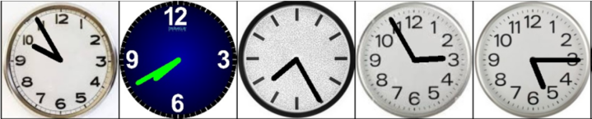
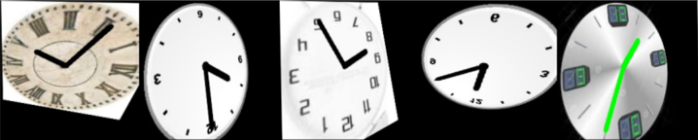
1. Implementing Convolution Neural Networks
Accuracy on Normal
Dataset: 99.72%
Accuracy on Homographic transformed Dataset: 40%

Slide 10
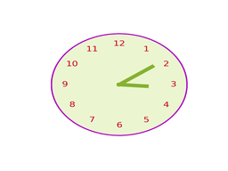
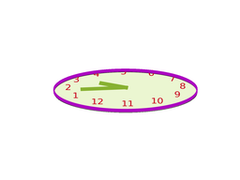
2. Generating Dataset using Synthetic Clock Generator
To produce input images depicting straight clocks & their corresponding transformed images.
Generating synthetic data pairs comprising both the original and distorted clock images, along with their labels.
Synthetic Clock Generator
3:10

Slide 11
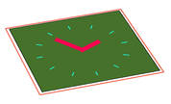
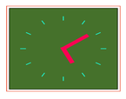
2. Synthetic Clock Generator Dataset
3:10
5:10

Slide 12
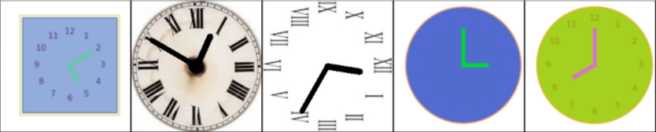
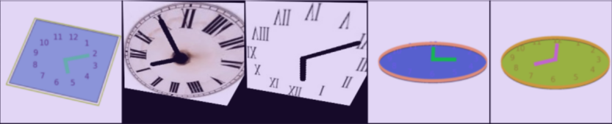
2. Combined SynClock + Time Image Dataset
Conical clock images
Homographic clock images

Slide 13
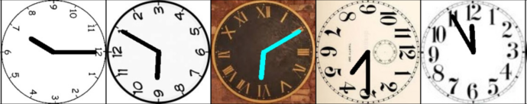
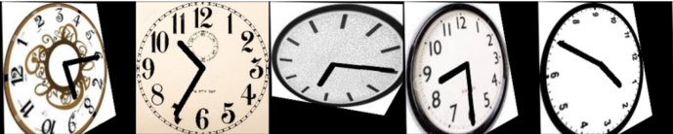
2. Training CNN using SynClock Generator Dataset
Accuracy on Normal
Dataset: 98.68%
Accuracy on transformed homographic Dataset: 99.03%

Slide 14
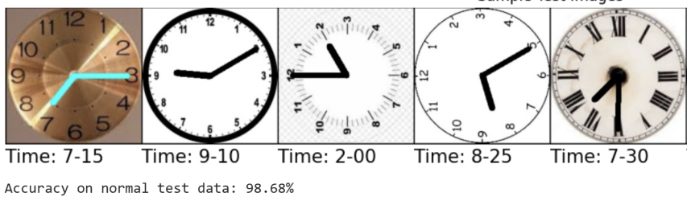
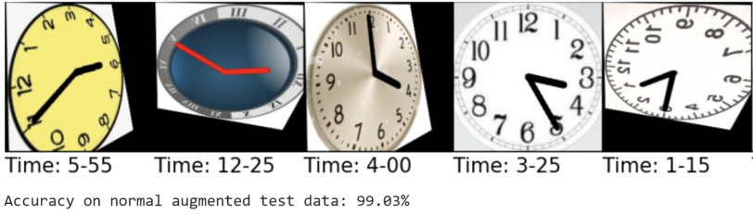
RESULTS

Slide 15
OBSERVATIONS
Models | Accuracy on Conical Clock images | Accuracy on Homo- graphic Clock images
Traditional CV Techniques | 50% | –
CNN | 99.72% | 40.42%
CNN on dataset generated by Synthetic Clock Generator | 98.68% | 99.03%

Slide 16
THANK YOU!

