Slide 1
Predicting Customer
Buying Behaviour
Machine Learning Model — Random Forest Classifier
British Airways | Data Science Team | Heathrow Terminal 3 | 2025
Forage Job Simulation — Task 2

Slide 2
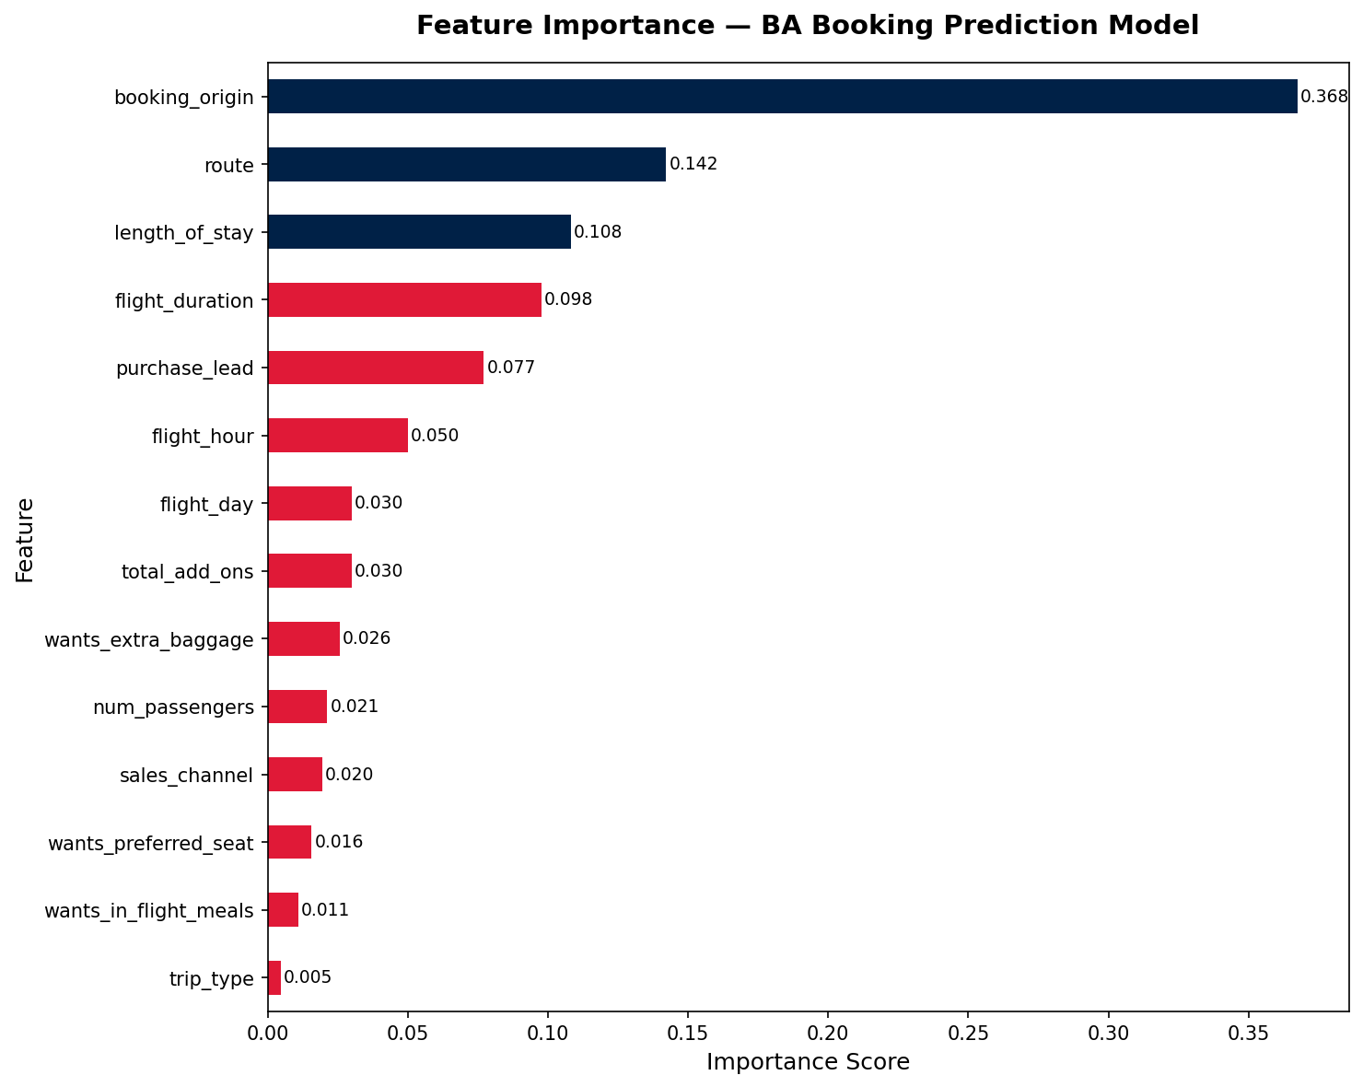
Predicting Customer Buying Behaviour — Model Summary
British Airways | Data Science
49,281
0.763
0.762
69%
85 / 15
Dataset Size
ROC-AUC Score
CV ROC-AUC
Recall (Booked)
Class Imbalance
rows after cleaning
test set performance
±0.002 stable model
actual bookers found
not booked vs booked
Feature Importance
Key Insights
📍 Booking Origin Dominates
booking_origin is the single strongest predictor (36.8% importance). Where a customer books from reflects cultural buying behaviour and purchase intent — BA should tailor regional marketing strategies accordingly.
✈️ Route & Stay Length Matter
route (14.2%) and length_of_stay (10.8%) are the 2nd and 3rd most predictive features. Customers on specific routes planning longer stays show significantly higher booking completion rates.
⚠️ Add-Ons Are Weak Signals
wants_extra_baggage, meals, and preferred_seat all score below 3%. Customers frequently add extras while browsing without completing the booking — these should not be used as primary targeting signals.
🎯 Business Recommendation
Deploy this model to score inbound web traffic by booking_origin + route. Customers with a high predicted probability should receive priority remarketing, dynamic pricing nudges, or targeted email campaigns before they abandon.
British Airways | Data Science Job Simulation | Random Forest Classifier | ROC-AUC: 0.763 | CV: 0.762 ±0.002

Slide 3
Model Methodology & Evaluation
Modelling Pipeline
Model Configuration
1
Data Cleaning
Algorithm
Random Forest Classifier
Removed 719 duplicate rows from 50,000. Zero null values confirmed across all 14 columns.
n_estimators
100 decision trees
2
Feature Engineering
max_depth
10 (prevents overfitting)
Created total_add_ons (sum of baggage + seat + meals) as a new engagement signal feature.
class_weight
balanced (handles 85/15 split)
3
Encoding
random_state
42 (reproducible results)
Label-encoded 5 categorical columns: sales_channel, trip_type, flight_day, route, booking_origin.
Train/Test
80% / 20% stratified split
4
Class Imbalance Handling
Applied class_weight='balanced' in Random Forest to address the severe 85/15 booking split.
Cross-Validation ROC-AUC (5 Folds)
5
Train / Test Split
80/20 stratified split (39,424 train / 9,857 test). Stratification preserves class ratio in both sets.
6
Cross Validation
StratifiedKFold (5-fold). Mean ROC-AUC = 0.7616 ± 0.0018. Near-zero variance confirms stability.
British Airways | Data Science Job Simulation | Random Forest Classifier | ROC-AUC: 0.763 | CV: 0.762 ±0.002

