Slide 1
ScoutPrice 🚀
AI-Powered Price Tracker & Shopping Assistant
Next-Gen Price Monitoring, Referral Shielding, & AI Shopping Companion
Stack: React • Node.js • Chrome MV3 • Redis • MongoDB • Nginx

Slide 2
The E-Commerce Chaos
• Dynamic Pricing Manipulation
Retailers continuously adjust prices in real-time, exploiting consumer urgency and browser cookies.
• Store Fragmentation
Comparing prices across Amazon, Flipkart, Myntra, Ajio, and Meesho is manual, slow, and frustrating.
• Fake Coupons & Stale Offers
Shoppers waste time testing invalid coupon codes manually during checkout.
• Anti-Scraping Barriers
Platforms block automated checkers with security walls, leading to error landing screens (e.g. Flipkart E002).

Slide 3
The ScoutPrice Solution
✔ Unified Scraper Workers
Dual-mode Puppeteer + Cheerio parser fetches accurate product data scheduled via Redis / BullMQ.
✔ Glassmorphism Dashboard
A sleek dark-themed analytics portal presenting history charts, lowest/highest price indicators, and buy recommendations.
✔ Automated Coupon Application
A Chrome Extension background script that loops through and auto-solves valid discount codes on the checkout page.
✔ Referrer Shield Proxy
Built-in server redirect gateway to strip referrers, bypass browser cache, and avoid store blockers.

Slide 4
Technical Stack & Architecture
Microservices Stack
▪ Vite React + Redux Toolkit
Renders the responsive state-synchronized dashboard UI.
▪ Node.js + Express.js
Core REST API server managing user sessions, watchlists, and price alerts.
▪ Nginx Reverse Proxy
Acts as the single port 80 entry gateway routing frontend & API services.
▪ Redis + BullMQ
Coordinates async scraper scheduling to prevent IP bans.
▪ MongoDB (Mongoose)
Houses product metadata, user alerts, and composite price history.
Key Infrastructure Flows
▸ Chrome Extension MV3 Helper
Injects active content script widgets to extract ASINs, titles, and match cross-store prices dynamically.
▸ WebSockets (Socket.io)
Pushes instant, low-latency price-drop alerts directly to connected user browser viewports.
▸ Anti-Bot Redirection Shield
Strips HTTP referrer tokens during merchant handoffs to prevent crawler block screens.

Slide 5
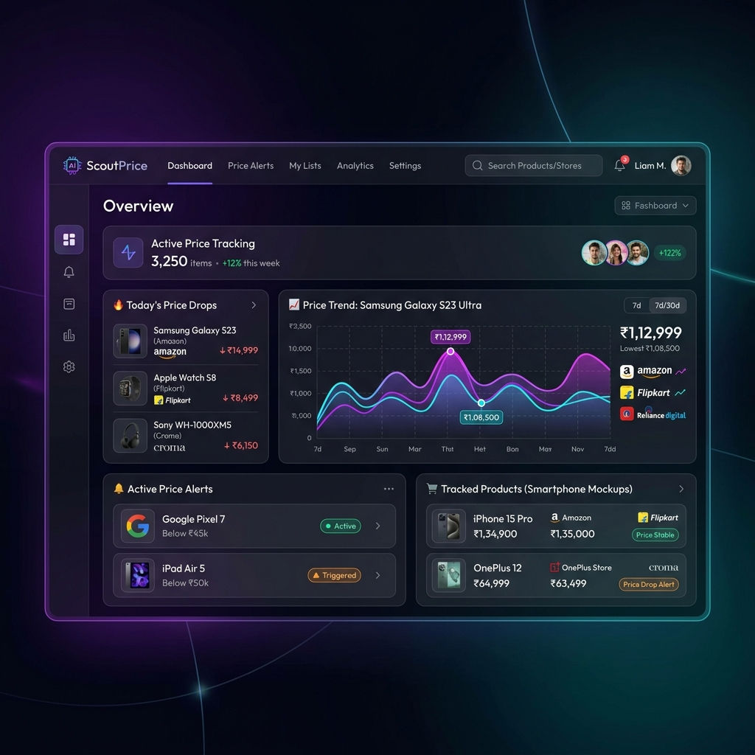
Sleek Dashboard & Analytics
• Visual Analytics
Clean charts powered by Recharts plotting detailed price variation graphs over time.
• Price Level Gauges
Highlights minimum, maximum, and average tags relative to the active price.
• Buy Recommendations
Calculates a target score determining whether to buy immediately or wait for price drops.
• Integrated Watchlist
Allows shoppers to save products and specify discount target thresholds.

Slide 6
Referrer Shield & Redirection
▪ The Redirect Challenge
E-commerce gateways (like Flipkart) flag requests initiated from 'localhost' development origins, showing bot block screens.
▪ Referrer Stripping Engine
By running outbound links through `/api/affiliate/redirect` and setting the response header `Referrer-Policy: no-referrer`, we strip trace vectors.
▪ Strict Browser Cache Bypass
Ensures browsers do not cache failed redirects by implementing anti-caching headers (Cache-Control: no-store, no-cache).
▪ Dynamic SKU Resolvers
Cross-platform token-based matching checks catalog entries to serve direct target pages (avoiding generic queries).

Slide 7
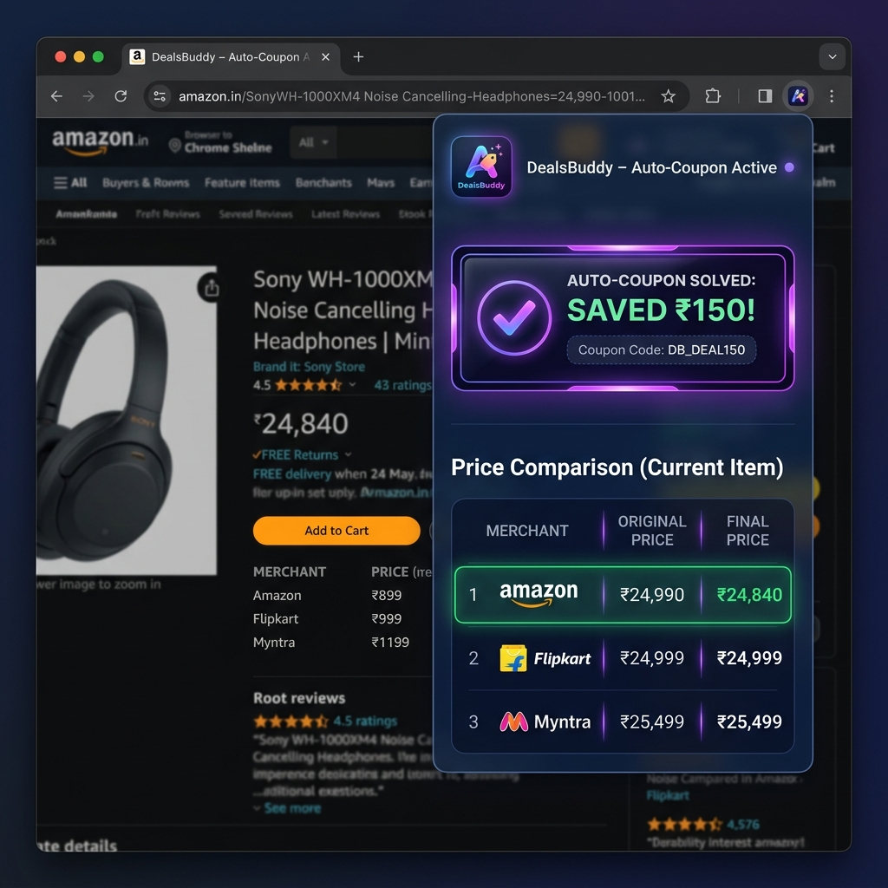
Chrome Extension Helper
• Zero-Click Automation
Runs content scripts in the background, executing code only when navigating matching store portals.
• On-Page Comparison Card
Injects a floating sidebar comparing current store pricing against competing merchants instantly.
• Coupon Autofill Engine
Gathers verified database codes and executes auto-type validation routines on the checkout page.
• User Preference Control
Minimal footprint widget that can be minimized or toggled without page reloads.

Slide 8
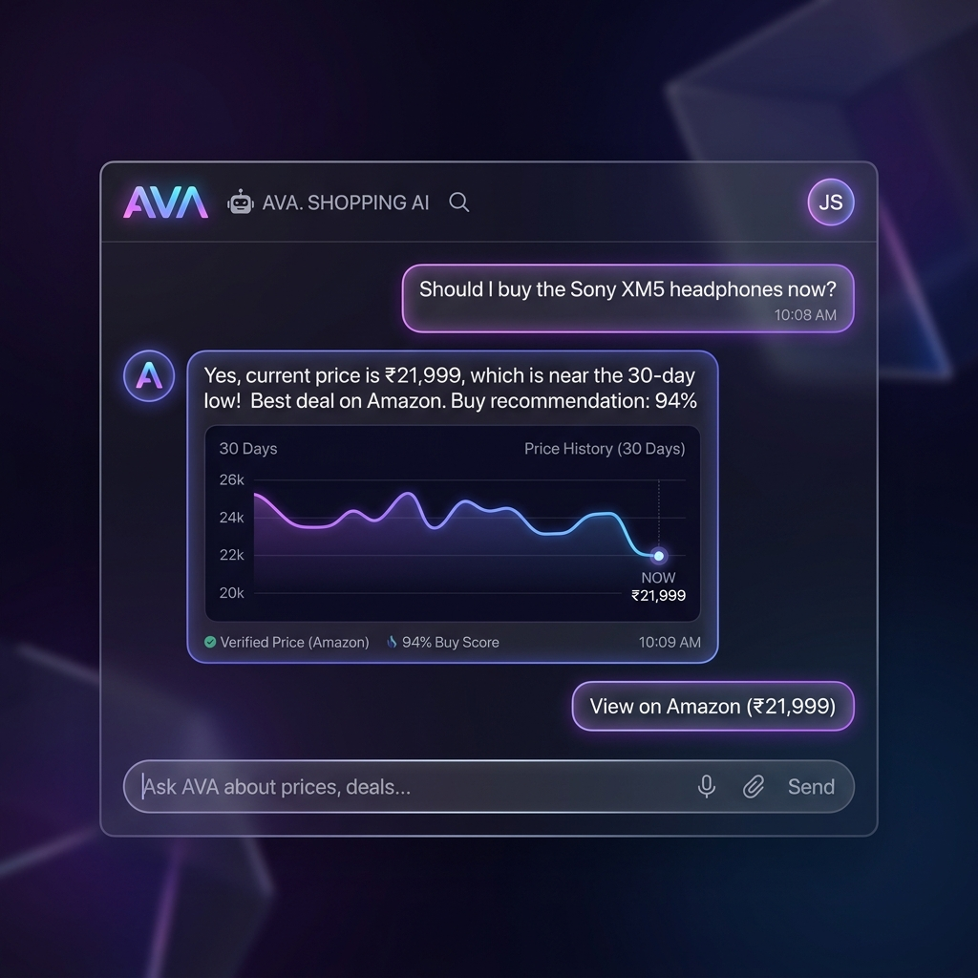
AI Shopping Chatbot
✔ Contextual Recommendations
Handles user questions about best timings, low prices, and specs via conversational interfaces.
✔ Expert Fallback Engines
Structured rule logic triggers if LLM API connections timeout, assuring 100% service availability.
✔ Case-Insensitive Searching
Corrects casing checks (e.g. 'electronics' to 'Electronics') dynamically to avoid empty collections queries.
✔ Interactive Data Snippets
Presents mini price logs and best store suggestion cards inside user chat bubbles.

Slide 9
Mongoose Database Design
▪ Users Collection
Encrypted hash logins, saved settings, and active watchlist lists.
▪ Products Collection
SKU identifiers, brand info, and merchant details across Amazon, Flipkart, Myntra, Ajio, and Meesho.
▪ PriceHistory Collection
Plot coordinates mapping timestamps to actual product pricing for detailed dashboard charting.
▪ Alerts Collection
Tracks target trigger prices, alert channels (Email / WebSockets), and status flags.
▪ Fitness & Sports Category
Added category mapping and catalog additions (e.g. Kore DM 20kg Dumbbell Sets) synced successfully.

Slide 10
Completed Technical Achievements
✔ Affiliate Path Optimization
Stripped referring headers and added cache controls to fix browser redirection and Flipkart E002 blocks.
✔ Cross-Merchant Sync
Configured real URLs and correct prices for products, filtering store listings based on category rules.
✔ Database & Logic Alignment
Fixed category case-sensitivity issue in search indexing and added the Fitness & Sports section.
✔ UI Component Refinement
Cleaned up charts layout spacing to prevent overlay elements colliding on product detail panels.
✔ Integration and Testing
Validated microservice setups via Docker and built a PowerShell REST API validation script.

