Slide 1
IGR 202 - Final Project
Grass Renderer
Kedadry Yannis

Slide 2
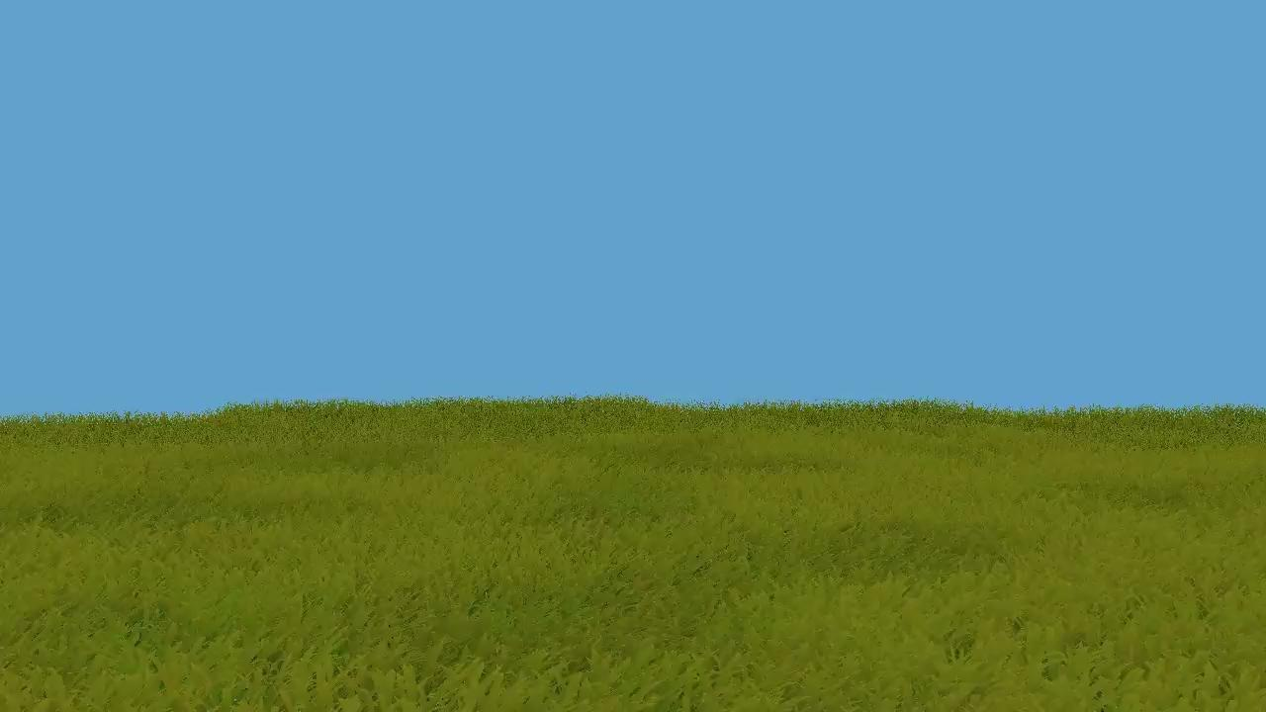
Quick demo

Slide 3
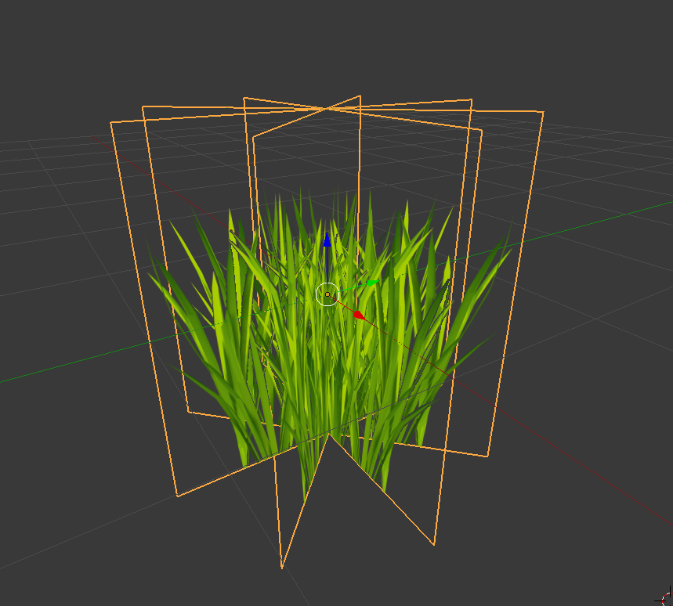
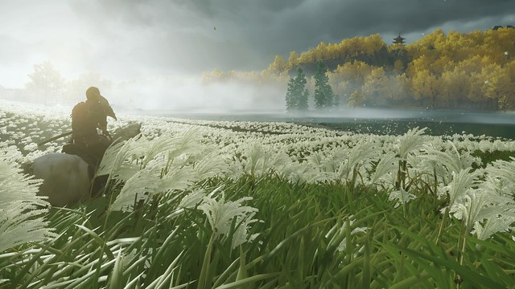
Why this project ?
Billboards to represent grass
Realistic grass from Ghost of Tsushima

Slide 4
Pipeline Architecture
Grass
Batch of tiles
Pos
Tile
Tile
Batch of tiles
Col
Tile
Tile
Batch of tiles
Tile
Tile

Slide 5
Pipeline Architecture
Grass
Compute Shader
Batch of tiles
Pos
Tile
Tile
Batch of tiles
Col
Tile
Tile
Batch of tiles
Tile
Tile

Slide 6
Pipeline Architecture
Grass
Compute Shader
Batch of tiles
Pos
Tile
Tile
Batch of tiles
Col
Tile
Tile
Batch of tiles
Tile
Tile

Slide 7
Pipeline Architecture
Grass
Compute Shader
Batch of tiles
Pos
Tile
Tile
Batch of tiles
Col
Tile
Tile
Batch of tiles
Tile
Tile

Slide 8
Pipeline Architecture
Grass
Compute Shader
Batch of tiles
Pos
Tile
Tile
Batch of tiles
Col
Tile
Tile
Vertex Shader
Vertex data
Blade Id
Batch of tiles
Tile
Tile
Pos
Col

Slide 9
Pipeline Architecture
Grass
Compute Shader
Batch of tiles
Pos
Tile
Tile
Batch of tiles
Col
Tile
Tile
Vertex Shader
Vertex data
Blade Id
Batch of tiles
Tile
Tile
Pos
Col

Slide 10
Pipeline Architecture
Grass
Compute Shader
Geometry Shader
Batch of tiles
Pos
Tile
Tile
Batch of tiles
Col
Tile
Tile
Vertex Shader
Vertex data
Blade Id
Batch of tiles
Tile
Tile
Pos
Col

Slide 11
Pipeline Architecture
Grass
Compute Shader
Geometry Shader
Batch of tiles
Pos
Tile
Tile
Batch of tiles
Col
Tile
Tile
Vertex Shader
Vertex data
Blade Id
Batch of tiles
Tile
Tile
Pos
Col

Slide 12
Pipeline Architecture
Grass
Compute Shader
Geometry Shader
Batch of tiles
Pos
Tile
Tile
Batch of tiles
Col
Tile
Tile
Vertex Shader
Vertex data
Blade Id
Batch of tiles
Tile
Tile
Pos
Col

Slide 13
Pipeline Architecture
Grass
Compute Shader
Geometry Shader
Batch of tiles
Pos
Tile
Tile
Batch of tiles
Col
Tile
Tile
Vertex Shader
Vertex data
Blade Id
Batch of tiles
Tile
Tile
Pos
Col

Slide 14
Pipeline Architecture
Grass
Compute Shader
Geometry Shader
Batch of tiles
Pos
Tile
Tile
Batch of tiles
Col
Tile
Tile
Vertex Shader
Vertex data
Blade Id
Batch of tiles
Tile
Tile
Pos
Col

Slide 15
Pipeline Architecture
Grass
Compute Shader
Geometry Shader
Batch of tiles
Pos
Tile
Tile
Batch of tiles
Col
Tile
Tile
Vertex Shader
Vertex data
Blade Id
Batch of tiles
Tile
Tile
Pos
Col

Slide 16
Pipeline Architecture
Grass
Compute Shader
Geometry Shader
Batch of tiles
Pos
Tile
Tile
Batch of tiles
Col
Tile
Tile
Vertex Shader
Vertex data
Blade Id
Batch of tiles
Tile
Tile
Pos
Col

Slide 17
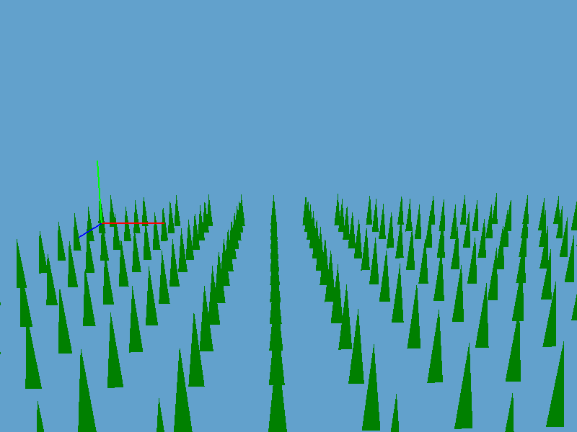
How to make blades more interesting ?

Slide 18
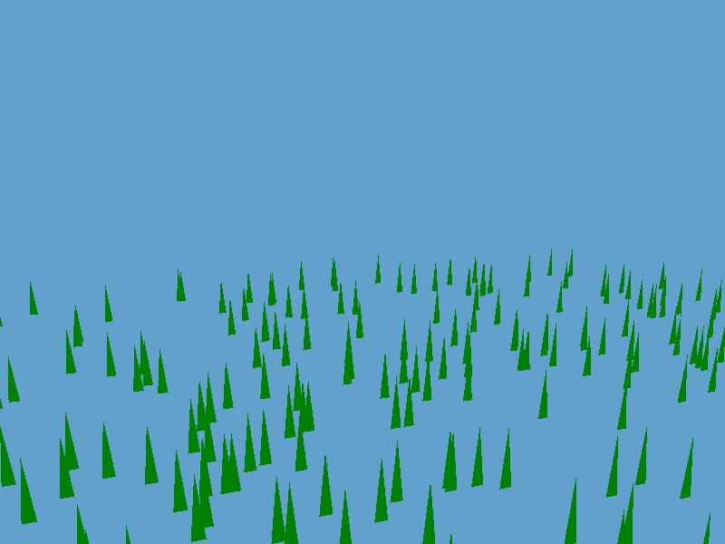
How to make blades more interesting ?
Initial output
Pseudo-random Positions

Slide 19
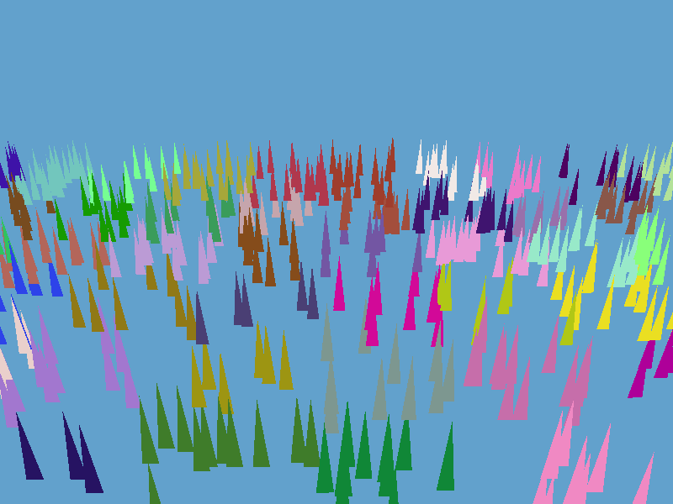
How to make blades more interesting ?
Pseudo-random Positions
Voronoi Clumps

Slide 20
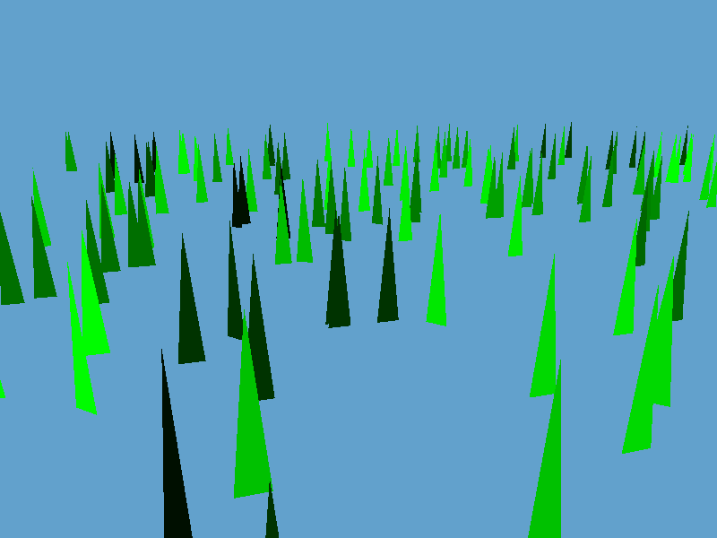
How to make blades more interesting ?
Voronoi Clumps
Pseudo-random Rotations

Slide 21
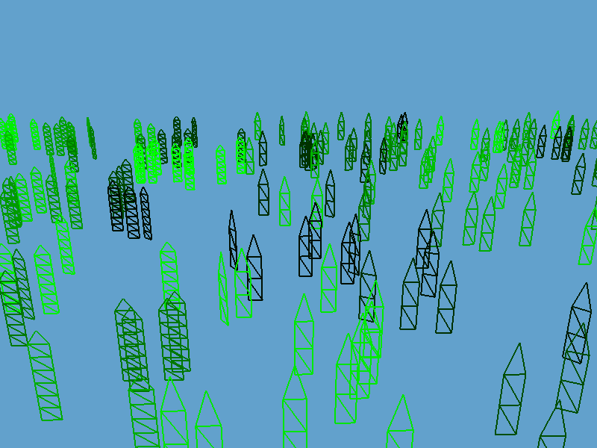
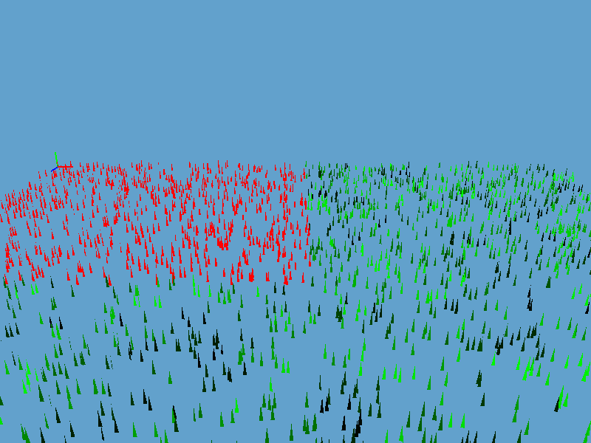
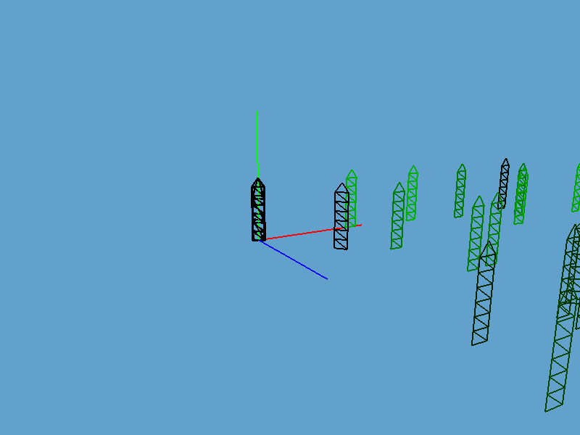
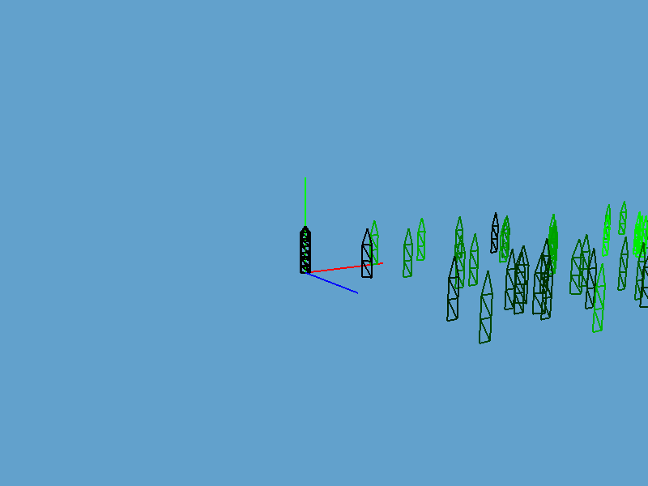
Level of Details
Multiple Tiles
Tiles LODs

Slide 22
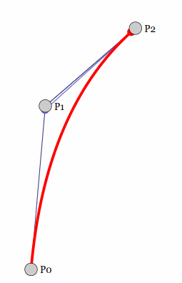
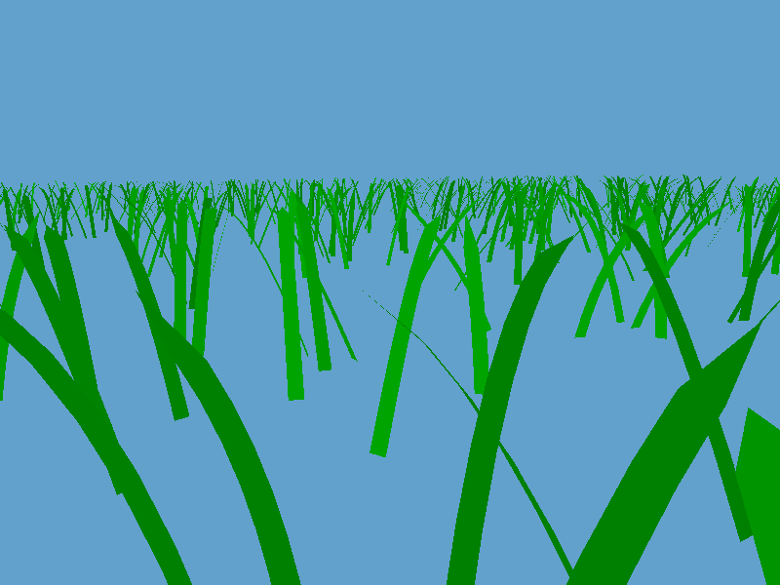
Bezier Curves

Slide 23
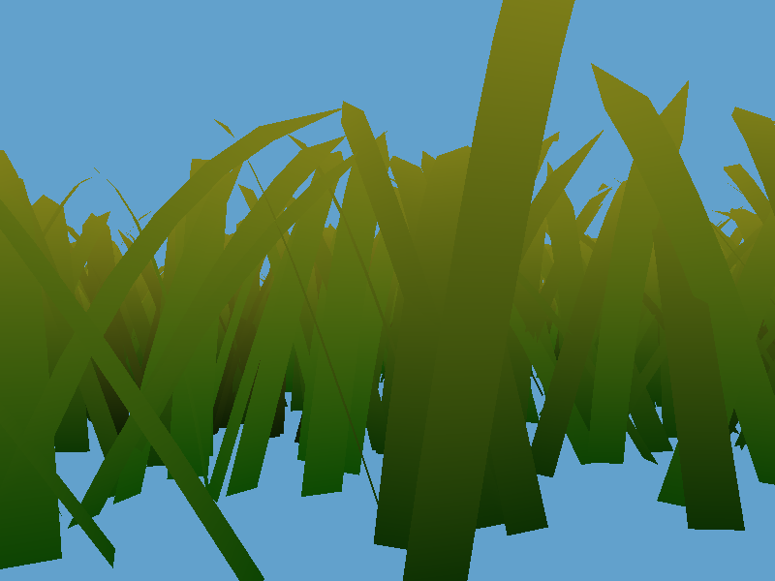
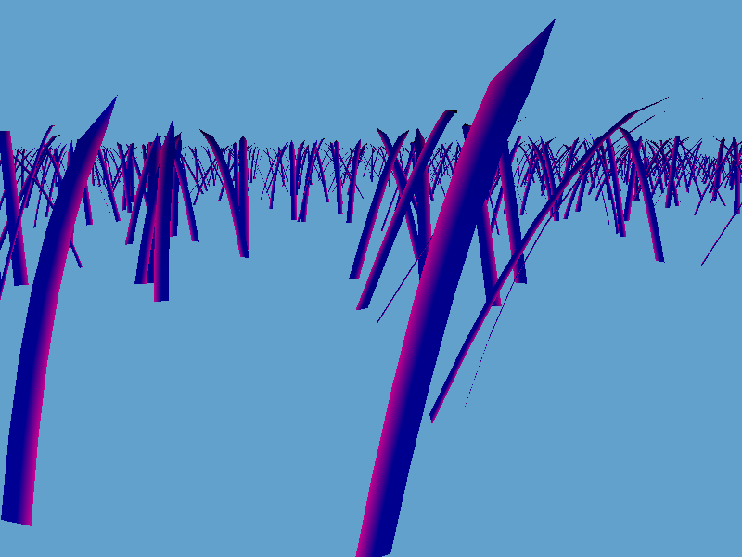
Colors

Slide 24
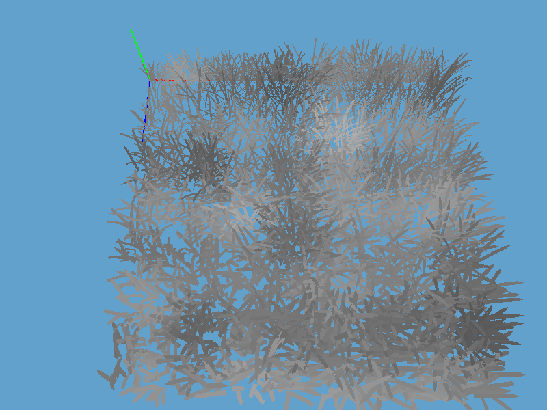
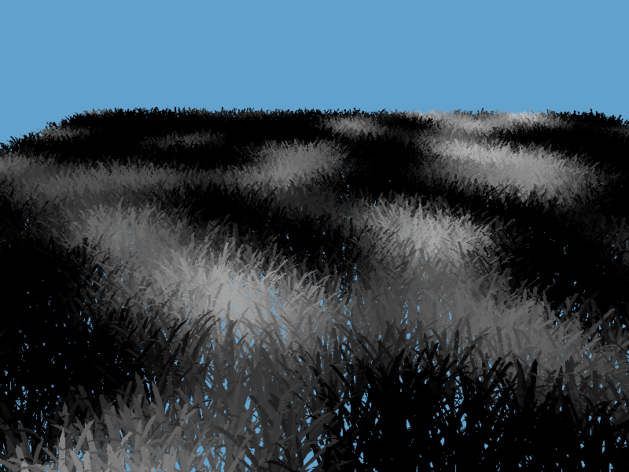
Wind System
Gradient Perlin Noise
(on 1 Tile)
Simplex Perlin Noise
(on multiple Tiles)

Slide 25
Results
Avg 15 FPS
20 x 20 Tiles
Between 1024 and 4096 blades / Tile
CPU: Intel i5-1135G7
GPU: Intel TigerLake-LP GT2

Slide 26
What’s Next ?
More parallelization (Vulkan)
Lighting issues
Sub passes
Tessellation shaders
Anisotropic BRDF
…

