Slide 1
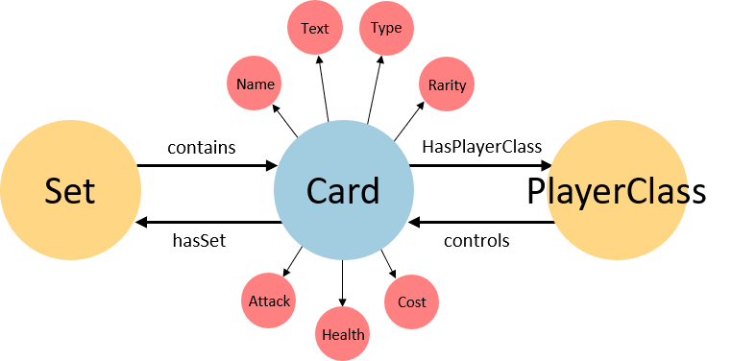
Ontologia

Slide 2
Text
Type
Name
Rarity
contains
HasPlayerClass
Set
Card
PlayerClass
hasSet
controls
Attack
Cost
Health

