Slide 1
Visual Languages

Slide 2
Outline
Visual Languages
Visual Programming Languages
Specification and Processing
Picture Layout Grammars
Visual Programming Environments
DEViL
Pros and Cons
Development workflow
Discussion
Automatic vs Manual generation of Visual Programming Environments

Slide 3
Visual Languages Definition
A Visual Language defines a set of sentences formed by the spatial disposition of graphical objects with a very well defined syntax and semantics.

Slide 4
Visual Languages Types
General Purpose Visual Languages
Used to concisely transmit a message through iconic compositions with (globally) accepted meaning;
Visual Programming Languages
Used to solve (complex) problems by describing their properties or their behaviour through iconic definitions;

Slide 5

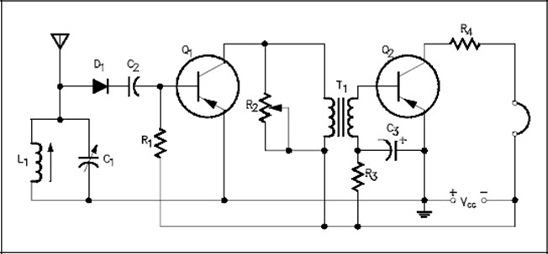
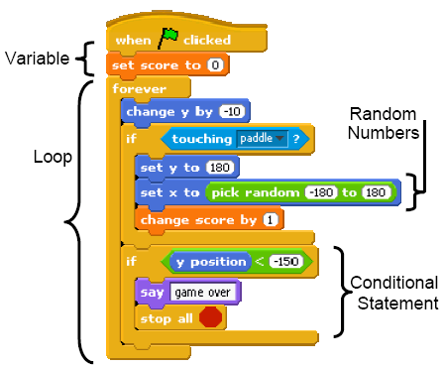

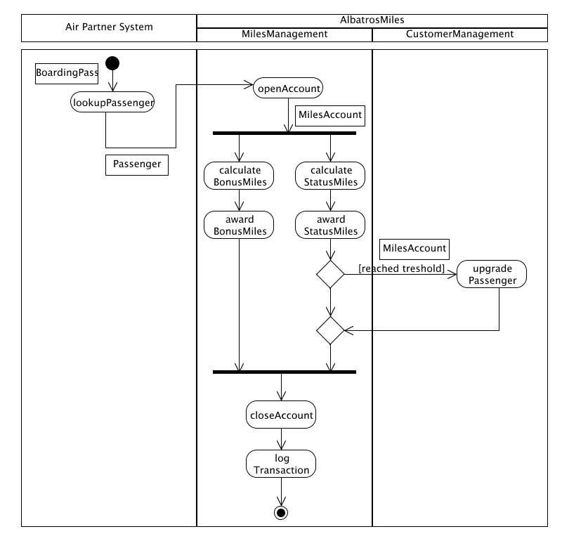
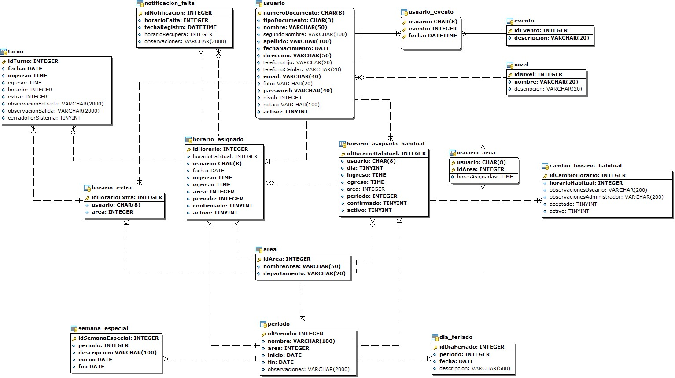
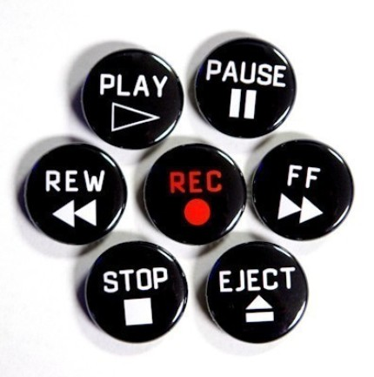
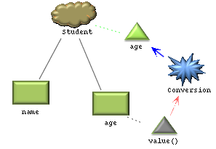
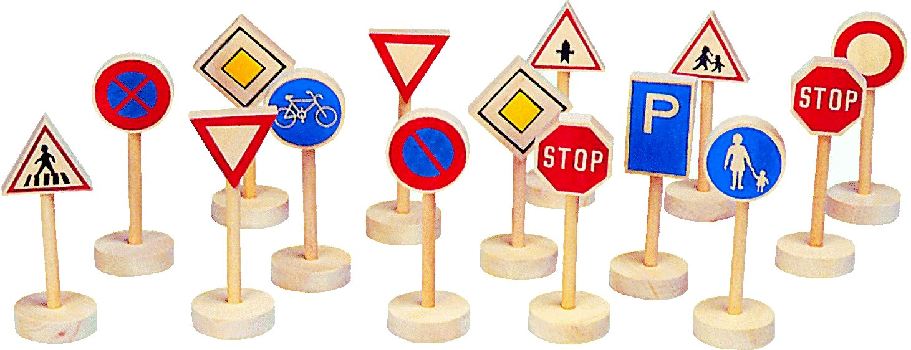
Visual Languages Examples

Slide 6
Outline
Visual Languages
Visual Programming Languages
Specification and Processing
Picture Layout Grammars
Visual Programming Environments
DEViL
Pros and Cons
Development workflow
Discussion
Automatic vs Manual generation of Visual Programmin Environments

Slide 7
Visual Programming Languages
Textual Programming Languages:
Require fine knowledge about their syntax;
Small errors can make programming activity boring;
Comprehension is very hard;
No need for programming environment (in general).
Visual Programming Languages:
Intended to have a simpler syntax;
Easier to recall and understand;
Comprehension should be easier;
Requires programming environment.

Slide 8
Visual Programming Languages Specification and Processing
Textual Programming Languages
specified via Context-free Grammars
with BNF or eBNF notation
processed with compiler compilers
traditional language processing (lexers, parsers, etc.)
Visual Programming Languages
How are they specified and processed?

Slide 9
Visual Programming Languages Specification and Processing
There are several specification formalisms for visual languages:
MASoViLa (Modular Attribute-based Specification of Visual Languages )
LGG (Layered Graph Grammars)
PLG (Picture Layout Grammars)

Slide 10
Picture Layout Grammar PLG
Attribute-based grammar
Each terminal and non-terminal has attributes
Minimal set of attributes: URx, URy, LLx, LLy;
Assumes a predefined set of terminal symbols
text, circle, rectangle, line
Develops on spatial relation operators
Black boxes for attribute specification

Slide 11
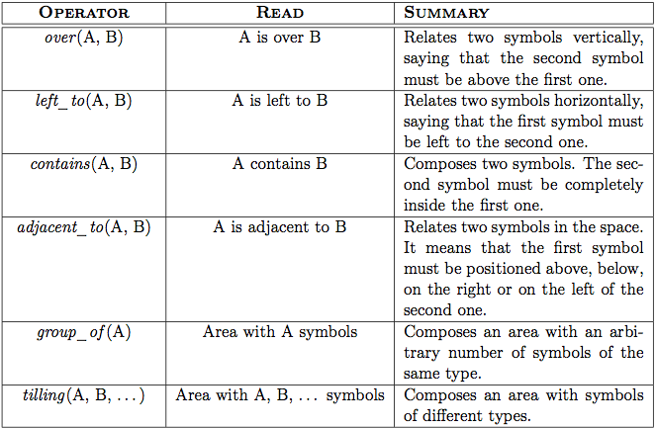
Picture Layout Grammar PLG

Slide 12
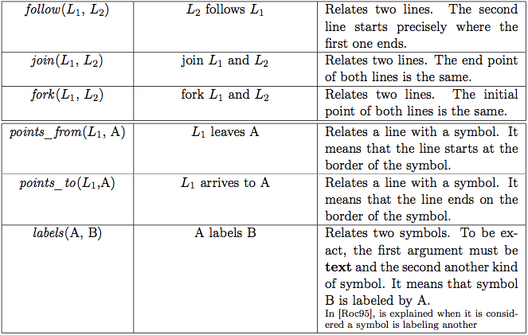
Picture Layout Grammar PLG

Slide 13
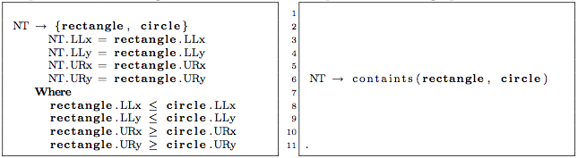
Picture Layout Grammar Specificaiton
Definition of NT is the same in both examples
Left
NT semantics is explicitly defined with attributes
Where is used to define semantic constraint
Right
NT semantics is implicitly defined using spatial operator “contains”

Slide 14
Picture Layout Grammar Processing
Uses the notion of FMD structure
Factored Multiple Derivation structure
Represents a set of possible derivations
A correct derivation is extracted by walking the FMD and the trace (tree-DAG) holds:
Constraints are satisfied
Root of tree-DAG is the root of the grammar
All the input symbols are consumed
It is a valid tree-DAG

Slide 15
Picture Layout Grammar FMD structure
TWO_BOXES -> left_to(BOX,BOX)
BOX -> rectangle
| points_from(line, rectangle)
TWO_BOXES -> Left_to(…)
BOX -> rectangle
BOX -> rectangle
BOX -> points_from(…)
rectangle
rectangle
line

Slide 16
Outline
Visual Languages
Visual Programming Languages
Specification and Processing
Picture Layout Grammars
Visual Programming Environments
DEViL
Pros and Cons
Development workflow
Discussion
Automatic vs Manual generation of Visual Programmin Environments

Slide 17
Visual Programming Environments
Usually are developed from scratch, without systematization ;
Code written for their development is (most of the times) hard to maintain/evolve;
But the environments are efficient and support large scale specifications.

Slide 18
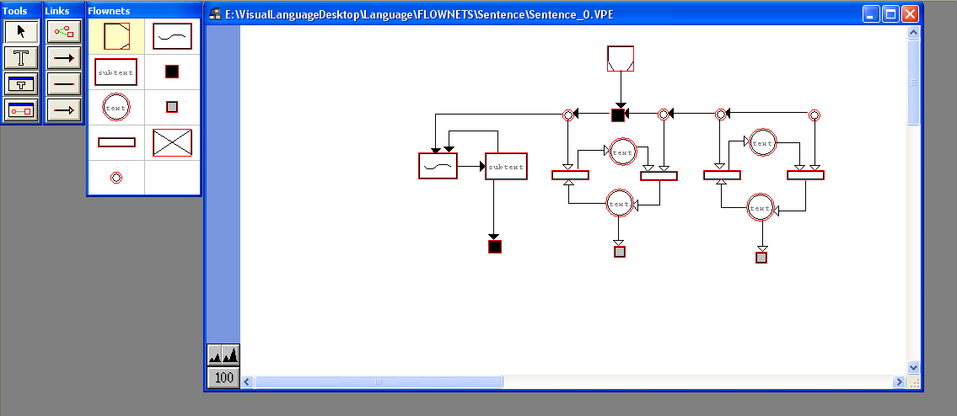
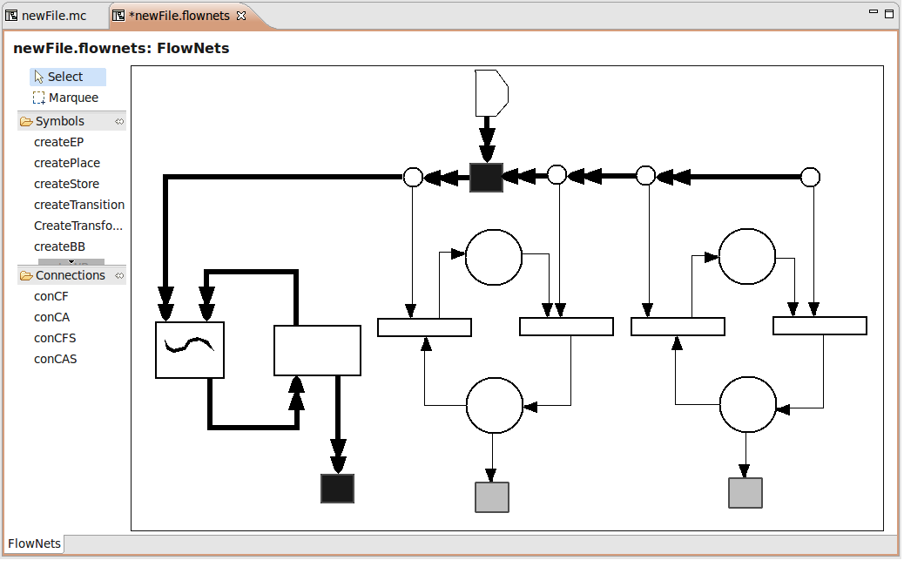
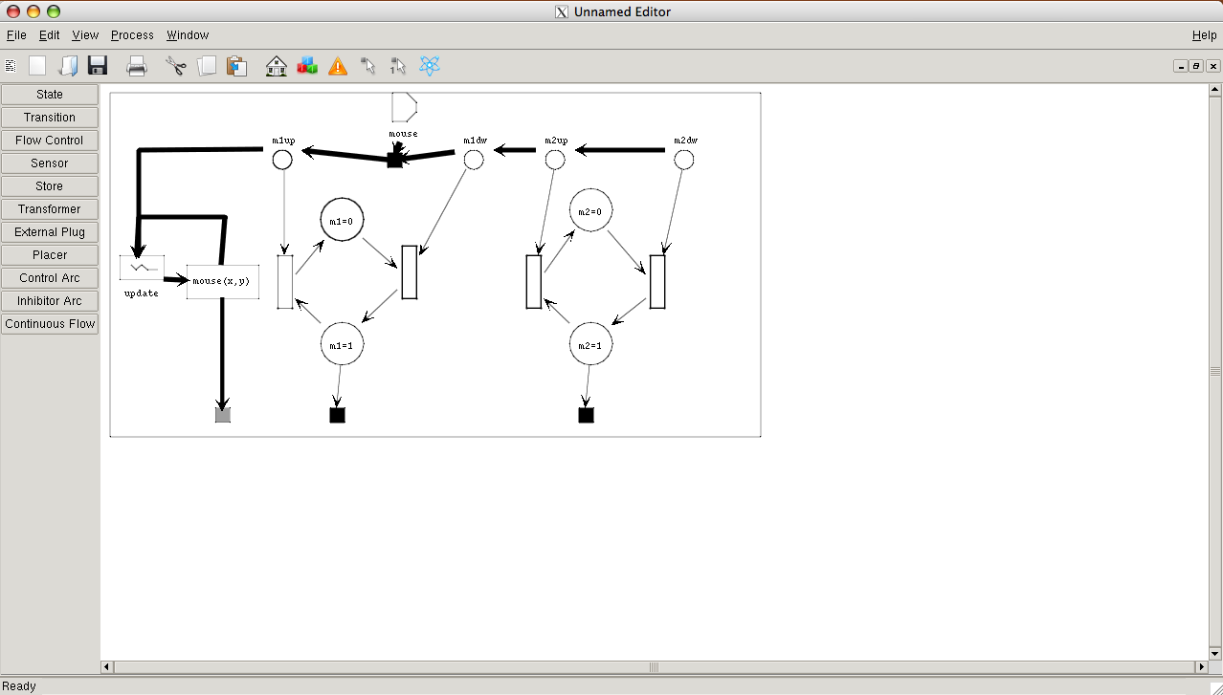
Visual Programming Environments Generators
VLDesk
Tiger
DEViL

Slide 19
DEViL: Development Environment for Visual Languages
Pros
Cons
Very good support;
Many examples, addressing several DEViL features;
Exists for MacOS, Windows and Linux;
Allows programmers to extend capabilities.
Complex Installation;
Disperse documen-tation and written in German;
Generated Editor is only compatible with the SO where it was developed;

Slide 20
DEViL: Development Environment for Visual Languages Workflow
Attribute Grammar Specification

Slide 21
Attribute Grammar
Modular definition of symbols;
Object Oriented Approach:
Grammar symbols can be seen as classes;
Symbol attributes can be seen as class attributes.
Syntax is defined by relations between the classes;

Slide 22
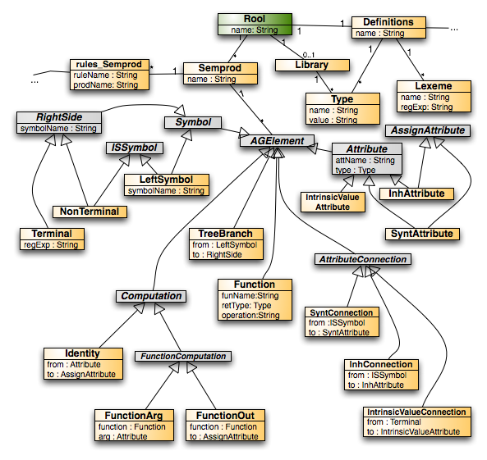
Model Representation
CLASS Root {
name: VAL VLString;
semprods: SUB Semprod*;
definitions: SUB Definitions!;
library: SUB Library?;
}
A Tree Grammar is produced

Slide 23
Attribute Grammar
Abstract classes are used to group symbols and refine syntactic aspects;
Coupling of grammar symbols used to replicate structures.

Slide 24
DEViL: Development Environment for Visual Languages Workflow
Attribute Grammar Specification
Interaction Definition
Buttons
Symbols L&F

Slide 25
Interaction Definition
Development of several files where:
Views of the VL are defined;
Dock Buttons are created;
L&F of buttons is declared (p.e. using images);
The behavior of a button is defined;
Tooltips can be added;
Events can be programmed to add extra behavior to the button’s actions.
Notes:
Ponto 1:- specifying the root symbol for that view;
Ponto 4:- specifying the language’s symbol created when clicking that button;

Slide 26

Interaction Definition
VIEW rootView ROOT Root {
BUTTON IMAGE "img::btnSemprod"
INSERTS Semprod
INFO "Inserts a new Grammar Production";
}

Slide 27
Interaction Definition
Definition of canvas’ L&F:
Visual Patterns are associated to tree-grammar symbols to define their basic appearence;
Computations are declared to implement the VPs;
Icons are associated to symbols;
Semantic rules can be declare to assign values to the attributes of the symbols.

Slide 28
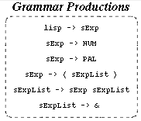
Interaction Definition
SYMBOL rootView_Root INHERITS VPRootElement, VPForm
COMPUTE
SYNT.drawing = ADDROF(rootViewDrawing);
END;
SYMBOL rootView_Root_semprods INHERITS
VPFormElement, VPSimpleList
COMPUTE
SYNT.formElementName = "productions";
END;

Slide 29
DEViL: Development Environment for Visual Languages Workflow
Attribute Grammar Specification
Interaction Definition
Semantic Analyzer Implementation
Buttons
Symbols L&F

Slide 30
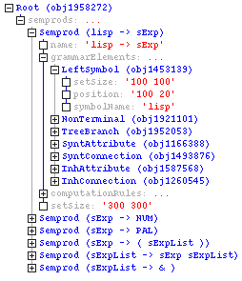
Semantic Analyser
DEViL offers tree-walker (function) named addCheck;
Tree-walker executes in a given context;
A tree-context is a symbol or attribute in the tree-grammar;
Id-Tables, Lists, etc. can be implemented easily;

Slide 31
Semantic Analyser Implementation
Contextual Condition: A production must have one and only one root symbol
checkutil::addCheck Semprod {
set n [llength [c::getList {$obj.grammarElements.CHILDREN[LeftSymbol]}]]
set symbName [c::get {$obj.name.VALUE}]
if { $n == 0 } {
eturn "Production '$symbName' must have one Root symbol!”
} elseif {$n > 1} {
return "Production '$symbName' must have only one Root symbol!”
}
return ””
}

Slide 32
DEViL: Development Environment for Visual Languages Workflow
Attribute Grammar Specification
Interaction Definition
Semantic Analyzer Implementation
Code Generation
Buttons
Symbols L&F

Slide 33
Code Generation
Templates for structuring the output are used;
Typical AG approach:
Attributes can be associated to symbols of the tree-grammar;
Semantic rules are declared to compute value for these attributes;
Attributes can be referenced outside the context of the symbol;
Auxiliary functions can be defined to aid the computations;

Slide 34
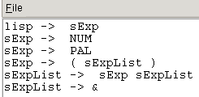
Code Generation
bnfProd(lhs, rhs):
[lhs] -> [rhs]
SYMBOL bnfgen_Semprod: bnfLHS : PTGNode;
SYMBOL bnfgen_Semprod: bnfRHS : PTGNode;
SYMBOL bnfgen_Semprod: bnfCode : PTGNode;
SYMBOL bnfgen_Semprod
COMPUTE
SYNT.bnfLHS = CONSTITUENTS bnfgen_LeftSymbol.pers_symbolName
WITH(PTGNode, PTGNewLineSeq, PTGAsIs, PTGNull);
SYNT.bnfRHS = PTGAsIs(VLString(SELECT(vlList(
"printBNFOrderedRHSElements",THIS.objId),eval())));
SYNT.bnfCode = PTGbnfProd(THIS.bnfLHS, THIS.bnfRHS);
END;

Slide 35
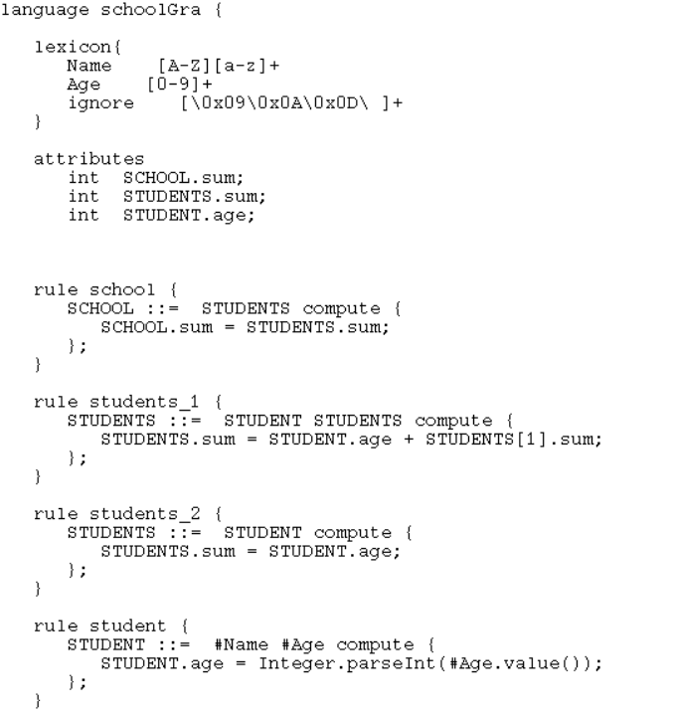
Code Generation

Slide 36
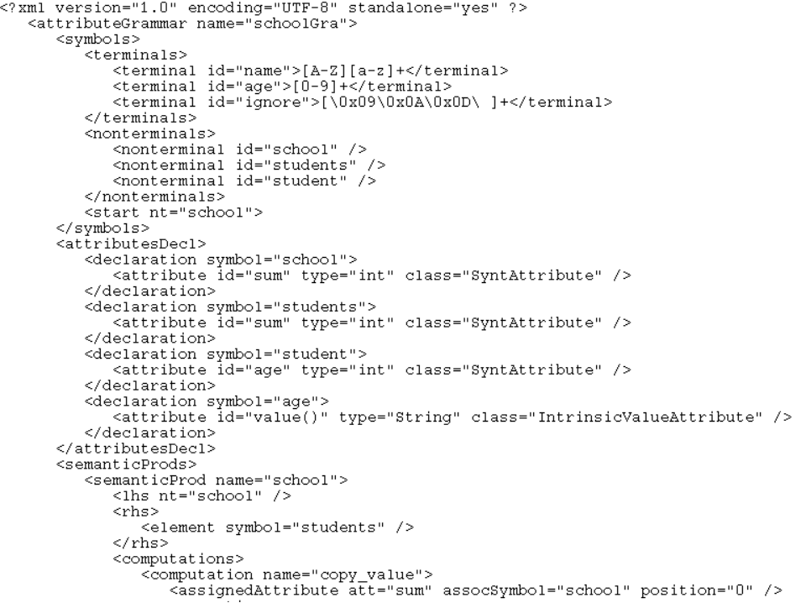
Code Generation

Slide 37
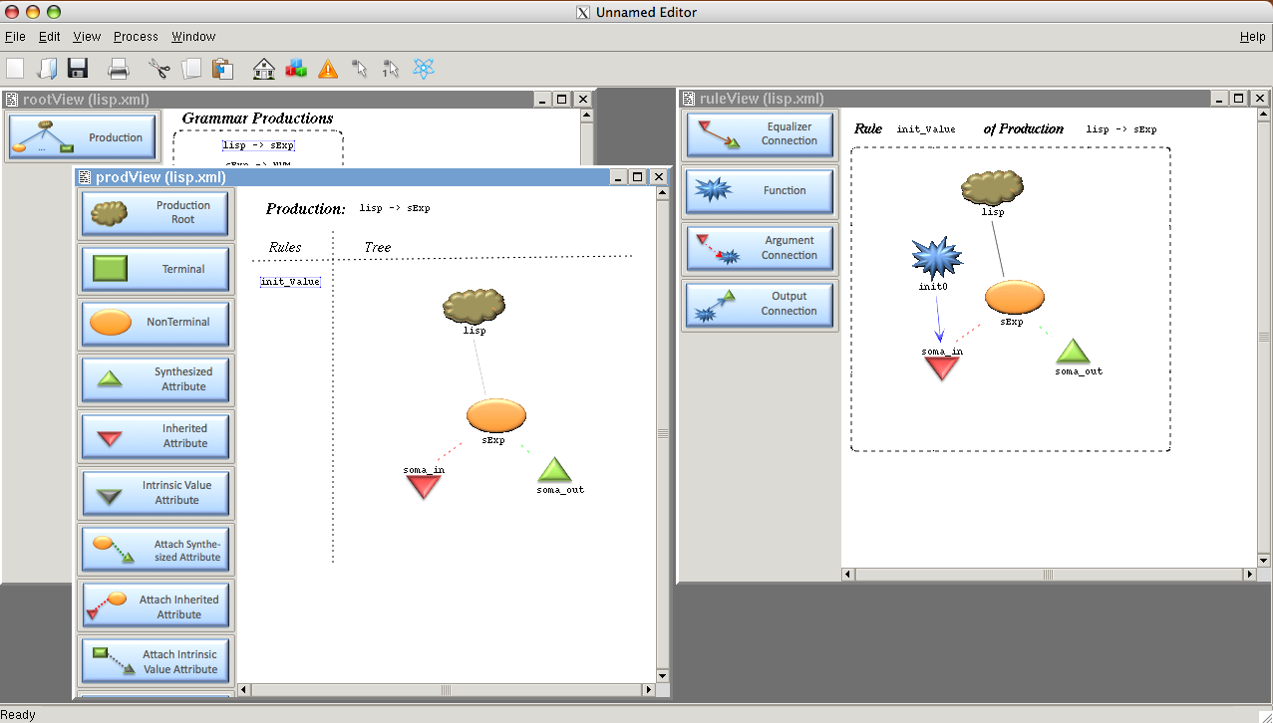
DEViL Files dependency
Symbols.GIF
Viag.XMODEL
images.GDR
Buttons.PNG
View.LIDO
Semantics.TCL
Edit.TCL
Sync.TCL
View.MODEL
Code.IPTG
Viag.DEFS
Code.SPECS
Code.HEAD
Code.LIDO
Code.MODEL
Aux.TCL
Template.RES

Slide 38
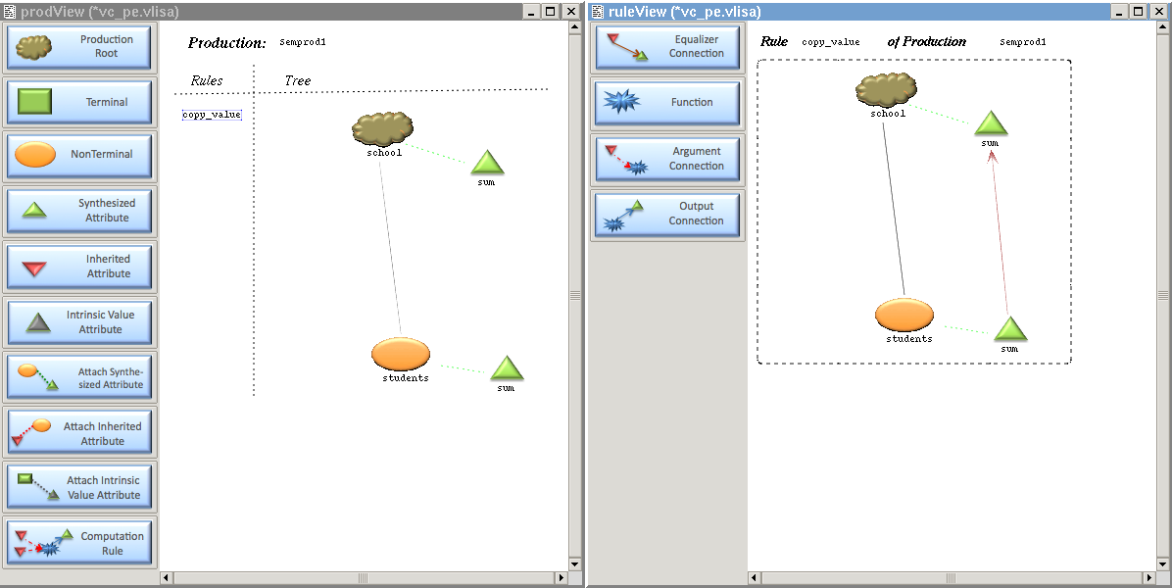
Generated Environment

Slide 39
Discussion Automatic or Manual Generation of Visual Programming Environments?
Manual
Automatic
Complex specification and Development
Hard to evolve
Prone to errors and bugs
More features
More customization
Better performance (due to optimization)
From a simple (abstract) specification
Easy to evolve
Less errors (or none at all)
Less features
Less customization
Low performance

Slide 40
Discussion Automatic or Manual Generation in General?
What other examples of automatic generation exists in programming?
How are these compared with the manual construction?
Is generic better than specific, in programming?
Can these dimensions be approximated?

Slide 41
Visual Languages

