Slide 1

NA StockMarket Trading Company
Josiah Tolentino，Ashish Tripathi, Mengyao Wang

Slide 2
Purpose
Our project for Info 3150 is online web application, where traders and human resource managers upload, view and calculate winnings in the stock exchange.

Slide 3
Product Scope
The application should allow users to login, register or reclaim their account with by changing their password.
The application should also allow traders to change their password, upload their trading records to a database, and view their previous trades on their account.
The application will let human resource managers change their password, view a traders previous trades, and calculate their winning rates.

Slide 4
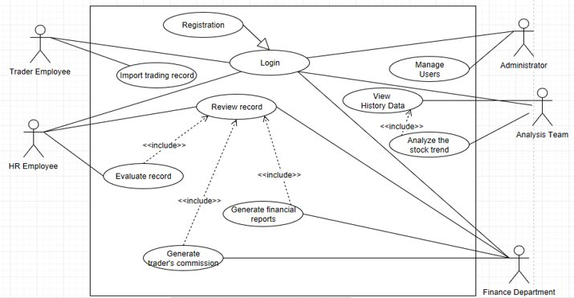
System Requirements

Slide 5
Functional Requirements
uses SSL connection
Register and log in
normal accounts: low privilege, view their own data
higher privilege accounts: approved by administrator, view all the data
data are stored in a database
the system can send queries to let the database show the recording report, show the history data, calculate the winning rate of each trader, participate the stock trend analysis, generate the financial reports and trader's commission to specific roles. All the results are displayed to each sepicific roles

Slide 6
Nonfunctional Requirements
Compatibility requirements:
The web pages of the system support all major browsers.
Security requirements:
Passwords encryption.
Connection from WAN user and to database server is secured with SSL.
Give warning message if connection to database lost.
Automatically logout after 30 minutes’ no response from user.
Business Rule:
Trader: can only upload or review his own record.
HR: have privilege to review and evaluate the records.
Finance employees: have privilege to review and generate the records.
Analysts: have privilege to review and analyze the data.

Slide 7
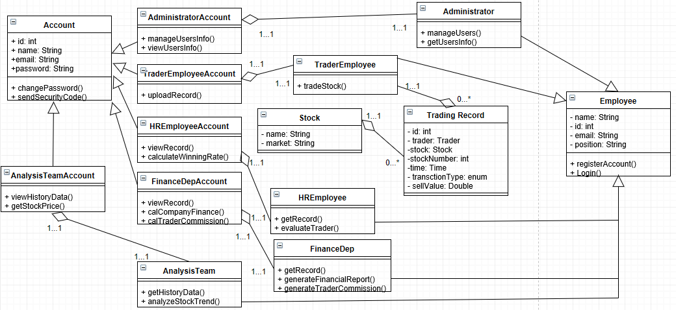
System Classes Overview

Slide 8
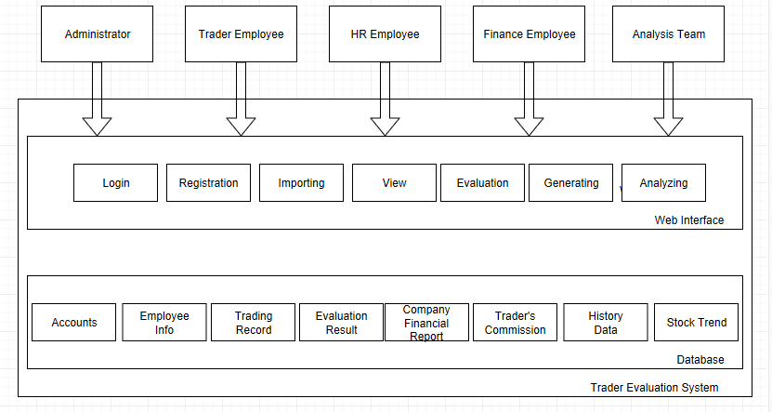
Architectural Design

Slide 9
Operating Environment
The front end of the system supports major browsers in major platforms. The back end of the system requires a PHP web server and a MySQL database server.
The User Interface was created using HTML with a CSS style sheet and javascript.

Slide 10
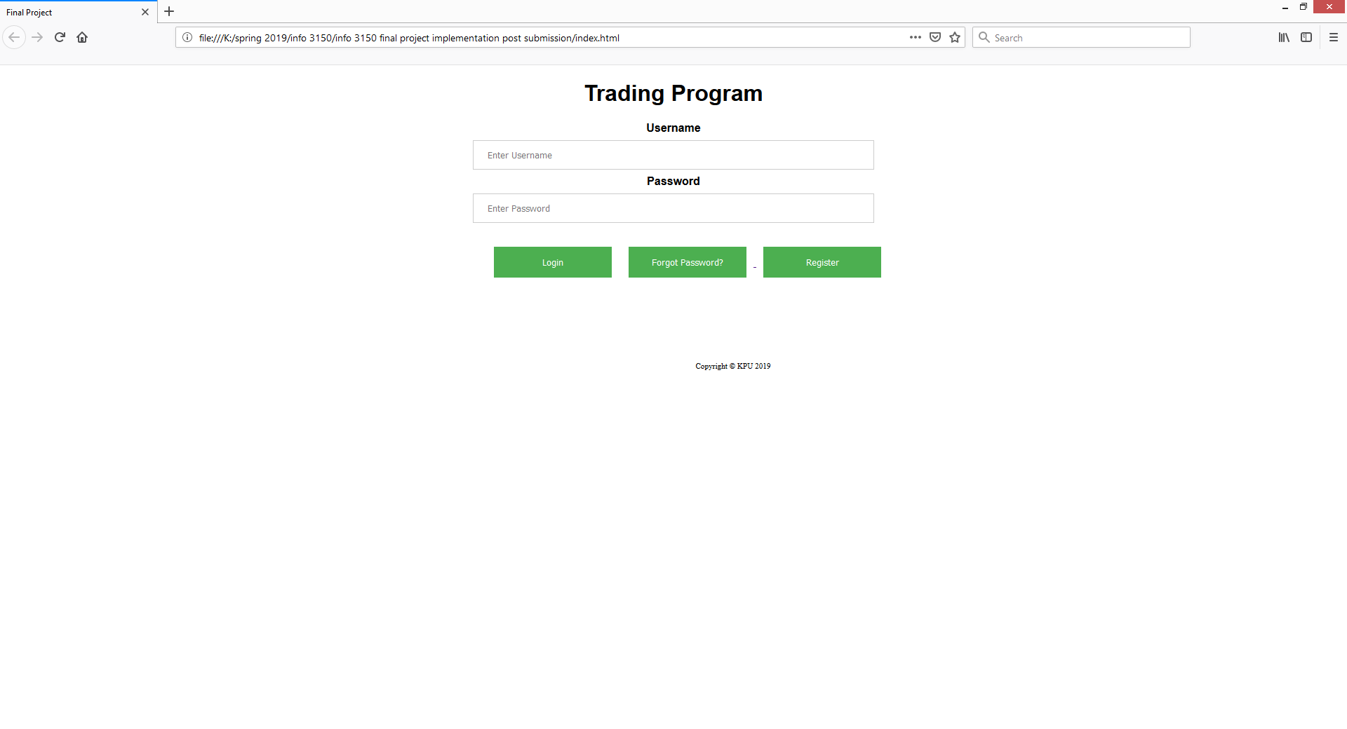
Login Page

Slide 11
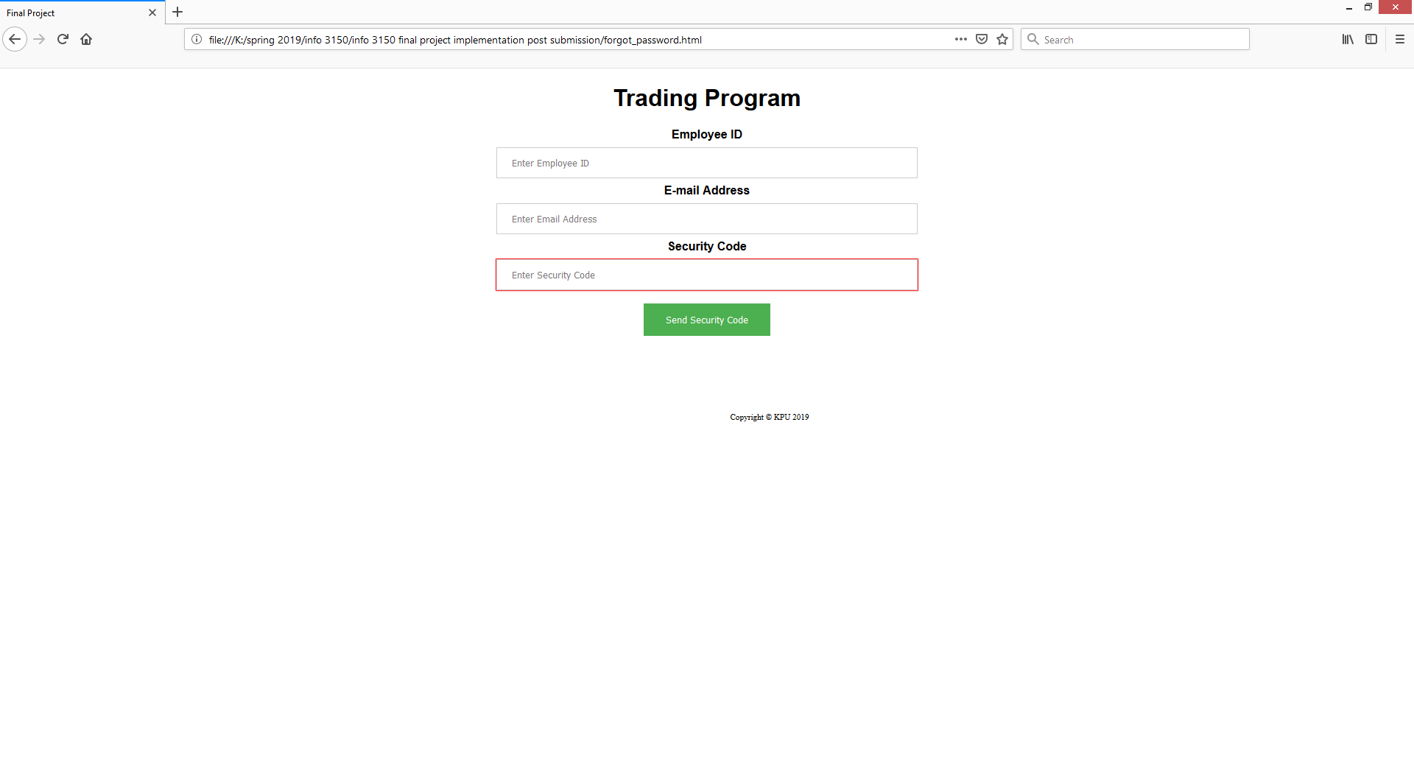
Forgot Password

Slide 12
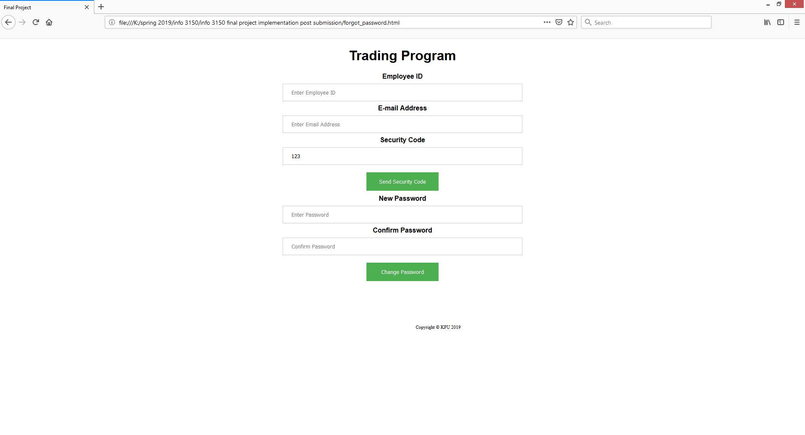
Forgot Password Cont.

Slide 13
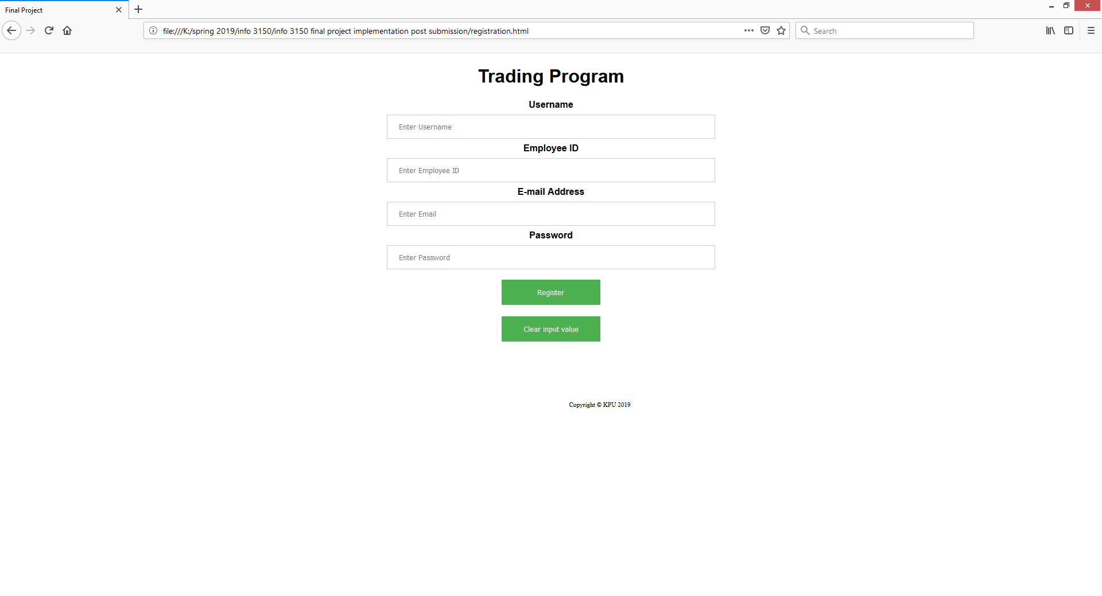
Registration

Slide 14
Registration Cont.

Slide 15
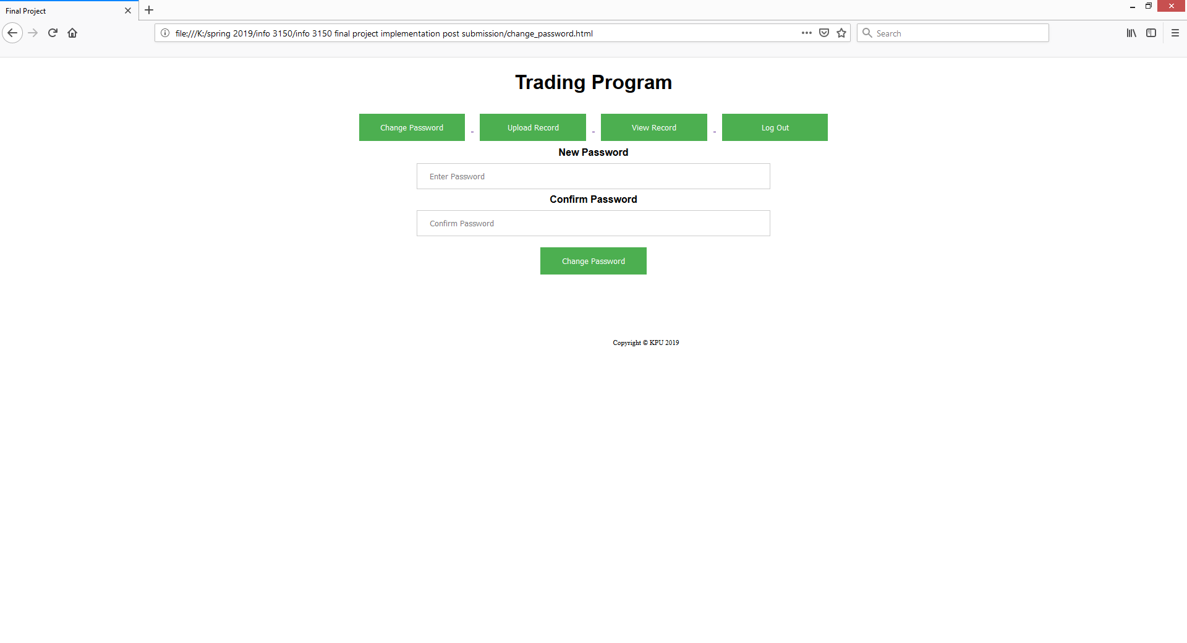
Change Password

Slide 16
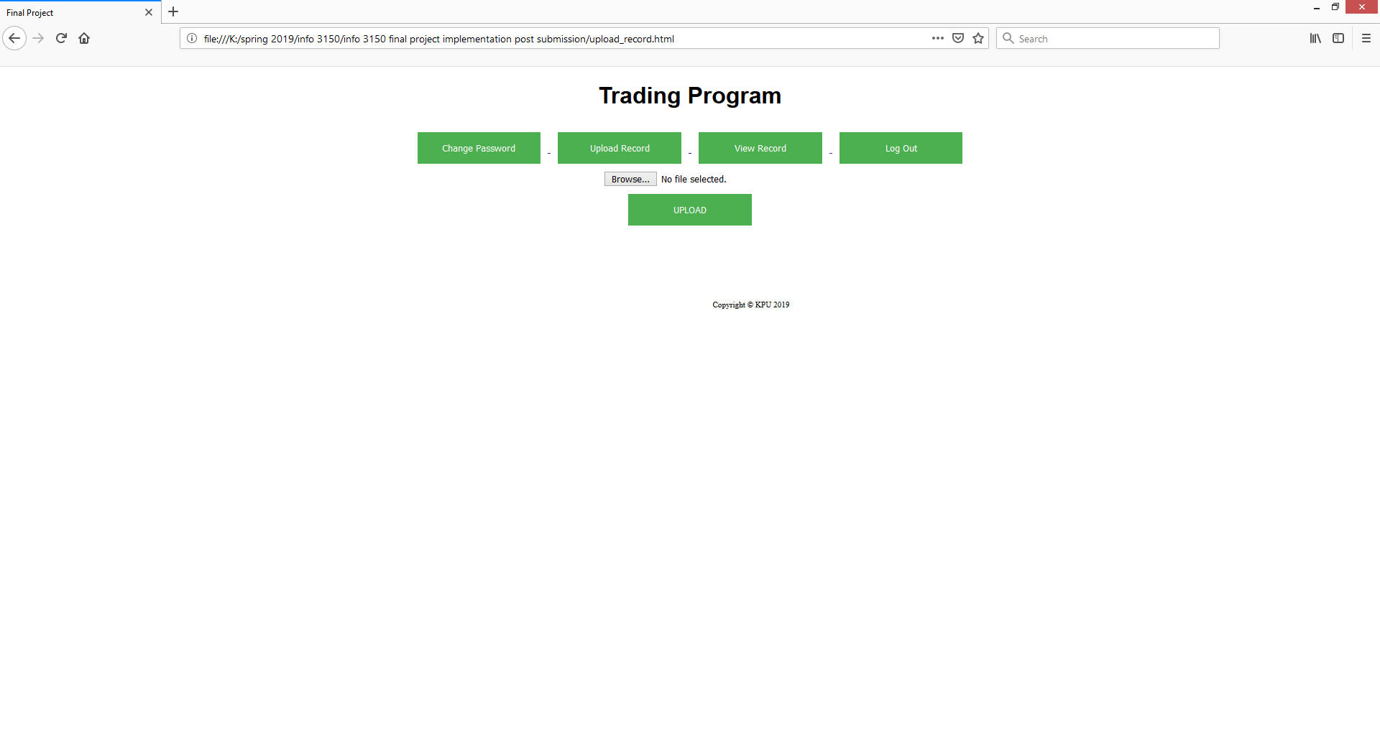
Upload Record

Slide 17
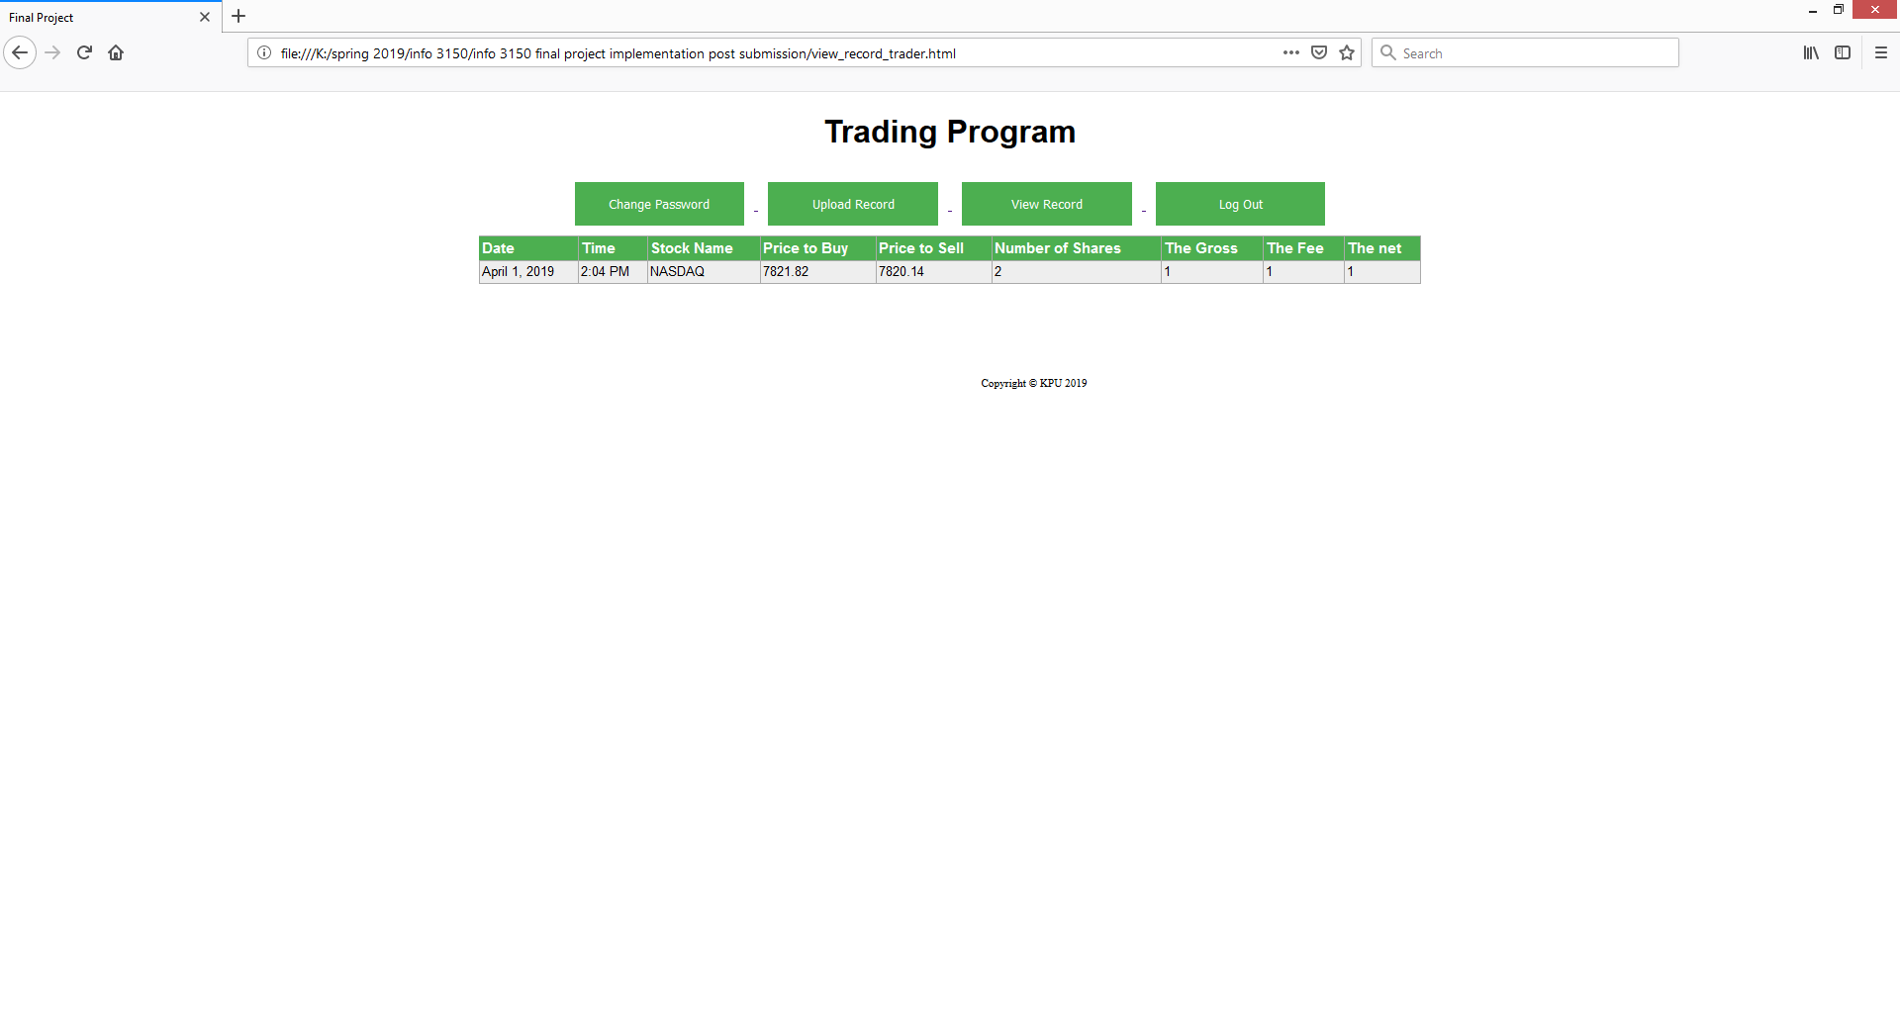
View Record

Slide 18
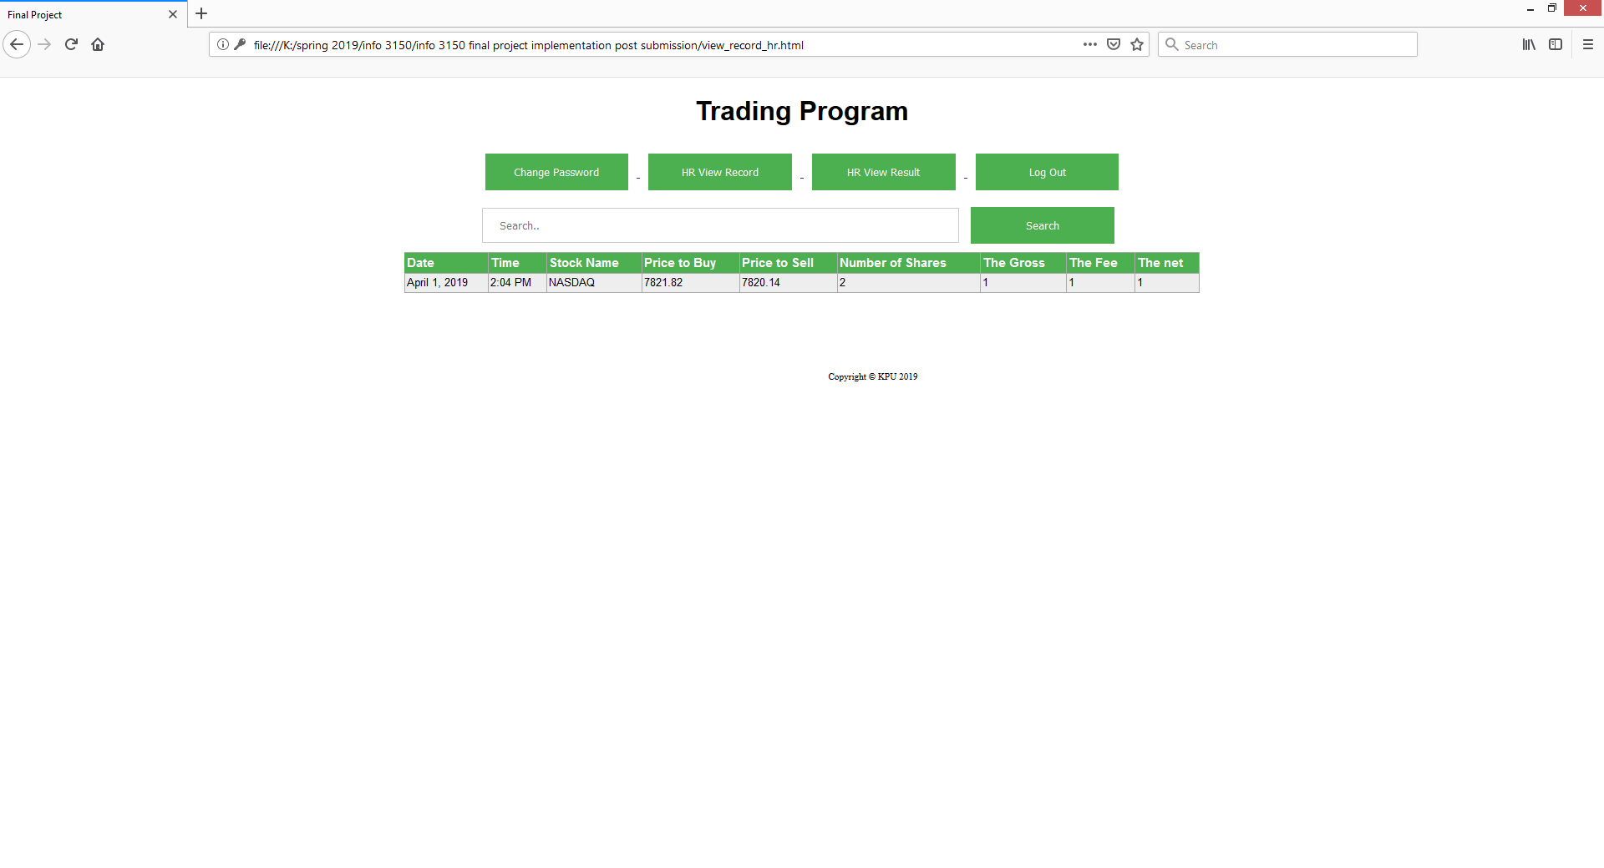
View Record HR

Slide 19
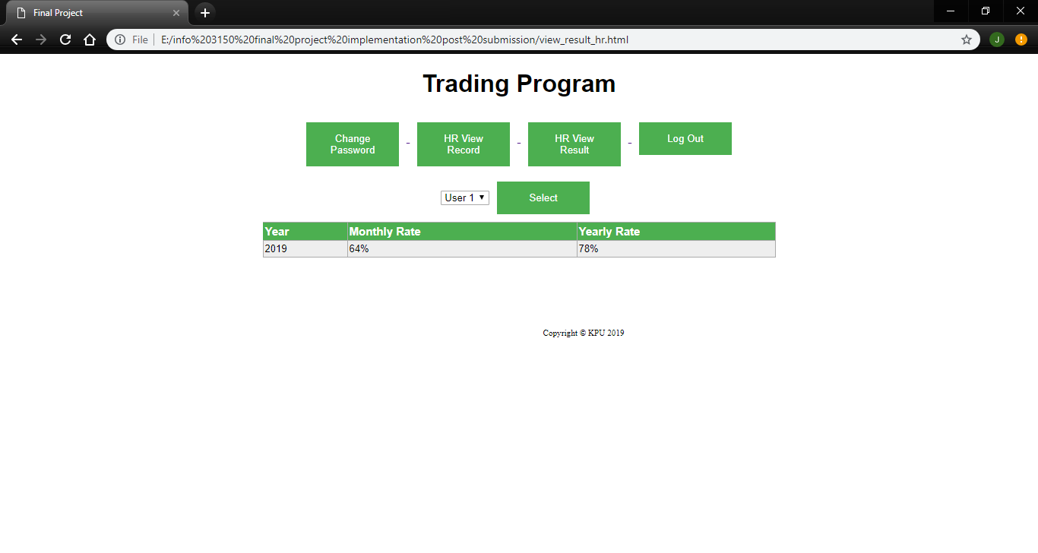
View Results HR

Slide 20
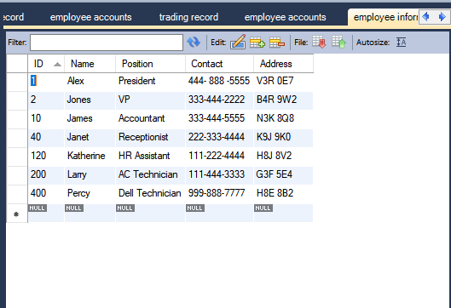
Employee Information

Slide 21
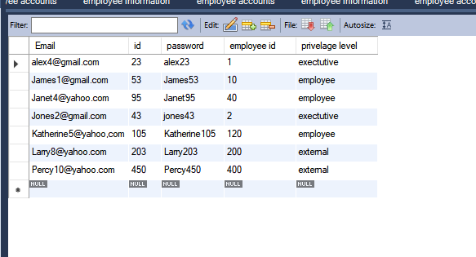
Employee Accounts

Slide 22
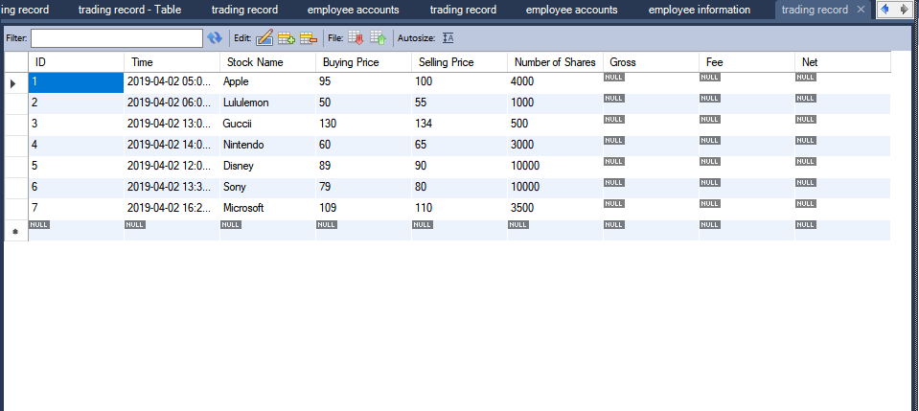
Trading Records

Slide 23
Design and Implementation Constraints
Trader employees should have their trading records generated by a third-party application
Trading records format and the importing function of this system have to be compatible, changing of records format can lead to errors
Connection to the database server has to be reliable

Slide 24
Thank you.
--Josiah Tolento，Ashish Tripathi, Mengyao Wang

