Slide 1
Info 3235 Project:
Fitness App
Raman Vandal
Enoch Chew
Josiah Tolentino

Slide 2

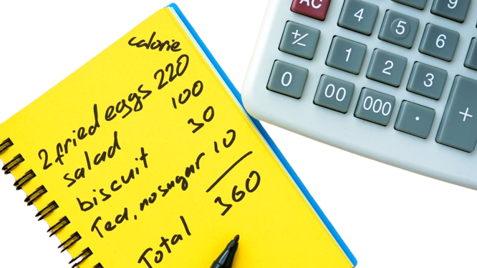
Overview: Fitness App
Users can use this app to calculate the number of calories needed to lose weight.
Users can track and store their calorie intake.
The application's UI will be console-based
Each screen will have instructions for the user, allowing them to easily navigate the app.

Slide 3
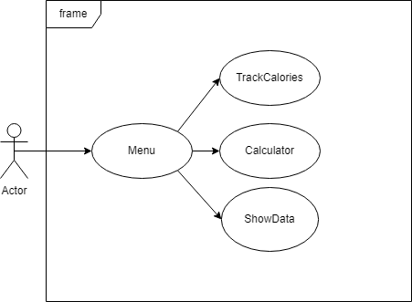
UML: Use Case Diagram

Slide 4
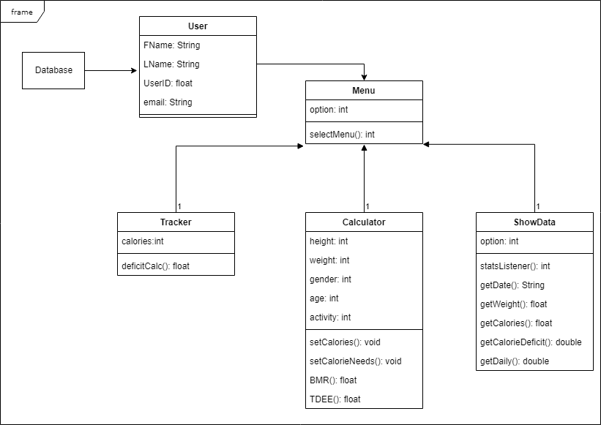
UML: Class Diagrams

Slide 5
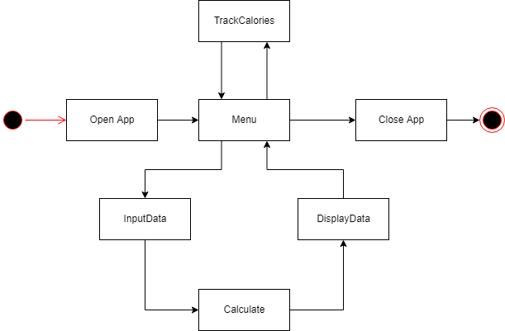
UML: State Diagram

Slide 6
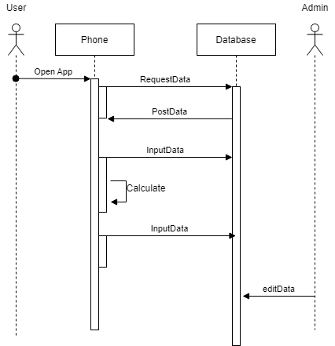
UML: Sequence Diagram

Slide 7
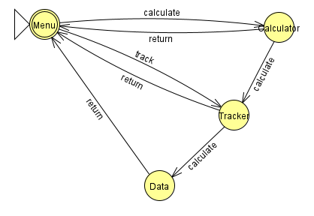
White-box Testing
Finite state machine to check transitions between the programs 4 screens
All values must be filled in so limited conditions in the program

Slide 8
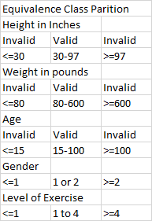
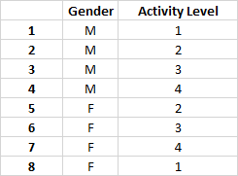
Black-box Testing
Equivalence Class Partition to ensure inputs are valid within normal human conditions
Pairwise Test that covers the variable Gender and Activity Level options

Slide 9
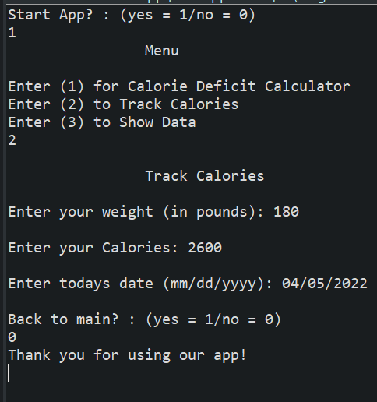
Java Prototype
Console based UI
The user is able to navigate between 4 screens
1: Menu screen
2: Calculator screen
3: Track calories screen
4: Show data screen
The users can:
Use the calorie deficit calculator
Track calories
View the entered Data

Slide 10
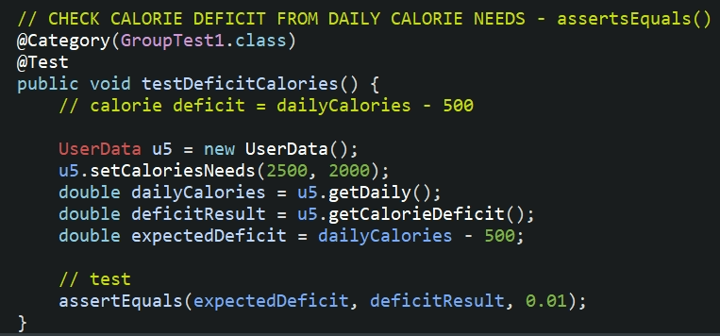
JUnit Testing
Example of assertEquals() method:
Test the calorie deficit calculation
Calorie deficit = Daily calorie needs - 500;

Slide 11
Thank You

