Slide 1

Introspecter
A game by FLASCware
Judy, Jenny, Noah, Daren

Slide 2


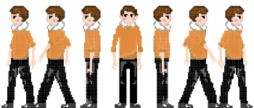
The Characters

Slide 3





Characters (cont.)

Slide 4

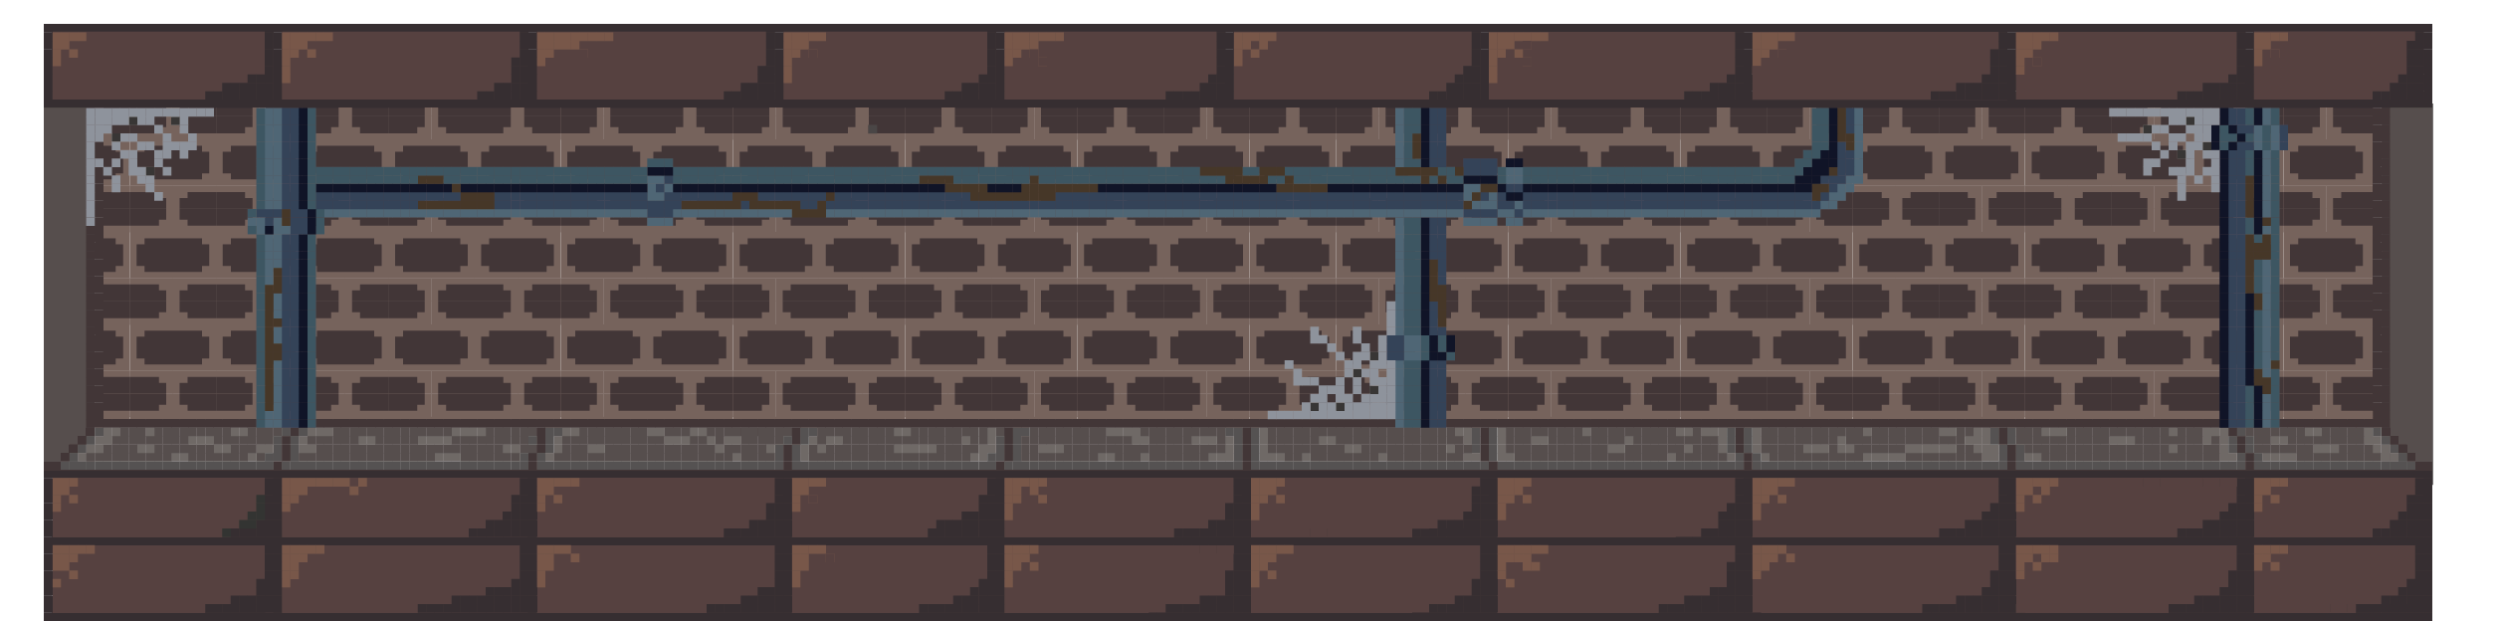
Backgrounds

Slide 5

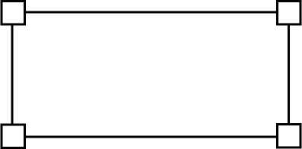


General User Interface

