Slide 1

SNAKE
ARCADE
Press
To start

Slide 2
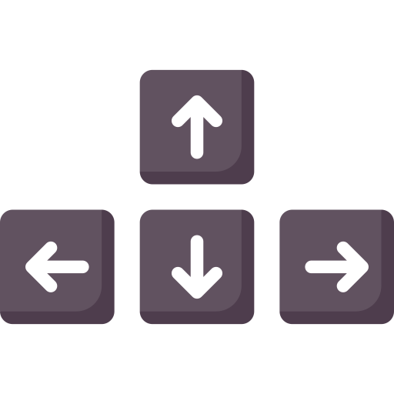
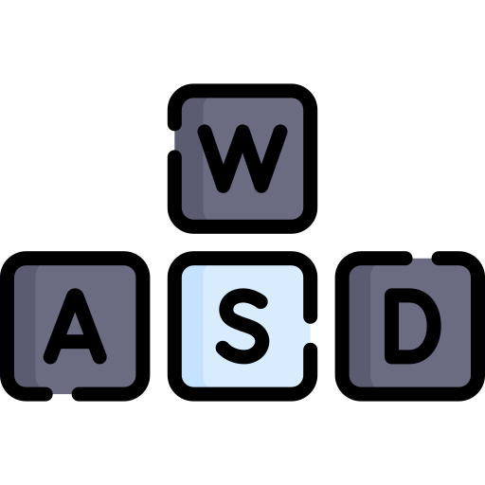
SNAKE
ARCADE
Select difficulty:
Normal
Medium
Hard
Press
To start

