Slide 1
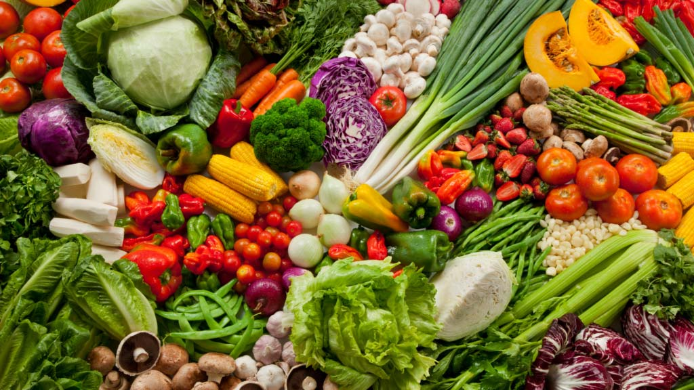
FreshChoice
Developers: Giovanni, Luuk, Sasha, Romy, Abdoelkadhir

Slide 2
Ons idee
Bestelsysteem
Allergien aangeven
Barcode bestelling
Barcode scannen
Pad genereren

Slide 3
Flowchart

Slide 4
Flowchart

