Slide 1



Slide 2


  Risico analyse
  Flowchart geupdate
  Analyse & Advice [Feedback]
Software

Slide 3
  Implimentatie pathfinder algorithme
  Visualiseren
Technology

Slide 4
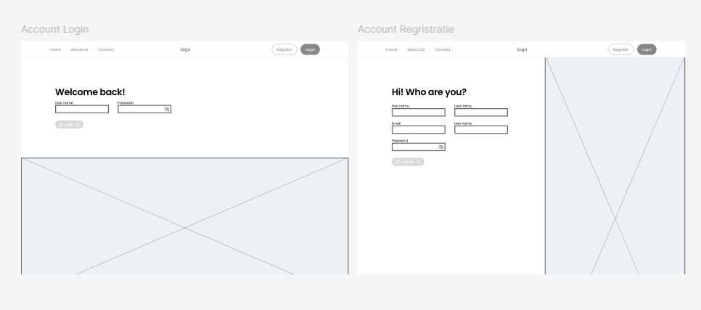
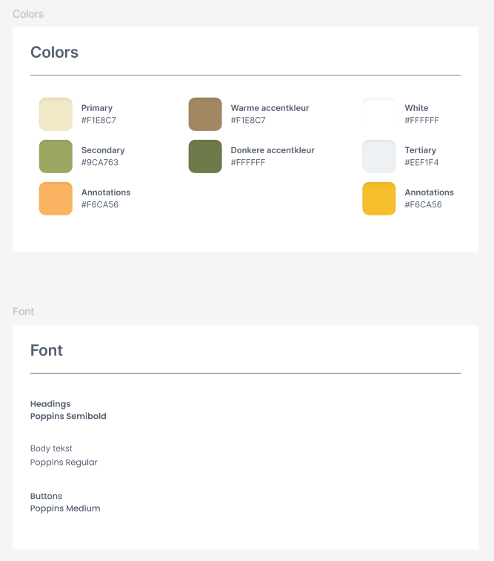
  Wireframe
  Media analyse
  Huisstijl
Media

Slide 5
  Data base sheme
Business

Slide 6
  Moscow & planning
  Realisatie

Slide 7



