Slide 1
CMDS + RWR + Landing Gear

Slide 2
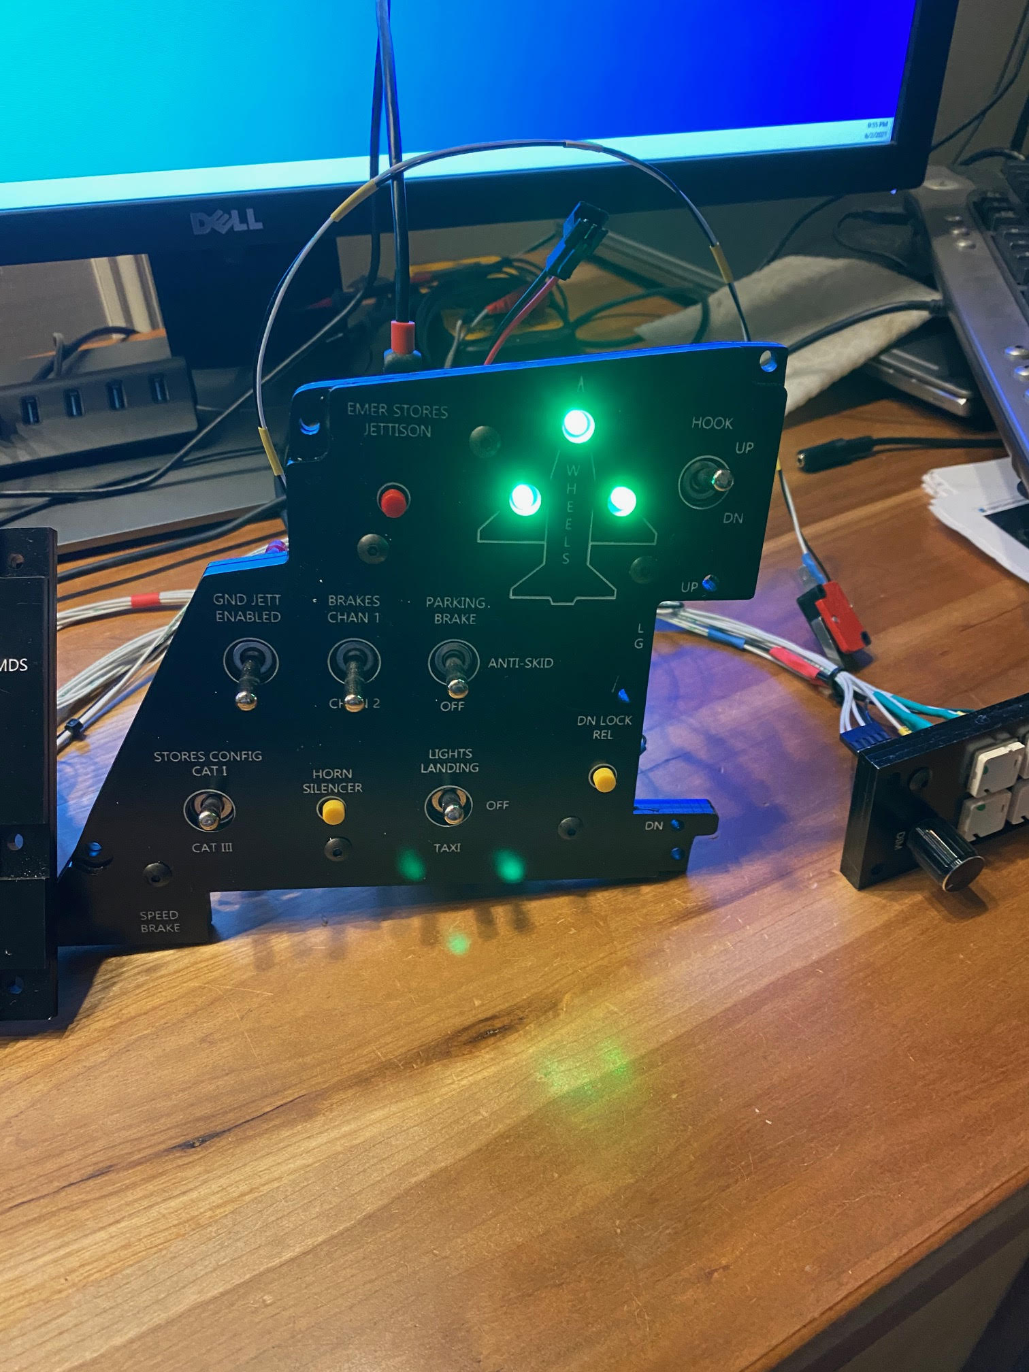
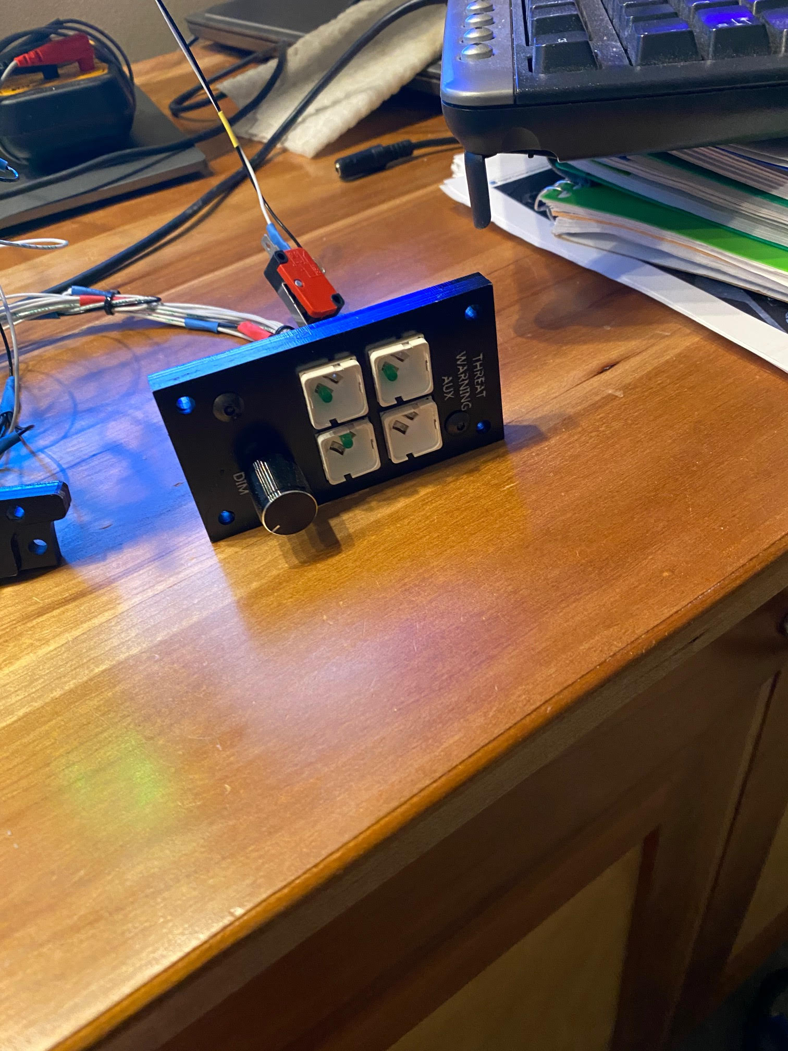
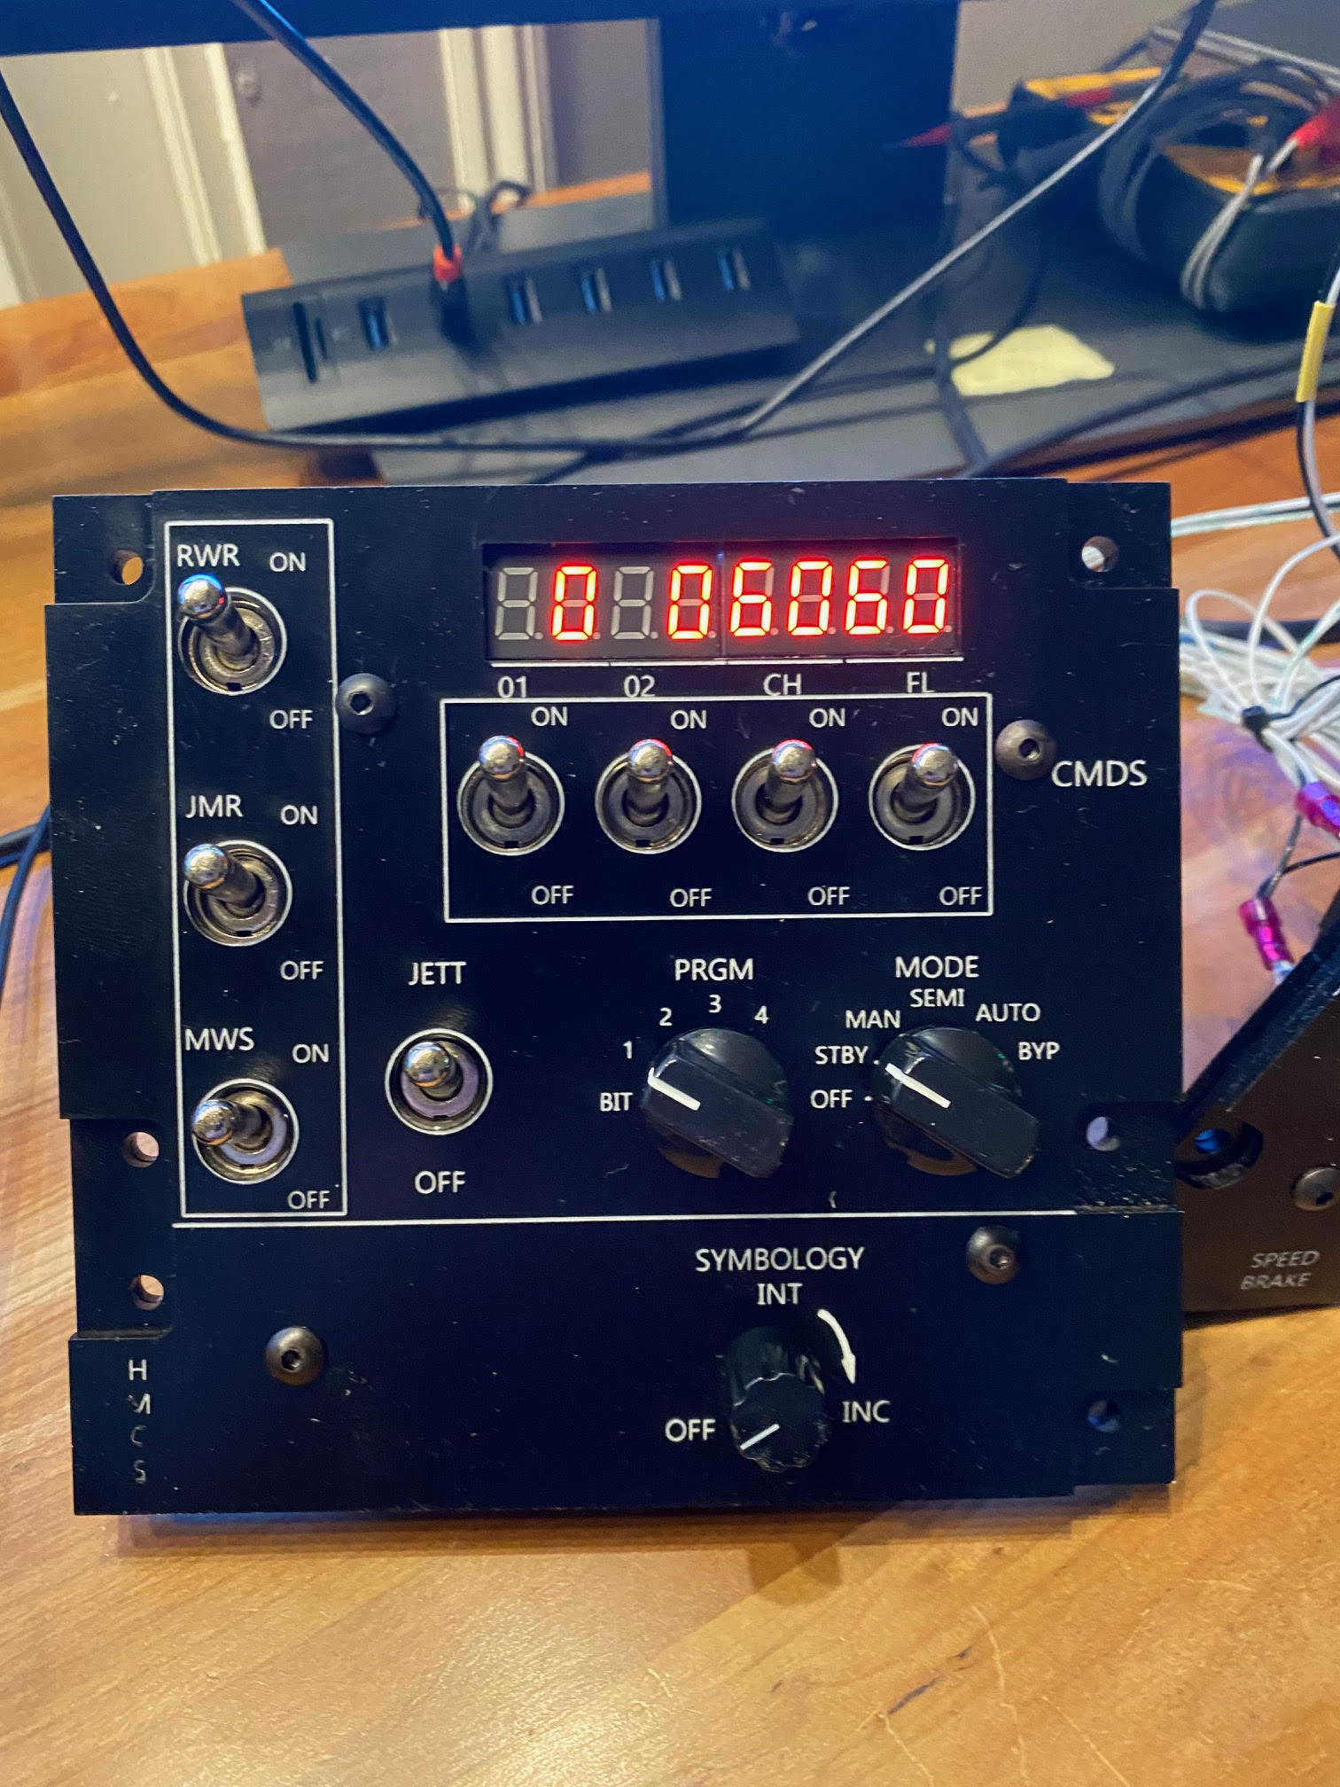

Slide 3
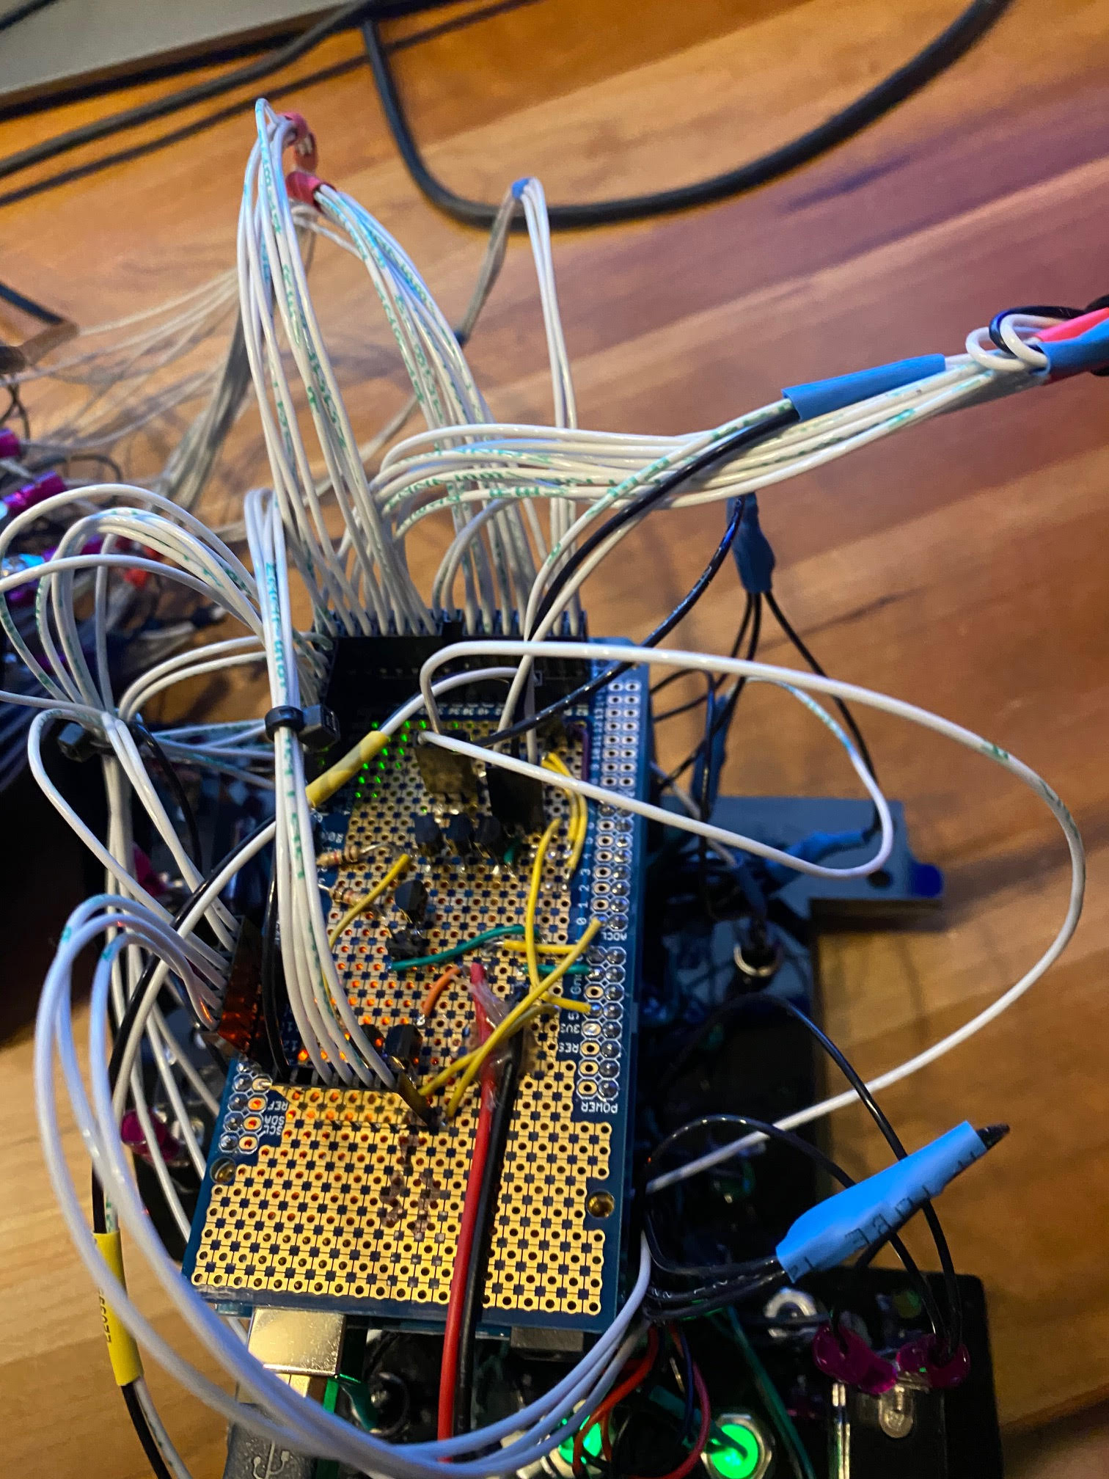
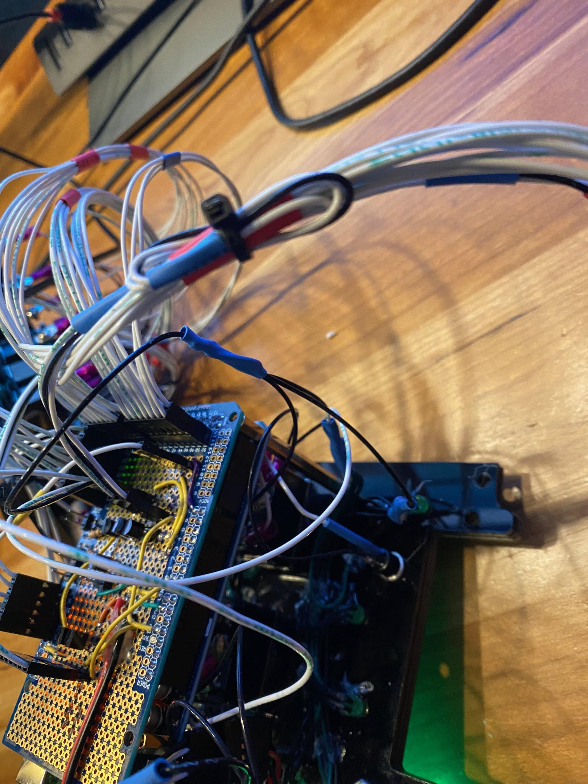

Slide 4
/* EnginePanels */ #define DCSBIOS_IRQ_SERIAL #include <Servo.h> #include "LedControl.h" #include "DcsBios.h" // PUT commands from library //file:///C:/Users/chris/Saved%20Games/DCS/Scripts/DCS-BIOS/doc/control-reference.html // unsigned long previousMillis_ = 0; // will store last time LED was updated unsigned int lastUpdateCounter_ = 0; unsigned int priorUpdateCounter_ = 0; int wentLightsOut_ = 1; char lastcmds_[7]; bool lastWheelLight0_; bool lastWheelLight1_; bool lastWheelLight2_; DcsBios::Switch2Pos emergStroreJett("EMERG_STRORE_JETT", 8); DcsBios::Switch3Pos antiSkidSw("ANTI_SKID_SW", 9, 10); DcsBios::Switch2Pos hookSw("HOOK_SW", 14); DcsBios::Switch2Pos gndJettEnableSw("GND_JETT_ENABLE_SW", 15); DcsBios::Switch2Pos brakeChanSw("BRAKE_CHAN_SW", 16); DcsBios::Switch2Pos storesConfigSw("STORES_CONFIG_SW", 17); DcsBios::Switch2Pos hornSilenceBtn("HORN_SILENCE_BTN", 18); DcsBios::Switch3Pos landTaxiLightSw("LAND_TAXI_LIGHT_SW", 20, 19); DcsBios::Switch2Pos dnLockBtn("DN_LOCK_BTN", 21); DcsBios::Switch2Pos gearHandle("GEAR_HANDLE", A7); DcsBios::LED lightGearN(0x4474, 0x0200, 13); DcsBios::LED lightGearL(0x4474, 0x0400, 12); //if we tied each leg DcsBios::LED lightGearR(0x4474, 0x0800, 11); //if we tied each leg //RWR DcsBios::Switch2Pos rwrActPwrBtn("RWR_ACT_PWR_BTN", 23); DcsBios::Switch2Pos rwrSearchBtn("RWR_SEARCH_BTN", 25); DcsBios::LED lightRwrSearch(0x4478, 0x0020, 27); DcsBios::Switch2Pos rwrAltBtn("RWR_ALT_BTN", 29); DcsBios::LED lightRwrAltLow(0x4478, 0x0100, 31); DcsBios::ToggleButton rwrPwrBtnToggle("RWR_PWR_BTN", "0","1", 33); //DcsBios::Switch2Pos rwrPwrBtn("RWR_PWR_BTN", 33); DcsBios::LED lightRwrPower(0x4478, 0x0400, 35); DcsBios::RotaryEncoder rwrIndDimKnb("RWR_IND_DIM_KNB", "-1024", "+1024", 39, 37); //Need to save light state void onLightGearNChange(unsigned int newValue) { if (newValue == 0) { lastWheelLight2_ = false; } else { lastWheelLight2_ = true; } } DcsBios::IntegerBuffer lightGearNBuffer(0x4474, 0x0200, 9, onLightGearNChange); void onLightGearRChange(unsigned int newValue) { if (newValue == 0) { lastWheelLight0_ = false; } else { lastWheelLight0_ = true; } } DcsBios::IntegerBuffer lightGearRBuffer(0x4474, 0x0800, 11, onLightGearRChange); void onLightGearLChange(unsigned int newValue) { if (newValue == 0) { lastWheelLight1_ = false; } else { lastWheelLight1_ = true; } } DcsBios::IntegerBuffer lightGearLBuffer(0x4474, 0x0400, 10, onLightGearLChange); //CMDS const byte cmdsModeKnbPins[6] = {41, 43, 45, 47, 49, 51}; DcsBios::SwitchMultiPos cmdsModeKnb("CMDS_MODE_KNB", cmdsModeKnbPins, 6); const byte cmdsProgKnbPins[5] = {40, 42, 44, 46, 48}; DcsBios::SwitchMultiPos cmdsProgKnb("CMDS_PROG_KNB", cmdsProgKnbPins, 5); DcsBios::Switch2Pos cmdsPwrSourcheSw("CMDS_PWR_SOURCHE_SW", 28); DcsBios::Switch2Pos cmdsJmrSourcheSw("CMDS_JMR_SOURCHE_SW", 26); DcsBios::Switch2Pos cmdsMwsSourcheSw("CMDS_MWS_SOURCHE_SW", 24); DcsBios::Switch2Pos cmdsJettSw("CMDS_JETT_SW", 22); DcsBios::Switch2Pos cmds01ExpCatSw("CMDS_01_EXP_CAT_SW", 30); DcsBios::Switch2Pos cmds02ExpCatSw("CMDS_02_EXP_CAT_SW", 32); DcsBios::Switch2Pos cmdsChExpCatSw("CMDS_CH_EXP_CAT_SW", 34); DcsBios::Switch2Pos cmdsFlExpCatSw("CMDS_FL_EXP_CAT_SW", 36); DcsBios::Potentiometer hmcsIntKnb("HMCS_INT_KNB", A0); //Stuff to drive the LED! int intensVal = 1; LedControl lc=LedControl(52,53,50,1);//DIN,clk,cs void onCmdsO1AmountChange(char* newValue) { lastcmds_[7] = newValue[2]; lastcmds_[6] = newValue[3]; lc.setChar(0,7,newValue[2],false); lc.setChar(0,6,newValue[3],false); } DcsBios::StringBuffer<4> cmdsO1AmountBuffer(0x457e, onCmdsO1AmountChange); void onCmdsO2AmountChange(char* newValue) { lastcmds_[5] = newValue[2]; lastcmds_[4] = newValue[3]; lc.setChar(0,5,newValue[2],false); lc.setChar(0,4,newValue[3],false); } DcsBios::StringBuffer<4> cmdsO2AmountBuffer(0x4582, onCmdsO2AmountChange); void onCmdsChAmountChange(char* newValue) { lastcmds_[3] = newValue[2]; lastcmds_[2] = newValue[3]; lc.setChar(0,3,newValue[2],false); lc.setChar(0,2,newValue[3],false); } DcsBios::StringBuffer<4> cmdsChAmountBuffer(0x4586, onCmdsChAmountChange); void onCmdsFlAmountChange(char* newValue) { lastcmds_[1] = newValue[2]; lastcmds_[0] = newValue[3]; lc.setChar(0,1,newValue[2],false); lc.setChar(0,0,newValue[3],false); } DcsBios::StringBuffer<4> cmdsFlAmountBuffer(0x458a, onCmdsFlAmountChange); //Restore the led after a power off void resetCMDSLED(char* newValue) { lc.setChar(0,7,newValue[7],false); lc.setChar(0,6,newValue[6],false); lc.setChar(0,5,newValue[5],false); lc.setChar(0,4,newValue[4],false); lc.setChar(0,3,newValue[3],false); lc.setChar(0,2,newValue[2],false); lc.setChar(0,1,newValue[1],false); lc.setChar(0,0,newValue[0],false); } // //Read back the brightness for the LEDS // int consolePwmPout_ = 2; byte consoleOutLevel_ = 0; void onPriConsolesBrtKnbChange(unsigned int newValue) // { consoleOutLevel_ = map(newValue, 0, 65535, 0, 100); analogWrite( consolePwmPout_, consoleOutLevel_); //pwm to drive the lights } DcsBios::IntegerBuffer priConsolesBrtKnbBuffer(0x440e, 0xffff, 0, onPriConsolesBrtKnbChange); // //Sync the game with the buttons // void PollAllControls() { emergStroreJett.pollInputCurrent(); //antiSkidSw.pollInputCurrent(); hookSw.pollInputCurrent(); gndJettEnableSw.pollInputCurrent(); brakeChanSw.pollInputCurrent(); storesConfigSw.pollInputCurrent(); landTaxiLightSw.pollInputCurrent(); gearHandle.pollInputCurrent(); hmcsIntKnb.pollInputCurrent(); //cmds cmdsPwrSourcheSw.pollInputCurrent(); cmdsJmrSourcheSw.pollInputCurrent(); cmdsMwsSourcheSw.pollInputCurrent(); cmdsJettSw.pollInputCurrent(); cmds01ExpCatSw.pollInputCurrent(); cmds02ExpCatSw.pollInputCurrent(); cmdsChExpCatSw.pollInputCurrent(); cmdsFlExpCatSw.pollInputCurrent(); } // //This is the update counter, we can use this to force a sync between buttons and game // void onUpdateCounterChange(unsigned int newValue) { if (newValue%25 == 0) { PollAllControls(); } lastUpdateCounter_ = newValue; } DcsBios::IntegerBuffer UpdateCounterBuffer(0xfffe, 0x00ff, 0, onUpdateCounterChange); void timeoutlightsOut( ) { consoleOutLevel_ = 0; wentLightsOut_ = 1; //so we dont keep calling this lc.clearDisplay(0); digitalWrite(11, LOW); //landing gear light digitalWrite(12, LOW); //landing gear light digitalWrite(13, LOW); //landing gear light analogWrite( consolePwmPout_, consoleOutLevel_); //pwm to drive the lights //Turn off all the leds //digitalWrite(3, LOW); //lightFlcsRly } //LCD functions void initLCD() { lc.shutdown(0,false); lc.setIntensity(0,intensVal); lc.clearDisplay(0); delay(200); lc.setChar(0,7,'1',false); lc.setChar(0,6,'2',false); lc.setChar(0,5,'3',false); lc.setChar(0,4,'4',false); lc.setChar(0,3,'5',false); lc.setChar(0,2,'6',false); lc.setChar(0,1,'7',false); lc.setChar(0,0,'8',false); delay(200); lastcmds_[7] = '1'; lastcmds_[6] = '2'; lastcmds_[5] = '3'; lastcmds_[4] = '4'; lastcmds_[3] = '5'; lastcmds_[2] = '6'; lastcmds_[1] = '7'; lastcmds_[0] = '8'; } /* * * MAIN FUNCTIONS * * */ // // Main Functions // void setup() { //Setup LCD initLCD(); pinMode(consolePwmPout_, OUTPUT); //for the backlight analogWrite( consolePwmPout_, consoleOutLevel_); //pwm to drive the lights DcsBios::setup(); PollAllControls(); //sync the buttons at start } void loop() { DcsBios::loop(); //This code checks eveyr 10 seconds to see if DCS is still locked and turns off the LEDS unsigned long currentMillis = millis(); if (currentMillis - previousMillis_ >= 10e3) { // save the last time you blinked the LED previousMillis_ = currentMillis; if (lastUpdateCounter_ == priorUpdateCounter_) //We havnt gotten any new data { timeoutlightsOut(); } priorUpdateCounter_ = lastUpdateCounter_; } if (lastUpdateCounter_ != priorUpdateCounter_) //We havnt gotten any new data { if (wentLightsOut_ == 1) { wentLightsOut_ = 0; //clear lights out flag //had issue that uhv doesnt send a message unlees it changes //so after a lights out the screen stayed off //so now we push the last hting we saw resetCMDSLED(lastcmds_); if (lastWheelLight0_) { digitalWrite(11, HIGH); //landing gear light } if (lastWheelLight1_) { digitalWrite(12, HIGH); //landing gear light } if (lastWheelLight2_) { digitalWrite(13, HIGH); //landing gear light } } } }

