Slide 1
Drawings for DED and ICP

Slide 2
Laser Templates File:

Slide 3
LED Circuit
2n222 (viewed from top)
12V
LEDs are 470 Ohm
Then wired in parallel
About 10-12 max
1K
470
LED
470
470

Slide 4
Source CODE
/*
*
* VERSION 1 - MAke sure you update the LCD version num
*
*/
#define DCSBIOS_IRQ_SERIAL
#include "DcsBios.h"
#include <Keypad.h>
#include <Arduino.h>
#include <U8g2lib.h>
#ifdef U8X8_HAVE_HW_SPI
#include <SPI.h>
#endif
#ifdef U8X8_HAVE_HW_I2C
#include <Wire.h>
#endif
//Some variables
unsigned long previousMillis_ = 0; // will store last time LED was updated
unsigned int lastUpdateCounter_ = 0;
unsigned int priorUpdateCounter_ = 0;
//DCS Connections
//UFC
DcsBios::Potentiometer icpHudBrtKnb("ICP_HUD_BRT_KNB", A0, true);
DcsBios::Potentiometer icpRasterContrKnb("ICP_RASTER_CONTR_KNB", A1);
DcsBios::Potentiometer icpRasterBrtKnb("ICP_RASTER_BRT_KNB", A2, true);
DcsBios::Potentiometer icpReticleDepressKnb("ICP_RETICLE_DEPRESS_KNB", A3);
//Switches on UFC
DcsBios::Switch3Pos icpDriftSw("ICP_DRIFT_SW", 12,10);
DcsBios::Switch3Pos icpFlirGainSw("ICP_FLIR_GAIN_SW", 11, 9);
//Dobber
DcsBios::Switch3Pos icpDataUpDnSw("ICP_DATA_UP_DN_SW", 43, 41);
DcsBios::Switch3Pos icpDataRtnSeqSw("ICP_DATA_RTN_SEQ_SW", 33, 8);
//ACES-II
int ejectionPin_ = 46;
DcsBios::Switch2Pos seatEjectSafe("SEAT_EJECT_SAFE", 48);
//
//Read back the brightness for the LEDS
//
int consolePwmPout_ = 13;
byte consoleOutLevel_ = 0;
void onPriConsolesBrtKnbChange(unsigned int newValue)
//
{
consoleOutLevel_ = map(newValue, 0, 65535, 0, 255);
analogWrite( consolePwmPout_, consoleOutLevel_); //pwm to drive the lights
}
DcsBios::IntegerBuffer priConsolesBrtKnbBuffer(0x440e, 0xffff, 0, onPriConsolesBrtKnbChange);
//
//Sync the game with the buttons
//
void PollAllControls()
{
icpHudBrtKnb.pollInputCurrent();
icpRasterContrKnb.pollInputCurrent();
icpRasterBrtKnb.pollInputCurrent();
icpReticleDepressKnb.pollInputCurrent();
//icpDriftSw.pollInputCurrent();
icpFlirGainSw.pollInputCurrent();
icpDataUpDnSw.pollInputCurrent();
icpDataRtnSeqSw.pollInputCurrent();
seatEjectSafe.pollInputCurrent();
}
//
//This is the update counter, we can use this to force a sync between buttons and game
//
void onUpdateCounterChange(unsigned int newValue)
{
if (newValue%25 == 0)
{
PollAllControls();
}
lastUpdateCounter_ = newValue;
}
DcsBios::IntegerBuffer UpdateCounterBuffer(0xfffe, 0x00ff, 0, onUpdateCounterChange);
/*
*
* Main Functions
*
*/
void setup()
{
testBacklight();
initDED();
DcsBios::setup();
PollAllControls(); //sync the buttons at start
setupEject();
}
void loop() {
updateDED();
processMatrixKeys();
checkEject();
DcsBios::loop();
}
void testBacklight()
{
for (int j=0;j<3;j++)
{
for (int i=0;i<255;i+=10)
{
analogWrite( consolePwmPout_, i ); //pwm to drive the lights
delay(25);
}
for (int i=255;i>=0;i-=10)
{
analogWrite( consolePwmPout_, i ); //pwm to drive the lights
delay(25);
}
}
analogWrite( consolePwmPout_, 0 ); //pwm to drive the lights
}

Slide 5
Source CODE
/*
*
* ER-OLEDM032-1Y
* This requires a library be install in you arduino libraries folder U8G2
*
*
*/
//Create the oled and set the DC/res/cs pins
//
U8G2_SSD1322_NHD_256X64_1_4W_HW_SPI dedScreen(U8G2_R0, /* cs=*/ 7, /* dc=*/ 6, /* reset=*/ 5);
char* line1;
char* line2;
char* line3;
char* line4;
char* line5;
bool bufferChanged;
void onDedLine1Change(char* newValue) {
line1 = newValue;
bufferChanged = true;
}
DcsBios::StringBuffer<25> dedLine1Buffer(0x44fc, onDedLine1Change);
void onDedLine2Change(char* newValue) {
line2 = newValue;
bufferChanged = true;
}
DcsBios::StringBuffer<25> dedLine2Buffer(0x4516, onDedLine2Change);
void onDedLine3Change(char* newValue) {
line3 = newValue;
bufferChanged = true;
}
DcsBios::StringBuffer<25> dedLine3Buffer(0x4530, onDedLine3Change);
void onDedLine4Change(char* newValue) {
line4 = newValue;
bufferChanged = true;
}
DcsBios::StringBuffer<25> dedLine4Buffer(0x454a, onDedLine4Change);
void onDedLine5Change(char* newValue) {
line5 = (newValue);
bufferChanged = true;
}
DcsBios::StringBuffer<25> dedLine5Buffer(0x4564, onDedLine5Change);
void initDED()
{
dedScreen.begin();
dedScreen.clearBuffer();
dedScreen.setFont(DEDfont16px);
dedScreen.firstPage();
do {
dedScreen.drawStr(0, 12, "***************************");
dedScreen.drawStr(0, 25, "* DCSBOIS F16 *");
dedScreen.drawStr(0, 38, "* DED + UFC V1.0 *"); //Column,Row,text,invert
dedScreen.drawStr(0, 51, "* BUZZKILLINGTON *");
dedScreen.drawStr(0, 64, "***************************");
} while ( dedScreen.nextPage() );
dedScreen.updateDisplay();
delay(1000);
bufferChanged = false;
}
void updateDED()
{
if (bufferChanged == true)
{
bufferChanged = false;
dedScreen.firstPage();
do {
dedScreen.drawStr(30, 12, line1);
dedScreen.drawStr(30, 25, line2);
dedScreen.drawStr(30, 38, line3);
dedScreen.drawStr(30, 51, line4);
dedScreen.drawStr(30, 64, line5);
} while ( dedScreen.nextPage() );
dedScreen.updateDisplay();
}
}

Slide 6
Source CODE
/*
*
* Code for ejection handle
*
*/
int currButState_ = 0;
int lastButState_ = 0;
void setupEject()
{
pinMode(ejectionPin_, INPUT_PULLUP);
currButState_ = digitalRead(ejectionPin_);
lastButState_ = currButState_;
}
//Function to call and check if the handle is pulled
void checkEject()
{
currButState_ = digitalRead(ejectionPin_);
if (currButState_ == lastButState_)
{
return; //Do nothing
}
if (currButState_ == HIGH) //debounce?
{
sendDcsBiosMessage("SEAT_EJECT_THANDLE", "1");
delay(10);
sendDcsBiosMessage("SEAT_EJECT_THANDLE", "1");
delay(10);
sendDcsBiosMessage("SEAT_EJECT_THANDLE", "1");
}
lastButState_ = currButState_;
}

Slide 7
Source CODE
/*
*
* Keyboard stuff
*
*/
bool keyPressedLast_ = false;
char lastKey_ = 0x00;
const byte ROWS = 5; //five rows
const byte COLS = 5; //five columns
char keys[ROWS][COLS] =
{
{11,12,13,14,15},
{21,22,23,24,25},
{31,32,33,34,35},
{41,42,43,44,45},
{51,52,53,54,55}
};
//byte rowPins[ROWS] = {53, 23,51,25,49}; //connect to the row pinouts of the keypad
byte rowPins[ROWS] = {37, 23,39,25,49}; //connect to the row pinouts of the keypad 39was 51
byte colPins[COLS] = {27,47,29,45,31}; //connect to the column pinouts of the keypad
Keypad keypad = Keypad( makeKeymap(keys), rowPins, colPins, ROWS, COLS );
void processMatrixKeys()
{
char key = keypad.getKey();
if (key != NO_KEY)
{
keyPressedLast_ = true;
processButton(key, 11, "ICP_COM1_BTN", "1");
processButton(key, 12, "ICP_COM2_BTN", "1");
processButton(key, 13, "ICP_IFF_BTN", "1");
processButton(key, 14, "ICP_LIST_BTN", "1");
processButton(key, 15, "ICP_AA_MODE_BTN", "1");
processButton(key, 21, "ICP_BTN_1", "1");
processButton(key, 22, "ICP_BTN_2", "1");
processButton(key, 23, "ICP_BTN_3", "1");
processButton(key, 24, "ICP_RCL_BTN", "1");
processButton(key, 25, "ICP_AG_MODE_BTN", "1");
processButton(key, 31, "ICP_BTN_4", "1");
processButton(key, 32, "ICP_BTN_5", "1");
processButton(key, 33, "ICP_BTN_6", "1");
processButton(key, 34, "ICP_ENTR_BTN", "1");
processButton(key, 35, "ICP_WX_BTN", "1");
processButton(key, 41, "ICP_BTN_7", "1");
processButton(key, 42, "ICP_BTN_8", "1");
processButton(key, 43, "ICP_BTN_9", "1");
processButton(key, 44, "ICP_BTN_0", "1");
processButton(key, 45, "ICP_FLIR_SW", "2");
processButton(key, 51, "ICP_DED_SW", "2");
processButton(key, 52, "ICP_DED_SW", "0");
processButton(key, 53, "ICP_BTN_9", "1");
processButton(key, 54, "ICP_BTN_0", "1");
processButton(key, 55, "ICP_FLIR_SW", "0");
} else {
if (keyPressedLast_ == true)
{
if (keypad.isPressed(lastKey_) || keypad.isHeld(lastKey_) )
{
//do something
} else {
clearButtons();
keyPressedLast_ = false;
}
}
}
}
//This function checks if the button is pressed and send bios the comand
void processButton(char keySeen, char check, const char* biosSignal, const char* biosCmd)
{
if (keySeen == check)
{
sendDcsBiosMessage(biosSignal, biosCmd);
lastKey_ = check;
}
}
void clearButtons()
{
sendDcsBiosMessage("ICP_COM1_BTN", "0");
sendDcsBiosMessage("ICP_COM2_BTN", "0");
sendDcsBiosMessage("ICP_IFF_BTN", "0");
sendDcsBiosMessage("ICP_LIST_BTN", "0");
sendDcsBiosMessage("ICP_AA_MODE_BTN", "0");
sendDcsBiosMessage("ICP_AG_MODE_BTN","0");
sendDcsBiosMessage("ICP_ENTR_BTN","0");
sendDcsBiosMessage("ICP_RCL_BTN","0");
sendDcsBiosMessage("ICP_WX_BTN","0");
sendDcsBiosMessage("ICP_BTN_1","0");
sendDcsBiosMessage("ICP_BTN_2","0");
sendDcsBiosMessage("ICP_BTN_3","0");
sendDcsBiosMessage("ICP_BTN_4","0");
sendDcsBiosMessage("ICP_BTN_5","0");
sendDcsBiosMessage("ICP_BTN_6","0");
sendDcsBiosMessage("ICP_BTN_7","0");
sendDcsBiosMessage("ICP_BTN_8","0");
sendDcsBiosMessage("ICP_BTN_9","0");
sendDcsBiosMessage("ICP_BTN_0","0");
sendDcsBiosMessage("ICP_FLIR_SW","1");
sendDcsBiosMessage("ICP_DED_SW","1");
}

Slide 8
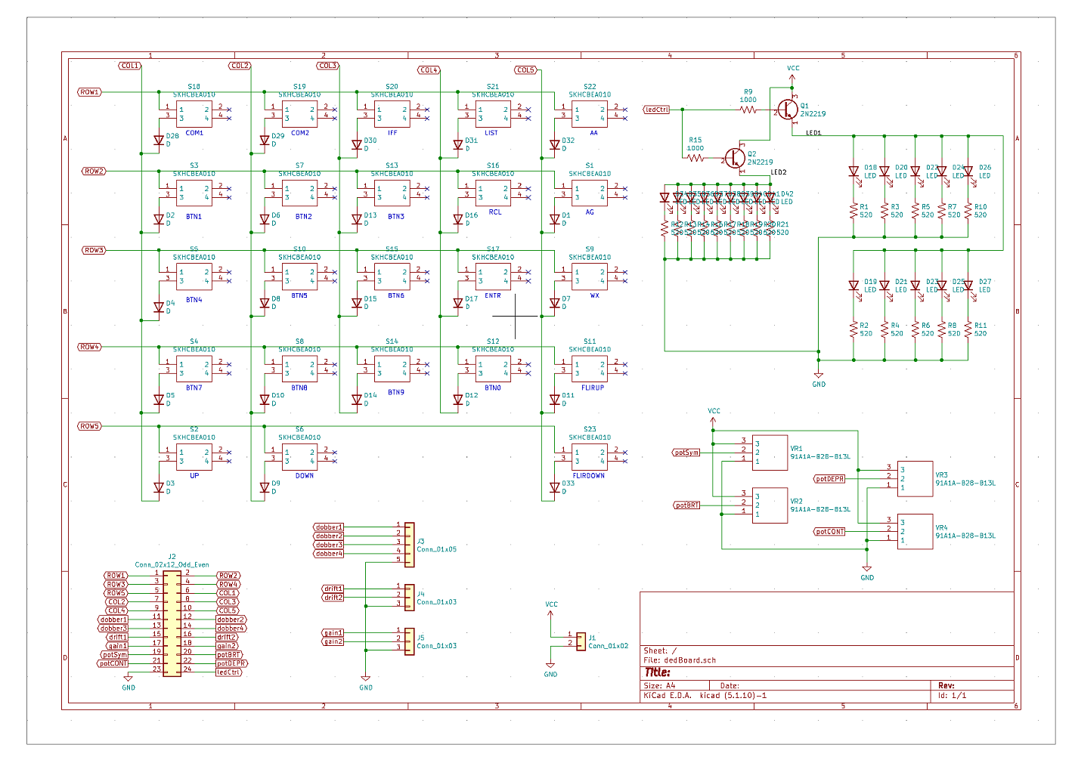
Schematic

Slide 9
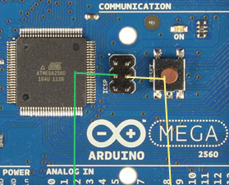
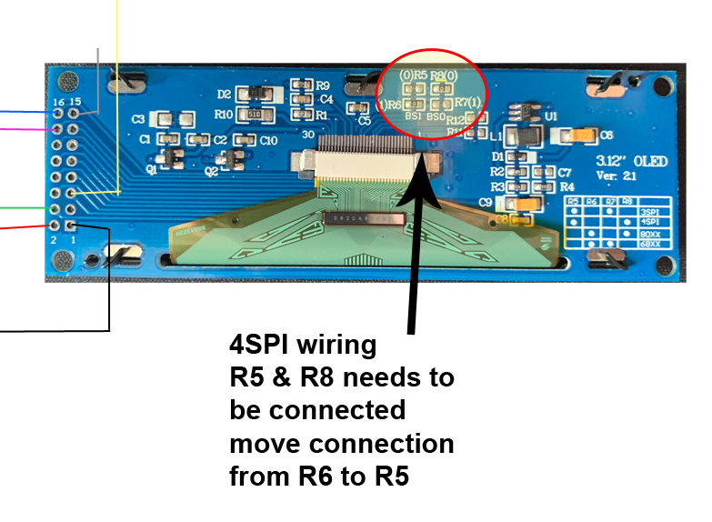
OLED Wiring
LCD | Arduino | Name
1 | Gnd | Gnd
2 | 3.vV | VCC
3 | N/C
4 | ISP3 | SCK
5 | ISP4 | SDI (MOSI)
6 | n/c
7-13 | GND
14 | 6 | Data/Instruction
15 | 5 | Reset
16 | 7 | Chip Select
ICP Pin out
1 | 2
3 | 4
5 | 6

Slide 10
Button PCB Wiring
PCB | Arduino | Name
1 | 37 | ROW1
2 | 23 | ROW2
3 | 39 | ROW3
4 | 25 | ROW4
5 | 49 | ROW5
6 | 27 | COL1
7 | 47 | COL2
8 | 29 | COL3
9 | 45 | COL4
10 | 31 | COL5
11 | 43 | Dobb1
12 | 33 | Dobb2
PCB | Arduino | Name
13 | 41 | Dobb3
14 | 8 | Dobb4
15 | 9 | Drift1
16 | 11 | Drift2
17 | 10 | Gain1
18 | 12 | Gain2
19 | A0 | Sym Pot
20 | A2 | Brt Pot
21 | A1 | Cont Pot
22 | A3 | Dep Pot
23 | GND | Gnd
24 | 13 | Backlight
Note you cant use 50-53 due to SPI LCD

Slide 11
Sw | Arduino | Name
 | 48 | Seat safe
 | 46 | eject
Note you cant use 50-53 due to SPI LCD

