Slide 1
Drawings Flight Control Test panel

Slide 3
LED Circuit
2n222 (viewed from top)
12V
LEDs are 470 Ohm
Then wired in parallel
About 10-12 max
1K
470
LED
470
470

Slide 4
OXYGEN
 | Signal | Arduino pin
 | Signal | Arduino pin
 | Signal | Arduino pin

Slide 5
Source CODE
/*
EnginePanels
*/
#define DCSBIOS_IRQ_SERIAL
#include <Servo.h>
#include "DcsBios.h"
// PUT commands from library
//file:///C:/Users/chris/Saved%20Games/DCS/Scripts/DCS-BIOS/doc/control-reference.html
//
unsigned long previousMillis_ = 0; // will store last time LED was updated
unsigned int lastUpdateCounter_ = 0;
unsigned int priorUpdateCounter_ = 0;
DcsBios::Switch2Pos altFlapsSw("ALT_FLAPS_SW", 38);
DcsBios::Switch2Pos digiBakSw("DIGI_BAK_SW", 40);
DcsBios::Switch2Pos manTfFlyupSw("MAN_TF_FLYUP_SW", 42,true);
DcsBios::Switch2Pos bitSw("BIT_SW", 44); //MagHeld!
DcsBios::Switch2Pos flcsResetSw("FLCS_RESET_SW", 46);
DcsBios::Switch2Pos leFlapsSw("LE_FLAPS_SW", 48);
DcsBios::Switch2Pos trimApDiscSw("TRIM_AP_DISC_SW", 41);
DcsBios::LED lightFlFail(0x4478, 0x0001, 50);
DcsBios::LED lightFlRun(0x4476, 0x8000, 52);
DcsBios::RotaryEncoder rollTrim("ROLL_TRIM", "-3200", "+3200", 47, 49);
DcsBios::RotaryEncoder pitchTrim("PITCH_TRIM", "-3200", "+3200", 51, 53);
DcsBios::RotaryEncoder yawTrim("YAW_TRIM", "-3200", "+3200", 43, 45);
DcsBios::ServoOutput pitchtrimind(0x44c4, 6, 2100, 744);
DcsBios::ServoOutput rolltrimind(0x44c2, 5, 2300, 800);
//Test panel
DcsBios::Switch2Pos fireOheatDetectBtn("FIRE_OHEAT_DETECT_BTN", 32);
DcsBios::Switch2Pos obogsSw("OBOGS_SW", 23);
DcsBios::Switch2Pos malIndLtsTest("MAL_IND_LTS_TEST", 30);
DcsBios::Switch3Pos probeHeatSw("PROBE_HEAT_SW", 27, 25);
DcsBios::Switch2Pos epuGenTestSw("EPU_GEN_TEST_SW", 31); //momentary
DcsBios::Switch3Pos flcsPwrTestSw("FLCS_PWR_TEST_SW", 35, 33);
DcsBios::LED lightFlcsPwrA(0x4478, 0x0002, 22);
DcsBios::LED lightFlcsPwrB(0x4478, 0x0004, 24);
DcsBios::LED lightFlcsPwrC(0x4478, 0x0008, 28);
DcsBios::LED lightFlcsPwrD(0x4478, 0x0010, 26);
//
//Read back the brightness for the LEDS
//
int consolePwmPout_ = 2;
byte consoleOutLevel_ = 0;
void onPriConsolesBrtKnbChange(unsigned int newValue)
//
{
consoleOutLevel_ = map(newValue, 0, 65535, 0, 255);
analogWrite( consolePwmPout_, consoleOutLevel_); //pwm to drive the lights
}
DcsBios::IntegerBuffer priConsolesBrtKnbBuffer(0x440e, 0xffff, 0, onPriConsolesBrtKnbChange);
//
//Sync the game with the buttons
//
void PollAllControls()
{
altFlapsSw.pollInputCurrent();
digiBakSw.pollInputCurrent();
manTfFlyupSw.pollInputCurrent();
//bitSw.pollInputCurrent();
flcsResetSw.pollInputCurrent();
leFlapsSw.pollInputCurrent();
trimApDiscSw.pollInputCurrent();
fireOheatDetectBtn.pollInputCurrent();
obogsSw.pollInputCurrent();
malIndLtsTest.pollInputCurrent();
probeHeatSw.pollInputCurrent();
//epuGenTestSw.pollInputCurrent(); //momentary
flcsPwrTestSw.pollInputCurrent();
}
//
//This is the update counter, we can use this to force a sync between buttons and game
//
void onUpdateCounterChange(unsigned int newValue)
{
if (newValue%25 == 0)
{
PollAllControls();
}
lastUpdateCounter_ = newValue;
}
DcsBios::IntegerBuffer UpdateCounterBuffer(0xfffe, 0x00ff, 0, onUpdateCounterChange);
void timeoutlightsOut( )
{
consoleOutLevel_ = 0;
analogWrite( consolePwmPout_, consoleOutLevel_); //pwm to drive the lights
//turn off leds
digitalWrite(50, LOW); //lightFlFailEpuGen
digitalWrite(52, LOW); //lightFlRun
digitalWrite(22, LOW); //FLC Power A
digitalWrite(24, LOW); //B
digitalWrite(26, LOW); //D
digitalWrite(28, LOW); //C
}
/*
*
* MAIN FUNCTIONS
*
*
*/
//
// Main Functions
//
void setup()
{
pinMode(consolePwmPout_, OUTPUT); //for the backlight
analogWrite( consolePwmPout_, consoleOutLevel_); //pwm to drive the lights
DcsBios::setup();
PollAllControls(); //sync the buttons at start
}
void loop() {
DcsBios::loop();
//This code checks eveyr 10 seconds to see if DCS is still locked and turns off the LEDS
unsigned long currentMillis = millis();
if (currentMillis - previousMillis_ >= 10e3)
{
// save the last time you blinked the LED
previousMillis_ = currentMillis;
if (lastUpdateCounter_ == priorUpdateCounter_) //We havnt gotten any new data
{
timeoutlightsOut();
}
priorUpdateCounter_ = lastUpdateCounter_;
}
}

Slide 6
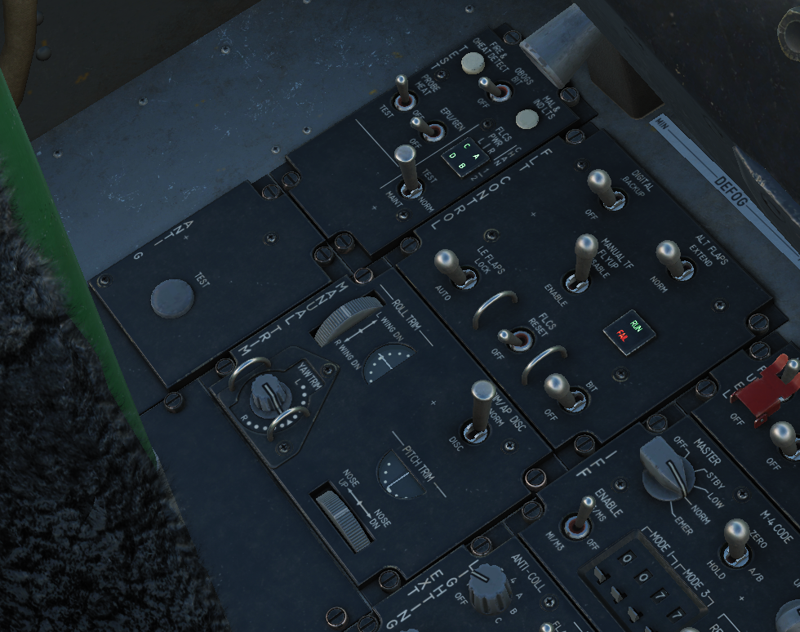

Slide 7
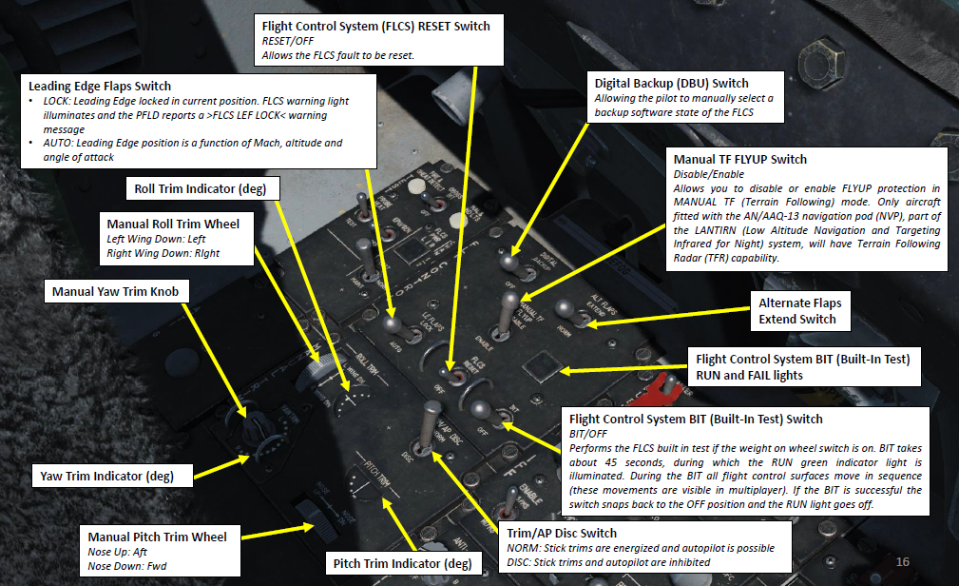

Slide 8
