Slide 1
Exterior Lights and IFF panel

Slide 2
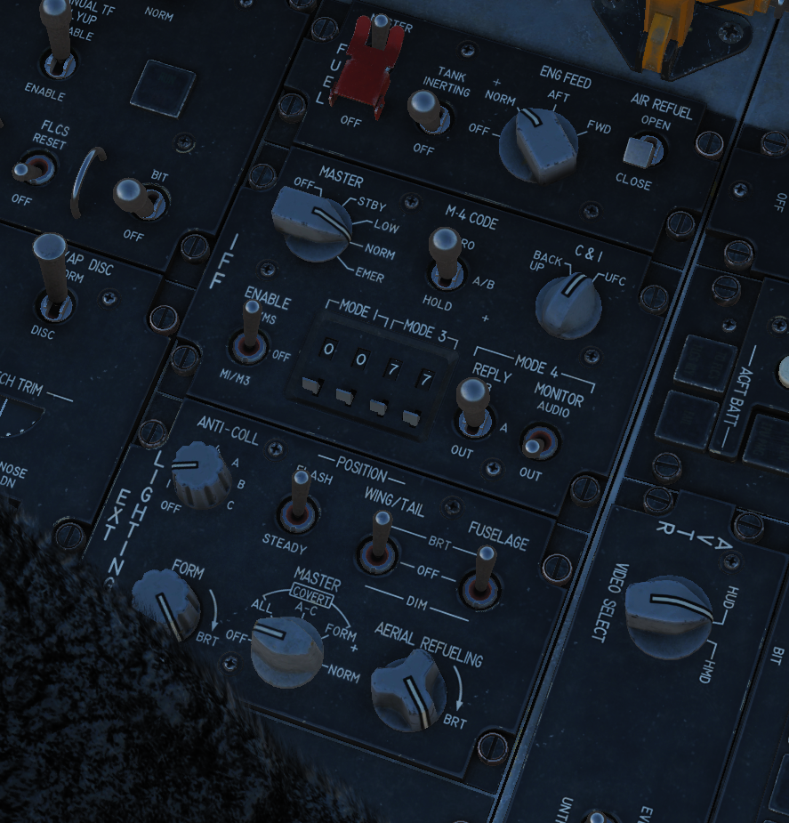
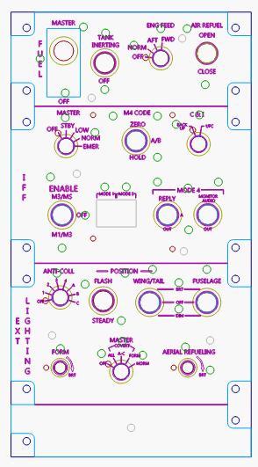
Laser Templates File: iff_lights

Slide 3
LED Circuit
2n222 (viewed from top)
12V
LEDs are 470 Ohm
Then wired in parallel
About 10-12 max
1K
470
LED
470
470

Slide 4
OXYGEN
 | Signal | Arduino pin
 | Aerial Fuel lig | A0
 | Form light | A1
 | MoniAud sw | A2
 | IFF Enable | A3
 | IFF Enable | A4
 | MasterSw | 3-7
 | Fuel Master | 8
 | Tank Inert | 9
 | Eng Feed | 10
 | Eng Feed | 11
 | Eng Feed | 12
 | Eng Feed | 13
 | C&I | 14
 | M4 Code | 15
 | M4 Code | 16
 | Signal | Arduino pin
 | Air Fuel Door | 17
 | Mode 4 | 18
 | Mode 4 Hold | 19
 | Fuselage | 20
 | Fuselage | 21
 | IFF Mode3 BCD LSB | 22-25
 | IFF Mode 3 BCD MSB | 26-29
 | IFF MODE 1 BCD LSB | 30-33
 | IFF MODE 1 BCD MSB | 34-37
 | Anti-Coll | 38-45
 | MAstCov | 46-50
 | Position Flash | 51
 | Wing Tail | 52
 | Wing Tail | 53
 | Signal | Arduino pin

Slide 5
Source CODE
/*
EnginePanels
*/
#define DCSBIOS_IRQ_SERIAL
#include <Servo.h>
#include "DcsBios.h"
// PUT commands from library
//file:///C:/Users/chris/Saved%20Games/DCS/Scripts/DCS-BIOS/doc/control-reference.html
//
unsigned int lastUpdateCounter_ = 0;
unsigned int priorUpdateCounter_ = 0;
bool lightsOut_ = false;
/*
*
* Define All the buttons here
*
*
*/
//IFF PAnel Panel
DcsBios::Switch3Pos iffEnableSw("IFF_ENABLE_SW", A3, A4);
DcsBios::Switch2Pos iffCIKnb("IFF_C_I_KNB", 14);
DcsBios::Switch3Pos iffM4CodeSw("IFF_M4_CODE_SW", 16, 15);
DcsBios::Switch3Pos iffM4ReplySw("IFF_M4_REPLY_SW", 18, 19);
const byte iffMasterKnbPins[5] = {3,4,5,6,7};
DcsBios::SwitchMultiPos iffMasterKnb("IFF_MASTER_KNB", iffMasterKnbPins, 5);
DcsBios::Switch2Pos iffM4MonitorSw("IFF_M4_MONITOR_SW", A2);
//Exterior lights
const byte antiCollLightKnbPins[8] = {38, 39, 40, 41, 42, 43, 44, 45};
DcsBios::SwitchMultiPos antiCollLightKnb("ANTI_COLL_LIGHT_KNB", antiCollLightKnbPins, 8);
DcsBios::Switch2Pos posFlashLightSw("POS_FLASH_LIGHT_SW", 51);
DcsBios::Switch3Pos posWingTailLightSw("POS_WING_TAIL_LIGHT_SW", 53, 52);
DcsBios::Switch3Pos posFuselageLightSw("POS_FUSELAGE_LIGHT_SW", 20, 21);
const byte masterLightSwPins[5] = {46, 47, 48, 49, 50};
DcsBios::SwitchMultiPos masterLightSw("MASTER_LIGHT_SW", masterLightSwPins, 5);
DcsBios::Potentiometer airRefuelLightKnb("AIR_REFUEL_LIGHT_KNB", A0);
DcsBios::Potentiometer formLightKnb("FORM_LIGHT_KNB", A1);
//Fuel
DcsBios::Switch2Pos fuelMasterCv("FUEL_MASTER_CV", 8);
DcsBios::Switch2Pos fuelMasterSw("FUEL_MASTER_SW", 8);
DcsBios::Switch2Pos tankIntertingSw("TANK_INTERTING_SW", 9);
const byte engineFeedKnbPins[4] = {10, 11, 12, 13};
DcsBios::SwitchMultiPos engineFeedKnb("ENGINE_FEED_KNB", engineFeedKnbPins, 4);
DcsBios::Switch2Pos airRefuelSw("AIR_REFUEL_SW", 17);
//IFF switches are in seperate code file
/*
*
* Sync the game with the buttons
* This is the update counter, we can use this to force a sync between buttons and game
*
*/
void PollAllControls()
{
iffEnableSw.pollInputCurrent();
iffCIKnb.pollInputCurrent();
iffM4CodeSw.pollInputCurrent();
iffM4ReplySw.pollInputCurrent();
iffMasterKnb.pollInputCurrent();
iffM4MonitorSw.pollInputCurrent();
antiCollLightKnb.pollInputCurrent();
posFlashLightSw.pollInputCurrent();
posWingTailLightSw.pollInputCurrent();
posFuselageLightSw.pollInputCurrent();
masterLightSw.pollInputCurrent();
airRefuelLightKnb.pollInputCurrent();
formLightKnb.pollInputCurrent();
fuelMasterCv.pollInputCurrent();
fuelMasterSw.pollInputCurrent();
tankIntertingSw.pollInputCurrent();
engineFeedKnb.pollInputCurrent();
airRefuelSw.pollInputCurrent();
}
//Function that gets call over and over
void onUpdateCounterChange(unsigned int newValue)
{
if (newValue%25 == 0)
{
PollAllControls();
}
if (newValue%10 == 0) //read the IFF switches
{
checkIFFSwitches();
}
lastUpdateCounter_ = newValue;
}
DcsBios::IntegerBuffer UpdateCounterBuffer(0xfffe, 0x00ff, 0, onUpdateCounterChange);
/*
*
* In here you can force all your displays to off
*
*/
void timeoutlightsOff( )
{
backlightOFF();
//Turn off all the leds
//digitalWrite(3, LOW); //lightFlcsRly
}
void timeoutlightsOn( )
{
resetIFF();
}
/*
*
* MAIN FUNCTIONS
*
*/
//
// Main Functions
//
void setup()
{
DcsBios::setup();
initBackLight();
initIFFSwitches();
PollAllControls(); //sync the buttons at start
}
void loop() {
DcsBios::loop();
checkBackLightTimer();
//This code checks eveyr 10 seconds to see if DCS is still locked and turns off the LEDS
}

Slide 6
/*
*
* The IFF knobs need some massaging to make work
*
*/
int iffM1S1Cur_ = 0;
int iffM1S2Cur_ = 0;
int iffM3S1Cur_ = 0;
int iffM3S2Cur_ = 0;
int iffM1S1DCS_ = 0;
int iffM1S2DCS_ = 0;
int iffM3S1DCS_ = 0;
int iffM3S2DCS_ = 0;
//Function to convert BCD into an int
int bcdToInt (int v3, int v2, int v1, int v0)
{
int retVal = 0;
if (v3 == LOW)
{
retVal = retVal + 8;
}
if (v2 == LOW)
{
retVal = retVal + 4;
}
if (v1 == LOW)
{
retVal = retVal + 2;
}
if (v0 == LOW)
{
retVal = retVal + 1;
}
return retVal;
}
void checkIFFSwitches()
{
processIFF_M1S2( );
processIFF_M1S1( );
processIFF_M3S2( );
processIFF_M3S1( );
}
//IF no change then no action
//if 8/9 reset back to known state
//if other, toggle until match
void processIFF_M1S2( )
{
int lastIFFM1S2 = iffM1S2Cur_;
iffM1S2Cur_ = bcdToInt(digitalRead(36),digitalRead(34),digitalRead(32),digitalRead(30));
if (lastIFFM1S2 == iffM1S2Cur_)
{
return; //nothing to do
}
//if you chose 8, then we set back to zero
if (iffM1S2Cur_ >= 7)
{
if (iffM1S2DCS_ == 7)
{
return;
}
//force it to 7
for (int i = 0; i < 10; i++)
{
incSwitch("IFF_M1_SEL_2");
}
iffM1S2DCS_ = 7;
return;
}
if (iffM1S2Cur_ == 0)
{
//force it to 7
for (int i = 0; i < 10; i++)
{
decSwitch("IFF_M1_SEL_2");
}
iffM1S2DCS_ = 0;
return;
}
while( iffM1S2DCS_ != iffM1S2Cur_)
{
if (iffM1S2DCS_ > iffM1S2Cur_)
{
decSwitch("IFF_M1_SEL_2");
iffM1S2DCS_ = iffM1S2DCS_ - 1;
} else {
incSwitch("IFF_M1_SEL_2");
iffM1S2DCS_ = iffM1S2DCS_ + 1;
}
}
}
void processIFF_M1S1( )
{
int lastIFFM1S1 = iffM1S1Cur_;
iffM1S1Cur_ = bcdToInt(digitalRead(28),digitalRead(26),digitalRead(24),digitalRead(22));
if (lastIFFM1S1 == iffM1S1Cur_)
{
return; //nothing to do
}
//if you chose 8, then we set back to zero
if (iffM1S1Cur_ >= 7)
{
if (iffM1S1DCS_ == 7)
{
return;
}
//force it to 7
for (int i = 0; i < 10; i++)
{
incSwitch("IFF_M1_SEL_1");
}
iffM1S1DCS_ = 7;
return;
}
if (iffM1S1Cur_ == 0)
{
//force it to 7
for (int i = 0; i < 10; i++)
{
decSwitch("IFF_M1_SEL_1");
}
iffM1S1DCS_ = 0;
return;
}
while( iffM1S1DCS_ != iffM1S1Cur_)
{
if (iffM1S1DCS_ > iffM1S1Cur_)
{
decSwitch("IFF_M1_SEL_1");
iffM1S1DCS_ = iffM1S1DCS_ - 1;
} else {
incSwitch("IFF_M1_SEL_1");
iffM1S1DCS_ = iffM1S1DCS_ + 1;
}
}
}
//MODE3
void processIFF_M3S2( )
{
int lastIFFM3S2 = iffM3S2Cur_;
iffM3S2Cur_ = bcdToInt(digitalRead(37),digitalRead(35),digitalRead(33),digitalRead(31));
if (lastIFFM3S2 == iffM3S2Cur_)
{
return; //nothing to do
}
//if you chose 8, then we set back to zero
if (iffM3S2Cur_ >= 7)
{
if (iffM3S2DCS_ == 7)
{
return;
}
//force it to 7
for (int i = 0; i < 10; i++)
{
incSwitch("IFF_M3_SEL_2");
}
iffM3S2DCS_ = 7;
return;
}
if (iffM3S2Cur_ == 0)
{
//force it to 7
for (int i = 0; i < 10; i++)
{
decSwitch("IFF_M3_SEL_2");
}
iffM3S2DCS_ = 0;
return;
}
while( iffM3S2DCS_ != iffM3S2Cur_)
{
if (iffM3S2DCS_ > iffM3S2Cur_)
{
decSwitch("IFF_M3_SEL_2");
iffM3S2DCS_ = iffM3S2DCS_ - 1;
} else {
incSwitch("IFF_M3_SEL_2");
iffM3S2DCS_ = iffM3S2DCS_ + 1;
}
}
}
void processIFF_M3S1( )
{
int lastIFFM3S1 = iffM3S1Cur_;
iffM3S1Cur_ = bcdToInt(digitalRead(29),digitalRead(27),digitalRead(25),digitalRead(23));
if (lastIFFM3S1 == iffM3S1Cur_)
{
return; //nothing to do
}
//if you chose 8, then we set back to zero
if (iffM3S1Cur_ >= 7)
{
if (iffM3S1DCS_ == 7)
{
return;
}
//force it to 7
for (int i = 0; i < 10; i++)
{
incSwitch("IFF_M3_SEL_1");
}
iffM3S1DCS_ = 7;
return;
}
if (iffM3S1Cur_ == 0)
{
//force it to 7
for (int i = 0; i < 10; i++)
{
decSwitch("IFF_M3_SEL_1");
}
iffM3S1DCS_ = 0;
return;
}
while( iffM3S1DCS_ != iffM3S1Cur_)
{
if (iffM3S1DCS_ > iffM3S1Cur_)
{
decSwitch("IFF_M3_SEL_1");
iffM3S1DCS_ = iffM3S1DCS_ - 1;
} else {
incSwitch("IFF_M3_SEL_1");
iffM3S1DCS_ = iffM3S1DCS_ + 1;
}
}
}
void initIFFSwitches()
{
//IFF pins
pinMode(22, INPUT_PULLUP);
pinMode(23, INPUT_PULLUP);
pinMode(24, INPUT_PULLUP);
pinMode(25, INPUT_PULLUP);
pinMode(26, INPUT_PULLUP);
pinMode(27, INPUT_PULLUP);
pinMode(28, INPUT_PULLUP);
pinMode(29, INPUT_PULLUP);
pinMode(30, INPUT_PULLUP);
pinMode(31, INPUT_PULLUP);
pinMode(32, INPUT_PULLUP);
pinMode(33, INPUT_PULLUP);
pinMode(34, INPUT_PULLUP);
pinMode(35, INPUT_PULLUP);
pinMode(36, INPUT_PULLUP);
pinMode(37, INPUT_PULLUP);
//Get the current Switch state
checkIFFSwitches();
//force them all to 0;
resetIFF();
}
void resetIFF()
{
iffM1S2Cur_ = 10;
iffM1S1Cur_ = 10;
iffM3S2Cur_ = 10;
iffM3S1Cur_ = 10;
//force them all to 0
for (int i = 0; i < 8; i++)
{
decSwitch("IFF_M3_SEL_2");
decSwitch("IFF_M3_SEL_1");
decSwitch("IFF_M1_SEL_2");
decSwitch("IFF_M1_SEL_1");
}
iffM3S1DCS_ = 0;
iffM3S2DCS_ = 0;
iffM1S1DCS_ = 0;
iffM1S2DCS_ = 0;
processIFF_M1S2( );
processIFF_M1S1( );
processIFF_M3S2( );
processIFF_M3S1( );
}
int sleepTime_ = 150;
void decSwitch(char* swName)
{
DcsBios::tryToSendDcsBiosMessage(swName, "0"); //down
delay(sleepTime_);
DcsBios::tryToSendDcsBiosMessage(swName, "1"); //middle
delay(sleepTime_);
}
void incSwitch(char* swName)
{
DcsBios::tryToSendDcsBiosMessage(swName, "2"); //up
delay(sleepTime_);
DcsBios::tryToSendDcsBiosMessage(swName, "1"); //middle
delay(sleepTime_);
}

Slide 7
/*
*
* BACKLIIGNTS on pin 2
*
*
*/
unsigned long previousMillis_ = 0; // will store last time LED was updated
int consolePwmPout_ = 2; //This assumes its on Pin2!
byte consoleOutLevel_ = 0;
/*
*
* This controls backlight brightness
*
*/
void onPriConsolesBrtKnbChange(unsigned int newValue)
{
consoleOutLevel_ = map(newValue, 0, 65535, 0, 100);
analogWrite( consolePwmPout_, consoleOutLevel_); //pwm to drive the lights
}
DcsBios::IntegerBuffer priConsolesBrtKnbBuffer(0x440e, 0xffff, 0, onPriConsolesBrtKnbChange);
void initBackLight()
{
pinMode(consolePwmPout_, OUTPUT); //for the backlight
analogWrite( consolePwmPout_, consoleOutLevel_); //pwm to drive the lights
}
void backlightOFF()
{
consoleOutLevel_ = 0;
analogWrite( consolePwmPout_, consoleOutLevel_); //pwm to drive the lights
}
void checkBackLightTimer()
{
unsigned long currentMillis = millis();
if (currentMillis - previousMillis_ >= 5e3)
{
// save the last time you blinked the LED
previousMillis_ = currentMillis;
if ((lightsOut_ == true) && (lastUpdateCounter_ != priorUpdateCounter_) )
{
timeoutlightsOn();
lightsOut_ = false;
}
if (lastUpdateCounter_ == priorUpdateCounter_) //We havnt gotten any new data
{
timeoutlightsOff();
lightsOut_ = true;
}
priorUpdateCounter_ = lastUpdateCounter_;
}
}

Slide 8
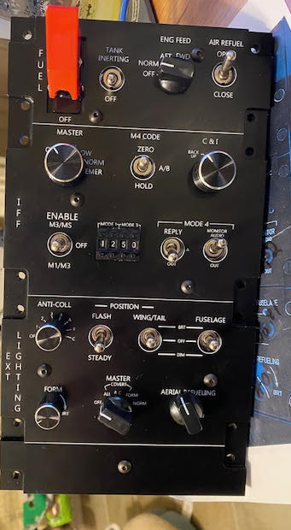
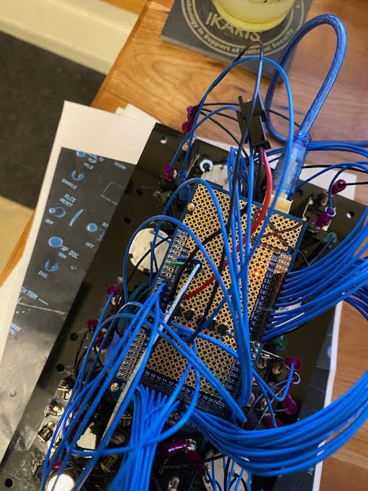
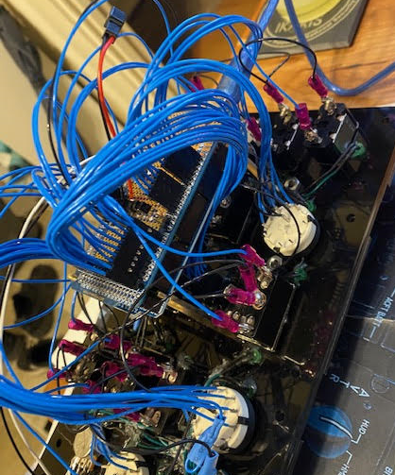
Panel photos

