Slide 1
Drawings for Right console panels

Slide 2
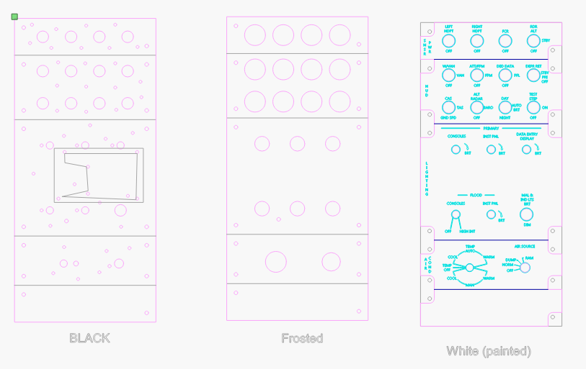
Laser Templates

Slide 3
 | Signal | Arduino pin
1 | Left HDPT | 28
2 | Right HDPT | 3
3 | FCR | 4
4 | RDR On | 5
5 | RDR Off | 6
6 | WVOn | 7
7 | Wv OFF | 8
8 | ATT ON | 9
9 | ATT off | 10
10 | DED on | 11
11 | DED off | 12
12 | DEPR STB | 13
13 | DEPR OFF | 14
14 | CAS | 15
15 | CAS GND | 16
 | Signal | Arduino pin
16 | ALT RDR | 17
17 | ALT OFF | 18
18 | DAY | 19
19 | Night | 20
20 | TEST STEP | 22
21 | STEP OFF | 24
22 | CON BRT | A1
23 | INST BRT | A2
24 | DED BRT | A3
25 | Flood CON | A4
26 | Flood INS | A5
27 | MAL IND Brt | 21
28 | Mal Dim | 26
28 | TX | ?
29 | Rx | ?
 | Signal | Arduino pin
 | LED PWM | 2
 | LED PWM
 | LED PWM
 | LED PWM

Slide 4
Source CODE
/*
Panel For the power and hut lighting
*/
#define DCSBIOS_IRQ_SERIAL
#include <Servo.h>
#include "DcsBios.h"
// PUT commands from library
//file:///C:/Users/chris/Saved%20Games/DCS/Scripts/DCS-BIOS/doc/control-reference.html
//
unsigned long previousMillis_ = 0; // will store last time LED was updated
unsigned int lastUpdateCounter_ = 0;
unsigned int priorUpdateCounter_ = 0;
//Sensor Panel
DcsBios::Switch2Pos hdptSwL("HDPT_SW_L", 28);
DcsBios::Switch2Pos hdptSwR("HDPT_SW_R", 3);
DcsBios::Switch2Pos fcrPwrSw("FCR_PWR_SW", 4);
DcsBios::Switch3Pos rdrAltPwrSw("RDR_ALT_PWR_SW", 6, 5);
//HUD Control panel
DcsBios::Switch3Pos hudScalesSw("HUD_SCALES_SW", 8,7);//Wvah/vah
DcsBios::Switch3Pos hudFpMarkerSw("HUD_FP_MARKER_SW", 10, 9);
DcsBios::Switch3Pos hudDedDataSw("HUD_DED_DATA_SW", 12, 11);
DcsBios::Switch3Pos hudDepressRetSw("HUD_DEPRESS_RET_SW", 14, 13);
DcsBios::Switch3Pos hudSpeedSw("HUD_SPEED_SW", 16, 15); //cas/tas/gnd
DcsBios::Switch3Pos hudAltSw("HUD_ALT_SW", 18, 17);
DcsBios::Switch3Pos hudBrtSw("HUD_BRT_SW", 20, 19);
DcsBios::Switch3Pos hudTestSw("HUD_TEST_SW", 24, 22);
DcsBios::Switch3Pos malIndLtsBrtSw("MAL_IND_LTS_BRT_SW", 26, 21);
//Brightness adjust
DcsBios::Potentiometer priConsolesBrtKnb("PRI_CONSOLES_BRT_KNB", A0);
DcsBios::Potentiometer priInstPnlBrtKnb("PRI_INST_PNL_BRT_KNB", A1);
DcsBios::Potentiometer priDataDisplayBrtKnb("PRI_DATA_DISPLAY_BRT_KNB", A2);
DcsBios::Potentiometer floodConsolesBrtKnb("FLOOD_CONSOLES_BRT_KNB", A3);
DcsBios::Potentiometer floodInstPnlBrtKnb("FLOOD_INST_PNL_BRT_KNB", A4);
//consnent panel
DcsBios::Switch3Pos plainCipherSw("PLAIN_CIPHER_SW", 51,53);
//
//Read back the brightness for the LEDS
//
int consolePwmPout_ = 2;
byte consoleOutLevel_ = 0;
void onPriConsolesBrtKnbChange(unsigned int newValue)
//
{
consoleOutLevel_ = map(newValue, 0, 65535, 0, 100);
analogWrite( consolePwmPout_, consoleOutLevel_); //pwm to drive the lights
}
DcsBios::IntegerBuffer priConsolesBrtKnbBuffer(0x440e, 0xffff, 0, onPriConsolesBrtKnbChange);
//
//Sync the game with the buttons
//
void PollAllControls()
{
hdptSwL.pollInputCurrent();
hdptSwR.pollInputCurrent();
fcrPwrSw.pollInputCurrent();
rdrAltPwrSw.pollInputCurrent();
//HUD Control panel
hudScalesSw.pollInputCurrent();
hudFpMarkerSw.pollInputCurrent();
hudDedDataSw.pollInputCurrent();
hudDepressRetSw.pollInputCurrent();
hudSpeedSw.pollInputCurrent();
hudAltSw.pollInputCurrent();
hudBrtSw.pollInputCurrent();
hudTestSw.pollInputCurrent();
malIndLtsBrtSw.pollInputCurrent();
priConsolesBrtKnb.pollInputCurrent();
priInstPnlBrtKnb.pollInputCurrent();
priDataDisplayBrtKnb.pollInputCurrent();
floodConsolesBrtKnb.pollInputCurrent();
floodInstPnlBrtKnb.pollInputCurrent();
plainCipherSw.pollInputCurrent();
}
//
//This is the update counter, we can use this to force a sync between buttons and game
//
void onUpdateCounterChange(unsigned int newValue)
{
if (newValue%25 == 0)
{
PollAllControls();
}
lastUpdateCounter_ = newValue;
}
DcsBios::IntegerBuffer UpdateCounterBuffer(0xfffe, 0x00ff, 0, onUpdateCounterChange);
//
// Main Functions
//
void setup() {
pinMode(consolePwmPout_, OUTPUT); //for the backlight
analogWrite( consolePwmPout_, consoleOutLevel_); //pwm to drive the lights
DcsBios::setup();
PollAllControls(); //sync the buttons at start
}
void loop() {
DcsBios::loop();
//This code checks eveyr 10 seconds to see if DCS is still locked and turns off the LEDS
unsigned long currentMillis = millis();
if (currentMillis - previousMillis_ >= 10e3)
{
// save the last time you blinked the LED
previousMillis_ = currentMillis;
if (lastUpdateCounter_ == priorUpdateCounter_) //We havnt gotten any new data
{
consoleOutLevel_ = 0;
analogWrite( consolePwmPout_, consoleOutLevel_); //pwm to drive the lights
}
priorUpdateCounter_ = lastUpdateCounter_;
}
}

