Slide 1
Wiring for throttle

Slide 2
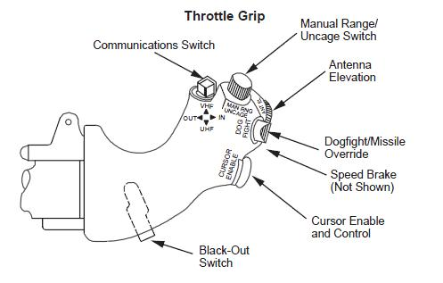
Brn/yel/orng/red (6,7,8,9)
 |  | HD26 | Arduino
Coms Up | Brown | 6 | 8
Coms dwn | Yello | 7 | 11
Coms In | Orange | 8 | 10
Coms Out | Red | 9 | 9
Range | Grey | 11 | A3
Uncage | Black | 12 | 7
Antenna El | Purple | 10 | A2
Dogfight | Orange | 15 | 5
Override | Brown | 16 | 3
Speed Brake1 | White | 13 | 6
Speed Brake2 | Red | 14 | 4
Cursor Gnd | blue | 1
Cursor Button | blue | 2 | 2
Cursor Axis 1 | Blue | 3 | A0
Cursor Axis 2 | blue | 4 | A1
Cursor 5V | blue | 5
Gnd | Yellow | 19
5V | blue | 21

Slide 3
Connector
17ehd026paa000
17ehd026saa000
Adapter
throttle
Arm
Digital Pot
Hall sensor
P3022

