Slide 1
IFY Statistics
Week 3 • Class A
Measuring
Central
Tendency
Notes:
Suggested time: 0.5 minutes.
Outcomes: calculate central tendency and spread, select suitable summaries, recognise skewness. This is Class A of the agreed Week 3 sequence. All fictional contexts are instructional examples.
[Sources]
Visual template: Statistics-Week-2-Class-A.pptx, locked version 1. Original Bellerbys master/layouts, photographic cover/dividers and brand backgrounds retained.
Course content: user-provided Statistics Week 3 Lecture.pptx; Statistics Week 3 Seminar 2 Questions/Answers. Quartiles follow (n+1)p with linear interpolation.
Phone-call dataset: Michael Sullivan III, Statistics: Informed Decisions Using Data, 7th ed., p.126 (uploaded PDF p.156), Example 5/Table 3. Correction/deletion task is an original adaptation.
Distribution-shape teaching reference: Larson & Farber, Elementary Statistics: Picturing the World, 9th ed., p.72 (uploaded PDF p.96). Figures redrawn for this lesson.
Cafe waiting times and paired spread datasets are fictional instructional examples. Exact charts and mathematical figures were computed from the stated values. The 200-member gym context and large-set median examples are fictional teaching extensions. Typeset formulas and quartile diagrams are newly rendered mathematical assets. Campus illustrations were generated with ImageGen and are not documentary photographs of the source participants.
[/Sources]

Slide 2

Back to our gym survey
A gym wants to know exercise hours for all 200 members.
It surveys 16 members.
1. Who is the population?
2. Who is the sample?
3. What type of data is time?
Population: the whole group we want to understand. Sample: the members we ask.
Notes:
Suggested time: 1.5 minutes.
Quick retrieval. The population is all 200 gym members. The sample contains the 16 surveyed members. Exercise time is quantitative and continuous even when respondents round it to whole hours. Do not spend more than 90 seconds here.
[Sources]
Visual template: Statistics-Week-2-Class-A.pptx, locked version 1. Original Bellerbys master/layouts, photographic cover/dividers and brand backgrounds retained.
Course content: user-provided Statistics Week 3 Lecture.pptx; Statistics Week 3 Seminar 2 Questions/Answers. Quartiles follow (n+1)p with linear interpolation.
Phone-call dataset: Michael Sullivan III, Statistics: Informed Decisions Using Data, 7th ed., p.126 (uploaded PDF p.156), Example 5/Table 3. Correction/deletion task is an original adaptation.
Distribution-shape teaching reference: Larson & Farber, Elementary Statistics: Picturing the World, 9th ed., p.72 (uploaded PDF p.96). Figures redrawn for this lesson.
Cafe waiting times and paired spread datasets are fictional instructional examples. Exact charts and mathematical figures were computed from the stated values. The 200-member gym context and large-set median examples are fictional teaching extensions. Typeset formulas and quartile diagrams are newly rendered mathematical assets. Campus illustrations were generated with ImageGen and are not documentary photographs of the source participants.
[/Sources]

Slide 3
Section 1:
Finding a
typical value
Notes:
Suggested time: 0.25 minutes.
Brief section transition. Retain authentic Bellerbys photographic divider.
[Sources]
Visual template: Statistics-Week-2-Class-A.pptx, locked version 1. Original Bellerbys master/layouts, photographic cover/dividers and brand backgrounds retained.
Course content: user-provided Statistics Week 3 Lecture.pptx; Statistics Week 3 Seminar 2 Questions/Answers. Quartiles follow (n+1)p with linear interpolation.
Phone-call dataset: Michael Sullivan III, Statistics: Informed Decisions Using Data, 7th ed., p.126 (uploaded PDF p.156), Example 5/Table 3. Correction/deletion task is an original adaptation.
Distribution-shape teaching reference: Larson & Farber, Elementary Statistics: Picturing the World, 9th ed., p.72 (uploaded PDF p.96). Figures redrawn for this lesson.
Cafe waiting times and paired spread datasets are fictional instructional examples. Exact charts and mathematical figures were computed from the stated values. The 200-member gym context and large-set median examples are fictional teaching extensions. Typeset formulas and quartile diagrams are newly rendered mathematical assets. Campus illustrations were generated with ImageGen and are not documentary photographs of the source participants.
[/Sources]

Slide 4
What is a typical wait?
Six customers record their waiting time, in minutes.
4, 6, 6, 8, 11, 13
Choose one number to
describe a typical wait.
Why did you choose it?
A typical value describes the centre of a dataset.
Notes:
Suggested time: 1.5 minutes.
Illustrative fictional cafe case. Invite several suggestions before naming the mean, median and mode. Do not reveal 8 until next slide.
[Sources]
Visual template: Statistics-Week-2-Class-A.pptx, locked version 1. Original Bellerbys master/layouts, photographic cover/dividers and brand backgrounds retained.
Course content: user-provided Statistics Week 3 Lecture.pptx; Statistics Week 3 Seminar 2 Questions/Answers. Quartiles follow (n+1)p with linear interpolation.
Phone-call dataset: Michael Sullivan III, Statistics: Informed Decisions Using Data, 7th ed., p.126 (uploaded PDF p.156), Example 5/Table 3. Correction/deletion task is an original adaptation.
Distribution-shape teaching reference: Larson & Farber, Elementary Statistics: Picturing the World, 9th ed., p.72 (uploaded PDF p.96). Figures redrawn for this lesson.
Cafe waiting times and paired spread datasets are fictional instructional examples. Exact charts and mathematical figures were computed from the stated values. The 200-member gym context and large-set median examples are fictional teaching extensions. Typeset formulas and quartile diagrams are newly rendered mathematical assets. Campus illustrations were generated with ImageGen and are not documentary photographs of the source participants.
[/Sources]

Slide 5

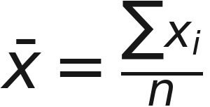
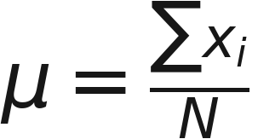
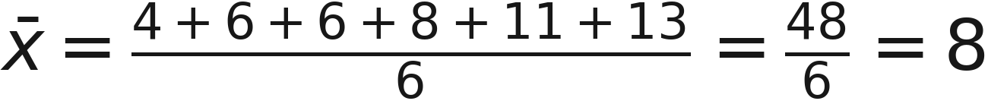
Mean: share the total
Add every value, then divide by the number of values.
Sample mean: x-bar
Population mean: mu
Symbol / name | Meaning
xᵢ (x sub i) | One value, labeled i.
Σ (capital sigma) | Add the values.
n (lowercase n) | Number in the sample.
N (capital N) | Number in the population.
Our six waiting times
Notes:
Suggested time: 3 minutes.
Say x-bar (sample mean), mu (population mean), capital sigma (add the values), x sub i (one observed value), lowercase n and capital N. Both mean formulas use total divided by count. Here the six waits total 48 minutes, so the mean is 8 minutes. Keep every symbol tied to its meaning.
[Sources]
Visual template: Statistics-Week-2-Class-A.pptx, locked version 1. Original Bellerbys master/layouts, photographic cover/dividers and brand backgrounds retained.
Course content: user-provided Statistics Week 3 Lecture.pptx; Statistics Week 3 Seminar 2 Questions/Answers. Quartiles follow (n+1)p with linear interpolation.
Phone-call dataset: Michael Sullivan III, Statistics: Informed Decisions Using Data, 7th ed., p.126 (uploaded PDF p.156), Example 5/Table 3. Correction/deletion task is an original adaptation.
Distribution-shape teaching reference: Larson & Farber, Elementary Statistics: Picturing the World, 9th ed., p.72 (uploaded PDF p.96). Figures redrawn for this lesson.
Cafe waiting times and paired spread datasets are fictional instructional examples. Exact charts and mathematical figures were computed from the stated values. The 200-member gym context and large-set median examples are fictional teaching extensions. Typeset formulas and quartile diagrams are newly rendered mathematical assets. Campus illustrations were generated with ImageGen and are not documentary photographs of the source participants.
[/Sources]

Slide 6
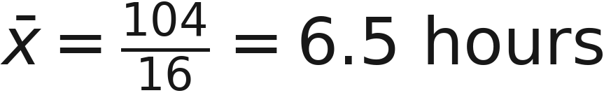
Why do we have two means?
We want the mean exercise time for all 200 gym members.
Population: all 200 members
Sample: the 16 surveyed
μ (mu) is the population mean.
It describes the whole group.
Measuring everyone takes time.
x̄ (x-bar) is the sample mean.
The sample total is 104 hours.
We use the sample mean to estimate the population mean.
A different sample may give a different estimate.
Notes:
Suggested time: 2 minutes.
The target group is all 200 members. Our 16-member sample totals 104 hours and has mean 6.5 hours. This sample mean estimates the unknown population mean. A different sample can give a different result. The formula rule is the same, but the group and purpose differ.
[Sources]
Visual template: Statistics-Week-2-Class-A.pptx, locked version 1. Original Bellerbys master/layouts, photographic cover/dividers and brand backgrounds retained.
Course content: user-provided Statistics Week 3 Lecture.pptx; Statistics Week 3 Seminar 2 Questions/Answers. Quartiles follow (n+1)p with linear interpolation.
Phone-call dataset: Michael Sullivan III, Statistics: Informed Decisions Using Data, 7th ed., p.126 (uploaded PDF p.156), Example 5/Table 3. Correction/deletion task is an original adaptation.
Distribution-shape teaching reference: Larson & Farber, Elementary Statistics: Picturing the World, 9th ed., p.72 (uploaded PDF p.96). Figures redrawn for this lesson.
Cafe waiting times and paired spread datasets are fictional instructional examples. Exact charts and mathematical figures were computed from the stated values. The 200-member gym context and large-set median examples are fictional teaching extensions. Typeset formulas and quartile diagrams are newly rendered mathematical assets. Campus illustrations were generated with ImageGen and are not documentary photographs of the source participants.
[/Sources]
Revised exercise data and prompts are original fictional teaching examples. The gym sample now contains 16 observations with total104 hours.

Slide 7
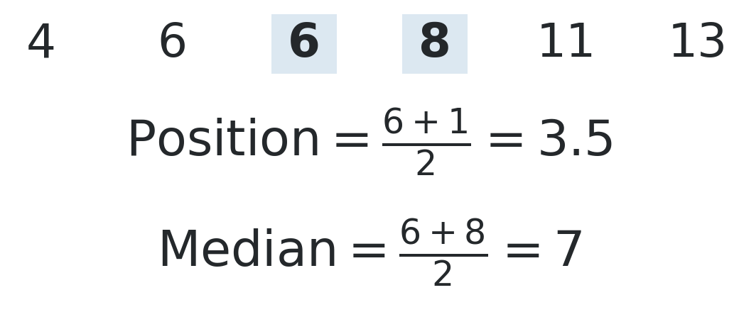
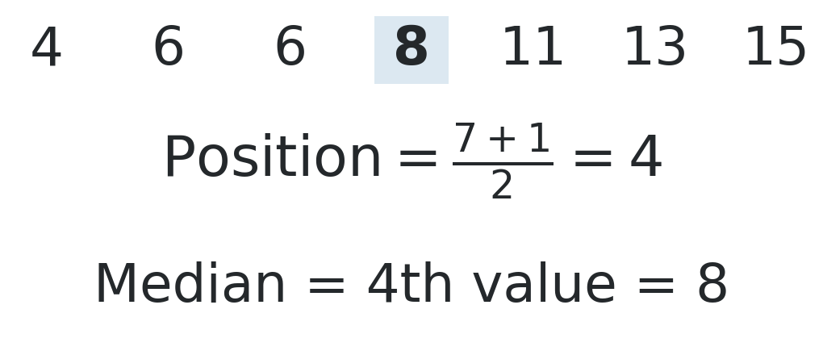
Median: find the middle
Six values: even
Seven values: odd
Sort first. Position 3.5 means average the 3rd and 4th values; position 4 means take the 4th value.
Notes:
Suggested time: 2.5 minutes.
Two stages: find the middle position, then use the value or values there. For n=6, position3.5 means average the3rd and4th values:6and8, giving7. For n=7, position4 selects the4th value,8. A position is not the median value.
[Sources]
Visual template: Statistics-Week-2-Class-A.pptx, locked version 1. Original Bellerbys master/layouts, photographic cover/dividers and brand backgrounds retained.
Course content: user-provided Statistics Week 3 Lecture.pptx; Statistics Week 3 Seminar 2 Questions/Answers. Quartiles follow (n+1)p with linear interpolation.
Phone-call dataset: Michael Sullivan III, Statistics: Informed Decisions Using Data, 7th ed., p.126 (uploaded PDF p.156), Example 5/Table 3. Correction/deletion task is an original adaptation.
Distribution-shape teaching reference: Larson & Farber, Elementary Statistics: Picturing the World, 9th ed., p.72 (uploaded PDF p.96). Figures redrawn for this lesson.
Cafe waiting times and paired spread datasets are fictional instructional examples. Exact charts and mathematical figures were computed from the stated values. The 200-member gym context and large-set median examples are fictional teaching extensions. Typeset formulas and quartile diagrams are newly rendered mathematical assets. Campus illustrations were generated with ImageGen and are not documentary photographs of the source participants.
[/Sources]

Slide 8
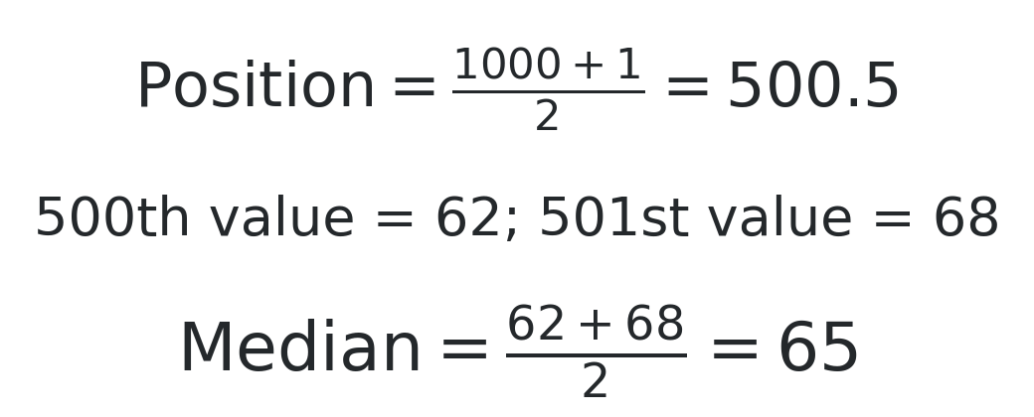
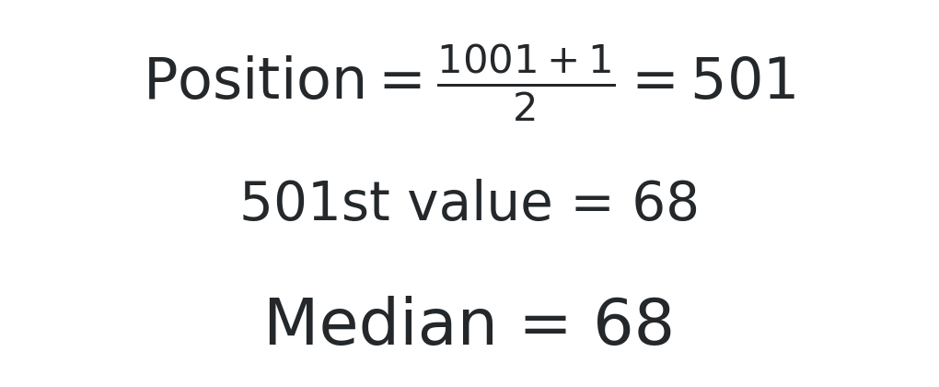
The same rule works for large sets
These two examples use ordered exam scores.
1,000 scores: even
1,001 scores: odd
Once the scores are ordered, use the middle position(s); there is no need to add every score.
Notes:
Suggested time: 1 minutes.
Two separate hypothetical datasets. For1000 observations, position500.5 means average values500and501:62and68, giving65. For1001, take the501st value; here68. Ask which values are needed before calculating.
[Sources]
Visual template: Statistics-Week-2-Class-A.pptx, locked version 1. Original Bellerbys master/layouts, photographic cover/dividers and brand backgrounds retained.
Course content: user-provided Statistics Week 3 Lecture.pptx; Statistics Week 3 Seminar 2 Questions/Answers. Quartiles follow (n+1)p with linear interpolation.
Phone-call dataset: Michael Sullivan III, Statistics: Informed Decisions Using Data, 7th ed., p.126 (uploaded PDF p.156), Example 5/Table 3. Correction/deletion task is an original adaptation.
Distribution-shape teaching reference: Larson & Farber, Elementary Statistics: Picturing the World, 9th ed., p.72 (uploaded PDF p.96). Figures redrawn for this lesson.
Cafe waiting times and paired spread datasets are fictional instructional examples. Exact charts and mathematical figures were computed from the stated values. The 200-member gym context and large-set median examples are fictional teaching extensions. Typeset formulas and quartile diagrams are newly rendered mathematical assets. Campus illustrations were generated with ImageGen and are not documentary photographs of the source participants.
[/Sources]

Slide 9
Mode: the most frequent
The mode is the value or category that occurs most often.
Case | Data | Mode
One mode | 4, 6, 6, 8, 11, 13 | 6
Two modes | 1, 1, 2, 2, 3 | 1 and 2
No mode | 2, 4, 7, 9 | None
Categorical example: Tea, Coffee, Tea → mode = Tea.
Notes:
Suggested time: 1 minutes.
Bimodal means two modes. In the course convention a dataset with all distinct values has no mode. The mode may be categorical; we do not take a numerical mean of drink names.
[Sources]
Visual template: Statistics-Week-2-Class-A.pptx, locked version 1. Original Bellerbys master/layouts, photographic cover/dividers and brand backgrounds retained.
Course content: user-provided Statistics Week 3 Lecture.pptx; Statistics Week 3 Seminar 2 Questions/Answers. Quartiles follow (n+1)p with linear interpolation.
Phone-call dataset: Michael Sullivan III, Statistics: Informed Decisions Using Data, 7th ed., p.126 (uploaded PDF p.156), Example 5/Table 3. Correction/deletion task is an original adaptation.
Distribution-shape teaching reference: Larson & Farber, Elementary Statistics: Picturing the World, 9th ed., p.72 (uploaded PDF p.96). Figures redrawn for this lesson.
Cafe waiting times and paired spread datasets are fictional instructional examples. Exact charts and mathematical figures were computed from the stated values. The 200-member gym context and large-set median examples are fictional teaching extensions. Typeset formulas and quartile diagrams are newly rendered mathematical assets. Campus illustrations were generated with ImageGen and are not documentary photographs of the source participants.
[/Sources]

Slide 10

How long is a typical call?
HANDOUT • EXERCISE A1
A random sample of 12 phone-call lengths, in minutes:
1, 7, 4, 1, 2, 4,
3, 48, 3, 5, 3, 6
1. Find mean, median and mode.
2. Choose the best description
of a typical call.
Show your working and give one reason for your choice.
Notes:
Suggested time: 4.5 minutes.
A1. Give students time to order the 12 values and calculate before revealing the next slide. Then ask which measure describes a typical call and why. Mean 7.25, median 3.5, mode 3 minutes.
[Sources]
Visual template: Statistics-Week-2-Class-A.pptx, locked version 1. Original Bellerbys master/layouts, photographic cover/dividers and brand backgrounds retained.
Course content: user-provided Statistics Week 3 Lecture.pptx; Statistics Week 3 Seminar 2 Questions/Answers. Quartiles follow (n+1)p with linear interpolation.
Phone-call dataset: Michael Sullivan III, Statistics: Informed Decisions Using Data, 7th ed., p.126 (uploaded PDF p.156), Example 5/Table 3. Correction/deletion task is an original adaptation.
Distribution-shape teaching reference: Larson & Farber, Elementary Statistics: Picturing the World, 9th ed., p.72 (uploaded PDF p.96). Figures redrawn for this lesson.
Cafe waiting times and paired spread datasets are fictional instructional examples. Exact charts and mathematical figures were computed from the stated values. The 200-member gym context and large-set median examples are fictional teaching extensions. Typeset formulas and quartile diagrams are newly rendered mathematical assets. Campus illustrations were generated with ImageGen and are not documentary photographs of the source participants.
[/Sources]

Slide 11
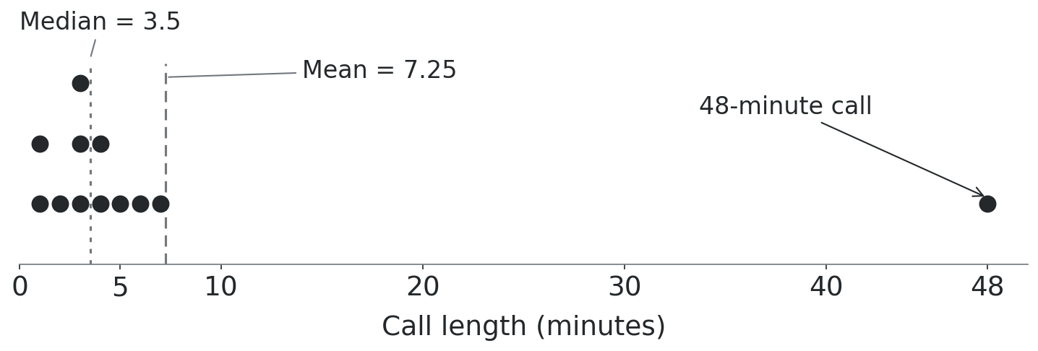
A typical call
HANDOUT • EXERCISE A1
The 48-minute call pulls the mean up.
The median better describes a typical call here.
Notes:
Suggested time: 1.5 minutes.
Ordered data:1,1,2,3,3,3,4,4,5,6,7,48. Median=(3+4)/2=3.5. Mode3 occurs3times. Dotplot shows all12observations on a continuous unbroken scale. Mean7.25 andmedian3.5 are distinct positions. Sullivan p126; recalculate full precision, use two decimals for mean.
[Sources]
Visual template: Statistics-Week-2-Class-A.pptx, locked version 1. Original Bellerbys master/layouts, photographic cover/dividers and brand backgrounds retained.
Course content: user-provided Statistics Week 3 Lecture.pptx; Statistics Week 3 Seminar 2 Questions/Answers. Quartiles follow (n+1)p with linear interpolation.
Phone-call dataset: Michael Sullivan III, Statistics: Informed Decisions Using Data, 7th ed., p.126 (uploaded PDF p.156), Example 5/Table 3. Correction/deletion task is an original adaptation.
Distribution-shape teaching reference: Larson & Farber, Elementary Statistics: Picturing the World, 9th ed., p.72 (uploaded PDF p.96). Figures redrawn for this lesson.
Cafe waiting times and paired spread datasets are fictional instructional examples. Exact charts and mathematical figures were computed from the stated values. The 200-member gym context and large-set median examples are fictional teaching extensions. Typeset formulas and quartile diagrams are newly rendered mathematical assets. Campus illustrations were generated with ImageGen and are not documentary photographs of the source participants.
[/Sources]

Slide 12
Correct it or delete it?
HANDOUT • EXERCISE A2
Start again with the original 12 calls: total = 87 minutes.
(a) Correct a recording error
(b) Exclude an ineligible call
The 48-minute call should be
5 minutes.
Find the new mean and median.
The 48-minute call was outside
the observation period. Delete it.
Find the new mean and median.
Treat (a) and (b) separately. Reorder the values after each change.
Notes:
Suggested time: 4 minutes.
A2. Ask for a prediction before calculations. Each part starts from the original 12 calls, total 87. Correction: 87-48+5=44, n=12, mean 3.6667 and median 3.5. Deletion: 87-48=39, n=11, mean 3.54545 and median 3. Remove a value only when there is a valid reason, such as an ineligible observation.
[Sources]
Visual template: Statistics-Week-2-Class-A.pptx, locked version 1. Original Bellerbys master/layouts, photographic cover/dividers and brand backgrounds retained.
Course content: user-provided Statistics Week 3 Lecture.pptx; Statistics Week 3 Seminar 2 Questions/Answers. Quartiles follow (n+1)p with linear interpolation.
Phone-call dataset: Michael Sullivan III, Statistics: Informed Decisions Using Data, 7th ed., p.126 (uploaded PDF p.156), Example 5/Table 3. Correction/deletion task is an original adaptation.
Distribution-shape teaching reference: Larson & Farber, Elementary Statistics: Picturing the World, 9th ed., p.72 (uploaded PDF p.96). Figures redrawn for this lesson.
Cafe waiting times and paired spread datasets are fictional instructional examples. Exact charts and mathematical figures were computed from the stated values. The 200-member gym context and large-set median examples are fictional teaching extensions. Typeset formulas and quartile diagrams are newly rendered mathematical assets. Campus illustrations were generated with ImageGen and are not documentary photographs of the source participants.
[/Sources]

Slide 13
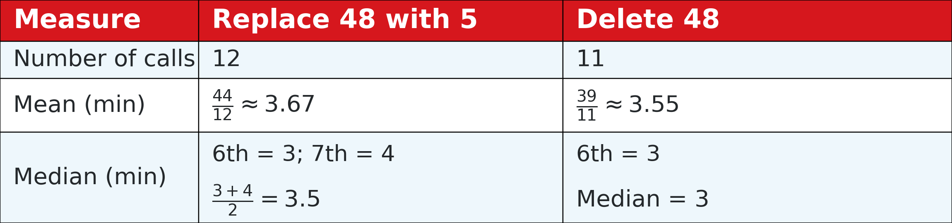
Check what changed
HANDOUT • EXERCISE A2
A correction keeps the call. A deletion reduces the sample size.
Resistant means less sensitive to extremes.
The median can still change.
Notes:
Suggested time: 2 minutes.
Replacement exactmean44/12=3.6667; deletion39/11=3.54545. Removing max leaves eleven observations whose middle is3. Correcting max to5 leaves middle3and4. Sullivan-inspired extension; generated question.
[Sources]
Visual template: Statistics-Week-2-Class-A.pptx, locked version 1. Original Bellerbys master/layouts, photographic cover/dividers and brand backgrounds retained.
Course content: user-provided Statistics Week 3 Lecture.pptx; Statistics Week 3 Seminar 2 Questions/Answers. Quartiles follow (n+1)p with linear interpolation.
Phone-call dataset: Michael Sullivan III, Statistics: Informed Decisions Using Data, 7th ed., p.126 (uploaded PDF p.156), Example 5/Table 3. Correction/deletion task is an original adaptation.
Distribution-shape teaching reference: Larson & Farber, Elementary Statistics: Picturing the World, 9th ed., p.72 (uploaded PDF p.96). Figures redrawn for this lesson.
Cafe waiting times and paired spread datasets are fictional instructional examples. Exact charts and mathematical figures were computed from the stated values. The 200-member gym context and large-set median examples are fictional teaching extensions. Typeset formulas and quartile diagrams are newly rendered mathematical assets. Campus illustrations were generated with ImageGen and are not documentary photographs of the source participants.
[/Sources]

Slide 14
Typical salary and total payroll
HANDOUT • EXERCISE A3
A café employs 14 staff. A few staff earn much more than the others.
Monthly salary summary | Amount
Mean | £1,475
Median | £1,280
1. Which figure better describes a typical employee’s salary? Why?
2. Calculate the café’s total monthly payroll.
3. Explain why median × 14 may give the wrong total.
Notes:
Suggested time: 3.5 minutes.
A3. Fictional teaching case. Mean and median refer to the same complete group of 14 staff. Allow independent calculation, followed by a short paired explanation. Typical salary: median £1,280. Total payroll: 14 times £1,475 = £20,650. Median times count is £17,920 and does not recover the total.
[Sources]
Visual template: Statistics-Week-2-Class-A.pptx, locked version 1. Original Bellerbys master/layouts, photographic cover/dividers and brand backgrounds retained.
Course content: user-provided Statistics Week 3 Lecture.pptx; Statistics Week 3 Seminar 2 Questions/Answers. Quartiles follow (n+1)p with linear interpolation.
Phone-call dataset: Michael Sullivan III, Statistics: Informed Decisions Using Data, 7th ed., p.126 (uploaded PDF p.156), Example 5/Table 3. Correction/deletion task is an original adaptation.
Distribution-shape teaching reference: Larson & Farber, Elementary Statistics: Picturing the World, 9th ed., p.72 (uploaded PDF p.96). Figures redrawn for this lesson.
Cafe waiting times and paired spread datasets are fictional instructional examples. Exact charts and mathematical figures were computed from the stated values. The 200-member gym context and large-set median examples are fictional teaching extensions. Typeset formulas and quartile diagrams are newly rendered mathematical assets. Campus illustrations were generated with ImageGen and are not documentary photographs of the source participants.
[/Sources]
Revised exercise data and prompts are original fictional teaching examples. The gym sample now contains 16 observations with total104 hours.

Slide 15
The purpose determines the measure
HANDOUT • EXERCISE A3
1. Typical salary: median = £1,280
The few high salaries have less influence on the median.
2. Total payroll: use the mean for these 14 staff
3. The median tells us the middle salary.
It does not preserve the total across all staff.
This is not the payroll.
Notes:
Suggested time: 2 minutes.
A3 answers. Use the mean to recover the total because mean equals total divided by count. The median identifies the middle salary and has no such total-preserving property. A few high salaries make the median more representative of the typical employee here.
[Sources]
Visual template: Statistics-Week-2-Class-A.pptx, locked version 1. Original Bellerbys master/layouts, photographic cover/dividers and brand backgrounds retained.
Course content: user-provided Statistics Week 3 Lecture.pptx; Statistics Week 3 Seminar 2 Questions/Answers. Quartiles follow (n+1)p with linear interpolation.
Phone-call dataset: Michael Sullivan III, Statistics: Informed Decisions Using Data, 7th ed., p.126 (uploaded PDF p.156), Example 5/Table 3. Correction/deletion task is an original adaptation.
Distribution-shape teaching reference: Larson & Farber, Elementary Statistics: Picturing the World, 9th ed., p.72 (uploaded PDF p.96). Figures redrawn for this lesson.
Cafe waiting times and paired spread datasets are fictional instructional examples. Exact charts and mathematical figures were computed from the stated values. The 200-member gym context and large-set median examples are fictional teaching extensions. Typeset formulas and quartile diagrams are newly rendered mathematical assets. Campus illustrations were generated with ImageGen and are not documentary photographs of the source participants.
[/Sources]
Revised exercise data and prompts are original fictional teaching examples. The gym sample now contains 16 observations with total104 hours.

Slide 16
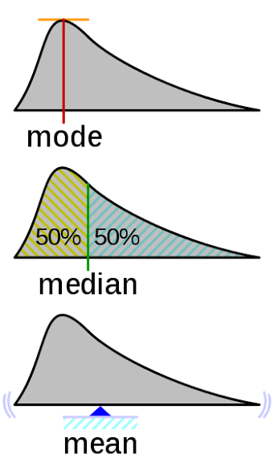
:D

Slide 17
Section 2:
Measuring
the spread
Notes:
Suggested time: 0.25 minutes.
Brief section transition. Retain authentic Bellerbys photographic divider.
[Sources]
Visual template: Statistics-Week-2-Class-A.pptx, locked version 1. Original Bellerbys master/layouts, photographic cover/dividers and brand backgrounds retained.
Course content: user-provided Statistics Week 3 Lecture.pptx; Statistics Week 3 Seminar 2 Questions/Answers. Quartiles follow (n+1)p with linear interpolation.
Phone-call dataset: Michael Sullivan III, Statistics: Informed Decisions Using Data, 7th ed., p.126 (uploaded PDF p.156), Example 5/Table 3. Correction/deletion task is an original adaptation.
Distribution-shape teaching reference: Larson & Farber, Elementary Statistics: Picturing the World, 9th ed., p.72 (uploaded PDF p.96). Figures redrawn for this lesson.
Cafe waiting times and paired spread datasets are fictional instructional examples. Exact charts and mathematical figures were computed from the stated values. The 200-member gym context and large-set median examples are fictional teaching extensions. Typeset formulas and quartile diagrams are newly rendered mathematical assets. Campus illustrations were generated with ImageGen and are not documentary photographs of the source participants.
[/Sources]

Slide 18
Range: from lowest to highest
Spread tells us how far apart the values are.
Waiting times
Phone calls
4, 6, 6, 8, 11, 13
Range = 13 − 4 = 9 minutes
Minimum = 1; maximum = 48
Range = 48 − 1 = 47 minutes
Range = maximum − minimum. One extreme value can change it greatly.
Notes:
Suggested time: 1.5 minutes.
Range is quantitative and has the same units as the data. Revisits familiar cases to avoid another scenario.
[Sources]
Visual template: Statistics-Week-2-Class-A.pptx, locked version 1. Original Bellerbys master/layouts, photographic cover/dividers and brand backgrounds retained.
Course content: user-provided Statistics Week 3 Lecture.pptx; Statistics Week 3 Seminar 2 Questions/Answers. Quartiles follow (n+1)p with linear interpolation.
Phone-call dataset: Michael Sullivan III, Statistics: Informed Decisions Using Data, 7th ed., p.126 (uploaded PDF p.156), Example 5/Table 3. Correction/deletion task is an original adaptation.
Distribution-shape teaching reference: Larson & Farber, Elementary Statistics: Picturing the World, 9th ed., p.72 (uploaded PDF p.96). Figures redrawn for this lesson.
Cafe waiting times and paired spread datasets are fictional instructional examples. Exact charts and mathematical figures were computed from the stated values. The 200-member gym context and large-set median examples are fictional teaching extensions. Typeset formulas and quartile diagrams are newly rendered mathematical assets. Campus illustrations were generated with ImageGen and are not documentary photographs of the source participants.
[/Sources]

Slide 19
Same mean, same range
HANDOUT • EXERCISE A4
Two datasets of waiting times, in minutes:
Dataset A
Dataset B
6, 10, 10, 10, 14
Mean = 10 Range = 8
6, 6, 10, 14, 14
Mean = 10 Range = 8
Are the values equally spread out? Explain without using a new formula.
Notes:
Suggested time: 2 minutes.
A4. Keep this conceptual check brief. Both means are 10 and both ranges are 8. Ask for evidence about where the observations lie. A has three observations at 10 and two at the endpoints. B has one at 10 and four at the endpoints. Standard deviation comes in Class B.
[Sources]
Visual template: Statistics-Week-2-Class-A.pptx, locked version 1. Original Bellerbys master/layouts, photographic cover/dividers and brand backgrounds retained.
Course content: user-provided Statistics Week 3 Lecture.pptx; Statistics Week 3 Seminar 2 Questions/Answers. Quartiles follow (n+1)p with linear interpolation.
Phone-call dataset: Michael Sullivan III, Statistics: Informed Decisions Using Data, 7th ed., p.126 (uploaded PDF p.156), Example 5/Table 3. Correction/deletion task is an original adaptation.
Distribution-shape teaching reference: Larson & Farber, Elementary Statistics: Picturing the World, 9th ed., p.72 (uploaded PDF p.96). Figures redrawn for this lesson.
Cafe waiting times and paired spread datasets are fictional instructional examples. Exact charts and mathematical figures were computed from the stated values. The 200-member gym context and large-set median examples are fictional teaching extensions. Typeset formulas and quartile diagrams are newly rendered mathematical assets. Campus illustrations were generated with ImageGen and are not documentary photographs of the source participants.
[/Sources]

Slide 20
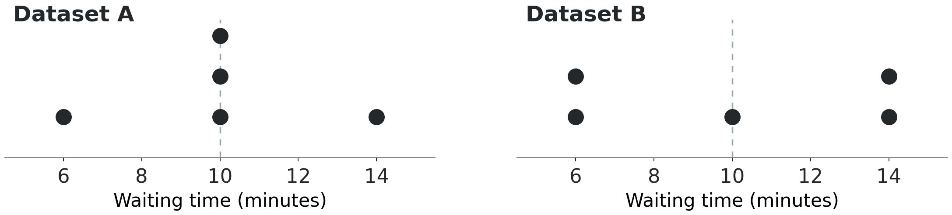
What the endpoints miss
HANDOUT • EXERCISE A4
Both datasets have mean 10 and range 8 minutes.
B has more values far from the mean.
We will measure this difference in Class B.
Notes:
Suggested time: 1 minutes.
The exact dotplots share the same scale. Dataset A has three values at 10; B has two values at 6 and two at 14. The range describes the endpoints but misses the difference in internal spread.
[Sources]
Visual template: Statistics-Week-2-Class-A.pptx, locked version 1. Original Bellerbys master/layouts, photographic cover/dividers and brand backgrounds retained.
Course content: user-provided Statistics Week 3 Lecture.pptx; Statistics Week 3 Seminar 2 Questions/Answers. Quartiles follow (n+1)p with linear interpolation.
Phone-call dataset: Michael Sullivan III, Statistics: Informed Decisions Using Data, 7th ed., p.126 (uploaded PDF p.156), Example 5/Table 3. Correction/deletion task is an original adaptation.
Distribution-shape teaching reference: Larson & Farber, Elementary Statistics: Picturing the World, 9th ed., p.72 (uploaded PDF p.96). Figures redrawn for this lesson.
Cafe waiting times and paired spread datasets are fictional instructional examples. Exact charts and mathematical figures were computed from the stated values. The 200-member gym context and large-set median examples are fictional teaching extensions. Typeset formulas and quartile diagrams are newly rendered mathematical assets. Campus illustrations were generated with ImageGen and are not documentary photographs of the source participants.
[/Sources]

Slide 21
Section 3:
Quartiles and
central spread
Notes:
Suggested time: 0.25 minutes.
Brief section transition. Retain authentic Bellerbys photographic divider.
[Sources]
Visual template: Statistics-Week-2-Class-A.pptx, locked version 1. Original Bellerbys master/layouts, photographic cover/dividers and brand backgrounds retained.
Course content: user-provided Statistics Week 3 Lecture.pptx; Statistics Week 3 Seminar 2 Questions/Answers. Quartiles follow (n+1)p with linear interpolation.
Phone-call dataset: Michael Sullivan III, Statistics: Informed Decisions Using Data, 7th ed., p.126 (uploaded PDF p.156), Example 5/Table 3. Correction/deletion task is an original adaptation.
Distribution-shape teaching reference: Larson & Farber, Elementary Statistics: Picturing the World, 9th ed., p.72 (uploaded PDF p.96). Figures redrawn for this lesson.
Cafe waiting times and paired spread datasets are fictional instructional examples. Exact charts and mathematical figures were computed from the stated values. The 200-member gym context and large-set median examples are fictional teaching extensions. Typeset formulas and quartile diagrams are newly rendered mathematical assets. Campus illustrations were generated with ImageGen and are not documentary photographs of the source participants.
[/Sources]

Slide 22
Why focus on the middle half?
Our phone-call range is 47 minutes because of one long call.
Can we describe the spread of the middle half,
with less influence from the extremes?
Notes:
Suggested time: 1 minutes.
Revisit the phone dataset deliberately. The range from1to48 is47minutes, but most calls are short. We need another measure for central spread with less influence from extremes. Introduce quartiles next. Do not delete observations to calculate this summary.
[Sources]
Visual template: Statistics-Week-2-Class-A.pptx, locked version 1. Original Bellerbys master/layouts, photographic cover/dividers and brand backgrounds retained.
Course content: user-provided Statistics Week 3 Lecture.pptx; Statistics Week 3 Seminar 2 Questions/Answers. Quartiles follow (n+1)p with linear interpolation.
Phone-call dataset: Michael Sullivan III, Statistics: Informed Decisions Using Data, 7th ed., p.126 (uploaded PDF p.156), Example 5/Table 3. Correction/deletion task is an original adaptation.
Distribution-shape teaching reference: Larson & Farber, Elementary Statistics: Picturing the World, 9th ed., p.72 (uploaded PDF p.96). Figures redrawn for this lesson.
Cafe waiting times and paired spread datasets are fictional instructional examples. Exact charts and mathematical figures were computed from the stated values. The 200-member gym context and large-set median examples are fictional teaching extensions. Typeset formulas and quartile diagrams are newly rendered mathematical assets. Campus illustrations were generated with ImageGen and are not documentary photographs of the source participants.
[/Sources]

Slide 23
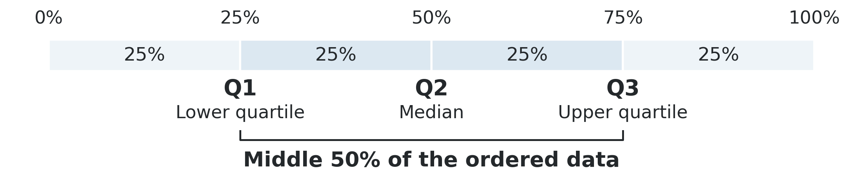
Quartiles mark three cut points
Ordered data is divided into four roughly equal groups.
Q2 is the median: the halfway point.
Q1 and Q3 mark the ends of the middle half.
Notes:
Suggested time: 2 minutes.
Quartile means a quarter point. Q1: lower quartile, near25%; Q2: median, near50%; Q3: upper quartile, near75%. The diagram shows ordered proportions, not equal distances in data units. With small datasets or ties, do not promise exactly25% strictly below each quartile. Locate the middle half before arithmetic.
[Sources]
Visual template: Statistics-Week-2-Class-A.pptx, locked version 1. Original Bellerbys master/layouts, photographic cover/dividers and brand backgrounds retained.
Course content: user-provided Statistics Week 3 Lecture.pptx; Statistics Week 3 Seminar 2 Questions/Answers. Quartiles follow (n+1)p with linear interpolation.
Phone-call dataset: Michael Sullivan III, Statistics: Informed Decisions Using Data, 7th ed., p.126 (uploaded PDF p.156), Example 5/Table 3. Correction/deletion task is an original adaptation.
Distribution-shape teaching reference: Larson & Farber, Elementary Statistics: Picturing the World, 9th ed., p.72 (uploaded PDF p.96). Figures redrawn for this lesson.
Cafe waiting times and paired spread datasets are fictional instructional examples. Exact charts and mathematical figures were computed from the stated values. The 200-member gym context and large-set median examples are fictional teaching extensions. Typeset formulas and quartile diagrams are newly rendered mathematical assets. Campus illustrations were generated with ImageGen and are not documentary photographs of the source participants.
[/Sources]

Slide 24
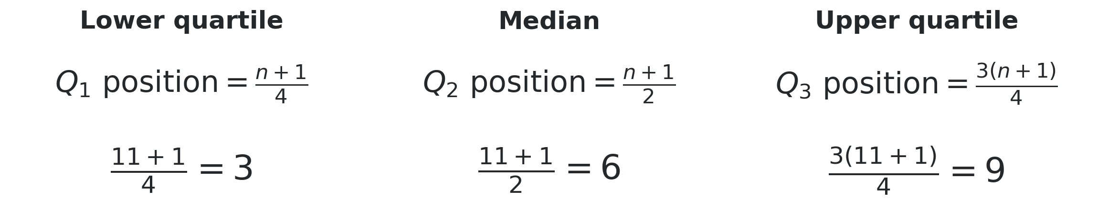
Find the quartile positions
n is the number of values. Example: 11 ordered test scores.
Our class method uses n + 1. These results are positions.
Next, read the values at those positions.
Notes:
Suggested time: 2.5 minutes.
Use the class quartile convention throughout: positions (n+1)/4, (n+1)/2 and 3(n+1)/4, followed by linear interpolation for fractional positions. For n=11 the positions are 3,6,9. Ask students which information is still needed: the observed values at those positions.
[Sources]
Visual template: Statistics-Week-2-Class-A.pptx, locked version 1. Original Bellerbys master/layouts, photographic cover/dividers and brand backgrounds retained.
Course content: user-provided Statistics Week 3 Lecture.pptx; Statistics Week 3 Seminar 2 Questions/Answers. Quartiles follow (n+1)p with linear interpolation.
Phone-call dataset: Michael Sullivan III, Statistics: Informed Decisions Using Data, 7th ed., p.126 (uploaded PDF p.156), Example 5/Table 3. Correction/deletion task is an original adaptation.
Distribution-shape teaching reference: Larson & Farber, Elementary Statistics: Picturing the World, 9th ed., p.72 (uploaded PDF p.96). Figures redrawn for this lesson.
Cafe waiting times and paired spread datasets are fictional instructional examples. Exact charts and mathematical figures were computed from the stated values. The 200-member gym context and large-set median examples are fictional teaching extensions. Typeset formulas and quartile diagrams are newly rendered mathematical assets. Campus illustrations were generated with ImageGen and are not documentary photographs of the source participants.
[/Sources]

Slide 25
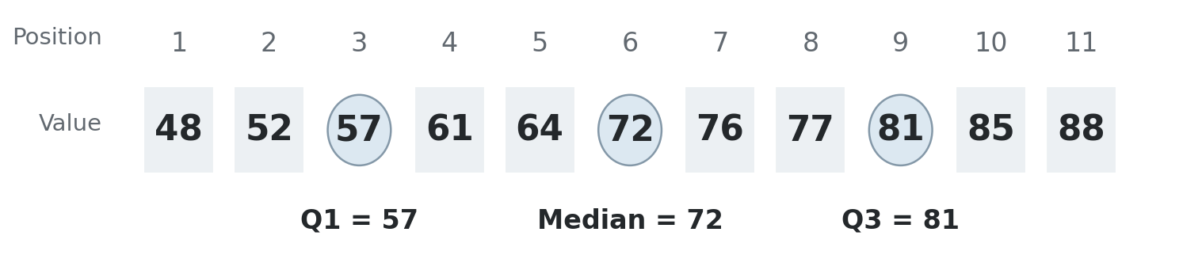
Read the quartile values
The 11 test scores below are ordered from lowest to highest.
3rd score: Q1 = 57; 6th score: median = 72
9th score: Q3 = 81
Notes:
Suggested time: 1.5 minutes.
Bellerbys Week3 lecture scores:48,52,57,61,64,72,76,77,81,85,88. Match positions3,6,9 with values57,72,81. Ask students to point to both rows. Define IQR on the next slide before using it.
[Sources]
Visual template: Statistics-Week-2-Class-A.pptx, locked version 1. Original Bellerbys master/layouts, photographic cover/dividers and brand backgrounds retained.
Course content: user-provided Statistics Week 3 Lecture.pptx; Statistics Week 3 Seminar 2 Questions/Answers. Quartiles follow (n+1)p with linear interpolation.
Phone-call dataset: Michael Sullivan III, Statistics: Informed Decisions Using Data, 7th ed., p.126 (uploaded PDF p.156), Example 5/Table 3. Correction/deletion task is an original adaptation.
Distribution-shape teaching reference: Larson & Farber, Elementary Statistics: Picturing the World, 9th ed., p.72 (uploaded PDF p.96). Figures redrawn for this lesson.
Cafe waiting times and paired spread datasets are fictional instructional examples. Exact charts and mathematical figures were computed from the stated values. The 200-member gym context and large-set median examples are fictional teaching extensions. Typeset formulas and quartile diagrams are newly rendered mathematical assets. Campus illustrations were generated with ImageGen and are not documentary photographs of the source participants.
[/Sources]

Slide 26

The interquartile range (IQR)
IQR is the distance from the lower quartile to the upper quartile.
The middle half runs from 57 to 81 points.
Its spread is 24 points.
Notes:
Suggested time: 2 minutes.
Say interquartile range before using IQR. Inter means between. It is upper quartile minus lower quartile:81−57=24points. This is a spread, not a central value. A smaller IQR means central values are closer together. IQR is less affected by extremes than the range.
[Sources]
Visual template: Statistics-Week-2-Class-A.pptx, locked version 1. Original Bellerbys master/layouts, photographic cover/dividers and brand backgrounds retained.
Course content: user-provided Statistics Week 3 Lecture.pptx; Statistics Week 3 Seminar 2 Questions/Answers. Quartiles follow (n+1)p with linear interpolation.
Phone-call dataset: Michael Sullivan III, Statistics: Informed Decisions Using Data, 7th ed., p.126 (uploaded PDF p.156), Example 5/Table 3. Correction/deletion task is an original adaptation.
Distribution-shape teaching reference: Larson & Farber, Elementary Statistics: Picturing the World, 9th ed., p.72 (uploaded PDF p.96). Figures redrawn for this lesson.
Cafe waiting times and paired spread datasets are fictional instructional examples. Exact charts and mathematical figures were computed from the stated values. The 200-member gym context and large-set median examples are fictional teaching extensions. Typeset formulas and quartile diagrams are newly rendered mathematical assets. Campus illustrations were generated with ImageGen and are not documentary photographs of the source participants.
[/Sources]

Slide 27
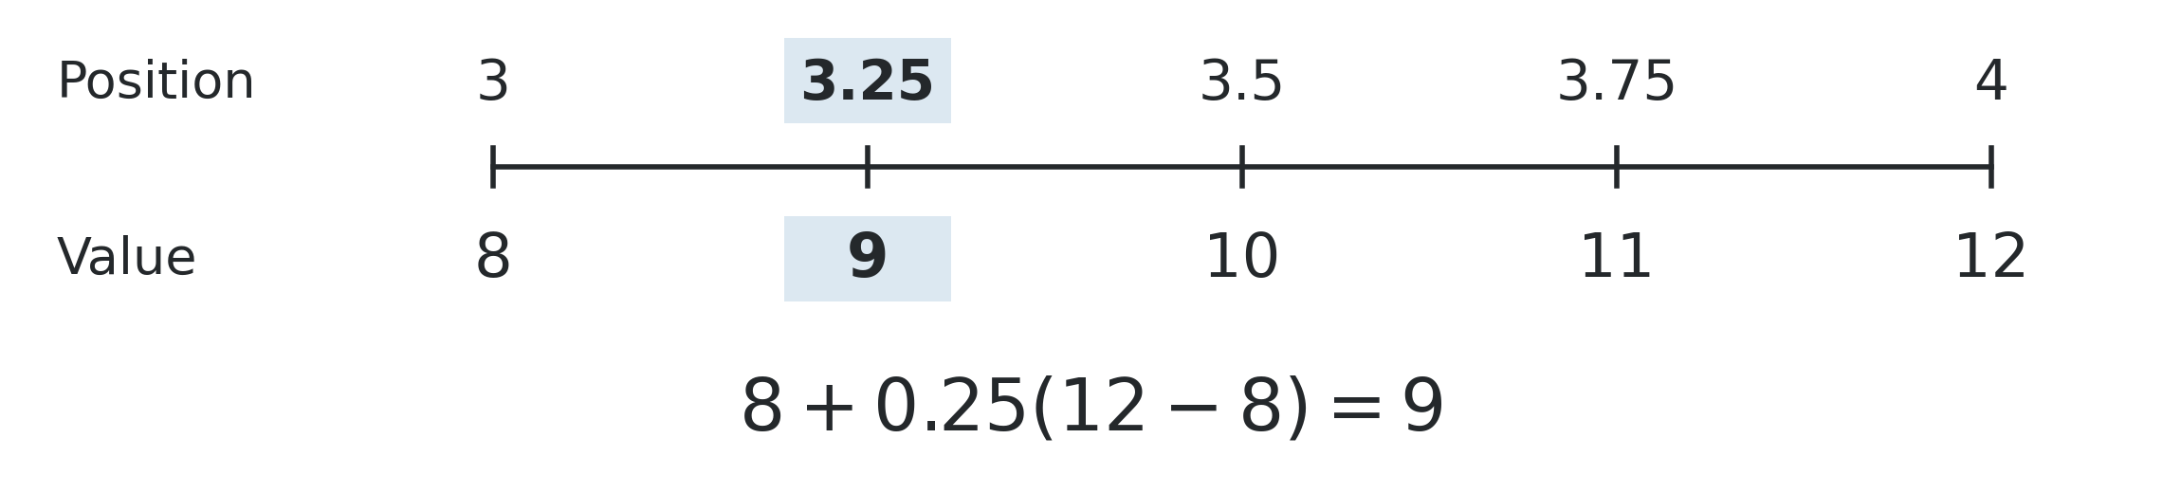
A value between two positions
At position 3.25, move 25% of the gap from the 3rd to the 4th value.
This method is called interpolation.
Your turn: position 2.75 lies between values 10 and 18.
What value belongs there? Show the fraction of the gap.
Notes:
Suggested time: 3.5 minutes.
Teach interpolation using the displayed 3.25 example: 8+0.25(12-8)=9. Then pause for the new 45-second check. At position 2.75 between values 10 and 18, start at 10 and move 0.75 of the gap: 10+0.75(18-10)=16. Invite students to explain the 0.75 before giving the answer.
[Sources]
Visual template: Statistics-Week-2-Class-A.pptx, locked version 1. Original Bellerbys master/layouts, photographic cover/dividers and brand backgrounds retained.
Course content: user-provided Statistics Week 3 Lecture.pptx; Statistics Week 3 Seminar 2 Questions/Answers. Quartiles follow (n+1)p with linear interpolation.
Phone-call dataset: Michael Sullivan III, Statistics: Informed Decisions Using Data, 7th ed., p.126 (uploaded PDF p.156), Example 5/Table 3. Correction/deletion task is an original adaptation.
Distribution-shape teaching reference: Larson & Farber, Elementary Statistics: Picturing the World, 9th ed., p.72 (uploaded PDF p.96). Figures redrawn for this lesson.
Cafe waiting times and paired spread datasets are fictional instructional examples. Exact charts and mathematical figures were computed from the stated values. The 200-member gym context and large-set median examples are fictional teaching extensions. Typeset formulas and quartile diagrams are newly rendered mathematical assets. Campus illustrations were generated with ImageGen and are not documentary photographs of the source participants.
[/Sources]

Slide 28
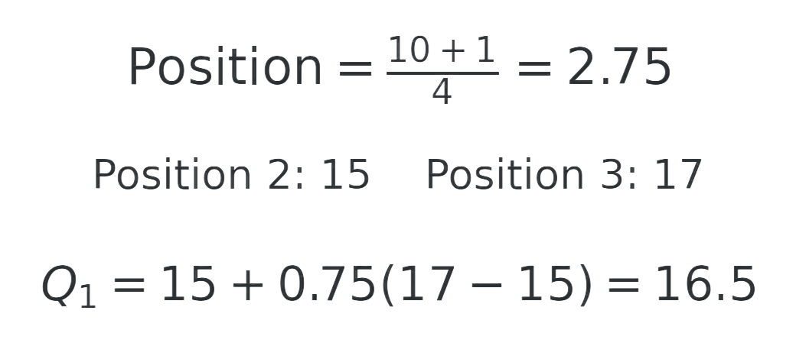
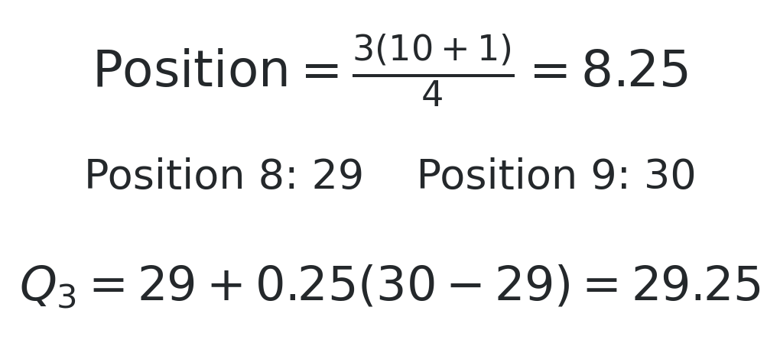
A worked example with 10 values
Daily transactions for 10 employees (ordered):
14, 15, 17, 22, 23, 24, 28, 29, 30, 37
Lower quartile: Q1
Upper quartile: Q3
IQR = 29.25 − 16.5 = 12.75 transactions. Keep the decimal part when finding each quartile.
Notes:
Suggested time: 3 minutes.
Bellerbys Seminar2 employee data; units are transactions. Show position, neighbours, interpolation. Q1position2.75 is between15and17; Q3position8.25 is between29and30. Q1=16.5,Q3=29.25,IQR12.75. Median23.5 if asked. Fractional summaries are possible even when observations are integer counts.
[Sources]
Visual template: Statistics-Week-2-Class-A.pptx, locked version 1. Original Bellerbys master/layouts, photographic cover/dividers and brand backgrounds retained.
Course content: user-provided Statistics Week 3 Lecture.pptx; Statistics Week 3 Seminar 2 Questions/Answers. Quartiles follow (n+1)p with linear interpolation.
Phone-call dataset: Michael Sullivan III, Statistics: Informed Decisions Using Data, 7th ed., p.126 (uploaded PDF p.156), Example 5/Table 3. Correction/deletion task is an original adaptation.
Distribution-shape teaching reference: Larson & Farber, Elementary Statistics: Picturing the World, 9th ed., p.72 (uploaded PDF p.96). Figures redrawn for this lesson.
Cafe waiting times and paired spread datasets are fictional instructional examples. Exact charts and mathematical figures were computed from the stated values. The 200-member gym context and large-set median examples are fictional teaching extensions. Typeset formulas and quartile diagrams are newly rendered mathematical assets. Campus illustrations were generated with ImageGen and are not documentary photographs of the source participants.
[/Sources]

Slide 29
Weekly exercise hours
HANDOUT • EXERCISE A5
The gym records weekly exercise hours for a sample of 16 members.
5, 1, 9, 3, 14, 6, 0, 11,
4, 18, 3, 8, 2, 12, 1, 7
1. Sort the observations.
2. Find Q₁, the median and Q₃.
3. Calculate and interpret the IQR.
Show the positions and interpolation.
Keep the original data for A6.
Notes:
Suggested time: 8 minutes.
A5. Protect 8 minutes for students to sort all 16 observations and calculate. The dataset is an original fictional teaching extension of the recurring gym case. Ordered values: 0,1,1,2,3,3,4,5,6,7,8,9,11,12,14,18. Total 104. Quartile positions 4.25,8.5,12.75. Q1=2.25, median=5.5, Q3=10.5, IQR=8.25 hours. Use the table in the revised handout. Keep this original dataset for A6.
[Sources]
Visual template: Statistics-Week-2-Class-A.pptx, locked version 1. Original Bellerbys master/layouts, photographic cover/dividers and brand backgrounds retained.
Course content: user-provided Statistics Week 3 Lecture.pptx; Statistics Week 3 Seminar 2 Questions/Answers. Quartiles follow (n+1)p with linear interpolation.
Phone-call dataset: Michael Sullivan III, Statistics: Informed Decisions Using Data, 7th ed., p.126 (uploaded PDF p.156), Example 5/Table 3. Correction/deletion task is an original adaptation.
Distribution-shape teaching reference: Larson & Farber, Elementary Statistics: Picturing the World, 9th ed., p.72 (uploaded PDF p.96). Figures redrawn for this lesson.
Cafe waiting times and paired spread datasets are fictional instructional examples. Exact charts and mathematical figures were computed from the stated values. The 200-member gym context and large-set median examples are fictional teaching extensions. Typeset formulas and quartile diagrams are newly rendered mathematical assets. Campus illustrations were generated with ImageGen and are not documentary photographs of the source participants.
[/Sources]
Revised exercise data and prompts are original fictional teaching examples. The gym sample now contains 16 observations with total104 hours.

Slide 30
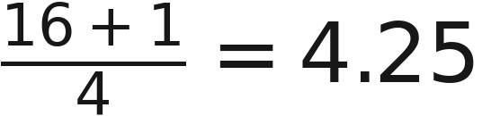
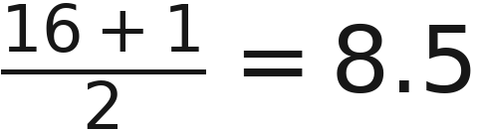
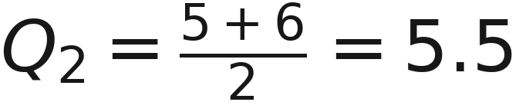
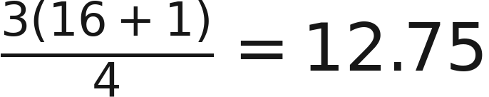
Quartiles and IQR
HANDOUT • EXERCISE A5
Ordered: 0, 1, 1, 2, 3, 3, 4, 5, 6, 7, 8, 9, 11, 12, 14, 18
Measure | Position | Working and value (hours)
Lower quartile, Q₁
Median, Q₂
Upper quartile, Q₃
Notes:
Suggested time: 3 minutes.
A5 answers. Q1 is between the 4th value 2 and 5th value 3: 2+0.25(3-2)=2.25. Median averages the 8th value 5 and 9th value 6, giving 5.5. Q3 is between the 12th value 9 and 13th value 11: 9+0.75(11-9)=10.5. IQR=10.5-2.25=8.25 hours. These are values, not positions.
[Sources]
Visual template: Statistics-Week-2-Class-A.pptx, locked version 1. Original Bellerbys master/layouts, photographic cover/dividers and brand backgrounds retained.
Course content: user-provided Statistics Week 3 Lecture.pptx; Statistics Week 3 Seminar 2 Questions/Answers. Quartiles follow (n+1)p with linear interpolation.
Phone-call dataset: Michael Sullivan III, Statistics: Informed Decisions Using Data, 7th ed., p.126 (uploaded PDF p.156), Example 5/Table 3. Correction/deletion task is an original adaptation.
Distribution-shape teaching reference: Larson & Farber, Elementary Statistics: Picturing the World, 9th ed., p.72 (uploaded PDF p.96). Figures redrawn for this lesson.
Cafe waiting times and paired spread datasets are fictional instructional examples. Exact charts and mathematical figures were computed from the stated values. The 200-member gym context and large-set median examples are fictional teaching extensions. Typeset formulas and quartile diagrams are newly rendered mathematical assets. Campus illustrations were generated with ImageGen and are not documentary photographs of the source participants.
[/Sources]
Revised exercise data and prompts are original fictional teaching examples. The gym sample now contains 16 observations with total104 hours.

Slide 31
The five-number summary
HANDOUT • EXERCISE A5
Add the minimum and maximum to the three quartiles.
Minimum | Q₁ | Median | Q₃ | Maximum
0 | 2.25 | 5.5 | 10.5 | 18
The middle half runs from 2.25 to 10.5 hours.
Its spread is 8.25 hours.
Notes:
Suggested time: 1 minutes.
The five-number summary is 0,2.25,5.5,10.5,18 hours. The IQR measures the spread of the middle half. With finite samples and ties, do not insist that exactly half the observations lie strictly between the quartiles.
[Sources]
Visual template: Statistics-Week-2-Class-A.pptx, locked version 1. Original Bellerbys master/layouts, photographic cover/dividers and brand backgrounds retained.
Course content: user-provided Statistics Week 3 Lecture.pptx; Statistics Week 3 Seminar 2 Questions/Answers. Quartiles follow (n+1)p with linear interpolation.
Phone-call dataset: Michael Sullivan III, Statistics: Informed Decisions Using Data, 7th ed., p.126 (uploaded PDF p.156), Example 5/Table 3. Correction/deletion task is an original adaptation.
Distribution-shape teaching reference: Larson & Farber, Elementary Statistics: Picturing the World, 9th ed., p.72 (uploaded PDF p.96). Figures redrawn for this lesson.
Cafe waiting times and paired spread datasets are fictional instructional examples. Exact charts and mathematical figures were computed from the stated values. The 200-member gym context and large-set median examples are fictional teaching extensions. Typeset formulas and quartile diagrams are newly rendered mathematical assets. Campus illustrations were generated with ImageGen and are not documentary photographs of the source participants.
[/Sources]
Revised exercise data and prompts are original fictional teaching examples. The gym sample now contains 16 observations with total104 hours.

Slide 32
One value changes
HANDOUT • EXERCISE A6
Replace 18 hours with 30 hours. Keep the other 15 observations.
Original total = 104 hours. Number of observations = 16.
1. Predict which summaries will change.
2. Check the mean, median, range and IQR.
3. Explain which summaries stay the same.
Stretch: start again with the original data. Replace 18 with
an unknown value so the new mean is 7.625 hours.
Find the unknown value. Does the IQR change?
Notes:
Suggested time: 5 minutes.
A6 core: replace 18 with 30, keeping n=16. Predict before checking. New total 104-18+30=116, mean 7.25 hours, median 5.5, range 30 and IQR 8.25. Optional stretch adds up to 3 minutes within the lesson buffer: start again with original total104 and replace18 by an unknown so mean7.625. New total122, remaining15 values total86, unknown36. Median and IQR stay unchanged because only the largest value changes. If time is short, set stretch for homework.
[Sources]
Visual template: Statistics-Week-2-Class-A.pptx, locked version 1. Original Bellerbys master/layouts, photographic cover/dividers and brand backgrounds retained.
Course content: user-provided Statistics Week 3 Lecture.pptx; Statistics Week 3 Seminar 2 Questions/Answers. Quartiles follow (n+1)p with linear interpolation.
Phone-call dataset: Michael Sullivan III, Statistics: Informed Decisions Using Data, 7th ed., p.126 (uploaded PDF p.156), Example 5/Table 3. Correction/deletion task is an original adaptation.
Distribution-shape teaching reference: Larson & Farber, Elementary Statistics: Picturing the World, 9th ed., p.72 (uploaded PDF p.96). Figures redrawn for this lesson.
Cafe waiting times and paired spread datasets are fictional instructional examples. Exact charts and mathematical figures were computed from the stated values. The 200-member gym context and large-set median examples are fictional teaching extensions. Typeset formulas and quartile diagrams are newly rendered mathematical assets. Campus illustrations were generated with ImageGen and are not documentary photographs of the source participants.
[/Sources]
Revised exercise data and prompts are original fictional teaching examples. The gym sample now contains 16 observations with total104 hours.

Slide 33
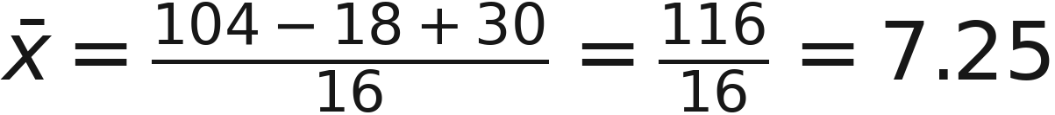
The effects of the replacement
HANDOUT • EXERCISE A6
Measure | Original data | Replace 18 with 30
Mean | 6.5 hours | 7.25 hours
Median | 5.5 hours | 5.5 hours
Range | 18 hours | 30 hours
IQR | 8.25 hours | 8.25 hours
The middle values stay fixed, so the median and IQR stay the same.
Stretch: the corrected record is 36 hours. The IQR stays 8.25 hours.
Notes:
Suggested time: 2 minutes.
A6 answers. Emphasise the reason for unchanged median and IQR: the relevant central ordered values stay the same. Resistance means less sensitivity, not that a summary never changes. Stretch answer: 16 times7.625=122; 122-(104-18)=36 hours. The two replacements are separate scenarios.
[Sources]
Visual template: Statistics-Week-2-Class-A.pptx, locked version 1. Original Bellerbys master/layouts, photographic cover/dividers and brand backgrounds retained.
Course content: user-provided Statistics Week 3 Lecture.pptx; Statistics Week 3 Seminar 2 Questions/Answers. Quartiles follow (n+1)p with linear interpolation.
Phone-call dataset: Michael Sullivan III, Statistics: Informed Decisions Using Data, 7th ed., p.126 (uploaded PDF p.156), Example 5/Table 3. Correction/deletion task is an original adaptation.
Distribution-shape teaching reference: Larson & Farber, Elementary Statistics: Picturing the World, 9th ed., p.72 (uploaded PDF p.96). Figures redrawn for this lesson.
Cafe waiting times and paired spread datasets are fictional instructional examples. Exact charts and mathematical figures were computed from the stated values. The 200-member gym context and large-set median examples are fictional teaching extensions. Typeset formulas and quartile diagrams are newly rendered mathematical assets. Campus illustrations were generated with ImageGen and are not documentary photographs of the source participants.
[/Sources]
Revised exercise data and prompts are original fictional teaching examples. The gym sample now contains 16 observations with total104 hours.

Slide 34
Section 4:
The shape
of data
Notes:
Suggested time: 0.25 minutes.
Brief section transition. Retain authentic Bellerbys photographic divider.
[Sources]
Visual template: Statistics-Week-2-Class-A.pptx, locked version 1. Original Bellerbys master/layouts, photographic cover/dividers and brand backgrounds retained.
Course content: user-provided Statistics Week 3 Lecture.pptx; Statistics Week 3 Seminar 2 Questions/Answers. Quartiles follow (n+1)p with linear interpolation.
Phone-call dataset: Michael Sullivan III, Statistics: Informed Decisions Using Data, 7th ed., p.126 (uploaded PDF p.156), Example 5/Table 3. Correction/deletion task is an original adaptation.
Distribution-shape teaching reference: Larson & Farber, Elementary Statistics: Picturing the World, 9th ed., p.72 (uploaded PDF p.96). Figures redrawn for this lesson.
Cafe waiting times and paired spread datasets are fictional instructional examples. Exact charts and mathematical figures were computed from the stated values. The 200-member gym context and large-set median examples are fictional teaching extensions. Typeset formulas and quartile diagrams are newly rendered mathematical assets. Campus illustrations were generated with ImageGen and are not documentary photographs of the source participants.
[/Sources]

Slide 35
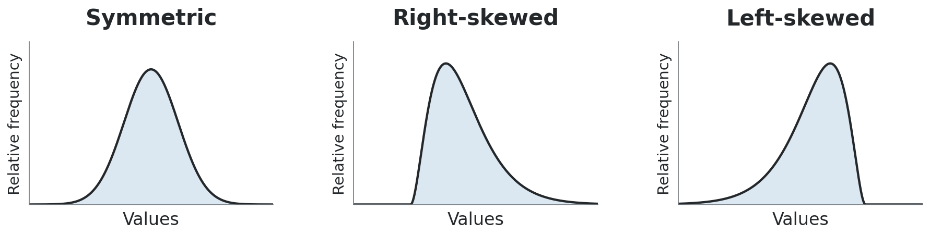
Which way does the tail go?
Values increase left to right. Height shows how common they are.
Name skewness by the long tail:
right tail = positive skew; left tail = negative skew.
Notes:
Suggested time: 2 minutes.
Illustrative shapes based on Larson and Farber, printed page 72 (PDF page 96), and Bellerbys Week 3 lecture slide 19. Explain the axes first. Identify skewness from the direction of the long tail. No histogram construction is required.
[Sources]
Visual template: Statistics-Week-2-Class-A.pptx, locked version 1. Original Bellerbys master/layouts, photographic cover/dividers and brand backgrounds retained.
Course content: user-provided Statistics Week 3 Lecture.pptx; Statistics Week 3 Seminar 2 Questions/Answers. Quartiles follow (n+1)p with linear interpolation.
Phone-call dataset: Michael Sullivan III, Statistics: Informed Decisions Using Data, 7th ed., p.126 (uploaded PDF p.156), Example 5/Table 3. Correction/deletion task is an original adaptation.
Distribution-shape teaching reference: Larson & Farber, Elementary Statistics: Picturing the World, 9th ed., p.72 (uploaded PDF p.96). Figures redrawn for this lesson.
Cafe waiting times and paired spread datasets are fictional instructional examples. Exact charts and mathematical figures were computed from the stated values. The 200-member gym context and large-set median examples are fictional teaching extensions. Typeset formulas and quartile diagrams are newly rendered mathematical assets. Campus illustrations were generated with ImageGen and are not documentary photographs of the source participants.
[/Sources]

Slide 36
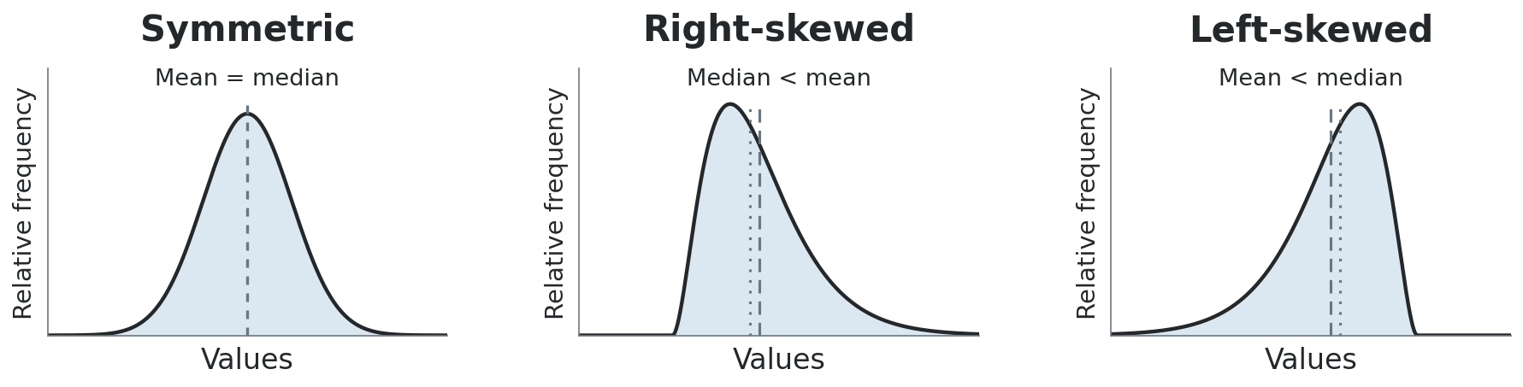
The mean follows the tail
Extreme values tend to pull the mean towards the tail.
For these typical shapes, compare mean and median.
Their order is a useful clue, not a proof of skewness.
Notes:
Suggested time: 1.5 minutes.
These typical unimodal distributions show the usual mean-median pattern. Treat that ordering as a clue, not a universal proof of skewness. A perfectly symmetric distribution with a finite mean and a unique median has the two at its centre.
[Sources]
Visual template: Statistics-Week-2-Class-A.pptx, locked version 1. Original Bellerbys master/layouts, photographic cover/dividers and brand backgrounds retained.
Course content: user-provided Statistics Week 3 Lecture.pptx; Statistics Week 3 Seminar 2 Questions/Answers. Quartiles follow (n+1)p with linear interpolation.
Phone-call dataset: Michael Sullivan III, Statistics: Informed Decisions Using Data, 7th ed., p.126 (uploaded PDF p.156), Example 5/Table 3. Correction/deletion task is an original adaptation.
Distribution-shape teaching reference: Larson & Farber, Elementary Statistics: Picturing the World, 9th ed., p.72 (uploaded PDF p.96). Figures redrawn for this lesson.
Cafe waiting times and paired spread datasets are fictional instructional examples. Exact charts and mathematical figures were computed from the stated values. The 200-member gym context and large-set median examples are fictional teaching extensions. Typeset formulas and quartile diagrams are newly rendered mathematical assets. Campus illustrations were generated with ImageGen and are not documentary photographs of the source participants.
[/Sources]

Slide 37
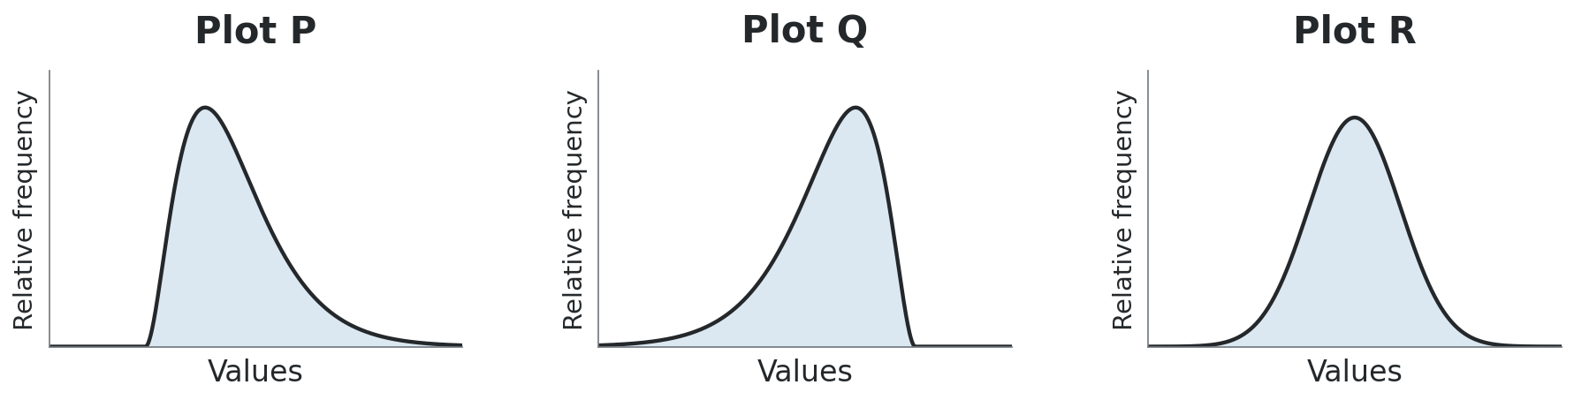
Shape detective
HANDOUT • EXERCISE A7
Match each situation to P, Q or R. Name the shape.
1. Most calls are short. A few calls last much longer.
2. Most test scores are high. A few are much lower.
3. Package weights spread similarly either side of 500 g.
Notes:
Suggested time: 1.5 minutes.
A7 part1. Consolidated matching check. Keep discussion brief. Calls match P, right-skewed. Scores match Q, left-skewed. Weights match R, symmetric. Require a reason based on the direction of the tail or the similar spread on both sides.
[Sources]
Visual template: Statistics-Week-2-Class-A.pptx, locked version 1. Original Bellerbys master/layouts, photographic cover/dividers and brand backgrounds retained.
Course content: user-provided Statistics Week 3 Lecture.pptx; Statistics Week 3 Seminar 2 Questions/Answers. Quartiles follow (n+1)p with linear interpolation.
Phone-call dataset: Michael Sullivan III, Statistics: Informed Decisions Using Data, 7th ed., p.126 (uploaded PDF p.156), Example 5/Table 3. Correction/deletion task is an original adaptation.
Distribution-shape teaching reference: Larson & Farber, Elementary Statistics: Picturing the World, 9th ed., p.72 (uploaded PDF p.96). Figures redrawn for this lesson.
Cafe waiting times and paired spread datasets are fictional instructional examples. Exact charts and mathematical figures were computed from the stated values. The 200-member gym context and large-set median examples are fictional teaching extensions. Typeset formulas and quartile diagrams are newly rendered mathematical assets. Campus illustrations were generated with ImageGen and are not documentary photographs of the source participants.
[/Sources]

Slide 38
The tail gives the direction
HANDOUT • EXERCISE A7
Situation | Plot and shape | Evidence
Call lengths | P: right-skewed | A few very long calls.
Test scores | Q: left-skewed | A few very low scores.
Package weights | R: symmetric | Similar spread on both sides.
The direction of the long tail determines the skew.
Notes:
Suggested time: 1 minutes.
A7 part1 answers. Matching is only the opening check. Continue directly to the explanation task. Symmetric does not necessarily mean bell-shaped; a uniform distribution is also symmetric.
[Sources]
Visual template: Statistics-Week-2-Class-A.pptx, locked version 1. Original Bellerbys master/layouts, photographic cover/dividers and brand backgrounds retained.
Course content: user-provided Statistics Week 3 Lecture.pptx; Statistics Week 3 Seminar 2 Questions/Answers. Quartiles follow (n+1)p with linear interpolation.
Phone-call dataset: Michael Sullivan III, Statistics: Informed Decisions Using Data, 7th ed., p.126 (uploaded PDF p.156), Example 5/Table 3. Correction/deletion task is an original adaptation.
Distribution-shape teaching reference: Larson & Farber, Elementary Statistics: Picturing the World, 9th ed., p.72 (uploaded PDF p.96). Figures redrawn for this lesson.
Cafe waiting times and paired spread datasets are fictional instructional examples. Exact charts and mathematical figures were computed from the stated values. The 200-member gym context and large-set median examples are fictional teaching extensions. Typeset formulas and quartile diagrams are newly rendered mathematical assets. Campus illustrations were generated with ImageGen and are not documentary photographs of the source participants.
[/Sources]

Slide 39
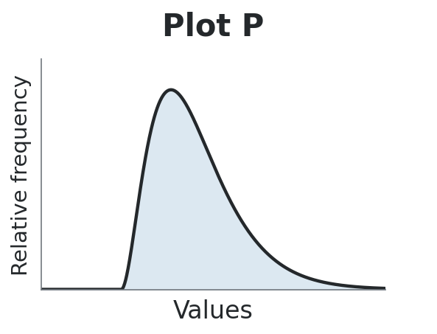
A student’s explanation
HANDOUT • EXERCISE A7
A student looks at plot P and says:
“Most calls are short,
so this is left-skewed.”
1. Correct the explanation using the tail.
2. For this shape, which is usually larger: mean or median?
3. Choose summaries for a typical call and the central spread.
Give a reason for each answer.
Notes:
Suggested time: 1.5 minutes.
A7 part2. Ask students to correct the claim, not merely say it is wrong. Plot P is right-skewed because the few long calls make a tail to the right. For this typical shape the mean is usually greater than the median. Median and IQR describe a typical call and the central spread with less influence from extremes.
[Sources]
Visual template: Statistics-Week-2-Class-A.pptx, locked version 1. Original Bellerbys master/layouts, photographic cover/dividers and brand backgrounds retained.
Course content: user-provided Statistics Week 3 Lecture.pptx; Statistics Week 3 Seminar 2 Questions/Answers. Quartiles follow (n+1)p with linear interpolation.
Phone-call dataset: Michael Sullivan III, Statistics: Informed Decisions Using Data, 7th ed., p.126 (uploaded PDF p.156), Example 5/Table 3. Correction/deletion task is an original adaptation.
Distribution-shape teaching reference: Larson & Farber, Elementary Statistics: Picturing the World, 9th ed., p.72 (uploaded PDF p.96). Figures redrawn for this lesson.
Cafe waiting times and paired spread datasets are fictional instructional examples. Exact charts and mathematical figures were computed from the stated values. The 200-member gym context and large-set median examples are fictional teaching extensions. Typeset formulas and quartile diagrams are newly rendered mathematical assets. Campus illustrations were generated with ImageGen and are not documentary photographs of the source participants.
[/Sources]

Slide 40
The explanation corrected
HANDOUT • EXERCISE A7
1. Plot P is right-skewed.
The few long calls form the tail towards larger values.
2. The mean is usually larger than the median here.
The long calls pull the mean towards the right tail.
3. Median for a typical call. IQR for central spread.
Both are less sensitive to the few very long calls.
Mean–median order is a clue. Check the distribution too.
Notes:
Suggested time: 1 minutes.
A7 part2 answers. Distinguish where most observations lie from the direction of the long tail. Mean-median ordering is a useful clue, not a universal proof. The mean can still be useful when the purpose involves totals.
[Sources]
Visual template: Statistics-Week-2-Class-A.pptx, locked version 1. Original Bellerbys master/layouts, photographic cover/dividers and brand backgrounds retained.
Course content: user-provided Statistics Week 3 Lecture.pptx; Statistics Week 3 Seminar 2 Questions/Answers. Quartiles follow (n+1)p with linear interpolation.
Phone-call dataset: Michael Sullivan III, Statistics: Informed Decisions Using Data, 7th ed., p.126 (uploaded PDF p.156), Example 5/Table 3. Correction/deletion task is an original adaptation.
Distribution-shape teaching reference: Larson & Farber, Elementary Statistics: Picturing the World, 9th ed., p.72 (uploaded PDF p.96). Figures redrawn for this lesson.
Cafe waiting times and paired spread datasets are fictional instructional examples. Exact charts and mathematical figures were computed from the stated values. The 200-member gym context and large-set median examples are fictional teaching extensions. Typeset formulas and quartile diagrams are newly rendered mathematical assets. Campus illustrations were generated with ImageGen and are not documentary photographs of the source participants.
[/Sources]

Slide 41
Choose measures together
What do you want your summary to describe?
Measure | What it uses | What it tells us
Mean | Every value | Arithmetic average
Median | Middle position(s) | The middle value
Range | Minimum and maximum | Spread from lowest to highest
IQR | Lower and upper quartiles | Spread of the middle half
With extreme values, median and IQR often describe a typical value and central spread well.
Notes:
Suggested time: 1 minutes.
Revisit the purpose of choosing centre and spread together. Mode was covered earlier; it answers most-popular-category or most-frequent-value questions. The mean remains useful for totals even when a distribution is asymmetric.
[Sources]
Visual template: Statistics-Week-2-Class-A.pptx, locked version 1. Original Bellerbys master/layouts, photographic cover/dividers and brand backgrounds retained.
Course content: user-provided Statistics Week 3 Lecture.pptx; Statistics Week 3 Seminar 2 Questions/Answers. Quartiles follow (n+1)p with linear interpolation.
Phone-call dataset: Michael Sullivan III, Statistics: Informed Decisions Using Data, 7th ed., p.126 (uploaded PDF p.156), Example 5/Table 3. Correction/deletion task is an original adaptation.
Distribution-shape teaching reference: Larson & Farber, Elementary Statistics: Picturing the World, 9th ed., p.72 (uploaded PDF p.96). Figures redrawn for this lesson.
Cafe waiting times and paired spread datasets are fictional instructional examples. Exact charts and mathematical figures were computed from the stated values. The 200-member gym context and large-set median examples are fictional teaching extensions. Typeset formulas and quartile diagrams are newly rendered mathematical assets. Campus illustrations were generated with ImageGen and are not documentary photographs of the source participants.
[/Sources]

Slide 42
Individual exit check
HANDOUT • EXERCISE A8
1. There are 18 ordered observations. The 4th value is 51
and the 5th is 59. Find Q₁ using our class method.
Explain why “Q₁ = 4.75” is incorrect.
2. Two gyms have the same median. Their IQRs are
3 hours and 8.25 hours. Which has less spread
in the middle half? Explain.
3. “Deleting an extreme value can never change the median.”
Agree or disagree? Use A2 as evidence.
Notes:
Suggested time: 3 minutes.
A8. Three minutes of individual work. Q1 position19/4=4.75, value51+0.75(59-51)=57. Gym with IQR3 has less spread in the central half; this does not assert that every observation is closer to the centre. Disagree with deletion claim: A2 changed median from3.5 to3.
[Sources]
Visual template: Statistics-Week-2-Class-A.pptx, locked version 1. Original Bellerbys master/layouts, photographic cover/dividers and brand backgrounds retained.
Course content: user-provided Statistics Week 3 Lecture.pptx; Statistics Week 3 Seminar 2 Questions/Answers. Quartiles follow (n+1)p with linear interpolation.
Phone-call dataset: Michael Sullivan III, Statistics: Informed Decisions Using Data, 7th ed., p.126 (uploaded PDF p.156), Example 5/Table 3. Correction/deletion task is an original adaptation.
Distribution-shape teaching reference: Larson & Farber, Elementary Statistics: Picturing the World, 9th ed., p.72 (uploaded PDF p.96). Figures redrawn for this lesson.
Cafe waiting times and paired spread datasets are fictional instructional examples. Exact charts and mathematical figures were computed from the stated values. The 200-member gym context and large-set median examples are fictional teaching extensions. Typeset formulas and quartile diagrams are newly rendered mathematical assets. Campus illustrations were generated with ImageGen and are not documentary photographs of the source participants.
[/Sources]
Revised exercise data and prompts are original fictional teaching examples. The gym sample now contains 16 observations with total104 hours.

Slide 43
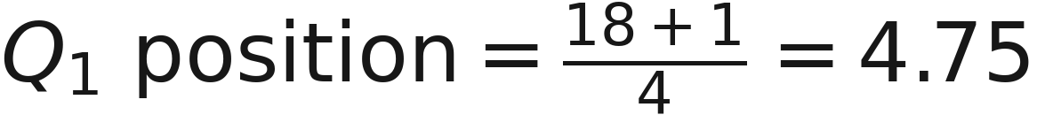
Exit check answers
HANDOUT • EXERCISE A8
1. The position is 4.75. The lower quartile value is 57.
2. The gym with IQR = 3 hours has less spread
in the middle half of its observations.
3. Disagree. In A2, deleting the 48-minute call
changed the median from 3.5 to 3 minutes.
Notes:
Suggested time: 2 minutes.
A8 answers. Ask for position and value separately. Do not infer complete spread from IQR alone. The phone-call counterexample shows why resistant does not mean never changes. Next class introduces deviation, variance and standard deviation. The core timings total 85.0 minutes, with a three-minute optional A6 stretch and remaining transition buffer.
[Sources]
Visual template: Statistics-Week-2-Class-A.pptx, locked version 1. Original Bellerbys master/layouts, photographic cover/dividers and brand backgrounds retained.
Course content: user-provided Statistics Week 3 Lecture.pptx; Statistics Week 3 Seminar 2 Questions/Answers. Quartiles follow (n+1)p with linear interpolation.
Phone-call dataset: Michael Sullivan III, Statistics: Informed Decisions Using Data, 7th ed., p.126 (uploaded PDF p.156), Example 5/Table 3. Correction/deletion task is an original adaptation.
Distribution-shape teaching reference: Larson & Farber, Elementary Statistics: Picturing the World, 9th ed., p.72 (uploaded PDF p.96). Figures redrawn for this lesson.
Cafe waiting times and paired spread datasets are fictional instructional examples. Exact charts and mathematical figures were computed from the stated values. The 200-member gym context and large-set median examples are fictional teaching extensions. Typeset formulas and quartile diagrams are newly rendered mathematical assets. Campus illustrations were generated with ImageGen and are not documentary photographs of the source participants.
[/Sources]
Revised exercise data and prompts are original fictional teaching examples. The gym sample now contains 16 observations with total104 hours.

