Slide 1
IFY Statistics
Week 3 • Class B
Understanding
variation
Notes:
This is a 90-minute class with 43 core slides and two optional extension slides. Allow 5 minutes for retrieval, 28 minutes for deviation, variance and SD, 25 minutes for population and sample calculations, 14 minutes for CV, 10 minutes for kurtosis and 5 minutes for the exit check, plus a 3-minute transition buffer. The optional challenge is outside this core timing.
Sources: User-provided IFY_Statistics_Week_3_Class_B(1).pptx for the original Bellerbys theme, layouts, photography and instructional figures. Statistics Week 3 Lecture(1).pptx for content scope and the eight-value sample exercise. Other numerical examples are illustrative classroom data.

Slide 2
Today’s route
Each section includes an example and a chance to practise.
1. Deviation
2. Variance and standard deviation
3. Population and sample
4. Coefficient of variation
5. Kurtosis and tail patterns
Calculate the result. Explain what it tells us.
Notes:
Briefly explain the five sections. We will first build the method together, then use guided and independent practice. Ask students to calculate each result and explain what it means in its context.
Sources: User-provided IFY_Statistics_Week_3_Class_B(1).pptx for the original Bellerbys theme, layouts, photography and instructional figures. Statistics Week 3 Lecture(1).pptx for content scope and the eight-value sample exercise. Other numerical examples are illustrative classroom data.

Slide 3

Revision: one complete shift
REVISION
These are the waits of all five customers in one shift.
6, 10, 10, 10, 14 minutes
1. Find the mean and range.
2. Population or sample
for this shift? Explain.
Our target group is the customers in this particular shift.
Notes:
All five customers in the specified shift were observed. Ask students to respond individually before revealing the next slide. The mean is 10 minutes and the range is 8 minutes; these five customers form the population for this shift.
Sources: User-provided IFY_Statistics_Week_3_Class_B(1).pptx for the original Bellerbys theme, layouts, photography and instructional figures. Statistics Week 3 Lecture(1).pptx for content scope and the eight-value sample exercise. Other numerical examples are illustrative classroom data.

Slide 4

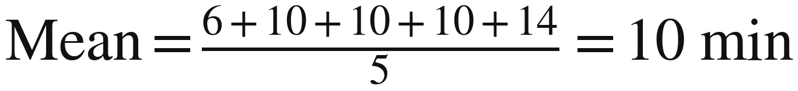

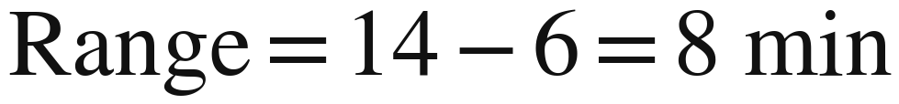
Revision: check your answers
REVISION ANSWERS
Mean describes the average. Range uses the two endpoints.
?
Population: every customer in the target shift is included.
Notes:
Check the mean, range and target group separately. The population is defined by the question: all customers in this particular shift are included. A small group can still be a population.
Sources: User-provided IFY_Statistics_Week_3_Class_B(1).pptx for the original Bellerbys theme, layouts, photography and instructional figures. Statistics Week 3 Lecture(1).pptx for content scope and the eight-value sample exercise. Other numerical examples are illustrative classroom data.

Slide 5
Section 1:
Deviation
How far above or below the mean
is one observation?
Notes:
Introduce variation, or dispersion, as how spread out the values are. First compare the two groups, then explain the signed difference between one observation and the mean.
Sources: User-provided IFY_Statistics_Week_3_Class_B(1).pptx for the original Bellerbys theme, layouts, photography and instructional figures. Statistics Week 3 Lecture(1).pptx for content scope and the eight-value sample exercise. Other numerical examples are illustrative classroom data.

Slide 6
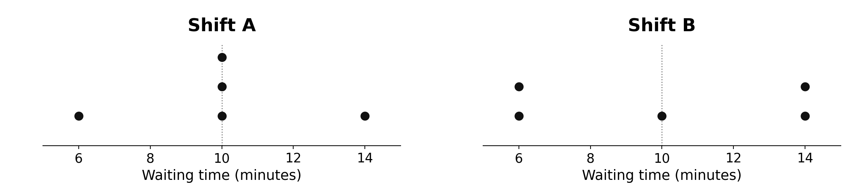
Same mean, same range
Variation, or dispersion, describes how spread out values are.
Which shift is more consistent? Use the dots to explain.
Notes:
Shift A contains 6, 10, 10, 10 and 14 minutes; Shift B contains 6, 6, 10, 14 and 14 minutes. Both have a mean of 10 minutes and a range of 8 minutes, but Shift B has more observations away from the mean. The dot plots use identical axes so students can compare their spread directly.
Sources: User-provided IFY_Statistics_Week_3_Class_B(1).pptx for the original Bellerbys theme, layouts, photography and instructional figures. Statistics Week 3 Lecture(1).pptx for content scope and the eight-value sample exercise. Other numerical examples are illustrative classroom data.

Slide 7
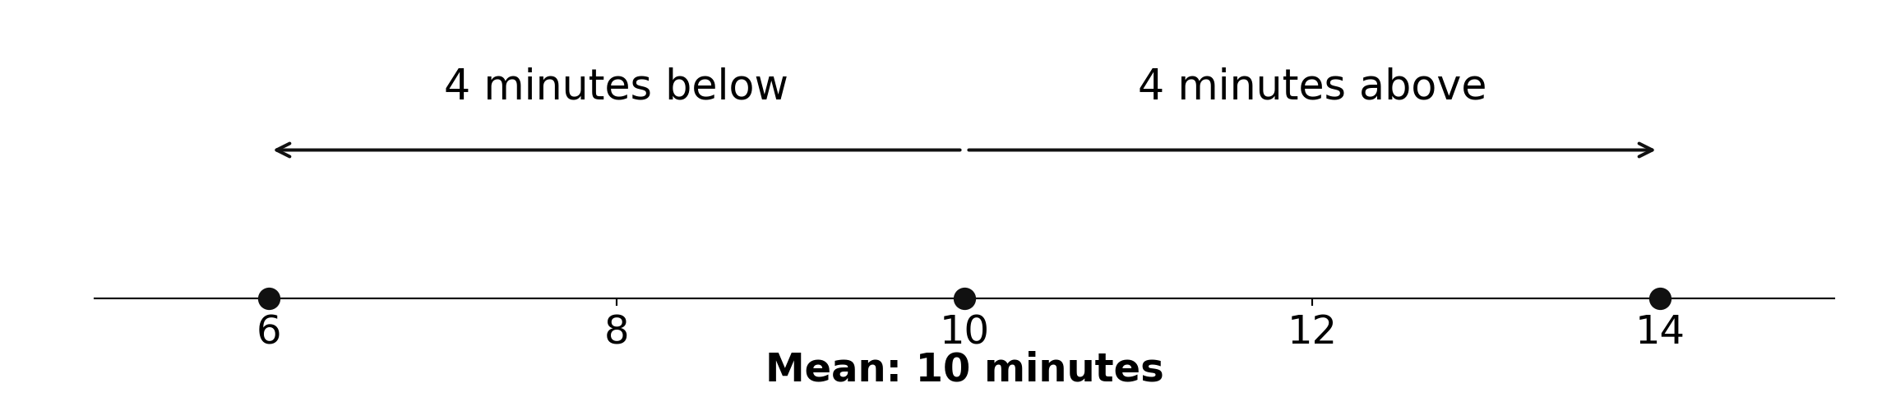
Above or below the mean?
The mean waiting time is 10 minutes.
Describe the direction first. Then calculate the difference.
Notes:
The mean is 10 minutes. A wait of 6 minutes is four minutes below the mean; 10 is at the mean; 14 is four minutes above it. Establish this everyday language before introducing signed deviations.
Sources: User-provided IFY_Statistics_Week_3_Class_B(1).pptx for the original Bellerbys theme, layouts, photography and instructional figures. Statistics Week 3 Lecture(1).pptx for content scope and the eight-value sample exercise. Other numerical examples are illustrative classroom data.

Slide 8
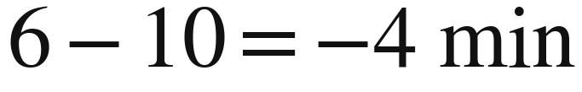
Deviation: one value and the mean
WORKED EXAMPLE
A deviation is one observation minus the mean.
Sign | Meaning
Negative | Below the mean
Zero | At the mean
Positive | Above the mean
A deviation of −4 minutes means a wait 4 minutes below the mean.
Notes:
A deviation is signed, whereas a distance is nonnegative. Read −4 as four minutes below the mean. The waiting time itself is still 6 minutes, not −4 minutes.
Sources: User-provided IFY_Statistics_Week_3_Class_B(1).pptx for the original Bellerbys theme, layouts, photography and instructional figures. Statistics Week 3 Lecture(1).pptx for content scope and the eight-value sample exercise. Other numerical examples are illustrative classroom data.

Slide 9
B1a: complete the deviations
B1a • GUIDED PRACTICE
Shift A: subtract the mean of 10 from each wait.
Wait (min) | Calculation | Deviation (min)
6 | 6 − 10 | −4
10 | Your turn
10
10
14
Total
Finish the blank cells. What is the total of the deviations?
Notes:
Model the first row. Students complete the remaining four rows and add the deviations before the next reveal. Work alongside students during this guided task.
Sources: User-provided IFY_Statistics_Week_3_Class_B(1).pptx for the original Bellerbys theme, layouts, photography and instructional figures. Statistics Week 3 Lecture(1).pptx for content scope and the eight-value sample exercise. Other numerical examples are illustrative classroom data.

Slide 10
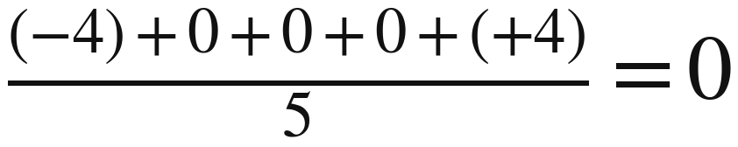
B1a: why does the total equal zero?
B1a • WORKED ANSWERS
Positive and negative deviations cancel.
Does zero here mean that everyone waited the same time?
Notes:
The deviations are −4, 0, 0, 0 and +4, with a total of zero. Signed deviations from the arithmetic mean cancel, so a zero total does not mean there is no spread. Squaring is one way to prevent cancellation; it is not the only possible way to measure spread.
Sources: User-provided IFY_Statistics_Week_3_Class_B(1).pptx for the original Bellerbys theme, layouts, photography and instructional figures. Statistics Week 3 Lecture(1).pptx for content scope and the eight-value sample exercise. Other numerical examples are illustrative classroom data.

Slide 11
Section 2:
Variance and
standard deviation
How can we combine all the
deviations into one measure of spread?
Notes:
Use the cancellation problem to motivate the next step. Continue with the same five-customer shift while introducing population variance and standard deviation.
Sources: User-provided IFY_Statistics_Week_3_Class_B(1).pptx for the original Bellerbys theme, layouts, photography and instructional figures. Statistics Week 3 Lecture(1).pptx for content scope and the eight-value sample exercise. Other numerical examples are illustrative classroom data.

Slide 12
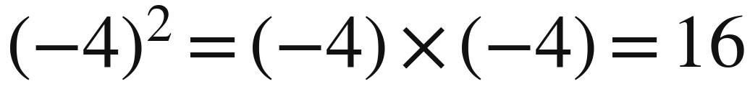
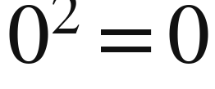
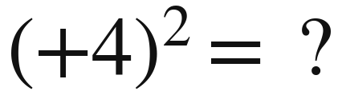
Squared deviation
WORKED EXAMPLE
A squared deviation is a deviation multiplied by itself.
Squares cannot be negative. Larger deviations contribute more.
Notes:
Squaring means multiplying a number by itself: (−4)² = 16, 0² = 0 and (+4)² = 16. Keep parentheses around negative numbers. Squaring also gives larger deviations more weight.
Sources: User-provided IFY_Statistics_Week_3_Class_B(1).pptx for the original Bellerbys theme, layouts, photography and instructional figures. Statistics Week 3 Lecture(1).pptx for content scope and the eight-value sample exercise. Other numerical examples are illustrative classroom data.

Slide 13

B1a: add the squared deviations
B1a • GUIDED PRACTICE
Keep the same values and the same mean: 10 minutes.
Wait (min) | Deviation (min) | Squared deviation (min²)
6 | −4 | 16
10 | 0
10 | 0
10 | 0
14 | +4
Total | 0
Σ is capital sigma. It means “add all these terms”. Total the last column.
Notes:
Students extend their existing table rather than start a new dataset. The squared deviations are 16, 0, 0, 0 and 16, with a total of 32 min². Introduce capital sigma, Σ, as the instruction to add the terms; distinguish it from lowercase sigma, σ, used for population SD. The next slide uses this total.
Sources: User-provided IFY_Statistics_Week_3_Class_B(1).pptx for the original Bellerbys theme, layouts, photography and instructional figures. Statistics Week 3 Lecture(1).pptx for content scope and the eight-value sample exercise. Other numerical examples are illustrative classroom data.

Slide 14
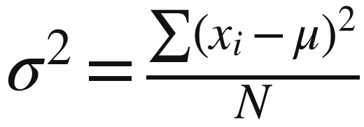
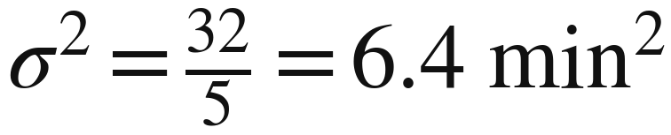
Population variance
WORKED EXAMPLE
Population variance is the average of the squared deviations.
Symbol / name | Meaning
σ² sigma squared | Population variance
xᵢ x sub i | One observation
μ mu | Population mean
N capital N | Population count
Σ capital sigma | Add all terms
All five customers are included. Divide by 5. Variance has squared units.
Notes:
Population variance is the average squared deviation from the population mean. Here the target is the complete five-customer shift, so divide the total of 32 min² by N = 5. Read σ² as sigma squared, μ as mu, N as capital N and Σ as capital sigma. Read xᵢ as x sub i: the ith observation.
Sources: User-provided IFY_Statistics_Week_3_Class_B(1).pptx for the original Bellerbys theme, layouts, photography and instructional figures. Statistics Week 3 Lecture(1).pptx for content scope and the eight-value sample exercise. Other numerical examples are illustrative classroom data.

Slide 15
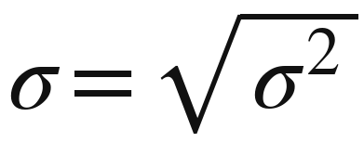
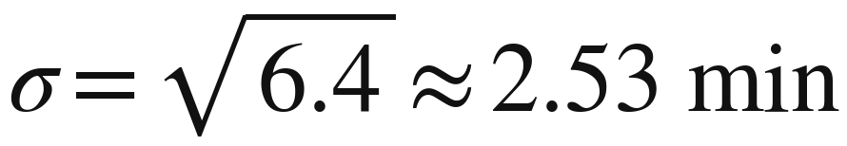
Standard deviation: back to minutes
WORKED EXAMPLE
Standard deviation is the square root of variance.
σ is “sigma”, population standard deviation.
The square root returns the result to the original units: minutes.
Notes:
Standard deviation is the square root of variance and expresses spread around the mean in the original units. It is not the arithmetic mean of absolute deviations, nor a fixed distance for every observation. Explain that the approximation sign indicates a rounded result.
Sources: User-provided IFY_Statistics_Week_3_Class_B(1).pptx for the original Bellerbys theme, layouts, photography and instructional figures. Statistics Week 3 Lecture(1).pptx for content scope and the eight-value sample exercise. Other numerical examples are illustrative classroom data.

Slide 16
Mean and SD answer different questions
The manager wants short waits and consistent waits.
Measure | Our shift | What it tells us
Mean | 10 minutes | The average wait
Standard deviation | About 2.53 minutes | Spread around the mean
If every customer waited 10 minutes: mean = 10, SD = 0.
Notes:
The manager wants both short waits and consistent waits. Five waits of exactly 10 minutes have a mean of 10 minutes and an SD of zero. Do not infer a normal-distribution percentage or a guaranteed range from mean ± SD in this example.
Sources: User-provided IFY_Statistics_Week_3_Class_B(1).pptx for the original Bellerbys theme, layouts, photography and instructional figures. Statistics Week 3 Lecture(1).pptx for content scope and the eight-value sample exercise. Other numerical examples are illustrative classroom data.

Slide 17
Deviation and standard deviation
One observation or spread across the whole dataset?
Feature | Deviation | Standard deviation
Describes | One observation | The whole dataset
Meaning | Signed difference from the mean | Overall spread around the mean
Possible sign | Negative, zero or positive | Zero or positive
Units | Original units | Original units
Example | 6 − 10 = −4 minutes | About 2.53 minutes
Several deviations combine through their squares to produce one SD.
Notes:
Each observation has its own signed deviation, while one standard deviation combines the squared deviations across the dataset. Both deviation and SD use the original units, but SD cannot be negative. Use this table as a reference during later tasks; ensure students can read the full table and its footer.
Sources: User-provided IFY_Statistics_Week_3_Class_B(1).pptx for the original Bellerbys theme, layouts, photography and instructional figures. Statistics Week 3 Lecture(1).pptx for content scope and the eight-value sample exercise. Other numerical examples are illustrative classroom data.

Slide 18
B1b: another complete shift
B1b • INDEPENDENT PRACTICE
All eight customers waited the following times, in minutes.
7, 12, 9, 14, 8, 11, 15, 10
1. Calculate the mean and complete your working table.
2. Calculate variance and standard deviation.
3. Compare the average and spread with Shift A.
Shift A: mean 10 min, SD 2.53 min. Give your SD to two decimal places.
Notes:
Allow 7 minutes of individual work, followed by a brief partner check. All eight customers form the population for this shift: the mean is 10.75 minutes, the sum of squared deviations is 55.5 min², the population variance is 6.9375 min² and the SD is about 2.63 minutes. Retain full calculator precision until the final answer. Compare only these observed shifts: Shift A has mean 10 minutes and SD 2.53 minutes.
Sources: User-provided IFY_Statistics_Week_3_Class_B(1).pptx for the original Bellerbys theme, layouts, photography and instructional figures. Statistics Week 3 Lecture(1).pptx for content scope and the eight-value sample exercise. Other numerical examples are illustrative classroom data.

Slide 19
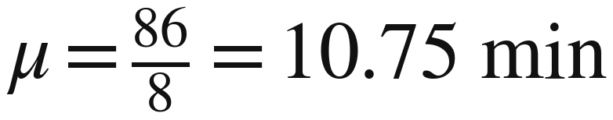
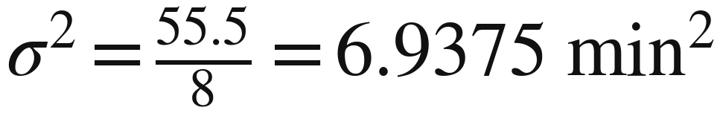
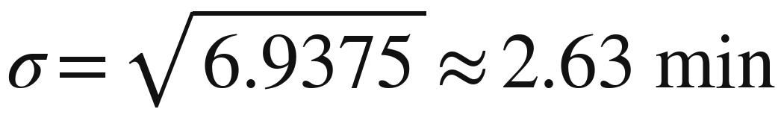
B1b: calculation and interpretation
B1b • WORKED ANSWERS
Use every customer in this shift: divide by 8.
Wait | Deviation | Squared deviation
7 | −3.75 | 14.0625
12 | 1.25 | 1.5625
9 | −1.75 | 3.0625
14 | 3.25 | 10.5625
8 | −2.75 | 7.5625
11 | 0.25 | 0.0625
15 | 4.25 | 18.0625
10 | −0.75 | 0.5625
Total | 0 | 55.5
Higher mean (10.75 vs 10) and slightly greater spread (2.63 vs 2.53).
Notes:
The table shows exact deviations and squares. The mean is 86 ÷ 8 = 10.75 minutes; the sum of squared deviations is 55.5 min²; population variance is 6.9375 min²; SD is 2.633913… minutes, which rounds to 2.63. This shift has a slightly higher mean and SD than Shift A. Do not make a wider population inference or a claim of statistical significance.
Sources: User-provided IFY_Statistics_Week_3_Class_B(1).pptx for the original Bellerbys theme, layouts, photography and instructional figures. Statistics Week 3 Lecture(1).pptx for content scope and the eight-value sample exercise. Other numerical examples are illustrative classroom data.

Slide 20
Section 3:
Population
and sample
Are we describing the whole group
or estimating it from a sample?
Notes:
Maintain the café context. The target group now changes from one complete shift to all customers in an entire month.
Sources: User-provided IFY_Statistics_Week_3_Class_B(1).pptx for the original Bellerbys theme, layouts, photography and instructional figures. Statistics Week 3 Lecture(1).pptx for content scope and the eight-value sample exercise. Other numerical examples are illustrative classroom data.

Slide 21
Population, sample and estimate
The manager wants to understand all 2,000 customers in a month.
Term | Plain meaning | Our café example
Population | The complete target group | All 2,000 customers
Sample | Selected observations from that group | 8 randomly selected customers
Estimate | A calculated approximation of an unknown value | Use the sample to estimate the month’s mean and SD
A sample saves time. A different sample can give different estimates.
Notes:
Define the target group first: all 2,000 customers in one month. A random sample consists of eight selected customers from that month. An estimate is a calculated approximation, not a guaranteed exact value. The guided and independent tasks below use separate illustrative random samples in the same café context.
Sources: User-provided IFY_Statistics_Week_3_Class_B(1).pptx for the original Bellerbys theme, layouts, photography and instructional figures. Statistics Week 3 Lecture(1).pptx for content scope and the eight-value sample exercise. Other numerical examples are illustrative classroom data.

Slide 22
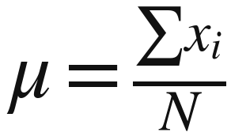
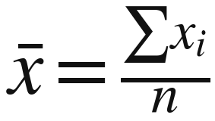
Population mean and sample mean
Both means use total divided by count. Their purposes differ.
Population mean
Sample mean
μ “mu” N population count
Describes the complete group.
x̄ “x-bar” n sample count
Estimates the population mean.
The sample mean describes the observed sample and estimates the larger group.
Notes:
Both means divide the total by the observation count. The sample mean describes the eight observed customers and estimates the unknown population mean for the month. Explicitly distinguish capital N from lowercase n. Neither mean uses n − 1 as its divisor.
Sources: User-provided IFY_Statistics_Week_3_Class_B(1).pptx for the original Bellerbys theme, layouts, photography and instructional figures. Statistics Week 3 Lecture(1).pptx for content scope and the eight-value sample exercise. Other numerical examples are illustrative classroom data.

Slide 23
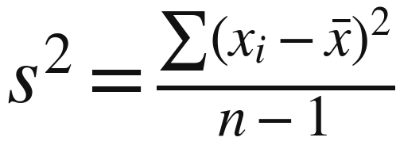
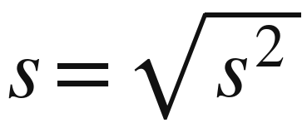
Sample variance and standard deviation
Use the same working table, with divisor n − 1.
Symbol / name | Meaning
s² s squared | Sample variance
s s | Sample SD
xᵢ x sub i | One observation
x̄ x-bar | Sample mean
n lowercase n | Sample count
Mean: divide by n. Variance: divide by n − 1. SD: take the square root.
Notes:
Read s² as s squared and s as s. The sample formula requires n greater than 1. Apply the n − 1 adjustment when calculating variance, then take the square root to obtain SD. Retain full precision, and remind students that the sample mean and count symbols have already been introduced.
Sources: User-provided IFY_Statistics_Week_3_Class_B(1).pptx for the original Bellerbys theme, layouts, photography and instructional figures. Statistics Week 3 Lecture(1).pptx for content scope and the eight-value sample exercise. Other numerical examples are illustrative classroom data.

Slide 24
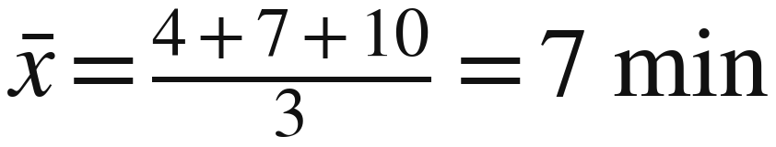
Why a sample needs an adjustment
WORKED EXAMPLE
We use a sample to estimate the spread of the whole population.
Sample waits: 4, 7, 10 minutes
1. We calculate the mean from the
same sample.
2. This mean makes the total of
squared deviations smallest.
Centre | Squared deviations | Total
6 | 4 + 1 + 16 | 21
7 (mean) | 9 + 0 + 9 | 18
8 | 16 + 1 + 4 | 21
3. Dividing that total by n gives
population variance estimates
that are too small on average.
The other centres are comparisons.
Using n − 1 corrects this average underestimate across repeated random samples.
Notes:
Replace the original abstract n-minus-one slide with these two slides, in this order. Allow around four minutes in total. This illustrative random sample contains waiting times 4, 7 and 10 minutes. We want to estimate the variance of a wider population whose mean is unknown.
First calculate the sample mean, 7 minutes. The table compares three possible centres. The rows for 6 and 8 are comparison centres, not claims about the population mean. For centre 6 the signed deviations are -2, 1, 4 and the squared deviations are 4, 1, 16. For centre 7 they are -3, 0, 3 and 9, 0, 9. For centre 8 they are -4, -1, 2 and 16, 1, 4. The sample mean minimises the sum of squared deviations among all possible centres, not merely the three shown.
When independent observations come from the same population with finite variance, using the sample mean and dividing by n gives an estimate with expectation (n-1)/n times the population variance. Dividing by n-1 corrects that downward bias. This is a statement about the method over repeated random samples, not a claim that each particular sample underestimates the true variance. The correction applies to variance. Taking its square root does not make sample SD exactly unbiased.
Source: https://online.stat.psu.edu/stat500/Lesson01 (Variance section). Numerical example developed for this class.

Slide 25
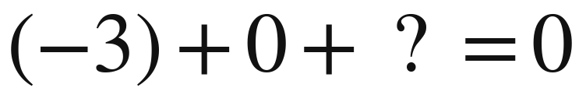
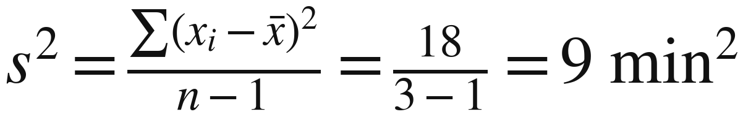
Why exactly one less?
WORKED EXAMPLE
Deviations from the sample mean must add to zero.
Three values (n = 3). Mean = 7 min.
Wait | Deviation | Squared
4 | 4 − 7 = −3 | 9
7 | 7 − 7 = 0 | 0
10 | 10 − 7 = +3 | 9
Total | 0 | 18
The last deviation must be +3.
Once the other two are known,
the last one is fixed.
Two deviations can vary freely.
These are 2 degrees of freedom.
We use all three values. The −1 changes the divisor and removes no observation.
Notes:
Continue with the same sample 4, 7, 10 minutes and mean 7. The table shows every subtraction before any squaring. Cover or pause before reading the +3 row and ask: if deviations must total zero, what must the last one be? Once the other two deviations are known, the third must be +3. There are n-1 freely varying deviations. This number is called the degrees of freedom. The zero-sum constraint illustrates why one is lost when the mean is calculated from the sample; it is not a full proof of the unbiasedness result.
The squared deviations are 9, 0, 9, giving a total of 18 minutes squared. Sample variance s-squared is 18/(3-1) = 9 minutes squared. If desired, sample SD is sqrt(9) = 3 minutes. Dividing by 3 would give 6 minutes squared, which is the variance of these three observed values when treated as the whole population of interest; it is the uncorrected choice when using the sample to estimate a wider population variance.
Every observation stays in the numerator. No customer or value is deleted. A corrected estimate can still be above or below the true population variance. The n-minus-one rule is used for sample variance when estimating population variance. Mean itself still uses n.
Source: https://online.stat.psu.edu/stat500/Lesson01 (Variance section). Numerical example developed for this class.

Slide 26
Population and sample: compare
Which group does the question ask us to understand?
Feature | Population | Sample
Purpose here | Describe the whole group | Estimate the larger group
Count | N | n
Mean | μ population mean | x̄ sample mean
Variance | σ² population variance | s² sample variance
Variance divisor | N | n − 1
Standard deviation | σ population SD | s sample SD
Both means use total ÷ count. The adjustment belongs to sample variance.
Notes:
Choose the method according to the target group and purpose, not merely the number of observations. A complete small population is still a population; a sample helps estimate characteristics of a larger population. Review the notation and divisor row carefully. Both means use total divided by count.
Sources: User-provided IFY_Statistics_Week_3_Class_B(1).pptx for the original Bellerbys theme, layouts, photography and instructional figures. Statistics Week 3 Lecture(1).pptx for content scope and the eight-value sample exercise. Other numerical examples are illustrative classroom data.

Slide 27
B2a: guided sample calculation
B2a • GUIDED PRACTICE
Eight randomly selected customers help us estimate the month’s waits.
1. Identify the target population and choose the divisor.
2. Calculate the variance, then the standard deviation.
3. Explain what the mean and SD estimate.
The mean and squared-deviation total are supplied so we can focus on the method.
Notes:
These eight randomly selected customers help estimate the entire month. The given sample mean is 15 minutes and the sum of squared deviations is 112 min². Model the choice of method and numerator, then let students supply the divisor and calculate. If a complete supporting dataset is useful, the illustrative values 9, 11, 13, 15, 15, 17, 19 and 21 give these totals.
Sources: User-provided IFY_Statistics_Week_3_Class_B(1).pptx for the original Bellerbys theme, layouts, photography and instructional figures. Statistics Week 3 Lecture(1).pptx for content scope and the eight-value sample exercise. Other numerical examples are illustrative classroom data.

Slide 28
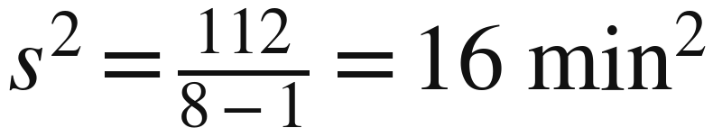
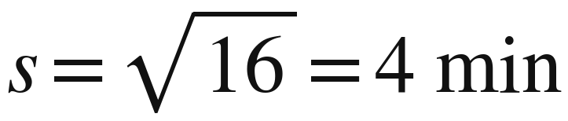
B2a: check the sample calculation
B2a • WORKED ANSWERS
The target is the whole month. We observed a sample of eight.
Mean 15 min and SD 4 min estimate the month’s average and spread.
Notes:
Sample variance is 112 ÷ 7 = 16 min², so sample SD is 4 minutes. The sample mean of 15 minutes and SD of 4 minutes estimate the month’s average wait and spread. They do not make the actual population parameters known.
Sources: User-provided IFY_Statistics_Week_3_Class_B(1).pptx for the original Bellerbys theme, layouts, photography and instructional figures. Statistics Week 3 Lecture(1).pptx for content scope and the eight-value sample exercise. Other numerical examples are illustrative classroom data.

Slide 29
B2b: independent sample calculation
B2b • INDEPENDENT PRACTICE
A new random sample of eight customers has these waits, in minutes.
25, 18, 31, 22, 28, 21, 30, 26
1. Choose the method and explain your choice.
2. Find the mean and complete the working table.
3. Calculate variance and SD. Interpret the results.
Keep the exact mean in your working. Round variance and SD only at the end.
Notes:
Allow 8 minutes for this new random sample of eight customers from the month. The data are reordered from slide 15 of the original Bellerbys Week 3 lecture and are used as a classroom example. The exact mean is 25.125, the sum of squared deviations is 144.875, sample variance is 20.69642857… and sample SD is 4.54933276…, which rounds to 4.55 rather than the original deck’s 4.54. Do not round the mean or intermediate squares.
Sources: User-provided IFY_Statistics_Week_3_Class_B(1).pptx for the original Bellerbys theme, layouts, photography and instructional figures. Statistics Week 3 Lecture(1).pptx for content scope and the eight-value sample exercise. Other numerical examples are illustrative classroom data.

Slide 30
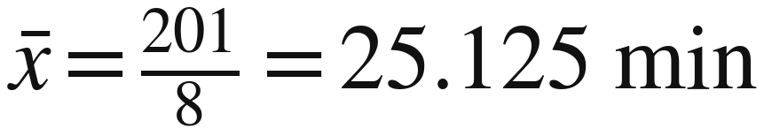
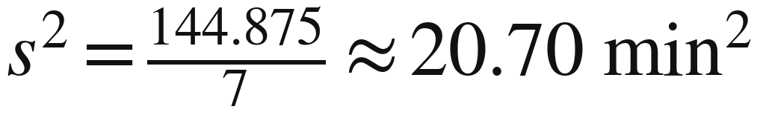
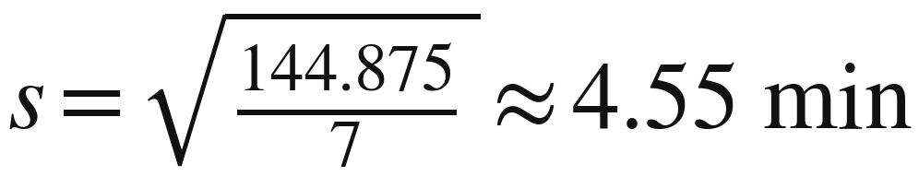
B2b: full working and answers
B2b • WORKED ANSWERS
Sample mean = 25.125 minutes. Use n − 1 = 7 for variance.
Wait | Deviation | Squared deviation
25 | −0.125 | 0.015625
18 | −7.125 | 50.765625
31 | 5.875 | 34.515625
22 | −3.125 | 9.765625
28 | 2.875 | 8.265625
21 | −4.125 | 17.015625
30 | 4.875 | 23.765625
26 | 0.875 | 0.765625
Total | 0 | 144.875
These estimate the month’s average wait and spread. SD is in minutes.
Notes:
Retain the exact mean of 25.125 minutes. The table uses exact deviations to three decimal places and exact squared deviations to six decimal places; the final column is in min². Sample variance is 144.875 ÷ 7 and SD is the square root of that quotient. The correctly rounded SD is 4.55 minutes, correcting the 4.54 shown on original Bellerbys slide 15.
Sources: User-provided IFY_Statistics_Week_3_Class_B(1).pptx for the original Bellerbys theme, layouts, photography and instructional figures. Statistics Week 3 Lecture(1).pptx for content scope and the eight-value sample exercise. Other numerical examples are illustrative classroom data.

Slide 31
Section 4:
Coefficient
of variation
Is an SD of 5 mL equally large
for a small and a large bottle?
Notes:
Move to bottle volumes because different average bottle sizes give a clear reason to compare relative variation. These are illustrative measurements with positive volumes and positive means.
Sources: User-provided IFY_Statistics_Week_3_Class_B(1).pptx for the original Bellerbys theme, layouts, photography and instructional figures. Statistics Week 3 Lecture(1).pptx for content scope and the eight-value sample exercise. Other numerical examples are illustrative classroom data.

Slide 32
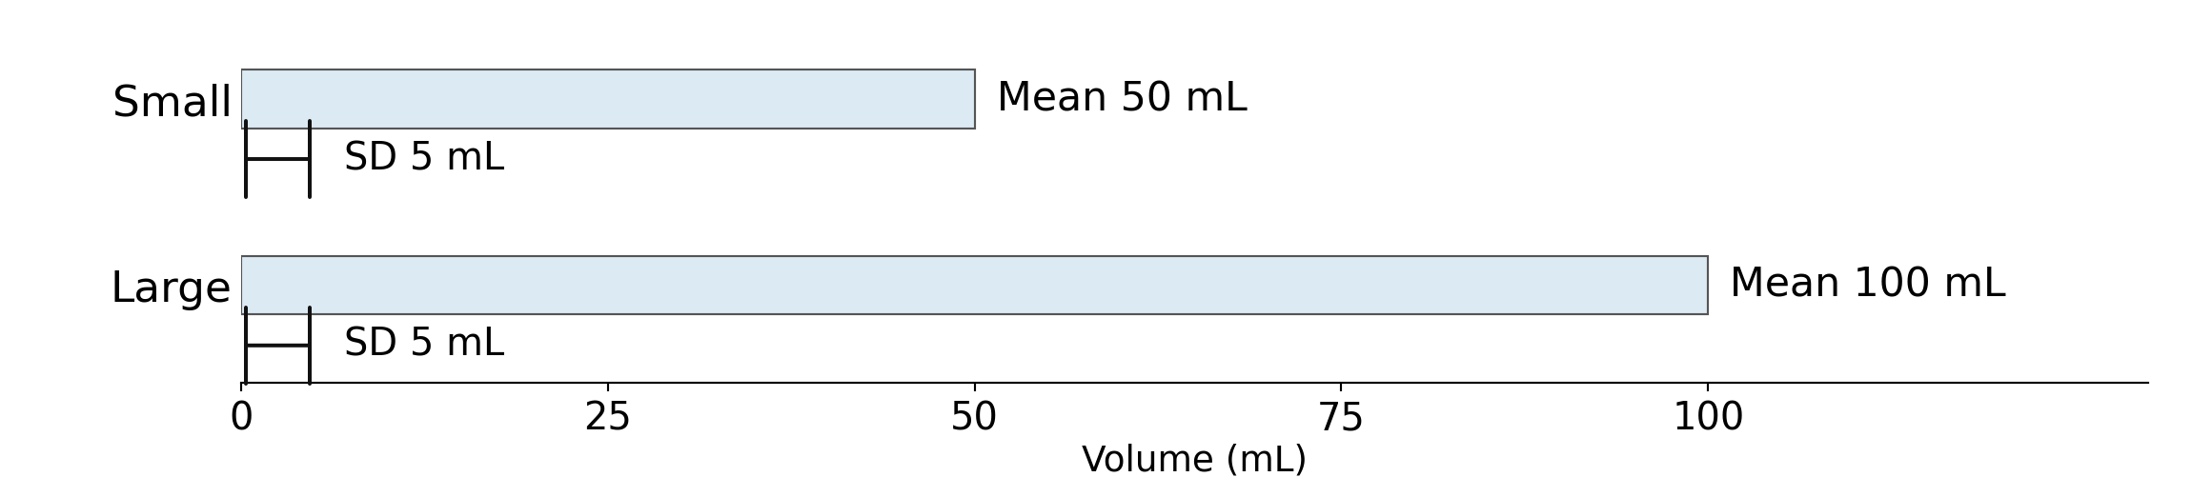
Absolute and relative variation
Absolute: spread in mL. Relative: spread compared with the mean.
Both SDs are 5 mL. Which is larger relative to its mean?
Notes:
Absolute variation uses the original units; relative variation compares SD with the mean. The bars show mean volumes of 50 and 100 mL, while each short marker represents an SD of 5 mL. These markers do not indicate a maximum error, a guaranteed range or a percentage of bottles.
Sources: User-provided IFY_Statistics_Week_3_Class_B(1).pptx for the original Bellerbys theme, layouts, photography and instructional figures. Statistics Week 3 Lecture(1).pptx for content scope and the eight-value sample exercise. Other numerical examples are illustrative classroom data. Coefficient of variation: https://www.itl.nist.gov/div898/software/dataplot/refman2/auxillar/coefvari.htm

Slide 33
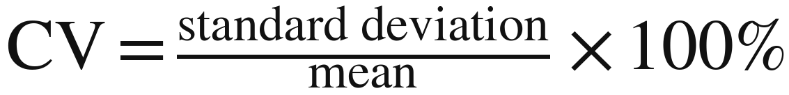
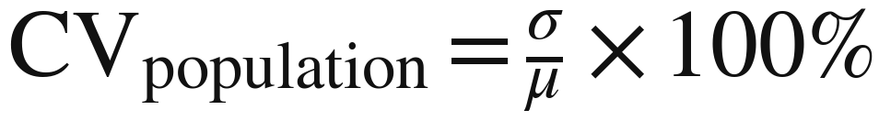
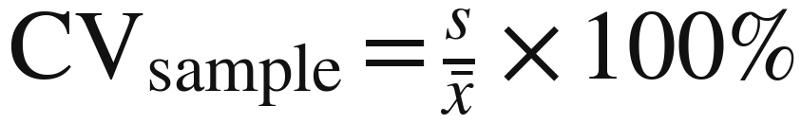
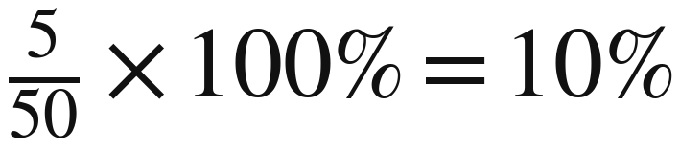
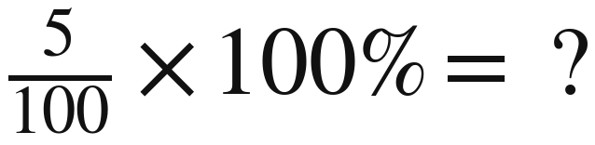
Coefficient of variation (CV)
WORKED EXAMPLE
The coefficient of variation (CV) helps us compare how consistent different groups are relative to their averages: a lower CV means greater relative consistency.
Your turn: finish the 100 mL example. Here, 0 mL means no liquid.
Notes:
Read the full name, coefficient of variation, before using CV. Model 5 ÷ 50 × 100% = 10%, then let students calculate 5 ÷ 100 × 100% = 5%; show both population and sample forms. Use measurements with a meaningful zero and a positive mean away from zero, such as volume; CV is not appropriate for comparisons using Celsius or Fahrenheit temperatures. Reference: https://www.itl.nist.gov/div898/software/dataplot/refman2/auxillar/coefvari.htm
Sources: User-provided IFY_Statistics_Week_3_Class_B(1).pptx for the original Bellerbys theme, layouts, photography and instructional figures. Statistics Week 3 Lecture(1).pptx for content scope and the eight-value sample exercise. Other numerical examples are illustrative classroom data. Coefficient of variation: https://www.itl.nist.gov/div898/software/dataplot/refman2/auxillar/coefvari.htm

Slide 34
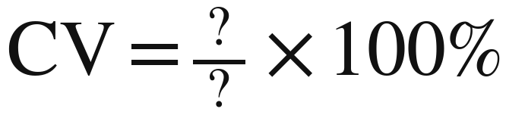
B3a: calculate relative spread
B3a • GUIDED PRACTICE
A sample of bottle fills has mean 137.5 mL and SD 4.4 mL.
Which number belongs on top? Which belongs underneath?
The standard deviation is ______% of the mean.
Notes:
The sample mean is 137.5 mL and sample SD is 4.4 mL, giving CV = 3.2%. Ask students to identify the SD as the numerator before substituting. Do not apply another n − 1 adjustment: the sample SD has already been supplied.
Sources: User-provided IFY_Statistics_Week_3_Class_B(1).pptx for the original Bellerbys theme, layouts, photography and instructional figures. Statistics Week 3 Lecture(1).pptx for content scope and the eight-value sample exercise. Other numerical examples are illustrative classroom data. Coefficient of variation: https://www.itl.nist.gov/div898/software/dataplot/refman2/auxillar/coefvari.htm

Slide 35
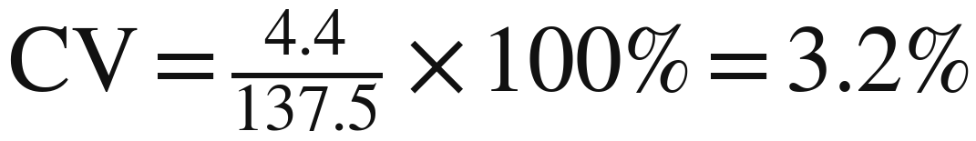
B3a: check the percentage
B3a • WORKED ANSWERS
Divide the sample SD by the sample mean.
The standard deviation is 3.2% of the mean.
This percentage describes relative spread, not the percentage of defective bottles.
Notes:
The SD is 3.2% of the mean. This is not the percentage of defective bottles or a normal-distribution coverage probability. Briefly confirm that the earlier 100 mL example has CV = 5%.
Sources: User-provided IFY_Statistics_Week_3_Class_B(1).pptx for the original Bellerbys theme, layouts, photography and instructional figures. Statistics Week 3 Lecture(1).pptx for content scope and the eight-value sample exercise. Other numerical examples are illustrative classroom data. Coefficient of variation: https://www.itl.nist.gov/div898/software/dataplot/refman2/auxillar/coefvari.htm

Slide 36
B3b: compare the bottle fills
B3b • INDEPENDENT PRACTICE
Two random samples of bottle fills, measured in millilitres.
Bottle type | Sample mean (mL) | Sample SD (mL)
Small | 248.6 | 6.8
Large | 742.3 | 18.9
1. Which has the lower absolute standard deviation?
2. Calculate both CVs to two decimal places.
3. Which has less relative variation? Explain.
Your absolute and relative comparisons may give different answers.
Notes:
Allow 4 minutes. The small-bottle CV is 2.7353178…% and the large-bottle CV is 2.5461404…%; round the final percentages to two decimal places. Small bottles have the lower SD in mL, while large bottles have lower relative variation. The sample SDs are already provided, so no additional sample-size divisor is needed.
Sources: User-provided IFY_Statistics_Week_3_Class_B(1).pptx for the original Bellerbys theme, layouts, photography and instructional figures. Statistics Week 3 Lecture(1).pptx for content scope and the eight-value sample exercise. Other numerical examples are illustrative classroom data. Coefficient of variation: https://www.itl.nist.gov/div898/software/dataplot/refman2/auxillar/coefvari.htm

Slide 37
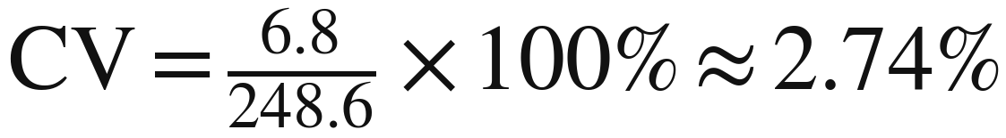
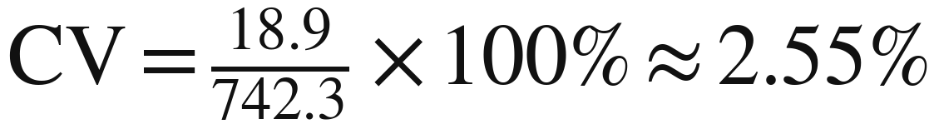
B3b: absolute and relative answers
B3b • WORKED ANSWERS
For each sample, divide its SD by its own mean.
Small bottles
Large bottles
Lower absolute SD:
small bottles.
Lower relative variation:
large bottles.
Accuracy also requires a target fill volume.
Notes:
Small bottles have lower absolute spread because 6.8 mL is less than 18.9 mL. Large bottles have lower relative variation because 2.55% is less than 2.74%. Judging filling accuracy also requires the target volume; CV alone does not establish overall quality.
Sources: User-provided IFY_Statistics_Week_3_Class_B(1).pptx for the original Bellerbys theme, layouts, photography and instructional figures. Statistics Week 3 Lecture(1).pptx for content scope and the eight-value sample exercise. Other numerical examples are illustrative classroom data. Coefficient of variation: https://www.itl.nist.gov/div898/software/dataplot/refman2/auxillar/coefvari.htm

Slide 38
Section 5:
Kurtosis
and tail patterns
Can equal means and SDs
hide different distribution shapes?
Notes:
This section covers the kurtosis topic on original Bellerbys slide 20. Introduce tails and the normal reference before naming kurtosis. Students interpret the concept; they do not calculate fourth moments.
Sources: User-provided IFY_Statistics_Week_3_Class_B(1).pptx for the original Bellerbys theme, layouts, photography and instructional figures. Statistics Week 3 Lecture(1).pptx for content scope and the eight-value sample exercise. Other numerical examples are illustrative classroom data. Kurtosis and tails: https://www.itl.nist.gov/div898/handbook/eda/section3/eda35b.htm

Slide 39
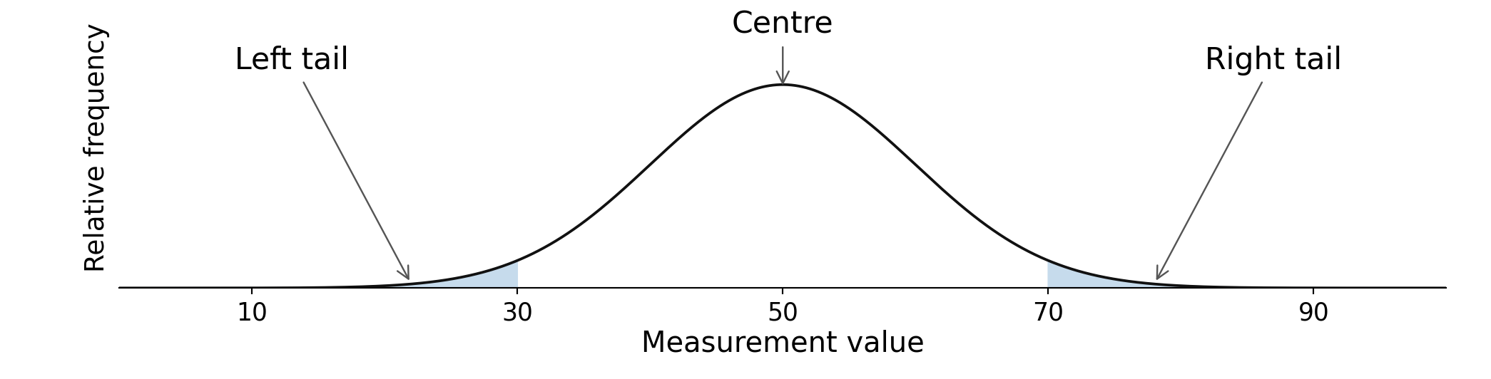
Tails and the normal reference
Tails are the outer regions containing unusually low or high values.
Normal distribution: a symmetric, bell-shaped reference.
Recall: skewness describes left–right asymmetry.
Notes:
Tails are the outer regions containing unusually low or high values. The reference graph is symmetric and normal, with mean 50 and SD 10. Recall that skewness concerns left–right asymmetry. Do not introduce normal probabilities or the 68–95–99.7 rule here.
Sources: User-provided IFY_Statistics_Week_3_Class_B(1).pptx for the original Bellerbys theme, layouts, photography and instructional figures. Statistics Week 3 Lecture(1).pptx for content scope and the eight-value sample exercise. Other numerical examples are illustrative classroom data. Kurtosis and tails: https://www.itl.nist.gov/div898/handbook/eda/section3/eda35b.htm

Slide 40
Kurtosis: extreme values and tails
Kurtosis describes the influence of extreme values, relative to spread.
Term | Ordinary kurtosis | Compared with normal
Mesokurtic | 3 | Same kurtosis benchmark
Leptokurtic | Above 3 | Greater influence of extremes
Platykurtic | Below 3 | Lower influence of extremes
The normal reference has kurtosis 3.
Peak height alone does not determine kurtosis.
Notes:
Use the ordinary kurtosis convention: the normal reference has kurtosis 3, and all numerical kurtosis values in this lesson are supplied rather than calculated by students. A mesokurtic value does not prove normality, and peak height alone cannot determine kurtosis; focus on the contribution of extreme values relative to spread. Teacher background only: some software uses excess kurtosis, whose normal benchmark is 0; do not add that alternative convention to this student lesson. Reference: https://www.itl.nist.gov/div898/handbook/eda/section3/eda35b.htm
Sources: User-provided IFY_Statistics_Week_3_Class_B(1).pptx for the original Bellerbys theme, layouts, photography and instructional figures. Statistics Week 3 Lecture(1).pptx for content scope and the eight-value sample exercise. Other numerical examples are illustrative classroom data. Kurtosis and tails: https://www.itl.nist.gov/div898/handbook/eda/section3/eda35b.htm

Slide 41
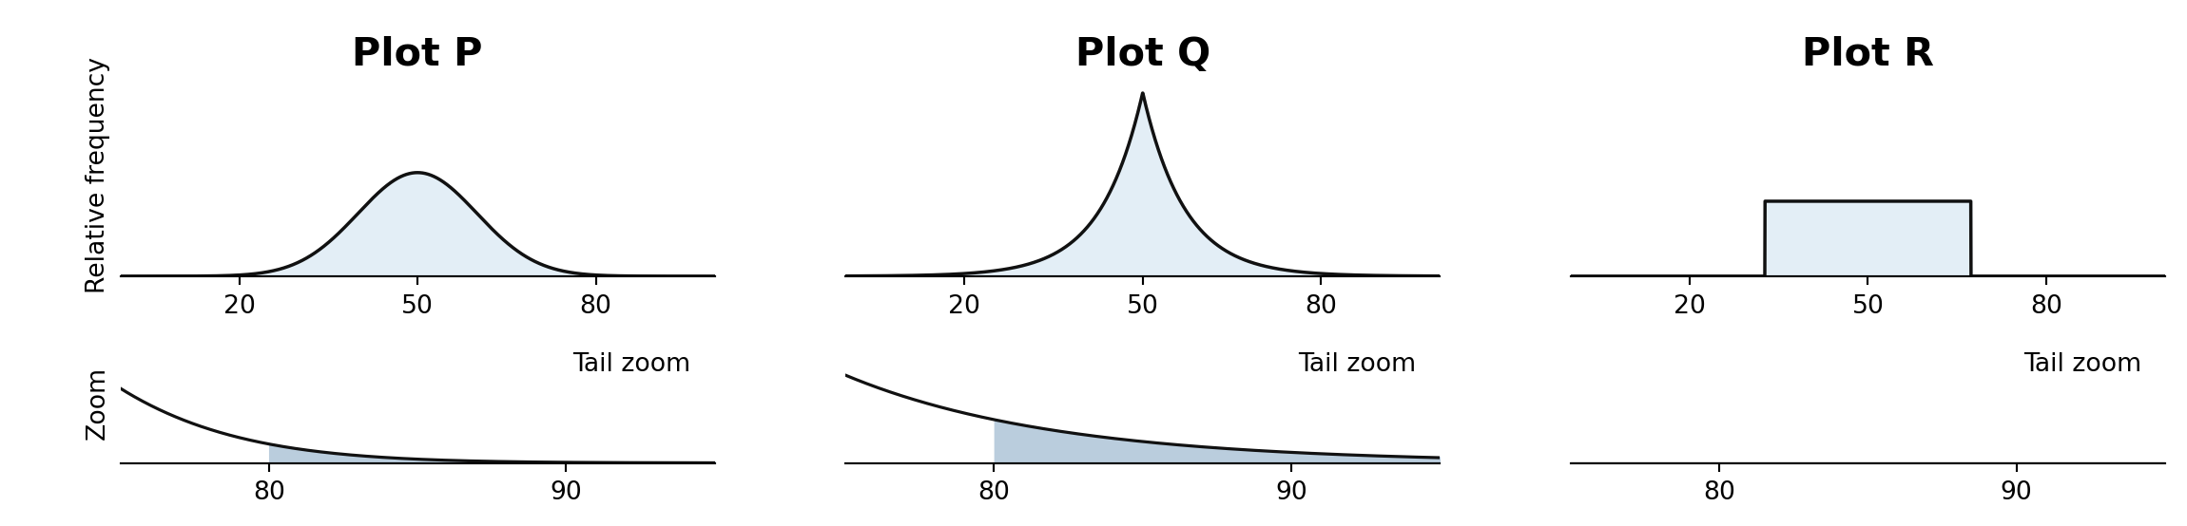
B4: interpret the tail patterns
B4 • INTERPRETATION
These symmetric distributions have the same mean and SD.
1. Which has the greatest influence from extreme values?
2. Correct: “Equal SDs mean the distributions have the same shape.”
Notes:
The plotted examples are P: normal, Q: standardised Laplace and R: uniform, all with mean 50 and SD 10. Their supplied ordinary kurtosis values are 3, 6 and 1.8 respectively; the tail enlargements use identical scales. Ask students to identify Q as having the greatest far-tail weight and explain their answer using the graphs. All three are symmetric, yet their tail patterns differ despite equal SDs.
Sources: User-provided IFY_Statistics_Week_3_Class_B(1).pptx for the original Bellerbys theme, layouts, photography and instructional figures. Statistics Week 3 Lecture(1).pptx for content scope and the eight-value sample exercise. Other numerical examples are illustrative classroom data. Kurtosis and tails: https://www.itl.nist.gov/div898/handbook/eda/section3/eda35b.htm

Slide 42
B4: equal SDs, different tails
B4 • WORKED ANSWERS
Q has the greatest influence from very extreme values.
Plot | Description | Ordinary kurtosis
P | Normal reference / mesokurtic | 3
Q | Heavier far tails / leptokurtic | 6
R | Bounded lighter tails / platykurtic | 1.8
Equal SDs can accompany different tail patterns.
Kurtosis values are supplied here. We interpret them rather than calculate them.
Notes:
Q has greater extreme-value influence and ordinary kurtosis 6; P is the normal reference with kurtosis 3; R is uniform with kurtosis 1.8. These values are given, not calculated in class, and the plotted distributions have been matched for mean and SD. Equal SD does not determine the full distribution shape: skewness concerns asymmetry, while kurtosis concerns extreme-value influence relative to spread. Keep the student explanation in the ordinary kurtosis convention and do not introduce software excess kurtosis here.
Sources: User-provided IFY_Statistics_Week_3_Class_B(1).pptx for the original Bellerbys theme, layouts, photography and instructional figures. Statistics Week 3 Lecture(1).pptx for content scope and the eight-value sample exercise. Other numerical examples are illustrative classroom data. Kurtosis and tails: https://www.itl.nist.gov/div898/handbook/eda/section3/eda35b.htm

Slide 43
B5: independent exit check
B5 • INDEPENDENT CHECK
A new random sample of ten customers gives these results.
1. Calculate variance and SD. Explain your divisor.
2. Find the deviation of a 19-minute wait. Explain its sign.
3. Correct: “Every observation is exactly one SD
from the mean.”
Notes:
Allow 5 minutes for independent work on this new random sample of 10 customers from a larger population. Sample variance is 90 ÷ (10 − 1) = 10 min² and SD is √10 ≈ 3.16 minutes. A wait of 19 minutes has deviation 19 − 24 = −5 minutes, meaning five minutes below the sample mean. Individual deviations can differ; SD does not give every observation’s distance from the mean. There is no CV calculation here because B3b already assesses it.
Sources: User-provided IFY_Statistics_Week_3_Class_B(1).pptx for the original Bellerbys theme, layouts, photography and instructional figures. Statistics Week 3 Lecture(1).pptx for content scope and the eight-value sample exercise. Other numerical examples are illustrative classroom data.

Slide 44
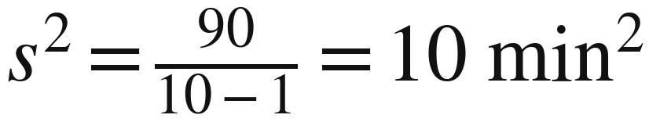
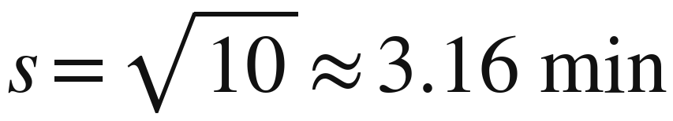
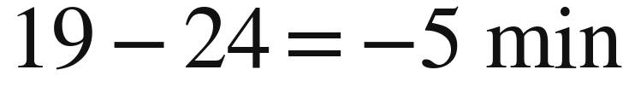
B5: check your understanding
B5 • WORKED ANSWERS
A sample estimates the larger group, so variance uses n − 1.
5 minutes below the sample mean.
SD summarises the spread. Individual deviations can differ.
Notes:
The core lesson ends at slide 43; the following two slides are optional and outside the 90-minute plan. Confirm the exit-check results: variance 10 min², SD about 3.16 minutes and deviation −5 minutes. Class C has a 60-minute workshop before the final 30 minutes reserved for FA1. The main mathematical source is the original Bellerbys Week 3 lecture, with explanations adapted from Sullivan section 3.2 and Larson section 2.4.
Sources: User-provided IFY_Statistics_Week_3_Class_B(1).pptx for the original Bellerbys theme, layouts, photography and instructional figures. Statistics Week 3 Lecture(1).pptx for content scope and the eight-value sample exercise. Other numerical examples are illustrative classroom data.

Slide 45
B6: work backwards
B6 • OPTIONAL CHALLENGE
Six values have mean 7 and sample standard deviation 2.
6, 7, 7, 8, ?, ?
Find the two missing values.
Use both the mean and the standard deviation.
Hint: the mean fixes the total. The SD fixes the squared-deviation total.
Notes:
This optional challenge is outside the core 90-minute lesson. It is adapted from Larson and Farber, Elementary Statistics: Picturing the World, 9th edition, section 2.4, Exercise 30 on printed page 94. Six observations have mean 7 and sample SD 2; the missing values are 4 and 10. This replaces the obsolete gym-dataset callback.
Sources: User-provided IFY_Statistics_Week_3_Class_B(1).pptx for the original Bellerbys theme, layouts, photography and instructional figures. Statistics Week 3 Lecture(1).pptx for content scope and the eight-value sample exercise. Other numerical examples are illustrative classroom data. Reverse problem adapted from Larson and Farber, Elementary Statistics: Picturing the World, 9th edition, section 2.4, exercise 30, printed page 94.

Slide 46
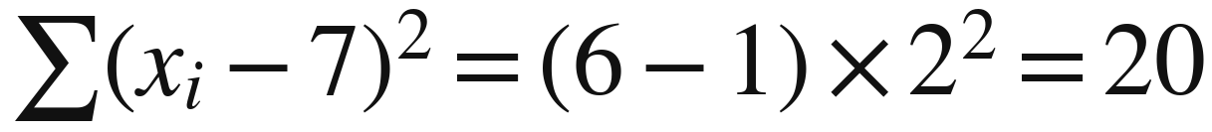
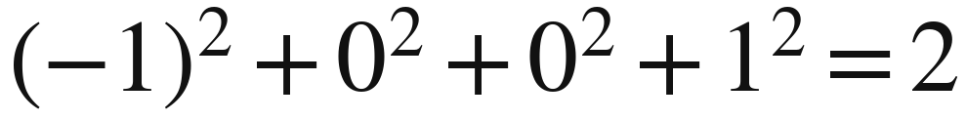
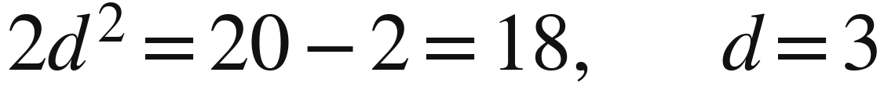
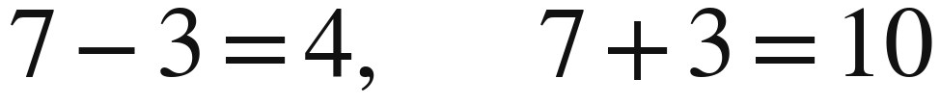
B6: the missing values
B6 • WORKED ANSWERS
The mean fixes the total. The SD fixes the squared spread.
Missing values total 14: write them as 7 − d and 7 + d.
Here, d is the distance of each missing value from the mean of 7.
Notes:
The mean gives a total of 6 × 7 = 42; the known values total 28, so the missing values must sum to 14 and lie equally far on opposite sides of 7. Let d be the nonnegative distance of either missing value from the mean: the two values are 7 − d and 7 + d. Sample SD 2 gives a total squared-deviation sum of (6 − 1) × 2² = 20; the known observations contribute 2, leaving 18. Therefore 2d² = 18, so d = 3 and the missing values are 4 and 10. Check that 6, 7, 7, 8, 4 and 10 have mean 7 and sample SD 2.
Sources: User-provided IFY_Statistics_Week_3_Class_B(1).pptx for the original Bellerbys theme, layouts, photography and instructional figures. Statistics Week 3 Lecture(1).pptx for content scope and the eight-value sample exercise. Other numerical examples are illustrative classroom data. Reverse problem adapted from Larson and Farber, Elementary Statistics: Picturing the World, 9th edition, section 2.4, exercise 30, printed page 94.

