Slide 1
IFY Statistics
Week 3 • Class C
Paper supplier
workshop
Notes:
Slide 1. IFY Statistics Week 3 • Class C Paper supplier workshop
Timing block: 0–4 min
60-minute workshop before FA1: 32 core slides and one optional challenge. Give students the printed data sheet, a calculator, and working paper or the activity handout. Every student works on BOTH suppliers, with 30 observations per supplier. Timing: opening 0–4; C1 4–9; C2 9–18; C3 18–40; C4 40–43; C5 43–48; C6 48–57; C7 57–60 minutes. Protect the final 17 minutes for the written decisions, discussion and exit response. Use the calculation checkpoints to keep moving. The dataset is simulated. Do not reveal the urgent-order deadlines during the opening case.
Source: User-approved simulated supplier data in IFY_Statistics_Week_3_Class_C_Data.xlsx, worksheet Supplier data, C9:D38. Visual template: IFY_Statistics_Week_3_Class_B_Revised_Final.pptx. Quartiles use the (n+1)p interpolation convention from Class A.

Slide 2
Revision: Classes A and B
REVISION • 5 MIN
Eight trial orders help us estimate the supplier’s overall delivery performance.
Delivery times (h): 40, 43, 44, 46, 49, 51, 54, 57
1. Sample or population?
4. Find the deviation for 57 hours.
Give the symbols for its mean and SD.
How is a deviation different from SD?
2. Find the median and range.
5. Calculate sample variance and SD.
Extreme delay: mean or median changes less?
Explain your choice of divisor.
3. Find the interquartile range (IQR).
6. Find coefficient of variation (CV).
Which part of the data does it describe?
What would a smaller CV mean?
Show your method and units. Keep the unrounded SD for the CV calculation.
Notes:
Allow around 5 minutes for individual revision, followed by a short answer check. Students may use calculators. These eight trial orders are a sample used to understand the supplier's wider delivery performance. The mean, squared-deviation total and quartiles are supplied so students do not repeat a full SD table. Ask for working and units. Use the unrounded SD for CV. Insert these slides after the Class C title, before the print-shop case. If used within the 60-minute session, shorten the opening recap and use the existing calculation checkpoints to protect the final decision-writing block.
Source: Original simulated revision data. Template: user-approved Week 3 Class C supplier workshop. Quartiles use (n+1)p interpolation.

Slide 3
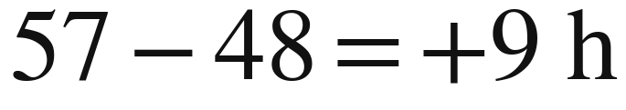
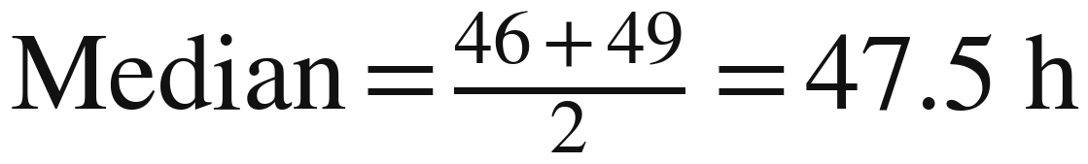
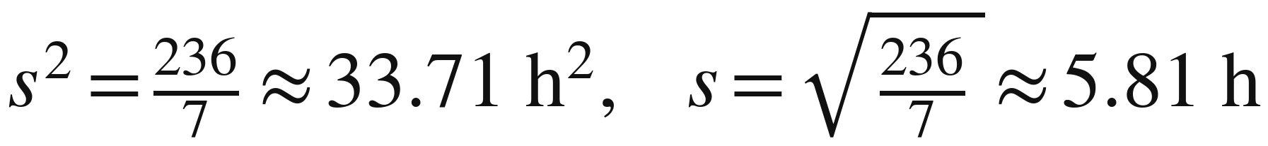

Revision: worked answers
REVISION • ANSWERS
Check the method, the units and what each result tells us.
1. A sample of the supplier’s orders
4. One signed deviation
9 h above the mean. SD describes overall spread.
2. Median and range
5. Sample variance and SD
Range = 57 − 40 = 17 h.
Median is less sensitive to an extreme delay.
Use n − 1 = 7 to estimate population variance.
3. Interquartile range
6. Coefficient of variation
IQR describes the spread of the middle 50%.
Smaller CV: less spread relative to the mean.
Notes:
1. Sample, because the purpose is to estimate wider performance. The sample mean is x-bar and sample SD is s. Population symbols are mu and sigma.
2. Median = (46 + 49)/2 = 47.5 hours. Range = 57 - 40 = 17 hours. The median is generally less sensitive to an extreme delay, but it can still change.
3. IQR = 53.25 - 43.25 = 10 hours, the width of the middle 50%.
4. Deviation = 57 - 48 = +9 hours, meaning this delivery is 9 hours above the mean. One deviation is a signed difference; SD combines information about spread across all observations.
5. Sample variance = 236/7 = 33.714285714 hours squared. Sample SD = sqrt(236/7) = 5.806400409 hours. Report 33.71 hours squared and 5.81 hours. Use n - 1 = 7 when estimating population variance from the sample. This adjustment accounts for estimating the population mean from the same data.
6. CV = 5.806400409/48 × 100% = 12.09666752%, rounded to 12.10%. A smaller CV means less variation relative to the mean. It is not the percentage of late orders and does not automatically identify the best supplier for every deadline.
Source: Original simulated revision data. Template: user-approved Week 3 Class C supplier workshop. Quartiles use (n+1)p interpolation.

Slide 4
The print shop’s problem
A university print shop needs a regular supplier of A4 paper.
Both suppliers offer the same paper quality,
order quantity and total price, including delivery.
Running out of paper can stop printing jobs.
The shop can place routine orders a few hours earlier.
Which supplier would you recommend, and what should the manager watch for?
Notes:
Slide 2. The print shop’s problem
Timing block: 0–4 min
Opening, minutes 0–4. Establish the routine-order problem: both suppliers offer the same paper quality, order quantity and total price, including delivery. Running out of paper can interrupt printing and delay customers. Routine orders can be placed a few hours earlier. Ask what the manager would value, but do not reveal either urgent deadline yet.
Source: User-approved simulated supplier data in IFY_Statistics_Week_3_Class_C_Data.xlsx, worksheet Supplier data, C9:D38. Visual template: IFY_Statistics_Week_3_Class_B_Revised_Final.pptx. Quartiles use the (n+1)p interpolation convention from Class A.

Slide 5
What the data represent
Delivery time: hours from order confirmation to arrival.
Trial | Supplier A (hours) | Supplier B (hours)
1 | 36 | 51
2 | 49 | 44
3 | 45 | 49
… | … | …
30 trial orders per supplier
60 delivery times altogether
Includes nights and weekends
Recorded to the nearest hour
Use both columns. These are simulated delivery records for our case.
Notes:
Slide 3. What the data represent
Timing block: 0–4 min
Opening, minutes 0–4. Each observation is the elapsed time from order confirmation to arrival, including nights and weekends, rounded to the nearest hour. Read the first row aloud: A took 36 hours; B took 51 hours. Trial numbers label separate orders within each supplier's records; they are not shared dates or matched pairs. Analyse each supplier separately: n = 30 for A and n = 30 for B, not one pooled sample of 60. Every student uses both columns.
Source: User-approved simulated supplier data in IFY_Statistics_Week_3_Class_C_Data.xlsx, worksheet Supplier data, C9:D38. Visual template: IFY_Statistics_Week_3_Class_B_Revised_Final.pptx. Quartiles use the (n+1)p interpolation convention from Class A.

Slide 6
Section 1:
Typical delivery
times
Which supplier usually
delivers sooner?
Notes:
Slide 4. Section 1: Typical delivery times
Timing block: 4–18 min
Brief transition within minutes 4–18. The first question is typical delivery time. Signal the section and move directly to C1; this is not a separate lecture.
Source: User-approved simulated supplier data in IFY_Statistics_Week_3_Class_C_Data.xlsx, worksheet Supplier data, C9:D38. Visual template: IFY_Statistics_Week_3_Class_B_Revised_Final.pptx. Quartiles use the (n+1)p interpolation convention from Class A.

Slide 7
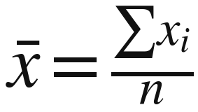
C1: average delivery time
C1 • CALCULATE
Calculate the mean delivery time for each supplier.
Symbol / name | Meaning
x̄ “x-bar” | Sample mean
Σ “capital sigma” | Add the values
xᵢ “x sub i” | One delivery time
n “lowercase n” | Number of observations
Total all 30 times.
Divide by 30.
Record the total and mean for each supplier. Keep the units: hours.
Notes:
Slide 5. C1: average delivery time
Timing block: 4–9 min
C1, minutes 4–9. Allow about four minutes for students to total all 30 times for each supplier, calculate both means, and check with a partner. Every student calculates both suppliers. Read the symbols: x-bar is the sample mean; x sub i is one delivery time; capital sigma means add; n is the number of observations. Divide each total by 30. Ask students to record their totals and means in hours before revealing the checkpoint.
Source: User-approved simulated supplier data in IFY_Statistics_Week_3_Class_C_Data.xlsx, worksheet Supplier data, C9:D38. Visual template: IFY_Statistics_Week_3_Class_B_Revised_Final.pptx. Quartiles use the (n+1)p interpolation convention from Class A.

Slide 8
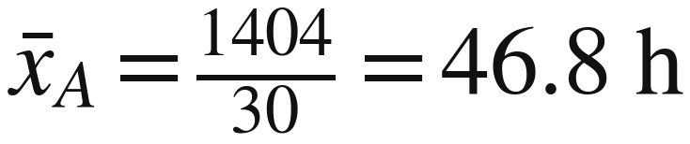
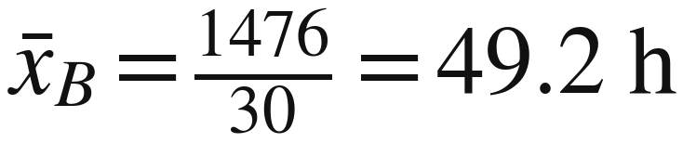
C1: mean checkpoint
C1 • CHECKPOINT
The mean describes average delivery time in these records.
Supplier A
Supplier B
Supplier A is 2.4 hours faster on average.
Does the faster average also mean more consistent deliveries?
Notes:
Slide 6. C1: mean checkpoint
Timing block: 4–9 min
C1 checkpoint; finish by minute 9. Supplier A: total 1,404 hours, mean 46.8 hours. Supplier B: total 1,476 hours, mean 49.2 hours. A is 2.4 hours faster on average in these records. This says nothing yet about consistency or whether an individual delivery will meet a deadline. If a total differs, check data entry and the count of 30 observations.
Source: User-approved simulated supplier data in IFY_Statistics_Week_3_Class_C_Data.xlsx, worksheet Supplier data, C9:D38. Visual template: IFY_Statistics_Week_3_Class_B_Revised_Final.pptx. Quartiles use the (n+1)p interpolation convention from Class A.

Slide 9

C2: median and range
C2 • CALCULATE
Order each supplier’s 30 delivery times from smallest to largest.
Median: the middle of the ordered data.
Range: the gap from the shortest to the longest delivery.
Calculate both measures for both suppliers.
Notes:
Slide 7. C2: median and range
Timing block: 9–18 min
C2, minutes 9–18. Use about the first three minutes to order both 30-value lists and find each median and range. Every student works on both lists. With 30 values, average the 15th and 16th ordered observations. The range uses only the minimum and maximum. Reveal the ordered-data checkpoint before interpolation so sorting errors do not propagate.
Source: User-approved simulated supplier data in IFY_Statistics_Week_3_Class_C_Data.xlsx, worksheet Supplier data, C9:D38. Visual template: IFY_Statistics_Week_3_Class_B_Revised_Final.pptx. Quartiles use the (n+1)p interpolation convention from Class A.

Slide 10
C2: ordered-data checkpoint
C2 • CHECKPOINT
Check your ordered lists before locating the middle positions.
Position | 1 | 2 | 3 | 4 | 5 | 6 | 7 | 8 | 9 | 10 | 11 | 12 | 13 | 14 | 15
A | 28 | 31 | 33 | 35 | 36 | 38 | 39 | 40 | 41 | 42 | 43 | 43 | 44 | 45 | 45
B | 28 | 44 | 44 | 45 | 45 | 46 | 46 | 47 | 47 | 47 | 48 | 48 | 48 | 49 | 49
Position | 16 | 17 | 18 | 19 | 20 | 21 | 22 | 23 | 24 | 25 | 26 | 27 | 28 | 29 | 30
A | 46 | 47 | 48 | 49 | 50 | 51 | 52 | 54 | 55 | 56 | 58 | 60 | 62 | 65 | 68
B | 49 | 50 | 50 | 50 | 51 | 51 | 51 | 52 | 52 | 53 | 53 | 54 | 55 | 56 | 68
Median: positions 15 and 16. Quartile positions: 7.75 and 23.25.
Notes:
Slide 8. C2: ordered-data checkpoint
Timing block: 9–18 min
C2 ordered-data checkpoint. Median neighbours: A has 45 and 46 at positions 15 and 16; B has 49 and 49. Under the Class A convention, Q1 is at position 7.75 and Q3 at position 23.25. Q1 neighbours: A 39 and 40; B 46 and 47. Q3 neighbours: A 54 and 55; B 52 and 52. The highlighted cells identify these positions. Stress that a position is not a delivery time. Keep the same (n + 1)p convention throughout.
Source: User-approved simulated supplier data in IFY_Statistics_Week_3_Class_C_Data.xlsx, worksheet Supplier data, C9:D38. Visual template: IFY_Statistics_Week_3_Class_B_Revised_Final.pptx. Quartiles use the (n+1)p interpolation convention from Class A.

Slide 11
C2: the middle 50%
C2 • CALCULATE
Q1 and Q3 are the lower and upper quartiles.
They mark the middle 50% of the ordered data.
The interquartile range (IQR) measures its width.
A fractional position lies part-way between two observations.
Find Q1 and Q3 for each supplier, then calculate IQR = Q3 − Q1.
Notes:
Slide 9. C2: the middle 50%
Timing block: 9–18 min
C2: allow about four minutes for quartiles and IQR. Q1 and Q3 bracket the middle half of the ordered data. Position 7.75 lies 75% of the way from the 7th to the 8th observation; position 23.25 lies 25% of the way from the 23rd to the 24th. Model A's Q1: 39 + 0.75(40 − 39) = 39.75 hours. Students calculate the remaining quartiles and both IQRs. B's Q3 is 52 + 0.25(52 − 52) = 52 hours. The fraction applies to the gap between neighbouring values, not to one observed value.
Source: User-approved simulated supplier data in IFY_Statistics_Week_3_Class_C_Data.xlsx, worksheet Supplier data, C9:D38. Visual template: IFY_Statistics_Week_3_Class_B_Revised_Final.pptx. Quartiles use the (n+1)p interpolation convention from Class A.

Slide 12
C2: comparing the results
C2 • CHECKPOINT
The range is equal. The middle half is much tighter for Supplier B.
Measure (hours) | Supplier A | Supplier B
Median | 45.5 | 49
Range | 40 | 40
Lower quartile, Q1 | 39.75 | 46.75
Upper quartile, Q3 | 54.25 | 52
Interquartile range, IQR | 14.5 | 5.25
Range uses the two extremes. IQR describes the spread of the middle 50%.
Notes:
Slide 10. C2: comparing the results
Timing block: 9–18 min
C2 checkpoint; move on by minute 18. A: median 45.5 h, range 40 h, Q1 39.75 h, Q3 54.25 h, IQR 14.5 h. B: median 49 h, range 40 h, Q1 46.75 h, Q3 52 h, IQR 5.25 h. Both have minimum 28 h and maximum 68 h. The equal ranges hide the much narrower central spread for B. With finite samples and interpolation, avoid claiming that exactly half the observations must lie strictly between the quartiles.
Source: User-approved simulated supplier data in IFY_Statistics_Week_3_Class_C_Data.xlsx, worksheet Supplier data, C9:D38. Visual template: IFY_Statistics_Week_3_Class_B_Revised_Final.pptx. Quartiles use the (n+1)p interpolation convention from Class A.

Slide 13
Section 2:
Measuring
variation
How spread out are deliveries
around each supplier’s mean?
Notes:
Slide 11. Section 2: Measuring variation
Timing block: 18–43 min
Brief transition within minutes 18–43. Move from the middle-half spread to variation around each supplier's own mean. This retrieves Class B methods; do not add new theory.
Source: User-approved simulated supplier data in IFY_Statistics_Week_3_Class_C_Data.xlsx, worksheet Supplier data, C9:D38. Visual template: IFY_Statistics_Week_3_Class_B_Revised_Final.pptx. Quartiles use the (n+1)p interpolation convention from Class A.

Slide 14
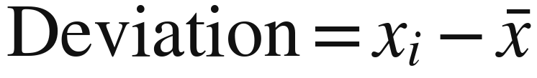
Deviation and standard deviation
These terms answer different questions.
Measure | What it describes | How to read it
Deviation | One delivery’s difference from the mean | Negative: below the mean Positive: above the mean
Standard deviation (SD) | Spread across all deliveries around their mean | Smaller SD: values tend to be closer to their mean
Both are measured in hours. One dataset has many deviations but one SD.
Notes:
Slide 12. Deviation and standard deviation
Timing block: 18–40 min
C3, minutes 18–40. Briefly retrieve the distinction: one deviation is one observed time minus its supplier's mean; SD combines the squared deviations into a single measure of spread. Negative deviations are below the mean; positive deviations are above it. Both deviation and SD use hours, but SD cannot be negative. A smaller SD does not guarantee a particular delivery time or deadline result.
Source: User-approved simulated supplier data in IFY_Statistics_Week_3_Class_C_Data.xlsx, worksheet Supplier data, C9:D38. Visual template: IFY_Statistics_Week_3_Class_B_Revised_Final.pptx. Quartiles use the (n+1)p interpolation convention from Class A.

Slide 15
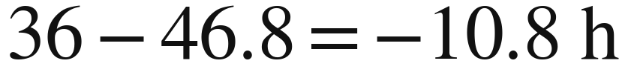
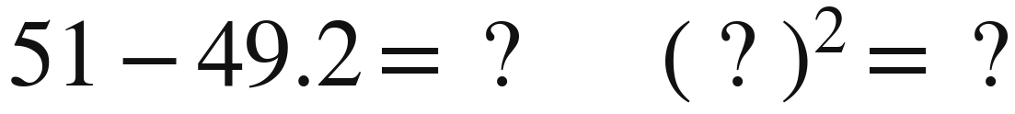
C3: one row, fully explained
C3 • WORKED + GUIDED
Subtract the supplier’s mean before squaring.
Supplier A: first delivery is 36 hours. Mean is 46.8 hours.
Your turn: Supplier B, first delivery 51 hours. Mean 49.2 hours.
Say what the sign of each deviation means.
Notes:
Slide 13. C3: one row, fully explained
Timing block: 18–40 min
C3 worked and guided rows. Model A's first row: 36 − 46.8 = −10.8 h, then (−10.8)² = 116.64 h². The observation is 10.8 hours below A's mean. Students then try B's first row: 51 − 49.2 = +1.8 h, and 1.8² = 3.24 h². Elicit and confirm B's answers aloud before independent work. Subtract the mean first, then square the deviation; do not square the original delivery time.
Source: User-approved simulated supplier data in IFY_Statistics_Week_3_Class_C_Data.xlsx, worksheet Supplier data, C9:D38. Visual template: IFY_Statistics_Week_3_Class_B_Revised_Final.pptx. Quartiles use the (n+1)p interpolation convention from Class A.

Slide 16
C3: your calculation tables
C3 • INDEPENDENT PRACTICE
Complete all 30 rows for each supplier. Work on both tables.
Delivery time, xᵢ (h) | Deviation, xᵢ − x̄ (h) | Squared deviation (h²)
36 (A, first row) | 36 − 46.8 = −10.8 | 116.64
Next delivery…
Continue to row 30…
Total of squared deviations
Supplier A mean: 46.8 h Supplier B mean: 49.2 h
Check after each 10 rows. Keep the two suppliers’ calculations separate.
Notes:
Slide 14. C3: your calculation tables
Timing block: 18–40 min
C3 independent practice: hold this slide for about 15–16 minutes. Every student works through both 30-row tables, using A's mean of 46.8 h and B's mean of 49.2 h. Preprinted delivery times reduce copying. Check with a partner after each ten rows, while retaining individual work on both suppliers. Use parentheses when squaring negative deviations. Sum the squared-deviation column. HARD CHECKPOINT: reveal the squared-deviation totals by minute 36 and proceed, even if some students need to use the supplied totals. Do not let unfinished arithmetic consume the final decision work.
Source: User-approved simulated supplier data in IFY_Statistics_Week_3_Class_C_Data.xlsx, worksheet Supplier data, C9:D38. Visual template: IFY_Statistics_Week_3_Class_B_Revised_Final.pptx. Quartiles use the (n+1)p interpolation convention from Class A.

Slide 17
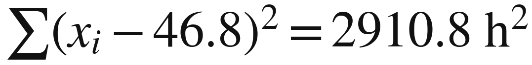
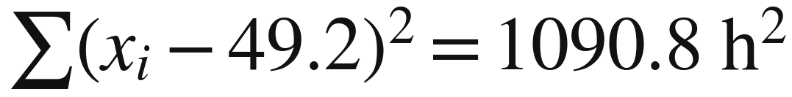
C3: squared-deviation checkpoint
C3 • CHECKPOINT
Add the 30 squared deviations for each supplier.
Supplier A
Supplier B
These are totals of squared deviations. We still need to divide to find variance.
Notes:
Slide 15. C3: squared-deviation checkpoint
Timing block: 18–40 min
C3 hard checkpoint, at about minute 36. A's sum of squared deviations is 2,910.8 h²; B's is 1,090.8 h². These are totals before division, not variances. The first-row squared deviations, 116.64 and 3.24, are each one of 30 terms. Give these totals to any students who need them so everyone can continue. As an optional arithmetic check, the signed deviations sum to zero because the means 46.8 and 49.2 are exact.
Source: User-approved simulated supplier data in IFY_Statistics_Week_3_Class_C_Data.xlsx, worksheet Supplier data, C9:D38. Visual template: IFY_Statistics_Week_3_Class_B_Revised_Final.pptx. Quartiles use the (n+1)p interpolation convention from Class A.

Slide 18
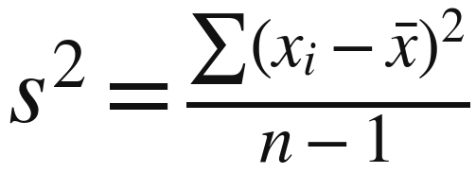
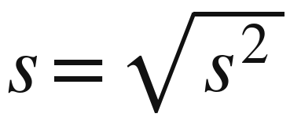
C3: sample variance and SD
C3 • CALCULATE
Use the trial sample to estimate each supplier’s wider performance.
Symbol / name | Meaning
s² “s squared” | Sample variance, in h²
s “s” | Sample SD, in hours
x̄ “x-bar” | Sample mean
n − 1 | 30 − 1 = 29
Divide each squared-deviation total by 29. Then take the square root for SD.
Notes:
Slide 16. C3: sample variance and SD
Timing block: 18–40 min
C3: treat each set of 30 trial orders as a sample used to estimate wider delivery performance. Therefore use sample variance, dividing each squared-deviation total by n − 1 = 29. The adjustment accounts for estimating the mean from the same data. The mean itself still divides by 30. Sample variance s² has units h²; sample SD s is its square root and has units hours. Students calculate both suppliers and retain full calculator precision.
Source: User-approved simulated supplier data in IFY_Statistics_Week_3_Class_C_Data.xlsx, worksheet Supplier data, C9:D38. Visual template: IFY_Statistics_Week_3_Class_B_Revised_Final.pptx. Quartiles use the (n+1)p interpolation convention from Class A.

Slide 19
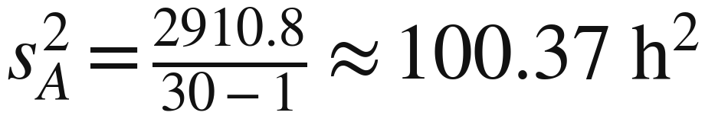
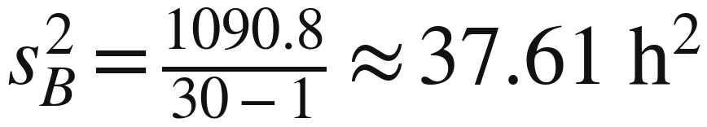
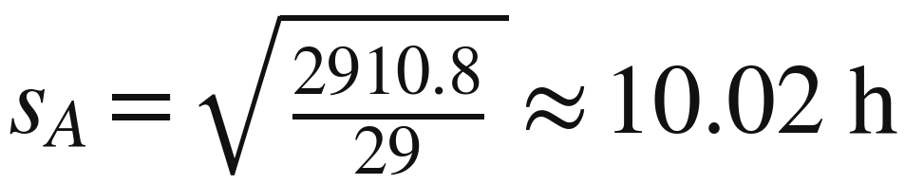
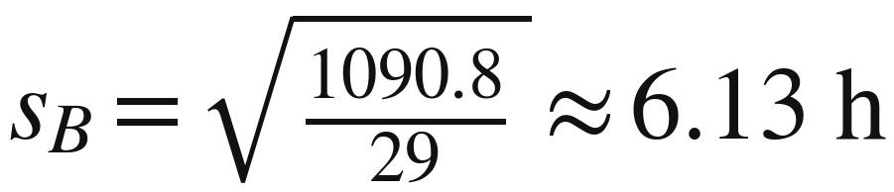
C3: variance and SD checkpoint
C3 • CHECKPOINT
Variance has squared units. SD returns to hours.
Supplier A
Supplier B
Keep the full SD in your calculator for the next calculation. Round only final answers.
Notes:
Slide 17. C3: variance and SD checkpoint
Timing block: 18–40 min
C3 checkpoint; finish by minute 40. A: variance 2,910.8/29 = 100.3724138 h² and SD 10.018603385 h, displayed as 100.37 h² and 10.02 h. B: variance 1,090.8/29 = 37.6137931 h² and SD 6.133008487 h, displayed as 37.61 h² and 6.13 h. Explain the change from squared hours back to hours. Students must store the unrounded SDs for CV. Do not interpret an SD as a guaranteed delivery interval.
Source: User-approved simulated supplier data in IFY_Statistics_Week_3_Class_C_Data.xlsx, worksheet Supplier data, C9:D38. Visual template: IFY_Statistics_Week_3_Class_B_Revised_Final.pptx. Quartiles use the (n+1)p interpolation convention from Class A.

Slide 20

C4: coefficient of variation (CV)
C4 • CALCULATE
The coefficient of variation expresses SD as a percentage of the mean.
1. Use the unrounded SD stored in your calculator.
2. Divide by that supplier’s mean and multiply by 100.
3. Round your final percentage to two decimal places.
A smaller CV means less variation relative to the mean.
Notes:
Slide 18. C4: coefficient of variation (CV)
Timing block: 40–43 min
C4, minutes 40–43. CV expresses SD as a percentage of the mean, so it describes relative variation. Students calculate both suppliers using the stored, unrounded SDs. A: 10.018603385/46.8 × 100 = 21.40727%, rounded to 21.41%. B: 6.133008487/49.2 × 100 = 12.46546%, rounded to 12.47%. Using B's rounded SD of 6.13 would produce 12.46%, so retain precision until the final answer. CV is not the percentage of late deliveries.
Source: User-approved simulated supplier data in IFY_Statistics_Week_3_Class_C_Data.xlsx, worksheet Supplier data, C9:D38. Visual template: IFY_Statistics_Week_3_Class_B_Revised_Final.pptx. Quartiles use the (n+1)p interpolation convention from Class A.

Slide 21
C4: the evidence together
C4 • CHECKPOINT
Supplier A is faster on average. Supplier B varies less.
Measure | Supplier A | Supplier B
Mean (h) | 46.8 | 49.2
Median (h) | 45.5 | 49
Interquartile range (h) | 14.5 | 5.25
Sample standard deviation (h) | 10.02 | 6.13
Coefficient of variation | 21.41% | 12.47%
Longest recorded delivery (h) | 68 | 68
Which evidence matters most for routine orders at this print shop?
Notes:
Slide 19. C4: the evidence together
Timing block: 40–43 min
C4 checkpoint; transition to decisions by minute 43. A has the lower mean, while B has the smaller IQR, SD and CV. The CVs are 21.41% and 12.47%. Both suppliers recorded a longest delivery of 68 hours. Do not announce a universal winner: the recommendation depends on the shop's purpose and priorities. Let students select and explain evidence in C5.
Source: User-approved simulated supplier data in IFY_Statistics_Week_3_Class_C_Data.xlsx, worksheet Supplier data, C9:D38. Visual template: IFY_Statistics_Week_3_Class_B_Revised_Final.pptx. Quartiles use the (n+1)p interpolation convention from Class A.

Slide 22
Section 3:
Routine orders
How will you turn the calculations
into a recommendation?
Notes:
Slide 20. Section 3: Routine orders
Timing block: 43–48 min
Brief transition into C5, minutes 43–48. Students now turn the calculations into a routine-order recommendation. Protect this writing and interpretation time; do not reopen unfinished calculation tables.
Source: User-approved simulated supplier data in IFY_Statistics_Week_3_Class_C_Data.xlsx, worksheet Supplier data, C9:D38. Visual template: IFY_Statistics_Week_3_Class_B_Revised_Final.pptx. Quartiles use the (n+1)p interpolation convention from Class A.

Slide 23
C5: your recommendation
C5 • WRITTEN RESPONSE
Recommend a supplier for the shop’s routine paper orders.
Choose a supplier and make your recommendation clear.
Compare the means and at least one measure of spread.
Explain how this helps the print shop plan its work.
Acknowledge an advantage of the other supplier.
Remember: routine orders can be placed a few hours earlier.
Notes:
Slide 21. C5: your recommendation
Timing block: 43–48 min
C5, minutes 43–48. Allow about three minutes of writing with the next slide visible, followed by about one minute of feedback and the model. Every student recommends a supplier, compares the means and SD or IQR with units, explains the business implications, and acknowledges a trade-off. Either supplier can earn credit with coherent reasoning. Require complete sentences, not an unexplained list of statistics. Do not reveal the urgent-order twist yet.
Source: User-approved simulated supplier data in IFY_Statistics_Week_3_Class_C_Data.xlsx, worksheet Supplier data, C9:D38. Visual template: IFY_Statistics_Week_3_Class_B_Revised_Final.pptx. Quartiles use the (n+1)p interpolation convention from Class A.

Slide 24
C5: recommendation scaffold
C5 • WRITING FRAME
Build a short paragraph. Explain the figures in the business context.
1. For routine orders, I recommend…
State your choice.
2. The delivery records support this because…
Compare the means and SD or IQR. Include the units.
3. For this print shop, this matters because…
Explain how the evidence affects ordering or avoiding interruptions.
4. The other supplier’s main advantage is…
Acknowledge the trade-off and one remaining delivery risk.
Use complete sentences. Numbers support your reasoning.
Notes:
Slide 22. C5: recommendation scaffold
Timing block: 43–48 min
Keep this neutral scaffold visible while students write a short paragraph of three or four sentences. Students choose the supplier themselves and compare both suppliers' evidence. Require hours for the means and SD or IQR. Prompt them to explain how the evidence affects ordering, planning or interrupted printing. The final part should acknowledge the other supplier's advantage and a remaining delivery risk. Do not supply the model's choice before students commit to their own reasoning.
Source: User-approved simulated supplier data in IFY_Statistics_Week_3_Class_C_Data.xlsx, worksheet Supplier data, C9:D38. Visual template: IFY_Statistics_Week_3_Class_B_Revised_Final.pptx. Quartiles use the (n+1)p interpolation convention from Class A.

Slide 25
C5: a supported recommendation
C5 • MODEL RESPONSE
One defensible answer for routine orders:
Recommendation
I recommend Supplier B for routine orders.
Evidence
Its mean is 49.2 h versus 46.8 h for A, but its SD is lower:
6.13 h versus 10.02 h.
Business meaning
The shop can order earlier to allow for the longer average.
Less variation may make routine deliveries easier to plan.
Trade-off and caution
A is 2.4 h faster on average. B still took 68 h once,
so the shop needs a plan for delays.
A different recommendation can earn credit if the evidence and reasoning support it.
Notes:
Slide 23. C5: a supported recommendation
Timing block: 43–48 min
C5 model response; show after the writing. B is defensible for routine orders because its smaller spread may help planning and the shop can order earlier to allow for its longer average. Ordering earlier compensates for the longer average, not every possible delay: B still recorded 68 hours. A remains defensible if a student prioritises average speed and acknowledges the greater variability. Discuss a practical delay plan without calculating inventory requirements from SD alone. Move to the urgent case at minute 48.
Source: User-approved simulated supplier data in IFY_Statistics_Week_3_Class_C_Data.xlsx, worksheet Supplier data, C9:D38. Visual template: IFY_Statistics_Week_3_Class_B_Revised_Final.pptx. Quartiles use the (n+1)p interpolation convention from Class A.

Slide 26
Section 4:
An urgent order
What changes when the paper
must arrive by a fixed deadline?
Notes:
Slide 24. Section 4: An urgent order
Timing block: 48–57 min
Brief transition into C6, minutes 48–57. Reveal that a new urgent order has a fixed deadline. Keep the later 54-hour change unrevealed until students have completed and checked their 48-hour decision.
Source: User-approved simulated supplier data in IFY_Statistics_Week_3_Class_C_Data.xlsx, worksheet Supplier data, C9:D38. Visual template: IFY_Statistics_Week_3_Class_B_Revised_Final.pptx. Quartiles use the (n+1)p interpolation convention from Class A.

Slide 27
C6a: the 48-hour deadline
C6a • CALCULATE + DECIDE
An urgent job needs the paper within 48 hours. The shop must order now.
Within 48 hours means a recorded delivery time of 48 h or less.
Count the deliveries that meet the deadline for each supplier.
Does your routine-order recommendation still fit this order?
Compare the observed on-time percentages, then explain your choice and its risk.
Notes:
Slide 25. C6a: the 48-hour deadline
Timing block: 48–57 min
C6a: the shop must order now and needs delivery within 48 hours. Within means a recorded time of 48 hours or less, including observations equal to 48. Students count both suppliers' qualifying deliveries and calculate the observed percentages. Do not reveal the answers until after the next writing scaffold. Teacher answers: A 18 of 30; B 13 of 30. These sample proportions are evidence, not guaranteed probabilities for the next order.
Source: User-approved simulated supplier data in IFY_Statistics_Week_3_Class_C_Data.xlsx, worksheet Supplier data, C9:D38. Visual template: IFY_Statistics_Week_3_Class_B_Revised_Final.pptx. Quartiles use the (n+1)p interpolation convention from Class A.

Slide 28
C6a: response scaffold
C6a • WRITING FRAME
Make a choice, support it, then explain how to manage the risk.
1. For an order needed within 48 hours, I would…
State your recommendation.
2. In the trial records…
Compare both suppliers’ on-time counts and percentages.
3. My choice still has a risk because…
Use the delivery evidence to explain what could go wrong.
4. The print shop could reduce this risk by…
Suggest a practical action for this urgent order.
The records provide evidence. They do not guarantee the next delivery.
Notes:
Slide 26. C6a: response scaffold
Timing block: 48–57 min
Keep this neutral C6a frame visible for a brief written response. Students state a choice, compare both suppliers' counts and percentages, identify a risk, and propose a practical action. Neither the choice nor the counts should be supplied on the frame. Possible actions include obtaining confirmed expedited delivery, arranging a backup supplier, or finding available paper elsewhere. The reasoning must address the 48-hour deadline; ordering this urgent order earlier is no longer possible.
Source: User-approved simulated supplier data in IFY_Statistics_Week_3_Class_C_Data.xlsx, worksheet Supplier data, C9:D38. Visual template: IFY_Statistics_Week_3_Class_B_Revised_Final.pptx. Quartiles use the (n+1)p interpolation convention from Class A.

Slide 29
C6a: deadline results
C6a • CHECKPOINT
Supplier A met the 48-hour deadline more often in these records.
Recorded delivery time | Supplier A | Supplier B
48 hours or less | 18 of 30 | 13 of 30
Percentage within deadline | 60% | 43.33%
Over 48 hours | 12 of 30 | 17 of 30
A looks better for this deadline, but 12 of its 30 deliveries were late.
For a critical job, seek a confirmed urgent service or a backup source of paper.
Notes:
Slide 27. C6a: deadline results
Timing block: 48–57 min
C6a checkpoint. A: 18/30 = 60% within 48 hours, with 12 late. B: 13/30 = 43.33% within 48 hours, with 17 late. A has the stronger observed result at this deadline, but neither record provides strong assurance for a critical job. A qualified preference for A should include a backup or confirmed urgent service. Keep feedback brief so students still have time to reason about the next deadline.
Source: User-approved simulated supplier data in IFY_Statistics_Week_3_Class_C_Data.xlsx, worksheet Supplier data, C9:D38. Visual template: IFY_Statistics_Week_3_Class_B_Revised_Final.pptx. Quartiles use the (n+1)p interpolation convention from Class A.

Slide 30
C6b: six more hours
C6b • RECALCULATE
The job starts six hours later. The shop now has 54 hours for delivery.
1. Count each supplier’s deliveries of 54 hours or less.
2. Calculate both percentages again.
3. Decide whether your recommendation should change.
Keep the order time the same. Only the delivery deadline has changed.
Notes:
Slide 28. C6b: six more hours
Timing block: 48–57 min
Now reveal C6b: the job starts six hours later, while the order time stays unchanged. The shop therefore has 54 hours. Students recount recorded times of 54 hours or less and reconsider their recommendation. Do not announce that the observed ranking changes. The newly included deliveries lie above 48 and at or below 54 hours: five for A and fourteen for B. Teacher totals are A 23 and B 27; reveal them only after the writing.
Source: User-approved simulated supplier data in IFY_Statistics_Week_3_Class_C_Data.xlsx, worksheet Supplier data, C9:D38. Visual template: IFY_Statistics_Week_3_Class_B_Revised_Final.pptx. Quartiles use the (n+1)p interpolation convention from Class A.

Slide 31
C6b: revised-decision scaffold
C6b • WRITING FRAME
Explain whether your recommendation changes and why.
1. With a 54-hour deadline, my recommendation is…
State your decision for the new deadline.
2. Compared with the 48-hour deadline, the records now show…
Use both suppliers’ percentages. Explain the comparison.
3. My recommendation changes / stays the same because…
Explain why the extra six hours matter for this decision.
The data stay the same. The business requirement has changed.
Notes:
Slide 29. C6b: revised-decision scaffold
Timing block: 48–57 min
Keep this neutral C6b frame visible while students write a brief revised decision. Ask whether their recommendation changes or stays the same, using both suppliers' percentages. Their explanation should connect the extra six hours to the additional deliveries now counted as on time. Require reasoning, not only the name of a new supplier. Show the results after students have committed to an answer.
Source: User-approved simulated supplier data in IFY_Statistics_Week_3_Class_C_Data.xlsx, worksheet Supplier data, C9:D38. Visual template: IFY_Statistics_Week_3_Class_B_Revised_Final.pptx. Quartiles use the (n+1)p interpolation convention from Class A.

Slide 32
C6b: the comparison changes
C6b • CHECKPOINT
Supplier B met the 54-hour deadline more often in these records.
Deadline | Supplier A | Supplier B
Within 48 h | 18/30 = 60% | 13/30 = 43.33%
Within 54 h | 23/30 = 76.67% | 27/30 = 90%
Extra deliveries included | 5 | 14
The extra six hours include many B deliveries that missed 48 hours.
At 54 hours, B has the stronger observed result. Three B deliveries still missed it.
Notes:
Slide 30. C6b: the comparison changes
Timing block: 48–57 min
C6b checkpoint. At 54 hours, A has 23/30 = 76.67% on time; B has 27/30 = 90%. The six extra hours include five additional A deliveries and fourteen additional B deliveries. B now has the stronger observed deadline result, although three of its deliveries still missed 54 hours. A suitable response explains both the comparison and why it changed. For a critical job, confirmation and a backup remain sensible.
Source: User-approved simulated supplier data in IFY_Statistics_Week_3_Class_C_Data.xlsx, worksheet Supplier data, C9:D38. Visual template: IFY_Statistics_Week_3_Class_B_Revised_Final.pptx. Quartiles use the (n+1)p interpolation convention from Class A.

Slide 33
Why the deadline results changed
Each dot is one delivery. Both plots use the same time scale.
SD describes spread around the mean. A deadline asks how many arrive by a specific time.
Notes:
Slide 31. Why the deadline results changed
Timing block: 48–57 min
C6 visual explanation; finish by minute 57. Each dot is one delivery and repeated values stack vertically. The two plots share the same horizontal scale, 25–70 hours. Use the 48- and 54-hour lines to show how many additional B deliveries fall inside the later deadline. B is concentrated around somewhat later times; its genuine short and long observations remain included. SD measures spread around each supplier's own mean. A deadline asks how many observations fall below an external cutoff, so smaller SD need not imply a better result at every deadline.
Source: User-approved simulated supplier data in IFY_Statistics_Week_3_Class_C_Data.xlsx, worksheet Supplier data, C9:D38. Visual template: IFY_Statistics_Week_3_Class_B_Revised_Final.pptx. Quartiles use the (n+1)p interpolation convention from Class A.

Slide 34
C7: exit question
C7 • INDEPENDENT RESPONSE
A manager says: “Always choose the supplier with the smallest SD.”
Do you agree? Use numerical evidence from our delivery records.
1. A smaller standard deviation tells us…
Explain what the statistic measures.
2. For a particular deadline, we also need to consider…
Connect the calculation to the business requirement.
3. Our delivery records illustrate this because…
Use at least one numerical comparison and explain it.
Write a short explanation in complete sentences.
Notes:
Slide 32. C7: exit question
Timing block: 57–60 min
C7, minutes 57–60: individual exit response before FA1. The manager's claim is too absolute. A good answer explains that smaller SD means less spread around the mean, but the mean and required deadline also matter. One valid numerical comparison is sufficient: B's SD is 6.13 h versus A's 10.02 h, yet A met 48 hours in 60% of trials versus B's 43.33%. At 54 hours, B achieved 90% versus A's 76.67%. Collect the explanation to check whether students distinguish consistency from deadline performance.
Source: User-approved simulated supplier data in IFY_Statistics_Week_3_Class_C_Data.xlsx, worksheet Supplier data, C9:D38. Visual template: IFY_Statistics_Week_3_Class_B_Revised_Final.pptx. Quartiles use the (n+1)p interpolation convention from Class A.

Slide 35
An inconvenient result
OPTIONAL • CHALLENGE
A manager wants to delete Supplier B’s 68-hour delivery.
“It makes Supplier B look worse. Let’s leave it out.”
The delivery happened and the time was recorded correctly.
Should it stay in the analysis? Explain your decision.
Consider what the manager would fail to learn if a genuine delay disappeared.
Notes:
Slide 33. An inconvenient result
Timing block: Outside core60 min
Optional early-finisher or later discussion; outside the required 60 minutes. The 68-hour B delivery happened and was recorded correctly, so it should not be deleted merely to improve the statistics. Investigate its cause and whether the records represent the conditions expected in future. A justified separate analysis may compare results with and without an unusual circumstance transparently; silently discarding an inconvenient delay is not acceptable. Do not let this optional discussion delay FA1.
Source: User-approved simulated supplier data in IFY_Statistics_Week_3_Class_C_Data.xlsx, worksheet Supplier data, C9:D38. Visual template: IFY_Statistics_Week_3_Class_B_Revised_Final.pptx. Quartiles use the (n+1)p interpolation convention from Class A.

