Slide 1
IFY Statistics
Semester 1 • Week 1 • Class A
Introduction to Statistics
Notes:
90-minute core route: opening/revision 7 min; sets 15; basic counting and factorial 15; permutations/combinations 18; numbers 8; arithmetic 14; A13 exit plus synthesis 8 (5 independent, 2 feedback, 1 synthesis). Reserve 5 minutes for recovery (85 + 5 = 90). Choose only targeted optional challenges within those section budgets. A12 must never displace A13. Teacher explanations are short; students first commit individually, then compare in pairs.
[Sources]
- Statistics Week 1 Lecture.pptx

Slide 2

Your lecturer
Jacob Mlynarski
Lecturer at Xi’an Eurasia University
Education
MBA Business Administration
University of Illinois Urbana-Champaign, USA
Subjects I teach
MA Educational Leadership and Management
University of Nottingham, UK
Statistics
MA TESOL
Corporate Finance
University of Liverpool, UK
Management 101
BA Education
UMCS, PL
Project Management

Slide 3
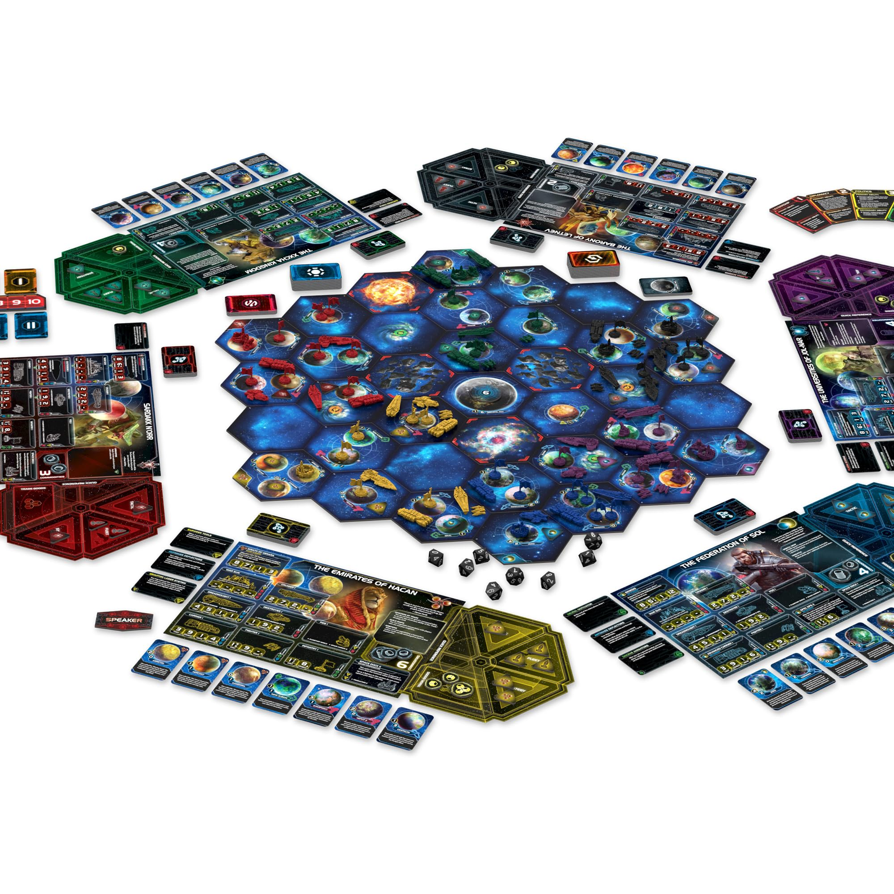
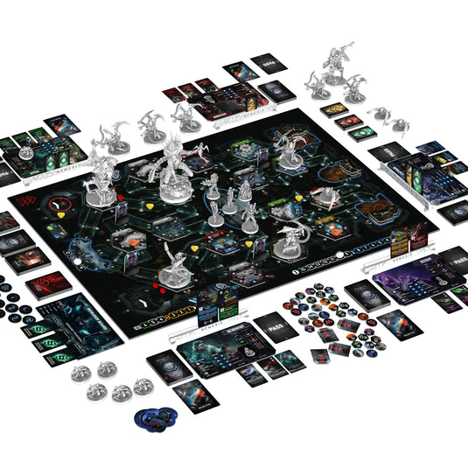
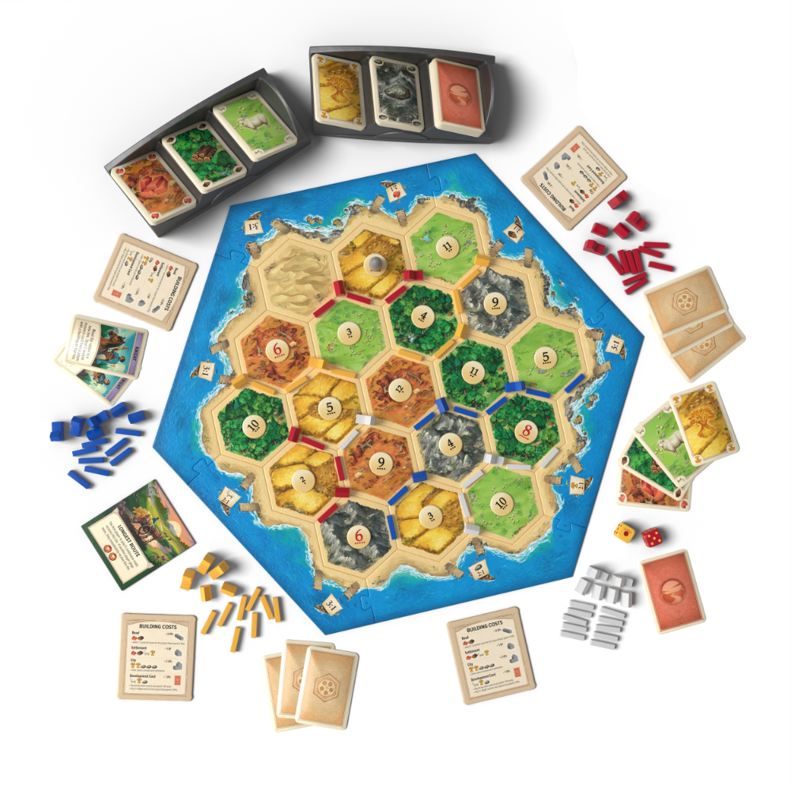
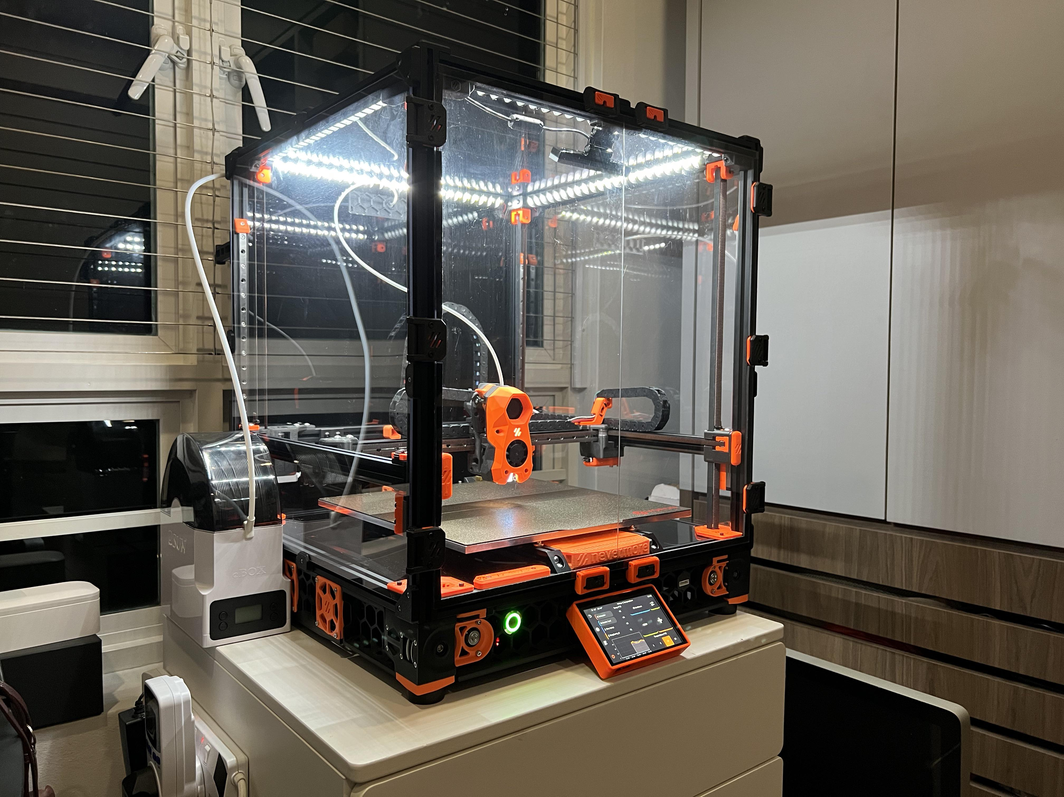
Outside the classroom
Board games
3D printing

Slide 4
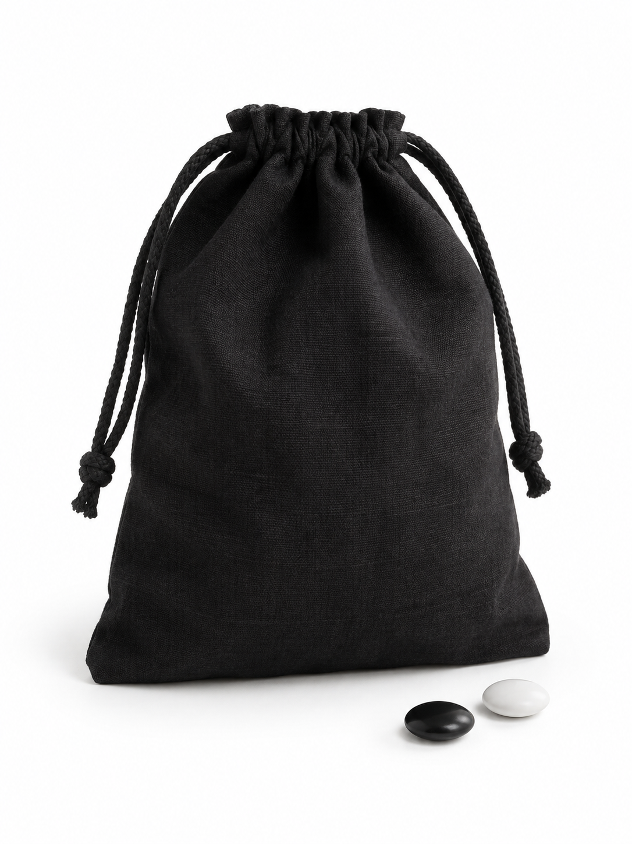
The Mystery Bag
50 tokens. Two colours.
Which colour is more common?
Show your prediction:
1 finger Black
2 fingers White
3 fingers Not enough information

Slide 5
What does our evidence suggest?
Draw 5 without looking. Keep them outside the bag.
Tokens examined | Black | White
First 5 | _____ | _____
First 10 | _____ | _____
First 15 | _____ | _____
Did your prediction change? What evidence supports it?
Could the unseen tokens change the result?
Notes:
Suggested time: 3–4 minutes. Mix the bag, then ask one seated student to take five tokens without looking. Keep the drawn tokens outside the bag. Record the cumulative black and white totals on the board. Ask for the same simultaneous vote: 1 black, 2 white, 3 not enough information. Repeat twice with different students, mixing the remaining tokens before each draw. The rows mean totals after 5, 10 and 15 unique tokens, not three separate totals to add together. Check each row’s black plus white count equals the number examined. Ask whether the prediction or confidence changed. More evidence need not make this particular prediction more accurate. With only 15 examined, the unseen 35 could still change which colour is most common.
[Sources]
Visual template: IFY_Statistics_Week_1_Class_A_Clean_Topology.pptx, version 2. Bellerbys source layouts, backgrounds, logo and Aptos fonts.
[/Sources]

Slide 6
The full result
Colour | Tokens
Black | 35
White | 15
Total | 50
Our evidence
Did the first 15 tokens give us a useful picture of the whole bag?
Would a different draw necessarily look the same?
Black was more common: 35 out of 50 tokens.
Notes:
Suggested time: 1–2 minutes. Before advancing to this reveal, empty the bag. Combine the remaining tokens with all 15 already drawn, sort by colour and count all 50. Use these fixed values only if the prepared bag contains 35 black and 15 white tokens as directed. Compare the actual class draws with the full count without inventing sample data. An accurate prediction is not proof that every small sample will give the correct answer.
[Sources]
Visual template: IFY_Statistics_Week_1_Class_A_Clean_Topology.pptx, version 2. Bellerbys source layouts, backgrounds, logo and Aptos fonts.
[/Sources]

Slide 7
You just did statistics
Asked a question
Which colour is more common?
Collected data
We drew tokens and recorded the colours.
Used evidence
We made or revised a prediction.
Checked the result
We counted the whole bag.
Statistics helps us learn from data when we cannot check everything.
Notes:
Suggested time: 45–60 seconds. Use the students’ actual experience to explain the steps. We described the observed tokens, made a prediction about the unseen bag and checked it against a complete count. Formal sampling methods come later. Connect to Class A: today’s mathematical tools help us organise data and calculate accurately.
[Sources]
Visual template: IFY_Statistics_Week_1_Class_A_Clean_Topology.pptx, version 2. Bellerbys source layouts, backgrounds, logo and Aptos fonts.
[/Sources]

Slide 8
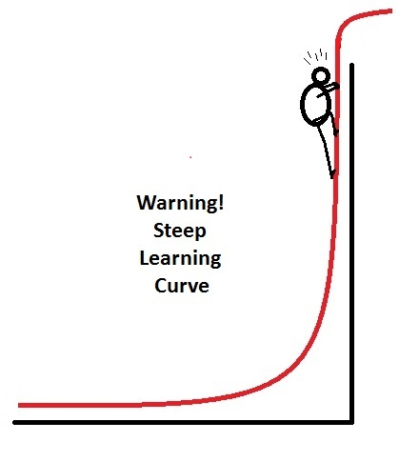
Course Learning Curve
Treat the first 3-5 weeks as a K12 revision
The course picks up in week 5 and gets significantly more difficult with every week

Slide 9

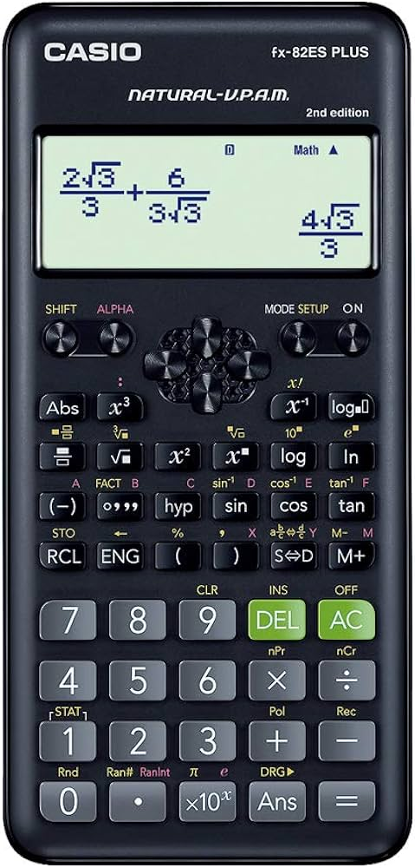
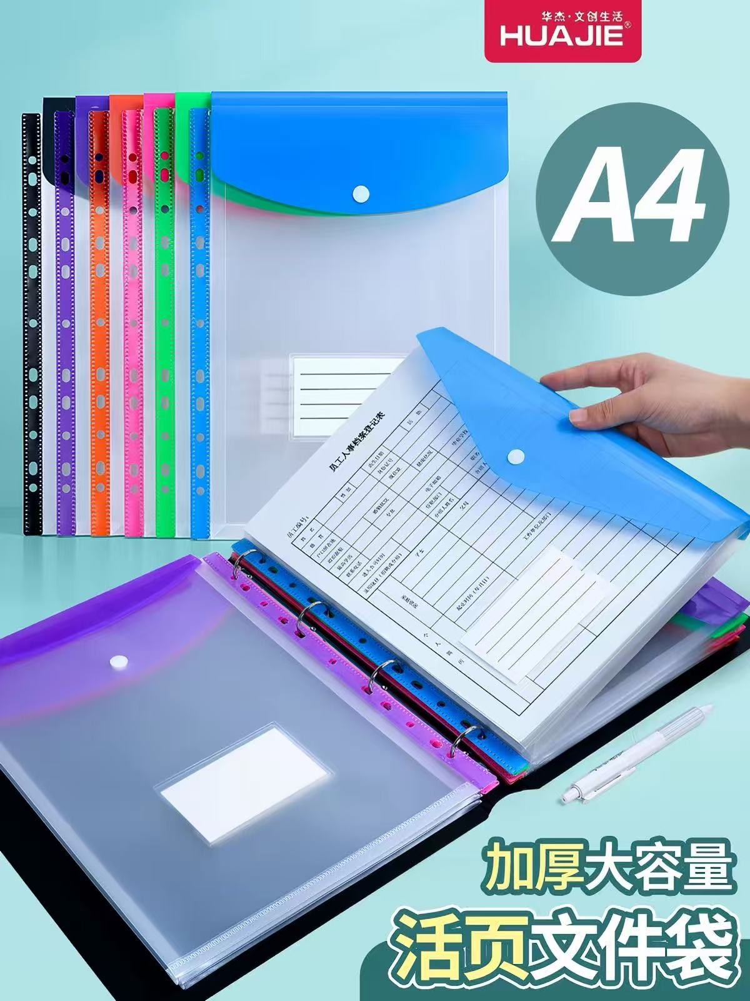
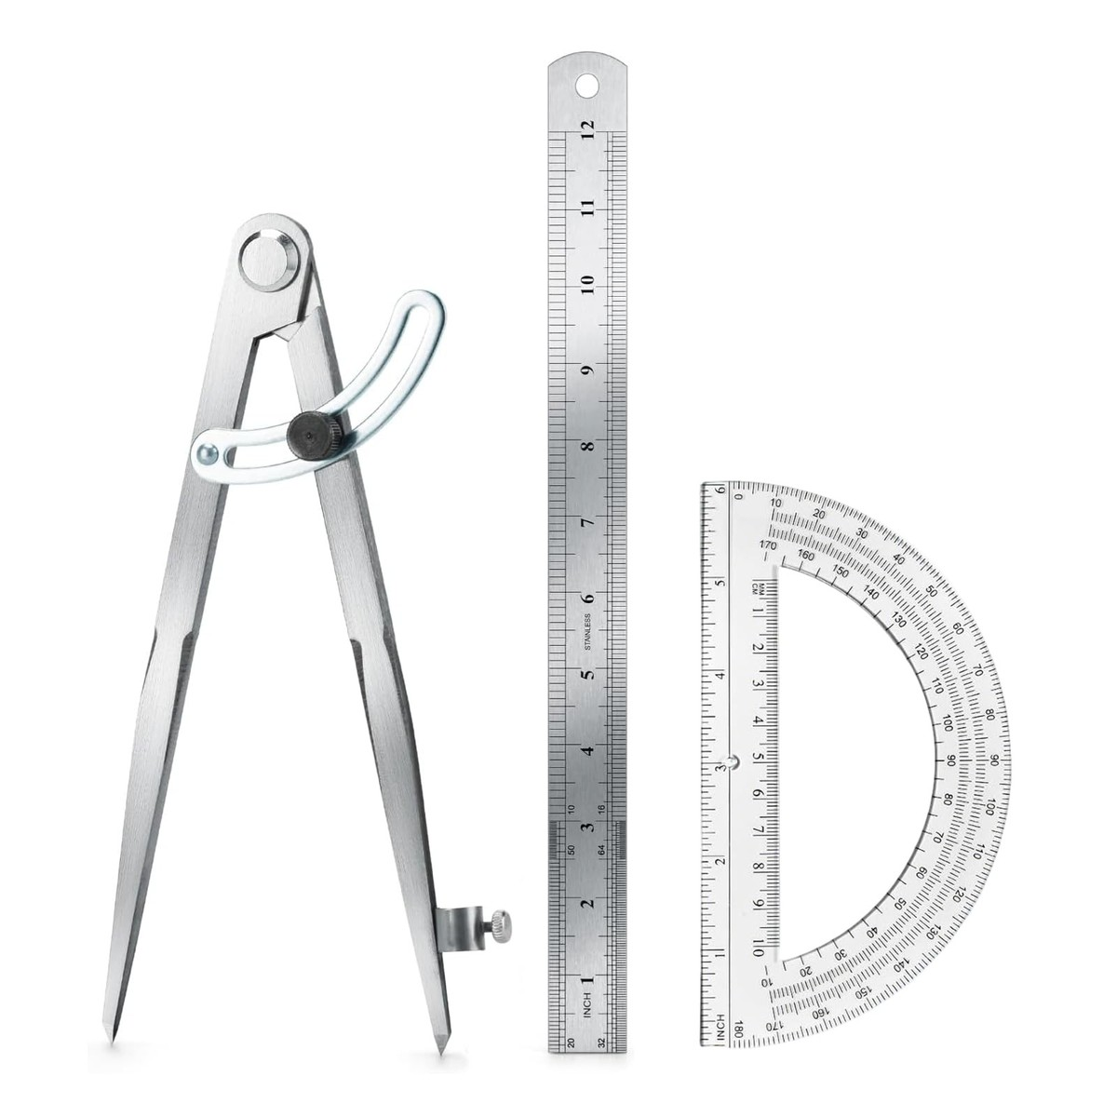
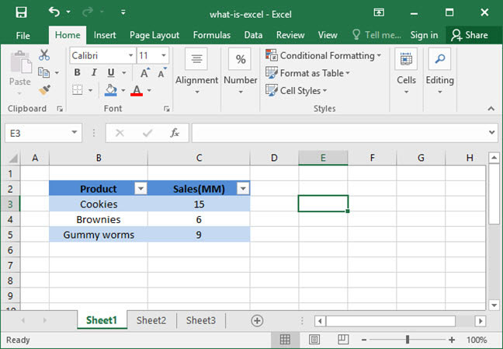
What will you need?
A Folder (12 Sleeves)
Ruler
Protractor
Compass
Scientific Calculator
Computer
Either Win or Mac
MUST have MS Office (pref. an English ver.)

Slide 10
Assessment
Practice and
final marks
Notes:
Suggested time: 10 seconds. Transition from the ungraded activity into how assessment works.
[Sources]
Visual template: IFY_Statistics_Week_1_Class_A_Clean_Topology.pptx, version 2. Bellerbys source layouts, backgrounds, logo and Aptos fonts.
[/Sources]

Slide 11
Formative and summative assessment
 | Formative | Summative
Purpose | Practise and improve. | Show what you have learned.
Final mark | 0% (Does not count to Final Mark) | Counts towards your final mark.
Examples | Quizzes, short tests, drafts and mocks | Semester 1: Final Exam Semester 2: group presentation/vlog, individual portfolio/blog
Feedback | Use it to correct mistakes and improve your next attempt. | Receive a result against the assessment criteria.
Draft feedback is formative. The final portfolio counts towards your mark.
Notes:
Suggested time: 1 minute. Formative assessment supports learning and contributes 0% to the final module mark. Summative assessment contributes to the final mark. Both can produce useful feedback. Use the Mystery Bag as an example of an ungraded learning activity. Clarify the distinction between formative feedback on a portfolio draft and the assessed final portfolio.
[Sources]
Template: Week_1_Introduction_and_Mystery_Bag_Bellerbys.pptx, existing Bellerbys layouts and fonts.
Calendar: IFY-Statistics-Teaching-Plan-With-Assessments.pdf, version 1, pages 1–4. This is the agreed tutor teaching plan.
Official assessment structure: IFY Statistics with Project Skills Module Spec(2).docx and (3).docx, assessment table. Semester 2 Week 13 Lesson 1 slide 8 confirms formative 0%; Week 22 SA2 and SA3 briefs give format and length.
[/Sources]

Slide 12
Semester 1: assessment weeks
Semester 1 weeks. These formative checks take place in Class C.
Assessment | Announced | Taken
FA1: Weeks 1–3 content | Week 2 | Week 3, Class C (30 min) (0%)
FA2: Weeks 4–6 content | Week 5 | Week 6, Class C (30 min) (0%)
FA3: Weeks 7–9 content | Week 8 | Week 9, Class C (30 min) (0%)
Mock examination | Week 11 | Week 12, Class C (60 min) (0%)
Final Exam | TBC | Week 14* (40%)
Summative: 2-hour examination, 40%, at the end of Semester 1.
Exact exam week/date: to be confirmed.
Notes:
Suggested time: 1 minute. All numbers are Semester 1 teaching weeks. FA1 covers Weeks 1–3: announced in Week 2 Class A, taken in the final 30 minutes of Week 3 Class C. FA2 covers Weeks 4–6: announced in Week 5 Class A, taken in the final 30 minutes of Week 6 Class C. FA3 covers Weeks 7–9: announced in Week 8 Class A, taken in the final 30 minutes of Week 9 Class C. Mock announced in Week 11 Class A and taken in Week 12 Class C: 60 minutes, approximately 60 marks. Tutorial corrections are in Weeks 5, 8 and 11. These are local planned formative timings. The summative exam is 2 hours, worth 40%, at the end of Semester 1. Its exact institutional week/date is not specified. Do not call the Week 12 mock the summative exam.
[Sources]
Template: Week_1_Introduction_and_Mystery_Bag_Bellerbys.pptx, existing Bellerbys layouts and fonts.
Calendar: IFY-Statistics-Teaching-Plan-With-Assessments.pdf, version 1, pages 1–4. This is the agreed tutor teaching plan.
Official assessment structure: IFY Statistics with Project Skills Module Spec(2).docx and (3).docx, assessment table. Semester 2 Week 13 Lesson 1 slide 8 confirms formative 0%; Week 22 SA2 and SA3 briefs give format and length.
[/Sources]

Slide 13
Semester 2: assessment weeks
Semester 2 weeks
Formative checkpoint | Preparation | Due / takes place
Project proposal | Week 3 | Week 4, Class C (0%)
Project progress review | Week 5 | Week 6, Class B (0%)
Timed rehearsal | Week 6 | Week 7, Class C (0%)
Draft review | Week 9 | Week 10, Class C (0%)
Draft feedback | From Week 9 | Week 11, Classes A/B (0%)
Mock presentations | Week 11 | Week 12, Classes A/B (0%)
Final Presentation | Portfolio/vlog | TBC | Week 13* (30% + 30%)
Project briefs: Week 1. Keep your individual evidence record each week.
Final assessment weeks/submission dates: to be confirmed.
Notes:
Suggested time: 1–2 minutes. These are Semester 2 weeks 1–12, equivalent to programme weeks 13–24. Project briefs SA2 and SA3 are issued in Week 1 Class A, and weekly SA3 evidence recording begins that week. Proposal assigned Week 3 Class A, submitted Week 4 Class C as a local formative checkpoint. Progress review prepared Week 5 Class C, held Week 6 Class B. Timed rehearsal prepared Week 6 Class C, held Week 7 Class C. Drafts prepared Week 9 Class C, reviewed Week 10 Class C. In Week 11, group SA2 draft feedback occurs in Class A and individual SA3 feedback in Class B. Mock presentations are prepared in Week 11 Class C and held in Week 12 Classes A/B. Week 12 Class C is for corrections and final submission checks. These milestones are formative, 0%. The plan explicitly leaves final SA2 and SA3 submission dates unconfirmed. Do not label Week 12 mocks as summative submissions.
[Sources]
Template: Week_1_Introduction_and_Mystery_Bag_Bellerbys.pptx, existing Bellerbys layouts and fonts.
Calendar: IFY-Statistics-Teaching-Plan-With-Assessments.pdf, version 1, pages 1–4. This is the agreed tutor teaching plan.
Official assessment structure: IFY Statistics with Project Skills Module Spec(2).docx and (3).docx, assessment table. Semester 2 Week 13 Lesson 1 slide 8 confirms formative 0%; Week 22 SA2 and SA3 briefs give format and length.
[/Sources]

Slide 14
Your final module mark
Summative assessment | Weight | When
Unseen examination 2 hours | 40% | End of Semester 1 Exact week/date to be confirmed
Group presentation or vlog | 30% | End of Semester 2 Exact week/date to be confirmed
Individual sustainability portfolio or blog | 30% | Developed continuously Final deadline to be confirmed
40% + 30% + 30% = 100%
Module pass mark: 40% overall*
*Pathway progression requirements may differ.
Notes:
Suggested time: 1 minute. The official weighting is 40% unseen examination, 30% group presentation or vlog, 30% individual sustainability portfolio/blog. This adds to 100%. The exam lasts 2 hours at the end of Semester 1; the group presentation/vlog takes place at the end of Semester 2. The individual portfolio develops continuously and is a summative assessment. Exact weeks and submission dates have not been supplied by the institution. Overall module pass threshold is 40%; progression requirements may vary by pathway.
[Sources]
Template: Week_1_Introduction_and_Mystery_Bag_Bellerbys.pptx, existing Bellerbys layouts and fonts.
Calendar: IFY-Statistics-Teaching-Plan-With-Assessments.pdf, version 1, pages 1–4. This is the agreed tutor teaching plan.
Official assessment structure: IFY Statistics with Project Skills Module Spec(2).docx and (3).docx, assessment table. Semester 2 Week 13 Lesson 1 slide 8 confirms formative 0%; Week 22 SA2 and SA3 briefs give format and length.
[/Sources]

Slide 15
Semester 2: presentation and portfolio
 | Group presentation / vlog | Individual portfolio / blog
Who? | Your group | You individually
What do I submit? | Live talk or recorded video, plus a group project item | Written portfolio or blog with weekly entries
What do I explain? | Research, evidence and conclusions | Your contribution and learning, with specific examples
Length | Up to 9 minutes per member | 1,500 words or equivalent
Weight | 30% | 30%
Project item (artefact): for example, a model, poster or video.
Notes:
Suggested time: 1–2 minutes. Both outputs relate to the same sustainability investigation. The group presentation can be live or a recorded vlog, and must accompany a group artefact. Explain artefact as something the group creates, such as a model, poster or video. A vlog here is a recorded video presentation. Each member has up to 9 minutes; the brief says material after the ninth minute is not marked. The individual portfolio/blog records and reflects on personal contribution and learning with weekly entries/evidence. Its limit is 1500 words or equivalent; the brief excludes bibliography, references and tables from the word count. The weekly record supports the assessed portfolio; it is not a separate additional 30% task. Do not launch permanent groups or topics during this introduction.
[Sources]
Template: Week_1_Introduction_and_Mystery_Bag_Bellerbys.pptx, existing Bellerbys layouts and fonts.
Calendar: IFY-Statistics-Teaching-Plan-With-Assessments.pdf, version 1, pages 1–4. This is the agreed tutor teaching plan.
Official assessment structure: IFY Statistics with Project Skills Module Spec(2).docx and (3).docx, assessment table. Semester 2 Week 13 Lesson 1 slide 8 confirms formative 0%; Week 22 SA2 and SA3 briefs give format and length.
[/Sources]

Slide 16
IFY Statistics
Semester 1 • Week 1 • Class A
Mathematical Foundations I
Sets, Counting & Arithmetic
Notes:
90-minute core route: opening/revision 7 min; sets 15; basic counting and factorial 15; permutations/combinations 18; numbers 8; arithmetic 14; A13 exit plus synthesis 8 (5 independent, 2 feedback, 1 synthesis). Reserve 5 minutes for recovery (85 + 5 = 90). Choose only targeted optional challenges within those section budgets. A12 must never displace A13. Teacher explanations are short; students first commit individually, then compare in pairs.
[Sources]
- Statistics Week 1 Lecture.pptx

Slide 17
Learning objectives
By the end of this class, you should be able to:
use basic set notation and set operations;
choose and apply a counting method;
classify common types of real numbers;
use the same order in PEMDAS and BODMAS.
Notes:
Connect each objective to one later check: A2 sets, A8 counting, A9 number types, A10 arithmetic. Ask students to name the objective they most want to strengthen.
[Sources]
- Statistics Week 1 Lecture.pptx

Slide 18
Quick revision
Work individually. Mark each answer: confident, unsure or guessed.
R1 3 + 5 × 2
R2 Is −3 an integer?
R3 If A = {2, 4, 6}, is 4 ∈ A?
R4 How many outfits can be made from 3 shirts and 2 pairs of trousers?
Notes:
Allow four minutes of individual retrieval. Ask students to mark confident, unsure or guessed. Do not reveal until everyone commits.
[Sources]
- Statistics Week 1 Lecture.pptx

Slide 19
Revision answers
R1 3 + 5 × 2 = 13
R2 Yes. −3 is an integer.
R3 Yes. 4 ∈ A.
R4 3 × 2 = 6 outfits.
Use your confidence marks to identify the topics needing the most attention.
Notes:
Ask for the operation performed first in R1 and the two choice stages in R4. Use confidence marks to choose one misconception to revisit.
[Sources]
- Statistics Week 1 Lecture.pptx

Slide 20
Section 1:
Sets and
Notation
Notes:
Ask for one familiar set. Transition to precise membership, not subjective descriptions.
[Sources]
- Statistics Week 1 Lecture.pptx

Slide 21
A set is a clear collection
Set: a collection of distinct objects.
Well-defined means we can decide clearly whether an object belongs.
Elements or members: the objects inside the set.
A = {2, 4, 6, 8}
Braces { } show the elements.
Order does not change a set.
Repeating an element does not create a new element.
Notes:
Ask whether changing order or repeating an element changes the set. Watch for treating duplicate entries as new elements.
[Sources]
- Statistics Week 1 Lecture.pptx

Slide 22
Essential set notation
Symbol | Read it aloud | Meaning / example
{ } | “braces” / “curly brackets” | A is the set containing 1, 2 and 3
∈ | “is an element of” | 2 ∈ A
∉ | “is not an element of” | 5 ∉ A
n(A) | “number of elements in A” | n(A) = 3
∅ | “empty set” | a set with no elements
U | “universal set” | all values being considered
Notes:
Read each symbol aloud with students. Check that n(A) is a count, whereas A names the set itself.
[Sources]
- Statistics Week 1 Lecture.pptx

Slide 23
A1: Symbol Decoder
HANDOUT • EXERCISE 1
Write each statement as a complete English sentence.
Q1 4 ∈ A
Q2 7 ∉ A
Q3 n(A) = 5
Q4 B = ∅
Compare your sentences with a partner.
Notes:
Students write all four complete English sentences, then pair-check. Do not accept reading the glyph name instead of its meaning.
[Sources]
- Statistics Week 1 Lecture.pptx

Slide 24
A1: Worked answers
HANDOUT • EXERCISE 1
Q1 Four is an element of set A.
Q2 Seven is not an element of set A.
Q3 Set A contains five elements.
Q4 Set B has no elements.
Mathematical symbols should be readable as language.
Notes:
Invite different valid sentence forms. Check that the empty set is not described as containing zero.
[Sources]
- Statistics Week 1 Lecture.pptx

Slide 25
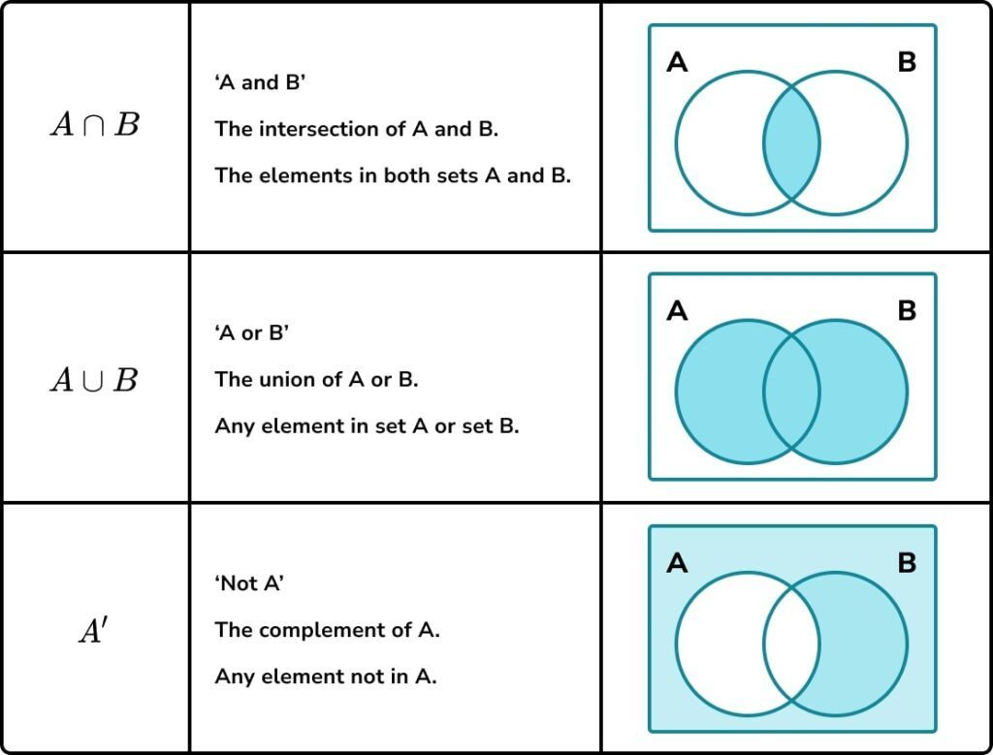
Union, intersection and complement
Intersection (A ∩ B):
elements in both A and B.
Union (A ∪ B):
in A, in B, or in both.
Complement (Aᶜ or A′):
in U, but not in A.
Define the universal set U first.
Here, U is the rectangle.
Notes:
Point to the inherited Venn regions for both, either-or-both and outside A. Define U before asking about complement.
[Sources]
- Statistics Week 1 Lecture.pptx

Slide 26
A2: Venn Detective
HANDOUT • EXERCISE 2
U = {1,2,3,4,5,6,7,8,9,10}
A = {1,2,4,6,8} B = {2,3,6,7,8}
Q1 Find A ∩ B.
Q2 Find A ∪ B.
Q3 Find Aᶜ.
Q4 Find n(A ∪ B).
Notes:
Students solve independently then compare sets, not just their cardinalities. Ask them to mark shared elements first.
[Sources]
- Statistics Week 1 Lecture.pptx

Slide 27
A2: Worked answers
HANDOUT • EXERCISE 2
Q1 A ∩ B = {2, 6, 8}
Q2 A ∪ B = {1, 2, 3, 4, 6, 7, 8}
Q3 Aᶜ = {3, 5, 7, 9, 10}
Q4 n(A ∪ B) = 7
Remember: intersection = shared; union = combined; complement = in U but outside A.
Notes:
Check that union contains no duplicates. Ask a student to count its seven elements and justify the complement using U.
[Sources]
- Statistics Week 1 Lecture.pptx

Slide 28
A3: Class survey sets
HANDOUT • EXERCISE 3
A class contains 30 students.
n(M) = 18 join Music; n(S) = 14 join Sport.
n(M ∩ S) = 6 join both groups.
Q1 Draw and label a Venn diagram.
Q2 Find Music only and Sport only.
Q3 Find n(M ∪ S).
Q4 Find how many join neither group.
Notes:
A3 is core applied set-counting practice. Students draw the rectangle and two circles, placing the overlap first. Give an individual attempt before pair discussion; check how students distinguish totals from disjoint regions.
[Sources]
- Statistics Week 1 Lecture.pptx

Slide 29
A3: Worked answers
HANDOUT • EXERCISE 3
Q1 Place both = 6 first.
Q2 Music only = 18 − 6 = 12
Sport only = 14 − 6 = 8
Q3 n(M ∪ S) = 12 + 6 + 8
= 26
Q4 Neither = 30 − 26 = 4
Check: 12 + 6 + 8 + 4 = 30
n(U) = 30
Music
Sport
12
6
8
4
Notes:
Reveal the completed Venn only after students draw. Check the four disjoint regions total 30. Main error: adding 18 and 14 without subtracting the overlap.
[Sources]
- Statistics Week 1 Lecture.pptx

Slide 30
Section 2:
Counting
Methods
Notes:
Connect the retrieval outfit question to a general count of complete outcomes.
[Sources]
- Statistics Week 1 Lecture.pptx

Slide 31
List possibilities first
Shirts: red, blue or green. Trousers: black or grey.
Red–black Red–grey
Blue–black Blue–grey
Green–black Green–grey
Complete outcome: one shirt and one pair of trousers.
3 shirts × 2 trousers = 6 complete outfits
Notes:
Have pairs check that every shirt occurs with both trousers. One complete outcome contains one of each item.
[Sources]
- Statistics Week 1 Lecture.pptx
- White, Stimmel & Searcy, Basic Math and Pre-Algebra, Cliffs Study Solver (2003).

Slide 32
Multiply choices at each stage
Stage: one decision or one position to fill.
Basic Counting Principle: count the choices at every stage, then multiply.
4 main dishes × 3 drinks × 2 desserts = 24 meals
Repeats allowed: the same choice remains available.
No repeats / without replacement: a used choice is unavailable.
If branches differ, draw a tree or count each valid branch.
Notes:
Ask how many decisions make a meal. Contrast a repeat-allowed code with a no-repeat selection; choices may shrink.
[Sources]
- Statistics Week 1 Lecture.pptx
- White, Stimmel & Searcy, Basic Math and Pre-Algebra, Cliffs Study Solver (2003).

Slide 33
A4: Basic counting practice
HANDOUT • EXERCISE 4
Draw one slot for each choice, then multiply.
Q1 Choose 1 snack from 4 and 1 drink from 3.
Q2 Choose one digit 0–9, then one letter A–F.
Q3 Create a 3-digit PIN; 0 may be first and repeats are allowed.
Q4 Optional: two uppercase letters A–Z, then three digits 0–9.
Repeats are allowed.
Notes:
Core Q1–Q3. Q4 is optional. Ask students to draw slots and write the choices above each slot; for Q4 uppercase A–Z gives 26 choices and 0–9 gives 10.
[Sources]
- Statistics Week 1 Lecture.pptx
- White, Stimmel & Searcy, Basic Math and Pre-Algebra, Cliffs Study Solver (2003).

Slide 34
A4: Worked answers
HANDOUT • EXERCISE 4
Q1 4 × 3 = 12 snack-and-drink choices
Q2 10 × 6 = 60 digit-and-letter codes
Q3 10 × 10 × 10 = 1,000 PINs
Q4 26 × 26 × 10 × 10 × 10 = 676,000 codes
The wording decides whether each choice remains available.
Notes:
Check that 0 may be the first PIN digit. Repeats allowed means the number of choices remains unchanged.
[Sources]
- Statistics Week 1 Lecture.pptx
- White, Stimmel & Searcy, Basic Math and Pre-Algebra, Cliffs Study Solver (2003).

Slide 35

Factorial arranges every item
Five different students stand in one line.
How many possible choices are there?
5 choices × 4 × 3 × 2 × 1 = 120 arrangements
Factorial: n! = n × (n−1) × … × 2 × 1
n: the number of distinct items being arranged.
5! = 120 and, by definition, 0! = 1
Factorial is a shortcut for multiplying decreasing choices.
Notes:
Use five students or names to explain 5,4,3,2,1 remaining choices. Note the definitions of n! and 0! without detouring into proofs.
[Sources]
- Statistics Week 1 Lecture.pptx
- White, Stimmel & Searcy, Basic Math and Pre-Algebra, Cliffs Study Solver (2003).

Slide 36
A5: Factorial practice
HANDOUT • EXERCISE 5
Write the multiplication before the factorial answer.
Q1 Arrange 4 different books in a row.
Q2 Arrange 6 students in a line.
Q3 Arrange 8 different photographs in a row.
Q4 Optional challenge: 6 books are arranged, but Statistics must be first.
Notes:
Core Q1–Q3; Q4 optional. Ask students to write the decreasing multiplication before the result.
[Sources]
- Statistics Week 1 Lecture.pptx
- White, Stimmel & Searcy, Basic Math and Pre-Algebra, Cliffs Study Solver (2003).

Slide 37
A5: Worked answers
HANDOUT • EXERCISE 5
Q1 4! = 4 × 3 × 2 × 1 = 24
Q2 6! = 6 × 5 × 4 × 3 × 2 × 1 = 720
Q3 8! = 8 × 7 × 6 × 5 × 4 × 3 × 2 × 1 = 40,320
Q4 Fix Statistics first, then arrange the other 5 books.
5! = 5 × 4 × 3 × 2 × 1 = 120
Next: what if only some positions are filled?
Notes:
In Q4 the first book is fixed, leaving exactly five distinct books to arrange. Connect to filling fewer than all positions.
[Sources]
- Statistics Week 1 Lecture.pptx
- White, Stimmel & Searcy, Basic Math and Pre-Algebra, Cliffs Study Solver (2003).

Slide 38
Permutation: different roles
Use a permutation when swapping selected items creates a new result.
From 5 students, fill 3 roles: president, secretary, treasurer.
5 × 4 × 3 = 60 ordered results
n = items available; r = positions filled
n!
Distinct items; no repeats; 0 ≤ r ≤ n.
P(n,r) =
(n − r)!
Calculator key: nPr
Notes:
Use the swap test: same people in different labelled roles means a different outcome. Read n and r aloud and state no repeats.
[Sources]
- Statistics Week 1 Lecture.pptx
- White, Stimmel & Searcy, Basic Math and Pre-Algebra, Cliffs Study Solver (2003).

Slide 39
Permutation: fill three roles
Five students: A, B, C, D and E.
Fill three labelled roles: President | Secretary | Treasurer.
Choices shrink: 5 for president, then 4, then 3.
5!
5!
P(5,3) =
=
= 5 × 4 × 3 = 60
(5 − 3)!
2!
Swap test: A–B–C and B–A–C are different.
The people are the same, but their roles changed.
Different roles or positions → permutation.
Notes:
Ask students to identify n=5 and r=3 in the substitution. The 2! cancels the unused tail of 5!, leaving 5×4×3.
[Sources]
- Week_1_Class_1_Mathematical_Foundations_A (2).pptx

Slide 40
A6: Permutation practice
HANDOUT • EXERCISE 6
Q1 Choose a president and vice-president from 8 students.
Q2 Arrange 4 letters selected from 9 different letters.
Q3 Award gold, silver and bronze to 6 teams.
Q4 Optional challenge: how many 5-digit numbers have no repeated digits?
For question 4, remember that the first digit cannot be 0.
Notes:
Core Q1–Q3; Q4 optional. Q4 is a number rather than a PIN, so its first digit cannot be zero.
[Sources]
- Statistics Week 1 Lecture.pptx
- White, Stimmel & Searcy, Basic Math and Pre-Algebra, Cliffs Study Solver (2003).

Slide 41
A6: Worked answers
HANDOUT • EXERCISE 6
Q1 P(8,2) = 8 × 7 = 56
Q2 P(9,4) = 9 × 8 × 7 × 6 = 3,024
Q3 P(6,3) = 6 × 5 × 4 = 120
Q4 9 × 9 × 8 × 7 × 6 = 27,216 five-digit numbers
Ordered positions make each different arrangement count.
Notes:
Explain the two initial factors 9 in Q4: 9 choices for the first non-zero digit, then 9 unused digits including zero.
[Sources]
- Statistics Week 1 Lecture.pptx
- White, Stimmel & Searcy, Basic Math and Pre-Algebra, Cliffs Study Solver (2003).

Slide 42
Combination: equal roles
Use a combination when swapping selected items does not create a new group.
From 5 students, choose 3 representatives with equal roles.
The 60 ordered results count every group 3! = 6 times.
60 ÷ 6 = 10 different groups
n!
n = total available; r = group size
C(n,r) =
r!(n − r)!
Calculator key: nCr
Notes:
Ask how often one group of three appears in the ordered count. Its 3! arrangements all represent the same equal-role group.
[Sources]
- Statistics Week 1 Lecture.pptx
- White, Stimmel & Searcy, Basic Math and Pre-Algebra, Cliffs Study Solver (2003).

Slide 43
Combination: the group stays the same
Choose 3 equal-role representatives from 5 students.
{A, B, C} = {C, A, B}: the group did not change.
Each group appears 3! = 6 times in the ordered count.
5!
5 × 4 × 3
C(5,3) =
=
= 10
3!2!
3 × 2 × 1
C(5,3) = P(5,3) ÷ 3! = 60 ÷ 6 = 10 groups
Same people + equal roles → combination.
Notes:
Use the same students to isolate the difference between permutations and combinations. Do not introduce the leader answer before A8 Q5.
[Sources]
- Week_1_Class_1_Mathematical_Foundations_A (2).pptx

Slide 44
A7: Combination practice
HANDOUT • EXERCISE 7
Q1 Choose 3 students from 8 for one team.
Q2 Choose 4 survey participants from 10 students.
Q3 Choose 2 different toppings from 7.
Q4 Optional challenge: choose 2 of 5 Year-1 and 2 of 6 Year-2 students.
Explain why order does not matter before calculating.
Notes:
Core Q1–Q3; Q4 optional. Students justify why order does not matter before they touch a calculator.
[Sources]
- Statistics Week 1 Lecture.pptx
- White, Stimmel & Searcy, Basic Math and Pre-Algebra, Cliffs Study Solver (2003).

Slide 45
A7: Worked answers
HANDOUT • EXERCISE 7
Q1 Choose a group: substitute n = 8 and r = 3.
8!
8 × 7 × 6
C(8,3) =
=
= 56
3!5!
3 × 2 × 1
Q2 C(10,4) = 210
Q3 C(7,2) = 21
Q4 C(5,2) × C(6,2) = 10 × 15 = 150
The optional challenge has two group-selection stages: multiply.
Notes:
Use Q1 to model substitution and cancellation. For optional Q4 there are two group-selection stages, so multiply their counts.
[Sources]
- Statistics Week 1 Lecture.pptx
- White, Stimmel & Searcy, Basic Math and Pre-Algebra, Cliffs Study Solver (2003).

Slide 46
Choose the counting method
Situation | Question to ask | Method | Typical calculation
Separate choice stages | One choice from each stage? | Basic counting | multiply stage choices
Arrange every item | Are all distinct items ordered? | Factorial | n!
Fill different roles | Would swapping people change it? | Permutation | P(n,r) / nPr
Choose one equal-role group | Would swapping people keep it? | Combination | C(n,r) / nCr
Restrictions or repeats | How many choices remain in each slot? | Count slots | multiply valid choices
Notes:
Read the situation first. Ask which test distinguishes permutation from combination: does swapping items change the outcome?
[Sources]
- Statistics Week 1 Lecture.pptx
- White, Stimmel & Searcy, Basic Math and Pre-Algebra, Cliffs Study Solver (2003).

Slide 47
A8: Choose, explain, calculate
HANDOUT • EXERCISE 8
Q1 Choose 1 main from 5, 1 drink from 4 and 1 dessert from 2.
Q2 Choose captain and vice-captain from 9 students.
Q3 Choose 2 equal-role delegates from 9 students.
Q4 Arrange all 7 laboratory samples in a row.
Q5 Optional challenge: choose a 3-person committee from 8, then its leader.
Choose one or more methods: Basic counting, Factorial, Permutation or Combination. Explain your choice in one sentence.
Notes:
Core Q1–Q4; Q5 optional. Students choose a method and explain their choice before calculating. Keep Q5 answer hidden until attempts are complete.
[Sources]
- Statistics Week 1 Lecture.pptx
- White, Stimmel & Searcy, Basic Math and Pre-Algebra, Cliffs Study Solver (2003).

Slide 48
A8: Worked answers
HANDOUT • EXERCISE 8
Q1 Basic counting: 5 × 4 × 2 = 40
Q2 Permutation: P(9,2) = 9 × 8 = 72
Q3 Combination: C(9,2) = 36
Q4 Factorial: 7! = 5,040
Q5 Optional: choose the committee, then its leader.
C(8,3) × 3 = 56 × 3 = 168
8 × 7 × 6
336
Alternative:
=
= 168
Two ordinary members can swap.
2!
2!
Notes:
Check each method as well as its count. For optional Q5 first choose the group then its leader; alternatively divide 336 by 2! because the two ordinary members can swap.
[Sources]
- Statistics Week 1 Lecture.pptx
- White, Stimmel & Searcy, Basic Math and Pre-Algebra, Cliffs Study Solver (2003).

Slide 49
Section 3:
Numbers and
Arithmetic
Notes:
Transition from counting to the number and operation rules needed for later calculations.
[Sources]
- Statistics Week 1 Lecture.pptx

Slide 50
Types of real numbers
Type | Definition | Examples | Important detail
Natural | counting numbers | 1, 2, 3, … | Positive whole numbers
Whole | natural numbers and 0 | 0, 1, 2, … | Non-negative integers; includes 0
Integer | negative, zero, positive | −5, 0, 12 | Positive and negative whole numbers, including zero
Rational | can be written as | −2, 0.25 | p and q are integers; q ≠ 0; decimal terminates or repeats
Irrational | cannot be written in rational form | π | Cannot be written as a ratio of integers; decimal neither terminates nor repeats
Real | includes rational and irrational | all examples above | points on the number line
p
3
q
4
√
2
Notes:
Use this course convention: natural numbers begin at 1; whole numbers include 0. Emphasise that a terminating or repeating decimal is rational.
[Sources]
- Statistics Week 1 Lecture.pptx

Slide 51
Number families overlap
Natural ⊂ Whole ⊂ Integer ⊂ Rational ⊂ Real
Irrational numbers are real but not rational.
When one type is requested, choose the smallest applicable category.
Simplify first:
√
9
= 3, so
√
9
is a natural number.
22
A fraction is not automatically irrational:
is rational.
7
Notes:
Ask why a number may belong to several families. When one type is requested, use the smallest applicable family after simplifying.
[Sources]
- Statistics Week 1 Lecture.pptx

Slide 52
A9: Simplify, then classify
HANDOUT • EXERCISE 9
Choose the smallest applicable category. Simplify first.
Q1 0
Q4 0.272727…
27 repeats
Q2 −
√
64
Q5
√
18
√
49
Q3
4
Q6 π
Notes:
Students simplify each number then classify. Watch the minus sign outside √64 and the whole fraction beneath the Q3 radical.
[Sources]
- Statistics Week 1 Lecture.pptx
- White, Stimmel & Searcy, Basic Math and Pre-Algebra, Cliffs Study Solver (2003).

Slide 53
A9: Worked answers
HANDOUT • EXERCISE 9
Q1 0 → whole
Q4 0.272727… =
3
→ rational
11
Q2 −
√
64
= −8 → integer
Q5
√
18
= 3
√
2
→ irrational
√
49
7
Q3
=
→ rational
4
2
Q6 π → irrational
All six values are real numbers.
Notes:
Ask why Q3 and Q4 are rational, and why a square root is not automatically irrational. All six answers are real.
[Sources]
- Statistics Week 1 Lecture.pptx
- White, Stimmel & Searcy, Basic Math and Pre-Algebra, Cliffs Study Solver (2003).

Slide 54
Arithmetic vocabulary
Addition (+): sum or total
Subtraction (−): difference or decrease
Multiplication (×): product; the word “of”
Division (÷): quotient or “per”
Power / root: squared, cubed, square root
Greatest common divisor (GCD): largest positive integer that divides both numbers exactly
Adjacency also means multiplication: 4(6) = 4 × 6.
Example: GCD(24, 36) = 12.
Notes:
Quick oral translation of sum, difference, product and quotient. Explain adjacency and ask why 12 is the GCD of 24 and 36.
[Sources]
- Statistics Week 1 Lecture.pptx

Slide 55
PEMDAS and BODMAS
Please Excuse My Dear Aunt Sally
P Parentheses (brackets)
E Exponents: powers and roots
M and D Multiplication and division: equal priority, left to right
A and S Addition and subtraction: equal priority, left to right
PEMDAS does not mean multiplication always comes before division.
PEMDAS and BODMAS produce exactly the same calculation order.
Notes:
M/D have equal priority, as do A/S; work left to right within each pair. BODMAS and PEMDAS describe the same order.
[Sources]
- Statistics Week 1 Lecture.pptx
- White, Stimmel & Searcy, Basic Math and Pre-Algebra, Cliffs Study Solver (2003).

Slide 56
PEMDAS: worked example 1
Example 1
1 + 2 × (3 + 4)²
= 1 + 2 × 7²
= 1 + 2 × 49
= 1 + 98
= 99
Notes:
Ask students to identify the next operation before each line. Each equality changes one operation only. Use the second example only if needed to reinforce left-to-right priority.
[Sources]
- Statistics Week 1 Lecture.pptx
- White, Stimmel & Searcy, Basic Math and Pre-Algebra, Cliffs Study Solver (2003).

Slide 57
PEMDAS: worked example 2
Example 2
3 + (3 + 3)³ ÷ 3 − 3 × 3
= 3 + 6³ ÷ 3 − 3 × 3
= 3 + 216 ÷ 3 − 3 × 3
= 3 + 72 − 3 × 3
= 3 + 72 − 9
= 75 − 9
= 66
Notes:
Ask students to identify the next operation before each line. Each equality changes one operation only. Use the second example only if needed to reinforce left-to-right priority.
[Sources]
- Statistics Week 1 Lecture.pptx
- White, Stimmel & Searcy, Basic Math and Pre-Algebra, Cliffs Study Solver (2003).

Slide 58
A10: Order-of-operations error clinic
HANDOUT • EXERCISE 10
Find the first incorrect step, then correct it.
Q1 3 + 5 × 2 = 8 × 2 = 16
Q2 24 ÷ 6 × 2 = 24 ÷ 12 = 2
Q3 18 − 6 + 2 = 18 − 8 = 10
Explain each error using a complete sentence.
Notes:
Students identify the first incorrect equality, not merely the final wrong answer. Then correct the calculation and explain the rule.
[Sources]
- Statistics Week 1 Lecture.pptx
- Statistics Week 1 Seminar 1 - Questions.docx
- Statistics Week 1 Seminar 1 - Answers.docx

Slide 59
A10: Worked answers
HANDOUT • EXERCISE 10
Q1 Multiplication before addition: 3 + 5 × 2 = 3 + 10 = 13
Q2 Division and multiplication left to right: 24 ÷ 6 × 2 = 4 × 2 = 8
Q3 Subtraction and addition left to right: 18 − 6 + 2 = 12 + 2 = 14
The letters D/M and A/S do not create priority within each pair.
Notes:
Check explanations of priority and left-to-right order. Ask students to name which exact step in each original chain fails.
[Sources]
- Statistics Week 1 Lecture.pptx
- Statistics Week 1 Seminar 1 - Questions.docx
- Statistics Week 1 Seminar 1 - Answers.docx

Slide 60
A11: PEMDAS challenge
HANDOUT • EXERCISE 11
No calculator. Show one operation per line.
Q1 36 ÷ 3 × (2 + 4) − 5²
Q2 5 + 3[8 − 2(3 + 1)]
Q3 120 − {4[3² + 6] − 8} ÷ 2
Check brackets first and equal-priority operations left to right.
Notes:
A11 is optional extension: select Q1 as a short check if time permits; Q2–Q3 stretch secure students. Do not compromise A13 exit time.
[Sources]
- Statistics Week 1 Lecture.pptx
- White, Stimmel & Searcy, Basic Math and Pre-Algebra, Cliffs Study Solver (2003).

Slide 61
A11: Q1 worked answer
HANDOUT • EXERCISE 11
Q1 36 ÷ 3 × (2 + 4) − 5²
= 36 ÷ 3 × 6 − 5²
= 36 ÷ 3 × 6 − 25
= 12 × 6 − 25
= 72 − 25
= 47
Notes:
Optional answer reveal. Every line keeps the unchanged terms visible and applies only one operation. Have students name that operation.
[Sources]
- Statistics Week 1 Lecture.pptx
- White, Stimmel & Searcy, Basic Math and Pre-Algebra, Cliffs Study Solver (2003).

Slide 62
A11: Q2 worked answer
HANDOUT • EXERCISE 11
Q2 5 + 3[8 − 2(3 + 1)]
= 5 + 3[8 − 2(4)]
= 5 + 3[8 − 8]
= 5 + 3(0)
= 5 + 0
= 5
Notes:
Optional answer reveal. Every line keeps the unchanged terms visible and applies only one operation. Have students name that operation.
[Sources]
- Statistics Week 1 Lecture.pptx
- White, Stimmel & Searcy, Basic Math and Pre-Algebra, Cliffs Study Solver (2003).

Slide 63
A11: Q3 worked answer
HANDOUT • EXERCISE 11
Q3 120 − {4[3² + 6] − 8} ÷ 2
= 120 − {4[9 + 6] − 8} ÷ 2
= 120 − {4[15] − 8} ÷ 2
= 120 − {60 − 8} ÷ 2
= 120 − 52 ÷ 2
= 120 − 26
= 94
Notes:
Optional answer reveal. Every line keeps the unchanged terms visible and applies only one operation. Have students name that operation.
[Sources]
- Statistics Week 1 Lecture.pptx
- White, Stimmel & Searcy, Basic Math and Pre-Algebra, Cliffs Study Solver (2003).

Slide 64
A12: Optional brain-boiling challenge
HANDOUT • EXERCISE 12
Optional extension. No calculator.
Q1 Simplify. Show one operation per line.
√
[(16 − 8) ÷ 2] + 5 × 11 − 4² −
8 × 2
Notes:
A12 is optional extension, not part of the core route. Start only if A13 exit time and the 5-minute recovery buffer are protected. Otherwise assign after class; keep it available in the deck.
[Sources]
- CliffsStudySolver Algebra I, Part 1, Chapter 1, problem 1, book p.67 / PDF p.85.

Slide 65
A12: Optional answer (1/2)
HANDOUT • EXERCISE 12
Q1 Brackets, then the power and root.
[(16 − 8) ÷ 2] + 5 × 11 − 4² −
√
8 × 2
= [8 ÷ 2] + 5 × 11 − 4² −
√
8 × 2
= 4 + 5 × 11 − 4² −
√
8 × 2
= 4 + 5 × 11 − 4² −
√
16
= 4 + 5 × 11 − 16 −
√
16
= 4 + 5 × 11 − 16 − 4
Notes:
Optional A12 reveal follows student attempt. Work inside brackets, then evaluate powers/root, multiplication, and addition/subtraction left to right. Preserve A13 time.
[Sources]
- CliffsStudySolver Algebra I, Part 1, official solution, book p.68 / PDF p.86.

Slide 66
A12: Optional answer (2/2)
HANDOUT • EXERCISE 12
Q1 Continue: multiplication, then left to right.
4 + 5 × 11 − 16 − 4
= 4 + 55 − 16 − 4
= 59 − 16 − 4
= 43 − 4
= 39
Notes:
Optional A12 reveal follows student attempt. Work inside brackets, then evaluate powers/root, multiplication, and addition/subtraction left to right. Preserve A13 time.
[Sources]
- CliffsStudySolver Algebra I, Part 1, official solution, book p.68 / PDF p.86.

Slide 67
A13: Independent exit ticket
HANDOUT • EXERCISE 13
Q1 A = {1,2,4,8}, B = {2,3,4,6}. Find A ∪ B.
Q2 Choose and calculate: select 3 equal-role students from 8.
Q3 Simplify and classify √27.
Q4 Calculate 48 ÷ [2 × (3 + 1)] + 5².
Write the method and the main calculation steps.
Notes:
Protect five minutes of independent exit work even if optional challenges are skipped, followed by two minutes of feedback and one minute of synthesis. Students show method plus main steps. Collect or inspect responses before revealing.
[Sources]
- Statistics Week 1 Lecture.pptx

Slide 68
A13: Worked answers
HANDOUT • EXERCISE 13
Q1 A ∪ B = {1,2,3,4,6,8}
Q2 Combination: C(8,3) = 56
Q3 √27 = 3√3 → irrational
Q4 48 ÷ 8 + 25 = 6 + 25 = 31
Use set notation accurately.
Read the story before selecting a formula.
Simplify numbers and use PEMDAS.
Notes:
Check one answer per objective. Use errors to plan the opening retrieval in Class B; ask students to correct one step in a different colour.
[Sources]
- Statistics Week 1 Lecture.pptx

Slide 69
What we can do now
Use precise notation. Choose the method. Show the steps.
Sets — identify membership and combine or compare groups.
Counting — decide whether swapping changes the result.
Numbers — simplify before choosing a number family.
Arithmetic — apply brackets, powers and equal-priority order.
Next: use these foundations to solve equations,
convert units and compare quantities in Class B.
Notes:
Ask students to name one method they can now explain. Bridge to equations, unit conversion, percentages and ratios in Class B.
[Sources]
- Statistics Week 1 Lecture.pptx

