Slide 1
IFY Statistics
Semester 1 • Week 1 • Class B
Mathematical Foundations II
Algebra & Units
Percentages
& Ratios
Notes:
Core route: 90 minutes including a protected 5-minute buffer. Opening/revision 7 minutes; algebra 18; quadratics 15; conversions 13; percentages 14; ratios 10; B13 exit and synthesis 8; buffer 5. B3 Q2 and B12 are optional and outside this core allocation. Skip their task/reveal sequences if time is tight; always preserve B13.
[Sources]
- Statistics Week 1 Lecture.pptx

Slide 2
Learning objectives
By the end of this class, you should be able to:
simplify algebra and solve linear equations;
recognise and solve simple quadratics;
convert measurement units correctly;
solve percentage and ratio problems.
Notes:
Check students can distinguish a method from an answer. The objectives are revisited after the exit check.
[Sources]
- Statistics Week 1 Lecture.pptx

Slide 3
Quick revision
R1 What does A ∩ B mean?
R2 Choose 3 equal-role representatives from 8 students: permutation or combination?
R3 Classify √7.
R4 Calculate 18 ÷ 3 × 2.
Answer alone before comparing.
Notes:
Allow independent recall, then compare pairs. Diagnose intersection versus union, equal roles versus ordered roles, irrational roots, and left-to-right operations.
[Sources]
- Statistics Week 1 Lecture.pptx

Slide 4
Revision answers
R1 Elements in both A and B.
R2 Combination — order does not matter.
R3 √7 is irrational.
R4 18 ÷ 3 × 2 = 6 × 2 = 12.
Carry method selection into today’s problems.
Notes:
Ask why the representatives form a combination. For R4, division and multiplication have equal priority; process left to right.
[Sources]
- Statistics Week 1 Lecture.pptx

Slide 5
Section 1:
Algebra and
Equations
Notes:
Ask what the equals sign means before showing algebra terminology.
[Sources]
- Statistics Week 1 Lecture.pptx

Slide 6
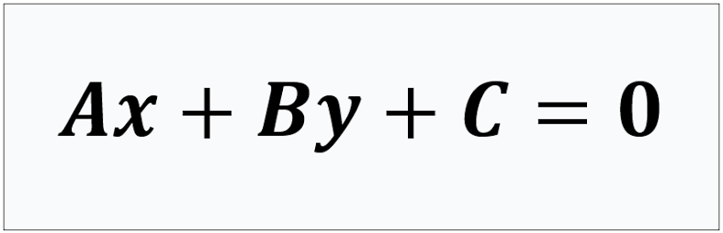
Parts of an equation
Variable: x and y — an unknown or changeable value
Coefficients: A and B — numbers multiplying x and y
Constants: C — numbers without variables
Notes:
Ask students to include the sign with −2. Contrast a coefficient with a constant and a term.
[Sources]
- Statistics Week 1 Lecture.pptx

Slide 7
Parts of an equation
5x − 2x + 3 = 18
Variable: x — an unknown or changeable value
Coefficients: 5 and −2 — numbers multiplying x
Constants: 3 and 18 — numbers without variables
Terms on the left: 5x, −2x and 3
Like terms: 5x and −2x
3x means 3 × x.
Notes:
Ask students to include the sign with −2. Contrast a coefficient with a constant and a term.
[Sources]
- Statistics Week 1 Lecture.pptx

Slide 8
B1: Label the mathematics
HANDOUT • EXERCISE 1
Use 7y − 3y + 4 = 20.
Q1 Circle the variable.
Q2 Underline the coefficients.
Q3 Box the constants.
Q4 Identify the terms on the left.
Q5 Identify the like terms.
Q6 Name the left side and right side.
Notes:
Give silent identification time. Check that −3, not 3, is recorded as a coefficient.
[Sources]
- Statistics Week 1 Lecture.pptx

Slide 9
B1: Worked answers
HANDOUT • EXERCISE 1
Q1 Variable: y
Q2 Coefficients: 7 and −3
Q3 Constants: 4 and 20
Q4 Terms on the left: 7y, −3y and 4
Q5 Like terms: 7y and −3y
Q6 Left side: 7y − 3y + 4; right side: 20
The equals sign says that both sides have the same value.
Notes:
Require students to point to the two sides. The equals sign is a statement of equal values, not an instruction to write an answer.
[Sources]
- Statistics Week 1 Lecture.pptx

Slide 10
Expression or equation?
Expression: numbers, variables and operations with no equals sign.
Example: 3x + 5
Equation: two expressions connected by an equals sign.
Example: 3x + 5 = 20
To solve an equation, find the value that makes both sides equal.
Notes:
Ask what changes when =20 is appended to the expression. Solving finds values that make the equation true.
[Sources]
- Statistics Week 1 Lecture.pptx

Slide 11
Three algebra jobs
Simplify: combine like terms.
5x − 2x + 3 = 3x + 3
Substitute: replace a variable with its value.
If x=4, then 3x+3 = 3(4)+3 = 15
Distribute: multiply every term inside brackets.
2(y−1) = 2y−2
Notes:
Elicit which job is requested before computing. Common error: 2(y−1)=2y−1; every term inside the bracket must be multiplied.
[Sources]
- Statistics Week 1 Lecture.pptx

Slide 12
Keep both sides balanced
Balance rule: use the same operation on both sides.
Inverse operations undo each other: + ↔ − and × ↔ ÷.
2x + 3 = 11
Subtract 3: 2x = 8
Divide by 2: x = 4
Now x is alone — isolated.
Check: 2(4) + 3 = 11 ✓ Name the operation; do not only say ‘move’.
Notes:
Ask students to name subtract 3 and divide by 2. Avoid explaining algebra as unqualified moving terms.
[Sources]
- Statistics Week 1 Lecture.pptx

Slide 13
B2: Balance chain
HANDOUT • EXERCISE 2
Solve 5x − 3 = 2x + 9.
Q1 Write the operation applied to both sides.
Q2 Isolate x.
Q3 Check the result in the original equation.
Notes:
Collect one operation per line; ensure the same operation is applied to both sides.
[Sources]
- Statistics Week 1 Lecture.pptx
- Statistics Week 1 Seminar 1 - Questions.docx

Slide 14
B2: Worked answers
HANDOUT • EXERCISE 2
Q1 Apply the same operation to both sides.
Subtract 2x: 3x − 3 = 9
Add 3: 3x = 12
Q2 Isolate x: divide by 3, so x = 4.
Q3 Check in the original equation.
Left side = 5(4) − 3 = 17
Right side = 2(4) + 9 = 17
Therefore, x = 4.
Notes:
Check substitution into both original sides gives 17. A correct answer without a balanced chain is not full evidence.
[Sources]
- Statistics Week 1 Seminar 1 - Answers.docx

Slide 15
B3: Brackets and like terms
HANDOUT • EXERCISE 3
Q1 Solve 5y + 2(y − 1) = 3y + 10.
Distribute, then simplify.
Apply the same operation to both sides.
Check your value in the original equation.
Show each balancing step.
Notes:
B3 Q1 belongs to the core route. The fraction challenge Q2 is optional; skip all three Q2 slides together to protect exit time.
[Sources]
- Statistics Week 1 Lecture(1).pptx
- AlgebraI(CliffsStudySolver) Part1.pdf, Chapter 3, Example Problem 2, PDF p.150 / printed p.132; adapted and checked.

Slide 16
B3: Q1 worked answer
HANDOUT • EXERCISE 3
Q1 Distribute and combine like terms.
5y + 2y − 2 = 3y + 10
7y − 2 = 3y + 10
Subtract 3y from both sides: 4y − 2 = 10
Add 2 to both sides: 4y = 12
Divide both sides by 4: y = 3
Check: 5(3) + 2(3 − 1) = 19; 3(3) + 10 = 19.
Notes:
B3 Q1 check: both sides are 19. For optional Q2, multiply −z by 20 too; after expanding, adding 15z and then 4 isolates 3z. Substitute z=8 into both original fractions to get −5.
[Sources]
- Statistics Week 1 Lecture(1).pptx
- AlgebraI(CliffsStudySolver) Part1.pdf, Chapter 3, Example Problem 2, PDF p.150 / printed p.132; adapted and checked.

Slide 17
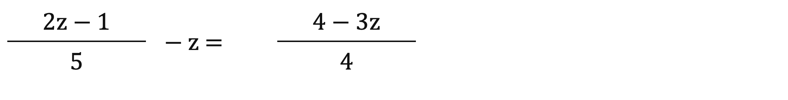
B3: Optional fraction challenge
HANDOUT • EXERCISE 3
Q2 Solve the equation below.
First multiply every term by 20 (GCD) to remove the fractions .
Then distribute, combine like terms, balance and check.
Show every operation on both sides.
Greatest Common Divisor
Notes:
B3 Q1 belongs to the core route. The fraction challenge Q2 is optional; skip all three Q2 slides together to protect exit time.
[Sources]
- Statistics Week 1 Lecture(1).pptx
- AlgebraI(CliffsStudySolver) Part1.pdf, Chapter 3, Example Problem 2, PDF p.150 / printed p.132; adapted and checked.

Slide 18
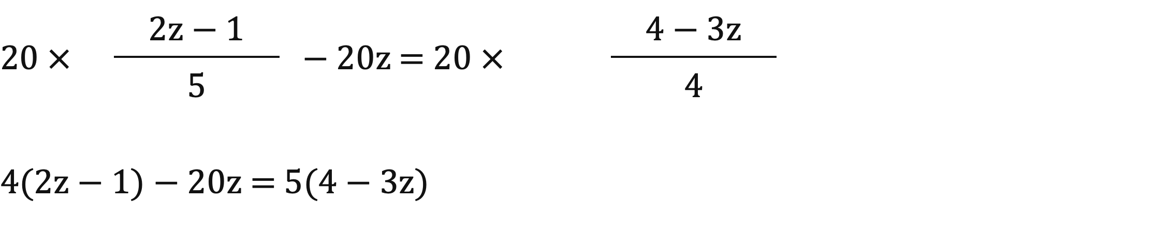
B3: Q2 remove the fractions
HANDOUT • EXERCISE 3
Q2 Optional challenge: multiply every term by 20.
This includes the term −z.
The denominators 5 and 4 both divide into 20.
Notes:
B3 Q1 check: both sides are 19. For optional Q2, multiply −z by 20 too; after expanding, adding 15z and then 4 isolates 3z. Substitute z=8 into both original fractions to get −5.
[Sources]
- Statistics Week 1 Lecture(1).pptx
- AlgebraI(CliffsStudySolver) Part1.pdf, Chapter 3, Example Problem 2, PDF p.150 / printed p.132; adapted and checked.

Slide 19

B3: Q2 balance and check
HANDOUT • EXERCISE 3
Q2 Optional challenge: distribute and combine.
8z − 4 − 20z = 20 − 15z
−12z − 4 = 20 − 15z
Add 15z to both sides: 3z − 4 = 20
Add 4 to both sides: 3z = 24
Divide both sides by 3: z = 8
Notes:
B3 Q1 check: both sides are 19. For optional Q2, multiply −z by 20 too; after expanding, adding 15z and then 4 isolates 3z. Substitute z=8 into both original fractions to get −5.
[Sources]
- Statistics Week 1 Lecture(1).pptx
- AlgebraI(CliffsStudySolver) Part1.pdf, Chapter 3, Example Problem 2, PDF p.150 / printed p.132; adapted and checked.

Slide 20
Section 2:
Quadratic
Equations
Notes:
Transition: equations with an x² term need a new method; do not try to isolate x as though x² were x.
[Sources]
- Statistics Week 1 Lecture.pptx

Slide 21
What makes a quadratic?
Standard form: ax² + bx + c = 0, a ≠ 0
The highest power of x is 2.
a, b and c include their signs.
A root is a value of x that makes the equation equal zero.
A quadratic may have two, one or no real-number roots.
This introductory class uses examples with real-number roots.
Notes:
Ask for the missing coefficient in 4x²−9=0: b=0. Clarify real roots may number zero, one, or two.
[Sources]
- Statistics Week 1 Lecture.pptx

Slide 22
B4: Quadratic or not?
HANDOUT • EXERCISE 4
Classify after rewriting into standard form.
Q1 2x + 5 = 0
Q2 x² + 5x + 6 = 0
Q3 x³ − 2 = 0
Q4 4x² = 9
Notes:
Students must put each equation in standard form before classification, especially 4x²=9.
[Sources]
- Statistics Week 1 Lecture.pptx

Slide 23
B4: Worked answers
HANDOUT • EXERCISE 4
Q1 Not quadratic — linear.
Q2 Quadratic.
Q3 Not quadratic — cubic.
Q4 Quadratic: 4x² − 9 = 0.
For question 4: a=4, b=0, c=−9.
Notes:
Q4 is quadratic even though it initially has a nonzero right-hand side; b=0 is still a coefficient.
[Sources]
- Statistics Week 1 Lecture.pptx

Slide 24

METHOD 1: Factoring
x² + 5x + 6 = 0 Here, a = 1.
Step 1 Find two numbers: multiply to 6 and add to 5 → 2 and 3.
Step 2 Write brackets: (x + 2)(x + 3) = 0
Step 3 Use the zero-product rule: if A × B = 0, then A = 0 or B = 0.
Step 4 Set each bracket to zero:
x + 2 = 0 or x + 3 = 0 → x = −2 or x = −3
Notes:
Check the pair both multiplies to 6 and adds to 5. Apply the zero-product rule only when the product is zero.
[Sources]
- Statistics Week 1 Lecture.pptx

Slide 25

Factoring – Guided Practice
*We are going to have factoring practice in Class C this week.
Notes:
Check the pair both multiplies to 6 and adds to 5. Apply the zero-product rule only when the product is zero.
[Sources]
- Statistics Week 1 Lecture.pptx

Slide 26
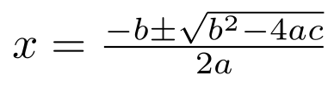
METHOD 2: The quadratic formula
Use values from ax² + bx + c = 0.
a: coefficient of x²
b: coefficient of x
c: constant — keep its sign
√ means square root.
± means two calculations: + and −.
Divide the whole numerator by 2a.
Notes:
Read the entire numerator over 2a. The ± gives two calculations, not one approximate answer.
[Sources]
- Statistics Week 1 Lecture.pptx

Slide 27
B5: Build the quadratic formula
HANDOUT • EXERCISE 5
Solve 2x² + 5x − 3 = 0.
Q1 Identify a, b and c.
Q2 Substitute carefully: c is negative.
Q3 Calculate both roots using ±.
Do not calculate until the substitution is checked.
Notes:
Require signed a,b,c and a checked substitution before calculator use.
[Sources]
- Statistics Week 1 Lecture.pptx

Slide 28
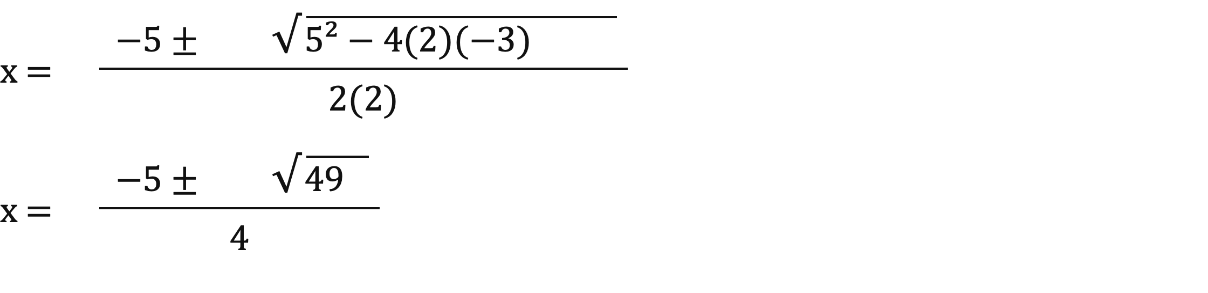
B5: Coefficients and substitution
HANDOUT • EXERCISE 5
Q1 a = 2, b = 5, c = −3. Keep the negative sign.
Q2 Discriminant: 5² − 4(2)(−3) = 25 + 24 = 49.
Denominator: 2a = 2(2) = 4.
Notes:
B5 uses two immediate reveal slides. First verify c=−3 and denominator 2(2)=4. Then reveal both branches. Ask why −5−7 is −12 and why 2/4 simplifies to 1/2.
[Sources]
- Statistics Week 1 Lecture.pptx

Slide 29
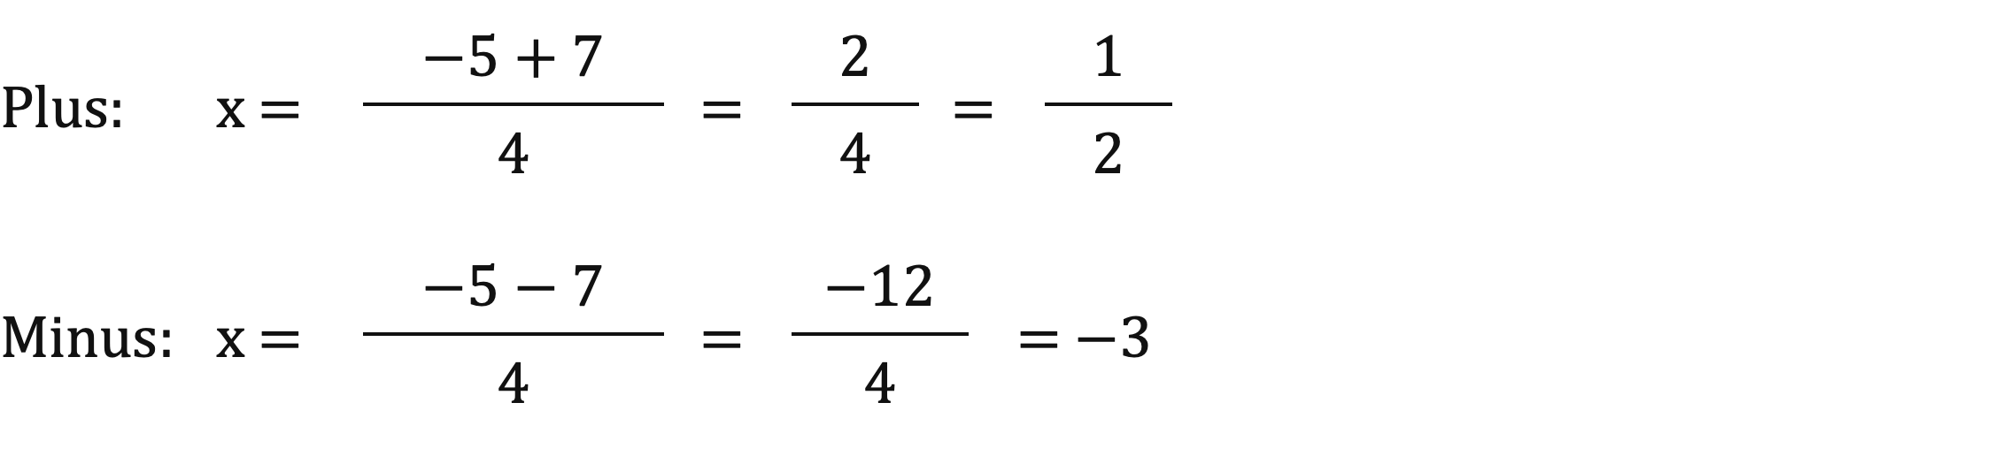
B5: Calculate both roots
HANDOUT • EXERCISE 5
Q3 √49 = 7. Calculate the + branch and the − branch.
Answer: x = 0.5 or x = −3.
Notes:
B5 uses two immediate reveal slides. First verify c=−3 and denominator 2(2)=4. Then reveal both branches. Ask why −5−7 is −12 and why 2/4 simplifies to 1/2.
[Sources]
- Statistics Week 1 Lecture.pptx

Slide 30
So…. Factoring or the Formula?
Factoring is faster when the two numbers are easy to find.
The quadratic formula is better when they are difficult to find or don’t exist as whole numbers.

Slide 31
Section 3:
Units and
Conversions
Notes:
Ask why the same physical amount can have a different numerical measure.
[Sources]
- Statistics Week 1 Lecture.pptx

Slide 32
Measurement systems
Quantity | Metric units | Imperial units | Useful relationship
Length | mm, cm, m, km | inch, foot, mile | 1 m = 100 cm; 1 km = 1000 m 1 m ≈ 3.281 ft; 1 in = 2.54 cm 1 mi ≈ 1.609 km
Mass | g, kg | ounce, pound | 1 kg = 1000 g 1 kg ≈ 2.20 lb
Volume | mL, L | US fl oz, US gallon | 1 L = 1000 mL; 1 L ≈ 33.814 US fl oz 1 US gal ≈ 3.785 L
Notes:
Preserve distinctions between US gallons/fluid ounces and other unit systems. Mark rounded conversion factors with ≈.
[Sources]
- Statistics Week 1 Lecture.pptx

Slide 33
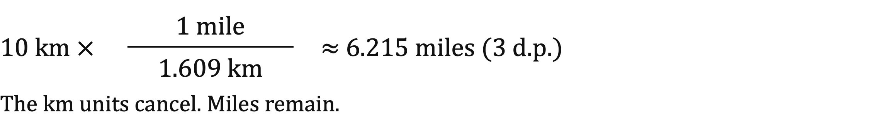
Use a conversion factor
Equivalent measurements form a ratio equal to 1.
Rounded conversion factors are approximate.
Convert 10 km to miles using 1 mile ≈ 1.609 km.
Put the old unit on the bottom so it cancels.
decimal points
Notes:
Ask which unit must be in the denominator. Estimate first: miles should be fewer than kilometres; 10/1.609≈6.215.
[Sources]
- Statistics Week 1 Lecture.pptx
- Statistics Week 1 Seminar 1 - Questions.docx
- Statistics Week 1 Seminar 1 - Answers.docx

Slide 34
B6: Predict, convert and check
HANDOUT • EXERCISE 6
Predict whether the number becomes larger or smaller.
The measured quantity stays the same.
Q1 750 mL → L
Q2 12 km → miles; 1 mile ≈ 1.609 km
Q3 100 inches → cm; 1 inch = 2.54 cm
Write the conversion factor and final unit.
Notes:
Check predictions before calculations. A larger unit requires a smaller numerical value for the same quantity.
[Sources]
- Statistics Week 1 Seminar 1 - Questions.docx

Slide 35
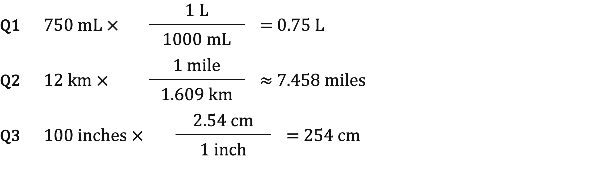
B6: Worked answers
HANDOUT • EXERCISE 6
Q1 Smaller. Q2 Smaller. Q3 Larger.
Check that the old unit cancels and the final unit is sensible.
Notes:
Read the denominator unit aloud. mL, km, and inches cancel in the three products. Kilometre-to-mile result is approximate; mL-to-L and inch-to-cm use exact stated factors.
[Sources]
- Statistics Week 1 Seminar 1 - Answers.docx

Slide 36
B7: Make a conversion safety decision
HANDOUT • EXERCISE 7
A 2,400 kg packaging machine must be lifted.
Forklift capacity: 5,000 lb
Use 1 kg ≈ 2.20 lb.
Q1 Convert the machine mass to pounds.
Q2 Is this forklift safe to use?
Q3 State the evidence for your decision.
Notes:
Use the stated classroom load limit and factor; compare in the same unit before making the decision.
[Sources]
- White, Stimmel & Searcy, Basic Math and Pre-Algebra, Cliffs Study Solver (2003).

Slide 37
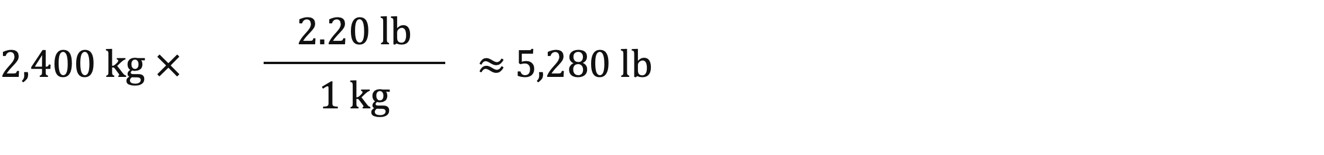
B7: Worked answers
HANDOUT • EXERCISE 7
Q1 Convert the mass using the rounded factor below.
Q2 Decision: do not use this forklift.
Q3 Evidence: about 5,280 lb is above the 5,000 lb limit.
The load is approximately 280 lb above capacity.
A correct conversion supports a safety decision.
Notes:
A load above rated capacity is rejected in this exercise. The rounded factor makes the converted amount and excess approximate.
[Sources]
- White, Stimmel & Searcy, Basic Math and Pre-Algebra, Cliffs Study Solver (2003).

Slide 38
Section 4:
Percentages
and Ratios
Notes:
Transition: percentage and ratio questions are about relationships; identify the comparison base.
[Sources]
- Statistics Week 1 Lecture.pptx

Slide 39
Find the missing quantity
PART = RATE × WHOLE
P = part; R = decimal rate; W = whole.
Find the part: P = R × W → 0.25 × 80 = 20
Find the percentage: R = P ÷ W → 20 ÷ 50 = 40%
Find the whole: W = P ÷ R → 24 ÷ 0.40 = 60
Percentage ÷ 100 gives the decimal rate.
Notes:
Ask which of P,R,W is unknown before selecting multiplication or division. Decimal rate 0.40 equals 40%, not 0.40%.
[Sources]
- Statistics Week 1 Lecture.pptx

Slide 40
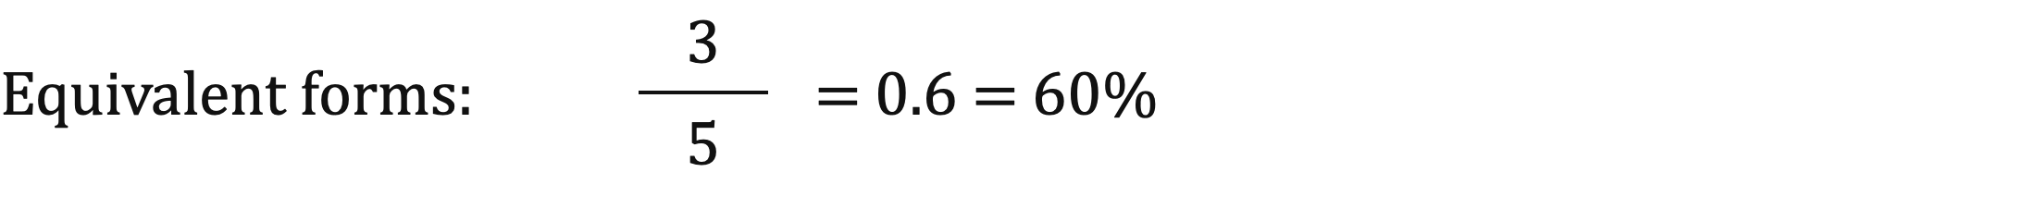
Discounts, tax and equivalents
Discount: subtract from the original price.
20% of £100 = £20; sale price = £100 − £20 = £80.
Tax: add to the original price.
8% of £50 = £4; total price = £50 + £4 = £54.
Fraction → decimal: divide.
Decimal → percentage: multiply by 100%.
Notes:
This method slide now precedes B8. Elicit subtract for discount and add for tax, using the original price as the base.
[Sources]
- Statistics Week 1 Lecture.pptx
- Statistics Week 1 Seminar 1 - Questions.docx
- Statistics Week 1 Seminar 1 - Answers.docx

Slide 41
B8: Choose the percentage method
HANDOUT • EXERCISE 8
Name the unknown before calculating.
Q1 Find 35% of 240.
Q2 18 is what percentage of 72?
Q3 42 is 35% of what number?
Q4 A £280 item has 15% off. Find the sale price.
Notes:
Teach discounts before this exercise. Ask students to write part, percentage, whole, or sale price next to each question.
[Sources]
- Statistics Week 1 Lecture.pptx

Slide 42
B8: Worked answers
HANDOUT • EXERCISE 8
Q1 Unknown: part. 0.35 × 240 = 84.
Q2 Unknown: percentage. 18 ÷ 72 = 0.25 = 25%.
Q3 Unknown: whole. 42 ÷ 0.35 = 120.
Q4 Unknown: sale price.
Discount = 0.15 × £280 = £42.
Sale price = £280 − £42 = £238.
Identify the unknown before choosing the operation.
Notes:
For Q4, separate the £42 discount from the £238 sale price. Common error: reporting the discount as the final price.
[Sources]
- Statistics Week 1 Lecture.pptx

Slide 43
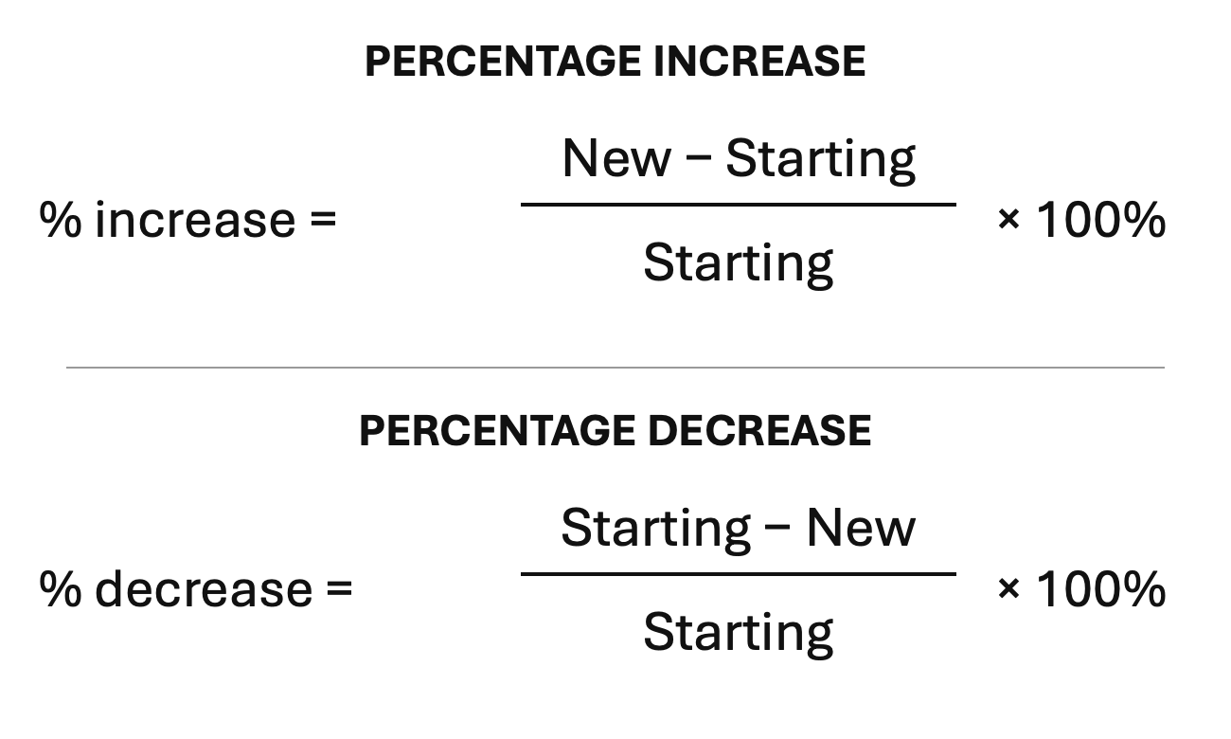
Use the starting value
The denominator is always the starting value.
The starting value must not be zero.
Example: £50 → £75 is a 50% increase.
Notes:
Ask why starting value must be nonzero. Increase and decrease use the original value, not the final value.
[Sources]
- Statistics Week 1 Lecture.pptx
- Statistics Week 1 Seminar 1 - Answers.docx

Slide 44
B9: Use the starting value
HANDOUT • EXERCISE 9
A product falls from £900 to £700.
Q1 Find the amount of change.
Q2 Find the percentage decrease.
Q3 Explain why dividing by £700 is wrong.
Notes:
Students name £900 as the original value before any calculation. Ask for the amount separately from the percentage.
[Sources]
- Statistics Week 1 Lecture.pptx

Slide 45
B9: Worked answers
HANDOUT • EXERCISE 9
Q1 Amount of change: £900 − £700 = £200.
Q2 Percentage decrease: £200 ÷ £900 × 100% ≈ 22.2%.
Q3 Why not divide by £700?
£900 is the starting value, so it is the denominator; £700 is the new value.
Answer: percentage decrease ≈ 22.2%.
Notes:
Check £200/£900×100≈22.2%. Using £700 answers a different comparison.
[Sources]
- Statistics Week 1 Lecture.pptx

Slide 46
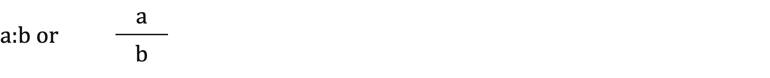
Ratios have a stated order
A ratio can use a colon or a fraction.
a:b means “for every a of the first, there are b of the second”.
Simplify integer ratios using the greatest common divisor.
GCD(8,12) = 4, so 8:12 = 2:3.
Convert different units before comparing.
For two parts of a complete whole, total parts = a + b.
Notes:
Make students read the ratio order aloud. Simplify both values by the same GCD and convert mixed units first.
[Sources]
- Statistics Week 1 Lecture.pptx

Slide 47
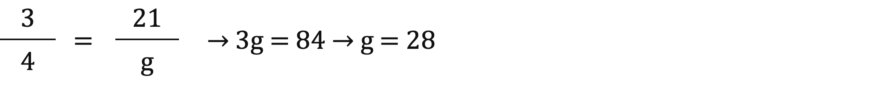
Scale every part equally
The boys:girls ratio is 3:4. There are 21 boys.
Scale-factor method: 3 parts → 21, so multiply by 7.
4 parts → 4 × 7 = 28 girls.
Both methods give the same answer.
Alternative proportion: let g = number of girls.
Notes:
Ask why multiplying only the boys value would break the ratio. The proportion compares boys/girls on both sides.
[Sources]
- Statistics Week 1 Lecture.pptx
- Statistics Week 1 Seminar 1 - Questions.docx
- Statistics Week 1 Seminar 1 - Answers.docx

Slide 48
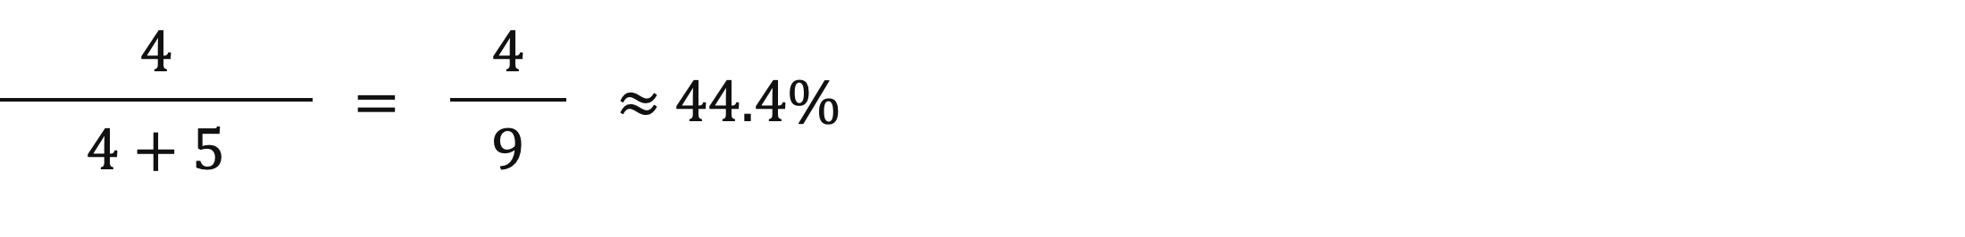
Choose the denominator
For 4:5, assume both quantities make the complete total.
Read the wording before choosing the denominator.
First compared with second:
4 ÷ 5 = 80%. “4 is 80% of 5.”
First as part of the total:
Notes:
Contrast part-to-part (4/5) with part-to-whole (4/9). The assumption that the two parts make the whole is essential.
[Sources]
- Statistics Week 1 Lecture.pptx

Slide 49
B10: Interpret ratios
HANDOUT • EXERCISE 10
Q1 Simplify 45:60.
Q2 A:B = 3:2. If A = 18 L, find B.
Q3 Divide 70 students in the ratio 2:5.
Q4 For 4:5, find the first quantity as a percentage of the second, then of the total.
Write what each number means before calculating.
Notes:
Students name the ratio job: simplify, scale, divide a total, interpret. Require units for B and counts for groups.
[Sources]
- Statistics Week 1 Lecture(1).pptx

Slide 50
B10: Worked answers
HANDOUT • EXERCISE 10
Q1 45:60 = 3:4
Q2 3 → 18 means ×6; B = 2 × 6 = 12 L
Q3 7 parts; 70 ÷ 7 = 10; groups = 20 and 50
Q4 4 ÷ 5 = 80%; 4 ÷ (4 + 5) ≈ 44.4%
The wording decides the denominator.
Notes:
Q3 uses 2+5=7 total parts, not 5. Ask why the two percentages in Q4 differ.
[Sources]
- Statistics Week 1 Lecture(1).pptx

Slide 51
B11: Find the missing total
HANDOUT • EXERCISE 11
9 out of every 10 customers recommend a product.
450 customers recommended it.
Q1 How many customers were surveyed?
Q2 How many did not recommend it?
Q3 Show the scale factor.
Notes:
Ask which ratio value corresponds to 450. The multiplier is 50, and it applies to the whole 10.
[Sources]
- Statistics Week 1 Lecture.pptx

Slide 52
B11: Worked answers
HANDOUT • EXERCISE 11
Q1 Total surveyed: 500 customers.
9 recommended becomes 450, so the scale factor is ×50.
10 surveyed becomes 10 × 50 = 500.
Q2 Did not recommend: 500 − 450 = 50 customers.
Q3 Scale factor: ×50.
CHECK The two linked steps give 500 surveyed and 50 who did not recommend.
Notes:
Check surveyed=500 and not recommending=50 sum consistently. A total of 450 would confuse part with whole.
[Sources]
- Statistics Week 1 Lecture.pptx

Slide 53
B12: Optional quadratic challenge
HANDOUT • EXERCISE 12
Q1 Solve 2x² + 5x − 12 = 0 in two ways.
Use factoring and the quadratic formula.
Factoring hint: split +5x into +8x − 3x.
Do both methods give the same roots?
Notes:
B12 is optional extension outside the 90-minute core route. Skip the full B12 block if needed and go directly to B13. Q1 checks factoring against formula; Q2 combines conversion and percentage.
[Sources]
- AlgebraI(CliffsStudySolver) Part1.pdf, Chapter 4, Example Problem 2, PDF pp.187–188 / printed pp.169–170; adapted to solve and compare methods.
- Basic Math and Pre-Algebra, Cliffs Study Solver (2003), Chapter 9, PDF pp.216–217 / printed pp.204–205; percentage extension based on Chapter 5, PDF pp.144–145 / printed pp.132–133.

Slide 54

B12: Optional factoring reveal
HANDOUT • EXERCISE 12
Q1 Split the middle term, then group.
2x² + 8x − 3x − 12 = 0
2x(x + 4) − 3(x + 4) = 0
(2x − 3)(x + 4) = 0
Set each factor equal to zero.
2x − 3 = 0 or x + 4 = 0
Notes:
Optional extension: inspect every factor sign. The middle-term split is +8x−3x. Safety quantities use ≈ because 2.20 is rounded. Never sacrifice the exit check for this extension.
[Sources]
- AlgebraI(CliffsStudySolver) Part1.pdf, Chapter 4, Example Problem 2, PDF pp.187–188 / printed pp.169–170; adapted to solve and compare methods.
- Basic Math and Pre-Algebra, Cliffs Study Solver (2003), Chapter 9, PDF pp.216–217 / printed pp.204–205; percentage extension based on Chapter 5, PDF pp.144–145 / printed pp.132–133.

Slide 55
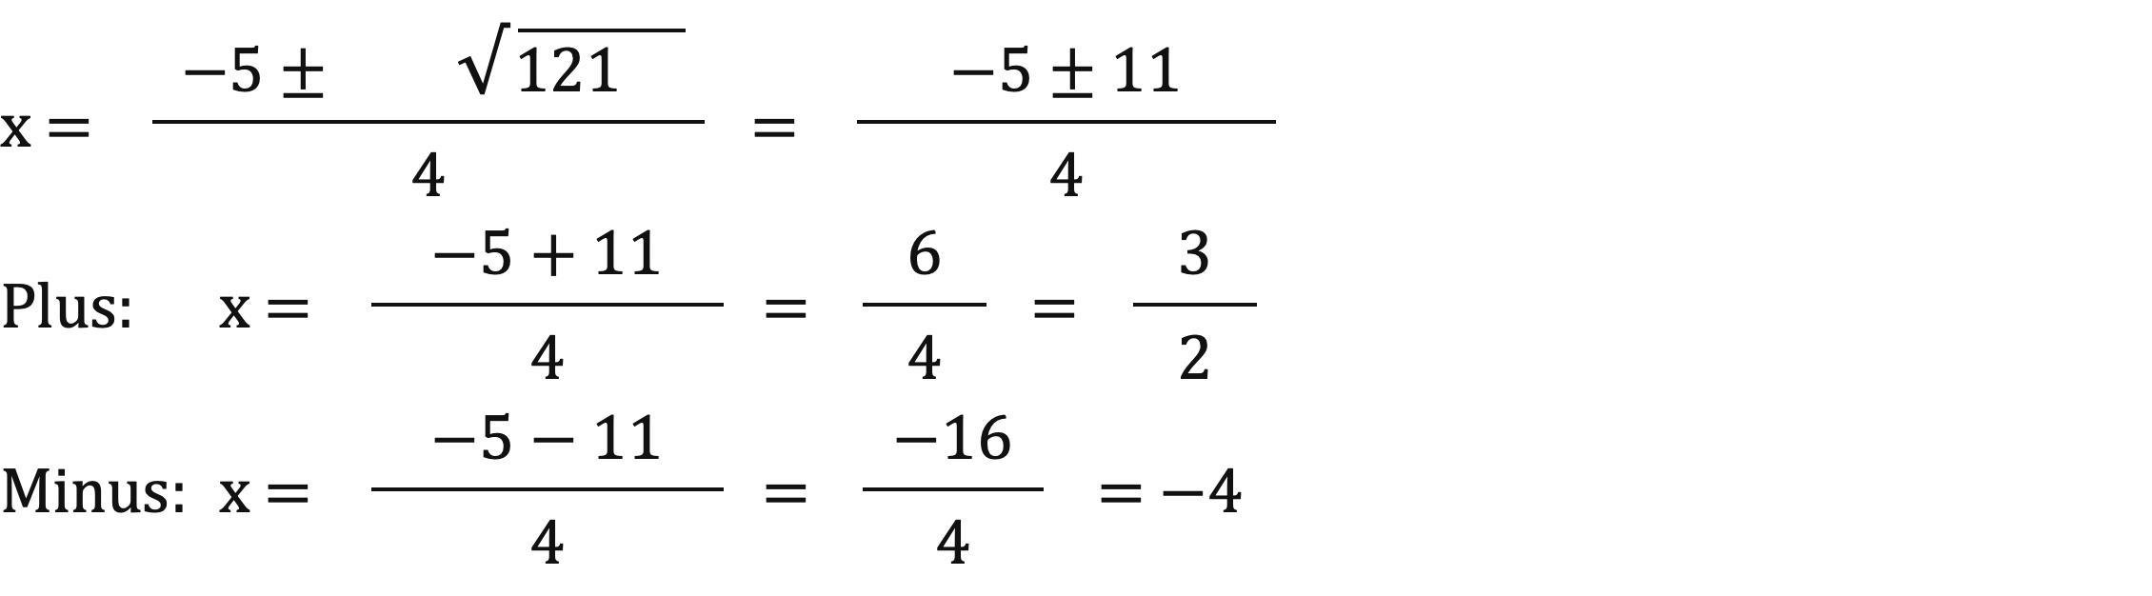
B12: Optional formula check
HANDOUT • EXERCISE 12
Q1 a = 2, b = 5, c = −12; 2a = 4.
Discriminant = 5² − 4(2)(−12) = 121.
The two methods agree.
Notes:
Optional extension: inspect every factor sign. The middle-term split is +8x−3x. Safety quantities use ≈ because 2.20 is rounded. Never sacrifice the exit check for this extension.
[Sources]
- AlgebraI(CliffsStudySolver) Part1.pdf, Chapter 4, Example Problem 2, PDF pp.187–188 / printed pp.169–170; adapted to solve and compare methods.
- Basic Math and Pre-Algebra, Cliffs Study Solver (2003), Chapter 9, PDF pp.216–217 / printed pp.204–205; percentage extension based on Chapter 5, PDF pp.144–145 / printed pp.132–133.

Slide 56
B12: Optional safety challenge
HANDOUT • EXERCISE 12
Q2 A machine has mass 3,000 kg.
Forklift limit: 5,000 lb. Use 1 kg ≈ 2.20 lb.
Is this forklift safe to use?
What percentage above the limit is the load?
Convert first, then compare with the stated limit.
Notes:
B12 is optional extension outside the 90-minute core route. Skip the full B12 block if needed and go directly to B13. Q1 checks factoring against formula; Q2 combines conversion and percentage.
[Sources]
- AlgebraI(CliffsStudySolver) Part1.pdf, Chapter 4, Example Problem 2, PDF pp.187–188 / printed pp.169–170; adapted to solve and compare methods.
- Basic Math and Pre-Algebra, Cliffs Study Solver (2003), Chapter 9, PDF pp.216–217 / printed pp.204–205; percentage extension based on Chapter 5, PDF pp.144–145 / printed pp.132–133.

Slide 57
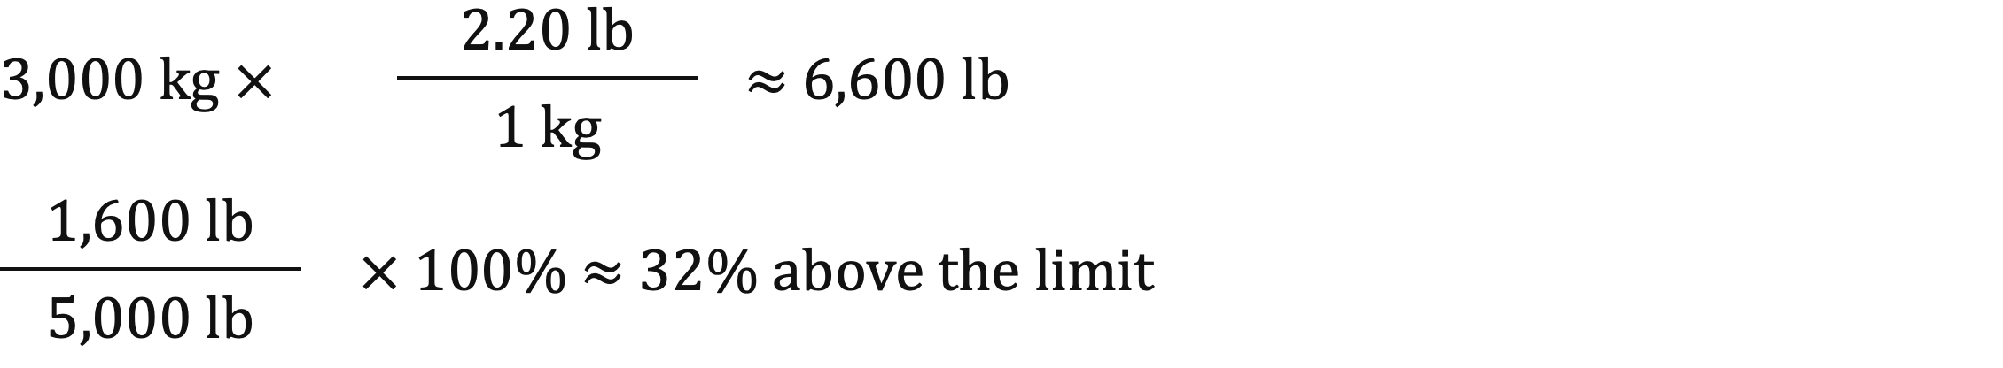
B12: Optional safety reveal
HANDOUT • EXERCISE 12
Q2 Do not use this forklift: the load is above the limit.
Converted mass ≈ 6,600 lb (rounded conversion factor).
Excess ≈ 6,600 − 5,000 = 1,600 lb.
The percentage denominator is the 5,000 lb limit.
Notes:
Optional extension: inspect every factor sign. The middle-term split is +8x−3x. Safety quantities use ≈ because 2.20 is rounded. Never sacrifice the exit check for this extension.
[Sources]
- AlgebraI(CliffsStudySolver) Part1.pdf, Chapter 4, Example Problem 2, PDF pp.187–188 / printed pp.169–170; adapted to solve and compare methods.
- Basic Math and Pre-Algebra, Cliffs Study Solver (2003), Chapter 9, PDF pp.216–217 / printed pp.204–205; percentage extension based on Chapter 5, PDF pp.144–145 / printed pp.132–133.

Slide 58
B13: Independent exit check
HANDOUT • EXERCISE 13
Q1 Solve 3x + 5 = 20.
Q2 Solve x² − 5x + 6 = 0 by factoring.
Q3 Convert 3 miles to kilometres; 1 mile ≈ 1.609 km.
Q4 Find the percentage increase from £40 to £50.
Q5 Simplify the ratio 16:24.
Write the method before the arithmetic.
Notes:
Protected B13 exit: 5 minutes independent work within the 8-minute exit/synthesis allocation. Students state methods before arithmetic; no partner help until collected.
[Sources]
- Statistics Week 1 Lecture.pptx

Slide 59
B13: Worked answers
HANDOUT • EXERCISE 13
Q1 3x + 5 = 20 → x = 5
Q2 (x − 2)(x − 3) = 0 → x = 2 or x = 3
Q3 3 × 1.609 ≈ 4.827 km
Q4 (£50 − £40) ÷ £40 × 100% = 25%
Q5 16:24 = 2:3
Check balance, roots, units, original value and ratio order.
Notes:
Use two minutes to compare each exit answer with its method. Collect the specific misconception, not only the score.
[Sources]
- Statistics Week 1 Lecture.pptx

Slide 60
What we can do now
Choose a method before calculating.
Algebra: simplify, balance and check.
Quadratics: find every root, then verify it.
Units: cancel the old unit and judge the size.
Percentages: name the unknown and the starting value.
Ratios: keep the stated order and scale both parts.
In Class C, combine these tools in the GreenSip application case.
Notes:
One-minute synthesis within the protected exit allocation. Ask students to name one check they will carry into Class C. Class C applies the full Week 1 toolkit in the GreenSip application case.
[Sources]
- Statistics Week 1 Lecture(1).pptx

