Slide 1
IFY Statistics
Week 2 • Class A
Data and
Sampling
Notes:
90-minute teaching plan: revision 5; population/sample 18; data types 12; simple random sampling explanation 8; systematic sampling 24; integrated application 18; exit check 5. Calculators and blank paper only. No cutting, bags, slips, physical draw or lookup roster is needed. Exercise labels run A1–A5. The Week 1 revision R3(a)/R3(b) split is preserved. The optional five-minute extension follows the summary. Teacher timetable is the final slide. Original Bellerbys visual template retained. New stock image sources appear in the relevant speaker notes.

Slide 2
Revision:
Week 1
Notes:
Section separator. Pause briefly, then continue.
[Sources]
Statistics Week 2 Lecture.pptx (user-provided Bellerbys source; content and inherited visual template).
Sullivan, Statistics: Informed Decisions Using Data, 7th ed., supplied PDF. Printed pp. 5, 7–8, 25, 35, 37 and 42–43: population/sample, data types, sampling methods and sampling error.
All classroom datasets and worked examples are illustrative. Mathematical diagrams created for this lesson from the stated values; no textbook artwork reproduced.
[/Sources]
Section lead-in: Bring back the key ideas.
[Sources]
Original Bellerby photographic divider inherited from 1_Image divider 1, as in the supplied Week 1 reference decks.
[/Sources]

Slide 3
Revision: calculations and counting
REVISION
Work with a partner. Show your method. Calculators allowed.
R1 Divide 486 in the ratio 7 : 11.
R2 What percentage is 83 out of 237?
R3(a) Choose two representatives from nine students.
Both have the same role. How many pairs are possible?
R3(b) From the same nine students, choose a captain and a deputy.
How many ways can two different students fill these roles?
Notes:
All numerical cases on this slide are fictional classroom examples. Round percentages to two decimal places unless stated otherwise. 3 minutes. R3 revisits order before sampling. Keep feedback brief.

Slide 4
Revision: answers
REVISION
Check both the calculation and the meaning.
R1 Ratio 7 : 11
R2 Percentage
486 ÷ 18 = 27 per part
7 × 27 = 189 11 × 27 = 297
83
× 100 ≈ 35.02%
237
R3(a) Representatives: order does not matter
R3(b) Captain and deputy: roles differ
9 × 8
= 36 pairs
9 × 8 = 72 arrangements
2
Notes:
All numerical cases on this slide are fictional classroom examples. Round percentages to two decimal places unless stated otherwise. 2 minutes. The same pair in the opposite drawing order still forms the same sample.

Slide 5
Section 1:
Who are we
studying?
Notes:
Section separator. Pause briefly, then continue.
[Sources]
Statistics Week 2 Lecture.pptx (user-provided Bellerbys source; content and inherited visual template).
Sullivan, Statistics: Informed Decisions Using Data, 7th ed., supplied PDF. Printed pp. 5, 7–8, 25, 35, 37 and 42–43: population/sample, data types, sampling methods and sampling error.
All classroom datasets and worked examples are illustrative. Mathematical diagrams created for this lesson from the stated values; no textbook artwork reproduced.
[/Sources]
Section lead-in: Start with a question about our university.
[Sources]
Original Bellerby photographic divider inherited from 1_Image divider 1, as in the supplied Week 1 reference decks.
[/Sources]

Slide 6

Can we ask everyone?
Xi’an Eurasia University has 20,000+ students.
We want to know whether students
want more vegetarian dishes
in the canteen.
D1. What would make asking
every student difficult?
Illustrative photograph
Notes:
2 minutes. Gather practical reasons why a census may be difficult: time, cost and access. Preserve the source deck’s university context. Image: Alexis Brown / Unsplash, https://unsplash.com/photos/omeaHbEFlN4 ; https://unsplash.com/license . Photograph is illustrative, not a photograph of Eurasia University.

Slide 7
Population and sample
We select 200 students for our survey.
Population
All enrolled Eurasia students
The sample is
part of
the population.
Sample
200 students
Notes:
Population = all enrolled students at Xi’an Eurasia University. The sample size 200 is a classroom example, not a real study or a recommended precision target.
[Sources]
https://en.eurasia.edu/About_Us/Introduction_of_the_University.htm (official university introduction; publishes more than 20,000 students; checked 6 September 2026).
Statistics Week 2 Lecture.pptx (user-provided Bellerbys source; content and inherited visual template).
[/Sources]
[Sources]
Statistics Week 2 Lecture.pptx (user-provided Bellerbys source; content and inherited visual template).
Sullivan, Statistics: Informed Decisions Using Data, 7th ed., supplied PDF. Printed pp. 5, 7–8, 25, 35, 37 and 42–43: population/sample, data types, sampling methods and sampling error.
All classroom datasets and worked examples are illustrative. Mathematical diagrams created for this lesson from the stated values; no textbook artwork reproduced.
[/Sources]

Slide 8
Census or sample?
Do we study everyone, or a selected part?
 | Census | Sample
Who is studied? | Every member | Part of the population
Time and cost | Often greater | Often lower
Practical example | Ask all 8 students in a small class | Survey selected students across a university
A census can be practical when the population is small.
Notes:
Ask students to justify census versus sample for a small class and for a city. A census is not automatically error-free; detailed bias is in Class B.
[Sources]
Statistics Week 2 Lecture.pptx (user-provided Bellerbys source; content and inherited visual template).
Sullivan, Statistics: Informed Decisions Using Data, 7th ed., supplied PDF. Printed pp. 5, 7–8, 25, 35, 37 and 42–43: population/sample, data types, sampling methods and sampling error.
All classroom datasets and worked examples are illustrative. Mathematical diagrams created for this lesson from the stated values; no textbook artwork reproduced.
[/Sources]

Slide 9
What do we want to know?
What percentage of all Eurasia students
want more vegetarian dishes?
?%
All enrolled
students
The percentage for
the whole population
We do not know this percentage yet.
Notes:
This is the whole-population target. Do not reveal a fictional population percentage as if known. Introduce the question before the term parameter.
[Sources]
Statistics Week 2 Lecture.pptx (user-provided Bellerbys source; content and inherited visual template).
Sullivan, Statistics: Informed Decisions Using Data, 7th ed., supplied PDF. Printed pp. 5, 7–8, 25, 35, 37 and 42–43: population/sample, data types, sampling methods and sampling error.
All classroom datasets and worked examples are illustrative. Mathematical diagrams created for this lesson from the stated values; no textbook artwork reproduced.
[/Sources]

Slide 10
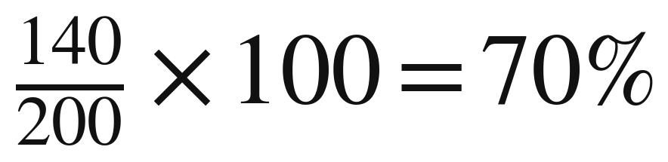
What did our survey find?
Classroom example: we survey 200 students.
Response | Students
Yes | 140
No | 60
Total | 200
70% of the surveyed students
said yes.
Notes:
The hypothetical responses sum to 200. The result describes the respondents in this sample, not a proven university-wide percentage.
[Sources]
Statistics Week 2 Lecture.pptx (user-provided Bellerbys source; content and inherited visual template).
Sullivan, Statistics: Informed Decisions Using Data, 7th ed., supplied PDF. Printed pp. 5, 7–8, 25, 35, 37 and 42–43: population/sample, data types, sampling methods and sampling error.
All classroom datasets and worked examples are illustrative. Mathematical diagrams created for this lesson from the stated values; no textbook artwork reproduced.
[/Sources]

Slide 11
Groups and their numbers
Parameter: a numerical summary of the whole population.
Statistic: a numerical summary of a sample.
 | Whole university | Our survey
Group name | Population | Sample
People | All enrolled students | 200 surveyed students
Percentage saying yes | Unknown here | 70%
Percentage name | Parameter | Statistic
Average height: whole population → parameter; sample → statistic.
Notes:
[Sources]
Statistics Week 2 Lecture.pptx (user-provided Bellerbys source; content and inherited visual template).
Sullivan, Statistics: Informed Decisions Using Data, 7th ed., supplied PDF. Printed pp. 5, 7–8, 25, 35, 37 and 42–43: population/sample, data types, sampling methods and sampling error.
All classroom datasets and worked examples are illustrative. Mathematical diagrams created for this lesson from the stated values; no textbook artwork reproduced.
[/Sources]
A numerical summary can be a percentage, average or other measure. Whether it is a parameter or statistic depends on the group it describes. A parameter may be known after a census; unknown is not its definition.

Slide 12
What can the sample tell us?
In our demonstration, 140 of 200 students said yes.
Sample result: 70%
Can we conclude that exactly 70%
of the whole university would say yes?
Discuss your reason before the answer appears.
Notes:
1 minute. Use the existing demonstration. Ask all students to think before taking an answer. Avoid implying that the sample percentage cannot ever equal the population percentage.

Slide 13
An estimate for the population
The sample gives evidence about the wider group.
70% describes the 200 surveyed students.
We may use it to estimate the population percentage.
The survey does not establish the exact population value.
Another valid random sample could give a different percentage.
Notes:
1 minute. Sampling variation is introduced here and demonstrated later. A statistic could equal the parameter by coincidence. The point is that this sample alone does not establish exact equality.

Slide 14
A1: Which group does it describe?
EXERCISE A1
Calculate each percentage, then classify it as a parameter or statistic.
A1.1 A club has 148 members. All reply. 53 prefer Friday.
The research concerns this club only.
A1.2 A factory has 1,825 items. It randomly tests 87.
11 fail. The research concerns the tested batch.
A1.3 We now use the same club result to describe the
whole university. Does its classification change? Why?
Notes:
All numerical cases on this slide are fictional classroom examples. Round percentages to two decimal places unless stated otherwise. 4 minutes independent then partner check. A1.3 is compulsory. Label the target population before calculating. Fast finishers explain why classifying a statistic does not show that it represents its target well.

Slide 15
A1: Answers and reasons
EXERCISE A1
The target population determines the classification.
A1.1 All 148 club members
53
Parameter
The whole club replied.
× 100 ≈ 35.81%
148
A1.2 The 87 tested items
11
Statistic
Only part of the batch.
× 100 ≈ 12.64%
87
Notes:
All numerical cases on this slide are fictional classroom examples. Round percentages to two decimal places unless stated otherwise. 2 minutes including the following short reveal. Students must state the group described, not classify by whether the percentage looks large or small.

Slide 16
A1.3: The research question changes
EXERCISE A1
The same 35.81% can play a different role.
Research concerns… | The 148 members are… | 35.81% is a…
This club only | The population | Parameter
The whole university | A sample | Statistic
The number stays the same. The target population changes.
Notes:
All numerical cases on this slide are fictional classroom examples. Round percentages to two decimal places unless stated otherwise. Part of the preceding two-minute answer discussion. Club membership may affect representativeness, but leave formal bias analysis for Class B.

Slide 17
A1.4: What do we actually know?
EXERCISE A1
A factory has 1,825 items. It randomly tests 87; 11 fail.
The remaining items have not been inspected.
(a) What is the smallest possible number of faulty items
in the whole batch?
(b) What is the largest possible number?
Explain what must be true of the uninspected items.
Notes:
All numerical examples are fictional teaching cases. Original Bellerbys template from the supplied Week 2 Class A deck. Calculators allowed; round percentages to two decimal places unless stated otherwise. Allow 3 minutes for individual work then partner reasoning. These are logical limits, not estimates or confidence intervals. Ask students to account for the 76 items already known to work.

Slide 18
A1.4: The possible limits
EXERCISE A1
There are 1,825 − 87 = 1,738 uninspected items.
Smallest possible: 11
Largest possible: 1,749
All 1,738 uninspected items
could work.
All 1,738 could fail:
11 + 1,738 = 1,749.
The sample establishes 11 failures and 76 working items.
It does not establish the exact total of failures.
Notes:
All numerical examples are fictional teaching cases. Original Bellerbys template from the supplied Week 2 Class A deck. Calculators allowed; round percentages to two decimal places unless stated otherwise. Allow 1 minute. Both extremes are consistent with the observed inspection results. Random selection supports estimation but does not turn the sample count into the exact batch count.

Slide 19
Section 2:
Types of data
Notes:
Section separator. Pause briefly, then continue.
[Sources]
Statistics Week 2 Lecture.pptx (user-provided Bellerbys source; content and inherited visual template).
Sullivan, Statistics: Informed Decisions Using Data, 7th ed., supplied PDF. Printed pp. 5, 7–8, 25, 35, 37 and 42–43: population/sample, data types, sampling methods and sampling error.
All classroom datasets and worked examples are illustrative. Mathematical diagrams created for this lesson from the stated values; no textbook artwork reproduced.
[/Sources]
Section lead-in: What information are we collecting?
[Sources]
Original Bellerby photographic divider inherited from 1_Image divider 1, as in the supplied Week 1 reference decks.
[/Sources]

Slide 20
What do we record?
A variable is something we record about each student.
Student | Meal choice | Meals per week | Waiting time
A | Noodles | 3 | 6.5 minutes
B | Rice | 5 | 4.2 minutes
C | Sandwich | 2 | 7.0 minutes
Categorical data are labels.
Quantitative (numerical) data are counts or measurements.
Notes:
Fictional data. Preview qualitative/categorical versus quantitative/numerical. Ask which columns could be added or averaged meaningfully; student labels cannot.
[Sources]
Statistics Week 2 Lecture.pptx (user-provided Bellerbys source; content and inherited visual template).
Sullivan, Statistics: Informed Decisions Using Data, 7th ed., supplied PDF. Printed pp. 5, 7–8, 25, 35, 37 and 42–43: population/sample, data types, sampling methods and sampling error.
All classroom datasets and worked examples are illustrative. Mathematical diagrams created for this lesson from the stated values; no textbook artwork reproduced.
[/Sources]

Slide 21
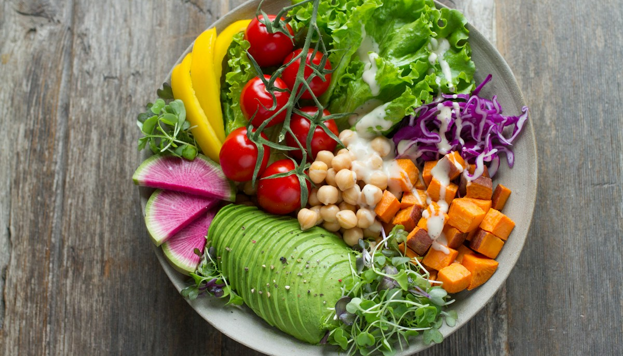
Categorical: record a label
The recorded value identifies a category.
“Salad” tells us which type.
It does not tell us how much.
Other examples:
Programme of study
Main transport mode
Meal type: salad
Notes:
All numerical examples are fictional teaching cases. Original Bellerbys template from the supplied Week 2 Class A deck. Calculators allowed; round percentages to two decimal places unless stated otherwise. Brief explanation. Ask what a numerical code for salad would mean: a label, not a quantity. Image: Anna Pelzer / Unsplash, https://unsplash.com/photos/IGfIGP5ONV0 ; https://unsplash.com/license .

Slide 22

Discrete: count whole items
Variable: the number of bicycles parked outside.
3 bicycles
We count each bicycle
once. The recorded
value is 3.
Possible counts: 0, 1, 2, 3, 4, …
A count can be 3 or 4 bicycles, but not 3.5 bicycles.
Notes:
All numerical examples are fictional teaching cases. Original Bellerbys template from the supplied Week 2 Class A deck. Calculators allowed; round percentages to two decimal places unless stated otherwise. This replaces the unexplained rectangles. Point to each of the three bicycles, then identify the variable and recorded count. Ask why 3.5 is not a possible count of whole bicycles. Counts are a familiar example of discrete data; discrete variables in general need not be whole-number counts. Stock graphic: Twemoji bicycle, https://github.com/twitter/twemoji/blob/master/assets/svg/1f6b2.svg ; graphics CC BY 4.0 https://creativecommons.org/licenses/by/4.0/ . Artwork unmodified and repeated to represent the exact count.

Slide 23

Continuous: measure an amount
Variable: the time taken to complete a task.
Time can be 6.2 seconds,
6.25 seconds or 6.251 seconds.
Values can lie between other values.
6.2
6.25
6.3
seconds
Rounding a recorded time does not make the underlying time discrete.
Notes:
All numerical examples are fictional teaching cases. Original Bellerbys template from the supplied Week 2 Class A deck. Calculators allowed; round percentages to two decimal places unless stated otherwise. Use the interval to show that intermediate times are possible. The example readings are illustrative and do not come from the photograph. The contrast is counting bicycles versus measuring elapsed time. Image: Andrik Langfield / Unsplash, https://unsplash.com/photos/0rTCXZM7Xfo ; https://unsplash.com/license .

Slide 24
How the data types fit together
Discrete and continuous are both types of quantitative data.
Data
Qualitative (Categorical)
Quantitative
Categories or labels
Example: meal choice
Discrete
Continuous
Count: meals
Measure: time
Notes:
[Sources]
Statistics Week 2 Lecture.pptx (user-provided Bellerbys source; content and inherited visual template).
Sullivan, Statistics: Informed Decisions Using Data, 7th ed., supplied PDF. Printed pp. 5, 7–8, 25, 35, 37 and 42–43: population/sample, data types, sampling methods and sampling error.
All classroom datasets and worked examples are illustrative. Mathematical diagrams created for this lesson from the stated values; no textbook artwork reproduced.
[/Sources]

Slide 25
Two common traps
Does writing a number always make data quantitative?
Student ID: 1042
Height: 172 cm
It identifies a student.
It is a categorical label.
It is a measurement.
It remains continuous,
even when rounded.
Notes:
Do not teach that integers are always discrete or decimals always continuous. The variable, not the written number alone, determines the data type.
[Sources]
Statistics Week 2 Lecture.pptx (user-provided Bellerbys source; content and inherited visual template).
Sullivan, Statistics: Informed Decisions Using Data, 7th ed., supplied PDF. Printed pp. 5, 7–8, 25, 35, 37 and 42–43: population/sample, data types, sampling methods and sampling error.
All classroom datasets and worked examples are illustrative. Mathematical diagrams created for this lesson from the stated values; no textbook artwork reproduced.
[/Sources]

Slide 26
A2: Classification practice
EXERCISE A2
Write categorical, quantitative–discrete, or quantitative–continuous.
No. | Variable | Example
1 | Programme code | 1 = Business, 2 = Engineering
2 | Rejected products in a batch | 17 products
3 | Journey duration, rounded for display | Recorded as 43 minutes
4 | Room number | B-317
5 | Customer calls received in a day | 137 calls
6 | Mass of food left over | 83.6 g
For 1 and 3, explain why the numerical appearance may mislead.
Notes:
All numerical cases on this slide are fictional classroom examples. Round percentages to two decimal places unless stated otherwise. 3 minutes individual work. For duration, classify the underlying measured quantity, not the rounded display. Do not infer data type merely from integer or decimal notation.

Slide 27
A2: More variables
EXERCISE A2
Classify the variable. Explain any answer that could be mistaken.
No. | Variable | Example
7 | Satisfaction category coded 1 to 5 | 1 = very dissatisfied, 5 = very satisfied
8 | Exact age | 18.73 years
9 | Complete years of age counted at a date | 18 complete years
10 | Faults found in one cable | 23 faults
11 | Temperature measured in a laboratory | 21.6°C
12 | Telephone number | Digits used to identify a phone
Notes:
All numerical cases on this slide are fictional classroom examples. Round percentages to two decimal places unless stated otherwise. 3 minutes. Age item 8 is the continuous elapsed duration. Item 9 explicitly defines the integer-valued count of completed years. Satisfaction codes remain categories for this introductory classification task. No need to introduce ordinal/nominal labels.

Slide 28
A2: Answers 1–6
EXERCISE A2
Classify what the variable means.
Variable | Type | Reason
1 Programme code | Categorical | Codes identify groups
2 Rejected products | Quantitative–discrete | Count of items
3 Journey duration | Quantitative–continuous | Underlying time is measured
4 Room number | Categorical | An identifier
5 Customer calls | Quantitative–discrete | Count of calls
6 Leftover mass | Quantitative–continuous | A measurement
Notes:
1 minute. Require one spoken explanation for a coded category or rounded measurement.

Slide 29
A2: Answers 7–12
EXERCISE A2
Exact age and completed years define different variables.
Variable | Type | Reason
7 Satisfaction code | Categorical | Ordered response labels
8 Exact age | Quantitative–continuous | Elapsed time
9 Complete years | Quantitative–discrete | Integer count of completed years
10 Faults | Quantitative–discrete | Count of faults
11 Temperature | Quantitative–continuous | A measurement
12 Telephone number | Categorical | An identifier
Notes:
1 minute. A measured quantity does not become inherently discrete merely because we round it. Item 9 deliberately asks about a different, count-valued variable.

Slide 30
Section 3:
Simple random
sampling
Notes:
Section separator. Pause briefly, then continue.
[Sources]
Statistics Week 2 Lecture.pptx (user-provided Bellerbys source; content and inherited visual template).
Sullivan, Statistics: Informed Decisions Using Data, 7th ed., supplied PDF. Printed pp. 5, 7–8, 25, 35, 37 and 42–43: population/sample, data types, sampling methods and sampling error.
All classroom datasets and worked examples are illustrative. Mathematical diagrams created for this lesson from the stated values; no textbook artwork reproduced.
[/Sources]
Section lead-in: Give every possible sample the same chance.
[Sources]
Original Bellerby photographic divider inherited from 1_Image divider 1, as in the supplied Week 1 reference decks.
[/Sources]

Slide 31
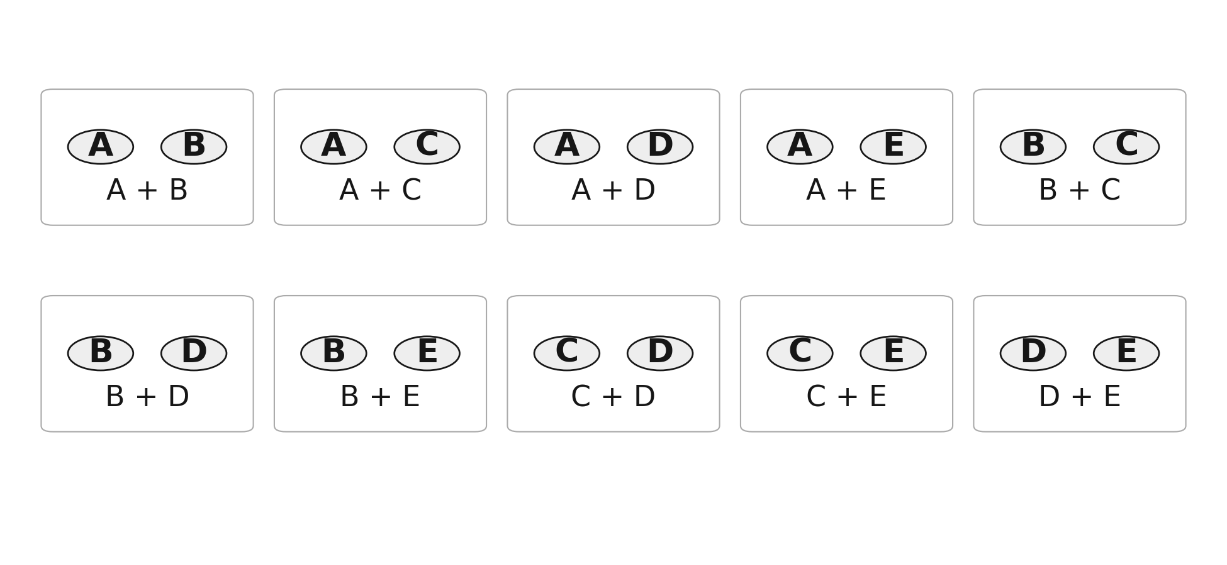
What makes a sample random?
Choose two students from five, in this small demonstration.
There are 10 possible pairs.
In simple random sampling,
every possible pair has
the same chance.
General rule: every possible sample of the chosen size has the same chance.
Notes:
2 minutes. Five people give ten possible unordered pairs. A simple random sample gives every possible sample of the specified size the same chance. Selection order does not make a different sample. Source: original supplied Class A deck and its Statistics Week 2 sources.

Slide 32
How simple random selection works
Use a random process to choose people from a complete list.
1
List everyone
Give each person a unique ID.
2
Let a random generator choose
Select the required number of distinct IDs,
with equal chances and no repeated IDs.
3
Match IDs back to people
The matching people form the selected sample.
Choosing familiar names or scattered-looking IDs is not a random process.
Notes:
All numerical examples are fictional teaching cases. Original Bellerbys template from the supplied Week 2 Class A deck. Calculators allowed; round percentages to two decimal places unless stated otherwise. Explain only: no student ID draw, cutting, materials, device exercise or preparation. A valid simple random procedure gives each remaining ID equal chance at every selection without replacement, so every sample of the chosen size is equally likely. A complete list is a sampling frame, not itself a randomisation mechanism. A repeated ID is rejected or prevented. Spend about 4 minutes explaining; use the slide titled What makes a sample random? for the equally likely sample definition.

Slide 33
Section 4:
Systematic
sampling
Notes:
Section separator. Pause briefly, then continue.
[Sources]
Statistics Week 2 Lecture.pptx (user-provided Bellerbys source; content and inherited visual template).
Sullivan, Statistics: Informed Decisions Using Data, 7th ed., supplied PDF. Printed pp. 5, 7–8, 25, 35, 37 and 42–43: population/sample, data types, sampling methods and sampling error.
All classroom datasets and worked examples are illustrative. Mathematical diagrams created for this lesson from the stated values; no textbook artwork reproduced.
[/Sources]
Section lead-in: Start randomly, then follow a regular step.
[Sources]
Original Bellerby photographic divider inherited from 1_Image divider 1, as in the supplied Week 1 reference decks.
[/Sources]

Slide 34
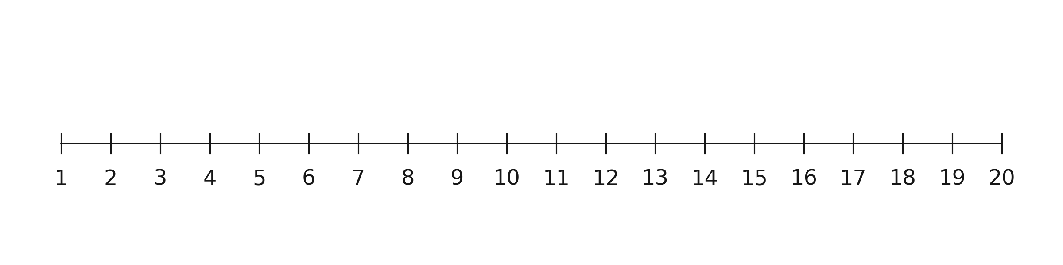
Twenty people; five places
This is a small demonstration list.
We need a sample of 5 from these 20 people.
How could we spread our five selections along the list?
Notes:
[Sources]
Statistics Week 2 Lecture.pptx (user-provided Bellerbys source; content and inherited visual template).
Sullivan, Statistics: Informed Decisions Using Data, 7th ed., supplied PDF. Printed pp. 5, 7–8, 25, 35, 37 and 42–43: population/sample, data types, sampling methods and sampling error.
All classroom datasets and worked examples are illustrative. Mathematical diagrams created for this lesson from the stated values; no textbook artwork reproduced.
[/Sources]

Slide 35
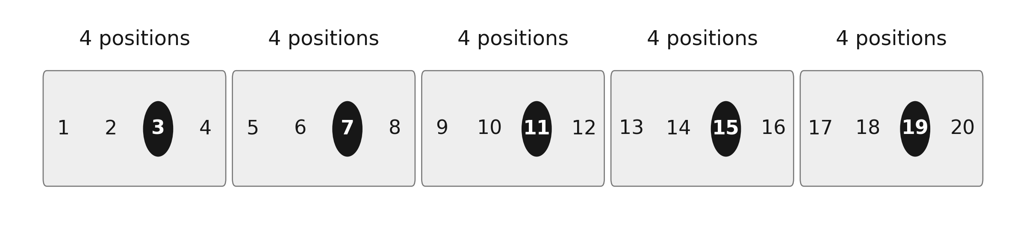
Why every fourth person?
20 people ÷ 5 selections = 4 positions per selection.
Interval = 4: move forward four positions each time.
Notes:
The temporary blocks explain spacing; they are not strata. The same start position is used throughout the list. Say move forward four positions, not skip four people.
[Sources]
Statistics Week 2 Lecture.pptx (user-provided Bellerbys source; content and inherited visual template).
Sullivan, Statistics: Informed Decisions Using Data, 7th ed., supplied PDF. Printed pp. 5, 7–8, 25, 35, 37 and 42–43: population/sample, data types, sampling methods and sampling error.
All classroom datasets and worked examples are illustrative. Mathematical diagrams created for this lesson from the stated values; no textbook artwork reproduced.
[/Sources]

Slide 36
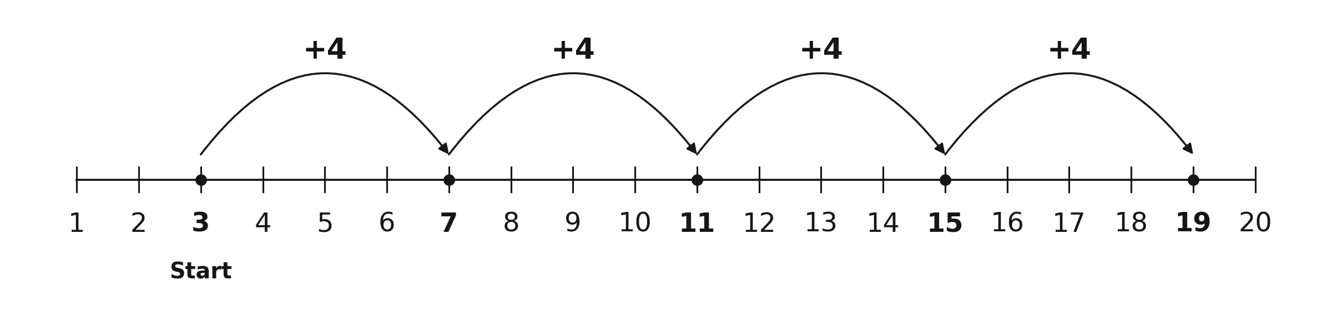
Start randomly, then add four
Choose a random start from 1, 2, 3 or 4. Suppose it is 3.
Selected IDs: 3, 7, 11, 15, 19. The first position is random; the step stays fixed.
Notes:
Point to each selection before reading the next. Ask students to predict the next ID. The firstblock and blank assets support the progressive explanation on previous slides.
[Sources]
Statistics Week 2 Lecture.pptx (user-provided Bellerbys source; content and inherited visual template).
Sullivan, Statistics: Informed Decisions Using Data, 7th ed., supplied PDF. Printed pp. 5, 7–8, 25, 35, 37 and 42–43: population/sample, data types, sampling methods and sampling error.
All classroom datasets and worked examples are illustrative. Mathematical diagrams created for this lesson from the stated values; no textbook artwork reproduced.
[/Sources]

Slide 37
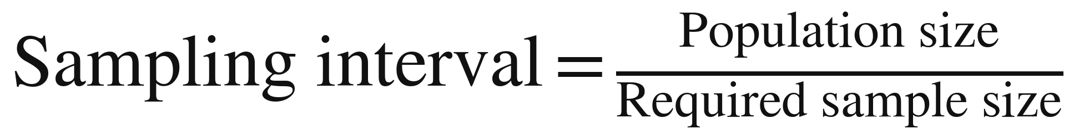
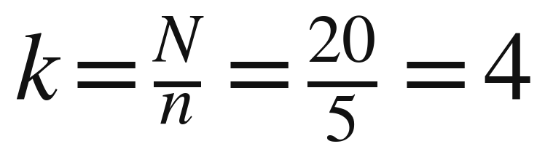
Write the method as a formula
The interval tells us how far to move along the list.
Symbol | Meaning
N | Population size
n | Required sample size
k | Sampling interval
k = 4 means: select every fourth person.
Notes:
[Sources]
Statistics Week 2 Lecture.pptx (user-provided Bellerbys source; content and inherited visual template).
Sullivan, Statistics: Informed Decisions Using Data, 7th ed., supplied PDF. Printed pp. 5, 7–8, 25, 35, 37 and 42–43: population/sample, data types, sampling methods and sampling error.
All classroom datasets and worked examples are illustrative. Mathematical diagrams created for this lesson from the stated values; no textbook artwork reproduced.
[/Sources]

Slide 38
Interval and sampling fraction
Both use N and n, but they answer different questions.
Sampling interval k
Sampling fraction
How far do we move along the list?
What share of the population is selected?
N
20
n
5
=
= 4 positions
=
= 0.25
n
5
N
20
Choose every fourth position.
25% of the population.
Notes:
2 minutes. This is deliberately a small demonstration. Define N population size,n sample size,k interval. Percent selected is100n/N. Under these exact-division examples the fraction is1/k. Larger independent calculations follow.

Slide 39
A3: Systematic selection
EXERCISE A3
A register has 2,184 students. Select 84 systematically.
A3.1 Calculate the interval. State every possible random start.
A3.2 A random generator gives start 19. Write the first six IDs.
Find the final selected ID and show how you found it.
A3.3 Calculate the sampling fraction as a simplified fraction,
a decimal and a percentage.
A3.4 A register contains 2,184 students. Every 39th student is selected, and the fifth selected ID is 184. Find the sample size and the starting ID.
Notes:
All numerical examples are fictional teaching cases. Original Bellerbys template from the supplied Week 2 Class A deck. Calculators allowed; round percentages to two decimal places unless stated otherwise. Allow 6 minutes independent work and 1 minute partner explanation. A3.4 deliberately reverses the process. The fifth ID follows four, not five, intervals. Early finishers: final ID in the alternative plan is 28+55×39=2173.

Slide 40
A3: Interval and selected IDs
EXERCISE A3
The first selection counts as student 1 in the sample.
A3.1
2,184
= 26
84
Random start: choose each of 1–26 with equal chance.
A3.2 First six IDs: 19, 45, 71, 97, 123, 149
Final ID = 19 + 83 × 26 = 2,177
Notes:
All numerical examples are fictional teaching cases. Original Bellerbys template from the supplied Week 2 Class A deck. Calculators allowed; round percentages to two decimal places unless stated otherwise. 1.5 minutes. Generate one uniform random integer from 1–26. Keep the interval fixed. There are 84 selections but only 83 gaps between the first and last.

Slide 41
A3: Fraction and reverse reasoning
EXERCISE A3
The fifth selected student comes after four jumps.
A3.3 Sampling fraction
84 ÷ 2,184 = 1/26 ≈ 0.03846 ≈ 3.85%
A3.4 Sample size: 2,184 ÷ 39 = 56
Starting ID = 184 − 4 × 39 = 28
Check: 28, 67, 106, 145, 184. Start 28 is within 1–39.
Notes:
All numerical examples are fictional teaching cases. Original Bellerbys template from the supplied Week 2 Class A deck. Calculators allowed; round percentages to two decimal places unless stated otherwise. Allow 2 minutes. Check: 2184/39=56; 184−4×39=28. A start of 28 is valid within 1–39. Distinguish the interval from the sampling fraction.

Slide 42
A3.5: The favourite-student start
EXERCISE A3
The teacher uses the correct interval of 26.
“My favourite student is at position 19,
so I will start at 19 and keep adding 26.”
What is wrong with this selection process?
Explain why using the correct interval does not repair it.
Describe a valid way to choose the starting position.
Notes:
All numerical cases on this slide are fictional classroom examples. Round percentages to two decimal places unless stated otherwise. 2 minutes in pairs. Student19 could be a valid start if a random mechanism selected it. The fault is deliberately choosing that student, not the number19 itself. Ask students to state the repair, not merely say biased.

Slide 43
A3.5: Why that start is wrong
EXERCISE A3
The teacher chose a person instead of randomly choosing a start.
Only the sequence 19, 45, 71, … can occur.
Positions in the other 25 possible sequences have no
chance under this fixed-start rule.
Repair: use a generator that gives each start from 1–26
equal chance. Then add 26. A randomly selected 19 is valid.
Notes:
All numerical examples are fictional teaching cases. Original Bellerbys template from the supplied Week 2 Class A deck. Calculators allowed; round percentages to two decimal places unless stated otherwise. Explain why choosing a favourite student is wrong: all other starting sequences have zero chance under that fixed rule. A generator choosing 19 randomly would be valid. The issue is the selection process, not whether the resulting sample happens to look balanced.

Slide 44
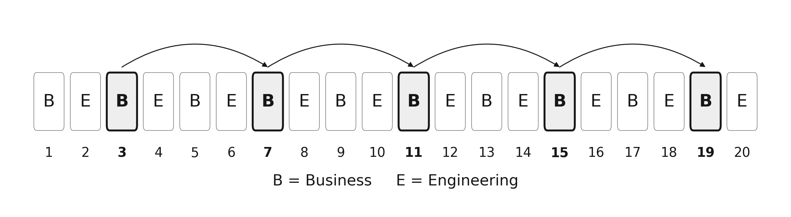
Can the list cause problems?
This list alternates business (B) and engineering (E) students.
D3. Which group does this sample miss? Why?
Notes:
1.5 minutes. Small demonstration list alternates Business and Engineering. Interval4 and random start3 selects onlyBusiness. Ask learners to explain using positions, then reveal next slide. This explores periodicity without introducing stratified or cluster methods.

Slide 45
The list pattern matters
Adding four keeps us on the same programme.
Start 3: 3, 7, 11, 15, 19
Every selected student is Business. Engineering is absent.
A start of 2 would select only Engineering.
Check repeating patterns before using a fixed interval.
Randomly shuffling the full list first can break this pattern.
Notes:
1 minute. A uniformly random start still gives each person equal inclusion probability here. It can nevertheless produce samples dominated by one programme and high sampling variability. Do not claim random-start systematic sampling is automatically biased. Randomly shuffling the list first is one remedy; an SRS is another. Leave formal bias taxonomy and programme stratification to ClassB.

Slide 46
How do these two methods compare?
Both use randomness, but the selection process differs.
 | Simple random | Systematic
How do we select? | Randomly choose distinct IDs | Choose a random start, then every k-th member
Useful feature | Every possible sample of the chosen size can occur | Easy to carry out along a list
What must we check? | A complete list and a proper random process | Repeating patterns that match the interval
Notes:
Question to class: Which is easier to carry out along an ordered list? Systematic can be simpler, but inspect relevant patterns. Do not teach that any ordering automatically creates bias.
[Sources]
Statistics Week 2 Lecture.pptx (user-provided Bellerbys source; content and inherited visual template).
Sullivan, Statistics: Informed Decisions Using Data, 7th ed., supplied PDF. Printed pp. 5, 7–8, 25, 35, 37 and 42–43: population/sample, data types, sampling methods and sampling error.
All classroom datasets and worked examples are illustrative. Mathematical diagrams created for this lesson from the stated values; no textbook artwork reproduced.
[/Sources]

Slide 47
Section 5:
Put it together
Notes:
Section separator. Pause briefly, then continue.
[Sources]
Statistics Week 2 Lecture.pptx (user-provided Bellerbys source; content and inherited visual template).
Sullivan, Statistics: Informed Decisions Using Data, 7th ed., supplied PDF. Printed pp. 5, 7–8, 25, 35, 37 and 42–43: population/sample, data types, sampling methods and sampling error.
All classroom datasets and worked examples are illustrative. Mathematical diagrams created for this lesson from the stated values; no textbook artwork reproduced.
[/Sources]
Section lead-in: Use the whole lesson in one study.
[Sources]
Original Bellerby photographic divider inherited from 1_Image divider 1, as in the supplied Week 1 reference decks.
[/Sources]

Slide 48

A4: Travel to college
EXERCISE A4
Fictional college: 2,460 enrolled students.
A valid random procedure selects
164 students. All 164 respond.
73 travel mainly by bus.
Variables recorded
Main transport mode: bus
Journeys per week: 13
Exact journey time: 37.6 minutes
Notes:
All numerical examples are fictional teaching cases. Original Bellerbys template from the supplied Week 2 Class A deck. Calculators allowed; round percentages to two decimal places unless stated otherwise. Allow 1 minute. Make explicit that the sample is selected by a valid random procedure and all selected students respond. For the systematic alternative use a complete register without a problematic repeating pattern. Image: Juan Encalada / Unsplash, https://unsplash.com/photos/6mcVaoGNz1w ; https://unsplash.com/license . Illustrative photograph; not the college or its actual transport.

Slide 49
A4: Independent questions
EXERCISE A4
Use N = 2,460, n = 164 and 73 bus users.
A4.1 Identify the population and sample. Calculate the bus
percentage and classify it as a parameter or statistic.
A4.2 Classify main transport mode, journeys per week
and exact journey time.
A4.3 Calculate the sampling fraction and systematic interval.
Start 11: write the first five IDs and the last selected ID.
A4.4 Estimate how many students in the whole college use buses.
Explain why your answer is not an established exact count.
Notes:
All numerical cases on this slide are fictional classroom examples. Round percentages to two decimal places unless stated otherwise. 6 minutes independent work. Students retain the three case numbers at the top of the page. Calculators allowed, percentages to2dp. For A4.4 apply the unrounded sample proportion to population size, assuming the sample is suitable for estimation. Do not silently replace an estimate with an exact census count.

Slide 50
A4: Checking a partner’s reasoning
EXERCISE A4
Compare methods before the answer reveal.
1 Explain why the bus percentage and sampling fraction
use different denominators.
2 Check that the final selected ID comes after 163 jumps.
3 Read your partner’s estimated bus count.
Does their sentence clearly call it an estimate?
Notes:
2 minutes. Both partners must explain one calculation. Collect one misconception about denominators before showing the answers.

Slide 51
A4: Groups, percentage and data
EXERCISE A4
A sample statistic describes the surveyed group.
A4.1 Population: all 2,460 students. Sample: 164 students.
73
Statistic: it describes
the 164 respondents.
× 100 ≈ 44.51%
164
A5.2 Variable | Type
Main transport mode | Categorical
Journeys per week | Quantitative–discrete
Exact journey time | Quantitative–continuous
Notes:
All numerical cases on this slide are fictional classroom examples. Round percentages to two decimal places unless stated otherwise. 2 minutes. 44.51% concerns bus travel among respondents. It is not the proportion of the college selected.

Slide 52
A4: Selection and estimation
EXERCISE A4
The estimates use the sample as evidence about the population.
A4.3 Sampling fraction
Interval = 2,460 ÷ 164 = 15
164
× 100 ≈ 6.67%
2,460
First IDs: 11, 26, 41, 56, 71
Last: 11 + 163 × 15 = 2,456
A4.4 Estimated number of bus users
73
1,095 is an estimate.
The sample does not establish
the exact population count.
× 2,460 = 1,095
164
Notes:
All numerical cases on this slide are fictional classroom examples. Round percentages to two decimal places unless stated otherwise. 3 minutes. Use73/164 rather than the rounded44.51% to estimate1095 exactly from the given ratio. That exact arithmetic result remains a statistical estimate. With a different random sample, the estimate may differ.

Slide 53
A4.5: Two samples, two estimates
EXERCISE A4
Both samples come from the same college of 2,460 students.
First random sample
Second random sample
73 bus users out of 164
86 bus users out of 164
(a) Use the second sample to estimate the total bus users.
(b) The first estimate was 1,095. Must one calculation
be wrong? Can we tell which estimate is closer?
Notes:
All numerical examples are fictional teaching cases. Original Bellerbys template from the supplied Week 2 Class A deck. Calculators allowed; round percentages to two decimal places unless stated otherwise. Allow 3 minutes. Both random procedures are valid and all selected students respond. Keep the population fixed. Learners calculate before interpreting the difference. No new sample is collected in class.

Slide 54
A4.5: Different samples can differ
EXERCISE A4
Random sampling does not guarantee identical results.
Second estimate: (86 ÷ 164) × 2,460 = 1,290
Both calculations can be correct.
Different random samples can contain different numbers
of bus users, so their estimates can differ.
These results alone do not show which estimate is closer
to the true population count.
Notes:
All numerical examples are fictional teaching cases. Original Bellerbys template from the supplied Week 2 Class A deck. Calculators allowed; round percentages to two decimal places unless stated otherwise. Allow 1 minute. Contrast an arithmetic error with sampling variation. Do not describe one estimate as biased merely because it differs. No inference about which is closer is justified from these two sample counts alone.

Slide 55
A5: Individual exit check
EXERCISE A5
Answer independently. Give a reason as well as a number.
A5.1 We ask all 31 students in one class about that class.
Is this a census? What if our target is the whole college?
A5.2 A survey codes transport: 1 = bus, 2 = bike, 3 = walk.
What type of variable is this? Explain.
A5.3 Select 87 people from 2,523 systematically.
Find k, the valid random starts and the first four IDs
if the random start is 17.
Notes:
All numerical cases on this slide are fictional classroom examples. Round percentages to two decimal places unless stated otherwise. 3 minutes without partner help. Collect or scan individual answers. Do not spend remaining time on an optional challenge if these core misconceptions remain.

Slide 56
A5: Answers
EXERCISE A5
The group, the variable and the process each matter.
A5.1 For this class: census. For the college: a sample.
The research question defines the population.
A5.2 Categorical. The numbers are labels for transport types.
A5.3 k = 2,523 ÷ 87 = 29. Random starts: 1–29.
Start 17 gives 17, 46, 75, 104.
Notes:
All numerical cases on this slide are fictional classroom examples. Round percentages to two decimal places unless stated otherwise. 1.5 minutes. Have students correct mistakes and write the reason. Topic for reteaching is the most common error, not necessarily the calculation.

Slide 57
What we can do now
Identify the group. Classify the data. Explain the selection.
Population and sample — groups of people or items.
Parameter and statistic — numbers describing those groups.
Simple random and systematic — two ways to select a sample.
Next: how can we make sure both business and
engineering students are included?
Notes:
0.5 minute. Close the90-minute core here. Next class considers ensuring inclusion of programmes and other sampling methods. Optional extension and teacher resources follow after this slide.

Slide 58
Extension: Equal chances for whom?
OPTIONAL EXTENSION
Six people: A, B, C, D, E and F. Select two.
A computer selects one of these pairs: AB, CD or EF.
Each of the three pairs has an equal chance.
X1 What is each person’s chance of selection?
X2 How many pairs could a simple random sample select?
X3 Is this process a simple random sample of two? Explain.
Notes:
All numerical examples are fictional teaching cases. Original Bellerbys template from the supplied Week 2 Class A deck. Calculators allowed; round percentages to two decimal places unless stated otherwise. Optional 5-minute reasoning extension outside the core 90 minutes. This is a stated computer-selection scenario, not a class practical. Small numbers make it possible to enumerate the complete sample space.

Slide 59
Extension: The possible samples
OPTIONAL EXTENSION
Equal individual chances alone do not establish simple random sampling.
X1 Each person is in one of the three pairs: chance 1/3.
X2 There are 15 possible pairs in a simple random sample.
X3 This process allows only AB, CD and EF.
Pairs such as AC and BD have no chance.
Simple random sampling gives every possible pair the same chance.
Notes:
All numerical examples are fictional teaching cases. Original Bellerbys template from the supplied Week 2 Class A deck. Calculators allowed; round percentages to two decimal places unless stated otherwise. Each person has probability 1/3. There are 6×5/2=15 possible unordered pairs, but this procedure can select only three. It is random, but not a simple random sample.

Slide 60
Teacher notes: the 90-minute route
TEACHER RESOURCE
End the core lesson at the summary. The extension is optional.
Block | Minutes | Main student work
Revision | 5 | Calculations and pair counting
Population and sample | 18 | A1: classification and limits of what we know
Data types | 12 | A2: twelve classifications with reasons
Simple random sampling | 8 | Teacher explanation; no selection practical
Systematic sampling | 24 | A3: reverse reasoning and selection faults
Integrated application | 18 | A4: calculations and two sample estimates
Individual exit check | 5 | A5: collect evidence of understanding
Notes:
Teacher resource. Suggested 90-minute allocation: 5+18+12+8+24+18+5=90. Timings include explanations, independent thinking, partner reasoning and answer reveals. The random sampling section is explanation only; no physical preparation or student selection practical. Strengthened tasks A1.4, A3.4 and A4.5 use the saved time. Give 3 minutes for A1.4, about 7 for the main A3 task, and 3 for A4.5 before revealing answers. For a fast group, use the optional five-minute sample-space challenge if there is time; do not stretch the explanation to fill time. Stop the projected core at the summary. Handout numbering is now A1–A5 and must be matched in any later handout.

