Slide 1
IFY Statistics
Week 2 • Class B
Sampling and
Reliable Results
Notes:
90-minute teaching plan. Recall 5 min. Stratified sampling and B1 20 min. Cluster sampling and B2 13 min. Variation, bias and B3 22 min. Accuracy and precision 6 min. Evaluation, B4 budget and B5 16 min. Exit 5 min. Buffer 3 min. Slides 49–50 are an optional extension outside the core timing. Calculators allowed. Round requested percentages to two decimal places. All numerical cases are fictional teaching examples. Reserve the complete investigation design for Class C.

Slide 2
Revision:
Class A
Notes:
Short retrieval practice from Class A. Do not reteach all foundations before allowing students to attempt the questions.
[Sources]
Visual template and inherited photo assets: Statistics-Week-2-Class-A.pptx, locked version 1, based on original Bellerby teaching materials.
Content base: Statistics Week 2 Lecture.pptx (original slides 3, 8, 9) and Week 2 Seminar 1/2 materials from the user-provided Semester 1 archive.
All college/company data and sample estimates in this lesson are fictional instructional examples. Exact diagrams and mathematical graphics were created from the stated values for this lesson.
[/Sources]

Slide 3
REVISION
Quick revision
A college has 3,216 students. All 268 randomly selected students
reply. 173 support longer library hours.
B-R1 Identify the population and sample.
B-R2 Calculate the support percentage. Is it a parameter or statistic?
B-R3 Name each method: random distinct IDs from the full list,
or a random start followed by every 12th student.
B-R4 A separate list has 2,592 people. Select 96 systematically.
Find the interval and the first four positions from random start 17.
Notes:
Recall block, slides 2–4: 5 minutes total. Give 3 minutes individually and 2 minutes for the answer. Do not spend time reteaching every Class A definition. B-R4 explicitly uses a separate population, so all data needed are present.

Slide 4
REVISION
Revision answers
B-R1 Population: all 3,216 students. Sample: the 268 selected.
B-R2 173 ÷ 268 × 100 ≈ 64.55%. A statistic: it describes the sample.
B-R3 Simple random sampling, then systematic sampling.
B-R4 Interval = 2,592 ÷ 96 = 27.
+27
+27
+27
17
44
71
98
Notes:
B-R2 is a sample statistic even though every selected student replied. B-R4 uses k=N/n. Starting position is counted as the first selected person.

Slide 5
Section 1:
Stratified
Sampling
Notes:
Introduce stratified sampling: random people from every chosen group.
[Sources]
Visual template and inherited photo assets: Statistics-Week-2-Class-A.pptx, locked version 1, based on original Bellerby teaching materials.
Content base: Statistics Week 2 Lecture.pptx (original slides 10, 17) and Week 2 Seminar 1/2 materials from the user-provided Semester 1 archive.
All college/company data and sample estimates in this lesson are fictional instructional examples. Exact diagrams and mathematical graphics were created from the stated values for this lesson.
[/Sources]

Slide 6
Our college: two programmes
We want views on longer library opening hours.
Programme | Students
Business | 1,200
Engineering | 800
Total | 2,000
Select 200 students.
Both programmes may have
different timetables and
library needs.
Business
1,200 (60%)
Engineering
800 (40%)
Fictional college example. “Selected” means invited; some students may not respond.
Notes:
Fictional demonstration. Select 200 from 2,000, with Business 1,200 and Engineering 800. The easy numbers make proportional allocation visible. Selected students are invitees, not guaranteed respondents.

Slide 7
Random selection in every group
A stratum is one group. Strata means several groups.
Every student belongs to exactly one group.
1 Divide the list
2 Select within each list
3 Combine
Business
1,200 students
120 random IDs
from Business
200 students
One sample
Engineering
800 students
80 random IDs
from Engineering
Each group contributes students, and selection is random within each group.
Notes:
Explain the distinction between allocating numbers and choosing people. Proportional stratified sampling keeps population shares. The groups must cover the population and not overlap.

Slide 8
The same proportions
Proportional stratified sampling keeps each group’s share.
Population: 2,000
Business 1,200 (60%)
Engineering 800 (40%)
Selected sample: 200
Business 120 (60%)
Engineering 80 (40%)
Notes:
Use the shared boundary at 60% to show what is preserved. The two bars represent different totals and each bar is normalized to 100%, so their equal lengths do not mean equal population counts.

Slide 9

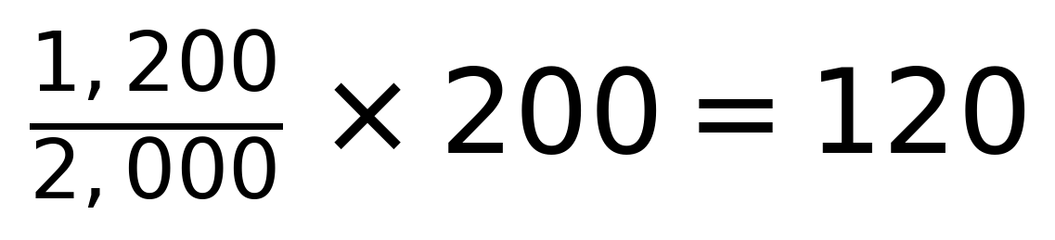
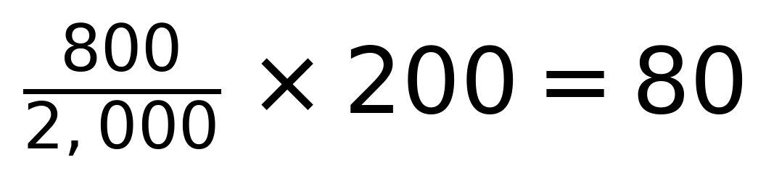
Calculate each group’s sample
Find the group’s share, then apply it to the sample size.
Business
Engineering
Check the total: 120 + 80 = 200 students.
Notes:
Demonstrate the group allocation formula with the simple college case. Group sample=(group population/total population)×total sample. Arithmetic is shown to teach the process. More demanding values follow in B1.

Slide 10
How the random choice works
Use a random-number generator with the complete list for each group.
Business list | Engineering list
Unique IDs 1–1,200 | Unique IDs 1–800
Generate 120 distinct IDs | Generate 80 distinct IDs
Match each generated ID to its student and send the invitation.
Use sampling without replacement. Prevent or reject repeated IDs.
Notes:
Do not cut up paper or stage a physical draw. Explain the generator setting: minimum ID, maximum ID, number required, no repeats. Every valid set of the required size within a stratum must be equally likely. Run each group separately and keep an auditable selected-ID list. Do not substitute friends for selected students who fail to reply. A generator demo is optional and should take under one minute.

Slide 11
Must the group samples be equal?
Stratified means random selection from every group.
Allocation | Business | Engineering
Proportional | 120 | 80
Equal numbers | 100 | 100
Both can be stratified samples.
Equal numbers may help us compare the programmes.
For an overall college result, account for the programmes’ different population sizes.
Notes:
Both proportional and equal-number allocation can be stratified if individuals are selected randomly within every group. Equal numbers may help programme comparisons, but an overall population estimate must account for unequal population shares. No weighting calculation is required here.

Slide 12
EXERCISE B1
B1: A proportional sample
A company has 2,478 employees. Select 177 proportionally.
Department | Employees
Production | 1,386
Sales | 714
Administration | 378
Total | 2,478
Calculate the allocation to:
B1.1 Production
B1.2 Sales
B1.3 Administration
B1.4 Describe an exact random
selection process within each
department.
Notes:
B1.1–B1.4: allow 4 minutes of pair work. Complete, current lists are available. Require calculations and specific selection steps rather than the phrase choose randomly. Answers 99,51,27. Fictional company.

Slide 13
EXERCISE B1
B1: Allocation and selection
Department | Calculation | Selected
Production | 1,386 ÷ 2,478 × 177 | 99
Sales | 714 ÷ 2,478 × 177 | 51
Administration | 378 ÷ 2,478 × 177 | 27
Check | 99 + 51 + 27 | 177
B1.4 Number each complete department list. Generate 99, 51 and 27
distinct random IDs in the respective ranges. Invite those employees.
Notes:
Allow 2 minutes to review. Require unique IDs and sampling without replacement inside every department. Randomly choosing department names is not enough.

Slide 14
EXERCISE B1
B1: The budget changes
The same company can now select only 173 employees.
Production | Sales | Administration
1,386 | 714 | 378
B1.5 Calculate each exact allocation, then choose whole numbers
that keep the total at 173.
Explain which departments receive the extra places after rounding down.
Notes:
B1.5: allow 3 minutes of pair work, then 2 minutes for the answer. Hint only if needed: allocate the integer parts first and compare the remaining decimals. This is the largest-remainder allocation convention, introduced informally. Fractional people cannot be selected.

Slide 15
EXERCISE B1
B1: Rounding with a fixed total
Department | Exact allocation | Whole number
Production | 96.7627… | 97
Sales | 49.8475… | 50
Administration | 26.3898… | 26
Rounding down gives 96 + 49 + 26 = 171. Two places remain.
Give them to Sales and Production, the largest decimal remainders.
Check: 97 + 50 + 26 = 173.
Notes:
Exact values = group size/2478×173. Largest fractional remainders are Sales .8474576 and Production .7627119. Nearest-integer rounding also happens to yield the same answer here, but checking the total is essential.

Slide 16
Section 2:
Cluster
Sampling
Notes:
Shift from selecting individuals in every group to selecting whole groups.
[Sources]
Visual template and inherited photo assets: Statistics-Week-2-Class-A.pptx, locked version 1, based on original Bellerby teaching materials.
Content base: Statistics Week 2 Lecture.pptx (original slides 11, 18) and Week 2 Seminar 1/2 materials from the user-provided Semester 1 archive.
All college/company data and sample estimates in this lesson are fictional instructional examples. Exact diagrams and mathematical graphics were created from the stated values for this lesson.
[/Sources]

Slide 17
Cluster sampling: whole classes
Our demonstration college has 40 classes of 50 students.
1
2
3
4
5
6
7
8
9
10
Randomly choose
4 distinct classes.
11
12
13
14
15
16
17
18
19
20
Invite every student
in those classes.
21
22
23
24
25
26
27
28
29
30
31
32
33
34
35
36
37
38
39
40
4 × 50 = 200 students
One square = one class of 50. Shaded squares are the selected classes.
Notes:
There is a complete list of all 40 classes and each student belongs to one class. Label classes 1–40, generate four distinct random class IDs, then invite everyone on those class registers. No second random draw of individuals is required for this one-stage cluster example. Do not teach a separate two-stage procedure here.

Slide 18
Stratified or cluster?
Small illustration: 6 classes of 6 students. Each plan selects 12.
Filled dot = selected student. Open dot = unselected student.
STRATIFIED
CLUSTER
Class 1
Class 2
Class 3
Class 1
Class 2
Class 3
Class 4
Class 5
Class 6
Class 4
Class 5
Class 6
Randomly select 2 from every class.
Randomly select 2 whole classes.
Notes:
Filled dots are selected students. Open dots are unselected. Each outlined box is one class. In this miniature example classes serve as strata on the left and clusters on the right. Left: random sample within every class. Right: random sample of classes followed by all six in each selected class. Both select 12 of 36, yet the possible samples differ.

Slide 19
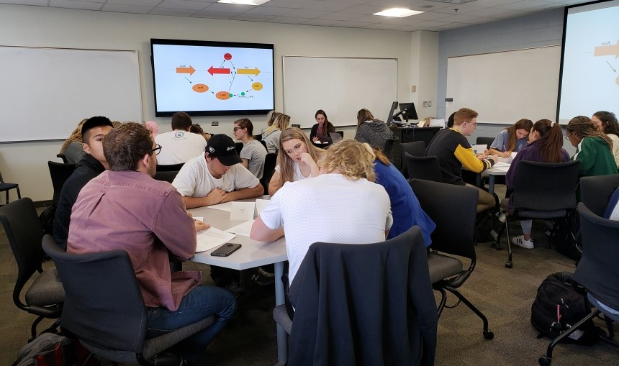
Why choose clusters?
A whole class is a group that researchers can visit together.
Fewer locations
Visiting a few whole classes can
reduce travel and setup costs.
Less variety within a class
Classmates may share views.
A few similar classes can give
more variable estimates.
Random cluster selection can be unbiased while still having lower precision.
Notes:
Show how the photograph represents one whole class as a possible cluster. Ask: which costs could fall if researchers visit only a few classes? Follow with the precision concern. Internal similarity is relevant to the variable measured, not an assumption about every classroom. Random cluster sampling is not automatically biased. Photo source: University of Georgia, https://mib.uga.edu/bs-microbiology . Photograph illustrates a classroom only and does not depict the fictional study.

Slide 20
EXERCISE B2
B2: Three selection plans
A different college has 54 classes of 42 students. Each student
belongs to one class. Complete lists are available.
Plan | Selection process
B2.1 | Randomly choose 7 distinct students from every class.
B2.2 | Randomly choose 9 distinct classes and invite everyone.
B2.3 | Randomly choose 378 distinct IDs from the college list.
For each plan: name the method, find the sample size and explain your classification.
Notes:
B2.1–B2.3: allow 3 minutes in pairs. Population 2268, target 378 in all three plans. The equal totals are deliberate, so classification must follow the selection process. The complete class partition is stated.

Slide 21
EXERCISE B2
B2: The process identifies it
Plan | Method | Number selected | Why?
B2.1 | Stratified | 54 × 7 = 378 | Some students from every class
B2.2 | Cluster | 9 × 42 = 378 | Everyone in selected classes
B2.3 | Simple random | 378 | Individual IDs from the full list
A sample size alone cannot identify the sampling method.
Notes:
Review for 1 minute. B2.1 is also proportional because all class sizes are equal and the same 7/42 fraction is selected within each. B2.2 is one-stage cluster sampling with equal-size clusters.

Slide 22
EXERCISE B2
B2: Is the selection valid?
Use the same 54 classes of 42 students.
B2.4 Take the first 7 names from every class register.
B2.5 Visit the 9 classrooms nearest the staff office
and invite everyone in them.
For each plan: identify the fault, explain who is favoured,
and give a precise repair.
Notes:
Allow 2 minutes discussion and 1 minute answer. Students must distinguish correct-looking group counts from a valid random process. The ordered register and convenient classroom choices are not random. Do not assert a definite direction of bias without information about register order or class characteristics.

Slide 23
EXERCISE B2
B2: Repairs to the process
Plan | Problem and possible effect | Repair
B2.4 | Early entries always get selected. Later entries have no chance. | Generate 7 distinct random IDs within each complete class list.
B2.5 | Nearby classes always get selected. Other locations have no chance. | Generate 9 distinct random class IDs from all 54 classes.
The selection rules exclude people systematically.
The direction of any resulting opinion bias is not given.
Notes:
A random-number generator is the repair in both cases, but its sampling unit differs: individuals within each class for B2.4, classes for B2.5. Answer the why-wrong part explicitly.

Slide 24
Section 3:
Sampling Variation
and Bias
Notes:
Separate chance variation from faults or systematic tendencies in the survey process. The original deck's taxonomy is simplified and imprecise; use the corrected distinctions.
[Sources]
Visual template and inherited photo assets: Statistics-Week-2-Class-A.pptx, locked version 1, based on original Bellerby teaching materials.
Content base: Statistics Week 2 Lecture.pptx (original slides 13, 14, 15) and Week 2 Seminar 1/2 materials from the user-provided Semester 1 archive.
All college/company data and sample estimates in this lesson are fictional instructional examples. Exact diagrams and mathematical graphics were created from the stated values for this lesson.
[/Sources]

Slide 25
Different samples, different results
Three valid random samples estimate support for longer library hours.
Sample 1
Sample 2
Sample 3
58%
63%
60%
Sampling variation: estimates change because different people
enter the samples.
Sampling error is the difference between a sample estimate and the population value.
Notes:
Before explaining, ask pairs: do different results prove that a team made a mistake? Take a 20-second prediction. The differences alone do not show that anyone made a mistake. Sampling variation is variability between samples. Sampling error is the realised estimate minus the true population quantity, which is normally unknown. This demonstration uses fictional results.

Slide 26
Chance variation and bias
Imagine repeating each sampling process many times.
Population value = 60%
A Narrow spread
B Wide spread
C Shifted results
40%
50%
60%
70%
80%
Each dot is an estimate from one sample.
A and B centre near the truth. C illustrates a process that tends to overestimate.
Notes:
These are deliberately simplified schematic dot plots, with five example estimates in each process, to illustrate properties over repetition. The true population percentage is stipulated to be 60%. A has small spread near 60; B has larger spread near 60; C has small spread but is centred near 72. One isolated estimate away from the truth is not evidence of a biased process.

Slide 27

Selection bias: who gets left out?
A survey about library hours recruits only people inside the library.
Who is missing?
Students who seldom use the
library, including those who
cannot attend its current hours.
Their views may differ.
Sample from the complete
college register.
Notes:
Illustrative photo: The Lantern, https://www.thelantern.com/2019/02/diversity-in-literature-essential-to-student-learning/ ; image https://www.thelantern.com/files/2019/02/IMG_9047-2a5qyvg.jpg . Photo does not depict an actual survey. Fictional selection-bias example. Do not claim a known direction: frequent users may favour longer hours, while people unable to attend may also favour them. The key is systematic exclusion from the invitation process.

Slide 28
Nonresponse: selected but missing
A random sample of 200 students receives an invitation.
60 reply
140 do not reply
Nonresponse bias can occur when respondents and nonrespondents
differ in ways relevant to the survey.
A low response rate raises concern. It does not, by itself, prove bias.
Notes:
Keep this demonstration simple. Explain that the original random selection and the responding group are different stages. Missing replies matter especially if willingness or ability to respond is related to the view being measured.

Slide 29
EXERCISE B3
B3: Which denominator?
A college randomly invites 263 students. Of these, 157 reply
and 112 respondents support longer library hours.
263
invited
157
replied
112
supported
B3.1 Calculate the response rate.
B3.2 Calculate support among respondents.
B3.3 Can we claim the same support across the college?
Explain exactly when nonresponse could distort this result.
Notes:
Allow 3 minutes for B3.1–B3.3 and 2 minutes for the answers. Round percentages to 2 decimal places. Require named denominators and an explanation conditional on nonrespondents having different relevant views. The fictional figures intentionally do not simplify to round percentages.

Slide 30
EXERCISE B3
B3: Rates and conclusions
B3.1 Response rate
B3.2 Support among
respondents
157 ÷ 263 × 100 ≈ 59.70%
112 ÷ 157 × 100 ≈ 71.34%
B3.3 We know the respondents’ percentage. To judge the college
estimate, investigate whether the 106 nonrespondents have
different views about longer hours.
Notes:
157/263×100=59.69581749%; 112/157×100=71.33757962%; 263−157=106. Random selection of invitees does not guarantee representative response. An estimate is possible under appropriate assumptions, but the college’s true percentage is not established by these counts. The optional extension in slides 49–50 explores worst-case bounds among invitees only.

Slide 31
Nonresponse bias
Randomly invite 200 students: “Should the library stay open later?”
Group | Students | Support
Reply | 60 | 48
Do not reply* | 140 | 42
All invitees | 200 | 90
Replies only
48 ÷ 60 = 80%
All 200 invitees
90 ÷ 200 = 45%
*Suppose 42 would support it. In real surveys,
the missing answers are unknown.
If supporters are more likely to reply, support looks too high.
This is nonresponse bias.
A low response rate alone does not prove bias.
Notes:
Hypothetical teaching example using the numbers discussed in class. Nonresponse means an invited student does not answer. Assume supporters are more likely to reply. Of the 60 respondents, 48 support later library hours (80%). Suppose 42 of the 140 nonrespondents would also support it (30%). Then 90 of all 200 invitees support it (45%). The hidden views are supplied only to demonstrate the mechanism. In an actual survey these views are usually unknown. The 45% refers to the 200 invitees, not a known percentage for the entire college. Nonresponse alone does not establish bias; concern depends on relevant differences associated with replying. Ask students why random invitations do not guarantee representative replies.

Slide 32
Question wording can change answers
Leading question
Neutral question
“Don’t you agree that extending
library hours would be a great
improvement?”
“Would you support extending
the library’s opening hours?”
Support / Oppose / Unsure
Privacy and the interviewer’s presence can also affect what people report.
Notes:
Ask students to identify the exact words that encourage a particular answer before discussing the neutral alternative. Response bias concerns the answers obtained from people who do respond. Wording may signal the desirable answer. Nonresponse bias concerns relevant differences between people who answer and those who do not. Use the distinction explicitly.

Slide 33
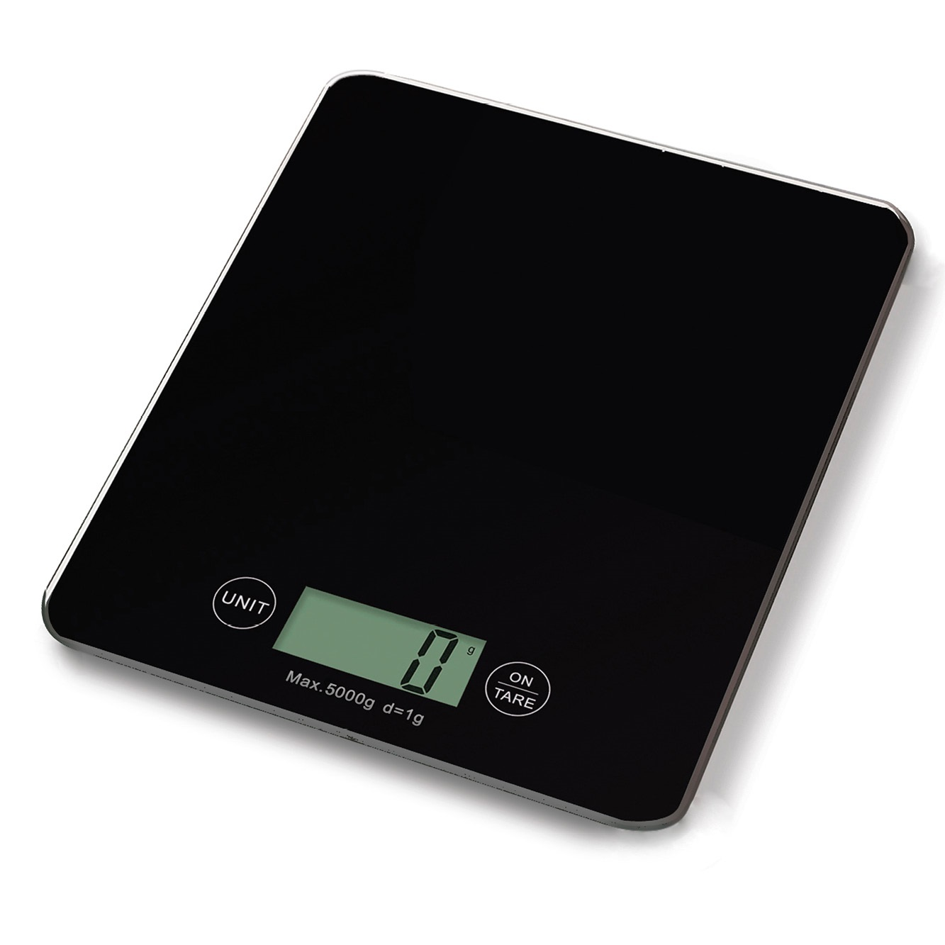
Measurement error: the scale
Imagine a scale that records every mass 20 g too high.
Actual mass | Recorded mass
100 g | 120 g
250 g | 270 g
400 g | 420 g
More measurements keep the same +20 g error.
Check zero and calibrate the equipment.
Notes:
Photo is illustrative and the error is fictional. The photographed scale displays zero and is not alleged to be faulty. Source: https://www.casseroles-et-ustensiles-culinaire.com/categories/78/balance-verres-mesureurs ; image https://www.casseroles-et-ustensiles-culinaire.com/images/products/10519_photo_1.jpg . A constant positive error overstates every reading and the mean by 20g. Repeating measurements does not remove it.

Slide 34
EXERCISE B3
B3: Diagnose and repair
For each case, identify the main issue, its possible effect and a repair.
Case | What happened?
B3.4 | Survey evening-transport needs only in 9 a.m. classes.
B3.5 | In a random staff survey, dissatisfied employees are twice as likely to reply.
B3.6 | A tutor asks named students: “Our feedback system is excellent, isn’t it?”
B3.7 | A laboratory balance overstates every reading by 0.18 g.
B3.8 | Two valid random samples estimate travel time at 27.4 and 29.1 minutes.
Notes:
Allow 4 minutes pair work and 2 minutes answer discussion. All five contexts are fictional. Students must transfer the ideas beyond the library examples. For B3.6 require a neutral alternative and consider privacy. For B3.8 no design fault is established by the two different estimates. B3.4 does not give a definite direction of bias.

Slide 35
EXERCISE B3
B3: Problems and repairs
Case / main issue | Effect | Appropriate response
B3.4 Selection bias | Students outside 9 a.m. classes are excluded. | Sample from the full student list.
B3.5 Nonresponse bias | Dissatisfaction may be overstated. | Reminders and accessible ways to reply.
B3.6 Response bias | Pressure to praise the system. | Ask privately: “How do you rate the feedback system?”
B3.7 Measurement error | Each reading is 0.18 g too high. | Check zero and calibrate.
B3.8 Sampling variation | Different people give different estimates. | No fault established. Random variation is expected.
Notes:
Distinguish selection, nonresponse and response bias. B3.5 explicitly makes dissatisfied employees more likely to respond, so dissatisfaction may be overstated. Better response rates help but do not guarantee absence of bias. B3.4 has no definite direction from the given facts. For B3.6 pair neutral wording with balanced options and privacy. B3.8 has no demonstrated fault.

Slide 36
Does a larger sample fix bias?
Which invitation process gives both programmes a chance?
PLAN A: 1,000 invitees
PLAN B: 200 invitees
Business
Engineering
Business
Engineering
1,000 selected
Excluded
Random choice
Random choice
More invitees, but one
programme has no chance.
200 selected across both lists
Sample size cannot repair systematic exclusion. Boxes show groups, not their sizes.
Notes:
Ask for a prediction before explaining. This diagram is schematic; no programme population size or Plan B numerical split is specified. Plan B selects individuals randomly within both programme lists. Do not infer an equal allocation from equal-sized boxes. A larger valid sample can reduce chance variation, but increasing an excluded-group design does not fix its coverage. Neither plan guarantees an accurate realised estimate.

Slide 37
Section 4:
Choosing and
Evaluating
Notes:
Move from identifying methods to defending a choice in a given context.
[Sources]
Visual template and inherited photo assets: Statistics-Week-2-Class-A.pptx, locked version 1, based on original Bellerby teaching materials.
Content base: Statistics Week 2 Lecture.pptx (original slides 12, 19) and Week 2 Seminar 1/2 materials from the user-provided Semester 1 archive.
All college/company data and sample estimates in this lesson are fictional instructional examples. Exact diagrams and mathematical graphics were created from the stated values for this lesson.
[/Sources]

Slide 38
Four sampling methods
Each illustration selects 4 of 12 people. Filled dots show the sample.
SIMPLE RANDOM
SYSTEMATIC
1
2
3
4
5
6
7
8
9
10
11
12
1
2
3
4
5
6
7
8
9
10
11
12
4 distinct IDs from the complete list.
Random start 2, then every 3rd person.
STRATIFIED
CLUSTER
2 random IDs from each of 2 groups.
1 random group, then all 4 members.
Notes:
Use as a 45-second reference rather than another lecture. All miniature examples select4 of12, so sample size cannot identify the method. SRS chooses4 individuals from the full list. Systematic has random start2 from1–3, selecting2,5,8,11. Stratified uses2 groups of6 and randomly selects2 from each. Cluster uses3 groups of4 and randomly selects one entire group. These different group partitions are intentional and stated. Filled dots are selected, open dots are unselected; boxes are defined groups. A favourite starting student is not a random start.

Slide 39
Strengths and limitations
Method | Useful feature | Point to consider
Simple random | Clear random choice of individuals | Needs a complete individual list
Systematic | Straightforward selection sequence | List patterns may align with the interval
Stratified | Includes every defined group | Needs correct group lists and allocation
Cluster | Fewer locations to visit | Similar people in a few groups may increase variation
Compare methods for the actual study. No method is best for every situation.
Notes:
Keep this as a reference for the upcoming decision. Spend no more than 45 seconds here rather than reading every row. Under appropriate designs stratification may improve precision, but merely having group labels does not guarantee it.

Slide 40
EXERCISE B4
B4: Accuracy and precision
Accuracy: closeness to the truth. Precision: consistency across samples.
B4.1 Which processes are precise? Which centre near the truth?
Explain why consistency alone is not enough.
Population value = 46%
A
B
C
30%
40%
50%
60%
70%
Each dot is a sample estimate. Judge both spread and distance from 46%.
Notes:
Accuracy and precision block: 6 minutes including explanation and discussion. Give 2 minutes to interpret this new graph first. A and C have the same small spread; A centres at61 and C at46. B is wider and centres at46. Population truth is stipulated to be46%. These schematic samples illustrate processes by construction, rather than proving real-world bias from five estimates.

Slide 41
EXERCISE B4
B4: Consistency can mislead
Process | Spread | Centre | Interpretation
A | Small | Near 61% | Precise but biased upwards in this illustration
B | Large | Near 46% | Less precise, with no systematic shift shown
C | Small | Near 46% | Precise and centred near the truth
A and C have the same precision. Only C combines a narrow
spread with a centre near the population value.
Notes:
Discuss why consistency does not ensure accuracy. In this task C combines both properties. The diagram illustrates the processes by construction. Do not teach that exactly five estimates suffice to establish real bias. Refer back to the constant scale error as an example of highly repeatable wrong readings.

Slide 42
Choosing a defensible method
A recommendation needs a reason and a limitation.
Criterion | What should we ask?
Accuracy | Could selection, nonresponse or measurement cause bias?
Precision | How much might estimates vary between samples?
Cost | How many people and locations must researchers visit?
Feasibility | Are complete lists, staff and time available?
Notes:
Keep the four terms connected to the earlier cases. The next task makes both plans feasible so students must justify a tradeoff rather than identify an obvious unaffordable option.

Slide 43
EXERCISE B4
B4: A sampling decision
Estimate support for evening classes: 72 centres, 34 trainees each.
Select 238. Complete lists are available. Assume everyone takes part.
Plan A | Plan B
Randomly select 238 individual IDs. This draw covers 67 centres. | Randomly select 7 whole centers. Interview all 34 trainees in each.
Cost: ¥85 per centre visited + ¥12.50 per trainee. Budget: ¥9,000.
B4.2 Name the methods. Calculate each cost and check the budget.
B4.3 Choose a plan. Give a reason and its strongest statistical objection.
B4.4 What extra information would help you decide?
Notes:
B4.2–B4.4: allow 4 minutes pair work and 5 minutes for competing defences and the answer. Each pair writes its choice and the strongest statistical objection to it. Hear one Plan A defence and one Plan B defence, then ask which extra information would change the decision. Do not reveal the answer before pairs commit. Fictional district and costs. All trainees belong to one centre, complete lists exist, all selected trainees respond and only the stated visit and interview costs are included. 67 centres is a supplied result of Plan A’s random draw, not something students must derive. Both plans fit the budget, deliberately. Arithmetic 238×12.50=2975; A 67×85+2975=8670; B 7×85+2975=3570.

Slide 44
EXERCISE B4
B4: Cost and precision
Both fit ¥9,000. Plan B saves ¥5,100.
A: 67 centres
B: 7 centres
67 × ¥85 + 238 × ¥12.50 = ¥8,670
7 × ¥85 + 238 × ¥12.50 = ¥3,570
Some centre types can still be
underrepresented by chance.
Similar trainees in 7 centres may
increase sampling variation.
Notes:
Both cost bars share a zero baseline and a maximum of9000yuan, equal to the budget. Visits cost5695forA and595forB. Interviews cost2975forboth. Both fit the budget; B saves5100. The diagram shows the same number of interviews but very different travel/setup costs. B4.3: A offers wider centre coverage in this draw, but SRS can underrepresent some centre types by chance and estimates retain sampling variation. B has lower costs but similarity within only7centres can reduce precision. Accept either plan when justified. B4.4: useful information is how views differ within and between centres. Hear the competing defences before revealing. All costs and categories are fictional exercise data.

Slide 45
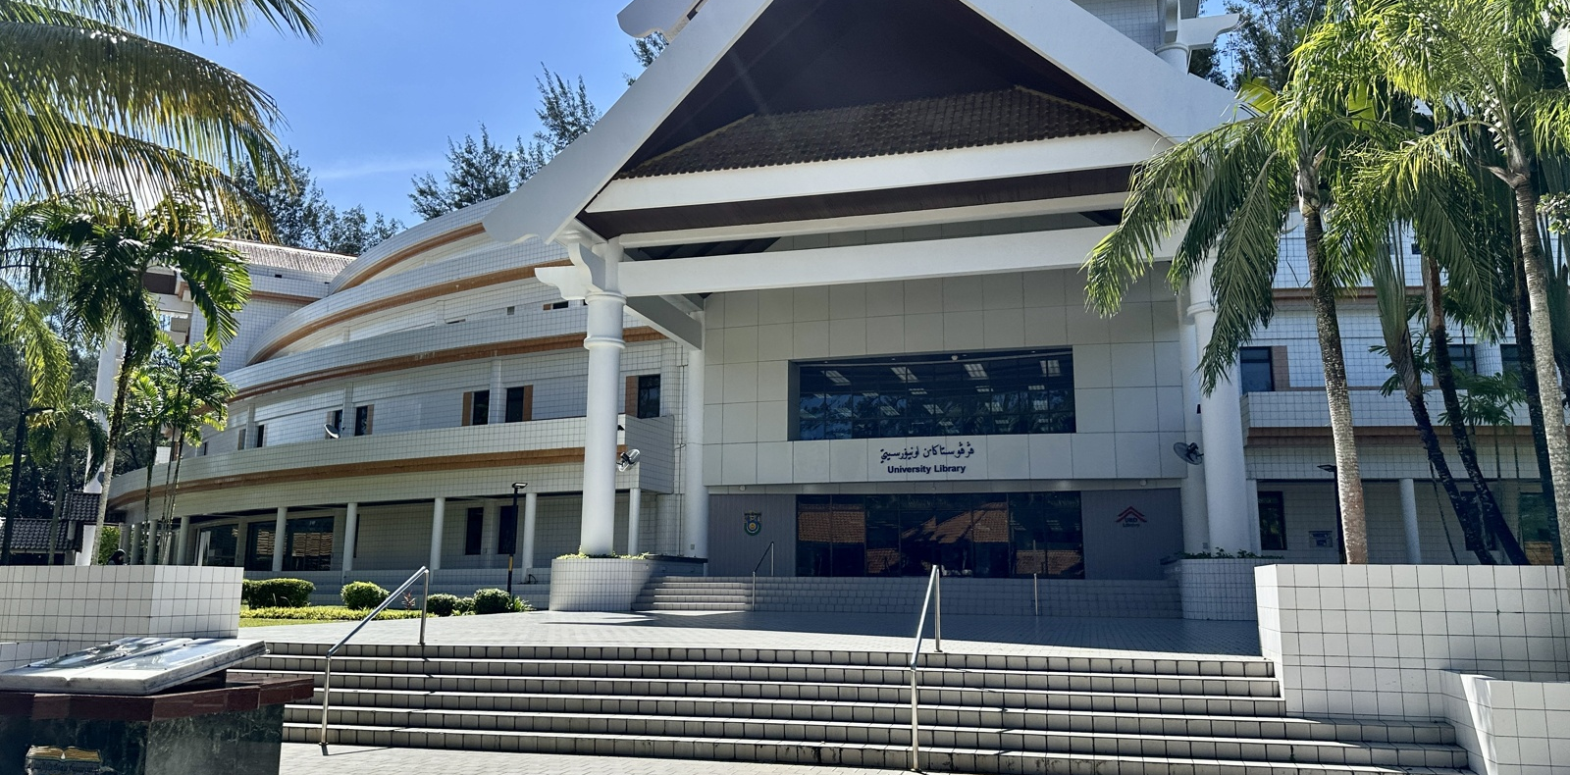
EXERCISE B5
B5: Does the headline hold up?
A college publishes this survey claim:
COLLEGE NEWS
“79.2% of students back
longer library hours”
B5.1 Identify four missing details. Rank the two most important
and explain why they matter.
B5.2 Assume 79.2% is the percentage among respondents.
Rewrite the headline. Does one decimal place make it trustworthy?
Notes:
B5:3minutes pairs and2minutes review. No counts supplied intentionally. Require a ranked judgement with reasons. Before the answer, hear two different top priorities and ask what makes each important. B5.2 explicitly supplies the respondent denominator, so the rewrite is now justified. The headline is fictional and does not describe the pictured university. Photo: UBD Library in2024, Pangalau, Wikimedia Commons, CC BY-SA4.0, https://commons.wikimedia.org/wiki/File:UBD_Library_in_2024.jpg ; license https://creativecommons.org/licenses/by-sa/4.0/ . Image resized and cropped.

Slide 46
EXERCISE B5
B5: Evidence behind the number
Missing detail | Why it matters
Selection process and coverage | Were some students systematically excluded?
Numbers invited and responding | How much evidence is there, and who is missing?
Exact question and response options | Could wording push answers towards support?
Which students the claim concerns | Does the sample match that target population?
B5.2 “79.2% of respondents in this survey supported longer hours.”
Extra decimal places do not establish trustworthy sampling.
Notes:
Accept other relevant missing details, for example survey timing and administration mode, with a clear link to reliability. Sample size alone is insufficient. The rewritten claim is conditional on the reported response percentage being correct. It deliberately avoids generalising to all students.

Slide 47
EXERCISE B6
B6: Individual exit check
B6.1 Two departments contain 184 and 327 people. Researchers
randomly select 19 from each. Name the method. Is it proportional?
B6.2 A random sample receives 287 invitations, but only 169 reply.
What type of bias is a concern, and when would it occur?
B6.3 A team doubles its sample but keeps a leading question.
Has it solved the problem? Explain.
Give reasons. Method names alone are not enough.
Notes:
Exit block 5 minutes: 3 minutes individually, 2 minutes answer/review. Do not turn B6.2 into a response-rate calculation; the focus is when nonresponse creates bias. B6.1 is intentionally nonproportional stratification.

Slide 48
EXERCISE B6
B6: Answers and reasons
B6.1 Stratified, but not proportional.
Random selection happens in both departments. Equal samples
from unequal populations do not preserve population shares.
B6.2 Possible nonresponse bias.
It occurs if respondents and nonrespondents differ in ways
relevant to what the survey measures.
B6.3 The wording problem remains.
More answers to the same leading question can still be biased.
Notes:
Look for explanations rather than copied labels. Larger samples can reduce sampling variation under a fixed valid design, while a systematic response problem may persist. If students confuse response bias and nonresponse bias, revisit whose answers are present and whether the answers themselves were influenced.

Slide 49
Next: a complete investigation
In Class C, you will repair and defend a full research plan.
You can now:
Explain who each sampling method selects.
Calculate allocations and compare practical costs.
Distinguish chance variation from bias.
Judge whether a conclusion matches its evidence.
Keep today’s method comparisons and written explanations for the workshop.
Notes:
End the core sequence here. Do not start a second full project design task in Class B. Optional B3.9 slides follow for early finishers or if discussion runs faster than expected.

Slide 50
OPTIONAL B3.9
B3: How much could be missing?
Return to the 263 invitees: 157 replied, and 112 supported
longer library hours. There are 106 nonrespondents.
B3.9 Among all 263 invitees, find the smallest and largest
possible support percentages if every missing answer is:
(a) Oppose
(b) Support
Could we conclude that a majority of the invitees support the change?
Notes:
Optional extension, 3–5 minutes including answer, outside the essential 90-minute sequence. Among invitees, minimum support112/263 and maximum(112+106)/263. This is not a confidence interval for the college and does not establish the population percentage. All 45 non-supporting respondents are known not to have selected Support.

Slide 51
OPTIONAL B3.9
B3: Bounds among the invitees
Smallest possible support
112 ÷ 263 × 100 ≈ 42.59%
Largest possible support
(112 + 106) ÷ 263 × 100 ≈ 82.89%
A majority is not established: possible support lies on both sides
of 50%. These bounds describe the 263 invitees only.
Notes:
Both endpoints use the same denominator, all263invitees. These worst-case bounds use no assumptions about nonrespondents. They are not a population confidence interval. If most nonrespondents oppose, the invitation group may lack a majority despite 71.34% support among respondents.

