Slide 1
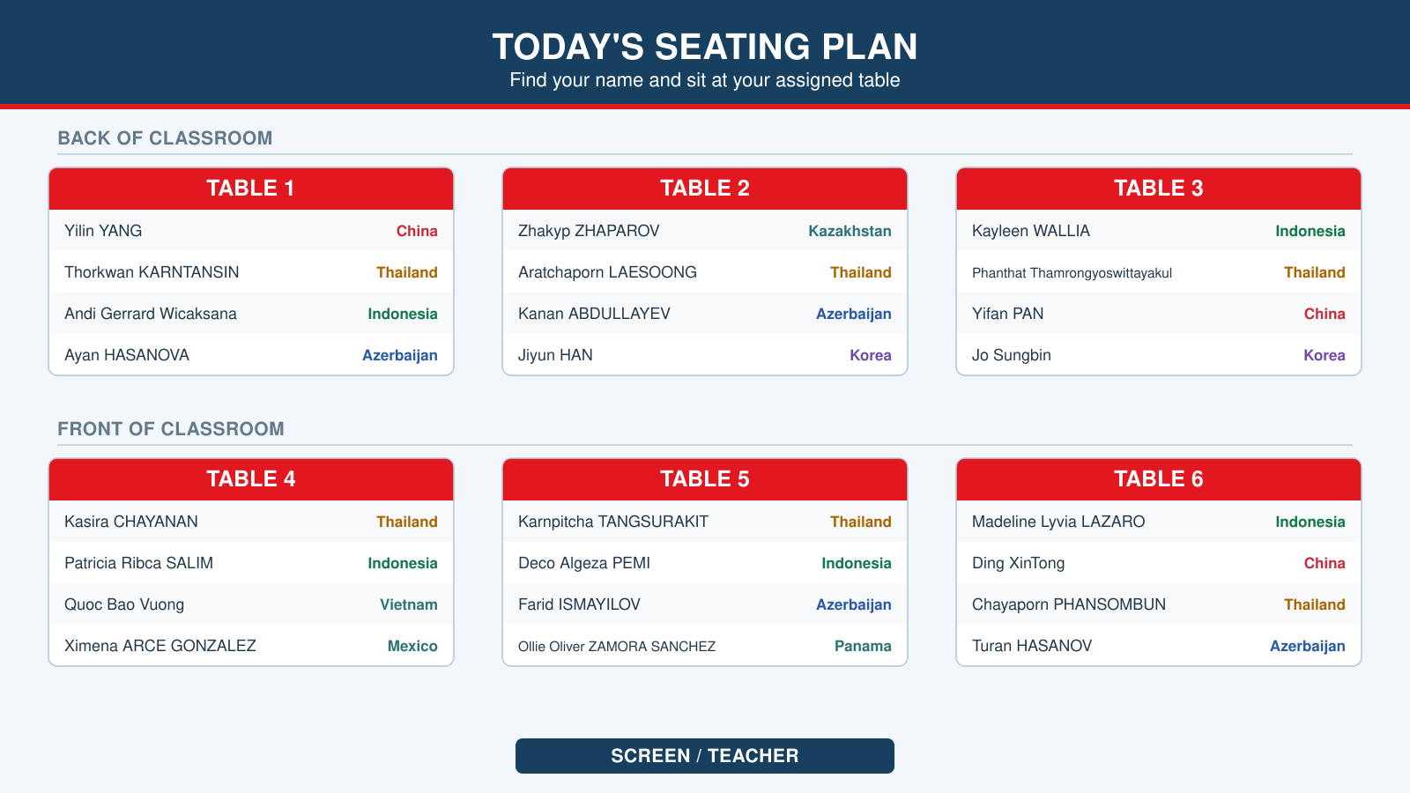

Slide 2
IFY Statistics
Week 2 Class C
Can We Trust
the Survey?
Evidence and decisions
Notes:
90-minute class. C1 and C2 (slides 2–10) 20 minutes. Sampling decisions (11–19) 20 minutes. Returned data and recording (20–23) 15 minutes. Final report (24–25) 5 minutes. Seminar (26–40) 25 minutes. Exit (41–42) 5 minutes. Calculators allowed. Use the first 60 minutes for the canteen investigation.
Purpose: Set up a single investigation
Timing: main canteen investigation 60 minutes, seven seminar rounds 25 minutes, individual exit 5 minutes. Seminar discussions last 2 or 3 minutes, followed immediately by a one-minute answer reveal.
All numerical cases are fictional teaching data. Percentages rounded to two decimal places. Bellerbys design and retained background photographs come from the supplied Class C deck. Seminar cases adapt the two supplied Week 2 seminar question sheets.

Slide 3
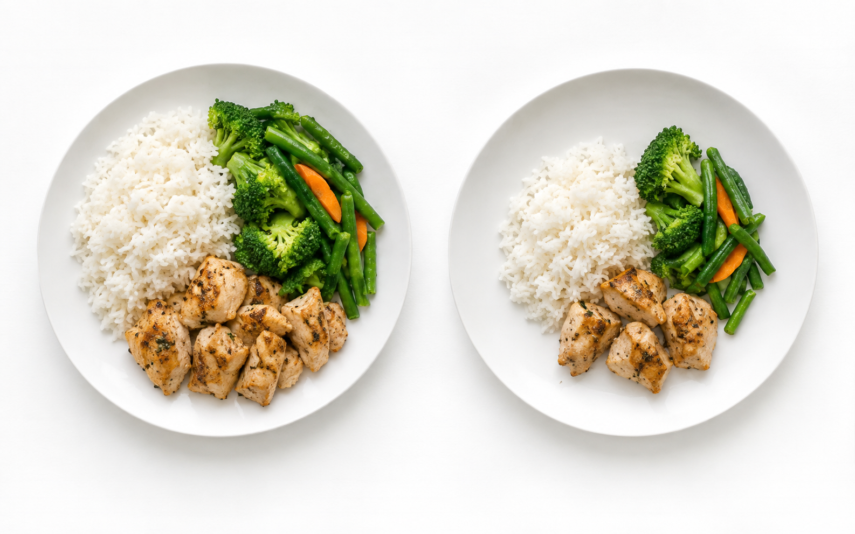
The canteen report
A fictional college has 3,696 students.
Usual: 425 g
Smaller: 315 g
The canteen proposes a smaller portion
alongside its usual portion.
The report claims:
“Around 68% of college students support it.”
“Food waste will fall by around 26%.”
Illustrative portions
2
Notes:
Fictional case. Separate the college opinion claim from the waste claim. The smaller portion is an additional option, not a replacement. Keep this briefing to one minute. The portion picture is illustrative and does not establish actual leftovers.
Purpose: Introduce the claims students must audit
Timing: main canteen investigation 60 minutes, seven seminar rounds 25 minutes, individual exit 5 minutes. Seminar discussions last 2 or 3 minutes, followed immediately by a one-minute answer reveal.
All numerical cases are fictional teaching data. Percentages rounded to two decimal places. Bellerbys design and retained background photographs come from the supplied Class C deck. Seminar cases adapt the two supplied Week 2 seminar question sheets.

Slide 4
HANDOUT C1.1
The evidence behind the waste claim
Independent pilot: same menu, two days, an accurate checked scale.
Portion | Mass served | Meals | Total leftovers
Usual | 425 g | 173 | 14,186 g
Smaller | 315 g | 173 | 15,397 g
a) Calculate the percentage change in portion size and leftovers.
b) What does this evidence establish about the waste claim?
DISCUSS 2 MIN
Explain why the two percentage changes differ.
3
Notes:
Accurate checked scale in this independent pilot. Same menu, different days, 173 meals each day. Students calculate the portion percentage decrease and leftover percentage increase. Equal meal counts make totals comparable on that dimension, but do not establish causal comparability. Allow about 3 minutes work, then reveal.
Purpose: Compare changes in portion size and measured waste
Timing: main canteen investigation 60 minutes, seven seminar rounds 25 minutes, individual exit 5 minutes. Seminar discussions last 2 or 3 minutes, followed immediately by a one-minute answer reveal.
All numerical cases are fictional teaching data. Percentages rounded to two decimal places. Bellerbys design and retained background photographs come from the supplied Class C deck. Seminar cases adapt the two supplied Week 2 seminar question sheets.

Slide 5
HANDOUT C1.1
Two measures, different results
Portion reduction: 425 − 315 = 110 g
Leftovers: 15,397 − 14,186 = 1,211 g
110
1,211
× 100 = 25.88%
× 100 = 8.54%
425
14,186
The pilot recorded more leftovers
alongside smaller portions.
Different days prevent a firm
conclusion about the cause.
4
Notes:
110/425 × 100 = 25.88235%. 1211/14186 × 100 = 8.53659%. Waste rose 8.54% in the two-day pilot, so serving 25.88% less does not establish a 25.88% waste reduction. Different customers, appetite or day effects may remain. More comparable observations are needed.
Purpose: Interpret the numerical contradiction without claiming causation
Timing: main canteen investigation 60 minutes, seven seminar rounds 25 minutes, individual exit 5 minutes. Seminar discussions last 2 or 3 minutes, followed immediately by a one-minute answer reveal.
All numerical cases are fictional teaching data. Percentages rounded to two decimal places. Bellerbys design and retained background photographs come from the supplied Class C deck. Seminar cases adapt the two supplied Week 2 seminar question sheets.

Slide 6
HANDOUT C1.2
What can the missing replies change?
237
143
97
›
›
club members invited
replied
supported
a) Calculate the response rate and support among respondents.
b) Find the lowest and highest possible support percentages
among all 237 invitees.
DISCUSS 3 MIN
Can we establish a majority among the invitees?
5
Notes:
237 environmental-club invitees, 143 valid replies, 97 supporters among replies. The 46 remaining replies did not select support. There are 94 unknown responses. Compute response rate, support among respondents, and minimum/maximum support among all invitees. Students can work briefly individually before the 3-minute discussion. Keep denominators explicit.
Purpose: Use missing data to bound a claim
Timing: main canteen investigation 60 minutes, seven seminar rounds 25 minutes, individual exit 5 minutes. Seminar discussions last 2 or 3 minutes, followed immediately by a one-minute answer reveal.
All numerical cases are fictional teaching data. Percentages rounded to two decimal places. Bellerbys design and retained background photographs come from the supplied Class C deck. Seminar cases adapt the two supplied Week 2 seminar question sheets.

Slide 7
HANDOUT C1.2
The majority claim remains uncertain
Response rate
Support among respondents
143
97
× 100 = 60.34%
× 100 = 67.83%
237
143
Possible support among all 237 invitees
The 94 missing replies | Supporters | Support
None support the option | 97 of 237 | 40.93%
All support the option | 191 of 237 | 80.59%
The unknown replies could change whether a majority supports it.
6
Notes:
Response rate 143/237 = 60.34%. Respondent support 97/143 = 67.83%. The possible support among invitees ranges from 97/237 = 40.93% to (97+94)/237 = 80.59%. These are logical limits under the stated missing-response assumptions, not a confidence interval. Even the invitee majority is unknown. The college population claim has the further club-only selection problem.
Purpose: Explain possible support among invitees
Timing: main canteen investigation 60 minutes, seven seminar rounds 25 minutes, individual exit 5 minutes. Seminar discussions last 2 or 3 minutes, followed immediately by a one-minute answer reveal.
All numerical cases are fictional teaching data. Percentages rounded to two decimal places. Bellerbys design and retained background photographs come from the supplied Class C deck. Seminar cases adapt the two supplied Week 2 seminar question sheets.

Slide 8
HANDOUT C2.1
What needs repairing?
The original investigation had three further problems:
1. Every invitee belonged to the environmental club.
2. “Don’t you agree that smaller portions are an excellent
way to protect the environment?”
3. Its scale recorded leftover masses 12 g too high.
4. EXTRA: Only 143 out of 237 invitees replied.
DISCUSS 2 MIN
Match each fault to a claim. Specify a repair.
The independent pilot used a different, accurate scale.
7
Notes:
Diagnose only the faults not resolved by the missing-response calculation: club-only invitation frame, leading wording and faulty scale in the original investigation. Students match faults to opinion or waste claims and propose specific repairs. The independent pilot in C1 used another accurate checked scale. Limit discussion to 2 minutes.
Purpose: Tie data-collection faults to the claims they threaten
Timing: main canteen investigation 60 minutes, seven seminar rounds 25 minutes, individual exit 5 minutes. Seminar discussions last 2 or 3 minutes, followed immediately by a one-minute answer reveal.
All numerical cases are fictional teaching data. Percentages rounded to two decimal places. Bellerbys design and retained background photographs come from the supplied Class C deck. Seminar cases adapt the two supplied Week 2 seminar question sheets.

Slide 9
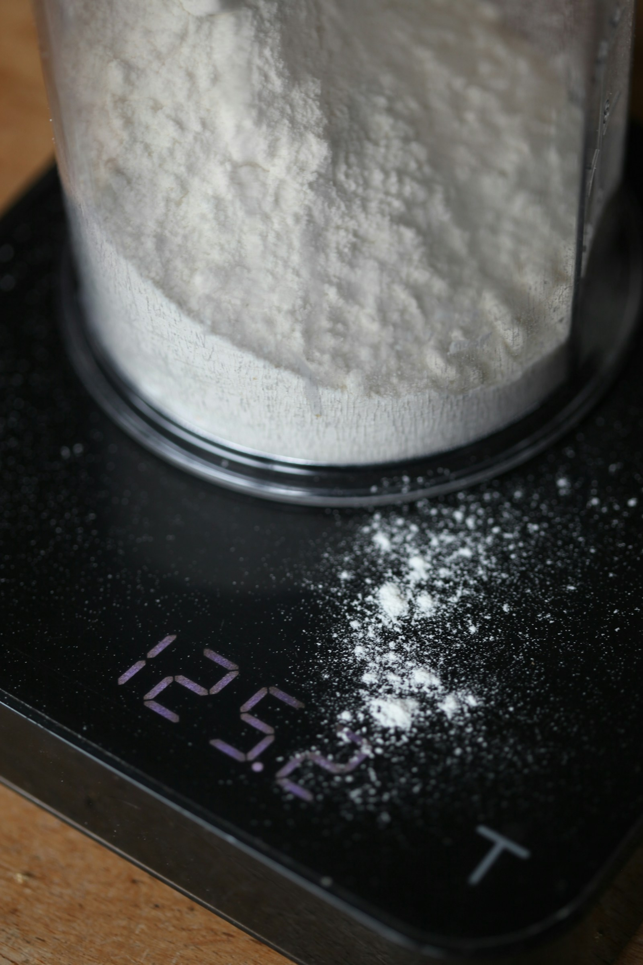
HANDOUT C2.1
Repairs before the next collection
Fault | What it threatens | Repair
Club-only invitations Selection bias | College-wide opinion claim | Use a complete college list.
Leading question Possible response bias | Accuracy of reported opinions | Use neutral wording.
Faulty scale Measurement error | Accuracy of leftover masses | Check and calibrate the scale.
Illustrative scale
Each repair addresses a different part of the data collection.
8
Notes:
Selection bias is about who enters the study; measurement error is about accuracy of recorded data. The leading question may cause response bias. Missing replies were treated in C1.2 and will be revisited through actual response patterns after the new sampling plan. Scale photo is illustrative, not the pilot instrument. Photo: Arwen / Unsplash https://unsplash.com/photos/white-powder-measured-on-a-digital-scale-u3gMcNvqrnI ; Unsplash License.
Purpose: Name the errors and specify actions
Timing: main canteen investigation 60 minutes, seven seminar rounds 25 minutes, individual exit 5 minutes. Seminar discussions last 2 or 3 minutes, followed immediately by a one-minute answer reveal.
All numerical cases are fictional teaching data. Percentages rounded to two decimal places. Bellerbys design and retained background photographs come from the supplied Class C deck. Seminar cases adapt the two supplied Week 2 seminar question sheets.

Slide 10
HANDOUT C2.2
A question that tests the proposal
The actual proposal
Add a 315 g option. Keep the usual 425 g portion available.
Write one neutral survey question with balanced response options.
Ask another pair to explain what your question means.
Check whether they understood the same proposal.
DISCUSS 2 MIN
Write, test and adjust your wording.
9
Notes:
Students write one neutral question about adding the 315 g option alongside the 425 g portion. Response options should allow support, opposition and uncertainty. Partner reads and explains the proposal back. Correct any wording that implies the usual portion is removed. 2 minutes table discussion, brief teacher reveal.
Purpose: Produce and pilot an operational survey question
Timing: main canteen investigation 60 minutes, seven seminar rounds 25 minutes, individual exit 5 minutes. Seminar discussions last 2 or 3 minutes, followed immediately by a one-minute answer reveal.
All numerical cases are fictional teaching data. Percentages rounded to two decimal places. Bellerbys design and retained background photographs come from the supplied Class C deck. Seminar cases adapt the two supplied Week 2 seminar question sheets.

Slide 11
HANDOUT C2.2
One usable survey question
“The canteen is considering offering a smaller portion
alongside its usual portion. Would you support this option?”
Support | Oppose | Unsure
This records opinion about offering a choice.
The waste claim still requires measurements of leftovers.
10
Notes:
Accept equivalent neutral wording. This question measures support for offering a choice. Actual waste must be measured separately. Do not restart a generic lesson on leading questions. Finish the report-and-repair stage by minute 20.
Purpose: Consolidate the survey wording before selecting people
Timing: main canteen investigation 60 minutes, seven seminar rounds 25 minutes, individual exit 5 minutes. Seminar discussions last 2 or 3 minutes, followed immediately by a one-minute answer reveal.
All numerical cases are fictional teaching data. Percentages rounded to two decimal places. Bellerbys design and retained background photographs come from the supplied Class C deck. Seminar cases adapt the two supplied Week 2 seminar question sheets.

Slide 12
The sampling brief
College information | Number
Business | 2,173
Engineering | 1,523
Total students | 3,696
Target invitations | 176
Goal: college-wide opinions
and separate findings for
each programme.
84 classes × 44 students
Each student belongs to one class.
Classes may mix programmes.
Complete student, programme and class lists are available.
11
Notes:
3,696 enrolled students: 2,173 Business and 1,523 Engineering. Select 176 invitations. 84 non-overlapping classes of 44 students, potentially mixed programmes. Complete current individual, programme and class lists exist. Need college-wide opinions and separate programme findings. No artificial online-versus-four-class-visit constraint.
Purpose: Define the frame and sampling goals once
Timing: main canteen investigation 60 minutes, seven seminar rounds 25 minutes, individual exit 5 minutes. Seminar discussions last 2 or 3 minutes, followed immediately by a one-minute answer reveal.
All numerical cases are fictional teaching data. Percentages rounded to two decimal places. Bellerbys design and retained background photographs come from the supplied Class C deck. Seminar cases adapt the two supplied Week 2 seminar question sheets.

Slide 13
HANDOUT C3.1
Two ways to draw 176 students
Procedure A
Procedure B
Uniformly select 176 different IDs
from 1–3,696.
Form 1,848 fixed pairs.
Randomly select 88 different pairs.
Invite both students in each pair.
Example pairs: 1 with 1,849; 2 with 1,850.
a) What fraction of students does each procedure select?
b) Which is a simple random sample of individual students?
DISCUSS 3 MIN
Describe a group that procedure B cannot select.
12
Notes:
A selects 176 distinct IDs uniformly without replacement. B randomly selects 88 of 1,848 fixed pairs and invites both members. Pairs are fixed before selection: ID r with ID r+1848. Both procedures give every individual the same 1/21 inclusion chance, but only A allows every possible 176-person subset. Explain with one impossible group under B. This deepens the previously taught definition of SRS without introducing new probability formulas.
Purpose: Distinguish an SRS of people from random selection of fixed pairs
Timing: main canteen investigation 60 minutes, seven seminar rounds 25 minutes, individual exit 5 minutes. Seminar discussions last 2 or 3 minutes, followed immediately by a one-minute answer reveal.
All numerical cases are fictional teaching data. Percentages rounded to two decimal places. Bellerbys design and retained background photographs come from the supplied Class C deck. Seminar cases adapt the two supplied Week 2 seminar question sheets.

Slide 14
HANDOUT C3.1
Which groups can be selected?
176
= 1/21 ≈ 4.76%
3,696
Procedure A gives every group of 176 students the same chance.
A possible group of 176 | Procedure A | Procedure B
Includes ID 1 but excludes ID 1,849 | Possible | Impossible
Both give each student a 1/21 chance. Only A is an SRS of individuals.
13
Notes:
176/3696 = 1/21 = 4.7619%. Under B, ID 1 cannot enter without ID 1849. A sample containing 1 but not 1849 is possible under A and impossible under B. B is random selection of pairs, essentially cluster sampling with pairs. It is not an SRS of individuals and is not automatically biased. Avoid suggesting that all non-SRS methods are invalid.
Purpose: Explain why equal individual chances alone are insufficient
Timing: main canteen investigation 60 minutes, seven seminar rounds 25 minutes, individual exit 5 minutes. Seminar discussions last 2 or 3 minutes, followed immediately by a one-minute answer reveal.
All numerical cases are fictional teaching data. Percentages rounded to two decimal places. Bellerbys design and retained background photographs come from the supplied Class C deck. Seminar cases adapt the two supplied Week 2 seminar question sheets.

Slide 15
HANDOUT C3.2
A systematic selection record
Population: 3,696. Target: 176. The fifth selected ID is 97.
a) Find the interval and starting ID.
1st
2nd
3rd
4th
5th
?
?
?
?
97
b) Can these IDs prove that the starting ID was chosen randomly?
What would you need to check?
14
Notes:
Same N=3696 and n=176. Fifth selected ID 97. Find k=21, then r=97−4×21=13. Ask whether the output proves a random start. It does not: the same sequence could result from a random start or a chosen favourite. Require a recorded random selection from 1–21. No repeated reverse-interval exercise here.
Purpose: Reconstruct an interval and distinguish process evidence from output
Timing: main canteen investigation 60 minutes, seven seminar rounds 25 minutes, individual exit 5 minutes. Seminar discussions last 2 or 3 minutes, followed immediately by a one-minute answer reveal.
All numerical cases are fictional teaching data. Percentages rounded to two decimal places. Bellerbys design and retained background photographs come from the supplied Class C deck. Seminar cases adapt the two supplied Week 2 seminar question sheets.

Slide 16
HANDOUT C3.2
The sequence and the procedure
3,696
Four jumps precede the fifth ID:
r + 4(21) = 97, so r = 13
= 21
176
+21
+21
+21
+21
13
34
55
76
97
The same sequence could follow a random start or a chosen favourite.
Check that the researcher chose the start randomly from 1–21.
15
Notes:
k=21, r=13; first five are 13,34,55,76,97. Four jumps precede the fifth ID. A valid systematic random-start procedure chooses uniformly from 1–21. The sequence alone does not reveal how 13 was selected. Later seminar case examines repeating list patterns.
Purpose: Separate recoverable information from an unverified assumption
Timing: main canteen investigation 60 minutes, seven seminar rounds 25 minutes, individual exit 5 minutes. Seminar discussions last 2 or 3 minutes, followed immediately by a one-minute answer reveal.
All numerical cases are fictional teaching data. Percentages rounded to two decimal places. Bellerbys design and retained background photographs come from the supplied Class C deck. Seminar cases adapt the two supplied Week 2 seminar question sheets.

Slide 17
HANDOUT C3.3
The total is right. Is the split closest?
Allocate 176 invitations proportionally between the programmes.
Programme | Population | Proposed invitations
Business | 2,173 | 104
Engineering | 1,523 | 72
Total | 3,696 | 176
Calculate the ideal allocations. Is the proposed split the closest?
DISCUSS 3 MIN
Justify the rounding and the selection process.
16
Notes:
Both 104+72 and 103+ 73 total 176, so simple addition cannot resolve the question. Compute ideal quotas, then choose the nearest whole-number allocation that preserves the target. Ask for random selection within programme lists. Do not call the less-close allocation an invalid sample.
Purpose: Improve a plausible proportional allocation
Timing: main canteen investigation 60 minutes, seven seminar rounds 25 minutes, individual exit 5 minutes. Seminar discussions last 2 or 3 minutes, followed immediately by a one-minute answer reveal.
All numerical cases are fictional teaching data. Percentages rounded to two decimal places. Bellerbys design and retained background photographs come from the supplied Class C deck. Seminar cases adapt the two supplied Week 2 seminar question sheets.

Slide 18
HANDOUT C3.3
The closest whole-number allocation
Business
2,173
103 Business + 73 Engineering = 176
× 176 = 103.476…
3,696
Engineering
104 and 72 give the right total,
but 103 and 73 are closer to
the unrounded allocations.
1,523
× 176 = 72.524…
3,696
Select randomly within each programme list.
17
Notes:
Ideal Business quota = 103.476190476, Engineering = 72.523809524. Nearest allocation is 103 and 73, each 0.47619 from ideal; 104 and 72 each 0.52381 away. The alternative has the correct total but is less close to proportionality. Random selection within each programme is essential.
Purpose: Justify rounding using unrounded quotas
Timing: main canteen investigation 60 minutes, seven seminar rounds 25 minutes, individual exit 5 minutes. Seminar discussions last 2 or 3 minutes, followed immediately by a one-minute answer reveal.
All numerical cases are fictional teaching data. Percentages rounded to two decimal places. Bellerbys design and retained background photographs come from the supplied Class C deck. Seminar cases adapt the two supplied Week 2 seminar question sheets.

Slide 19
HANDOUT C3.4
What if we sample whole classes?
An alternative selects four classes randomly from all 84,
then invites every student in those classes.
Programme | College | Selected sample
Business | 2,173 | 147
Engineering | 1,523 | 29
a) Compare Engineering’s percentage in the college and sample.
b) Which plan best supports separate programme findings next time?
DISCUSS 3 MIN
Does this outcome prove a biased selection procedure?
18
Notes:
Four classes selected uniformly from 84; invite every student, giving 176. Observed composition 147 Business and 29 Engineering. Engineering population share 1523/3696=41.2067%; sample 29/176=16.4773%. Does this one difference establish systematic bias? No. Which design best supports separate programme findings next? Stratified selection gives planned programme counts.
Purpose: Interpret a realised cluster sample and compare fitness for purpose
Timing: main canteen investigation 60 minutes, seven seminar rounds 25 minutes, individual exit 5 minutes. Seminar discussions last 2 or 3 minutes, followed immediately by a one-minute answer reveal.
All numerical cases are fictional teaching data. Percentages rounded to two decimal places. Bellerbys design and retained background photographs come from the supplied Class C deck. Seminar cases adapt the two supplied Week 2 seminar question sheets.

Slide 20
HANDOUT C3.4
What the imbalance establishes
Engineering is underrepresented
in this particular draw.
Randomly selecting whole classes
can produce imbalanced samples.
This one result does not prove bias.
For the next collection, invite 103 Business and 73 Engineering students,
with random selection within each programme.
19
Notes:
This is a cluster sample, and a realised imbalance alone does not prove a biased procedure. Cluster homogeneity can increase sampling variability. With programme lists available and a goal of separate findings, use 103/73 planned invitations and random selection within each programme. This choice leads directly to the returned-data exercise. Finish sampling decisions by minute 40.
Purpose: Choose planned representation without mislabelling random variation
Timing: main canteen investigation 60 minutes, seven seminar rounds 25 minutes, individual exit 5 minutes. Seminar discussions last 2 or 3 minutes, followed immediately by a one-minute answer reveal.
All numerical cases are fictional teaching data. Percentages rounded to two decimal places. Bellerbys design and retained background photographs come from the supplied Class C deck. Seminar cases adapt the two supplied Week 2 seminar question sheets.

Slide 21
HANDOUT C3.5
Who replied to the repaired survey?
The team uses the stratified plan. These questionnaires come back:
Programme | Invited | Replied
Business | 103 | 84
Engineering | 73 | 24
Total | 176 | 108
a) Find each response rate and Engineering’s share of respondents.
DISCUSS 3 MIN
Propose a follow-up based on the pattern you find.
20
Notes:
The team adopts 103 Business + 73 Engineering invitations. 84 Business and 24 Engineering students reply. Compute each programme response rate, then Engineering share of 108 respondents. Propose follow-up aimed at selected nonrespondents. Invitation target is not guaranteed response size. Allow about 3 minutes calculation/discussion.
Purpose: Measure how response patterns alter composition
Timing: main canteen investigation 60 minutes, seven seminar rounds 25 minutes, individual exit 5 minutes. Seminar discussions last 2 or 3 minutes, followed immediately by a one-minute answer reveal.
All numerical cases are fictional teaching data. Percentages rounded to two decimal places. Bellerbys design and retained background photographs come from the supplied Class C deck. Seminar cases adapt the two supplied Week 2 seminar question sheets.

Slide 22
HANDOUT C3.5
A new problem after selection
Engineering’s share
of all 108 respondents
24
× 100 = 22.22%
108
Follow up originally selected Engineering nonrespondents first.
Offer an accessible way to respond, then continue other follow-ups.
Bias depends on whether missing students hold different relevant views.
21
Notes:
Business response 84/103=81.5534%; Engineering 24/73=32.8767%. Engineering respondent share 24/108=22.2222%. Prioritise accessible reminders or alternative response modes for originally selected Engineering nonrespondents; continue follow-up for other selected nonrespondents too. Composition differences raise concern but opinion bias depends on relevant response differences. Do not replace missing students with convenient friends or claim follow-up guarantees no bias.
Purpose: Design follow-up from observed response differences
Timing: main canteen investigation 60 minutes, seven seminar rounds 25 minutes, individual exit 5 minutes. Seminar discussions last 2 or 3 minutes, followed immediately by a one-minute answer reveal.
All numerical cases are fictional teaching data. Percentages rounded to two decimal places. Bellerbys design and retained background photographs come from the supplied Class C deck. Seminar cases adapt the two supplied Week 2 seminar question sheets.

Slide 23
HANDOUT C4.1
The canteen data record
Categorical or quantitative? If quantitative: discrete or continuous.
Explain C, D and G. Which variable directly measures food waste?
Item | Recorded variable
A | Student ID: 03752
B | Programme code: 1 Business / 2 Engineering
C | Meals bought in seven days: 8
D | Portion mass rounded to the nearest gram: 315 g
E | Exact waiting time, recorded as 7.3 minutes
F | Waiting-time band: under 5 / 5–10 / over 10 min
G | Opinion code: 1 Support / 2 Oppose / 3 Unsure
H | Leftover mass rounded to the nearest gram: 84 g
22
Notes:
Eight canteen variables replace unrelated height/household examples. Classify categorical versus quantitative and, for quantitative variables, discrete versus continuous. C and D contrast a count with a rounded measurement; G is a numeric code for a category. H directly measures waste, D measures amount served. Underlying measured mass/time remain continuous even when recorded to a given precision.
Purpose: Audit variables from the same investigation
Timing: main canteen investigation 60 minutes, seven seminar rounds 25 minutes, individual exit 5 minutes. Seminar discussions last 2 or 3 minutes, followed immediately by a one-minute answer reveal.
All numerical cases are fictional teaching data. Percentages rounded to two decimal places. Bellerbys design and retained background photographs come from the supplied Class C deck. Seminar cases adapt the two supplied Week 2 seminar question sheets.

Slide 24
HANDOUT C4.1
Recording choices and data types
Item | Classification | Reason
A | Categorical | An identifier.
B | Categorical | Numbers stand for programmes.
C | Quantitative, discrete | A count of meals.
D | Quantitative, continuous | Mass is measured, then rounded.
E | Quantitative, continuous | Time is measured.
F | Categorical | The recorded result is a band.
G | Categorical | Numbers stand for opinion labels.
H | Quantitative, continuous | Mass is measured, then rounded.
H measures waste. D measures the amount served.
23
Notes:
A ID and B programme code are categorical; C meals bought discrete; D portion mass and E exact waiting time continuous; F waiting-time band and G opinion code categorical; H leftover mass continuous. A numeric code does not make data quantitative. Converting waiting time to a band changes the recorded variable. Finish returned-data and recording stage by minute 55.
Purpose: Justify the difficult classifications
Timing: main canteen investigation 60 minutes, seven seminar rounds 25 minutes, individual exit 5 minutes. Seminar discussions last 2 or 3 minutes, followed immediately by a one-minute answer reveal.
All numerical cases are fictional teaching data. Percentages rounded to two decimal places. Bellerbys design and retained background photographs come from the supplied Class C deck. Seminar cases adapt the two supplied Week 2 seminar question sheets.

Slide 25
HANDOUT C4.2
The college needs a corrected report
Write a corrected report in three sentences, up to 75 words.
1. State what the original support figures establish.
2. State what the pilot establishes about portions and waste.
3. Explain what further evidence or action the college needs.
DISCUSS 3 MIN
Use the evidence already calculated. Keep the claims precise.
24
Notes:
3-minute table discussion. Write up to 75 words in three sentences: what support data establish, what pilot measurements establish, and what further action is needed. Do not redo calculations or give formal presentations. This is the final product of the connected case. Spend remaining 2 minutes checking against the model.
Purpose: Synthesize the investigation into a defensible short conclusion
Timing: main canteen investigation 60 minutes, seven seminar rounds 25 minutes, individual exit 5 minutes. Seminar discussions last 2 or 3 minutes, followed immediately by a one-minute answer reveal.
All numerical cases are fictional teaching data. Percentages rounded to two decimal places. Bellerbys design and retained background photographs come from the supplied Class C deck. Seminar cases adapt the two supplied Week 2 seminar question sheets.

Slide 26
HANDOUT C4.2
A defensible report
“Among the 143 club respondents, 67.83% supported the option,
while support across all 3,696 students remains unknown.
The portion was 25.88% smaller, while leftovers rose 8.54%
in the two-day pilot.
Before a college-wide decision, collect waste measurements
over more comparable days and complete the repaired survey
with follow-up of selected nonrespondents.”
25
Notes:
Accept equivalent claims with correctly defined groups and caveats. Original 67.83% is among 143 club respondents. Accurate pilot shows portion−25.88% and leftovers+8.54%, without proving causation. The new invitation method fixes a frame/allocation problem but uneven response remains. End main case at minute 60. This completes the investigation; do not add another review or presentation stage.
Purpose: Model a concise conclusion that matches the evidence
Timing: main canteen investigation 60 minutes, seven seminar rounds 25 minutes, individual exit 5 minutes. Seminar discussions last 2 or 3 minutes, followed immediately by a one-minute answer reveal.
All numerical cases are fictional teaching data. Percentages rounded to two decimal places. Bellerbys design and retained background photographs come from the supplied Class C deck. Seminar cases adapt the two supplied Week 2 seminar question sheets.

Slide 27
Seven short
discussions
All tables answer the same question.
Discuss for 2–3 minutes.
Then check the potential answer.
Notes:
All tables discuss the same displayed question. Each question is immediately followed by its potential answer. No presentations or audience challenges. Discussion times are 2, 3, 3, 2, 2, 3 and 3 minutes: 18 minutes in total. Allow around one minute for each answer, making 25 minutes. Begin at minute 60. The future handout should give every student space for all seven questions.
Purpose: Explain the changed seminar routine
Timing: main canteen investigation 60 minutes, seven seminar rounds 25 minutes, individual exit 5 minutes. Seminar discussions last 2 or 3 minutes, followed immediately by a one-minute answer reveal.
All numerical cases are fictional teaching data. Percentages rounded to two decimal places. Bellerbys design and retained background photographs come from the supplied Class C deck. Seminar cases adapt the two supplied Week 2 seminar question sheets.

Slide 28
HANDOUT C5.1
1. Whose population?
Warehouse A inspects all 60,000 units in its current stock.
5,000 are defective: 8.33%. The company has eight warehouses.
Research concerns | How should we describe the evidence?
Warehouse A’s current stock | Population or sample? Parameter or statistic?
Current stock across all eight warehouses | Population or sample? Parameter or statistic?
DISCUSS 2 MIN
Explain why the same records can have different labels.
27
Notes:
Combine the original seminar questions on changing the population and the inventory parameter. Warehouse A inspects every one of its 60,000 current units. The company has eight warehouses. The given 8.33% is a parameter for Warehouse A and a statistic when the target is all company inventory. Discuss for two minutes. Focus on the defined population, not percentage arithmetic.
Purpose: Transfer parameter/statistic and population/sample to a changed scope
Timing: main canteen investigation 60 minutes, seven seminar rounds 25 minutes, individual exit 5 minutes. Seminar discussions last 2 or 3 minutes, followed immediately by a one-minute answer reveal.
All numerical cases are fictional teaching data. Percentages rounded to two decimal places. Bellerbys design and retained background photographs come from the supplied Class C deck. Seminar cases adapt the two supplied Week 2 seminar question sheets.

Slide 29
HANDOUT C5.1
1. Potential answer
Defined population | The inspected units | The 8.33%
Warehouse A’s current stock | The whole population | A parameter
All eight warehouses’ current stock | A sample of that population | A statistic
Inspecting one complete warehouse does not establish
the defective percentage across the entire company.
28
Notes:
The same inspected records can be the entire population for one research question and a sample for another. Inspecting one warehouse does not establish the company-wide defective percentage. A sample statistic can be calculated even when the sample has not been shown to be representative.
Purpose: Explain why classification depends on the target population
Timing: main canteen investigation 60 minutes, seven seminar rounds 25 minutes, individual exit 5 minutes. Seminar discussions last 2 or 3 minutes, followed immediately by a one-minute answer reveal.
All numerical cases are fictional teaching data. Percentages rounded to two decimal places. Bellerbys design and retained background photographs come from the supplied Class C deck. Seminar cases adapt the two supplied Week 2 seminar question sheets.

Slide 30

HANDOUT C5.2
2. A cleaner streaming dataset?
A streaming survey randomly selects 157 students.
117 reply. Of those, 19 report zero spending.
The analyst removes the 19 zeros and adds 40 volunteers
to replace the students who did not reply.
1. How many records are in the final dataset?
2. Identify two problems with these changes.
3. Explain how to repair the process.
Illustrative photograph
DISCUSS 3 MIN
Explain which records should remain and whom to contact.
29
Notes:
Three-minute discussion. Final count: 117 minus 19 plus 40 equals 138. The 19 zero-spending responses are valid observations. The 40 volunteers were not obtained through the original selection process. Keep all 117 valid original responses and follow up the 40 originally selected nonrespondents. Photo: charlesdeluvio / Unsplash, https://unsplash.com/photos/person-using-silver-and-black-laptop-computer-jtmwD4i4v1U . Unsplash License.
Purpose: Audit exclusion of valid zeros and volunteer replacement
Timing: main canteen investigation 60 minutes, seven seminar rounds 25 minutes, individual exit 5 minutes. Seminar discussions last 2 or 3 minutes, followed immediately by a one-minute answer reveal.
All numerical cases are fictional teaching data. Percentages rounded to two decimal places. Bellerbys design and retained background photographs come from the supplied Class C deck. Seminar cases adapt the two supplied Week 2 seminar question sheets.

Slide 31
HANDOUT C5.2
2. Potential answer
117 − 19 + 40 = 138 records
Change | Problem | Repair
Remove 19 zeros | Zero spending is valid data. | Keep all 117 original valid replies.
Add 40 volunteers | Volunteers enter by a different selection process. | Follow up the 40 originally selected nonrespondents.
The final dataset contains 98 original respondents and 40 volunteers.
30
Notes:
The final dataset contains 98 original respondents and 40 volunteers. Excluding valid zeros alone raises the average for the original respondent group. The effect of adding volunteers is unknown from the supplied information. Students should repair both exclusions and recruitment, rather than treating the final count as evidence of quality.
Purpose: Repair the process instead of valuing a larger cleaned dataset
Timing: main canteen investigation 60 minutes, seven seminar rounds 25 minutes, individual exit 5 minutes. Seminar discussions last 2 or 3 minutes, followed immediately by a one-minute answer reveal.
All numerical cases are fictional teaching data. Percentages rounded to two decimal places. Bellerbys design and retained background photographs come from the supplied Class C deck. Seminar cases adapt the two supplied Week 2 seminar question sheets.

Slide 32
HANDOUT C5.3
3. Equal numbers, equal chances?
The city randomly selects 50 residents from each age group.
Age in completed years | Population | Selected
0–18 | 1,846 | 50
19–40 | 3,927 | 50
41 and above | 2,615 | 50
a) Is the plan stratified? Is it proportional?
b) Find each selection chance. Compare the highest with the lowest.
DISCUSS 3 MIN
Compare the highest and lowest chances using a ratio.
31
Notes:
Three-minute discussion. The age groups contain 1,846, 3,927 and 2,615 residents. Select 50 uniformly without replacement from each. Inclusion chances are 50 divided by each group population. This is stratified sampling but not proportional allocation. The youngest group has the highest selection chance. The ratio of highest to lowest is 3,927 divided by 1,846, approximately 2.13.
Purpose: Quantify unequal selection probabilities within a stratified design
Timing: main canteen investigation 60 minutes, seven seminar rounds 25 minutes, individual exit 5 minutes. Seminar discussions last 2 or 3 minutes, followed immediately by a one-minute answer reveal.
All numerical cases are fictional teaching data. Percentages rounded to two decimal places. Bellerbys design and retained background photographs come from the supplied Class C deck. Seminar cases adapt the two supplied Week 2 seminar question sheets.

Slide 33
HANDOUT C5.3
3. Potential answer
Stratified: yes. Proportional: no, because group sizes differ.
Age group | Calculation | Selection chance
0–18 | 50 ÷ 1,846 | 2.71%
19–40 | 50 ÷ 3,927 | 1.27%
41 and above | 50 ÷ 2,615 | 1.91%
Highest: 0–18. Lowest: 19–40.
3,927
≈ 2.13 times
1,846
32
Notes:
Unrounded percentages are 2.708559%, 1.273237% and 1.912046%. Use unrounded values to compare chances. Equal sample counts do not give every resident an equal chance when the population groups differ in size. Equal or disproportionate allocations can still be stratified. Weighting an overall estimate is outside this class.
Purpose: Distinguish stratification from proportionality and equal individual chances
Timing: main canteen investigation 60 minutes, seven seminar rounds 25 minutes, individual exit 5 minutes. Seminar discussions last 2 or 3 minutes, followed immediately by a one-minute answer reveal.
All numerical cases are fictional teaching data. Percentages rounded to two decimal places. Bellerbys design and retained background photographs come from the supplied Class C deck. Seminar cases adapt the two supplied Week 2 seminar question sheets.

Slide 34
HANDOUT C5.4
4. Who is at home?
A health survey randomly selects 10 neighbourhoods.
Interviewers attempt every household on the complete lists.
They visit only between 9 and 11 am on Tuesday.
They make no return visits.
Who might be missed? When could this distort the health findings?
Can you predict the direction? Give one practical repair.
DISCUSS 2 MIN
Connect the missing households to the survey topic.
33
Notes:
Two-minute discussion. A complete household list is available, so the stated problem concerns contact and nonresponse rather than list coverage. Daytime workers or students may be absent. Relevant health differences between respondents and nonrespondents would be needed for nonresponse bias. Its direction cannot be inferred from being absent alone.
Purpose: Identify a plausible mechanism and avoid an unsupported bias direction
Timing: main canteen investigation 60 minutes, seven seminar rounds 25 minutes, individual exit 5 minutes. Seminar discussions last 2 or 3 minutes, followed immediately by a one-minute answer reveal.
All numerical cases are fictional teaching data. Percentages rounded to two decimal places. Bellerbys design and retained background photographs come from the supplied Class C deck. Seminar cases adapt the two supplied Week 2 seminar question sheets.

Slide 35
HANDOUT C5.4
4. Potential answer
Daytime workers or students may be absent.
Bias can occur if missing households have different health outcomes.
The facts do not show whether health would look better or worse.
Repair: return to the same households in the evening or at weekends.
Offer another accessible way to respond.
34
Notes:
Accept evening or weekend return visits to the originally selected households, or accessible alternative response modes. Students must connect missing households with differences in the health outcome. Randomly choosing neighbourhoods does not control what happens at the response stage.
Purpose: Connect missing households to relevant health differences
Timing: main canteen investigation 60 minutes, seven seminar rounds 25 minutes, individual exit 5 minutes. Seminar discussions last 2 or 3 minutes, followed immediately by a one-minute answer reveal.
All numerical cases are fictional teaching data. Percentages rounded to two decimal places. Bellerbys design and retained background photographs come from the supplied Class C deck. Seminar cases adapt the two supplied Week 2 seminar question sheets.

Slide 36
HANDOUT C5.5
5. Which headline is justified?
120 Boston residents report their holiday preferences.
A. “35% of Boston residents
prefer Massachusetts.”
B. “Massachusetts is the top choice
among the 120 respondents.”
C. “The sample is representative
because the percentages total 100.”
DISCUSS 2 MIN
Choose a supported headline. Rewrite an unsupported one.
35
Notes:
Two-minute discussion. Original Boston survey context: 120 residents, percentages 10, 25, 20, 35 and 10. B is supported because Massachusetts has the largest reported category. A overgeneralises to all Boston residents. C mistakes complete percentage totals for representative selection. Students rewrite one unsupported headline.
Purpose: Choose and repair a claim from the Boston evidence
Timing: main canteen investigation 60 minutes, seven seminar rounds 25 minutes, individual exit 5 minutes. Seminar discussions last 2 or 3 minutes, followed immediately by a one-minute answer reveal.
All numerical cases are fictional teaching data. Percentages rounded to two decimal places. Bellerbys design and retained background photographs come from the supplied Class C deck. Seminar cases adapt the two supplied Week 2 seminar question sheets.

Slide 37
HANDOUT C5.5
5. Potential answer
B is supported: 35% is the largest reported category.
A can become:
“Among the 120 surveyed residents, 35% selected Massachusetts.”
A total of 100% does not establish representativeness.
We still need the selection process, coverage and response information.
36
Notes:
The corrected claim refers specifically to the 120 surveyed residents. A total of 100% only shows that the reported categories account for the whole set of responses. Information about selection, list coverage and nonresponse is still needed before assessing representativeness.
Purpose: Make a correct statement without overgeneralising the sample
Timing: main canteen investigation 60 minutes, seven seminar rounds 25 minutes, individual exit 5 minutes. Seminar discussions last 2 or 3 minutes, followed immediately by a one-minute answer reveal.
All numerical cases are fictional teaching data. Percentages rounded to two decimal places. Bellerbys design and retained background photographs come from the supplied Class C deck. Seminar cases adapt the two supplied Week 2 seminar question sheets.

Slide 38
HANDOUT C5.6
6. A pattern in the register
Each block of 21 register positions has 20 day students,
then one evening student. Select every 21st student.
Block | Day students | Evening student
1 | Positions 1–20 | Position 21
2 | Positions 22–41 | Position 42
3 | Positions 43–62 | Position 63
a) What happens with random start 13? With random start 21?
DISCUSS 3 MIN
Does a random start solve this pattern? Suggest a change.
37
Notes:
Three-minute discussion. Each complete block of 21 positions contains 20 day students and one evening student. Choose the random start uniformly from 1 to 21. Start 13 selects only day students. Start 21 selects only evening students. The repeating ordering makes the sample composition depend sharply on the start.
Purpose: Expose systematic-sampling variation caused by periodic ordering
Timing: main canteen investigation 60 minutes, seven seminar rounds 25 minutes, individual exit 5 minutes. Seminar discussions last 2 or 3 minutes, followed immediately by a one-minute answer reveal.
All numerical cases are fictional teaching data. Percentages rounded to two decimal places. Bellerbys design and retained background photographs come from the supplied Class C deck. Seminar cases adapt the two supplied Week 2 seminar question sheets.

Slide 39
HANDOUT C5.6
6. Potential answer
Random start | First selected positions | Who enters?
13 | 13, 34, 55, 76, … | Day students only
21 | 21, 42, 63, 84, … | Evening students only
The interval keeps selecting the same position in each block.
Sample composition varies sharply with the random start.
Randomly shuffle the list first, or use strata if both groups must appear.
38
Notes:
The interval repeatedly lands in the same position within each block. Each individual still has an equal inclusion chance if the register consists of complete blocks. The extreme realised composition illustrates sampling variability, not proof of systematic bias. Shuffle the register uniformly first, or stratify if inclusion of both groups is required.
Purpose: Offer a procedural change and distinguish variation from bias
Timing: main canteen investigation 60 minutes, seven seminar rounds 25 minutes, individual exit 5 minutes. Seminar discussions last 2 or 3 minutes, followed immediately by a one-minute answer reveal.
All numerical cases are fictional teaching data. Percentages rounded to two decimal places. Bellerbys design and retained background photographs come from the supplied Class C deck. Seminar cases adapt the two supplied Week 2 seminar question sheets.

Slide 40
HANDOUT C5.7
7. A method that fits the job
Choose a method and one clear selection step for each case.
Case | Practical requirements
A. Online university survey | Complete contact list. Select 157 of 4,286 students.
B. Programme comparison | 3,287 students, including 148 Engineers. Of 173 invitations, at least 40 must go to Engineers.
C. In-person health study | 137 villages. The team can visit six villages and contact every household there.
DISCUSS 3 MIN
Make each procedure meet the stated constraints.
39
Notes:
Three-minute discussion. All tables answer all three cases. A has a complete university list and online contact. B requires at least 40 Engineers among 173 invitations, despite Engineers being a small population group. C can visit only six of 137 villages. Require one clear selection step as well as a method name. No presentations.
Purpose: Choose implementable procedures under three different constraints
Timing: main canteen investigation 60 minutes, seven seminar rounds 25 minutes, individual exit 5 minutes. Seminar discussions last 2 or 3 minutes, followed immediately by a one-minute answer reveal.
All numerical cases are fictional teaching data. Percentages rounded to two decimal places. Bellerbys design and retained background photographs come from the supplied Class C deck. Seminar cases adapt the two supplied Week 2 seminar question sheets.

Slide 41
HANDOUT C5.7
7. Potential answers
Case | Suitable method | Selection step
A | Simple random | Select 157 distinct student IDs uniformly.
B | Stratified | Randomly select 40 Engineers and 133 other students from separate lists.
C | Cluster | Randomly select six villages, then attempt every household within them.
B deliberately uses unequal selection chances to include the smaller group.
40
Notes:
A: select 157 distinct IDs uniformly from 1 to 4,286. B: randomly select 40 Engineers from the Engineering list and 133 students from the other-student list; other feasible allocations also satisfy the minimum. C: randomly select six villages and attempt every household in those villages. Accept other feasible, justified procedures. Mention remaining nonresponse or cluster-variability limitations briefly. Finish the seminar at minute 85.
Purpose: Check that methods satisfy the stated constraints
Timing: main canteen investigation 60 minutes, seven seminar rounds 25 minutes, individual exit 5 minutes. Seminar discussions last 2 or 3 minutes, followed immediately by a one-minute answer reveal.
All numerical cases are fictional teaching data. Percentages rounded to two decimal places. Bellerbys design and retained background photographs come from the supplied Class C deck. Seminar cases adapt the two supplied Week 2 seminar question sheets.

Slide 42
HANDOUT C6
What can this report tell you?
Another college numbers its student register from 1 to N.
Work independently. 4 minutes.
“We selected every 39th student. The fifth selected ID was 184.”
a) Find the starting ID. Show your reasoning.
b) Can you determine the exact sample size from this report?
c) Give two possible population sizes consistent with the report
that would produce different sample sizes.
41
Notes:
Work individually for four minutes. At a different college, student IDs run from 1 to an unspecified N. Every 39th student is selected and the fifth ID is 184. The start is 184 minus four intervals of 39, giving 28. The exact sample size requires the length of the register. Students construct two different populations consistent with the report.
Purpose: Identify missing information in a new individual problem
Timing: main canteen investigation 60 minutes, seven seminar rounds 25 minutes, individual exit 5 minutes. Seminar discussions last 2 or 3 minutes, followed immediately by a one-minute answer reveal.
All numerical cases are fictional teaching data. Percentages rounded to two decimal places. Bellerbys design and retained background photographs come from the supplied Class C deck. Seminar cases adapt the two supplied Week 2 seminar question sheets.

Slide 43
HANDOUT C6
The starting ID is known
Starting ID = 184 − 4 × 39 = 28
1st
2nd
3rd
4th
5th
+39
+39
+39
+39
28
67
106
145
184
Possible population N | Selected sample size | Last selected ID
195 | 5 | 184
390 | 10 | 379
At least five were selected. The exact sample size requires N.
42
Notes:
Starting sequence: 28, 67, 106, 145, 184. Population 195 gives five selections. Population 390 gives ten selections, ending at ID 379. At least five students were selected because the fifth selected ID is given. There is no unique sample size without N. Accept other consistent examples. Reveal and collect responses by minute 90.
Purpose: Demonstrate why sample size is not identified
Timing: main canteen investigation 60 minutes, seven seminar rounds 25 minutes, individual exit 5 minutes. Seminar discussions last 2 or 3 minutes, followed immediately by a one-minute answer reveal.
All numerical cases are fictional teaching data. Percentages rounded to two decimal places. Bellerbys design and retained background photographs come from the supplied Class C deck. Seminar cases adapt the two supplied Week 2 seminar question sheets.

