Slide 1

Must be updated on Title Master
Default title slide with background graphic

Slide 2
Wolters Kluwer Template Files
This template (.pot) file contains basic sample slides and simple instructions for using and modifying slide auto layouts
An alternate complementary template file with a dark background has also been supplied for use in creating presentations
  Pre-formatted sample slides in the template may be duplicated and edited

Slide 3
Updating Headers and Footers
Header and footer options may be updated under the “View>Header and Footer” menus
NOTE: the country of origin must be updated on the Slide Master
  “View>Master>Slide Master”
  Highlight the word “country” in the date and time placeholder on the slide master
  Update with the correct country of origin
  The correct country will now appear on all slides
Must be updated on Slide Master

Slide 4
Slide Color Scheme for Wolters Kluwer Presentations
The PRIMARY COLORS below are pre-programmed into the top row of color chips on all formatting pull-down menus (fills, lines and text). They are also pre-programmed into all chart menus. Bar, column and pie charts will all be automatically formatted with the colors below.
NOTE: Line chart menus contain these colors, however, line colors will need to be formatted manually within Microsoft Chart
White
WK
Gray
WK Primary Blue
WK Primary Green
WK
Primary Red
WK Primary Yellow
WK Secondary Blue
WK Secondary Green
RGB #: 255-255-255 71-71-71 7-104-169 110-187-31 238-1-76 255-209-0 6-24-68 128-167-165

Slide 5
Headlines Are Trebuchet 28pt Regular,
Title-case and May Go to 2 Lines
Text level 1 is Trebuchet 18pt regular, line spacing and bullets are automatically formatted
  Text level 2 is Trebuchet 16pt regular, line spacing and bullets are automatically formatted
    Text level 3 is Trebuchet 14pt regular, line spacing and bullets are automatically formatted
      Text level 4 is Trebuchet 14pt regular, line spacing and bullets are automatically formatted
        Text level 5 is Trebuchet 14pt regular, line spacing and bullets are automatically formatted

Slide 6
2-column Text Slide Format
Text level 1 is Trebuchet 16pt regular, line spacing and bullets are automatically formatted
  Text level 2 is Trebuchet 14pt regular, line spacing and bullets are automatically formatted
    Text level 3 is Trebuchet 12pt regular, line spacing and bullets are automatically formatted
      Text level 4 is Trebuchet 12pt regular, line spacing and bullets are automatically formatted
        Text level 5 is Trebuchet 12pt regular, line spacing and bullets are automatically formatted
Text level 1 is Trebuchet 16pt regular, line spacing and bullets are automatically formatted
  Text level 2 is Trebuchet 14pt regular, line spacing and bullets are automatically formatted
    Text level 3 is Trebuchet 12pt regular, line spacing and bullets are automatically formatted
      Text level 4 is Trebuchet 12pt regular, line spacing and bullets are automatically formatted
        Text level 5 is Trebuchet 12pt regular, line spacing and bullets are automatically formatted

Slide 7
Section Divider Text Typed in Title Placeholder
Text Color Changes to WK Primary Blue
Reposition Text Box at 1” Vertical and 1” Horizontal

Slide 8
Text Table Example
Key Operational Measures | 2003 | Target 2004 | Actual 2004
Revenue growth | 0% | 0-1% | 1%
Ordinary EBITA margin | 18% | 14-16% | 16%
Cash conversion | 109% | 100-110% | 126%
Key Financial Measures
Revenue growth | 0% | 0-1% | 1%
Ordinary EBITA margin | 18% | 14-16% | 16%
Cash conversion | 109% | 100-110% | 126%

Slide 9
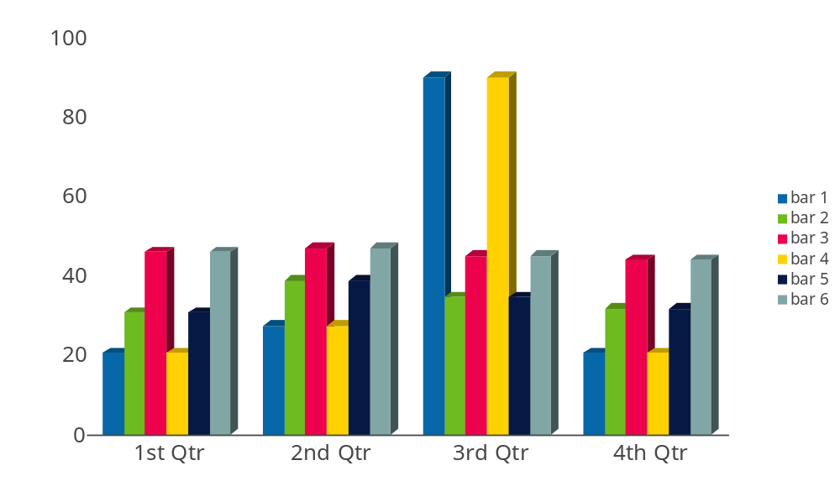
Chart Slides
Use the “Title Only” Slide Auto Layout
Source: Trebuchet 10pt regular, left-aligned with slide title

Slide 10
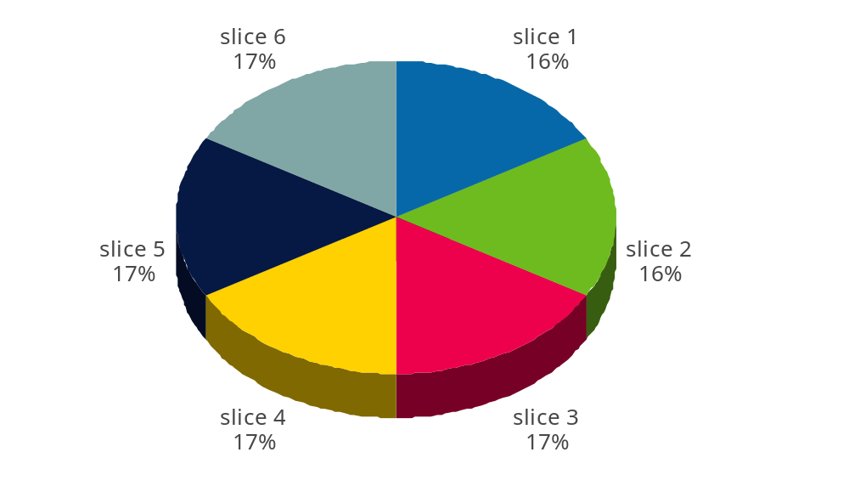
Chart Slides
Use the “Title Only” Slide Auto Layout
Source: Trebuchet 10pt regular, left-aligned with slide title

Slide 11
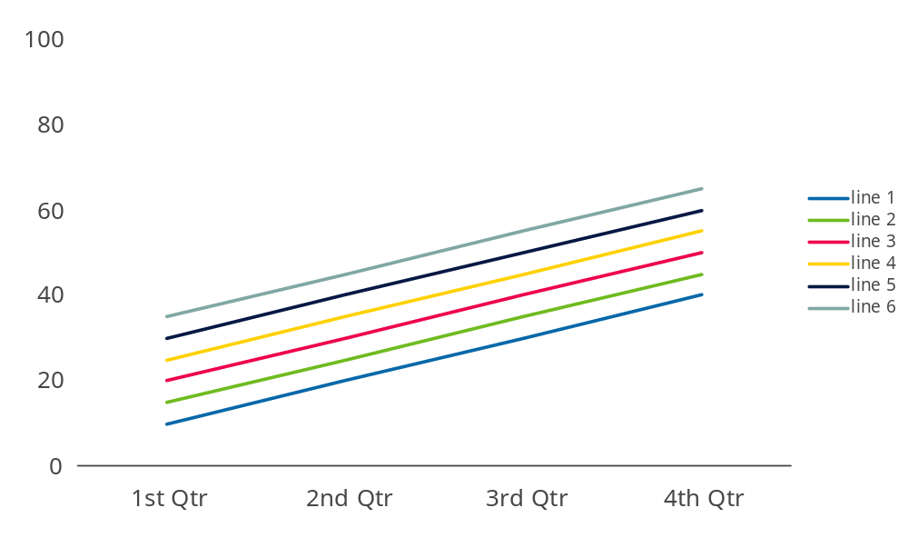
Chart Slides
Use the “Title Only” Slide Auto Layout
Source: Trebuchet 10pt regular, left-aligned with slide title

