Slide 1
The Future of Bitcoin

Slide 2
Contents
Benchmark with FB Prophet
Custom SARIMA Model
Forecasts
Conclusion

Slide 3
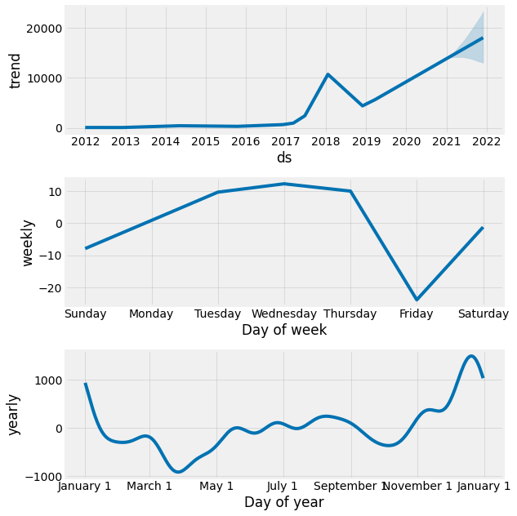
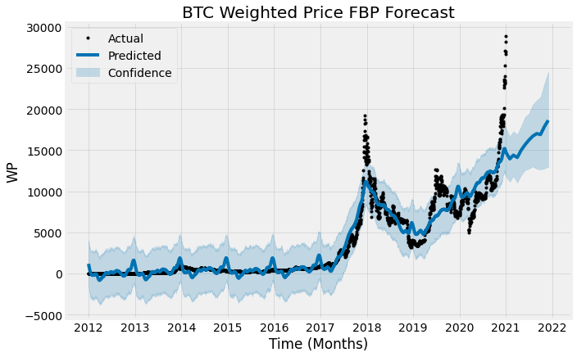
Facebook Prophet Forecast
Various Time-frequency Trends

Slide 4
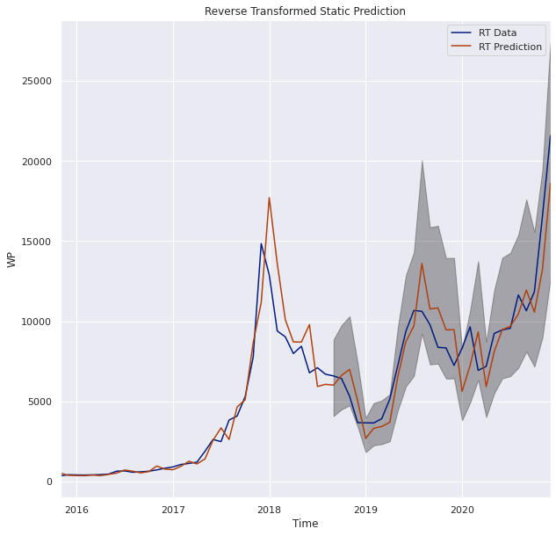
Static Predictions
Predictions have high variance
Relatively low error
MSE: .04

Slide 5
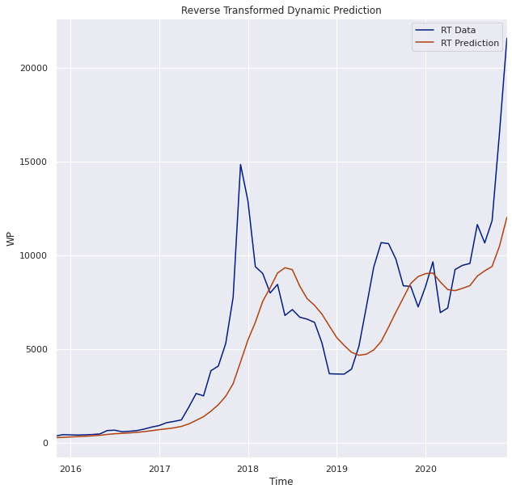
Dynamic Predictions
Dynamic model has lower variance than static
Tradeoff is higher error
MSE: .95

Slide 6
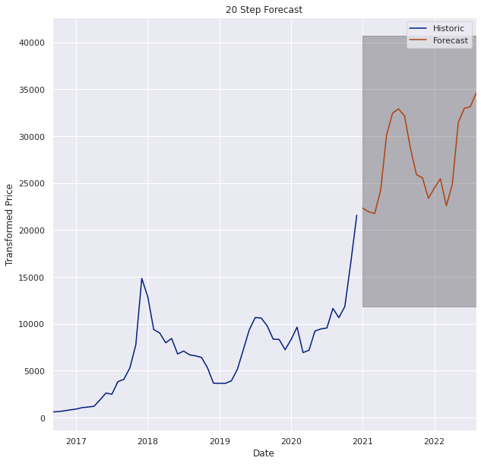
Forecast
The one step percent difference is forecasted at a 3.56% increase by this model
I.e. Jan. 2021 WP is predicted to be 3.56% higher than Dec. 2020
Long-term trend upwards
Agrees with FB Prophet long-term trend

Slide 7
Actual Increase
Actual increase:
87%
FB Prophet and alternate model both under predicted
 | Dec WP | Jan WP | % Change | % Error
FB Prophet | 21811.81 | 14754.04 | -32.36 | 137
Alternate | 21576.15 | 22343.62 | 3.56 | 96
Actual | 21576.15 | 40325.84 | 86.9 | -

Slide 8
Conclusions
Model could be improved
Compare monthly performance to daily/yearly
Investigate hyperparameters/preprocessing
Future plans
Keep watching long-term trends to monitor future performance

Slide 9
For questions or more information…
Email stevenchamp11@yahoo.com

