Slide 1
Telecommunications Churn
Model and Presentation by Steven Champion

Slide 2
LEAD IN

Slide 3


Customer Service Calls
Total Day Minutes
Voicemail Plan
International Plan
Total International Minutes
Total Evening Minutes
Total Evening Minutes
International Plan
Total Evening Minutes
Total Day Minutes
Total Night Minutes
99.9665%
99.9877%
99.9955%
99.9983%
99.9994%
99.9998%
99.7527%
50.0000%
98.2014%
99.9089%
Total Day Minutes
73.0797%
Total Day Minutes
88.0800%
95.2574%
99.3307%
XGB Tree 1
Under 264
Over 264
Under 4
Over 4
Yes
No
Yes
No
Under 174
Over 174
Under 185
Over 185
Yes
No
Under 13
Over 13
Under 223
Over 223
Under 212
Over 212
Under 139
Over 139
Under 311
Over 311
Under 127
Over 127

Slide 4
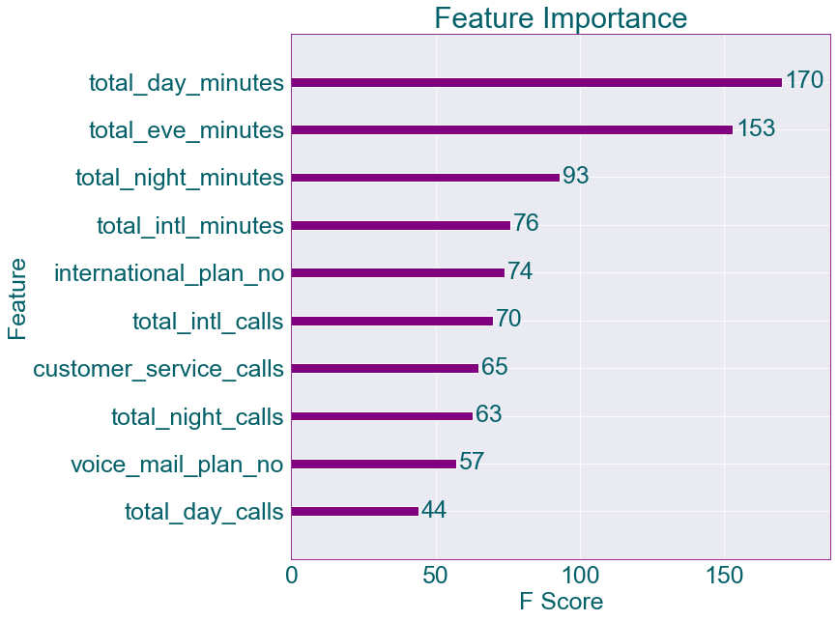

Slide 5
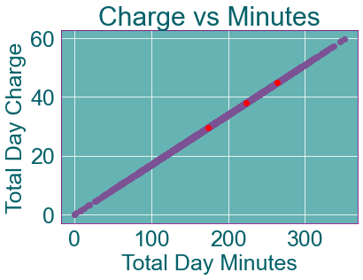
Total Call Minutes
Total Day Minutes
Primary Feature
Linear Cost Vs Minutes
Important Totals
174 min --> 29.58
223 min --> 37.91
264 min --> 44.88
Same With Evening, Night, International Minutes

Slide 6
Customer Service Calls
Threshold
Four
Not Correlated
Features uncorrelated with number of customer service calls

Slide 7
Model Critique and Reliability
Recall weakness
Perhaps develop data set more
Collect even more data
Attempt higher variety of test/train splits
Other models
Underperformed by significant amount (at least 30%)
 | Precision | Recall | F1-Score
False | 0.96 | 0.99 | 0.97
True | 0.94 | 0.74 | 0.83

Slide 8
Thoughts/Summary
With the goal of reducing churn:
Payment plans
Consider non-linear payment plans or discounts
Specifically when cost is around 45
Customer Service
Investigate customer service interactions
Training
Protocols
Collect repeat caller data
Analyze and investigate further
Why is four calls a useful tree split?

Slide 9
Questions
For questions email stevenchamp11@yahoo.com

