Slide 1

Financial (Stock) Data Collection and Storage
By Steve Champion

Slide 2
Contents
Current Status
Pros of New Database
Cursory Analysis
Future Plans
Conclusions

Slide 3
Current Stock Data
Name | Data Format/Acquirement Method | Currentness | Historic Data Granularity | Historic Options Data | Cost
Bloomberg Terminal |  | Real Time |  |  | $24,000/yr
Quandl | API Interface |  |  |  | Variable
Yahoo Finance | Raw Data | Up to 20 minute delay | Day | No | Free
Google Finance | Raw Data | Up to 20 minute delay | Day | No | Free
ToS TD Ameritrade | API Interface | Real Time |  | No | Free with Account

Slide 4
The Database
Data comes from Yahoo Finance
Stored with data science in mind
Cleaned
Program for simple feature adds
Programs for data adds
Collects Historic Options Data
Collects data daily after market close

Slide 5
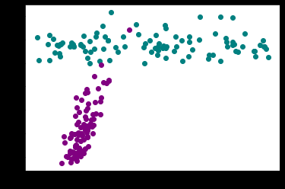
Cursory Results
Simple GAN does not perform very well
Generated data is not close to real data
No predictive ability
Needs work

Slide 6
Future Plans
Develop sentiment analysis programs
Create features from sentiment data and add into database
Develop TGAN
Mature GAN theory and update model
Multi-featured
Build alternate models

Slide 7
Conclusion
Stock data has many sources and formats
Easily organized and attainable data will make future model building much easier
GAN models are complicated
Multi-layered Deep Learning Models
Much theory behind them

Slide 8
Email any questions to stevenchamp11@yahoo.com

