Slide 1
Mod 3 Final Project
Northwind Data Hypothesis Testing

Slide 2
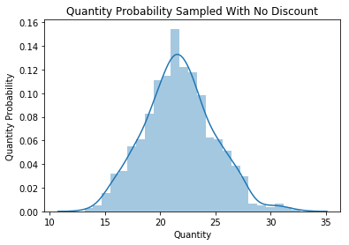
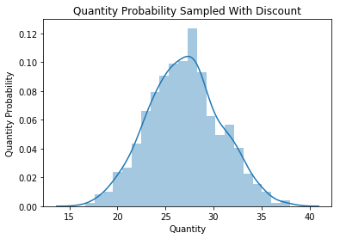
Comparison of Quantities Ordered and Discount

Slide 3
Results
Analysis supports the claim that quantity purchased and discount are related

Slide 4
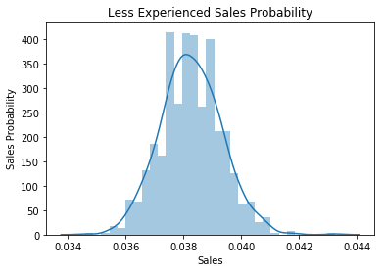
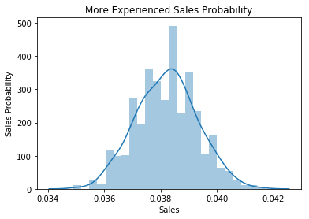
Comparison of Experience Versus Average Sales

Slide 5
Results
There is currently support to the claim “years of experience increases sales”

Slide 6
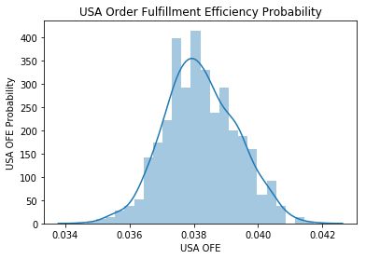
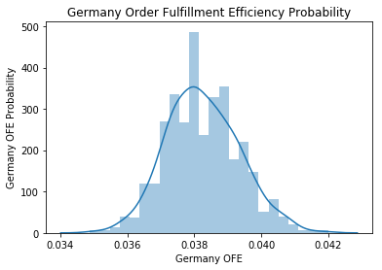
Comparison of Order Fulfillment Efficiency Between Top Two Order-Fulfillment Countries (USA/Germany)

Slide 7
Results
Of the top shipping Countries, there is no evidence to suggest order fulfillment efficiency is better in either country

Slide 8
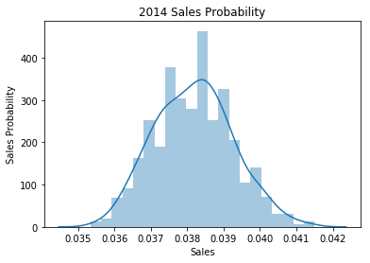
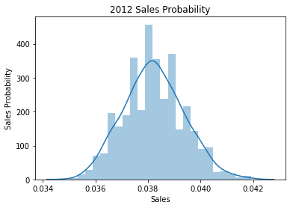
Comparison of 2012/2014 Sales Data

Slide 9
Results
The overall sales for the 2012 year and 2014 year are not significantly different

Slide 10
Conclusion/Recommendations
Consider strategically implementing discounts to increase sales quantity
Consider investigating OFE between higher order-fulfilling countries and lower ones
If there is a difference explore actual order filling methods in order to implement improvements where necessary
Look for ways to increase overall sales

Slide 11
Thanks!
Email any questions to stevenchamp11@yahoo.com

