Slide 1

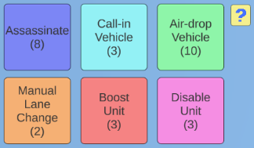
Frogs will spawn from the top of the map and attempt to cross the highway
Control the flow of traffic on the lanes to ram into the frogs
Each lane has speed toggles to adjust the vehicles’ speed on that lane
Utilize a variety of skills to directly influence the traffic and the frogs
Every frog kill will net you a skill point
Each skill has its own skill point requirement
and can only be used once per turn
The game will proceed in a turn-based manner: Player -> Frogs -> Vehicles -> (Repeat)
Every frog that crosses the road will damage you. You lose when your health reaches zero!
Lane Speed
Speed Toggles
Select “?” for more info on the skills

Slide 2
Snipe (8 pts): Snipes the frog for 1 HP (exceptions: cannot hit frogs on top of vehicles, or out of sight)
Call-in Vehicle (3pts): Calls in a chosen vehicle that arrives at the start of that lane on the following turn
Air-drop Vehicle (10 pts): Air-drops a chosen vehicle onto any point on the highway, killing any frogs on landing
Manual Lane Change (2pts): Performs a manual lane change on a vehicle (exceptions: cannot lane change into any frog or vehicle, or divider, or sidewalk)
Boost Unit (3pts): Give the unit an extra turn
Disable Unit (3pts): Stun the unit for 1 turn

