Slide 1

Browser Internals
by Dzmitry Varabei

Slide 2
Demo

Slide 3
Page Rendering Cycle
Request a page from server
Parse HTML and CSS files
Construct DOM tree

Slide 4
Nodes and the DOM tree
<html>
<body>
<div>
Hello
</div>
</body>
</html>
HTMLDocument
HTMLHTMLElement
HTMLBodyElement
HTMLDivElement
Text("Hello")

Slide 5
Characters -> <html>
Tokens -> html
Nodes - > HTMLDocument
DOM

Slide 6
Page Rendering Cycle
Request a page from server
Parse HTML and CSS files
Construct DOM tree
Construct CSSOM (styles from user agent and stylesheets + js)
Combine DOM and CSSOM (aka recalculate styles)
Build the rendering tree

Slide 7
RenderObject Tree
This is a data structure that helps the browser perform layout tasks.
display:none
<head>
<script>
<style>
anonymous line box
:before

Slide 8

Page Rendering Cycle
Build the rendering tree
Calculate layout (or calculate how many space is needed for each renderTree element )
Rasterization
Paint

Slide 9
Layout or reflow
body { width: 100%; } -> 320px
div {width: 50% } -> 160px
p {width: 100% } -> 160px
span { width: 50% } -> 80px

Slide 10
Re Layour
layout can be triggered by device orientation change on mobile, a window resize, or any other action that modifies the content of the DOM - e.g. adding or removing content from the DOM tree, toggling CSSOM properties on a node, and so on!

Slide 11
Page Rendering Cycle
Build the rendering tree
Calculate layout (or calculate how many space is needed for each renderTree element )
Paint
Composite
Draw the final screen image onto the screen

Slide 12
Example #1

Slide 13
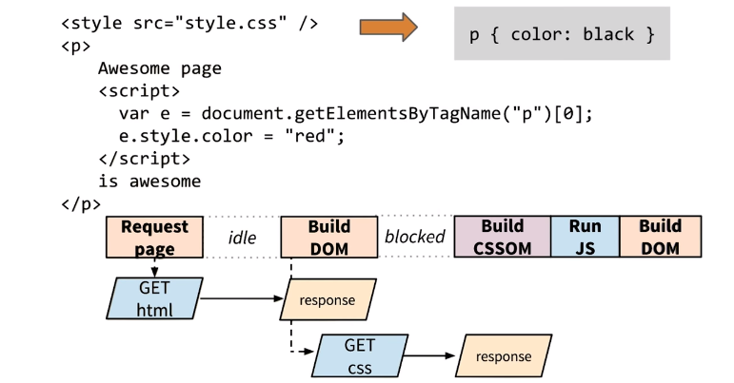
Render block by CSS

Slide 14
Inline CSS

Slide 15
JavaScript
Use Onload event
Or use async tag

Slide 16
Async scripts
Does not block DOM construction
Does not block on CSSOM
Do not use inline scripts

Slide 17
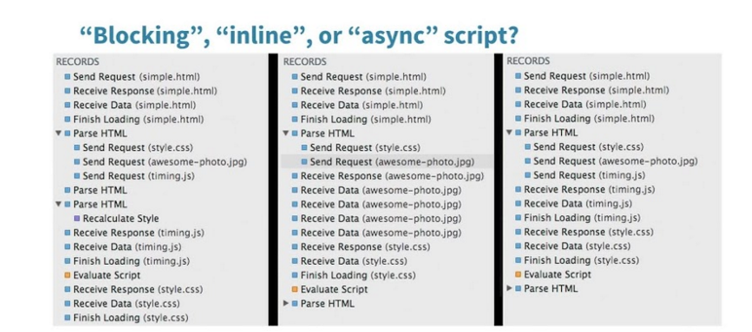

Slide 18
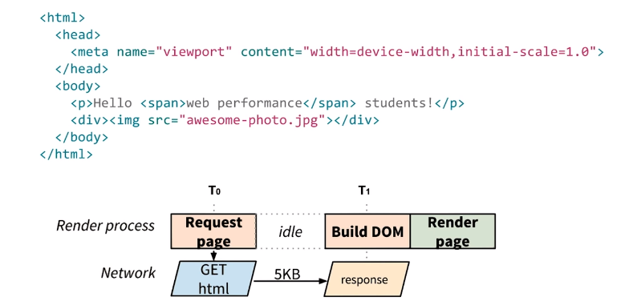
CRP #1

Slide 19
Ideal Page < 14kb

Slide 20
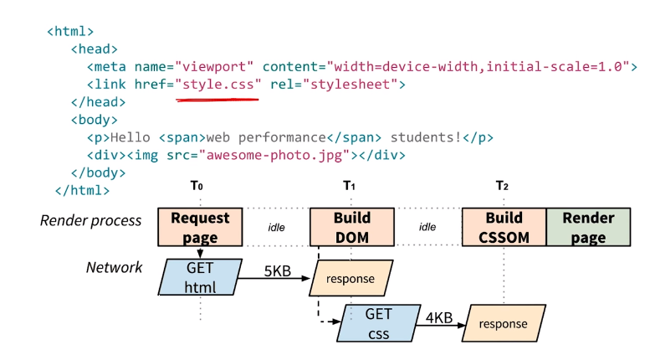
CRP #2

Slide 21
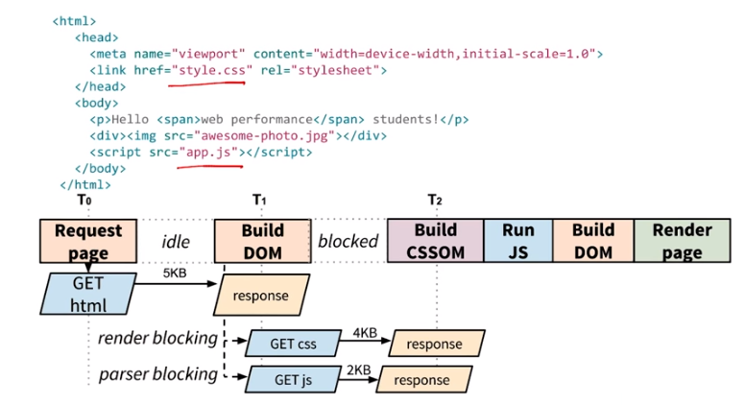
CRP #3
- download in parallel

Slide 22
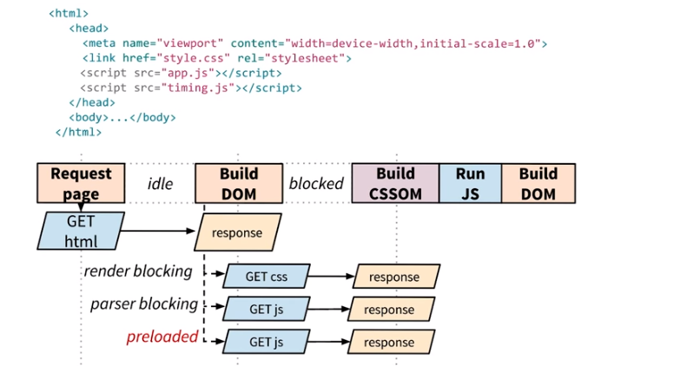
CRP #4

Slide 23
Display refresh rate
~ 60Hz or 60 FPS
or
~16.6ms (10) to make a frame

Slide 24

Google Chrome Canary
console> chrome.exe
--enable-threaded-compositing
--force-compositing-mode
--enable-impl-side-painting
--enable-skia-benchmarking
--allow-webui-compositing

Slide 25
Trace Event Profiling Tool
about://tracing/
Read more: http://dev.chromium.org/developers/how-tos/trace-event-profiling-tool

Slide 26
Demo – CSS Paint Order

Slide 27
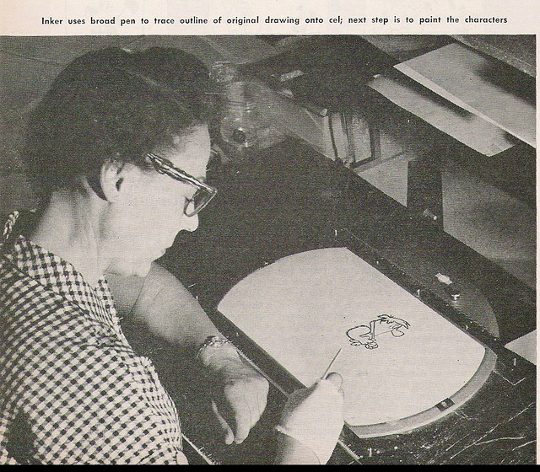
Paint
The phase of rendering where RenderObjects make calls into the GraphicsContext API to make a visual representation of themselves

Slide 28
Skia Graphics Engine
Skia is the open source C++ graphics library for drawing Text, Geometries, and Images.
https://code.google.com/p/skia/

Slide 29




Skia is currently used in
Google Chrome | Mozilla Firefox | Chrome OS | Android | Sublime Text 3

Slide 30
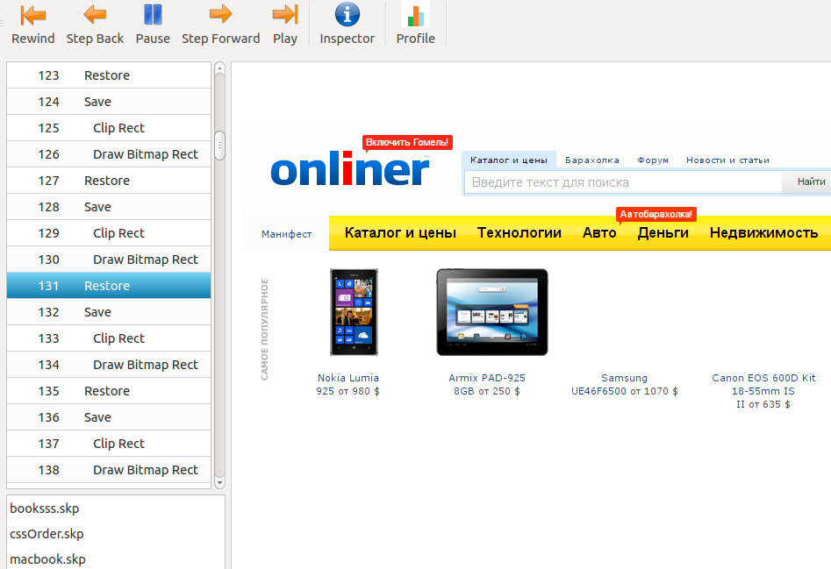
Skia Debugger
- Demo

Slide 31
How to save .skp files from Chromium?
http://www.chromium.org/developers/how-tos/trace-event-profiling-tool/saving-skp-s-from-chromium

Slide 32
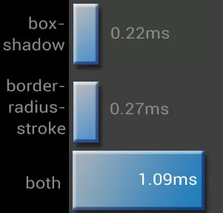
What cause complex painting?
image decodes/resizes
box-shadow (essentially
improved over
the past 2 years)
border-radius
border-radius + box-shadow
Read more: CSS Paint Times and Page Render Weight

Slide 33
Software mode VS Accelerated compositing mode

Slide 34
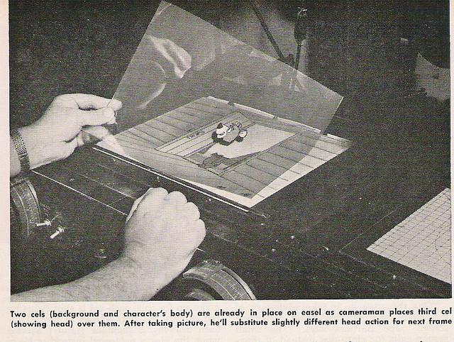
Composition

Slide 35
Accelerated compositing mode
Layer bitmaps are transferred to the GPU, combined ("composited"), and drawn on the screen.

Slide 36
Layer
Layer: section of the page, subtree of the DOM. Painted independently, composited on the GPU, and can stretch, move, and fade without repainting.

Slide 37
Which elements have their own layer?
Root page object
Canvas
Video element
plugins (flash and etc)
Elements with CSS properties: TranslateZ, Translate3d, Opacity, ScaleZ, RotateZ...
2D Transforms do not create layer

Slide 38
The cost of too many layers:
Additional GPU and memory usage

Slide 39
Render profiling tools
Show FPS
Show paint rectangles
Continuous page repainting
Show composited layer borders
Timeline -> Frames

Slide 40
Questions?

Slide 41
Resources
How Browsers Work
http://jankfree.org/
Jank Free: Chrome Rendering Performance
Compositing in Blink and WebKit
Trace Event Profiling Tool (about:tracing)
GPU Accelerated Compositing in Chrome
CSS Paint Times and Page Render Weight
http://dev.chromium.org/developers/tech-talk-videos

Slide 42
Layout boundaries
http://wilsonpage.co.uk/introducing-layout-boundaries/

Slide 43
CSS Triggers
http://csstriggers.com/

Slide 44
FLIP
https://aerotwist.com/blog/flip-your-animations/

Slide 45
Recommendation
Keep the DOM as small as possible.

Slide 46
Thanks!
Dzmitry.Varabei@gmail.com

